Slide 1
Some Ideas for Portable Microwave Stations
Bob Lear W4ZST
Microwave Update 2023

Slide 2
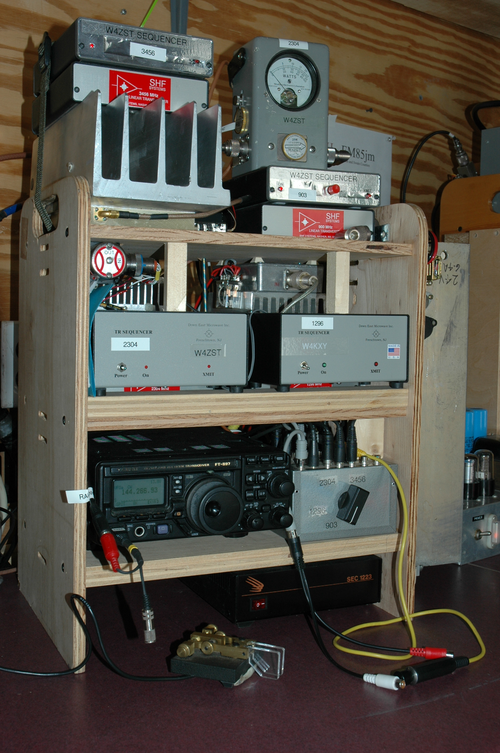
Station set up at a mountain top portable contest with W4NH
Four bands: 902/3, 1296, 2304 and 3456.
EM85

Slide 3
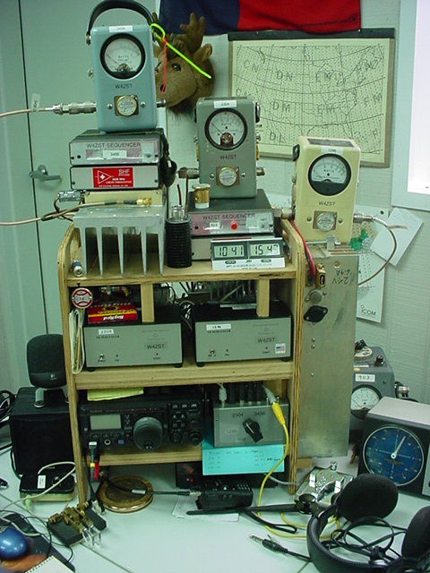
Set up in W4ZST shack for a VHF contest with W4NH
EM84
Four wattmeters
902/3, 1296, 2304, 3456

Slide 4
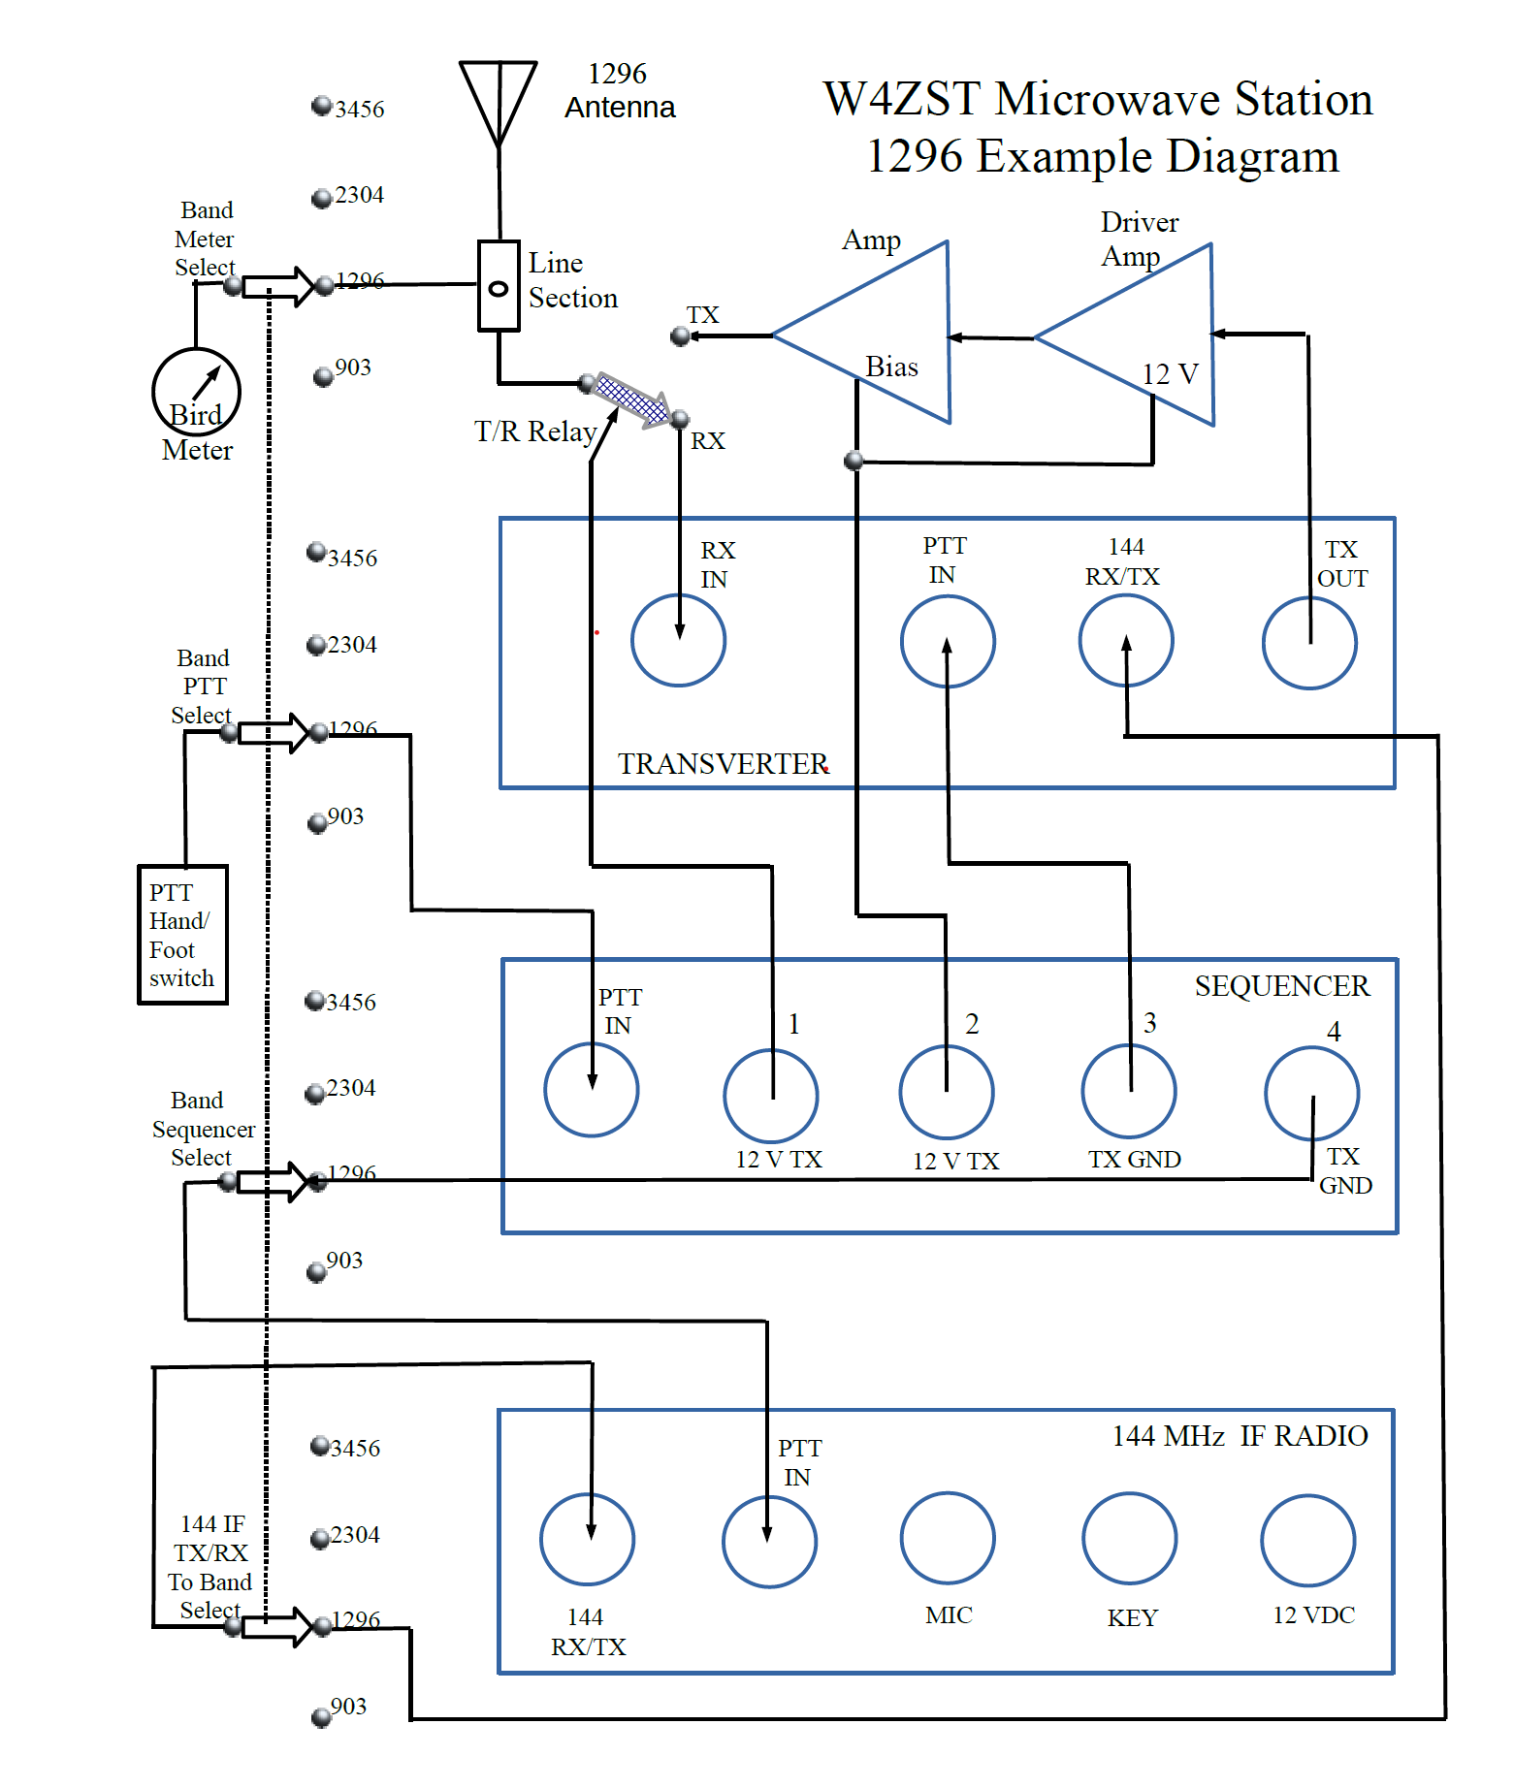
Wiring diagram showing one band transverter, sequencer and amp
Add sequencer, transverter and amp for each of the other bands desired

Slide 5
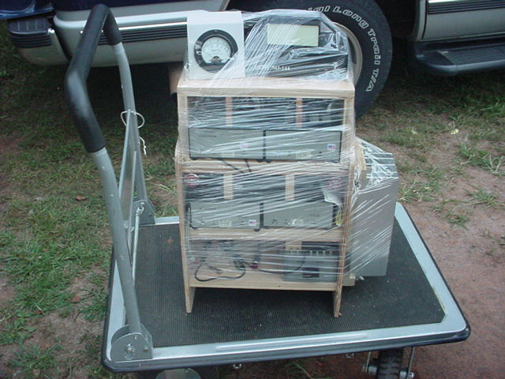
An earlier iteration of the station packed for travel
Being almost all wired ahead saves much time in setup and getting on the air

Slide 6
A idea and proposal for passing stations to other bands during contests.
Bob Lear W4ZST
MUD 2023

Slide 7
I thought of this idea for passing stations to other bands during a contest. As a multi-op station, it has been difficult to pass since the introduction and popularity of FT8 during contests. This is a pretty simple idea and will fit within the character confines of FT8 exchanges
Most would only require two characters if using the standard calling frequencies or agreed on pass frequencies (like examples in the chart)

Slide 8
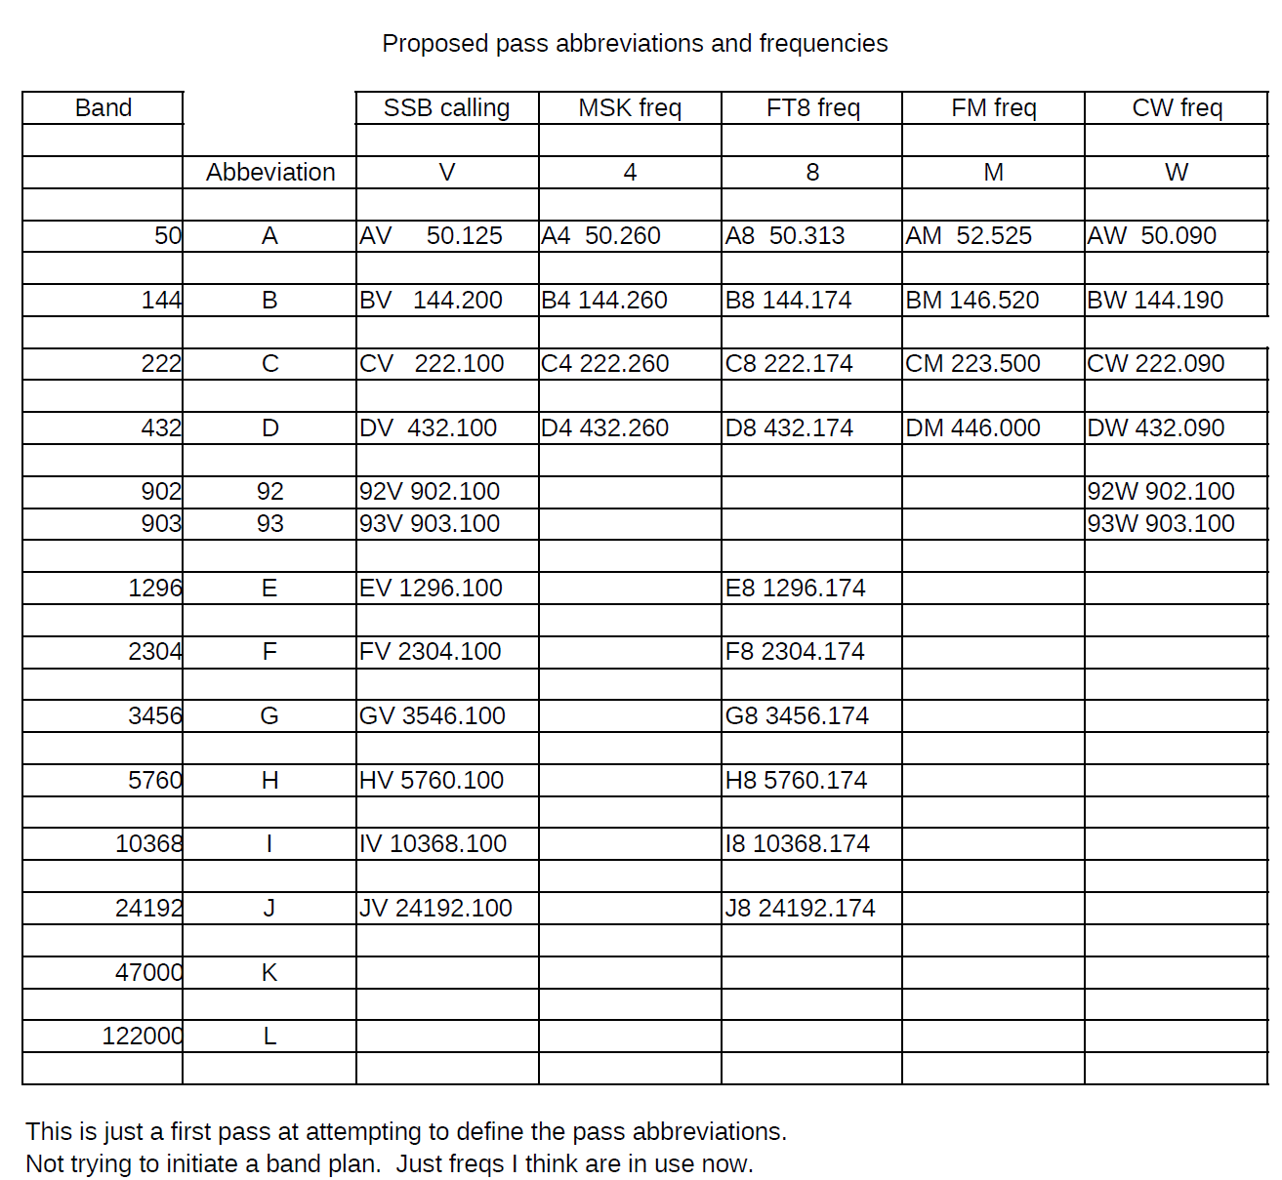

Slide 9
I must have done this before FT4 or I just missed that as a possibility. Instead of MSK144 being 4, let 4 be for FT4 and change MSK to S
Or course, more new modes will require more choices in future but would likely be feasible
e.g. 6m JT65 > AT 50.260
or 6m Q65 > AQ 50.275

