Slide 1
Design of Optimized Cassegrain Antenna Systems & Feedhorns
Paul Wade, W1GHZ ©2023

Slide 2
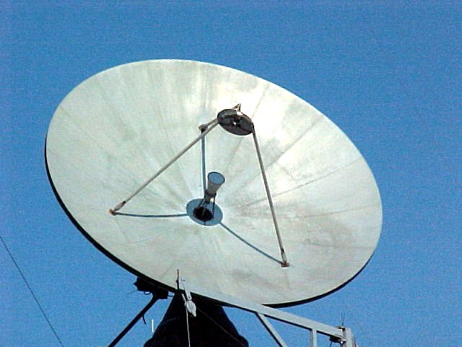
Cassegrain Antenna
Parabolic Dish with
Hyperbolic
Subreflector

Slide 3
Cassegrain Antenna System
Cassegrain Antenna geometry
System Design
Examples & results
Feedhorns

Slide 4
Why Cassegrain Antenna?
Reduce Feedline Loss
  Especially at Microwave bands
  Alternative is equipment at Dish Focus
Move equipment behind dish
  Reduce feedline loss
  Less weight at focus = better balance
Lower noise = higher G/T
  EME or Radio Astronomy
Illuminate Deep Dishes (f/D < 0.3)

Slide 5
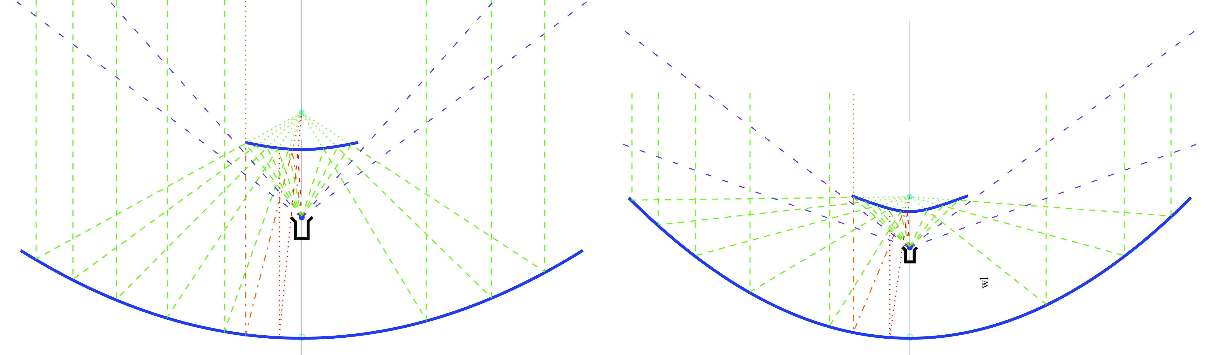
Lower noise – Spillover sees cold sky
Higher G/T for EME

Slide 6
Cassegrain Problems
Big dish to be effective – larger than ~50λ
Hyperbolic Subreflector difficult to make
  CNC machining
  3D printing
More complicated design

Slide 7
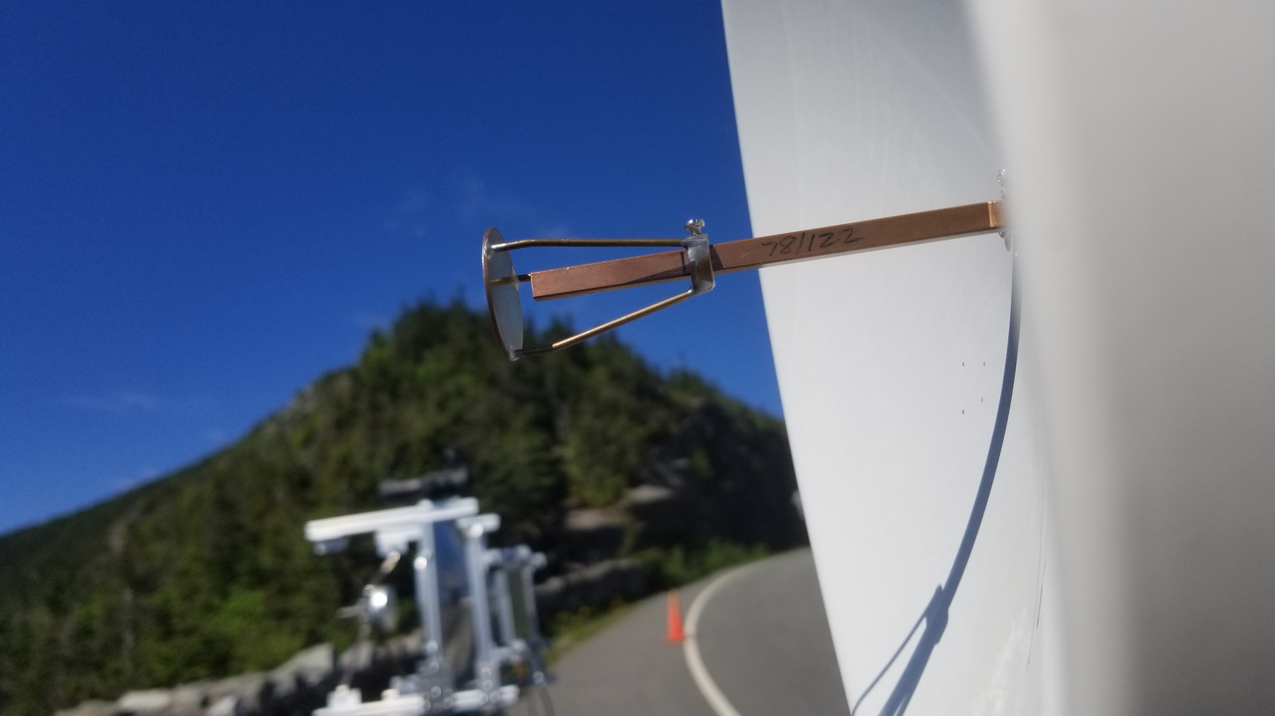
Simple case – Flat Subreflector at least 1 dB worse (with good feedhorn)
Not Possible
with very deep dish

Slide 8
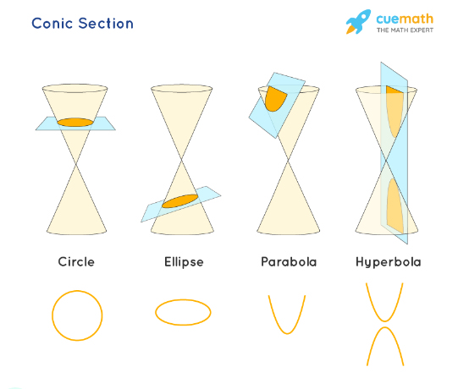
Hyperbola – Conic Section
(slice thru cone)
Two curves, mirror image

Slide 9
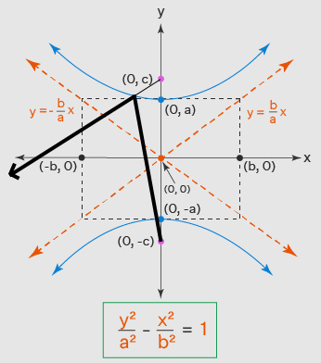
Hyperbola Geometry & Equation
Two Foci
Ray from one reflects as though it came from other focus

Slide 10
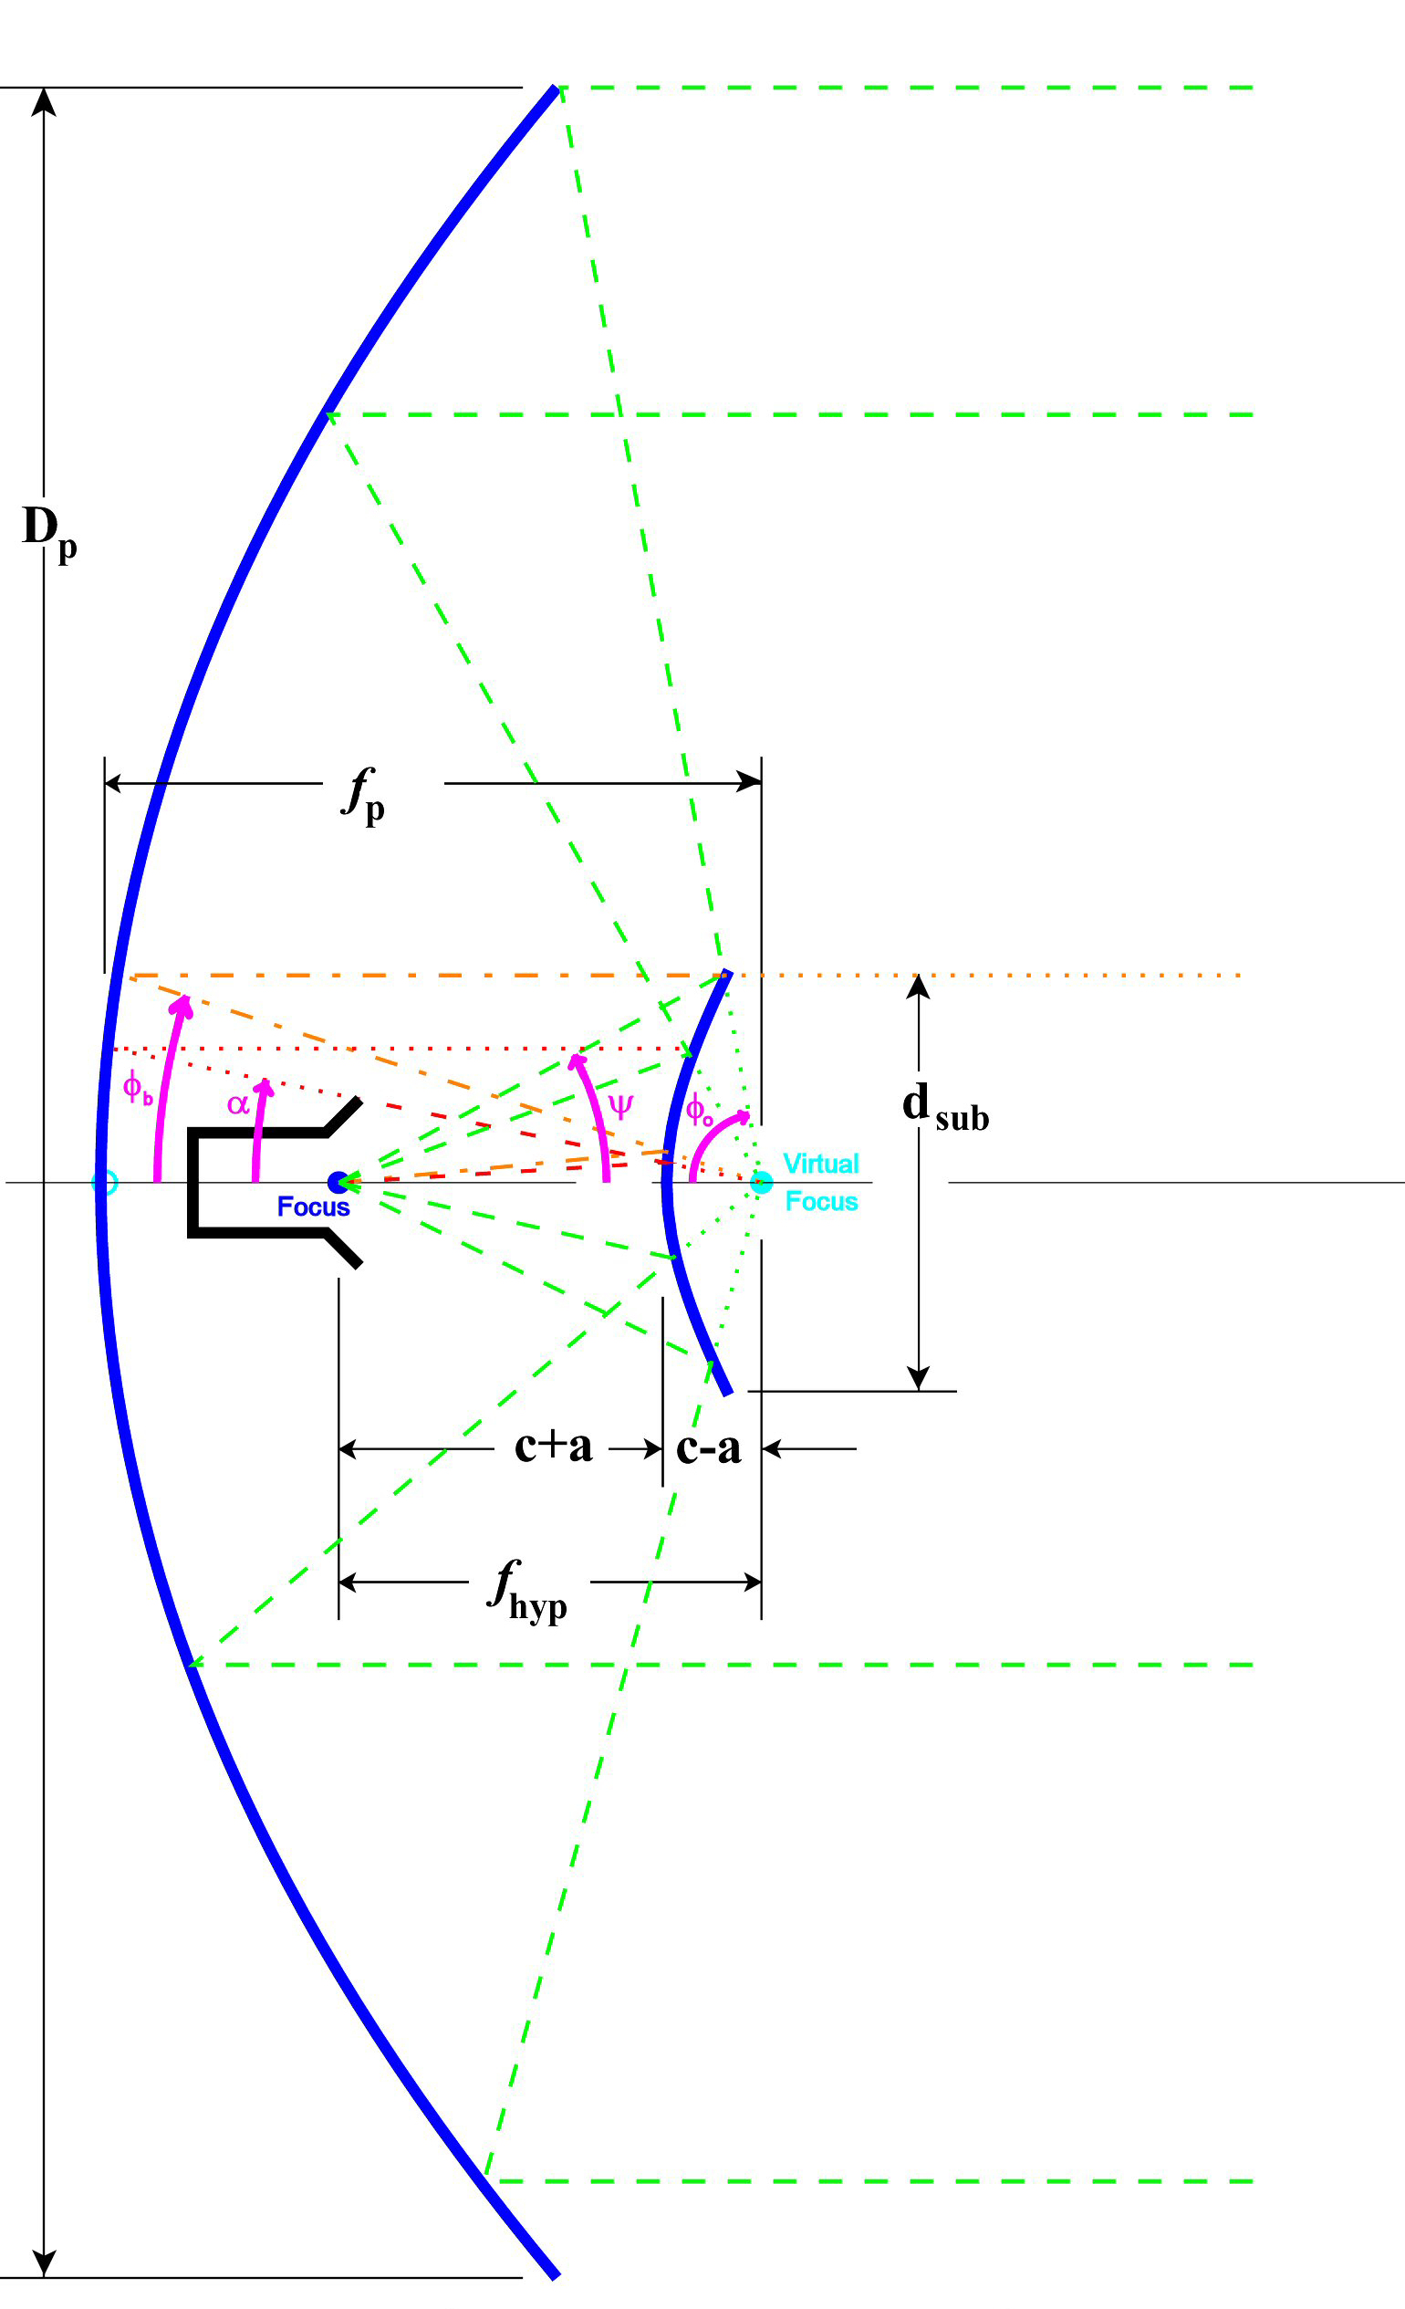
Cassegrain Antenna
Geometry
►Single Hyperbolic curve
► One focus at Feedhorn phase center
► Other focus at Parabolic dish focal point
►Frequency independent

Slide 11
Cassegrain Antenna
Geometry
Single Hyperbolic curve
Radiation from Feedhorn at one focus reflects from subreflector as though it comes from dish Prime focus

Slide 12
Casssegrain Antenna Design
} Tradeoff
Feedhorn Location
Subreflector Size
Calculate unique hyperbolic curve to reflect feed radiation to fully illuminate dish
Hyperbola parameters a, b, c
Note: 2c = Distance between foci

Slide 13
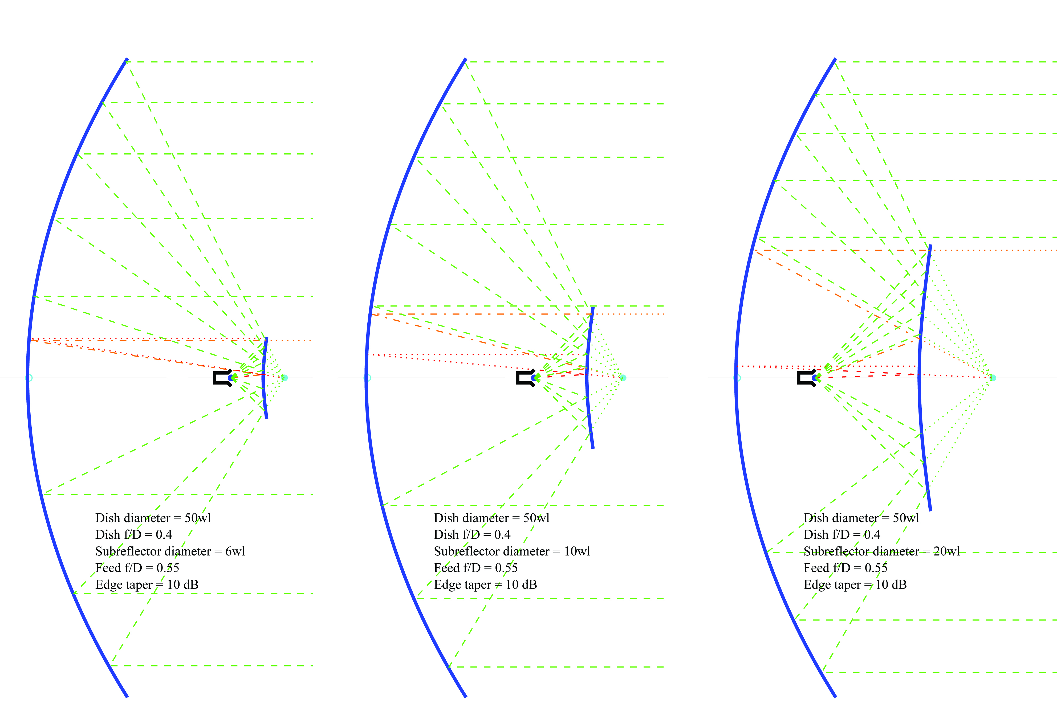
Feedhorn Location and radiation angle determine Subreflector size
Moving feedhorn
back requires larger subreflector

Slide 14
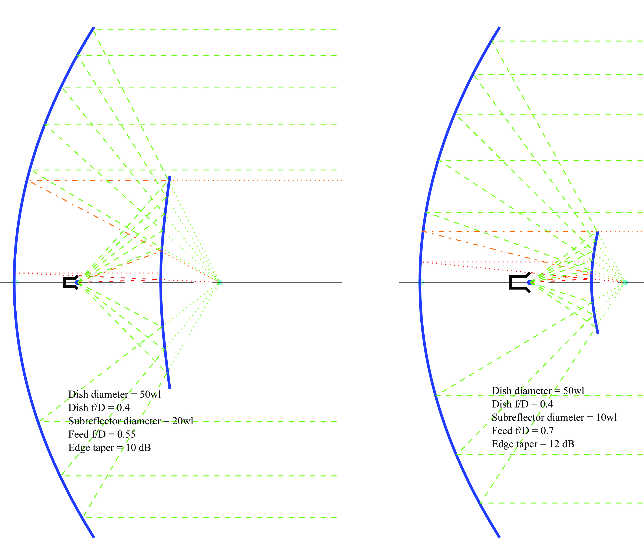
Feedhorn Location and radiation angle determine Subreflector size
Narrower Feedhorn beamwidth requires smaller subreflector

Slide 15
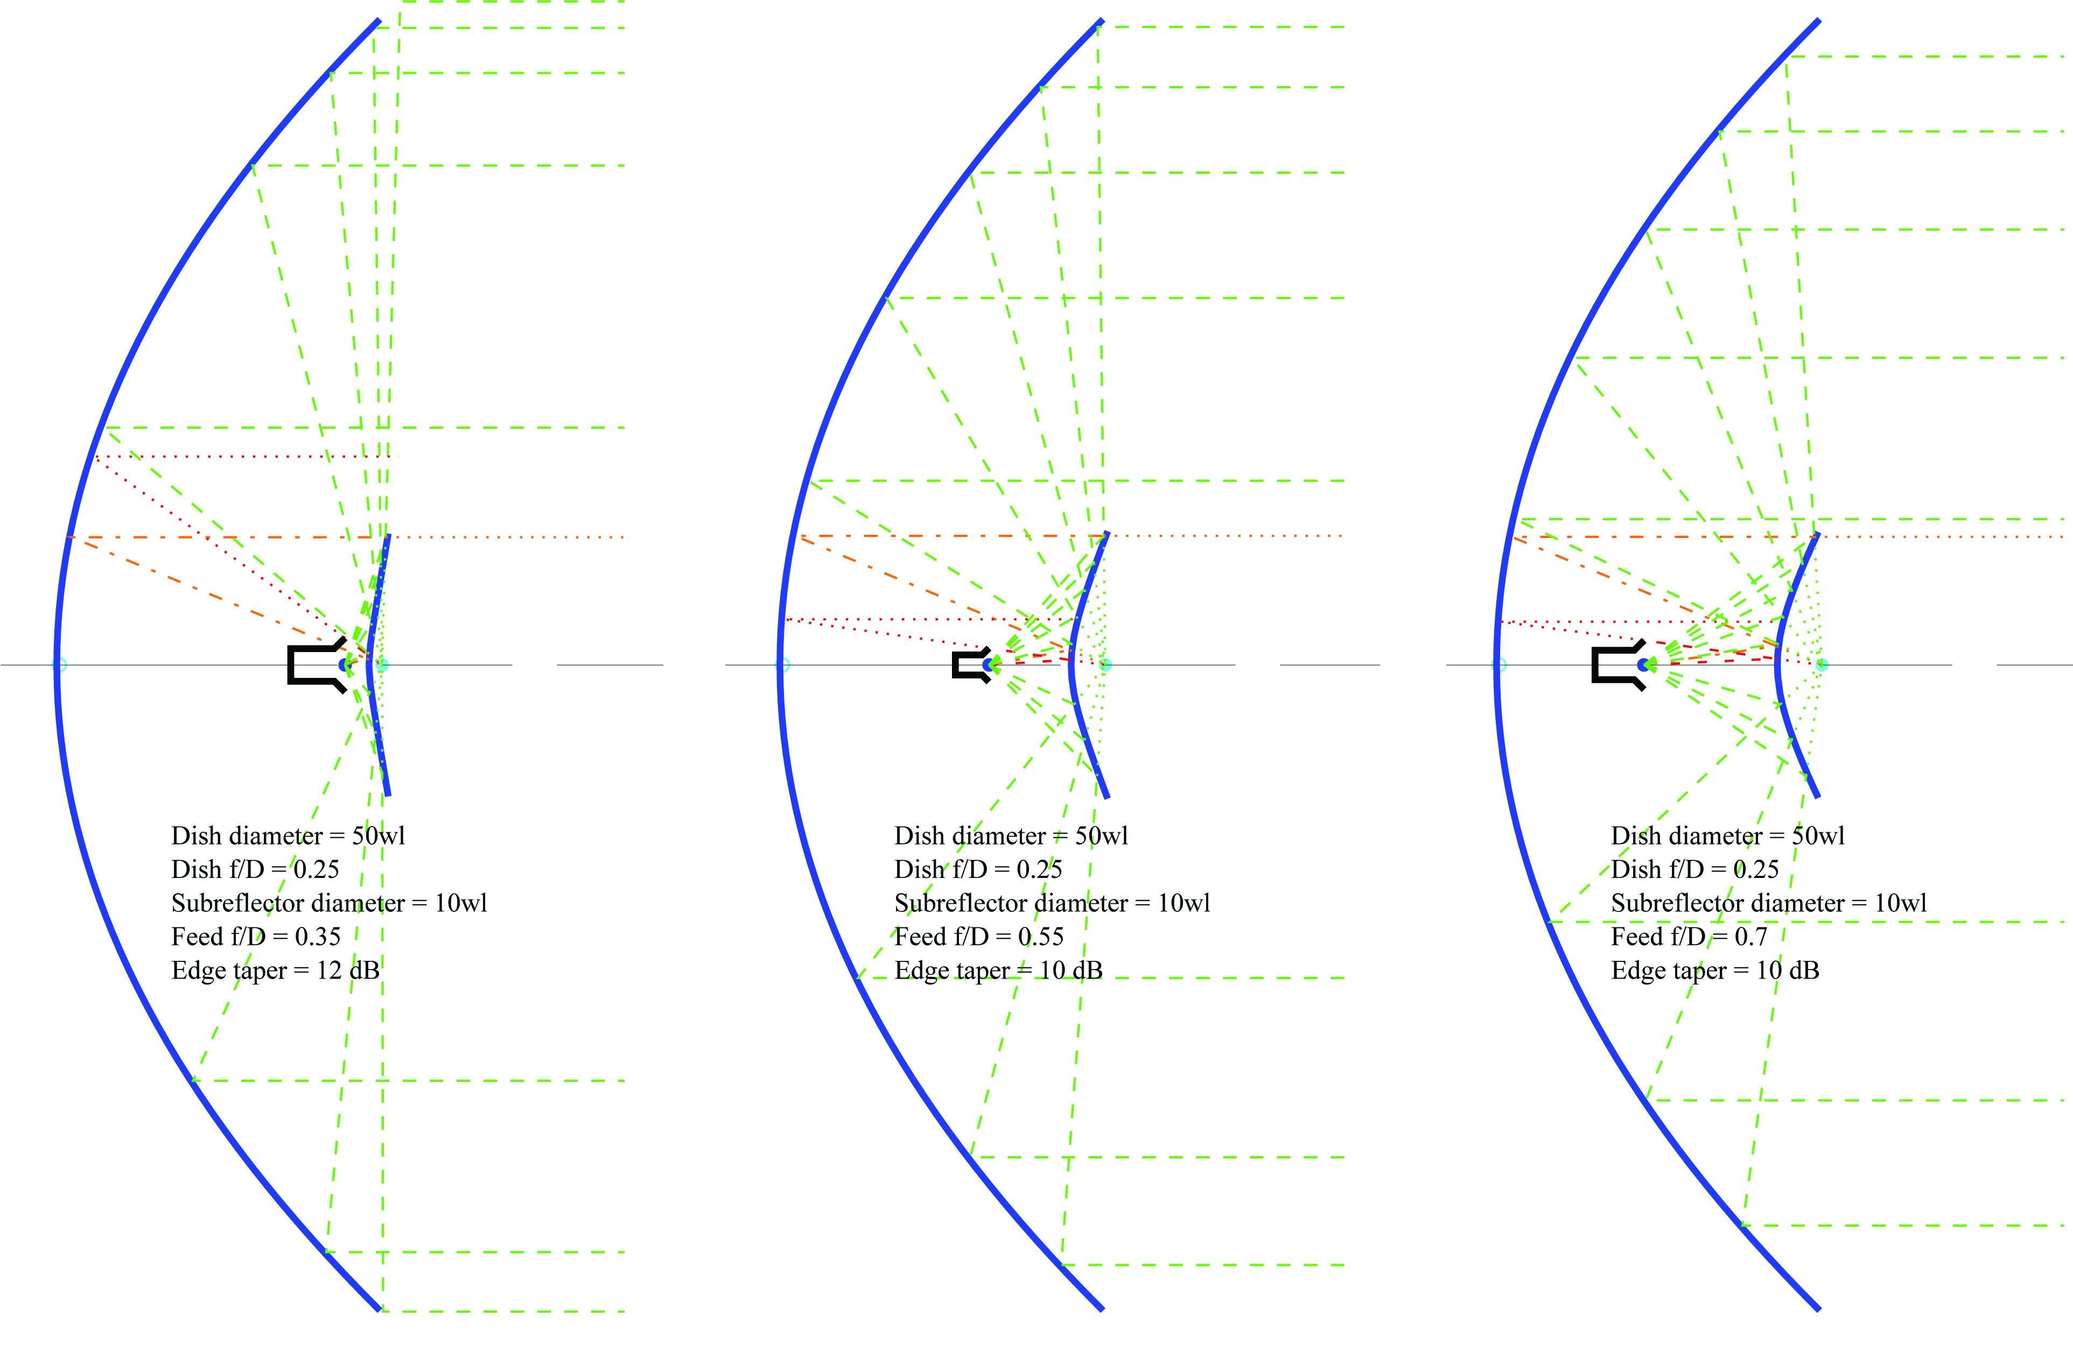
Cassegrain good for deep dishes
(no good prime feedhorns available)
Narrower Feedhorn beamwidth moves feed back – less blockage

Slide 16
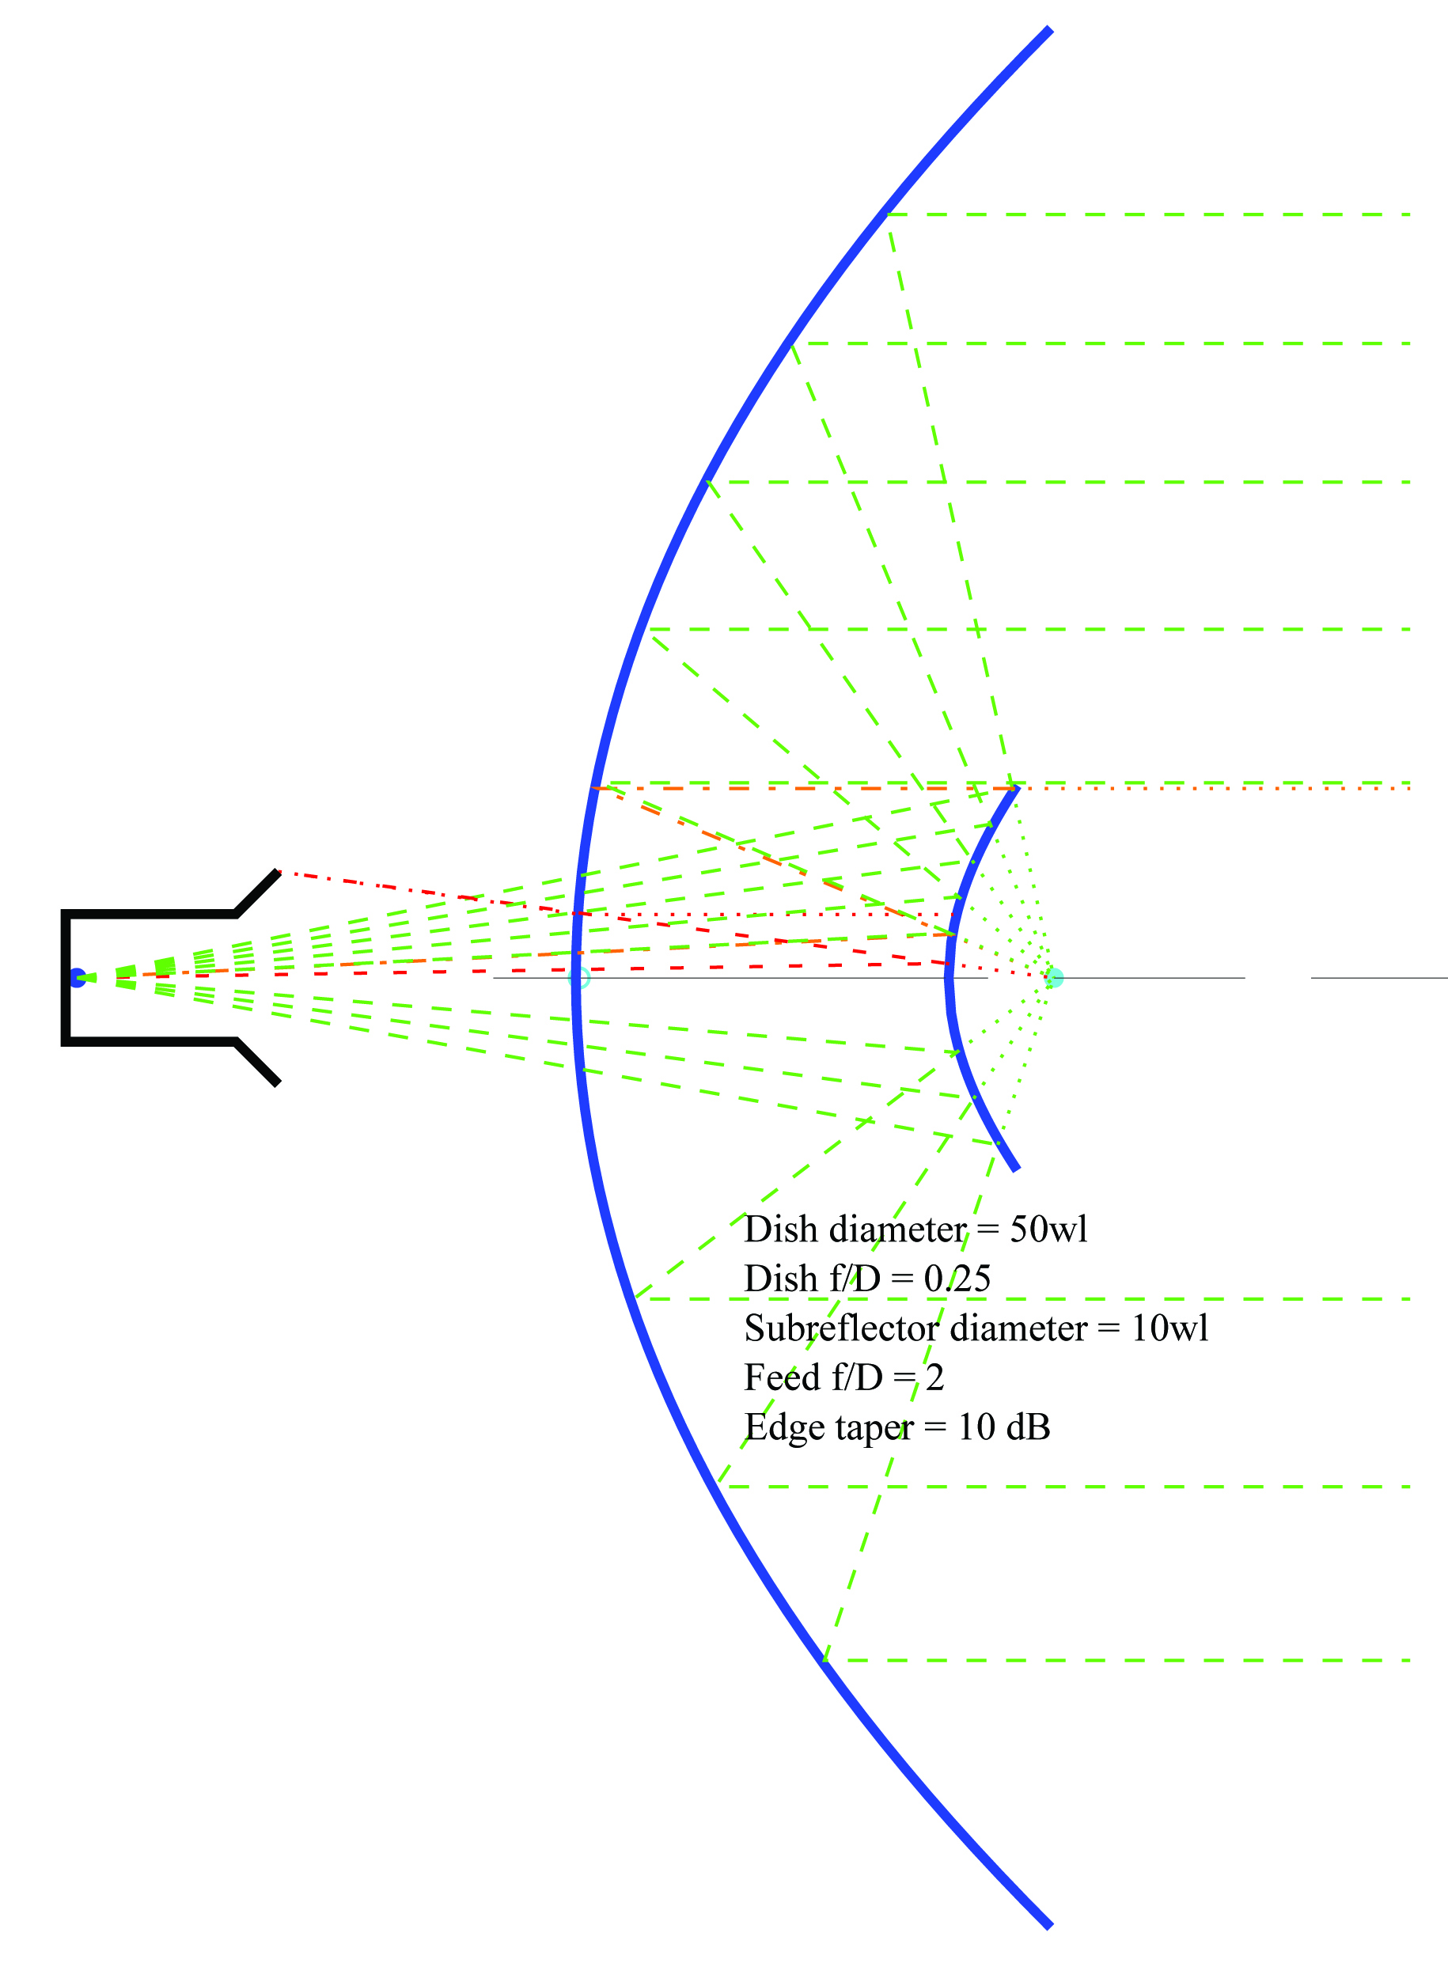
Feedhorn can be behind dish

Slide 17
Casssegrain Design Procedure
Dish f/D
Feedhorn location
Feedhorn radiation angle
  At 10 or12 dB feed taper
Calculate subreflector size
ITERATE
Calculate Hyperbola a, b, c
Generate hyperbolic curve using hyperbola equation

Slide 18
Cassegrain Design Tools
MATLAB routines
  Design calculations – quick iteration
  Hyperbola parameters (a, b, c) and curve
  G-code for CNC lathe or 3D printer
Perl script for antenna sketches
  Visual confirmation
Spreadsheet (updated)

Slide 19
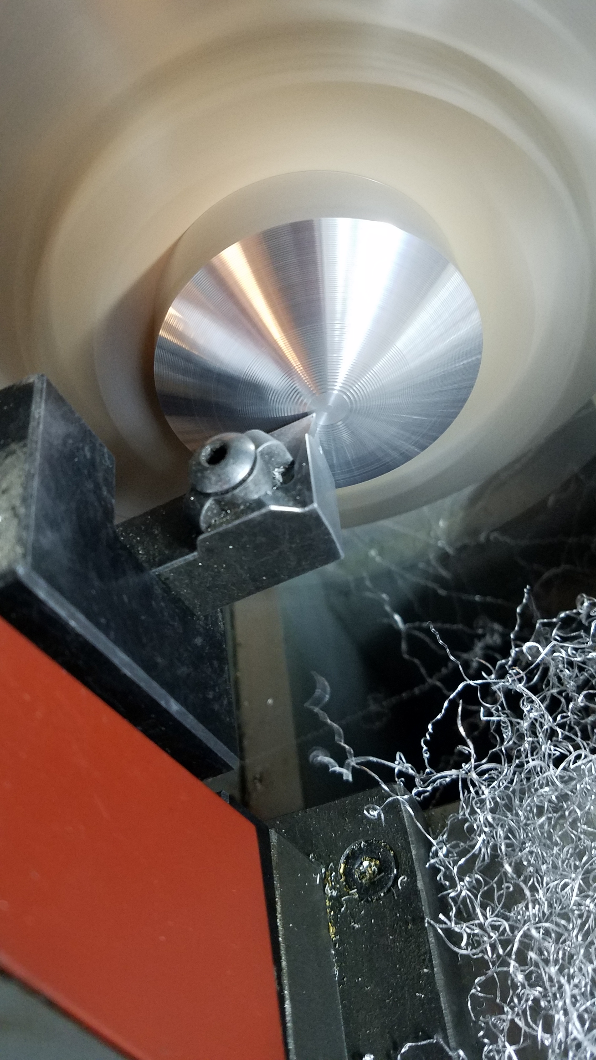
Subreflector machined on CNC Lathe

Slide 20
Spreadsheet update - 2022
EME 2004 spreadsheet designed for equal diffraction and blockage loss
  Fine for large dishes
For amateur size dishes, subreflector > 10λ preferred
Also tried to compensate for Space Attenuation
  Not needed with good feed simulation

Slide 21
Examples
Working examples
  High microwave frequencies
  Scale-model performance
Performance test
  Measure peak signal on (long) antenna range
  Move subreflector out of beam
  Measure signal difference with feedhorn only
  Feedhorn gain is known or calculated

Slide 22
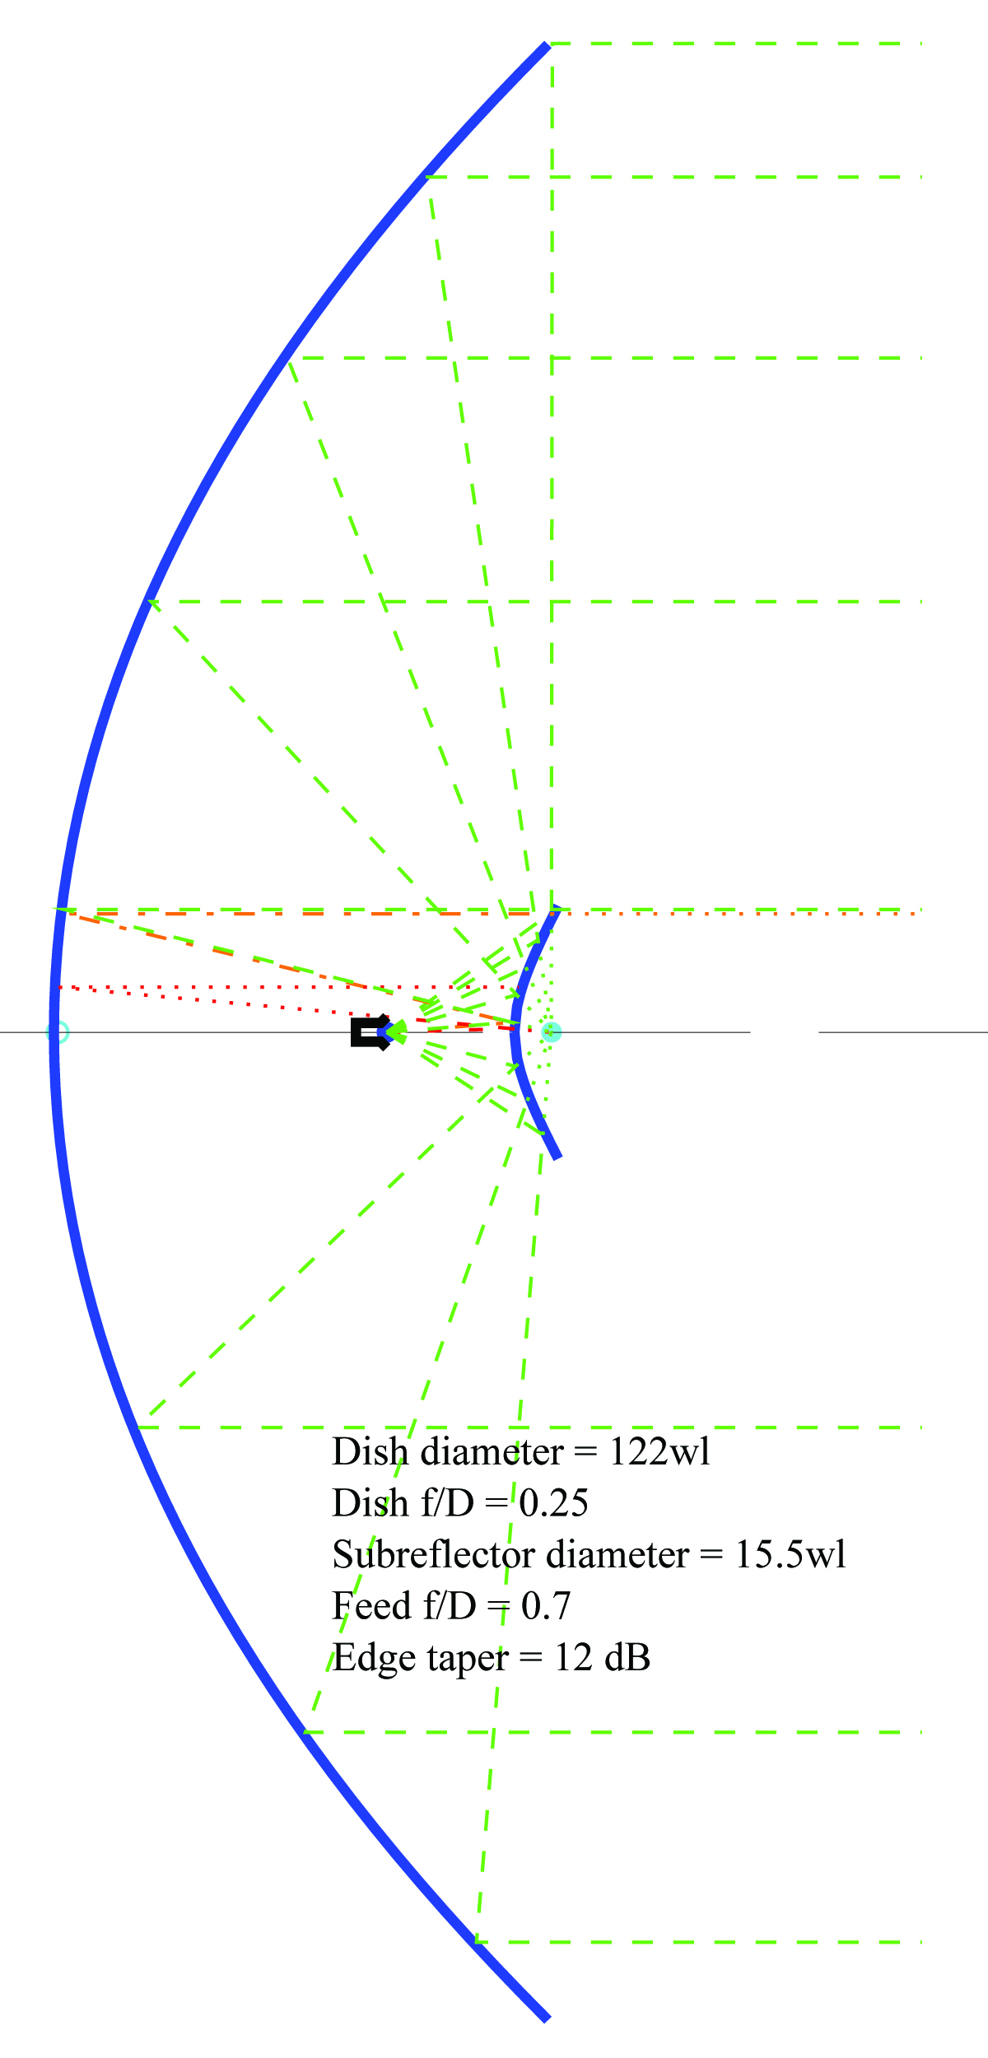
Example 1
122 GHz Project by VK3CV
123λ Diameter,
15.5λ Subreflector, f/D = 0.25

Slide 23
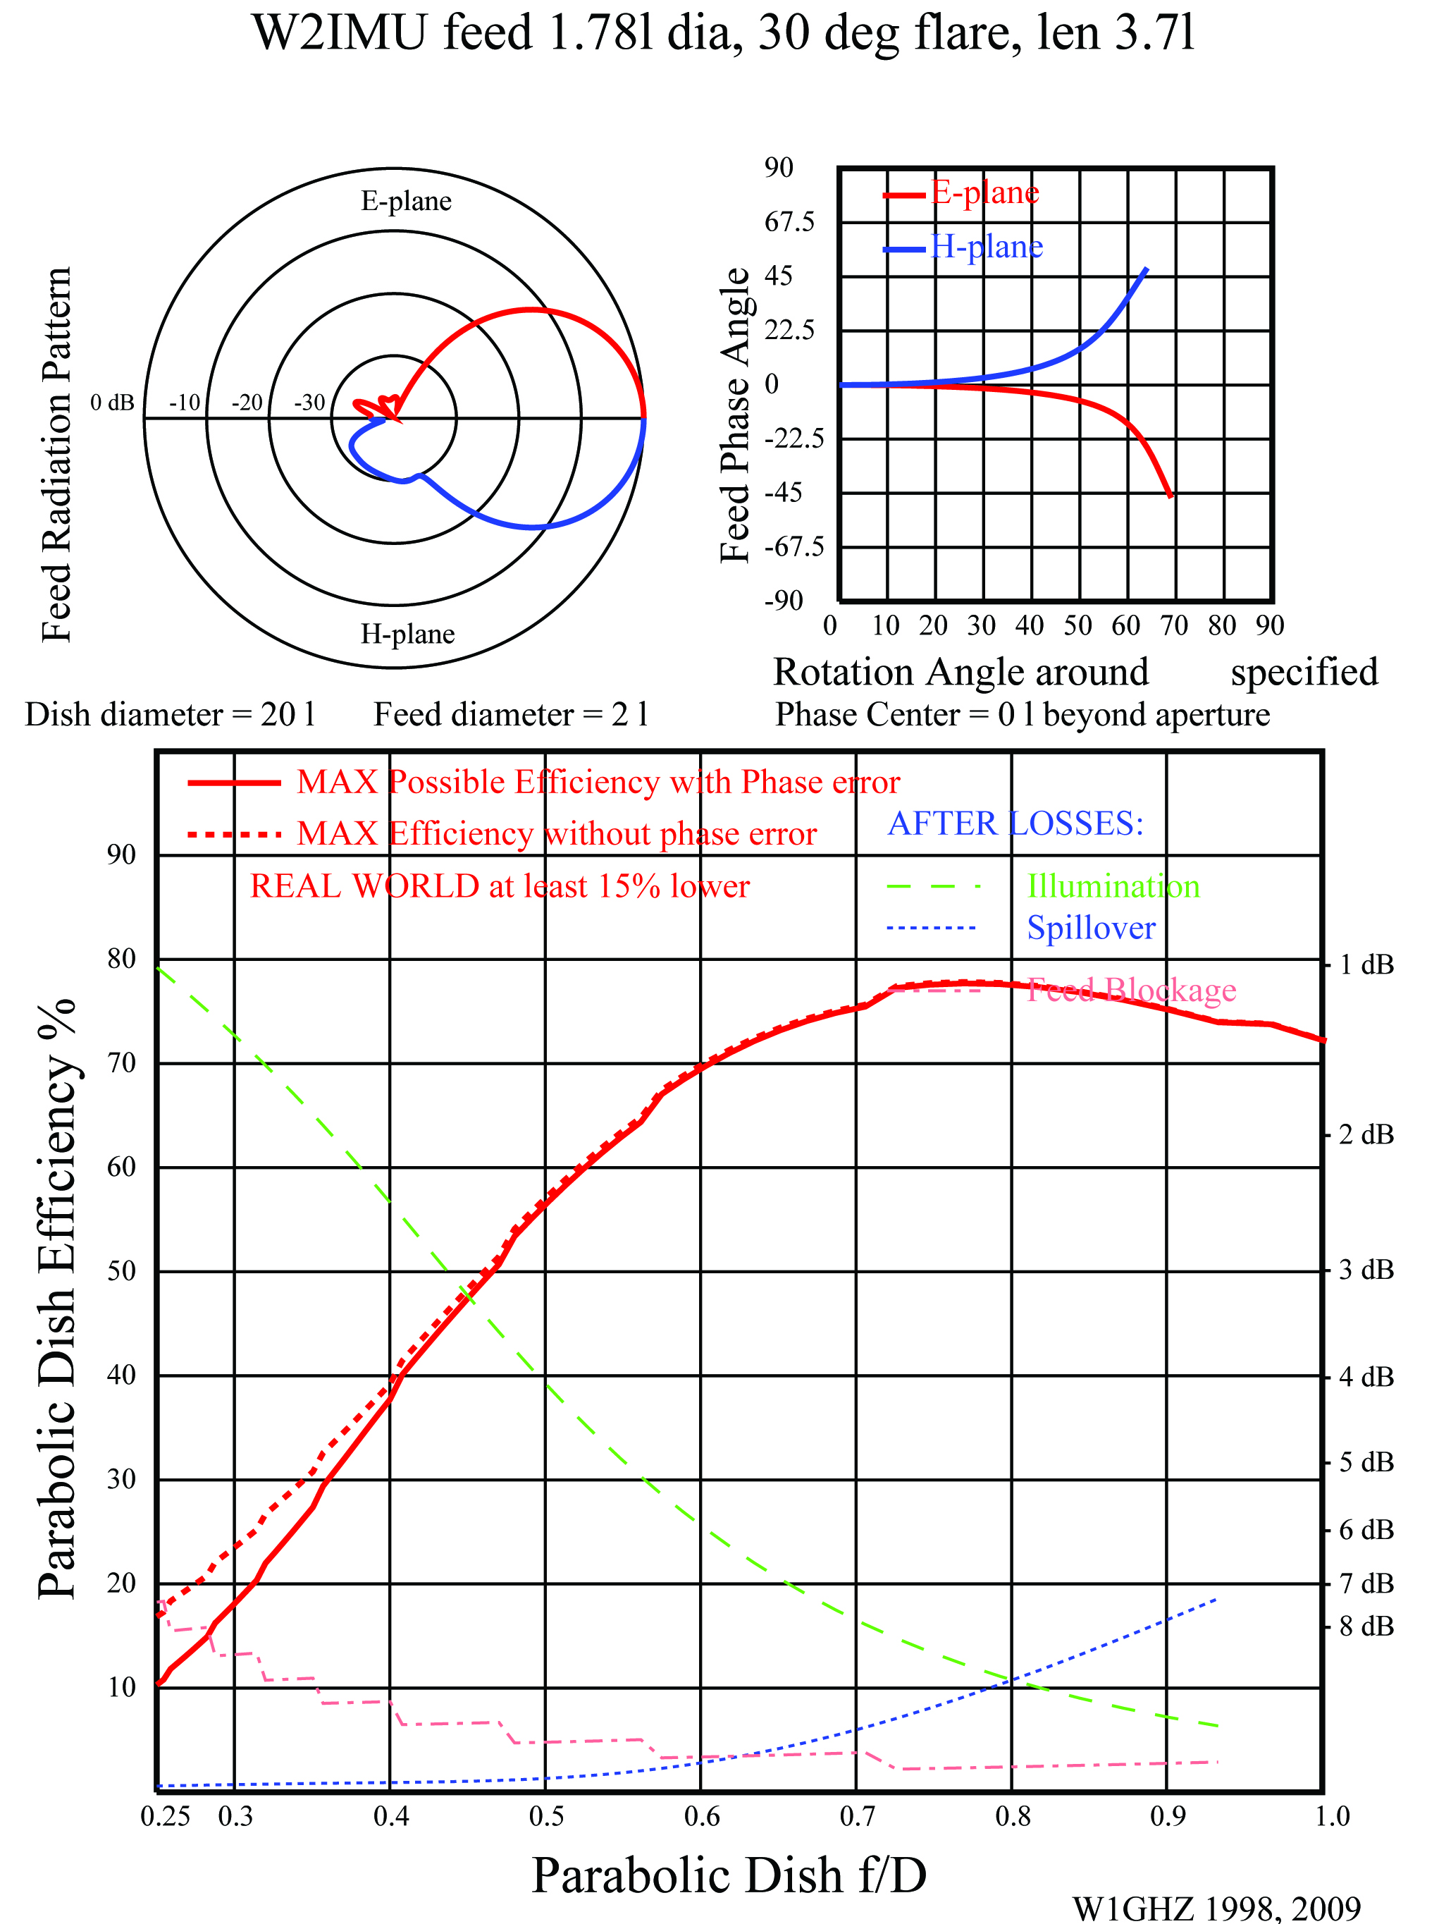
Feedhorn
Large W2IMU
Dual-mode horn
High performance
Easy to build

Slide 24
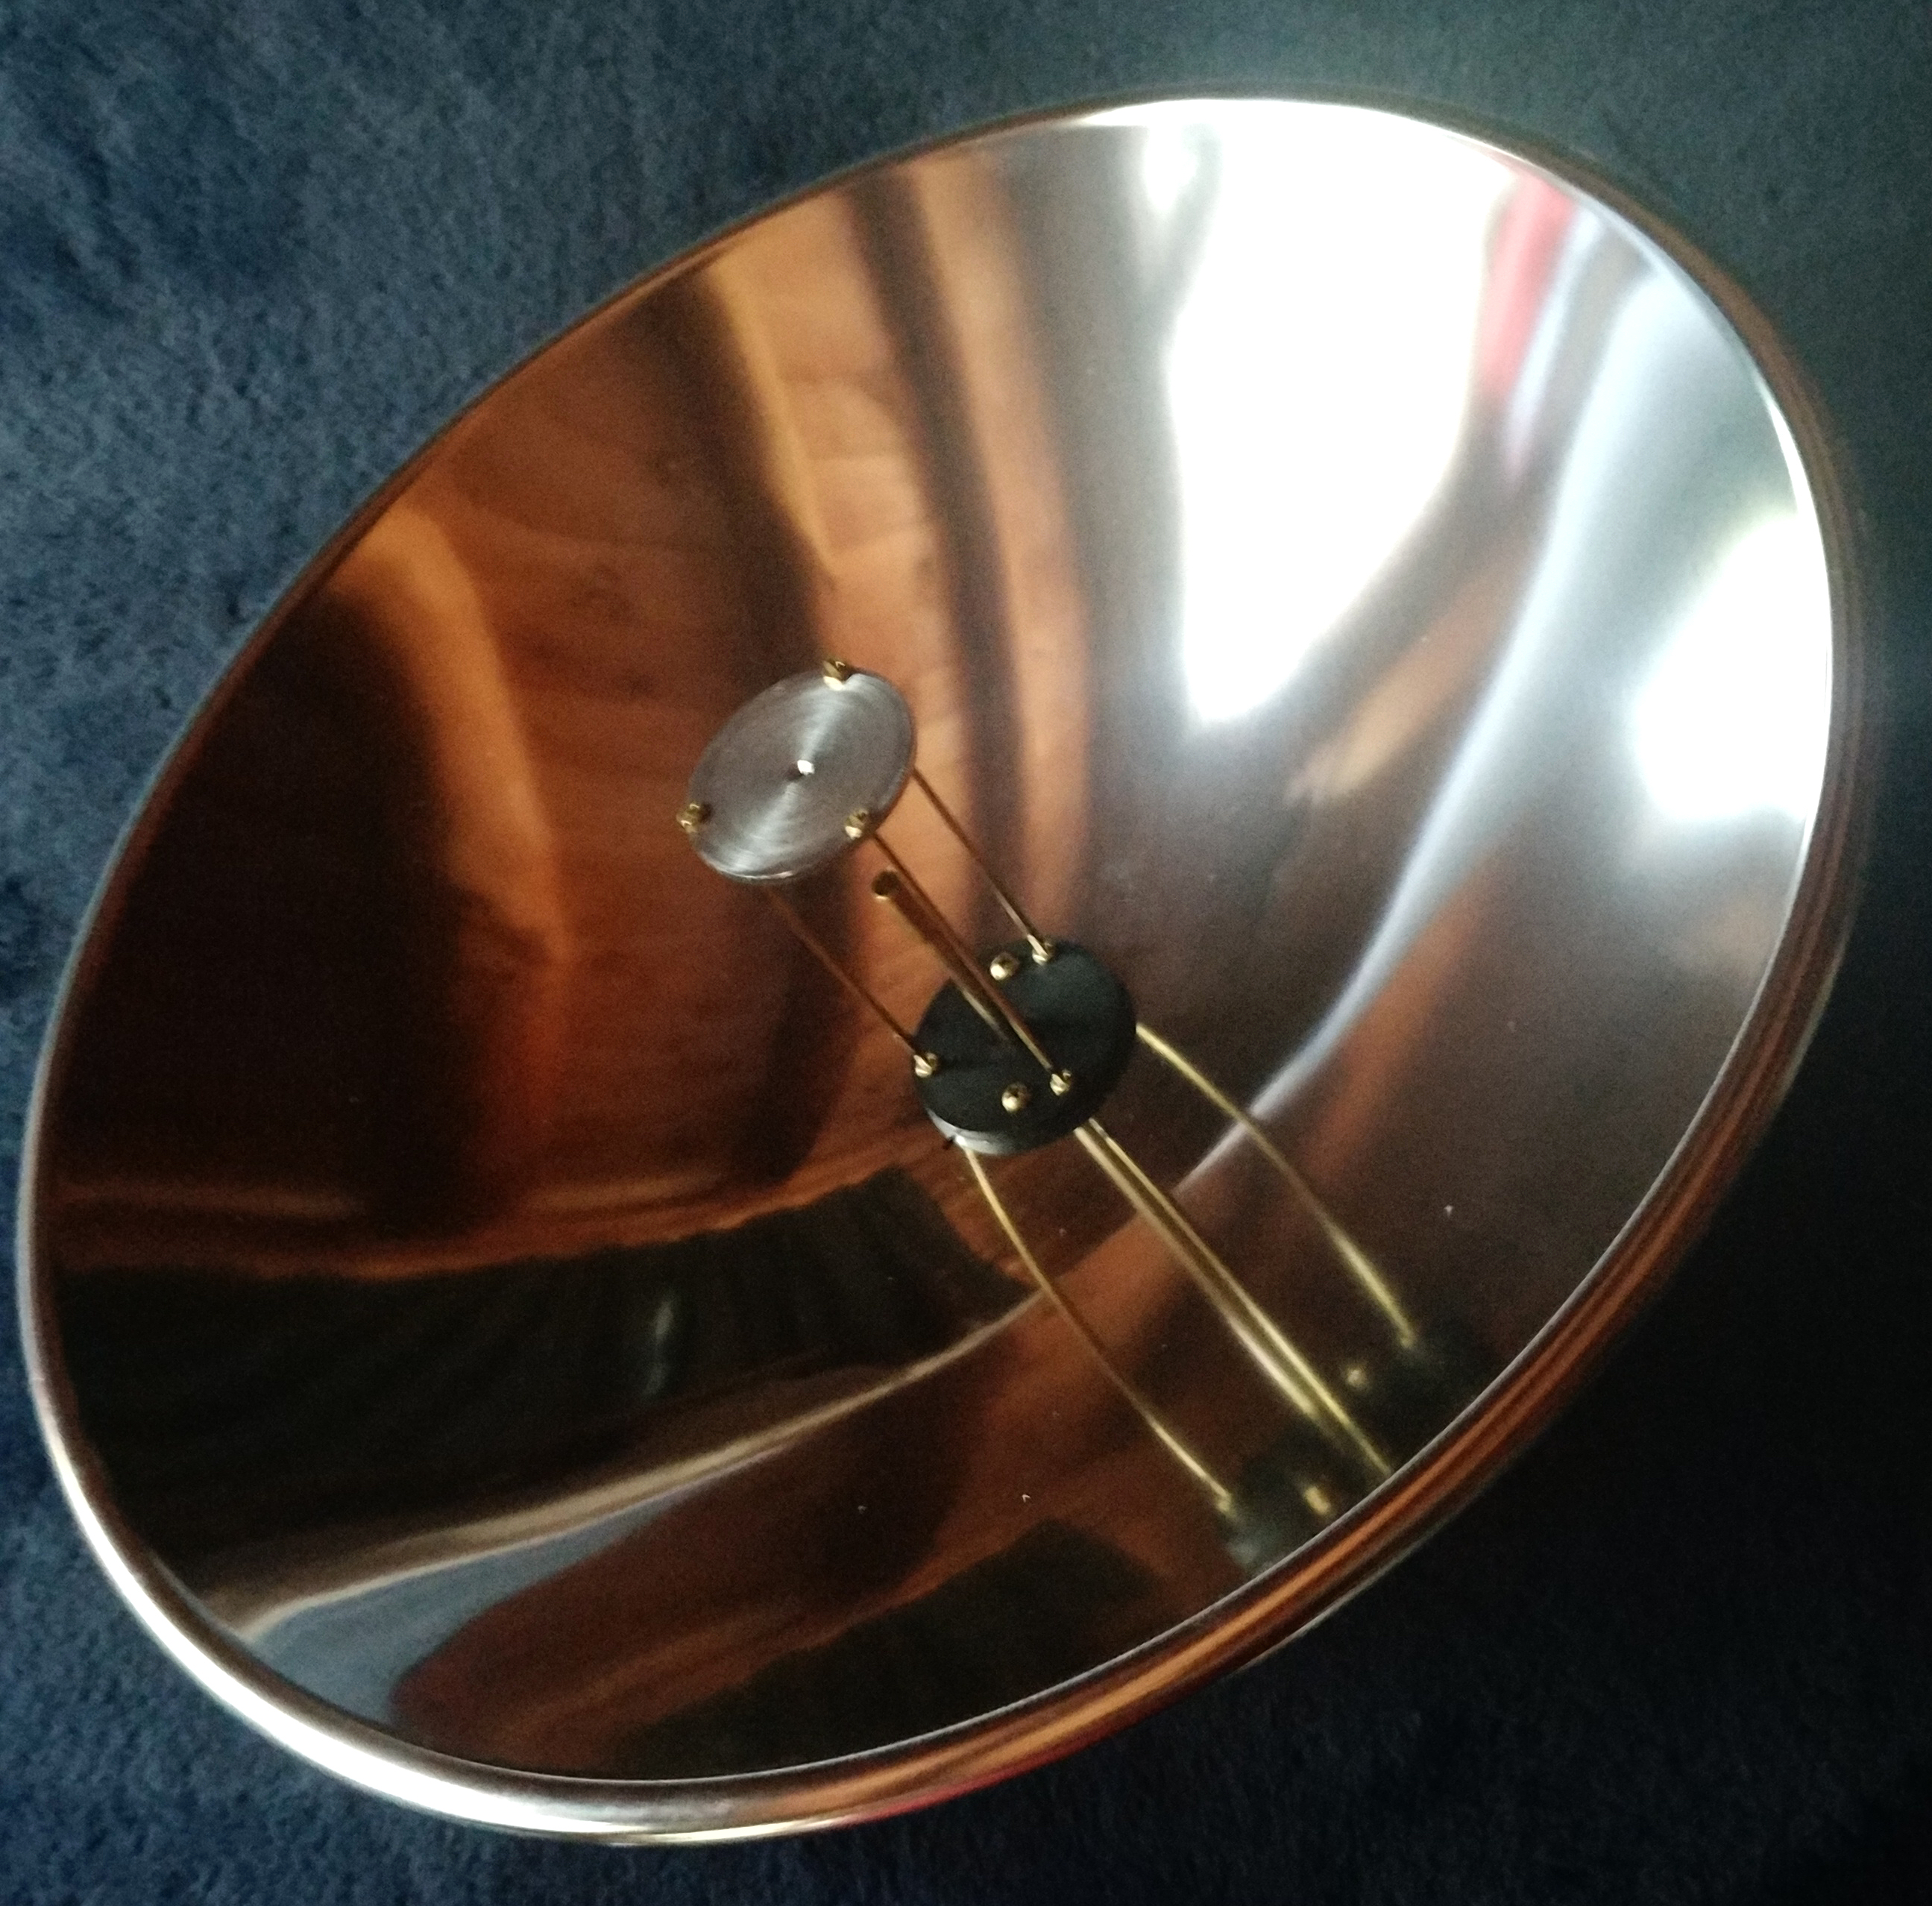
305 mm dish from
Edmund Optics
W2IMU Large
Dual-Mode Feed
1.9λ diameter by W1FKF

Slide 25
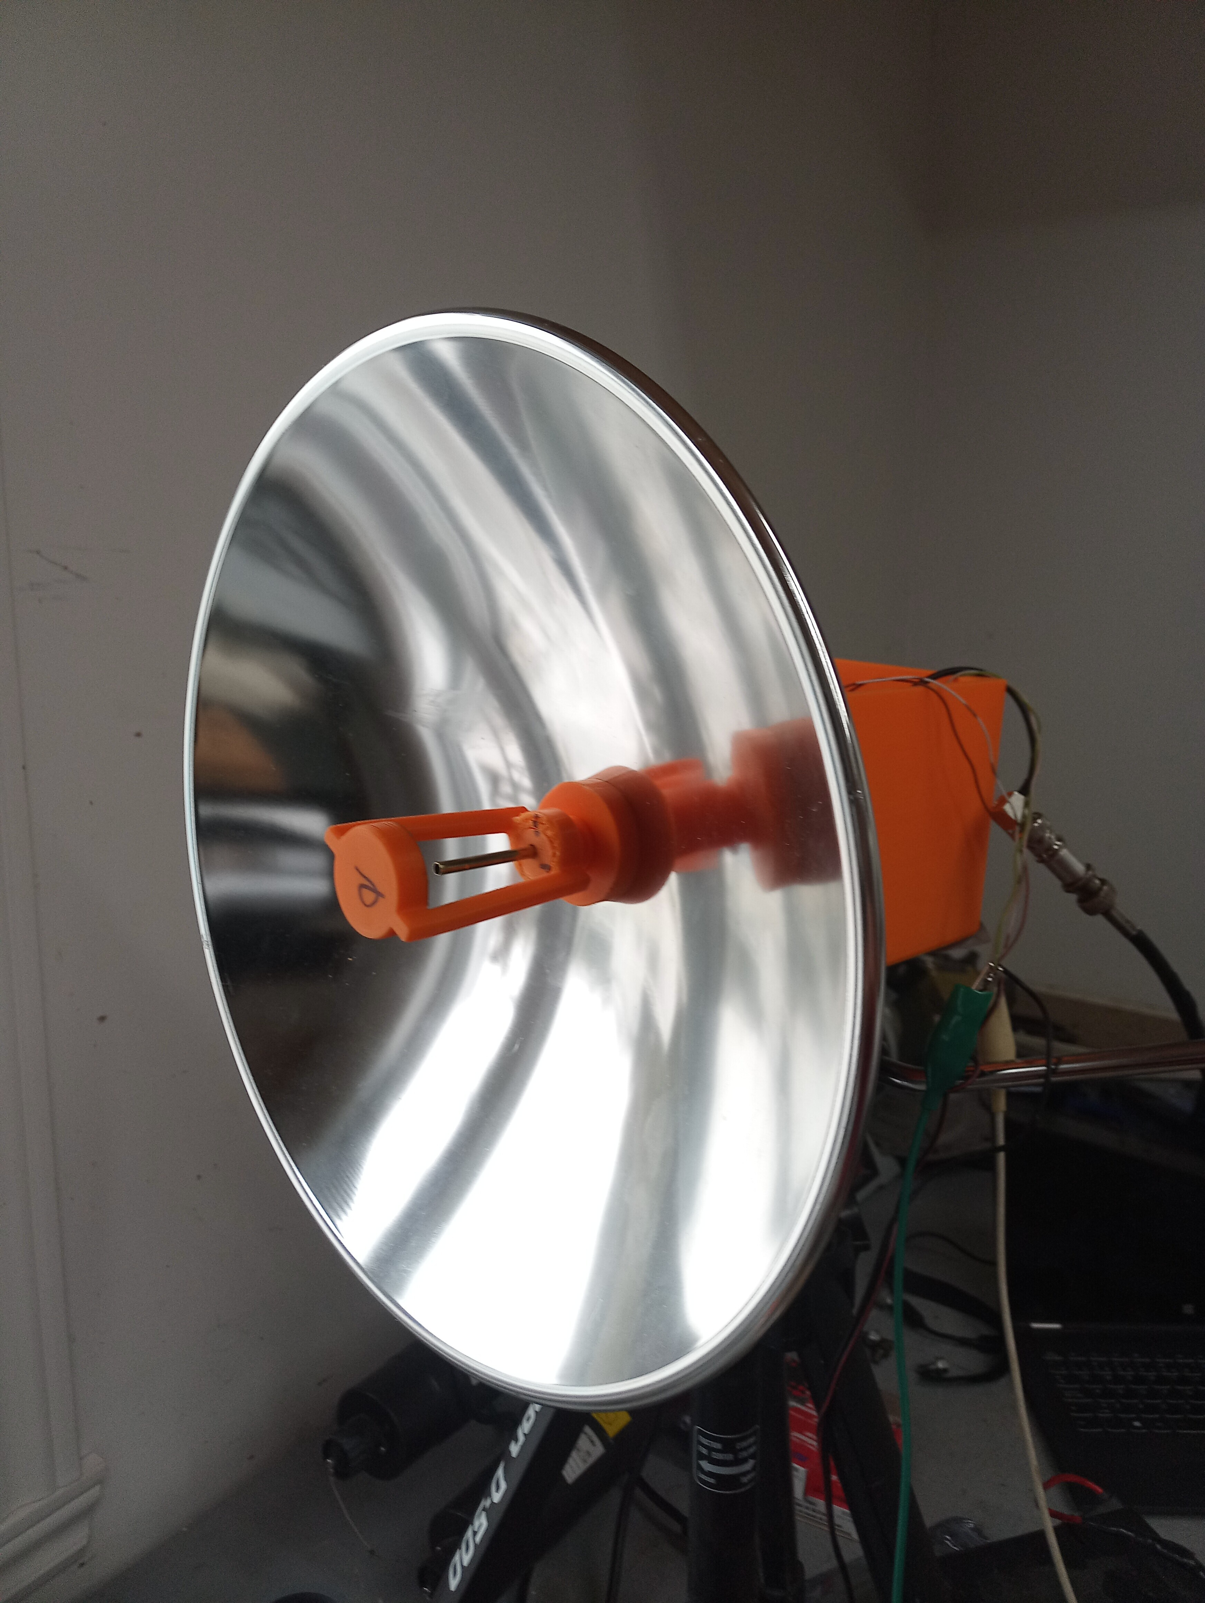
305mm dish with
3D printed removable
Subreflector assembly
Measurement: by VE2UG

Slide 26
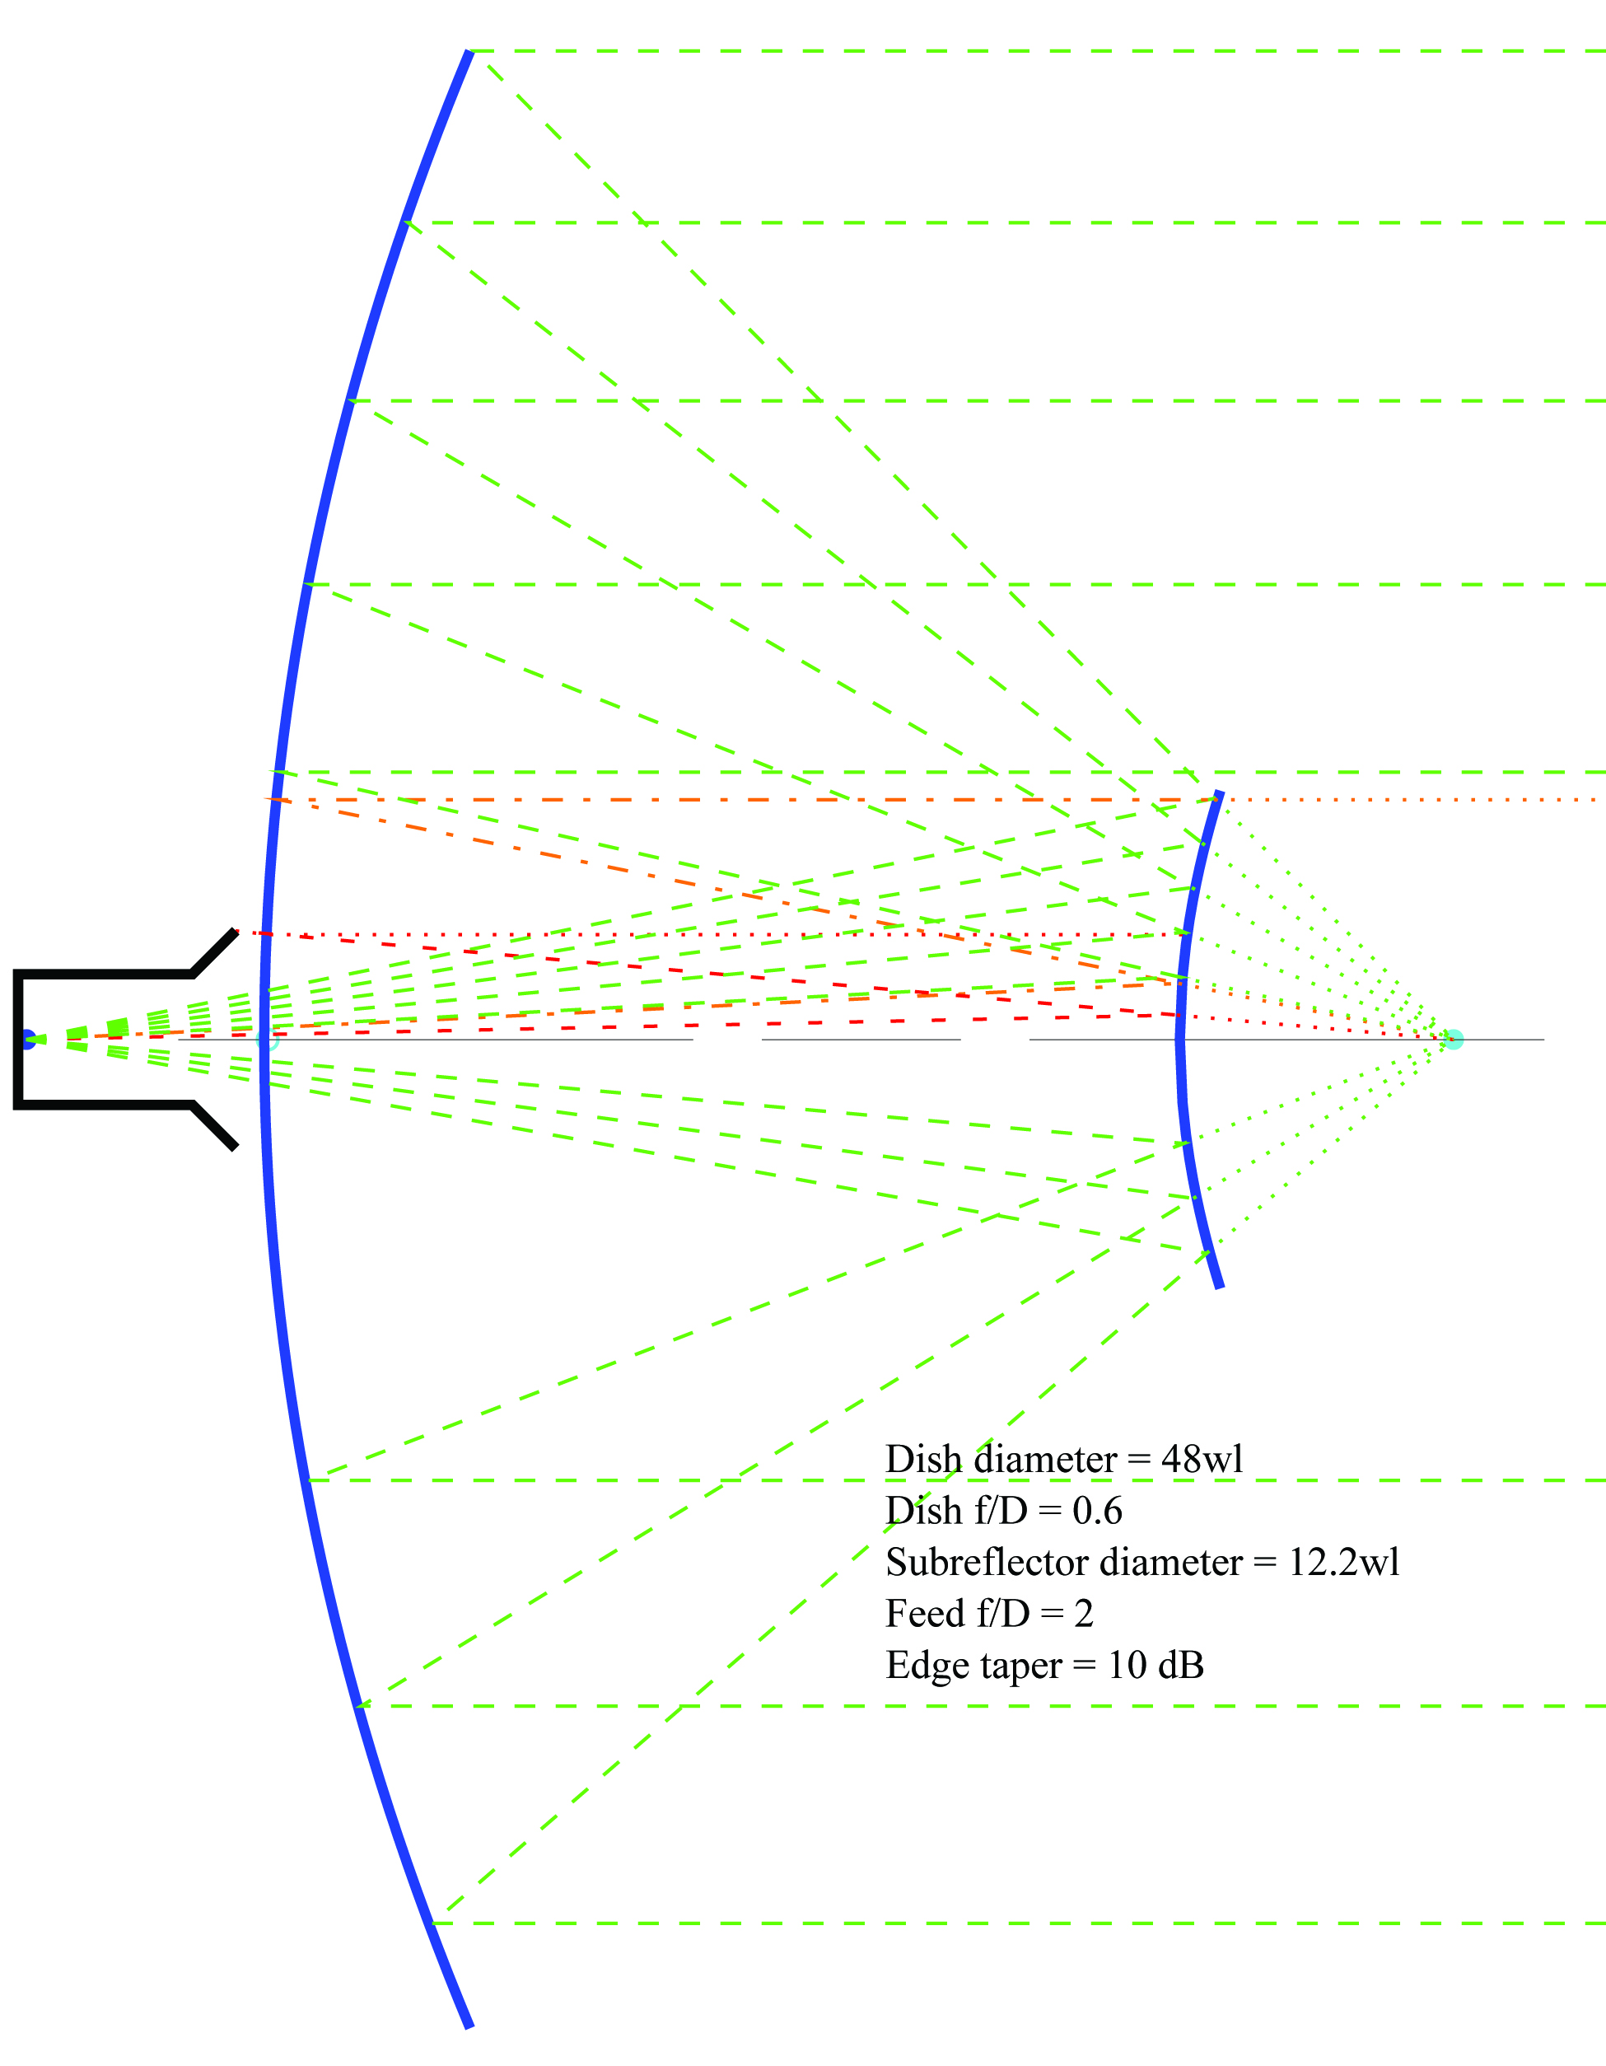
Example 2 – W1GHZ
48λ Diameter,
12λ Subreflector, f/D = 0.6
47 GHz

Slide 27
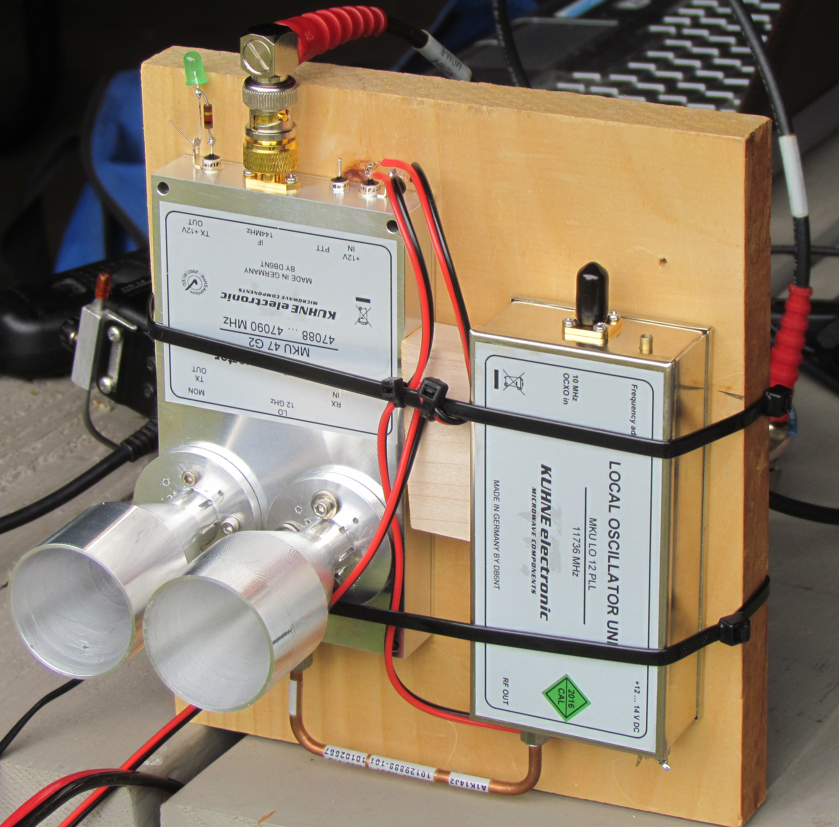
DB6NT 47 GHz
Transverter
Separate horns for TX and RX
(Skobolev 5.6λ) best DX 114 km

Slide 28
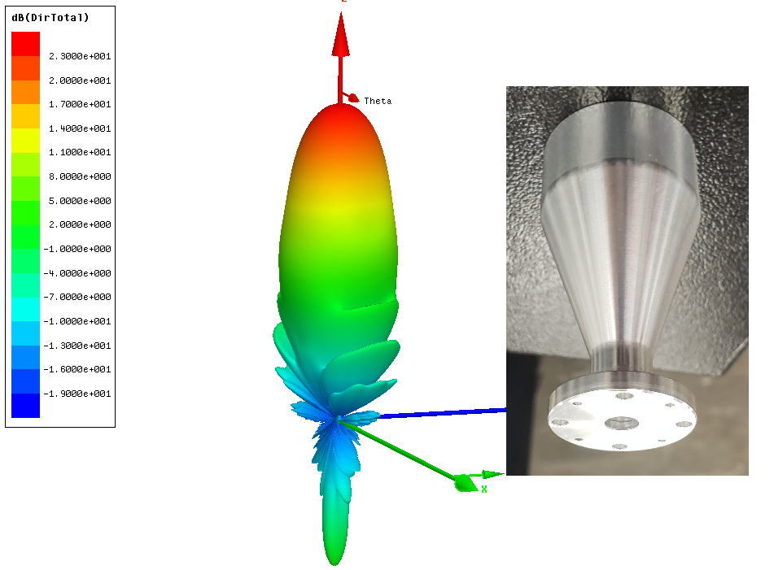
47 GHz
Skobolev horn
5.6λ dia
~23 dBi
BW ~12º

Slide 29
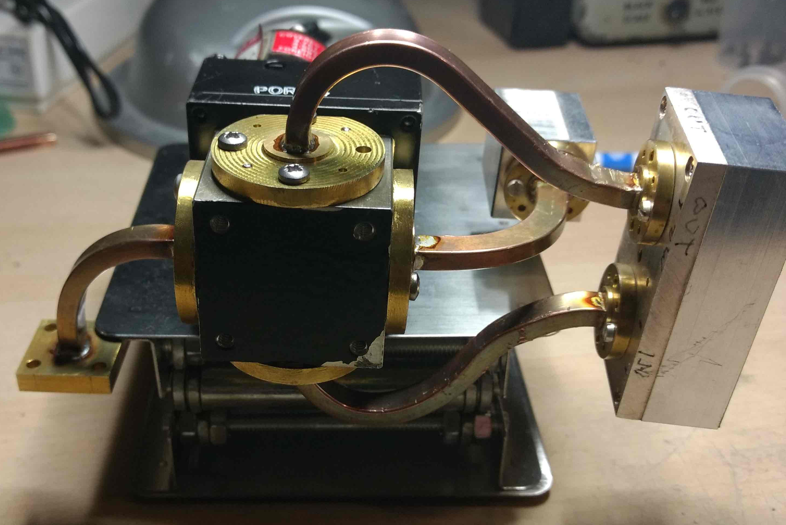
How about a waveguide switch
Waveguide
Spaghetti by VE3FN

Slide 30
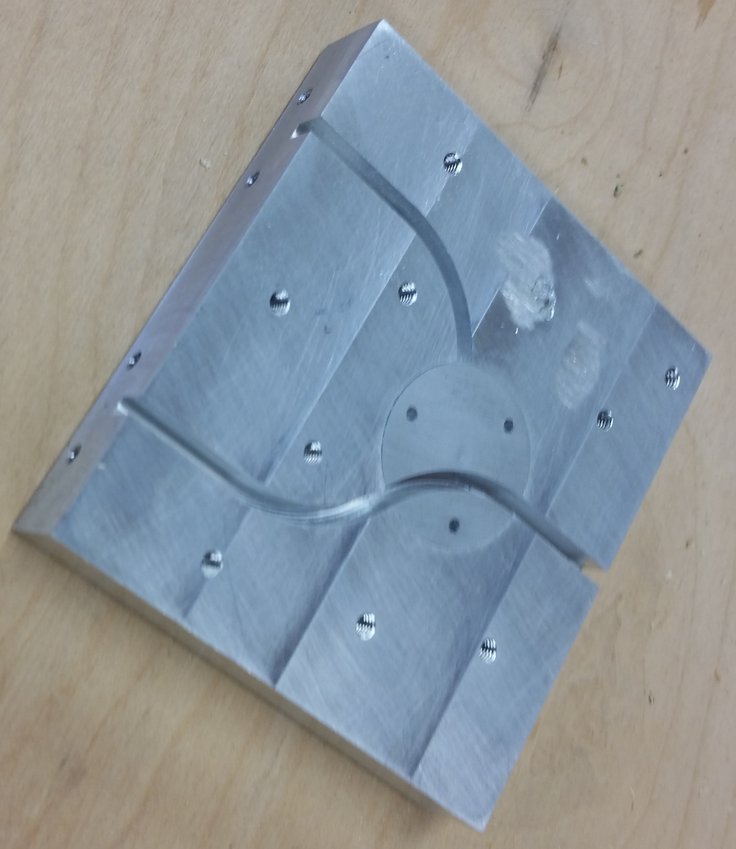
Machined
Waveguide
Switch
Mates with
DB6NT 47 GHz
Transverter

Slide 31
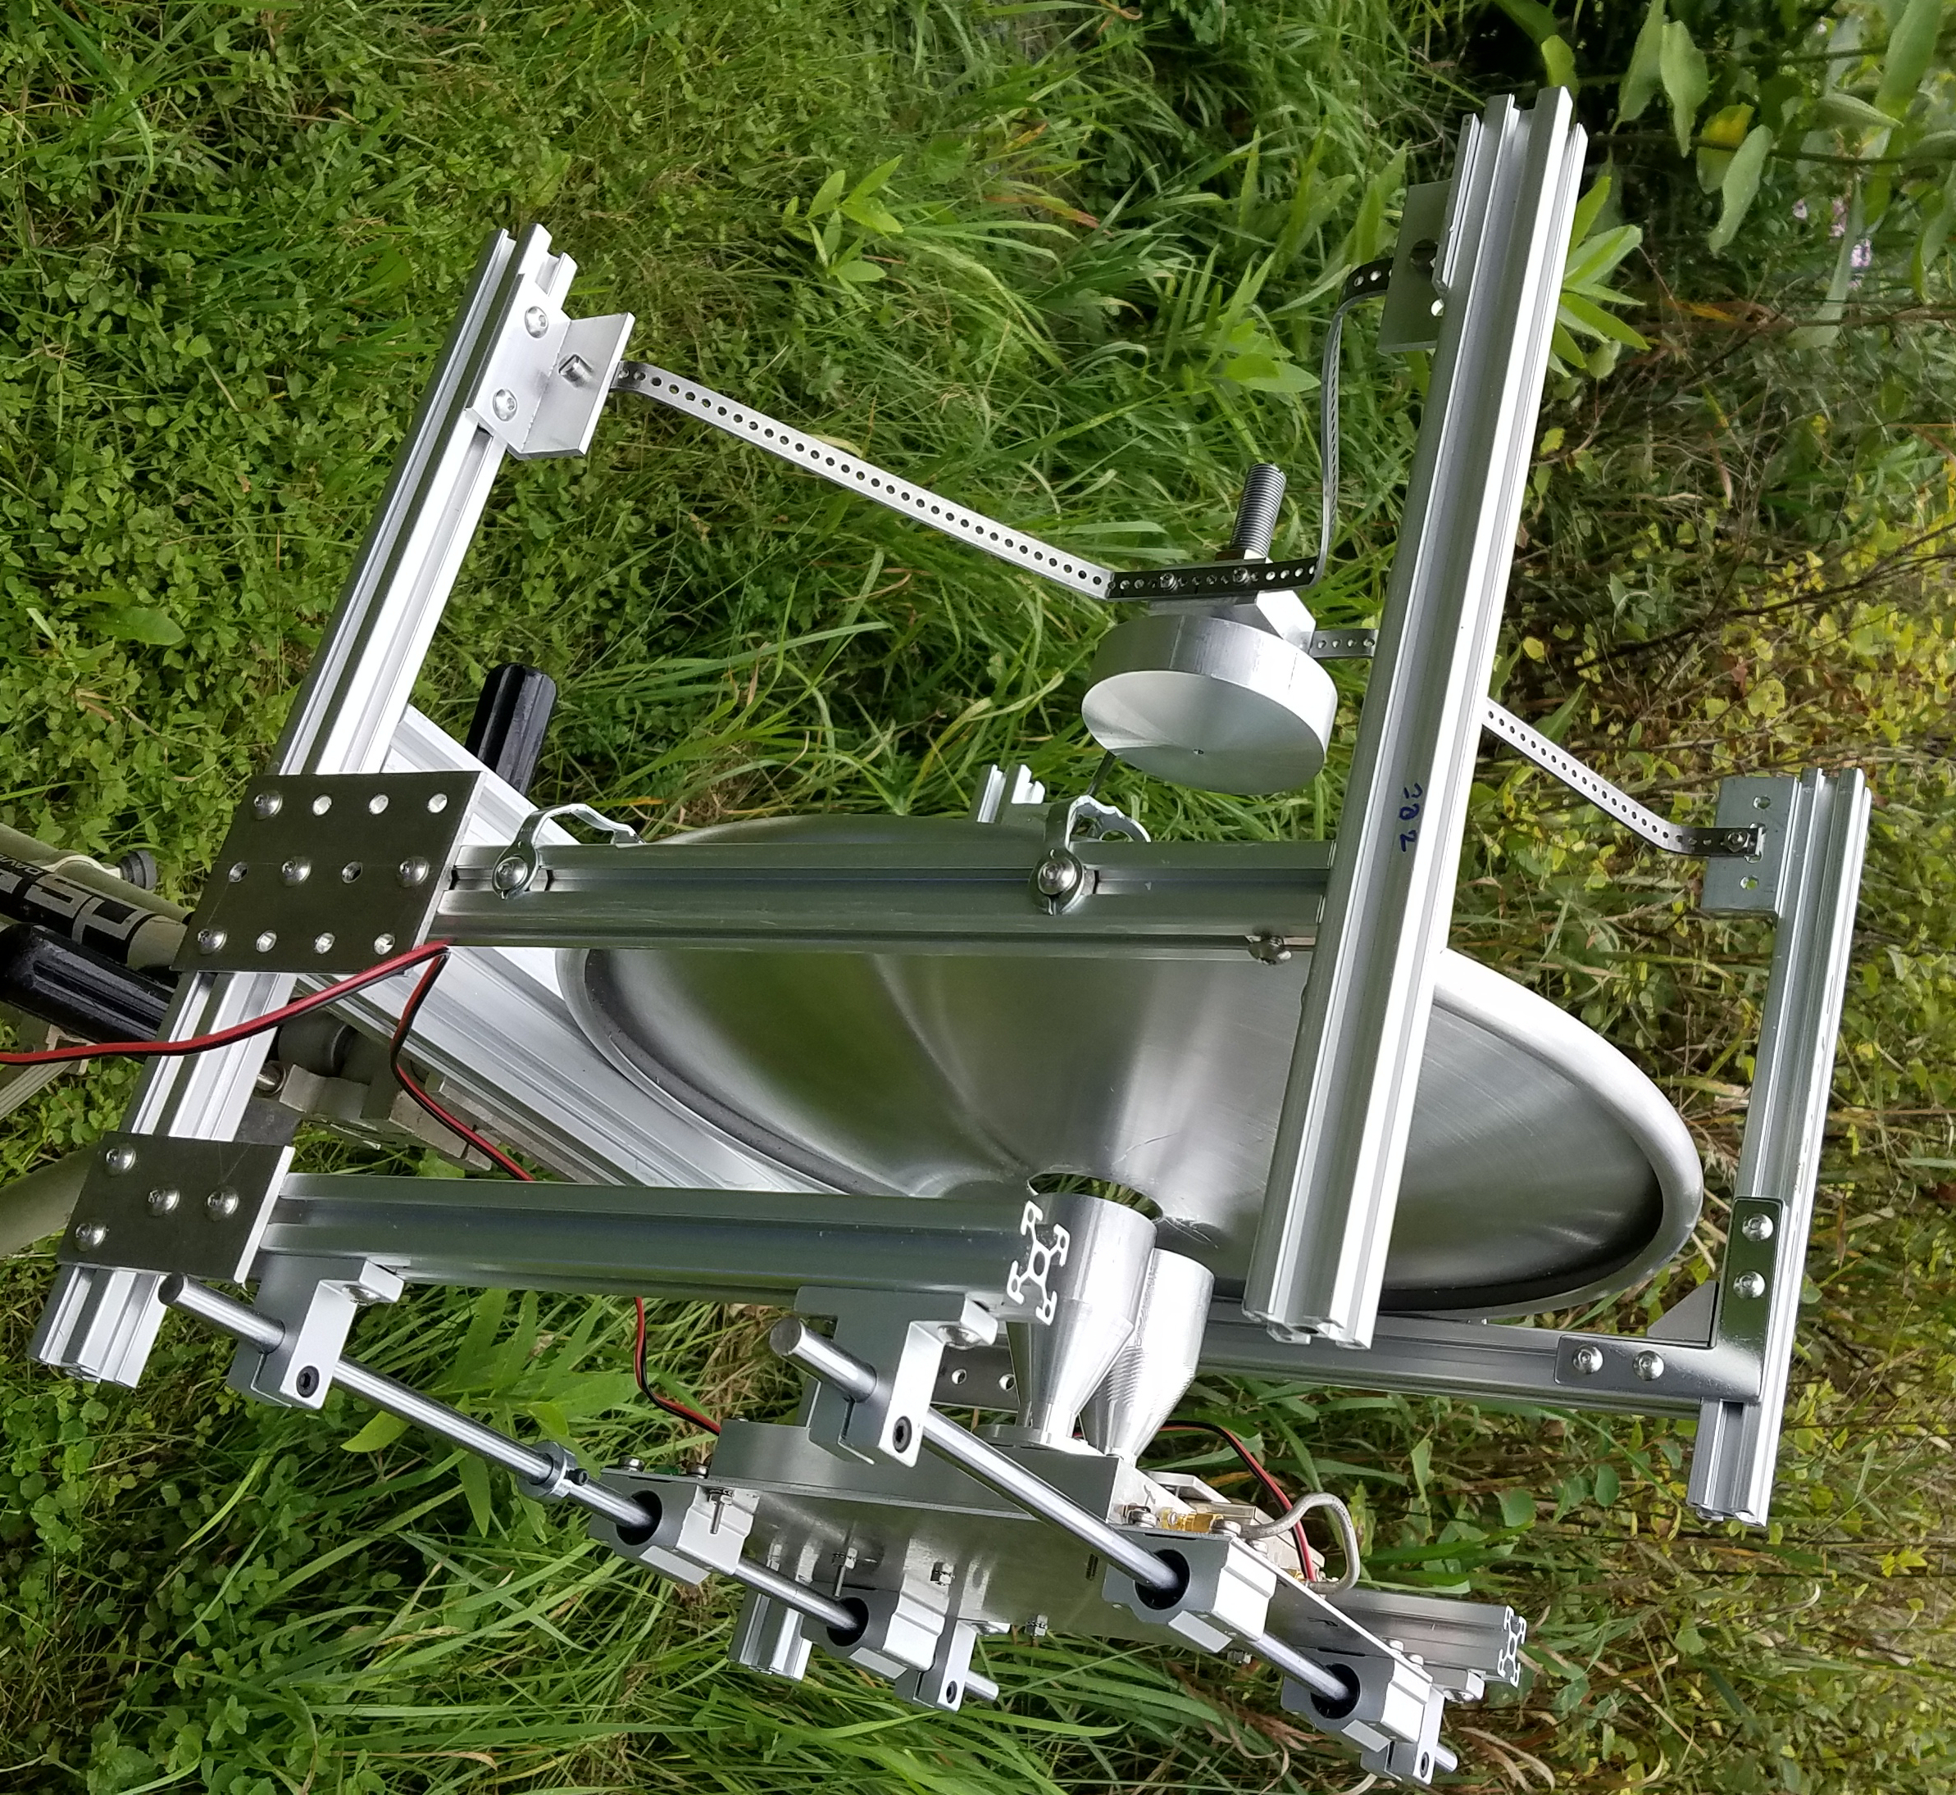
47GHz zero Feedline loss
SHF Micro 305mm dish
Subreflector swings down
Feedhorn ~23 dBi
Dish adds 18 to19 dB
~ 50% efficiency

Slide 32
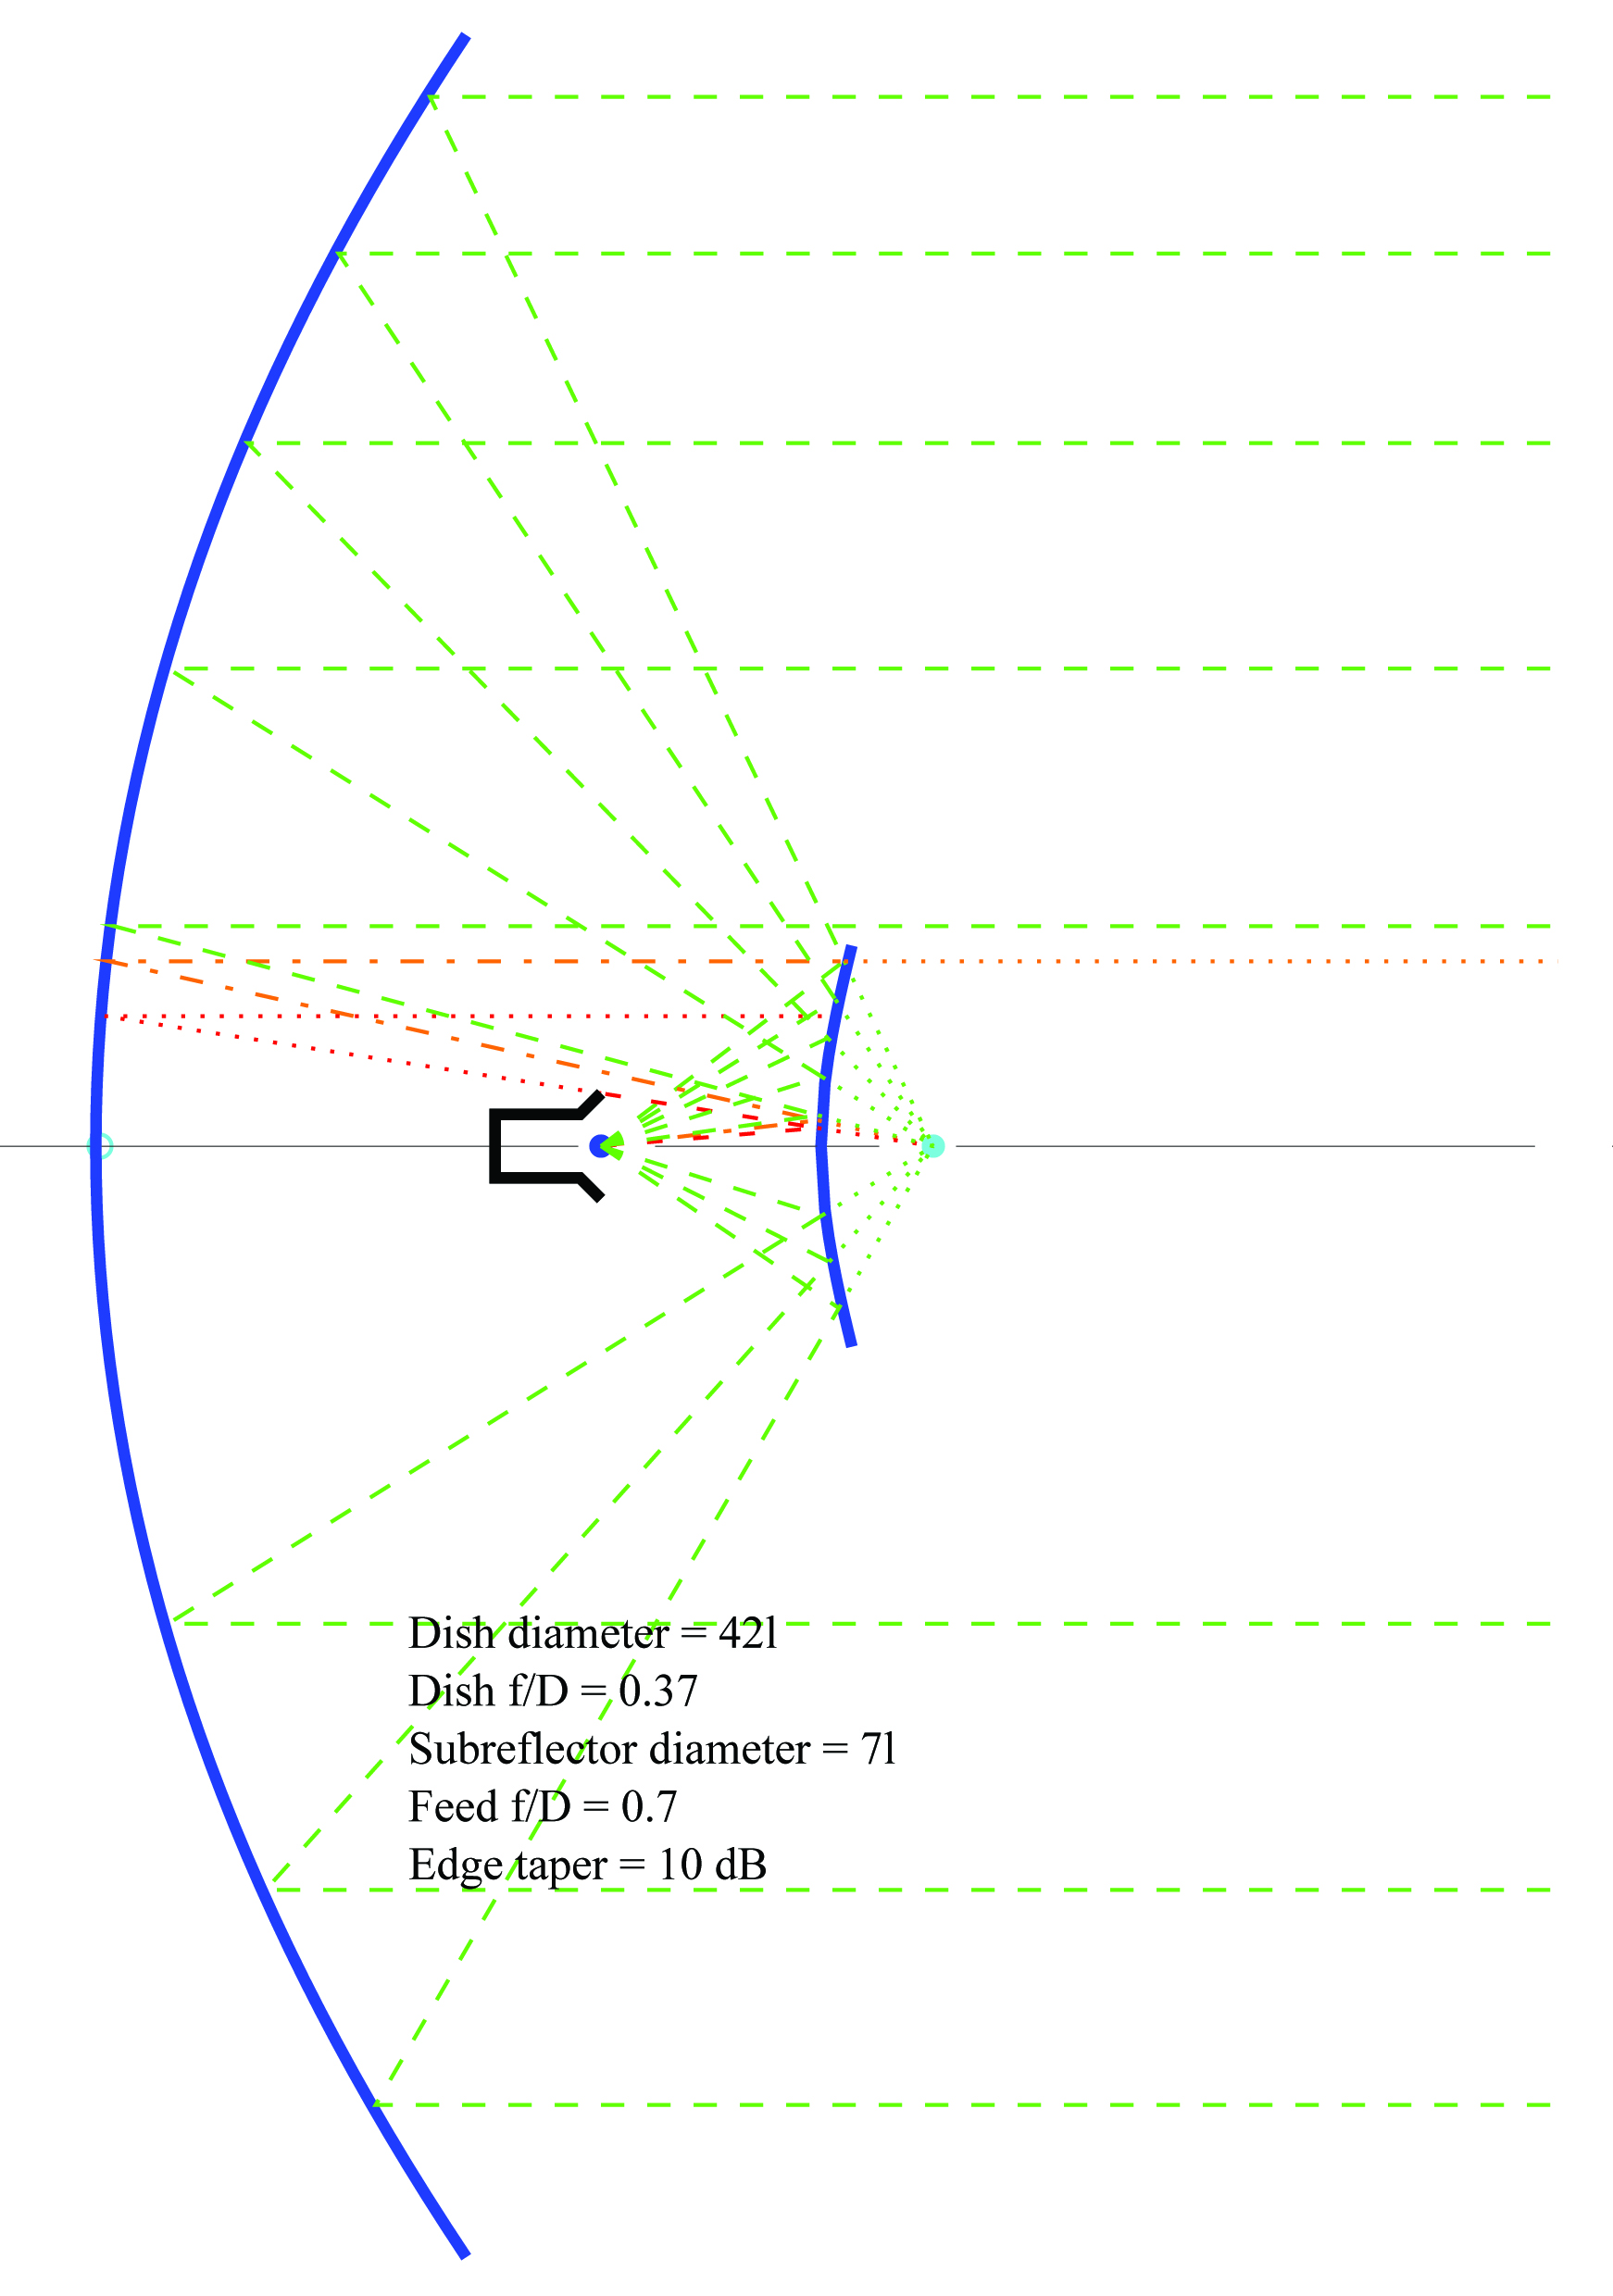
Example 3 – W1GHZ
42λ Diameter,
7λ Subreflector, f/D = 0.375
10 GHz EME

Slide 33
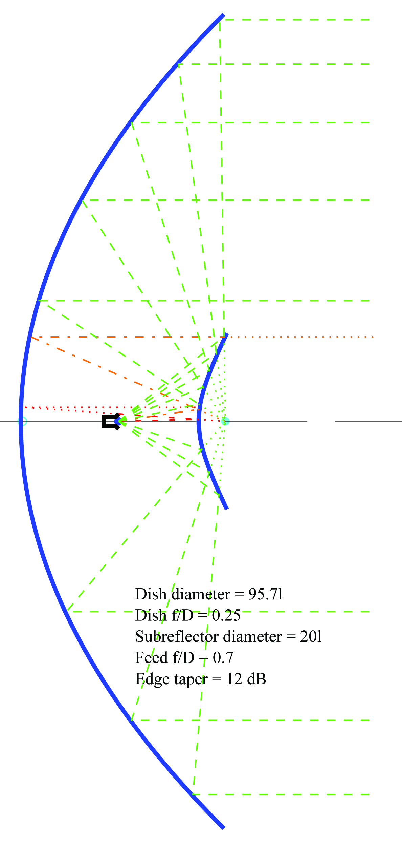
Example 4
96λ Diameter,
20λ Subreflector, f/D = 0.25
47 GHz
Feedhorn ~14 dBi
Dish adds 31.9 dB
~ 46% efficiency by VE2UG

Slide 34
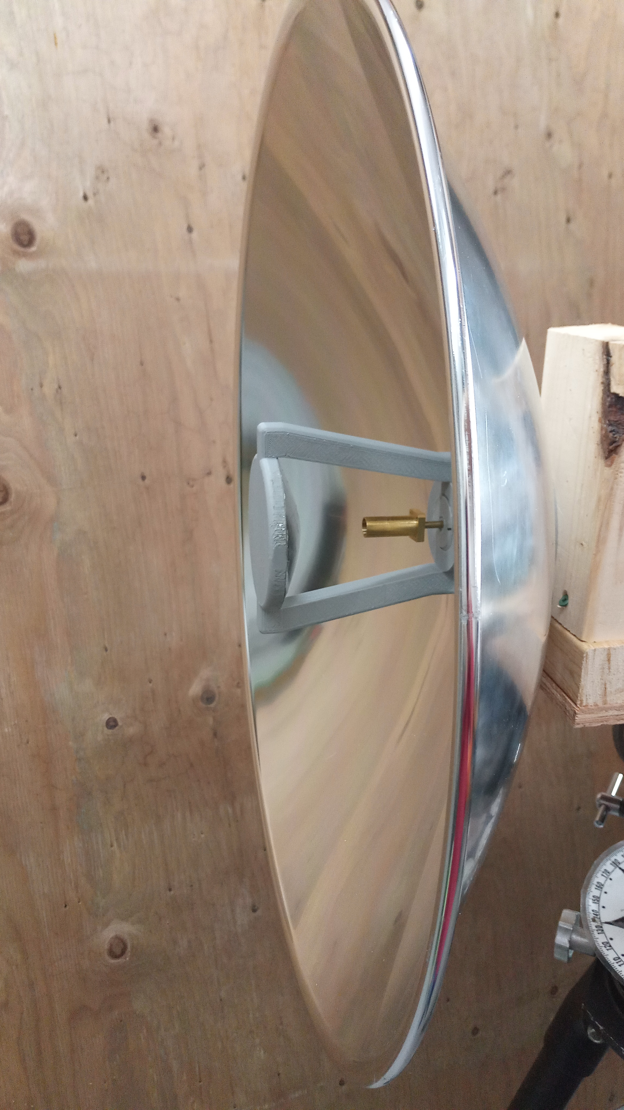
VE2UG
47 GHz
Edmund dish

Slide 35
Example 4 – VE2UG 47GHz
609mm dish (24 inches)
  Largest from Edmund Optic
W2IMU Large Dual-Mode Feed
  1.78λ diameter
100mm Subreflector (15.7 λ)
PLAN: Compare Subreflectors
  machined metal
  3D printed

Slide 36
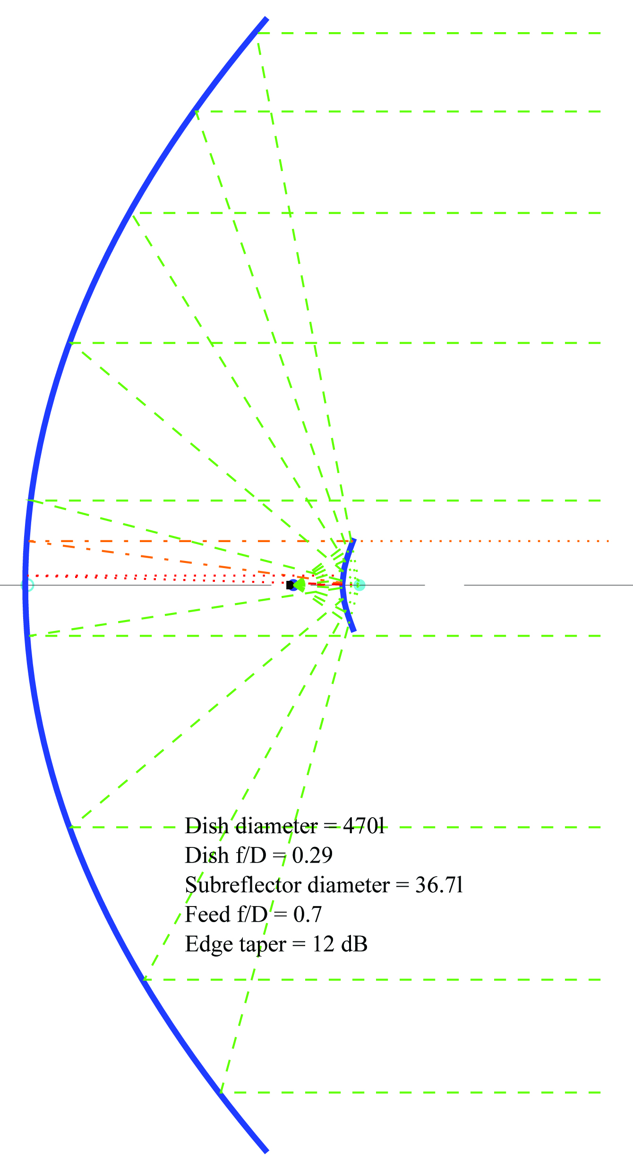
Example 5 – DK7LJ
3 meter Diameter, f/D = 0.29
Large W2IMU feedhorn
DL0SHF at 24 or 47 GHz

Slide 37
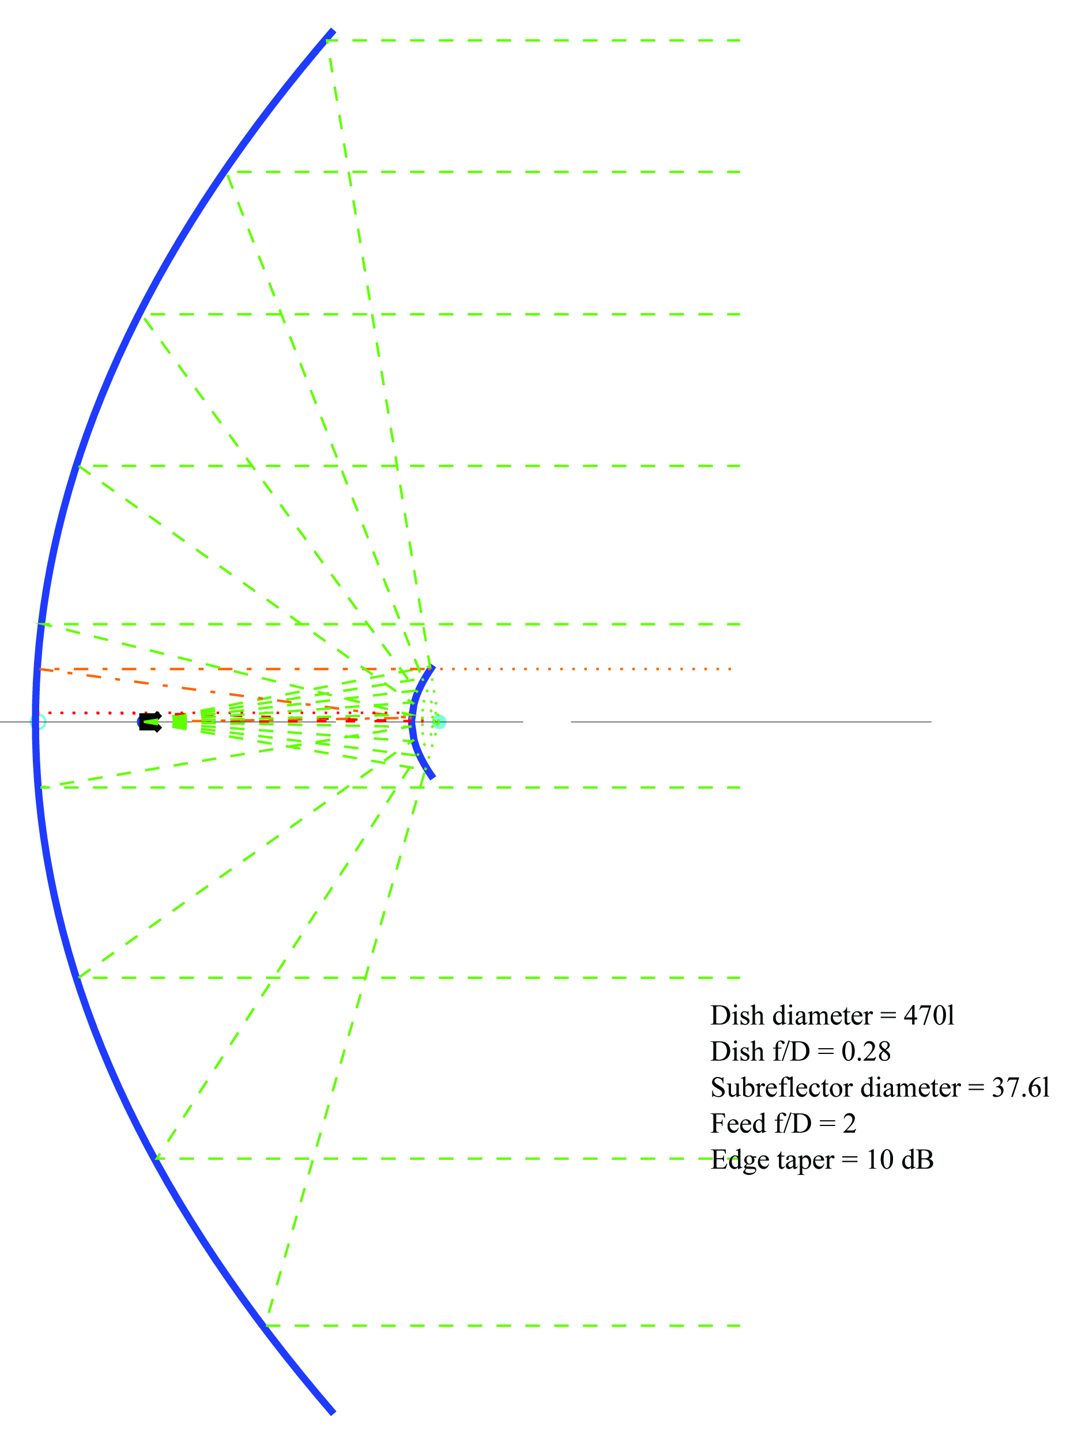
Example 5 – DK7LJ
3 meter Diameter, f/D = 0.29
Skobolev feed (Ex 2)
DL0SHF at 47 GHz

Slide 38
Cassegrain Summary
Cassegrain Antenna performance demonstrated
Advantages for Large Dishes
Advantages for Deep Dishes
Reduce feedline loss at microwaves
Amateur fabrication possible
Design Procedure and Tools

Slide 39
Feedhorns for Cassegrain Antennas
High Efficiency
Narrow Beamwidth => High Gain
Equal Phase Centers
Choices:
  W2IMU Dual-Mode
  Skobolev Optimum Dual-Mode
  Pickett-Potter

Slide 40
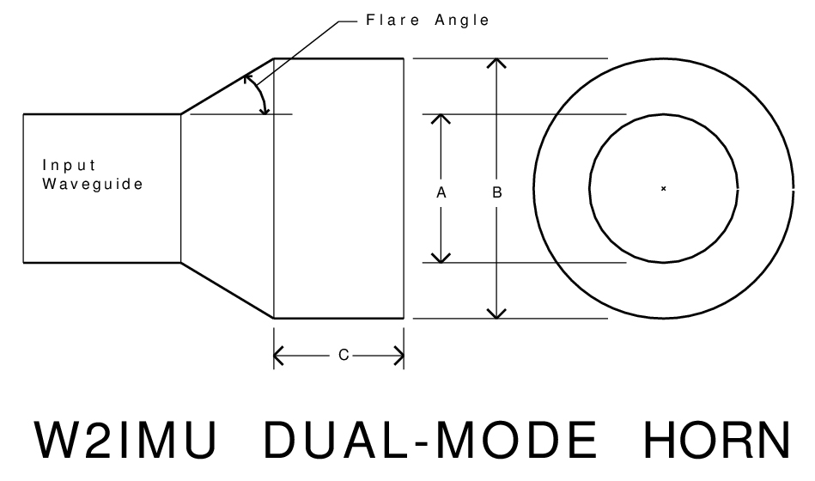
W2IMU Dual-Mode Feedhorn
Simple Design
Range of sizes
1.31λ Diameter – Original
1.22λ to 1.95λ Diameter
48º to 32º half-angle Beamwidth
Easy to machine for >47 GHz
30º Flare Angle if Length Adjusted

Slide 41
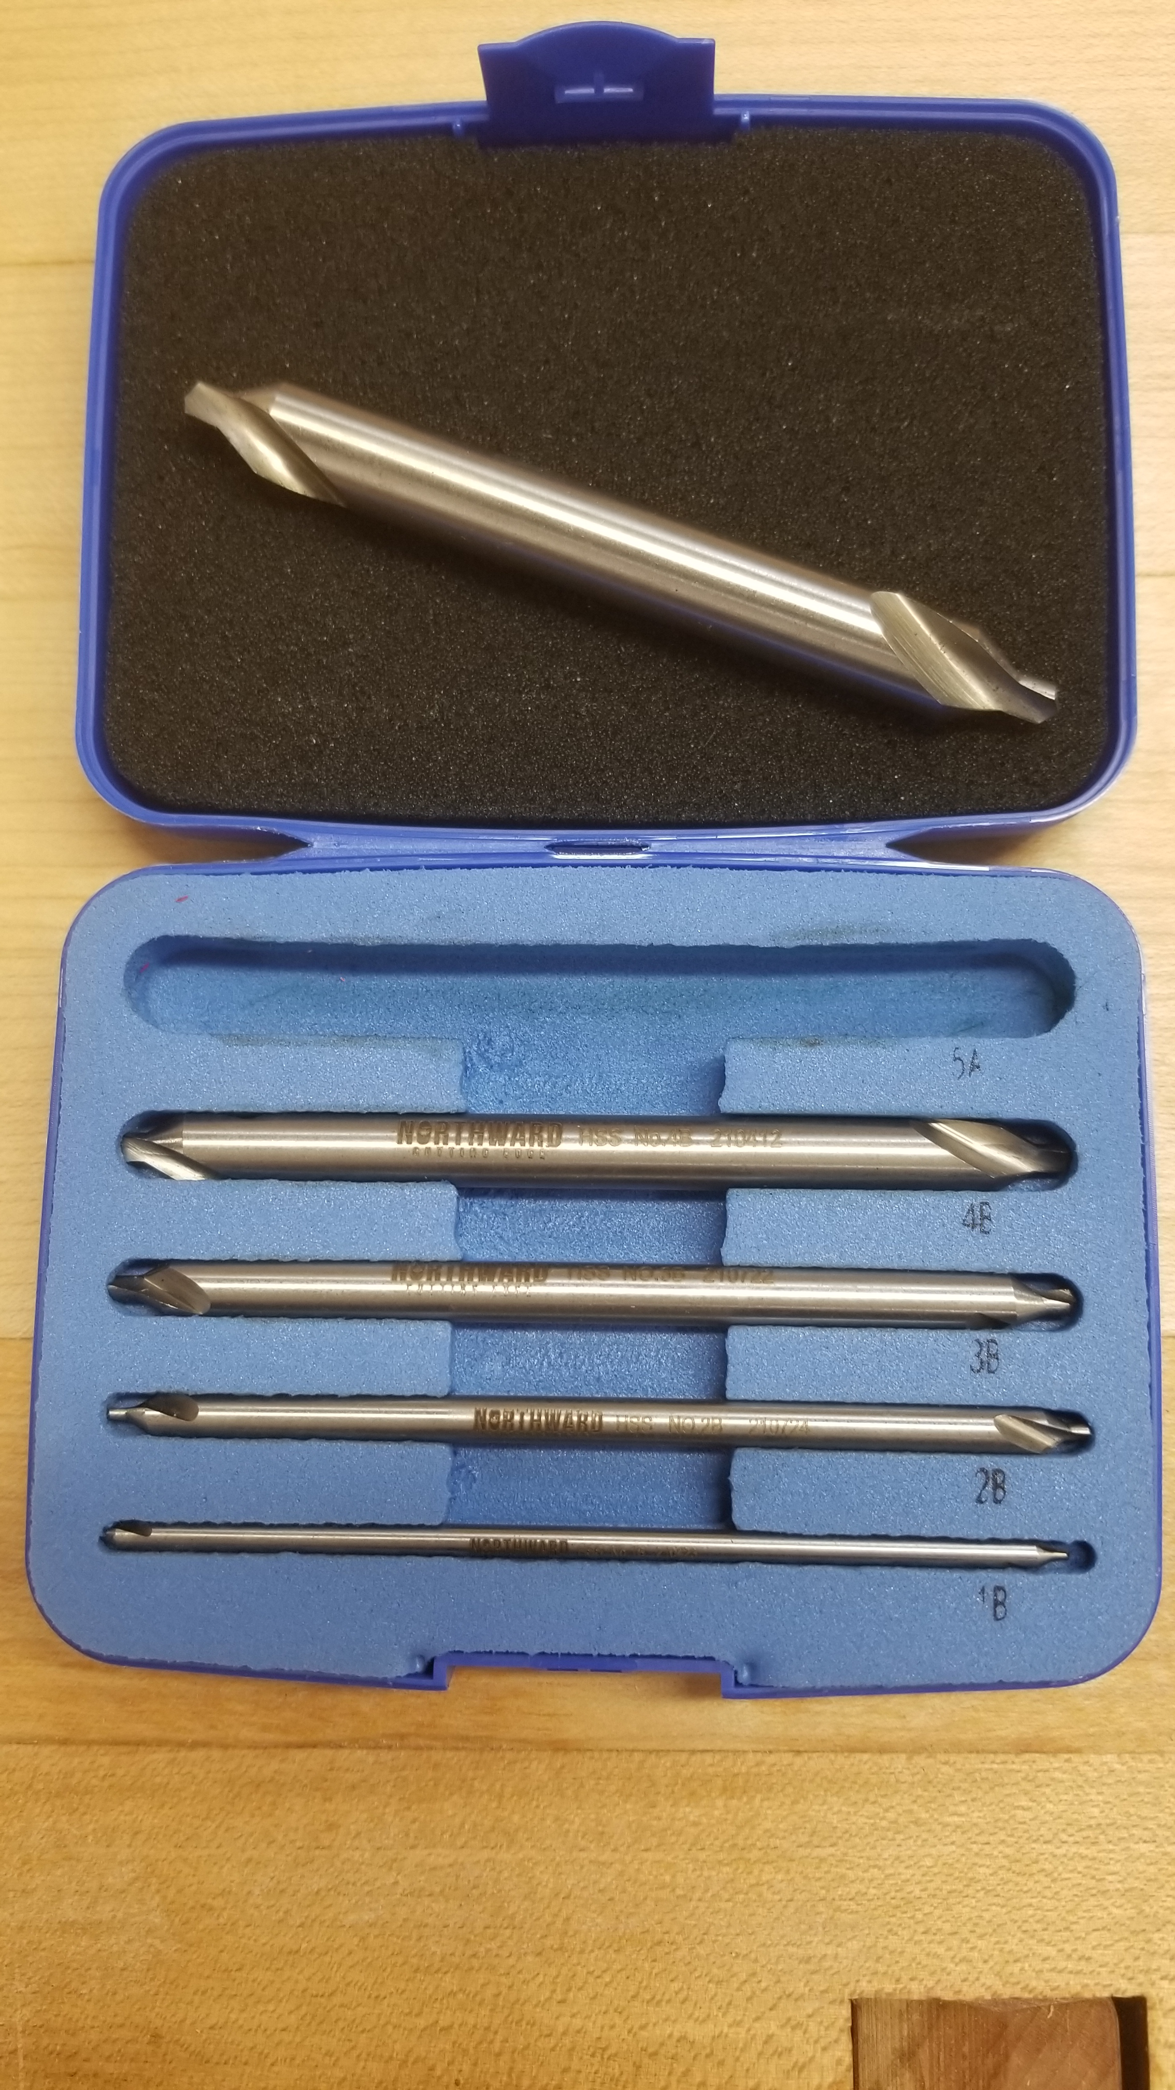
Machine with 60º Center Drill for 30º Flare Angle

Slide 42
Large W2IMU Dual-mode Feed Dimensions
 | with 30 degree flare angle
 |  |  |  | W1GHZ | Jan-23
 | Input Waveguide diameter 0.7 to 0.8l
Frequency | Flare | Tool | Horn diameter |  | Horn Length |  | Gain | BW -10
 | degrees |  | inches | l | inches | l | dB | degrees
10.368 | 30 |  | 2.00 | 1.78 | 4.215 | 3.7 | 13.9 | 35
24.192 | 30 | #9 | 0.875 | 1.79 | 1.806 | 3.7 | 13.9 | 35
47.088 | 30 | #5 | 0.4375 | 1.74 | 0.928 | 3.7 | 13.9 | 35
76 | 30 | #3 | 0.250 |  | 0.439 |  | 13.9 | 39
78 | 30 | #3 | 0.250 | 1.65 | 0.439 | 2.9 | 13.1 | 39
122 | 30 | #2 | 0.1875 | 1.94 | 0.415 | 4.3 | 14.6 | 32
122 | 30 | 4mm | 0.157 | 1.63 | 0.281 | 2.9 | 13.1 | 39
241 | 30 | 2mm | 0.079 | 1.66 | 0.142 | 2.9 | 13.1 | 39
HDL_ANT | 25 |  |  | 1.78 |  | 3.5
small IMU | 30 |  |  | 1.31 |  | 1.37 | 11.6 | 47

Slide 43
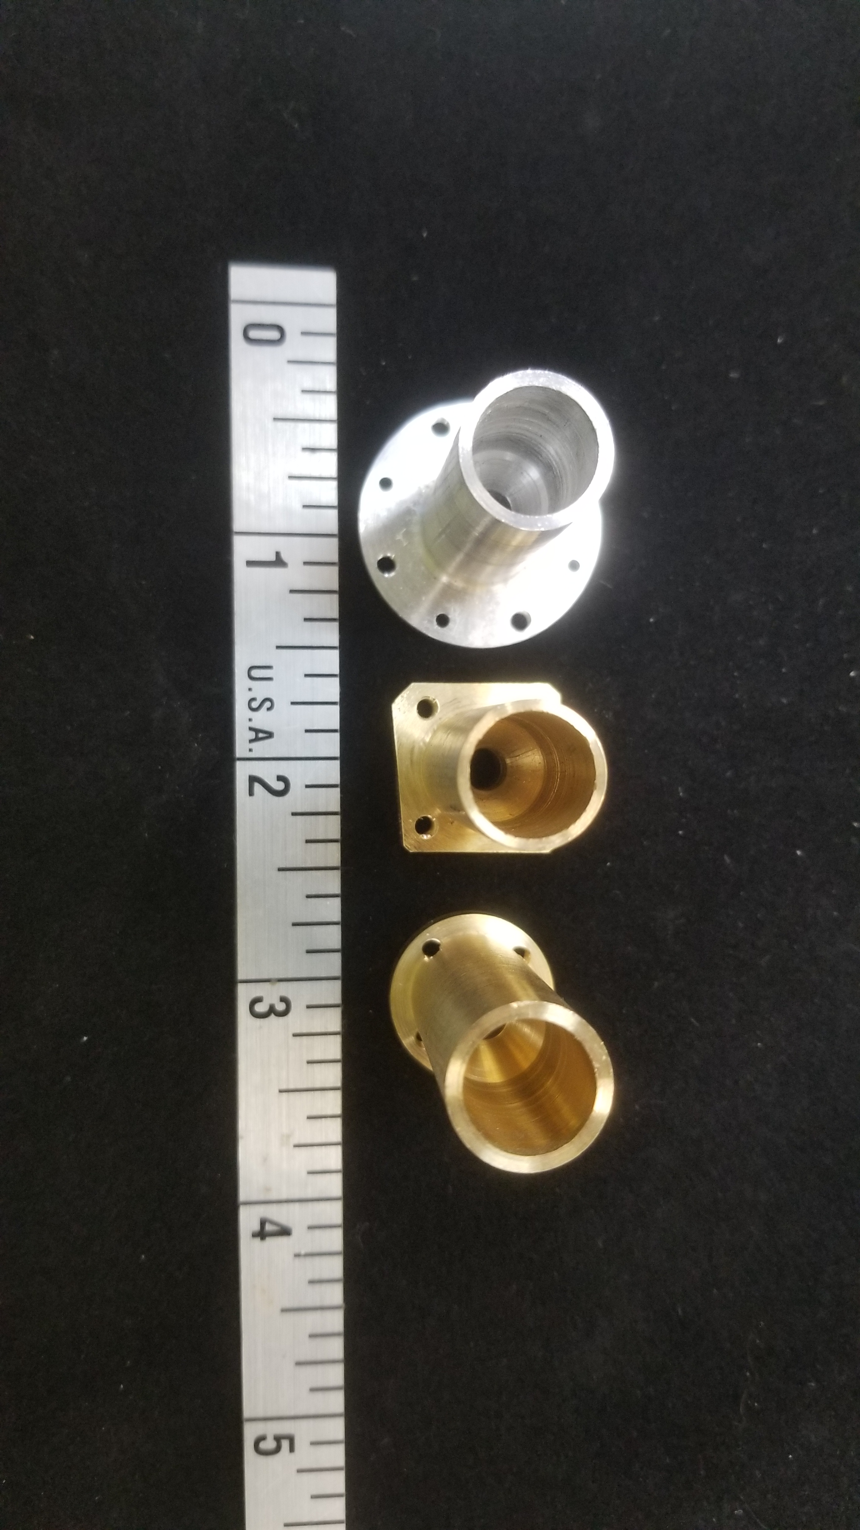
47 GHz, 1.74λ Diameter

Slide 44
Summary
Cassegrain Antenna performance demonstrated
Design Software available
Subreflector fabrication by CNC or 3D printing
Large W2IMU Dual-Mode Feedhorn easy to make
Works with inexpensive parabolic dishes
Some 122 GHz Feedhorns and Subreflectors available

Slide 45
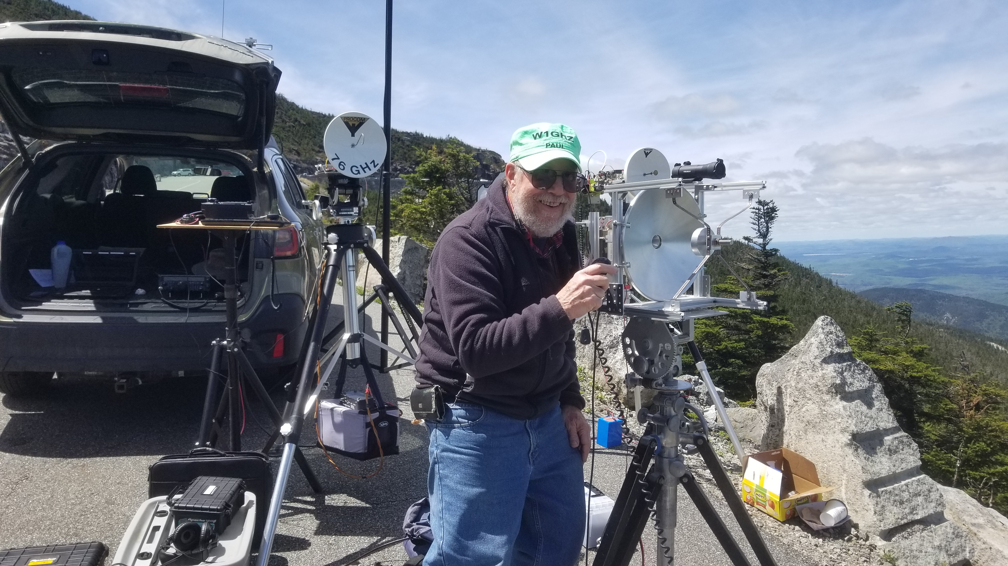
w1ghz.org

