Slide 1
A 47GHz “QRO” Beacon the 6mm wave band
FOR Microwave Update, April 2023
Brian Justin, WA1ZMS

Slide 2
Goal & Purpose
Install and operate a simple, reliable, GPS frequency-locked, modern design 47GHz beacon from FM07fm (same QTH as 144.285MHz, which has been low-power but shall return to QRO later this year)
PA power shall be 1W minimum.
Antenna shall be a W1GHZ sectoral horn…..and/or…..a 30cm Cassegrain feed dish. Pointing to be towards MD & New England.
This is promote activity on the next highest Amateur Primary Allocation above 2m. (that’s right….all bands in-between are shared or we’re secondary)

Slide 3
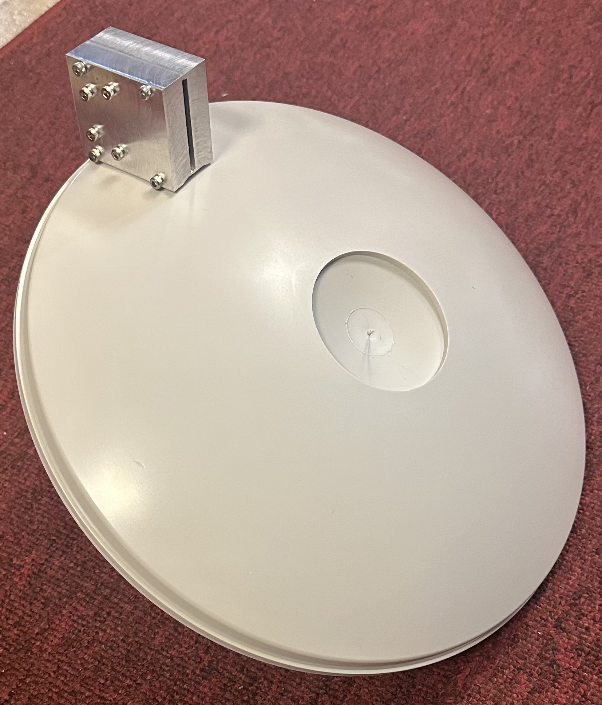
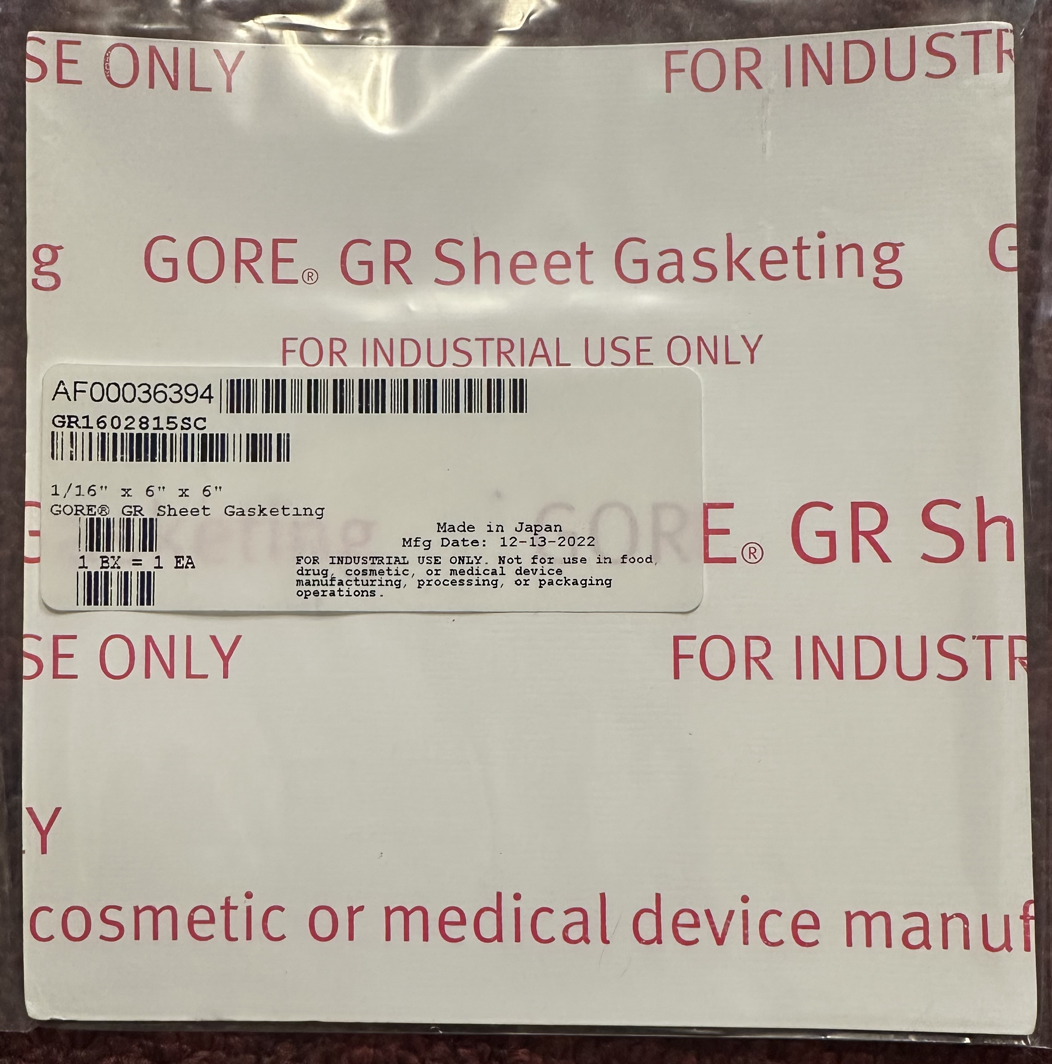
Antenna option
Sectoral horn vs. NURAD
30cm dish
Horn radome membrane
(McMaster-Carr)

Slide 4
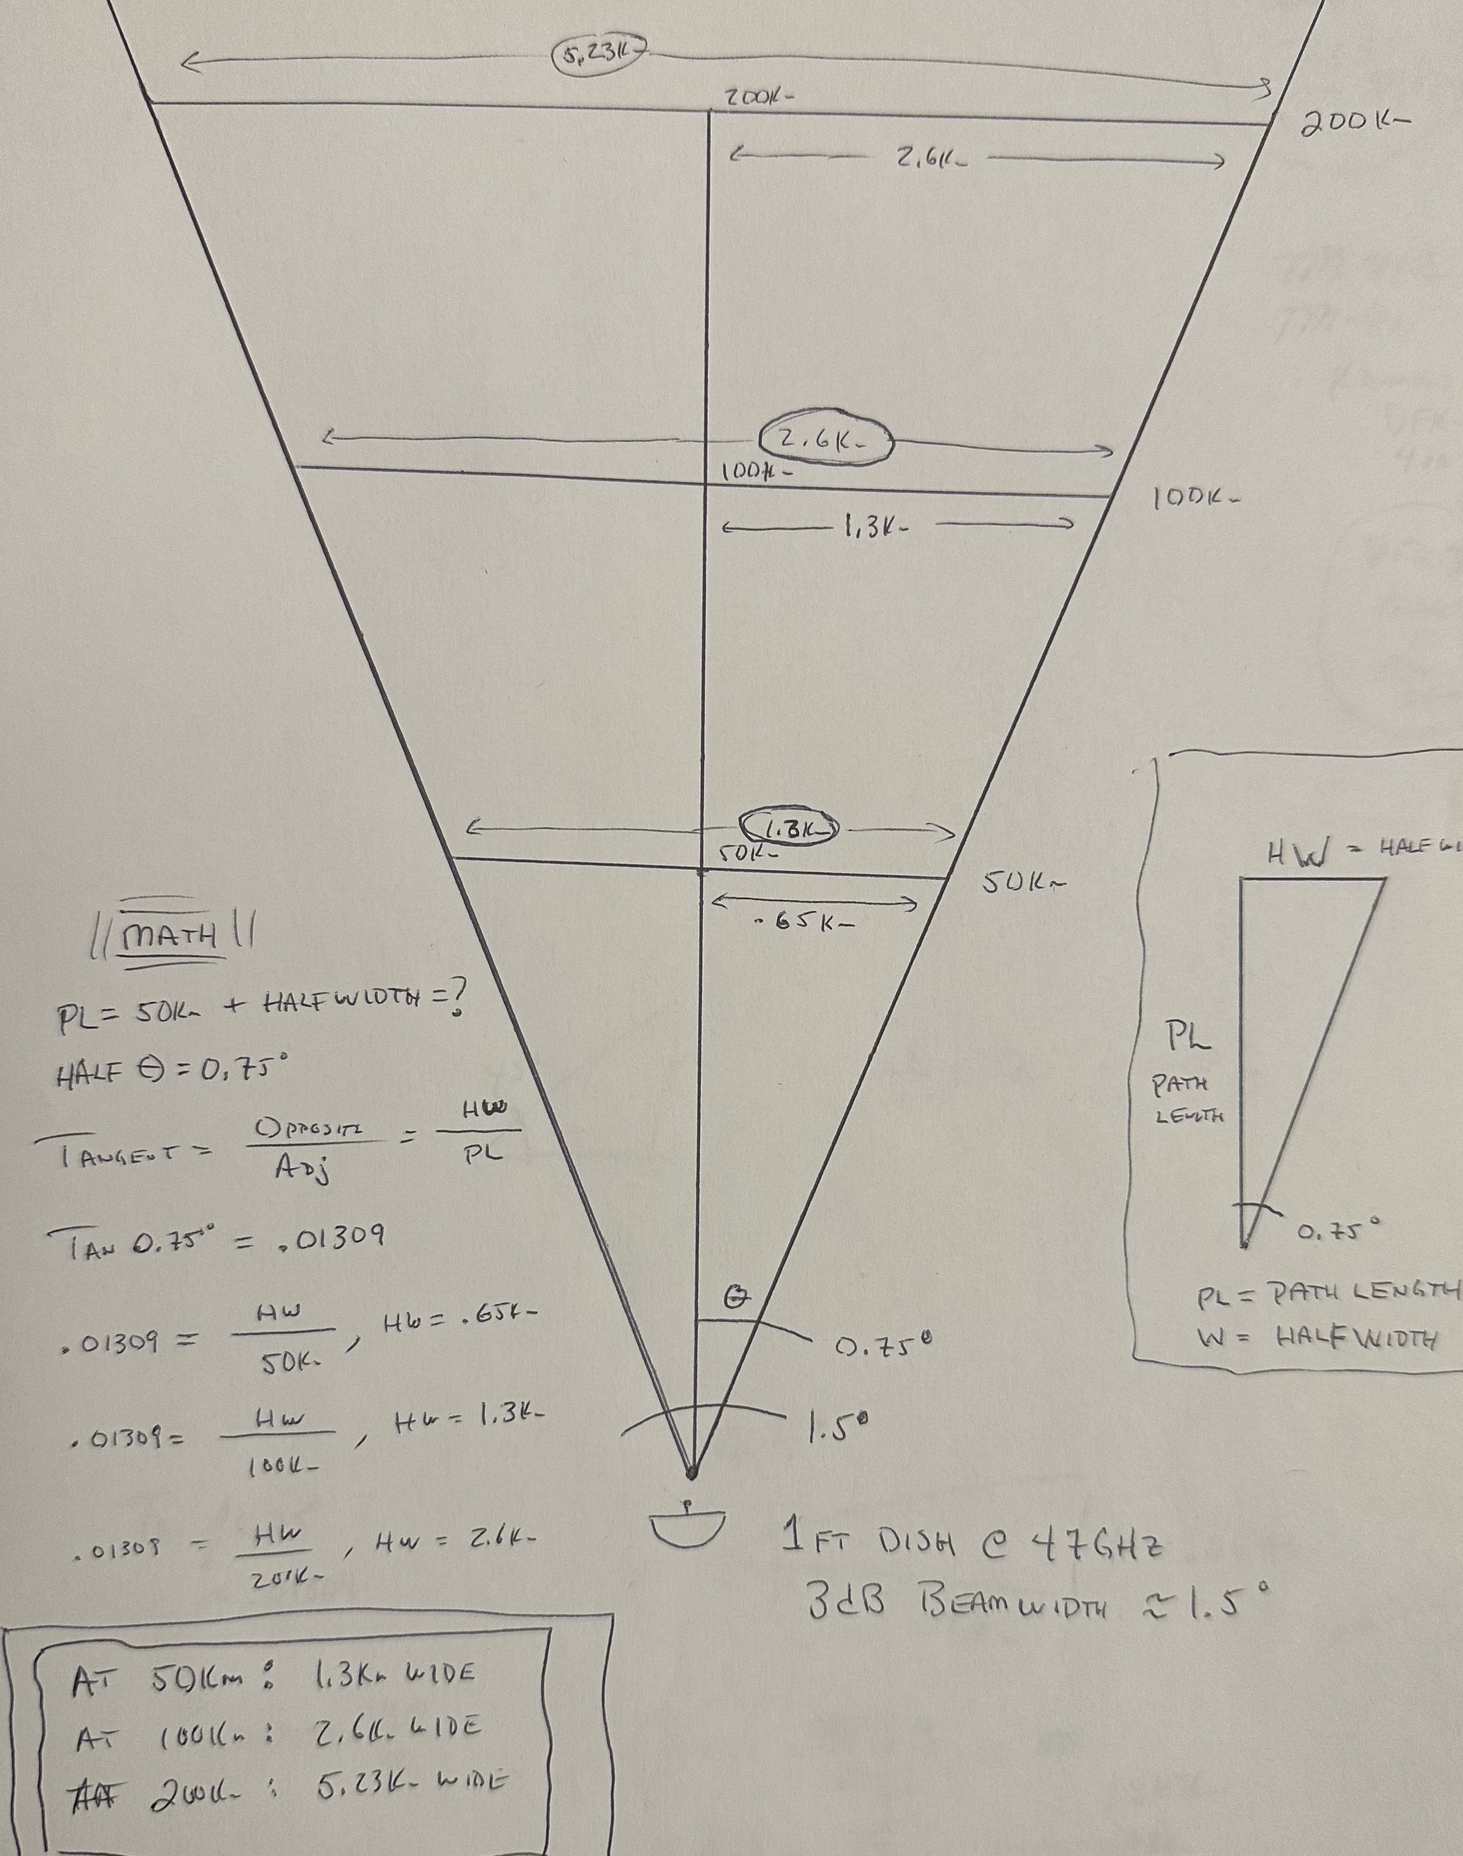
LIFE WITH A DISH
Forward gain is good (41dBi)
Great for scatter
But fixed azimuth
3dB points width vs DX when LOS
  1.3km wide @ 50km
  2.6km wide @ 100km
  6.3km wide @ 200km
Maybe not a good idea, unless there’s a simply way to switch between horn & dish

Slide 5
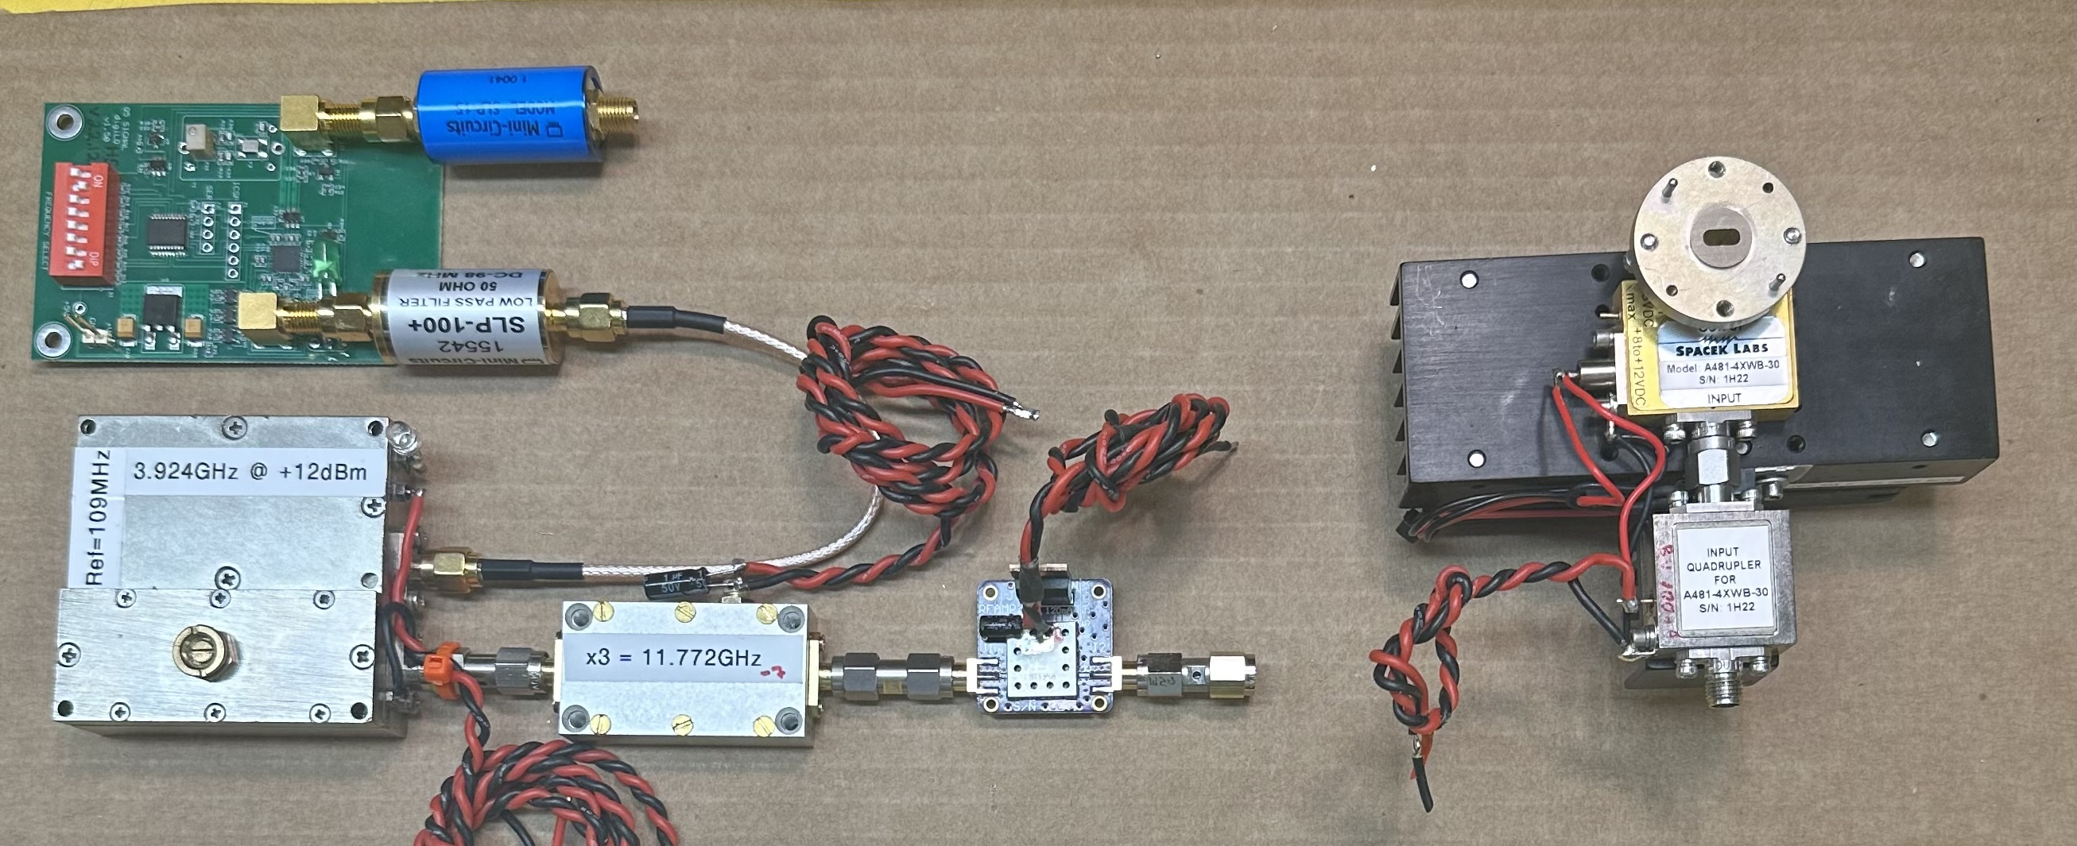
The RF parts
Need compact form-factor for tower mounting in WX-proof (IP67) box

Slide 6
Beacon frequency multiplier-chain plan
10MHz GPS disciplined reference - HP Z3801A
Q5 Signal DigiLO – 109.000463MHz (custom frequency)
Miteq DRO PLL – 3924.016667MHz
Minicircuits tripler - 11,772.05MHz
Spacek quadrupler - 47,088.200MHz
N = 47,088.2 / 109.000463 = 432
Frac-N for DigiLO 10MHz to 109.000463MHz

Slide 7
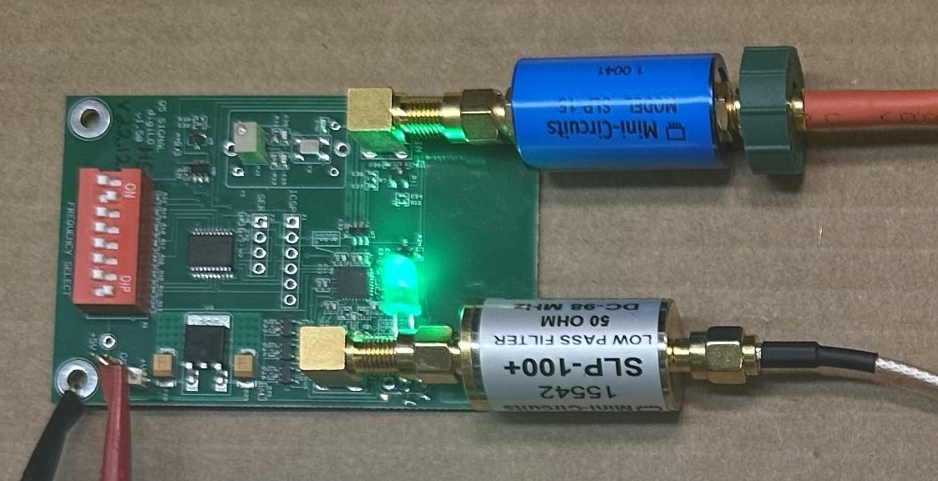
Q5 Signal Digilo

Slide 8
4GHz DRO on 3924.016667MHz

Slide 9
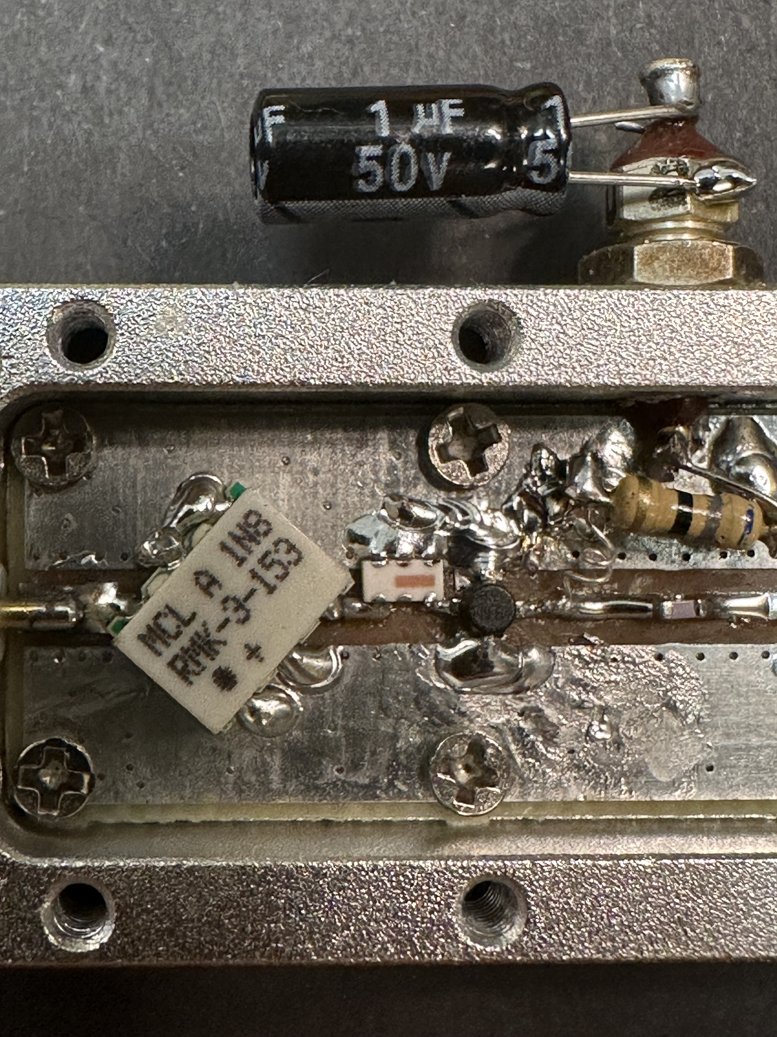
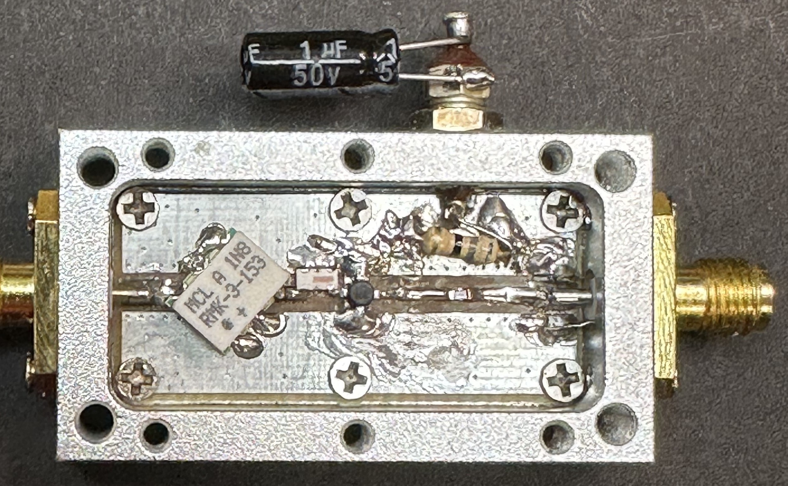
HOMEBREW Tripler
3.9 to 11.7GHz
+12dBm in, -7dBm out

Slide 10
TRIPLER INPUT & OUTPUT SPECTRA
-50dBc
-40dBc

Slide 11
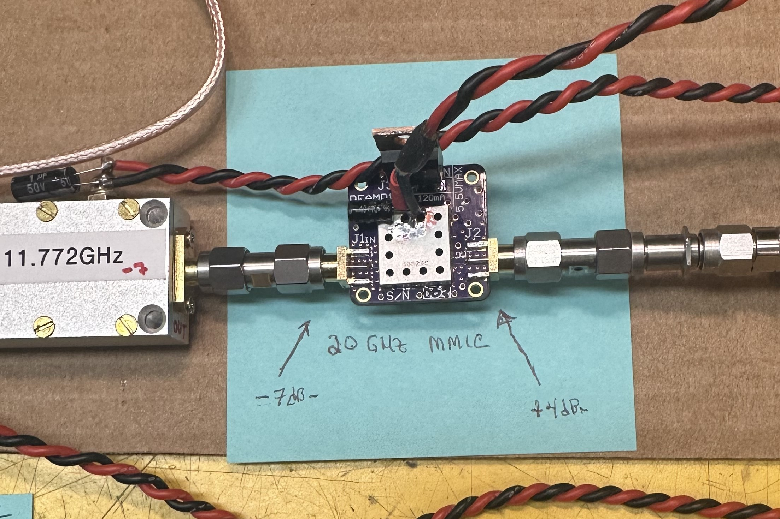
MMIC BUFFER AMP
eBay find (new)
Minicircuits AVA-24
5 to 20GHz
-7dBm in, +4dBm out
Need to buy another & optimize

Slide 12
Spacek x4 and 1.25W PA

Slide 13
Goal is to be QRV by late summer (FM07fm)
BUT…
Lots of packaging to do
Need to address PA cooling
Decide which antenna (or both via alternating WG switch?)
Where to point dish in azimuth
Co-sited 2m & 4m legacy beacons overdue for major maintenance effort (been super busy)
Even now have HW for a 222MHz beacon…(more work)
Stay-tuned…

Slide 14
Questions? Comments? Criticisms?
Thank you for your Time & attention ☺

