Slide 1
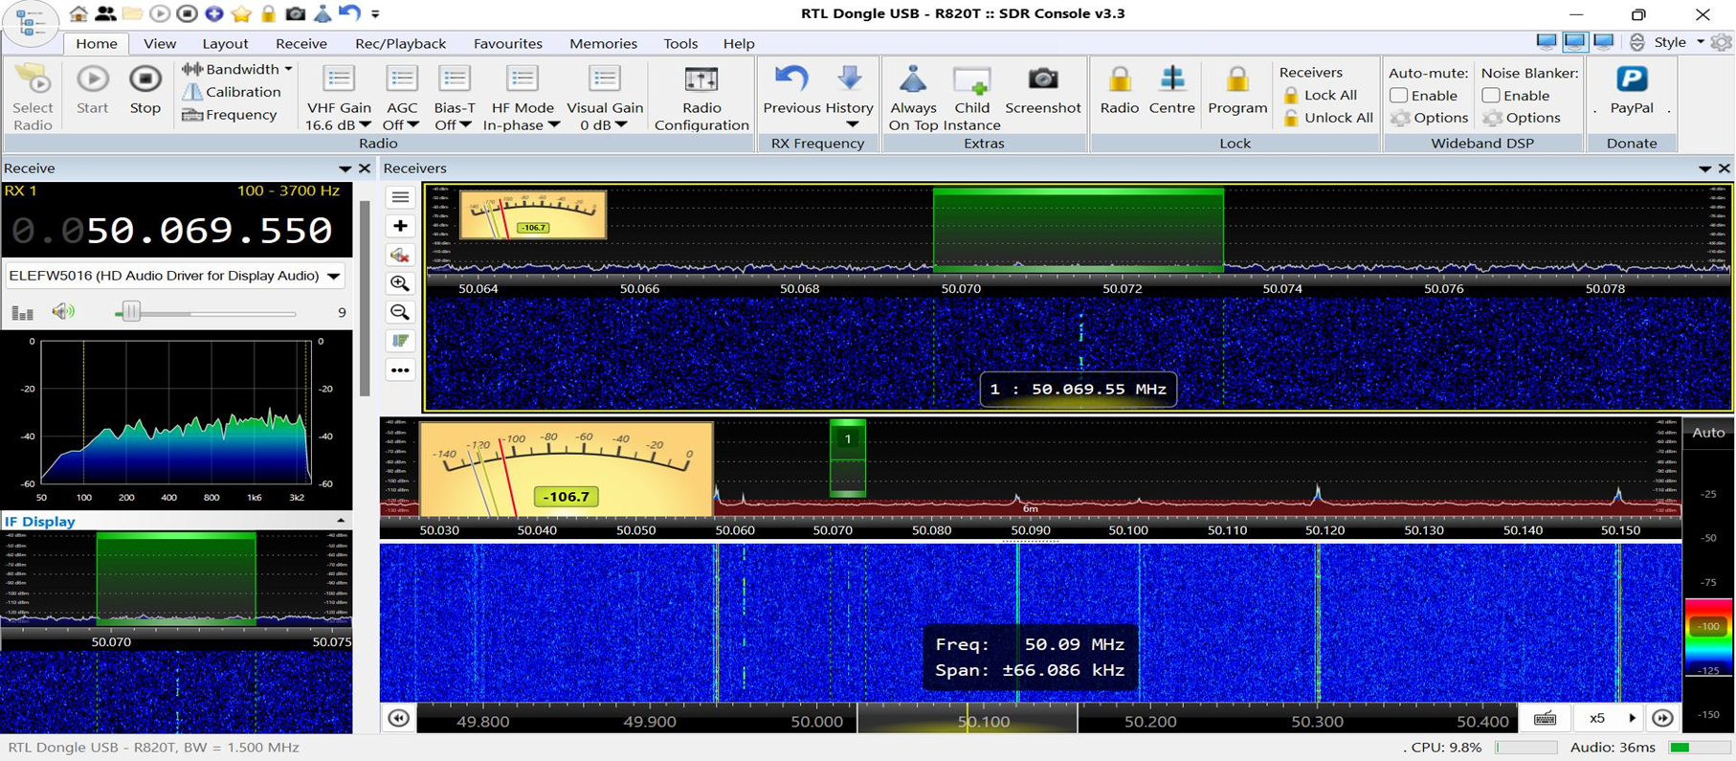
Omnirig – External Radio

Slide 2
Select the View tab in SDR Console Click on the 3 dots in More Options

Slide 3
Select External Radio Click on OK

Slide 4
Restart SDR Console

Slide 5
Click on the External Radio dropdown triangle

Slide 6
Click on External Radio “?”

Slide 7
Start External Radio - OmniRig

Slide 8
Click on the Omni-Rig Home page

Slide 9
Omni-Rig Homepage

Slide 10
Scroll down and click on Downloads

Slide 11
Download Omnirig

Slide 12
Install Omnirig

Slide 13
Install Omni-Rig

Slide 14
External Radio – Omnirig settings in SDR Console

Slide 15
In SDR Console External Radio click on the power “Key” and then click on the “?”

Slide 16
In the Pop-up click on Omni-Rig

Slide 17
An Omni-Rig Pop-up will open

Slide 18
Enter the settings for your radio These are the settings for my IC-7300

Slide 19
Note the Tracking options. These tell SDR Console and your radio how to track each other. Click on OK

Slide 20
Click on the power Arrow Click on Track

Slide 21
SDR Console, your Radio and WSJTX are all tracking each other and working as one

