Slide 1
An SDR is a Receiver not a Panadapter

Slide 2
Go to the SDR Console website

Slide 3
Go to the Download page Scroll down until you see the grey download options Click on Dropbox

Slide 4
Click on the Download button

Slide 5
Click on continue with download only

Slide 6
Install the SDR-Radio application

Slide 7
Install SDR-Radio

Slide 8
Open SDR Console and click on the Definitions button

Slide 9
Follow the instructions on the RTL Setup instructions for choosing a radio

Slide 10
SDR Console is the software that makes SDR work so well. Please remember to donate towards its continued development.

Slide 11
You now have SDR Console running with one RX

Slide 12
The available options under the Tabs will vary depending on which SDR RX you are using

Slide 13
How to add multiple RX’s

Slide 14
Multiple RXs are added via the Receive tab Receiver Pane

Slide 15
Click on Add to add additional RXs

Slide 16
Right clicking on the blue Receivers bar allows you to choose a Docking or Floating Receivers Pane

Slide 17
Click on the 3 dots to openup the options Pop-up

Slide 18
The Options Pop-up allows you to select your RX layout

Slide 19
SDR Console with 4 RXs selected

Slide 20
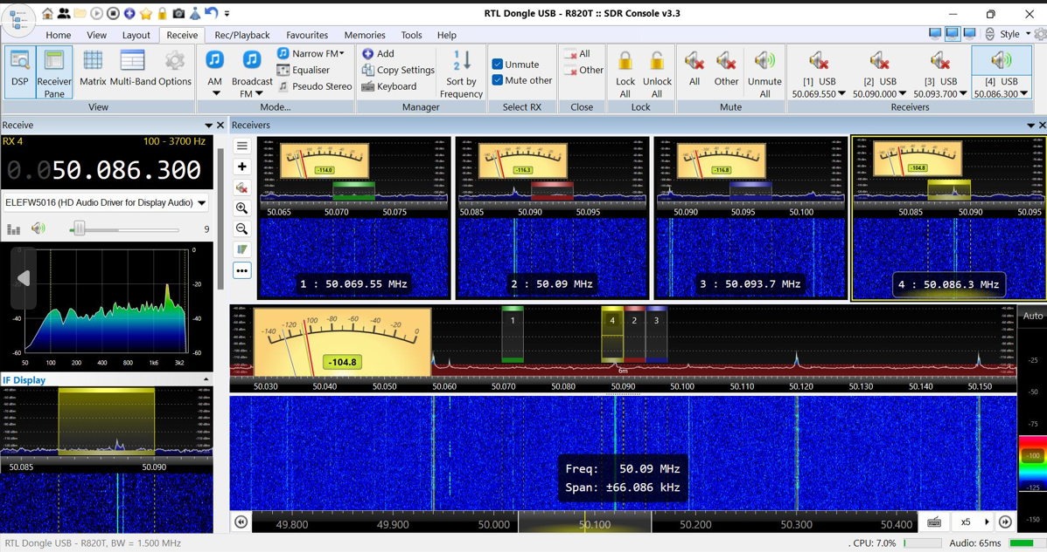
An SDR is a Receiver

Slide 21
RXs can be selected either from the Receive tab or by clicking on the red Pop-ups

Slide 22
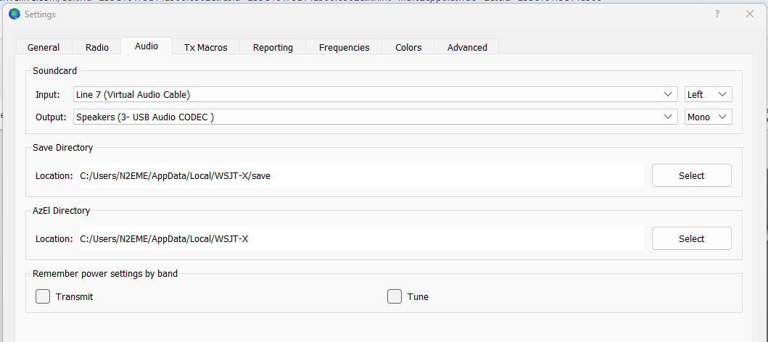
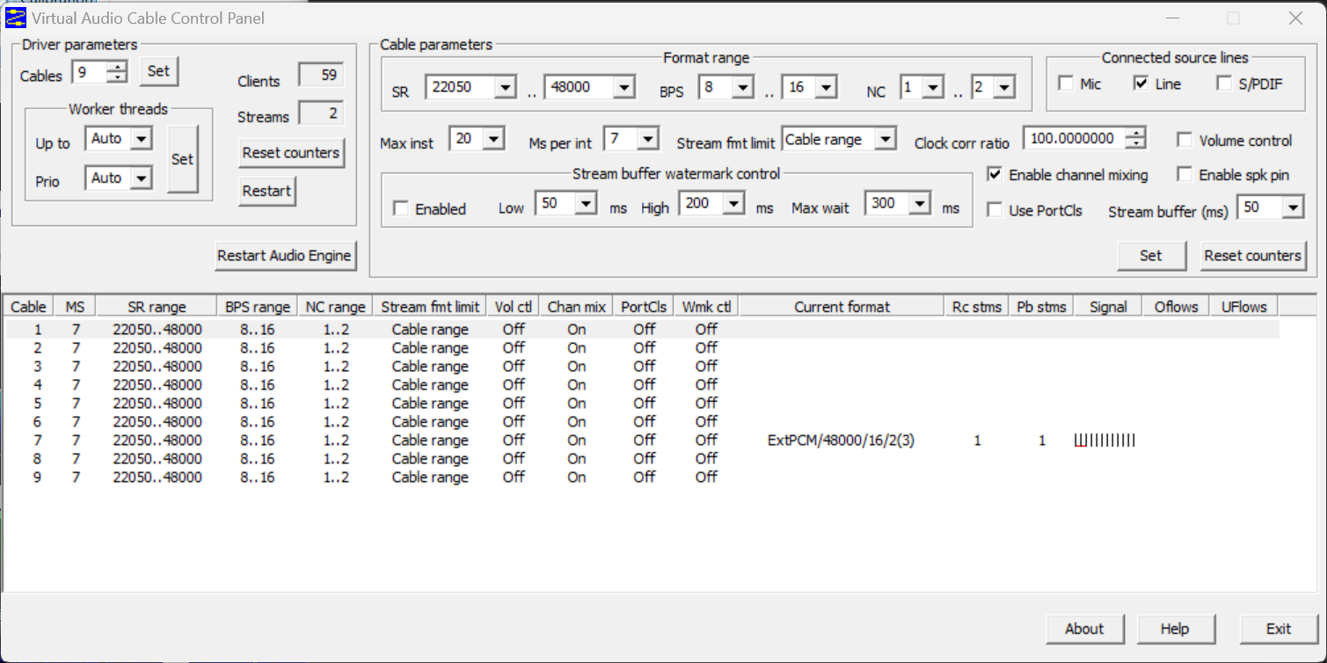
When running multiple RXs make sure all of your VAC cables match the chosen RX and instance of WSJTX or your speakers

Slide 23
You can have up to 24 RXs open at once. An RX will only be active when it is within the bandpass if your receiver.

