Slide 1
Setting up VAC

Slide 2
Google for Virtual Audio Cable Muzychenko

Slide 3
Download and Purchase VAC. The free trial will not work for you.

Slide 4
Purchase 1 License for $30

Slide 5
Install VAC

Slide 6
Important. Open VAC in Admin mode.

Slide 7
Add several sets of cables and then close VAC

Slide 8
Open VAC in normal mode

Slide 9
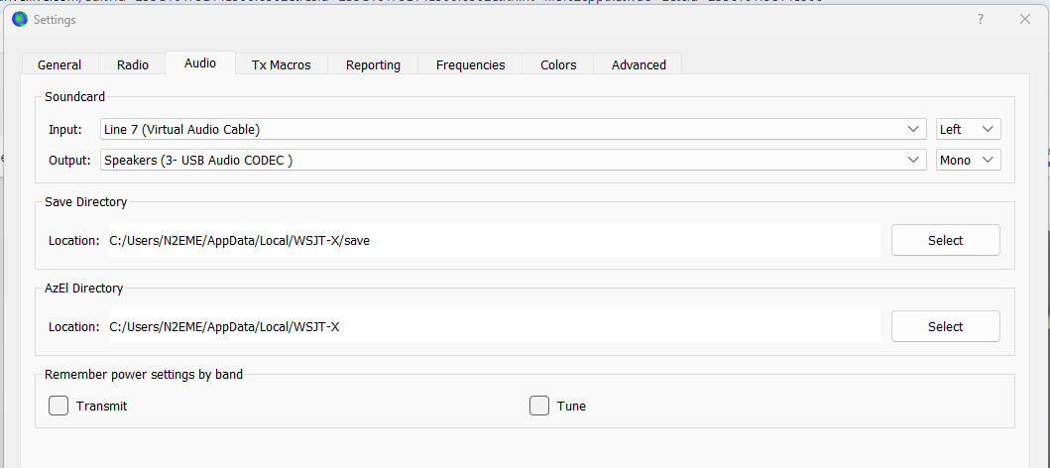
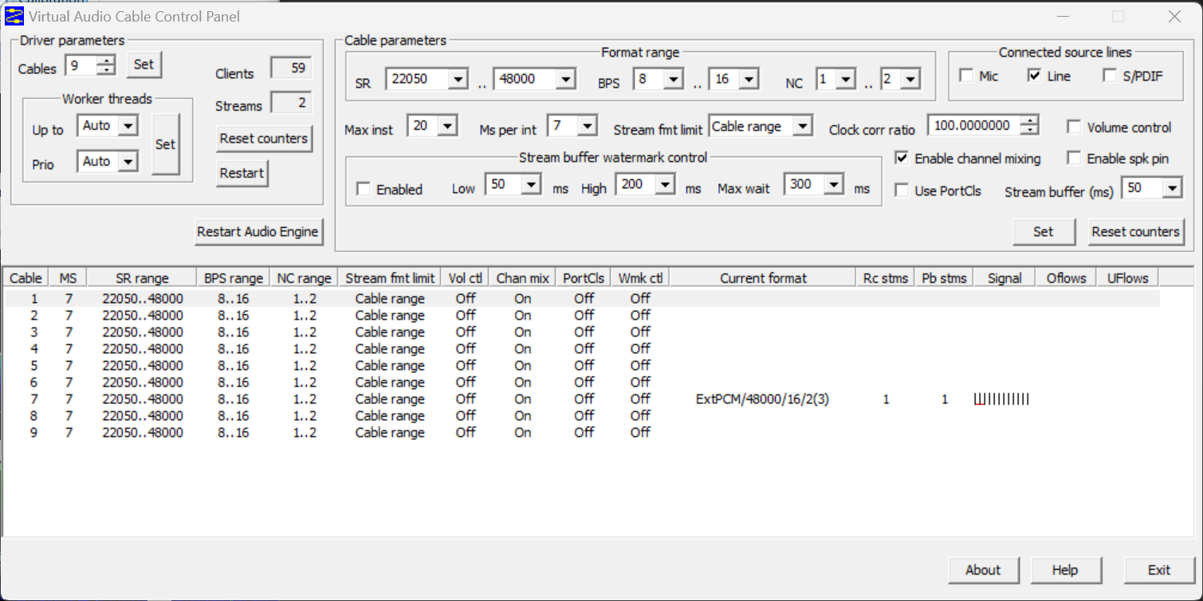
When running VAC make sure all of your cables match the chosen RX and WSJTX.

