Slide 1
A Comparison of Wattmeter Accuracies at 1296MHz
Based on Calorimetric Measurements by
Douglas Millar K6JEY
Presented at EME 2012
Aug 17, 2012

Slide 2
Purpose
The purpose of this paper is to measure the accuracy of a variety of UHF wattmeters at 1296MHz to see what their error is.
Most of the meters are not specified at this frequency so this will be new data.
Common knowledge supposes the additional error may be 10%.

Slide 3
Measurement Gear
There are very few meters that can do an accurate calibration at 23cm at high power.
I have been using a Bird 6091 calorimeter, one of the few meters that can do this type of measurement. It’s specifications are-
  Accuracy 1.25% of reading
  Frequency range 0-2500MHz
  Power range- 10-250 watts

Slide 4
System Calibration
Steve, K1FO emphasizes that both line SWR and element directivity can have a negative effect on accuracy. His paper is in the resource section. In the testing set-up I used a single double female N connector to connect wattmeters to the calibrator.
I compared an HP436/8487A and attenuator in current calibration with the Bird 6091 at 10Watts on 144MHz and found that the two meters agreed to within 1%. This verified that my measurements would be accurate enough to be meaningful.

Slide 5
Process
The idea was to take a group of randomly selected meters and test them in their intended range and then at 23cm and see how their accuracy changed. All the meters were used and except for some minor repair, all were tested as found, simulating “that great swap-meet deal”, rather than using all new meters.

Slide 6
Meter Accuracies
Most of the meters tested were specified at 5% accuracy as a percent of a full scale reading (OFS). On a 25 Watt scale a 10 Watt reading could be off by 1 Watt.
Some were specified at 5% of reading. This is a significantly better accuracy. On a 25 Watt scale a 10 Watt reading would be off by no more than 1/2Watt.
The source data shows that some meters looked better than they were at low ends of the scale.

Slide 7
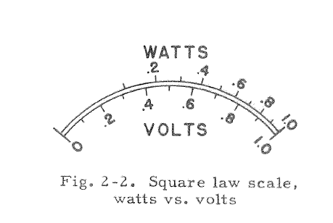
Meter Scales
Wattmeters read power as a voltage. Using E²/r produces a scale with ¼ power at mid range. This scaling helps compensate for the 5% ofs accuracy problem at low power. Somehow the Struthers meters use a linear power scale.

Slide 8
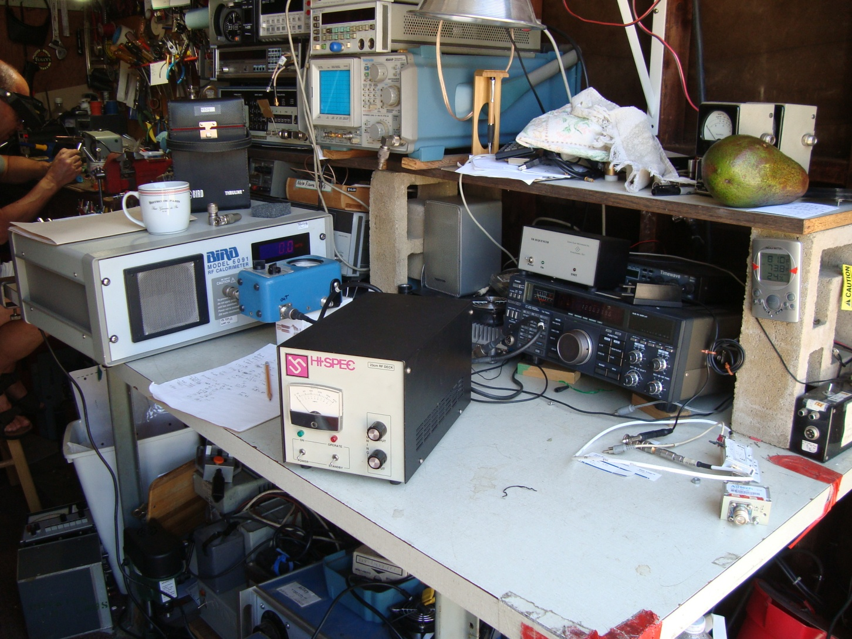
Testing in progress on 23cm
An M/M N connector was used to couple meters under test to the 6091.
(The avocado was not tested for accuracy, but tasted good.)

Slide 9
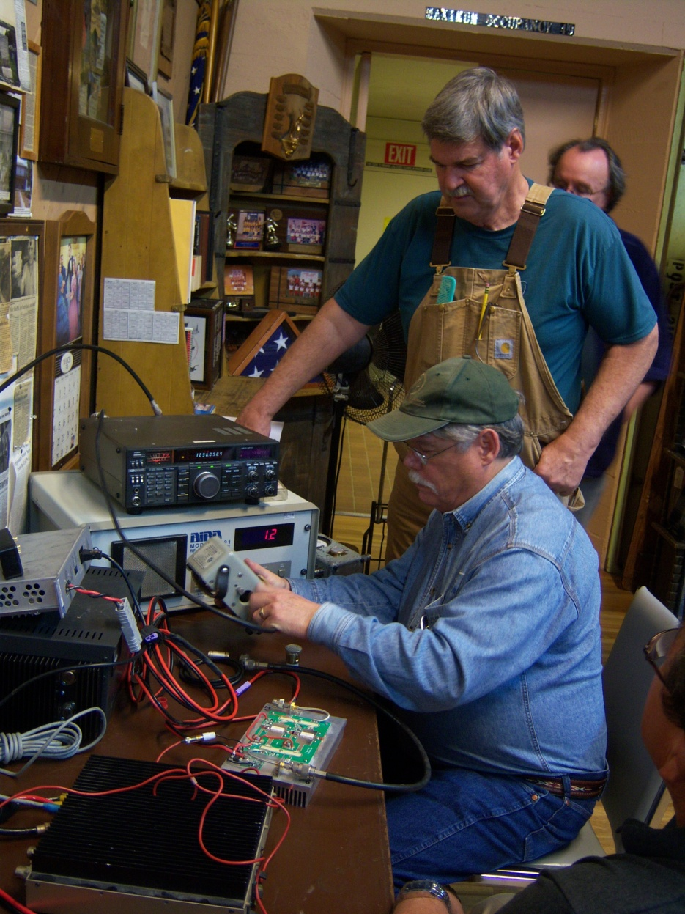
Further Testing
K6JEY,KN6VR and W6DQ
A San Bernardino Microwave Society meeting testing meters at 432MHz and 23cm.
At this session we found that combinations of elements and meters all read differently, but not necessarily out of spec at 5% OFS.

Slide 10
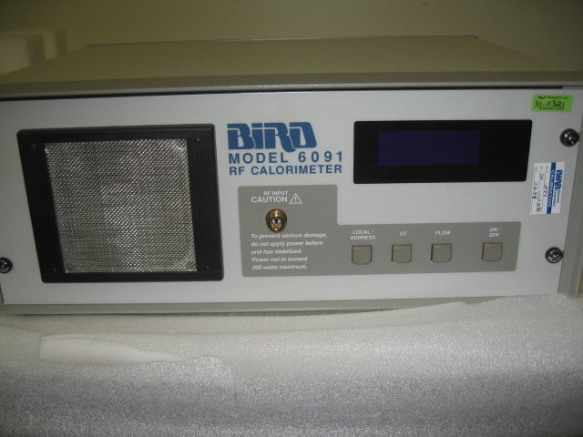
Bird 6091
The 6091 uses water for heat transfer and can be calibrated at DC.

Slide 11
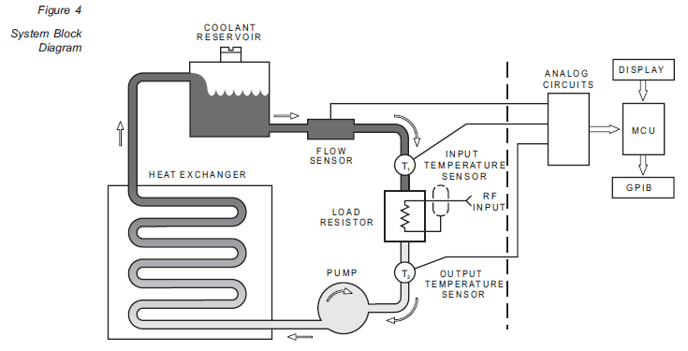
Bird 6091
Calorimeter diagram

Slide 12
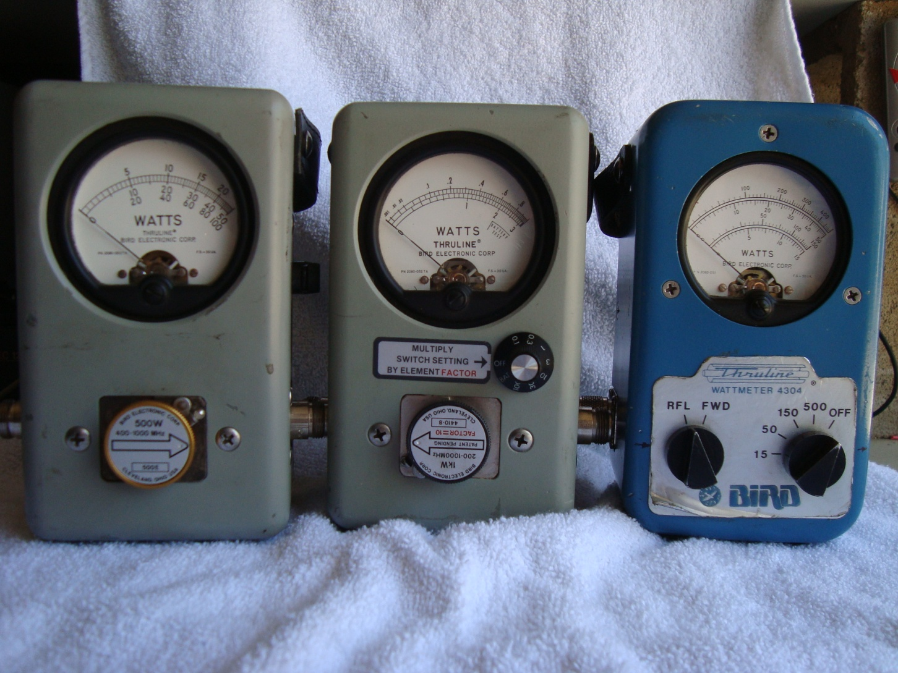
Pictures of the Meters Tested
Bird 43, 4410 and 4304

Slide 13
Thruline series
Bird 43- Uses elements with a directivity of about 17-20db. Specified at 5% OFS.
Bird 4410- special elements with 7 ranges as part of a bridge for thermal stability. 5% of reading accuracy.
Bird 4304- Multi range meter with two couplers. Needs calibration graph below 100MHz. Great from 144MHz to above 1000MHz. 5% OFS

Slide 14
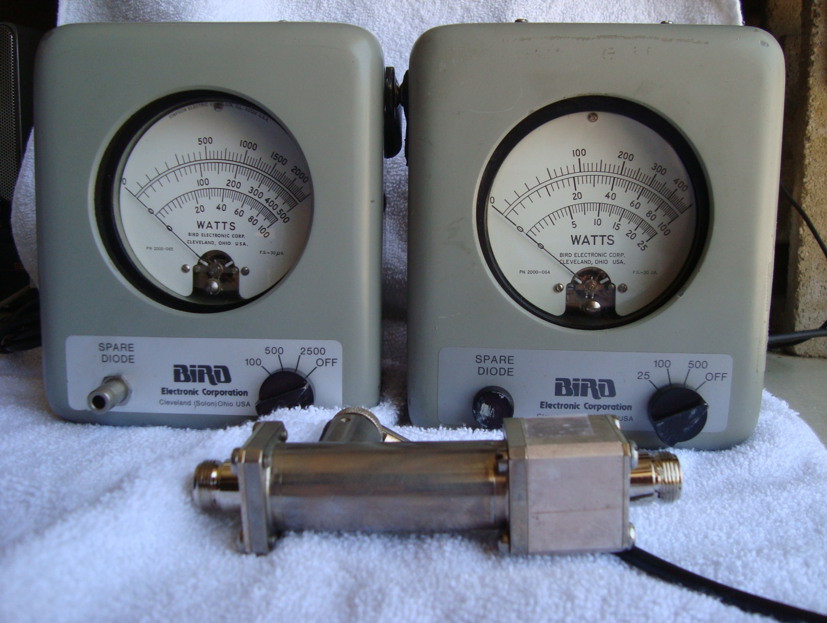
Bird Termaline
Note the F to F QC coupling block. Models 6737 and 6734.

Slide 15
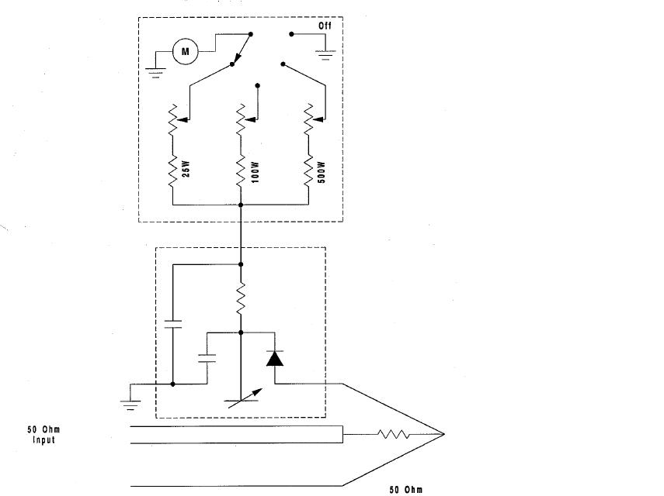
Bird Termaline Schematic
Sensors are a capacitive voltage divider * and have a broader frequency response than the regular inductive elements. At higher power all the elements seem to have a flatter frequency response. They are more accurate when one end is attached to a load. But work fine as pictured.
*
*

Slide 16
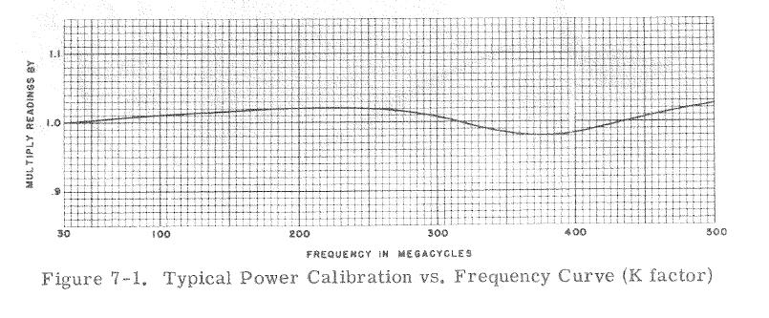
Termaline
Reading error vs. frequency

Slide 17
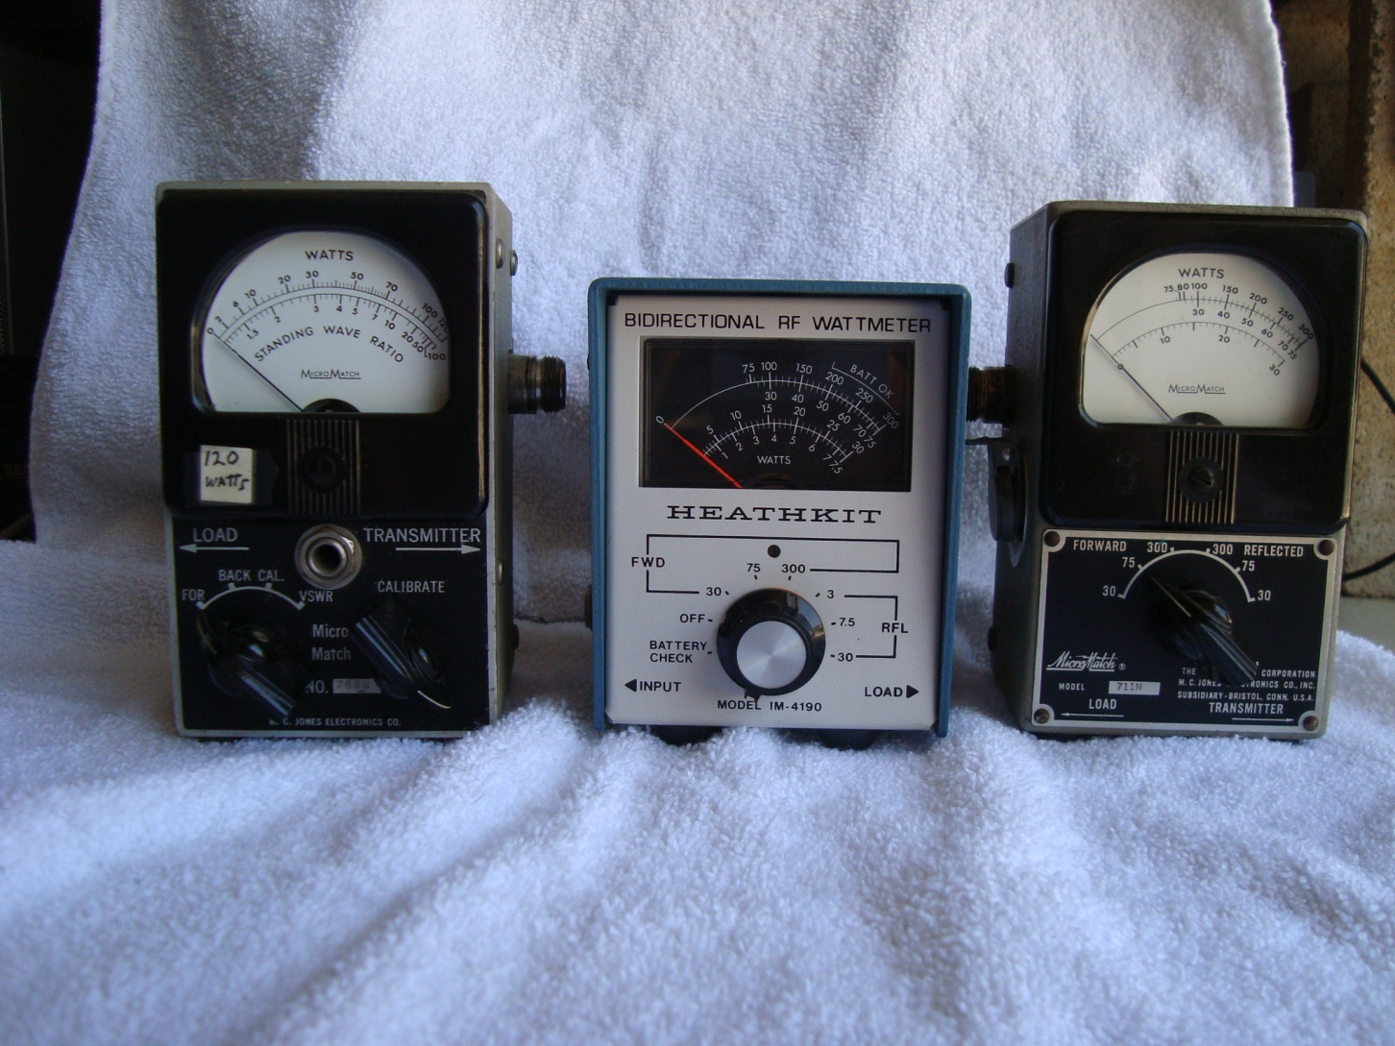
Micro Match and Heathkit
120Watt Heath IM 4190 711

Slide 18
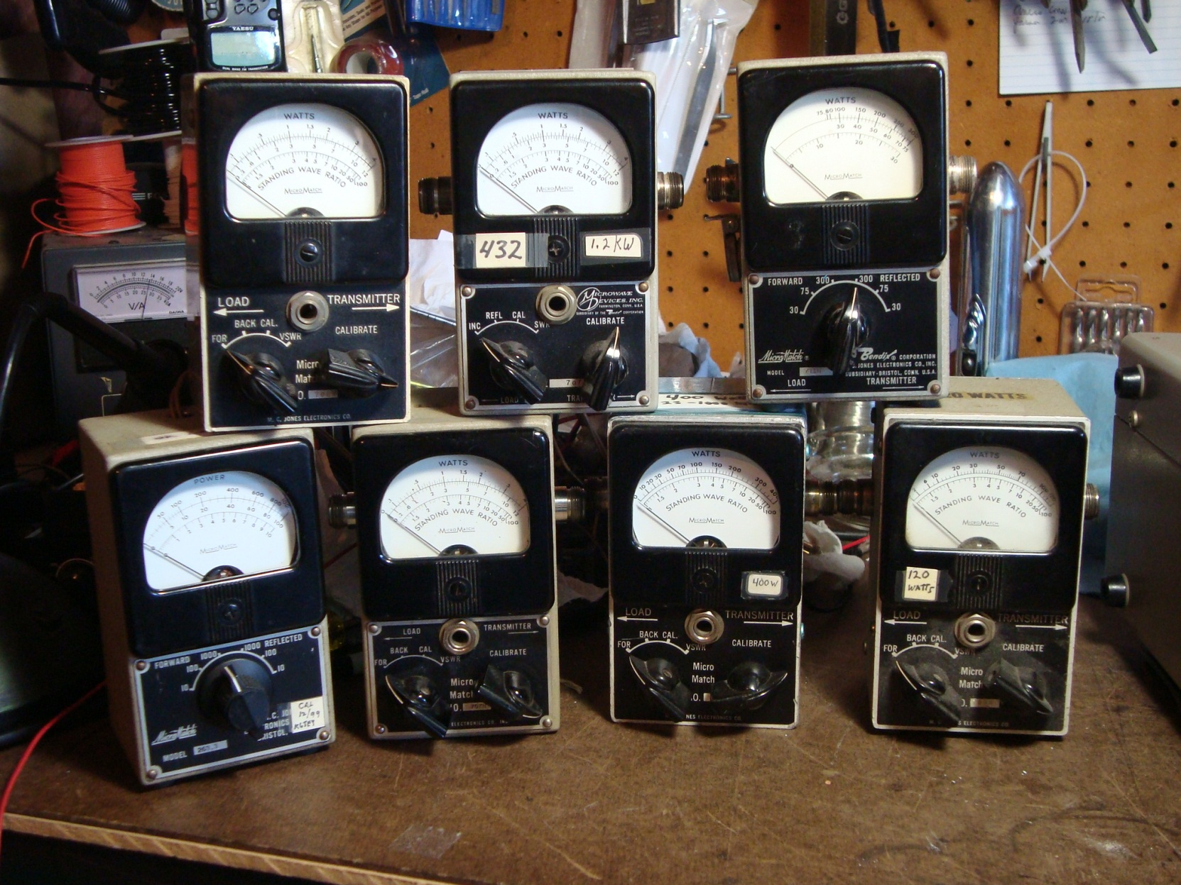
And Friends- Not Tested
Micro-
match

Slide 19
Little Boxes
All of the Micromatch single range boxes tested inconsistently from box to box. Accuracy vs. frequency range seems to be good however.
Several of the multi range box 711 tested did not meet specifications unless calibrated on a single frequency. Scale to scale readings off on the low ends, even after calibration.
The Heathkit IM4190 tested well at 432 and 23cm.

Slide 20
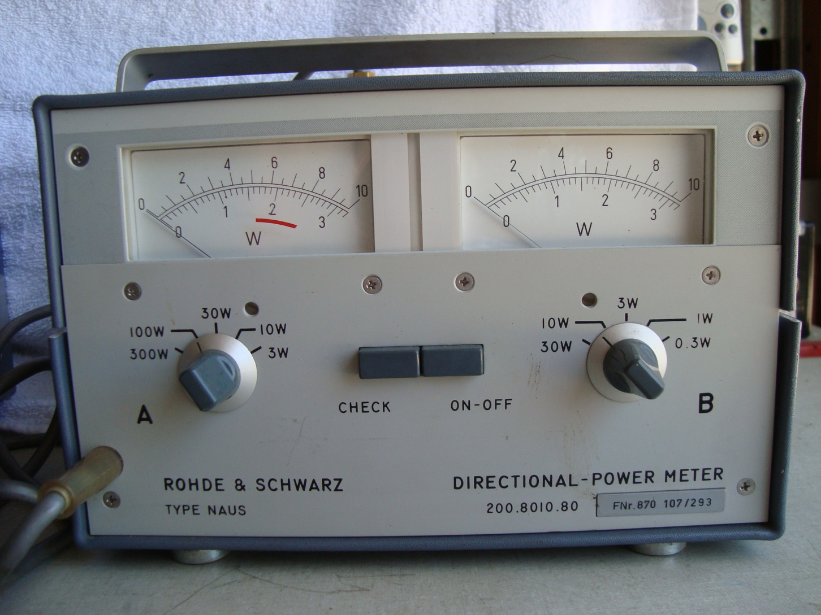
R&S NAUS
Notice the scale resolution.

Slide 21
R&S NAUS
The dial calibration intervals did not give as good a resolution as other meters tested.
The meter was not as accurate as I thought it would be, although it met specifications.
The meter itself is extremely well made with one of the best couplers I have ever seen and very rugged.
The coupler diodes can be easily blown in the low power direction and are custom made and extremely hard to find.

Slide 22
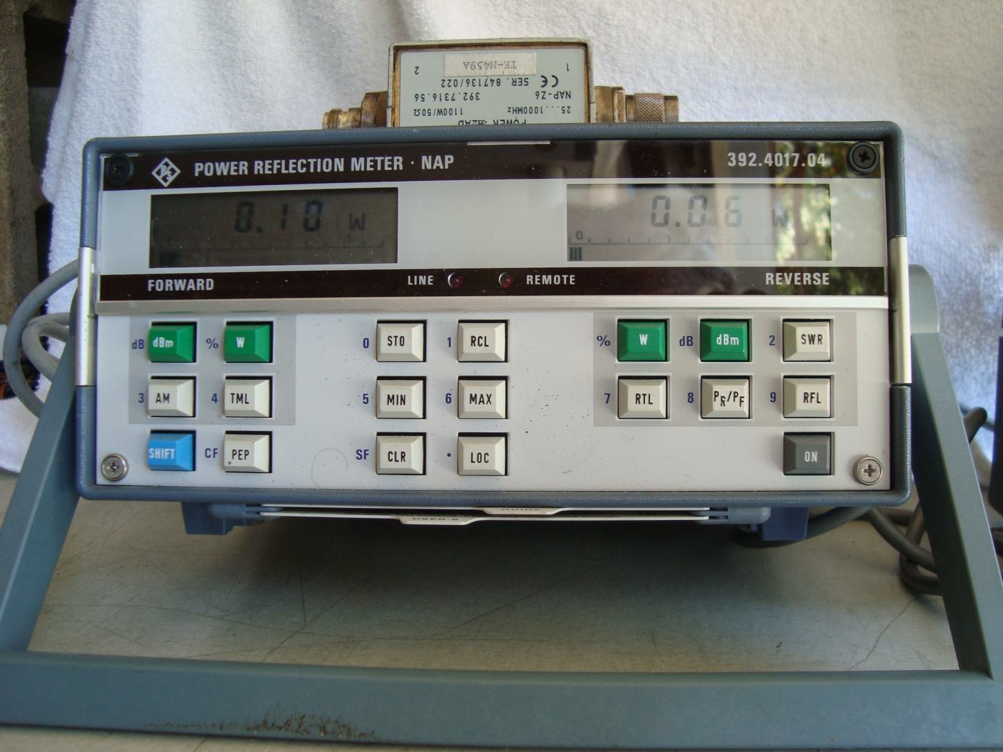
R&S NAP
Easily the most sophisticated meter tested. Battery operated or AC with several sensors available. Dual displays that are analog and digital. Auto ranging as well.

Slide 23
R&S NAP
The finest meter tested. Easily met specifications of 5% of reading on all frequencies.
Wide variety of measurements possible. Analogue and digital display.
Sturdy and robust.
Operated from either Ac or rechargeable batteries
A number of sensors available.
Expensive relative to the other meters.

Slide 24
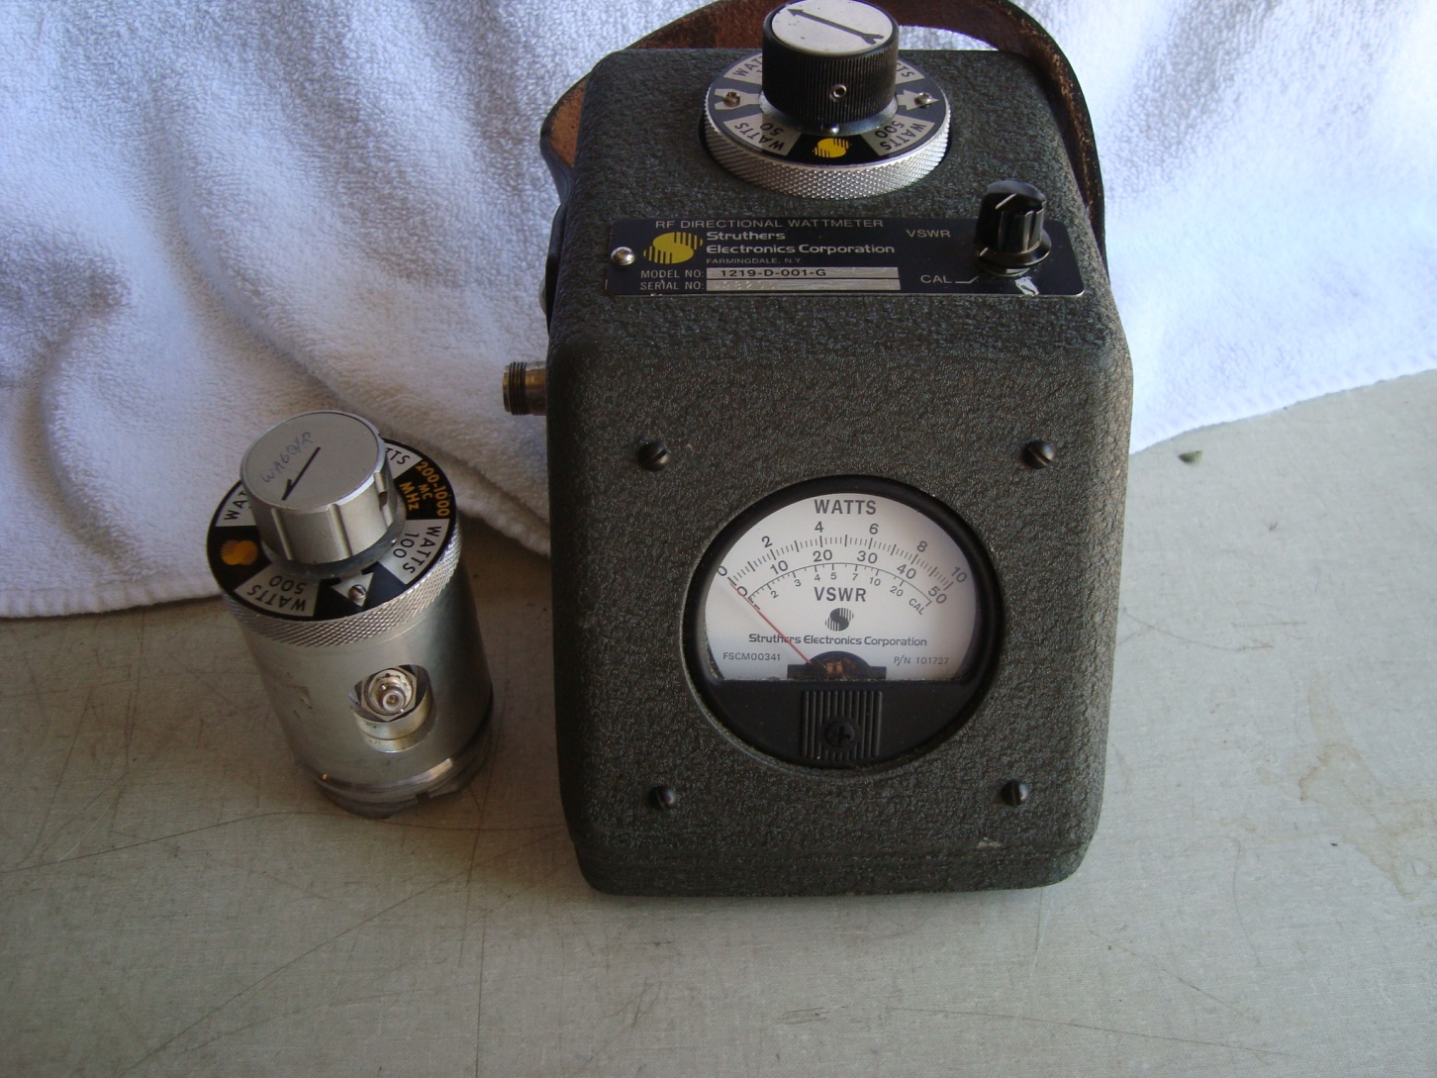
Struthers
Also made as Douglas Microwave , Sierra, and others

Slide 25
Struthers
Relies on mechanical adjustment for calibration. Rough handling and wear easily changes the calibration, but easy to calibrate.
The lid can fall away from the pot as latches are light duty, and coax cord can pull from connector.
Usually comes with a several multi range sensors.
Meets specifications.

Slide 26
Test Results
Bird Meters
Meter | Model | 144MHz | 432MHz | 1296MHz
Bird | 4410-6 | (4) | 0 | (-9)
 | 4304-150w | 0 | 1.2 | 0
 | 6737 | 0 | 0 | 10
 | 6734 | 0 | 0 | 10
 | 6737 | .6 | 0 | 10
Notes on Measurements: Numbers in parenthesis are % of reading. All others are % OFS.
Notes:
432

Slide 27
Elements
Element | Model | 144MHz | 432MHz | 1296MHz
Coaxial Dynamics | 82074 | 1 | 1.8 | 1.6
Bird | 500E | 1.8 | 1 | 0
 | 250E | 1.8 | -2 | 8

Slide 28
R&S Meters
R&S | Model | 144MHz | 432MHz | 1296MHz
NAUS | NAUS | 5 | 5 | -17
NAP | 1100w element | (4) | (4.8) | (-13)
 | 350w element | (4) | (4) | (-5)
MicroMatch Meters
uMatch | Model | 144MHZ | 432MHz | 1296MHZ
 | 120 | -19 | -15 | -21
 | 400 | 1.3 | 1 | 10

Slide 29
Heathkit
Meter | Range | 144MHz | 432MHz | 1296MHz
IM-4190 | 30 | -11 | 0 | -3
 | 75 | -4 | 0 | 8
 | 300 | - | - | 15

Slide 30
Struthers/Douglas
Meter | Range | 144MHz | 432MHz | 1296MHz
Struthers
.2-1GHz element | 10 | 1.4 | 1 | 9
 | 50 | 1 | 14 | 18
 | 100 | 3.5 | 3 | 7
Douglas
.2-1GHz element | 10 | 17 | 0 | 10
 | 50 | 12 | 25 | 12
 | 100 | 16 | 22 | 7
The Struthers meter looked new and tested well on all ranges. The Douglas was calibrated in 1994 but had obviously had rough usage.

Slide 31
Conclusions
Doing the measurements has been revealing.
The Bird 4410 seemed to be the most accurate at all frequencies and power levels
The NAP/350 exceeded its specifications.
The Bird 4304 more than met specifications and tracked well between ranges. The Bird Termalines were very accurate. The Thruline elements were all bought used except one made by Coaxial Dynamics and met specifications.

Slide 32
Overall Conclusions
The data clearly shows that if a meter does well on 432MHz, it will do well on 1296MHz and probably read not more than 10% ofs high. If the meter does not do well at 432MHz, it will not do well at 1296MHz. However, it is worth looking in the detailed measurement results to see how the full-scale calculations work out as a percentage of reading for the meters.

Slide 33
Specific Conclusions
If you have a high power Watt meter that you know is good at 432Mhz, you can use it with some assurance as to its accuracy on 23cm. It will likely be 10% OFS high in reading.

Slide 34
Resources
K1FO’s article on wattmeter accuracy
Bird Power Point on their metrology procedures and set up.
Bird’s manual on Termaline meters
Bird’s metrology procedures
The above are all available at K6JEY Presentations or
http://www.nitehawk.com/k6jey/presentations/

Slide 35
Thank you for your attention
Email is drzarkof56@yahoo.com

