Slide 1
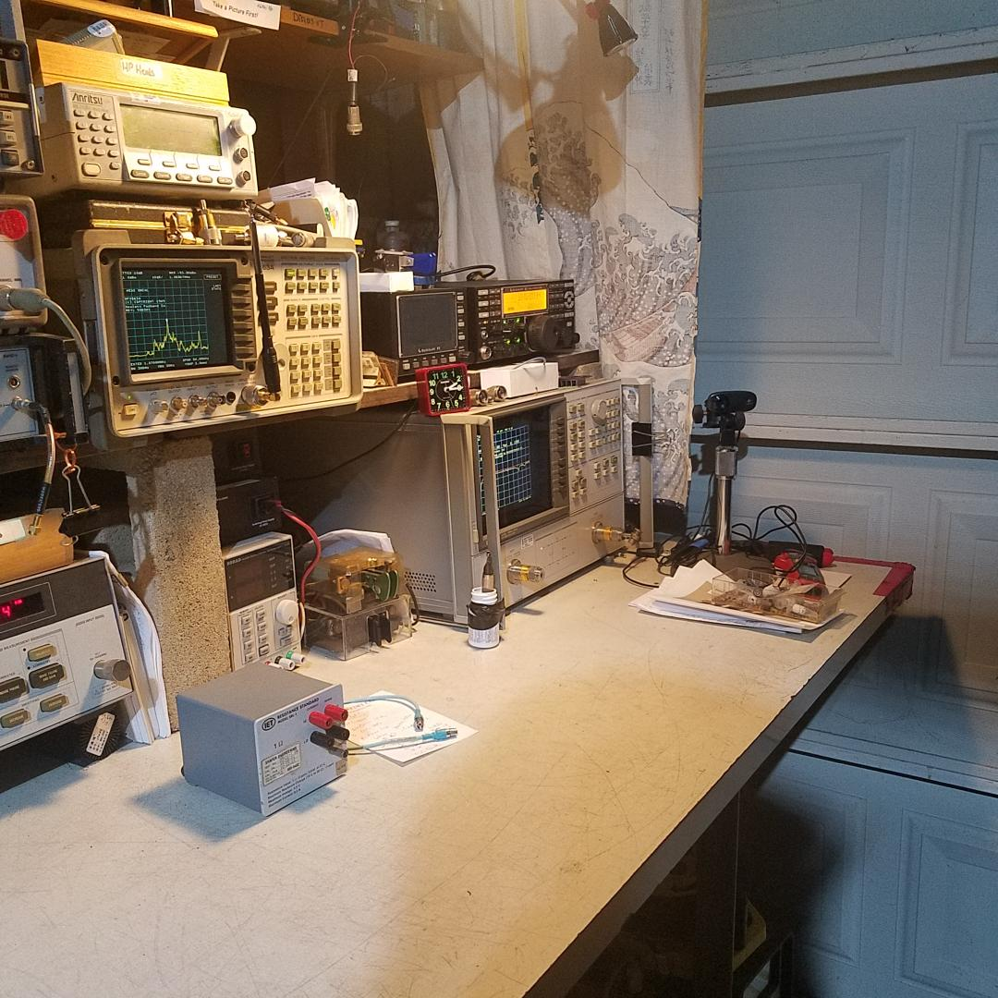
JEY Labs
b
Doug Millar
K6JEY
Notes:
Changes. More meters with BT
* HP improving the program with free Pathwave
* Prices going up*
*Keysight has redone the 34401 instruction and program to make it easier to use with a USB connection.
*Fluke still out of competition

Slide 2
Data Logging With Modern Multimeters for Microwavers

Slide 3
For Comparison
Fluke 8060A
1981 vintage
Does dB
relative to 600Ω
No data logging

Slide 4
Rustrack Data Logging
This was easier than
Industrial units.
Most were digital
Versions of this with
Poor interfaces.

Slide 5
Modern DMM’s
A lot is changing and will change.
External data logging programs via
USB, LAN, Bluetooth and Wi-Fi.
Better displays
TFT with excellent contrast
Colors
Much more information
Firmware updates
DBm measurements referenced to Z

Slide 6
EME Measurement Examples
Use the Sun for antenna beam width measurements
Sun to cold sky or ground noise
Power measurement from the DC jacks/ recorder output on a power meter. (eg HP436, HP400EL)
Frequency drift over time on your radio.
Measurements can be in dBm or dBV at a fixed resistance and to a reference level.
Auto scaled
Saved
Annotated
Printed
Use LAN /Wi-Fi or BT 5.3 for long distances from meter

Slide 7
Focus of the Talk
7 Different meters
Siglent SDM3045x 4 ½ digit (60K counts)
Agilent 34410A 6 ½ digit
Uni-T UT181A handheld 4 ½ digit. (60K counts)
Uni-T UT 61E+ handheld 4 ½ digit (22K counts)
Uni-T UT60BT Handheld (9.9k counts)
AN9002 Handheld (6K counts)
MEET Pencil DMM

Slide 8
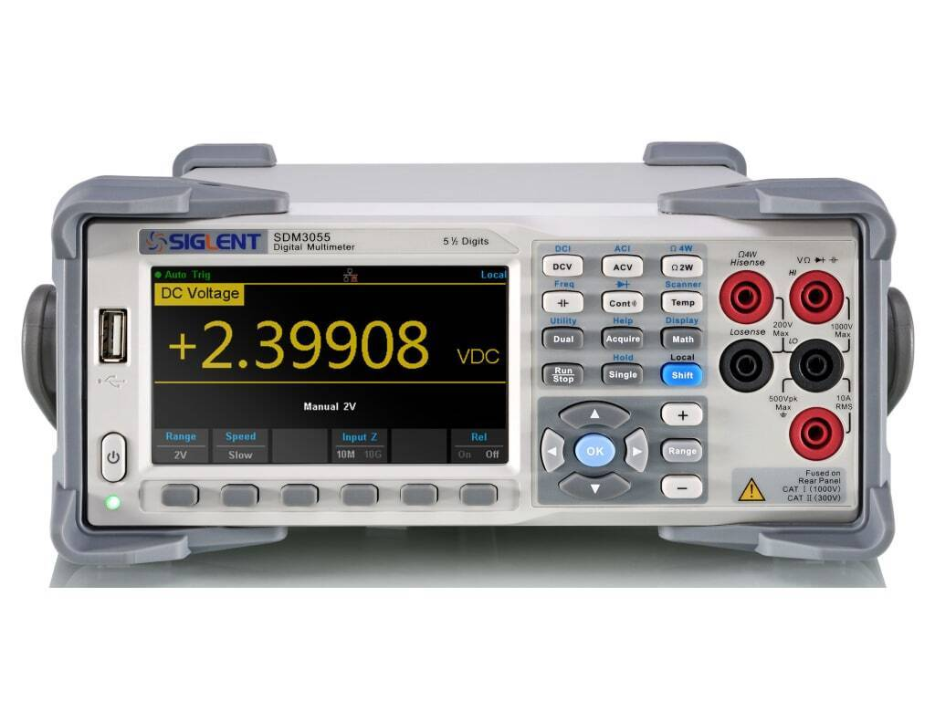
Siglent SDM3045,55,65
Very similar to an Agilent 34461A ($1,300+)
Does data logging and trend analysis live. 1Gb of memory and thumb drive.
Does dBm at Z or dBV
Simple Recalibration
1GB of memory +USB
4 ½ digit $250
5 ½ digit $350
6 ½ digit $600

Slide 9
Trend Display Data Logging

Slide 10
Siglent dBm

Slide 11
Siglent DMM Explorer Program

Slide 12
DMM Explorer Trend Data Via USB

Slide 13
Local Graph

Slide 14
Agilent 34410A
Updated and improved
34401a
Internal data logging
program via LAN.
Internal averaging
External BenchVue DMM prog via USB or LAN. Has excellent graphing. Use Connection Wizard program
dBV or dBm ref. to Z. is easy. Get free basic version.
About $450

Slide 15
Keysight BenchVue
First rate program
Averaging gives you one more digit (34461a)
Get Pathwave as a free download.
Regular BenchVue is $65/yr.
LAN and USB connections are easy
LAN can conflict with Wi-Fi.

Slide 16
Pathwave DMM Free version

Slide 17
BenchVue DMM Paid App and 34410A

Slide 18
HP34410a Remote Mode
Run LAN/USB cable to computer in BenchVue DMM app. (Use Connection Expert.)
LAN to portable Wi-Fi router should also work
Great for working on antennas and monitoring the radio.

Slide 19
Agilent 34401a Notes
34401a
Uses a Null Modem-DB9 connection.
Startech.com FTDI to null modem DB9 adapter cable should work. $45
Keysight serial cable instructions-
Keysight Serial cable Instructions
Meter will measure dBm.
Excellent meter but 1993 vintage

Slide 20
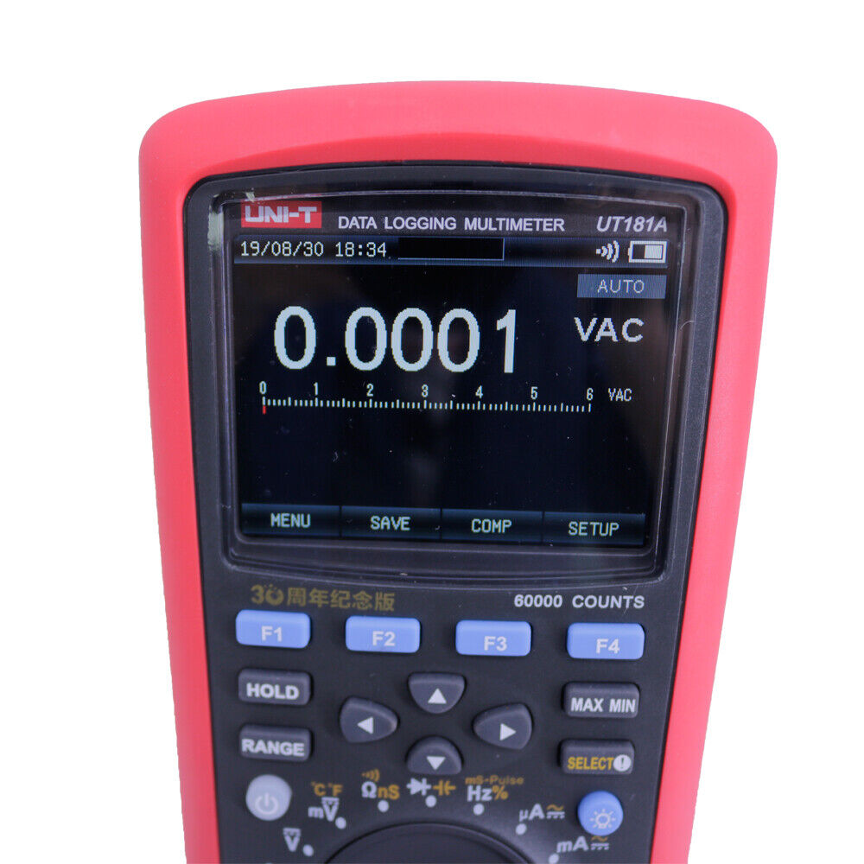
UNI-T 181A
Hand held
Bigger than average.
Excellent sharp display
Extensive data recording
Accurate and very fast
External USB/Bluetooth
Firmware upgradable
Recording and graphing
are internal and External.
About $280

Slide 21
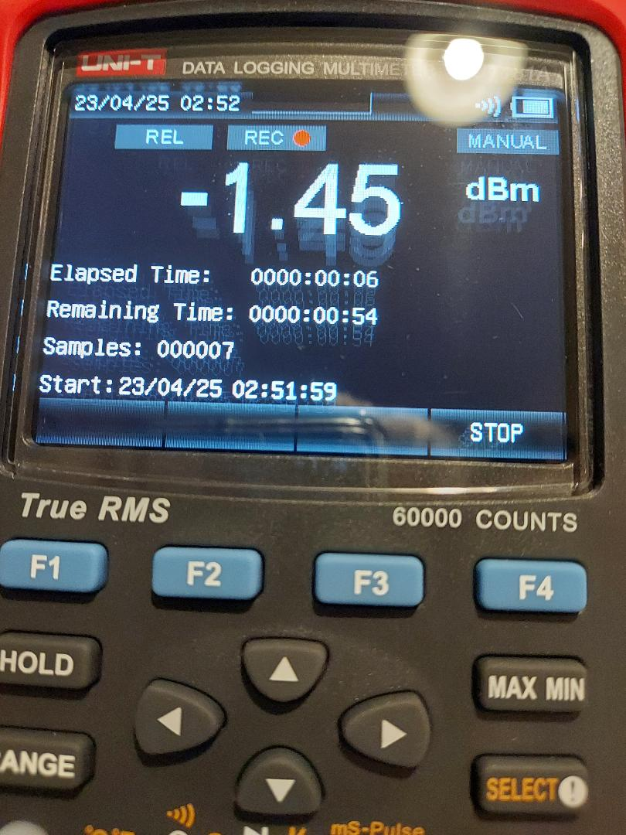
Relative dBm at Z and Record
DBM referenced to Z

Slide 22
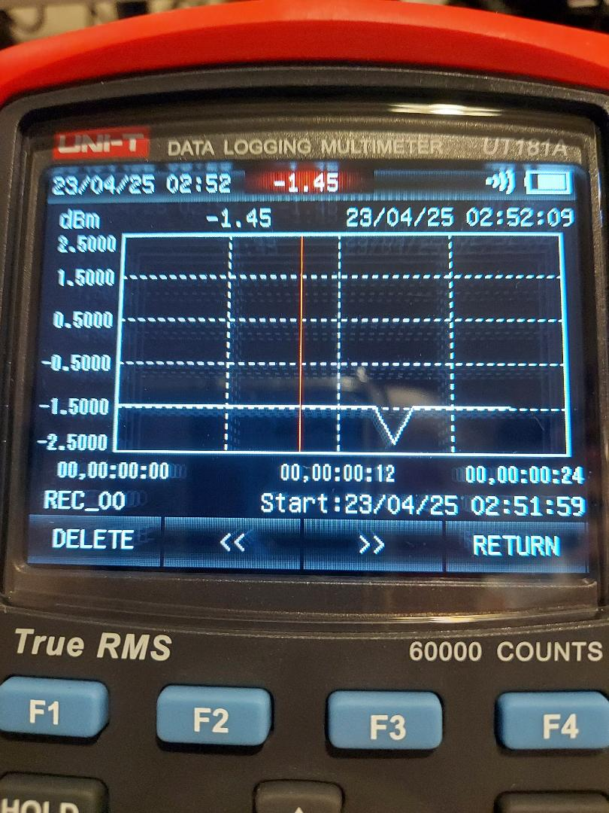
Save and Trend Views

Slide 23
UT181A
Data Logging
Use either
Internal data display or
External program via USB
Or via Bluetooth to Android
Easy set up! Live graphing.
Record data then get graph.
Use up and down to scale graph.
dBV or dBm
20,000 data point memory.

Slide 24
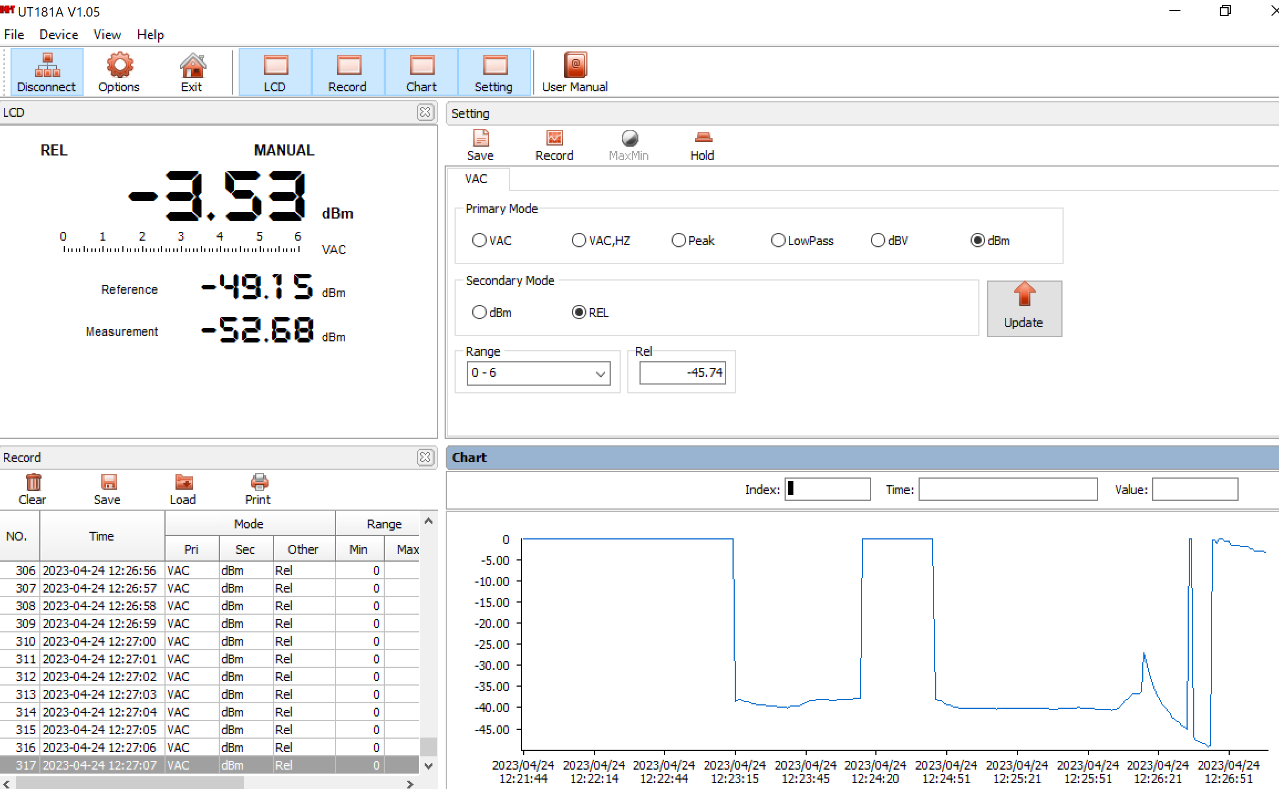
Software for UT181A
Close or open windows here
Auto ranges and records live

Slide 25
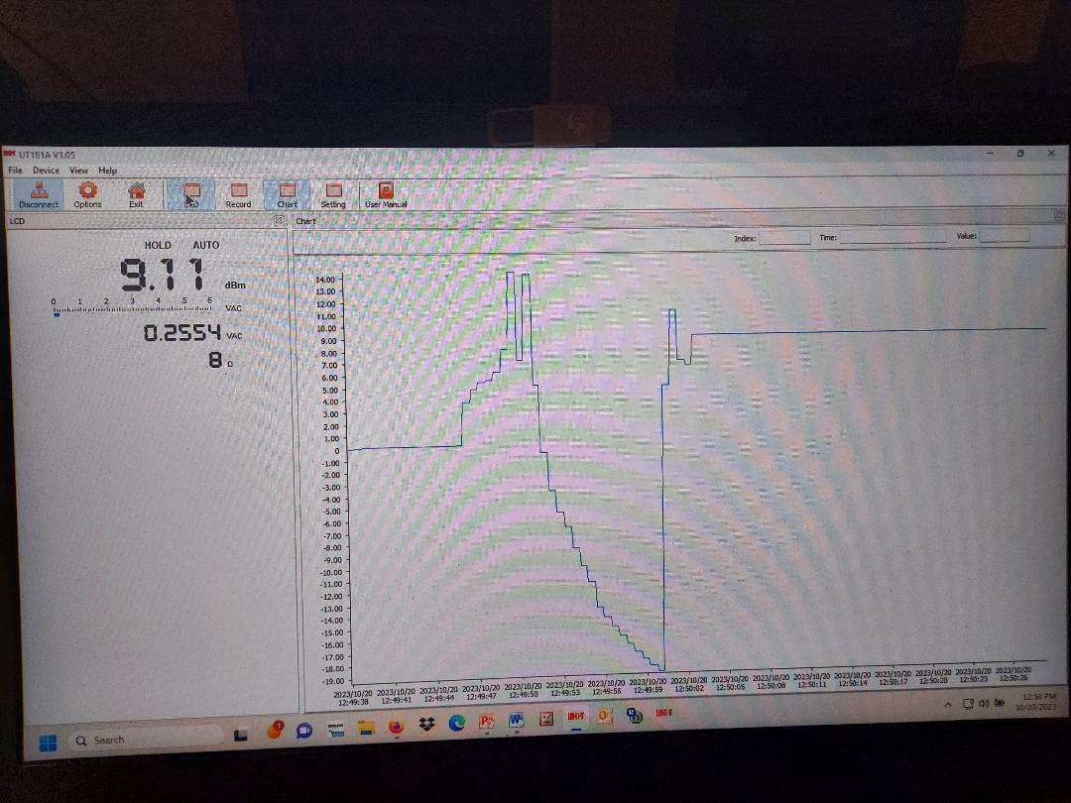
UT181 dBm Measurement Chart

Slide 26
UNI-T Program Notes
Chart can be full screened. Auto scaled.
Window sections can be opened or closed.
The Bluetooth programs are excellent.

Slide 27
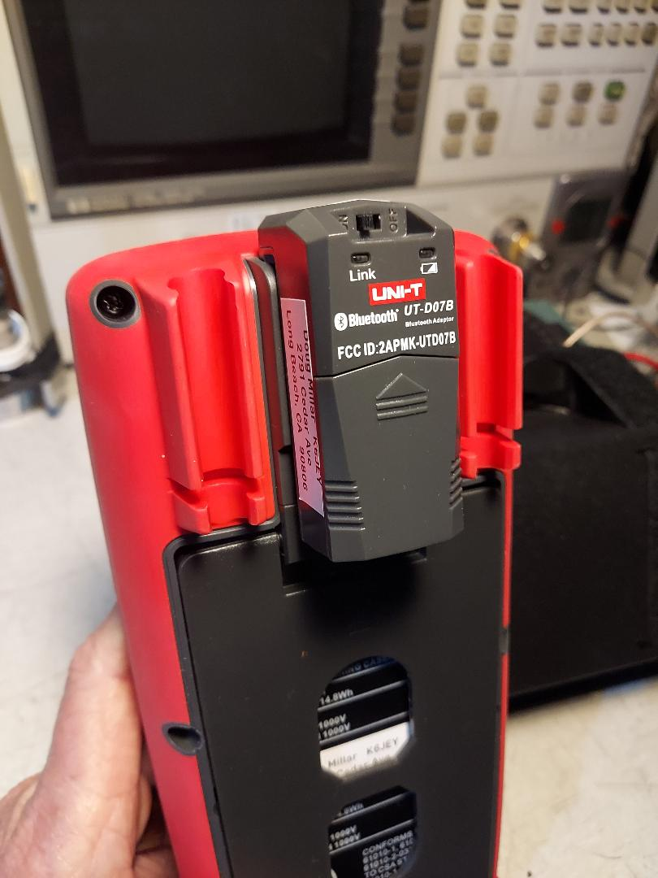
Bluetooth Adapter
Works well with
UNI-T and Android
or Apple
Data program
BT 4.0
Adapter $30

Slide 28
UT 181A via Android
You don’t have
To be at the
Meter to read it!!
Recording live
in dBm
Try- the meter
at the radio
and
The Android
at the antenna
Data saved on
Phone and DMM

Slide 29
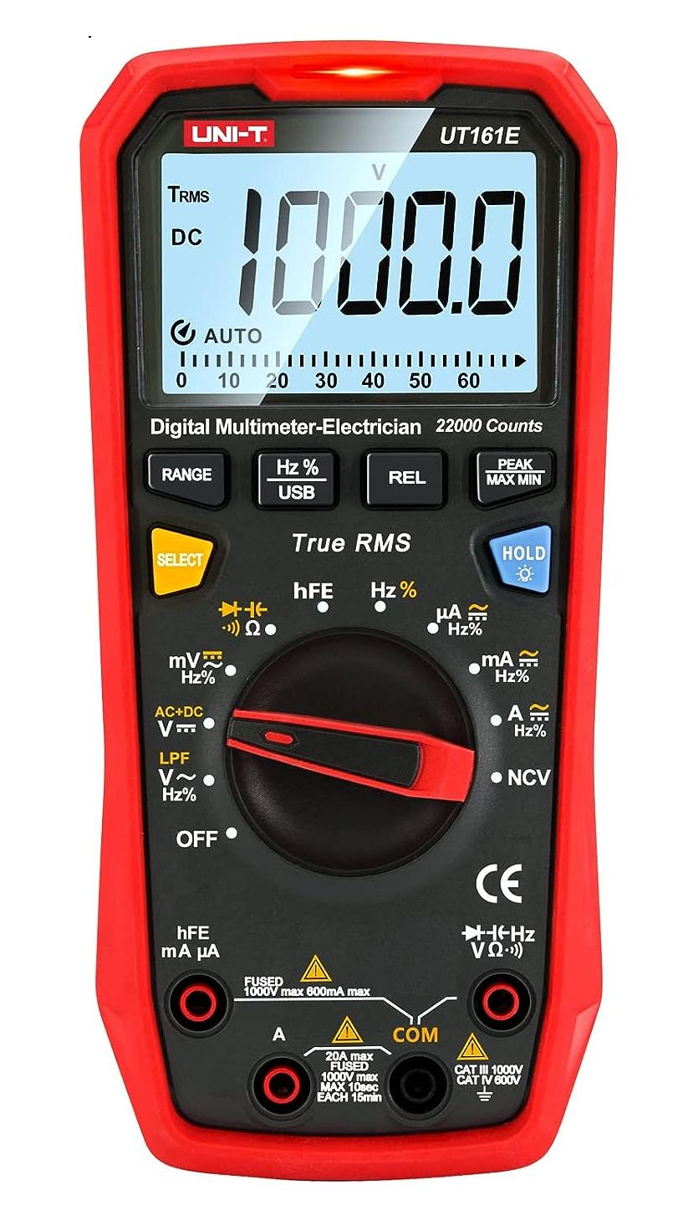
UNI-T 61E+
UNI-T 61E+ $85
Very accurate excellent Meter.
Has Relative measurement
Relative AC V measurement
No dBm measurement
No internal data logging
Has same Bluetooth adapter
and excellent program.
22,000 counts
$250 cheaper than UT 181

Slide 30
Android display Via Bluetooth
For dBV readings
1.Zero with relative button
in AC volts position.
2.Observe peak hold on chart.
3.Calculate dBm from AC
voltage difference.
Comes with calibration cert.
4. Order one that comes with a
case.

Slide 31
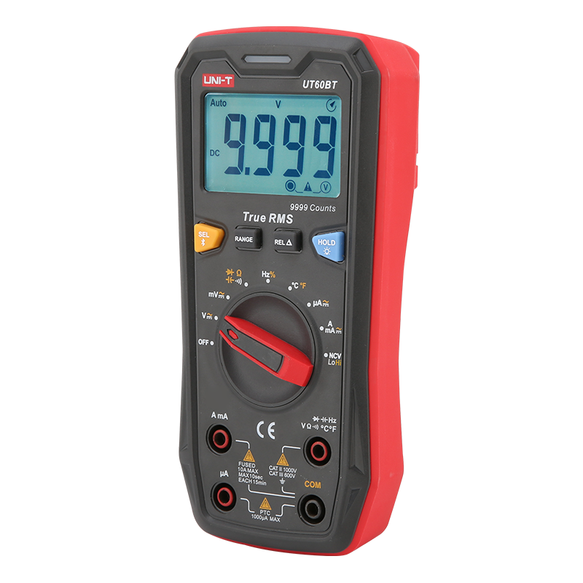
Uni-t UT60BT
Very cheap at $40
Internal Bluetooth
More limited
Same program
9.9k counts

Slide 32
AN9002
Cheap at $28
Excellent ext. Program
Internal Bluetooth
Slippery case.
Cheap leads
Display Lens not protected.
Good display, though.
6k counts

Slide 33
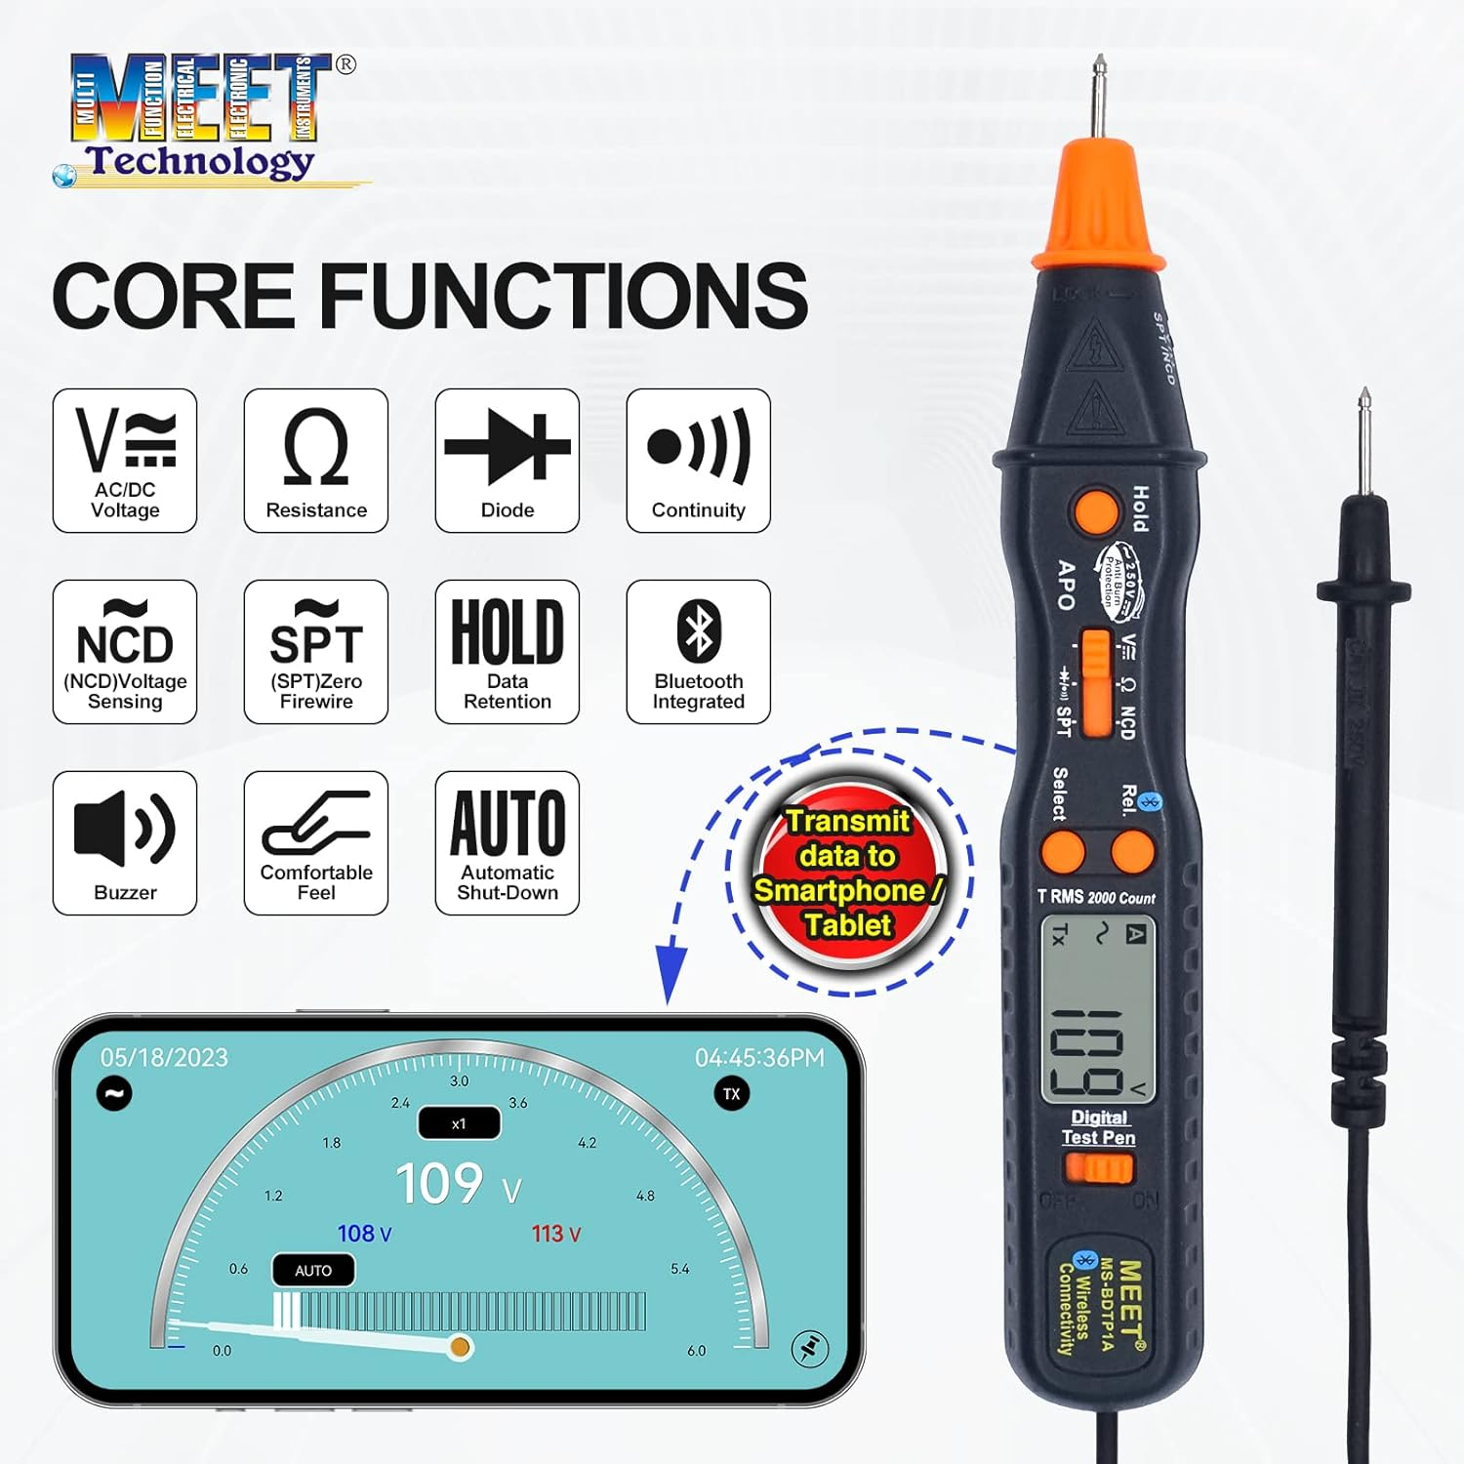
MEET- Pencil DMM
Relative and hold
Bluetooth for external
analog type meter.
“ DMM
without test leads”
Data logging,
and graphing
Takes pictures of the
setup.
$35 Amazon
“MSBDTP1A”

Slide 34
Meter and Phone
Turn the phone
clockwise for this display
Turn it anticlockwise
and get the graphing
display.
You can take pictures of
the measurements.
No test lead wires!
Did I say $35 from
Amazon?

Slide 35
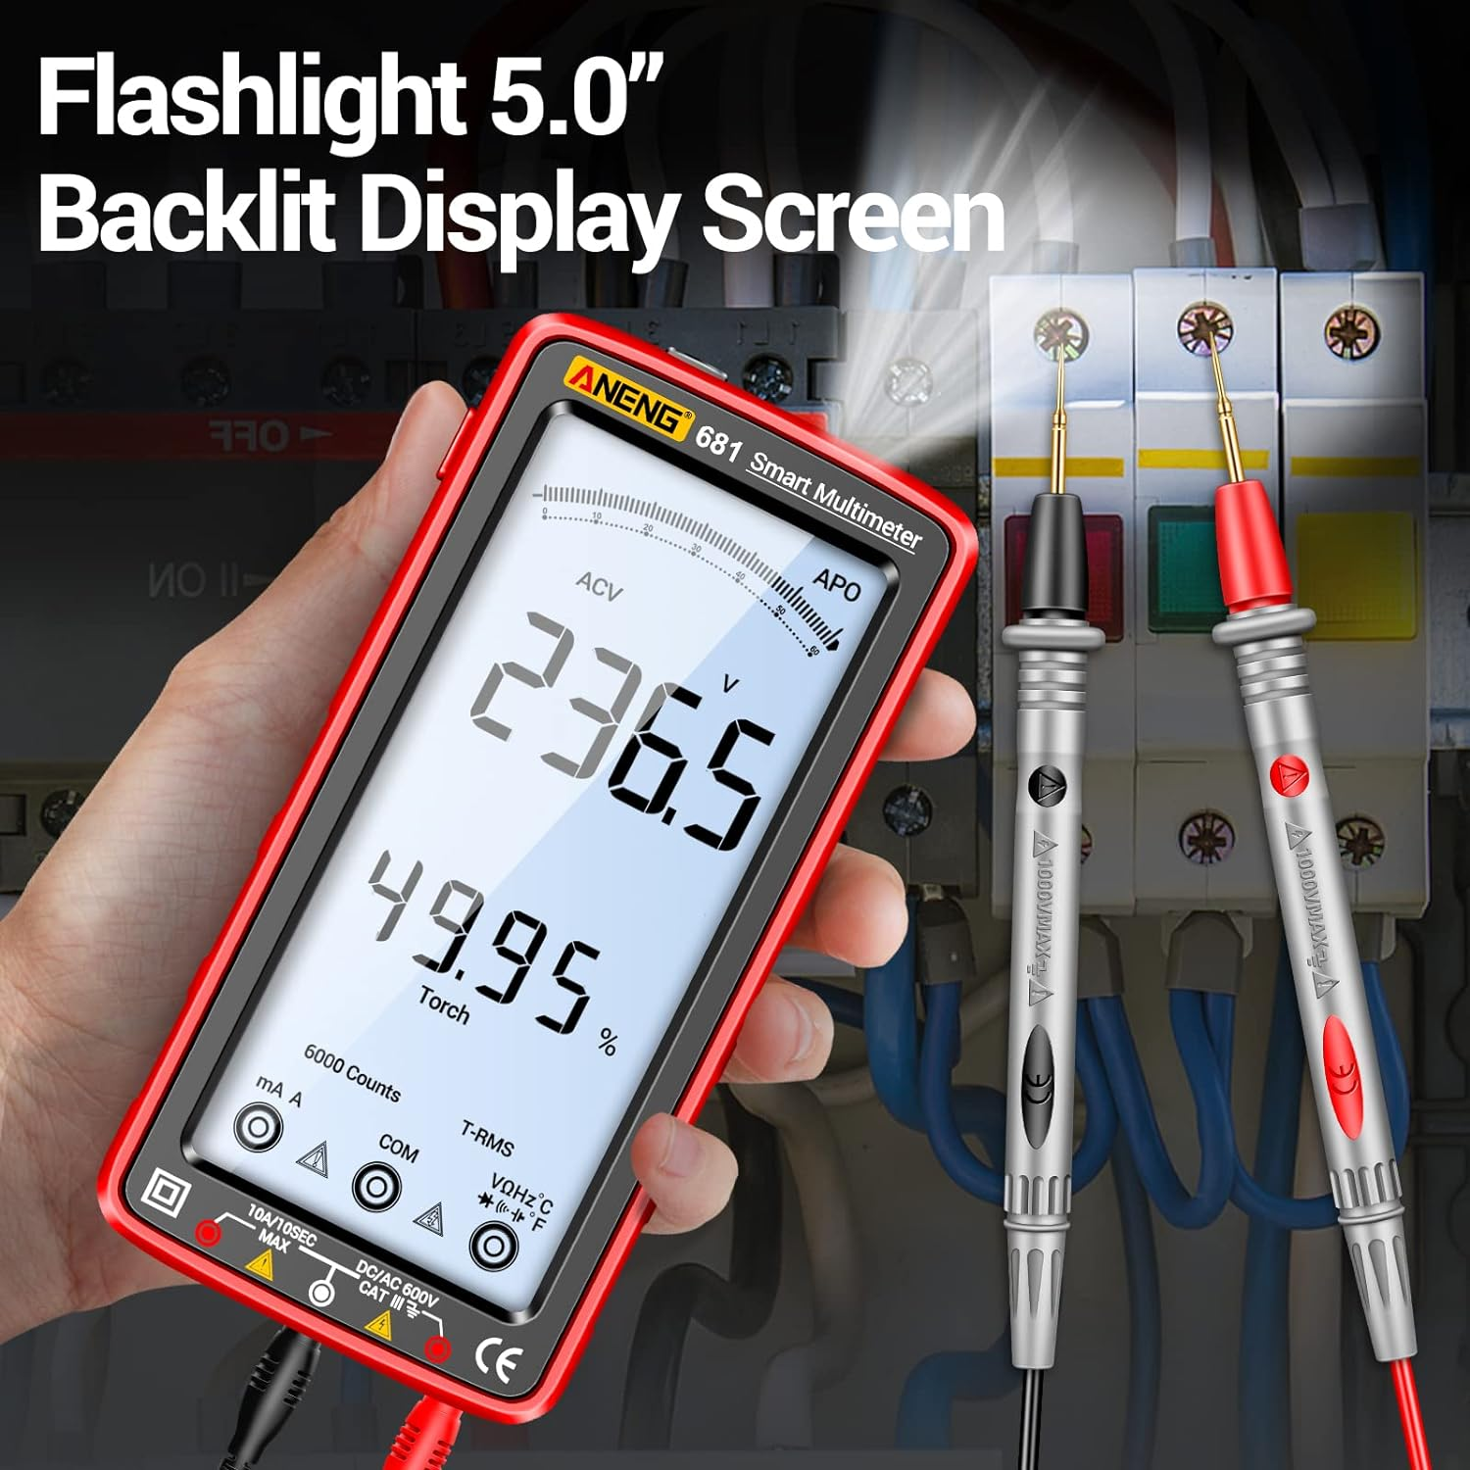
Extra ANENG 681
Color model available
Form factor of phone
USB charging
Excellent display
Auto function
Well built and sturdy
$26 Best Bang/$

Slide 36
EME Measurement Examples
Use the Sun for antenna beam width measurements
Sun to cold sky or ground noise
Power measurement from the DC jacks/ recorder output on a power meter.
Frequency drift over time on your radio.
Measurements can be in dBm or dBV at a fixed resistance and to a reference level.
Auto scaled
Saved
Annotated
Printed
Use LAN /Wi-Fi or BT 5.3 for long distances from meter

Slide 37
Meter Comparison- Expensive
Siglent 3045x- $250
Best display and easiest to use, thumb drive storage
Uses USB for remote program that works easily
Agilent 34410A- $450
Best accuracy, internal program hard to use. Outstanding ext. program BenchVue Basic (live graphing) LAN or Wi-Fi- USB
UT181A $290
Hand held, versatile, great display, accurate, many measurements and very fast. Unique bar graph.
Internal graph, easy and excellent interface and program
Graph after data on meter, but same time in ext. program
Bluetooth app works perfectly for Android and Apple.
UT61E+ $85
Like the 181- but no internal data logging or dBm.
Use Bluetooth and ext. program and ACV for logging.

Slide 38
Meter comparison- Cheap
Uni-t UT61BT- $37
Well built , good range, internal BT Good prog.
AN9002- $28
Cheaply made, Great Prog. internal BT
Pencil DMM- $35
A no brainer. No test lead DMM. Buy it.

Slide 39
Conclusions
The Siglent 3045x is an excellent lab meter with an easy to use USB program. Thumb drive storage.
A good combination for bench and portable are the Siglent 3045x and UT61E+
If you bought just one meter, the Uni-T 181A would be a good choice.
Buy the Pencil DMM for $35. No brainer.

Slide 40
Results
Worthwhile changes-
The addition of data logging and graphing programs.
USB and LAN connections that are easy to use.
Remote program via Bluetooth to phone.
Next Steps?
More phone based apps via Bluetooth 5.3
Wi-Fi to router to a laptop’s Wi-Fi input to run
Programs via Wi-Fi.

Slide 41
Time for Questions
Doug Millar K6JEY
drzarkof56@yahoo.com

