Slide 1
5 bands in 2U
Or maybe 8 bands in 3U
Or 10 in 4U
(if you don’t count HF)
(Or amplifiers)

Slide 2
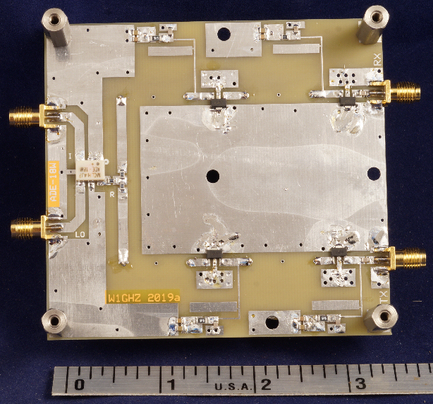
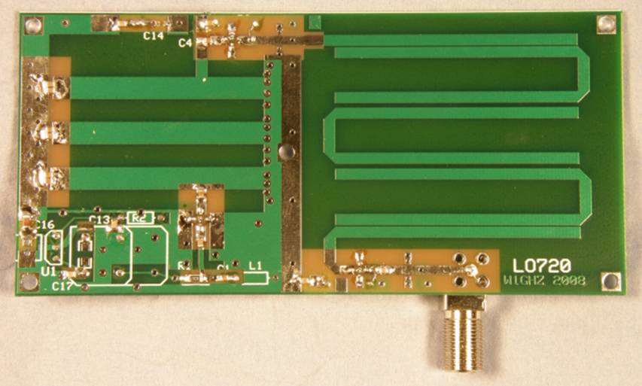
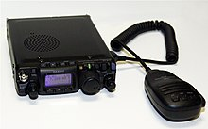
In The Beginning
There were W1GHZ Cheap and Simple Transverters
FT-817
2 GHz & 3 GHz
+
+
+

Slide 3
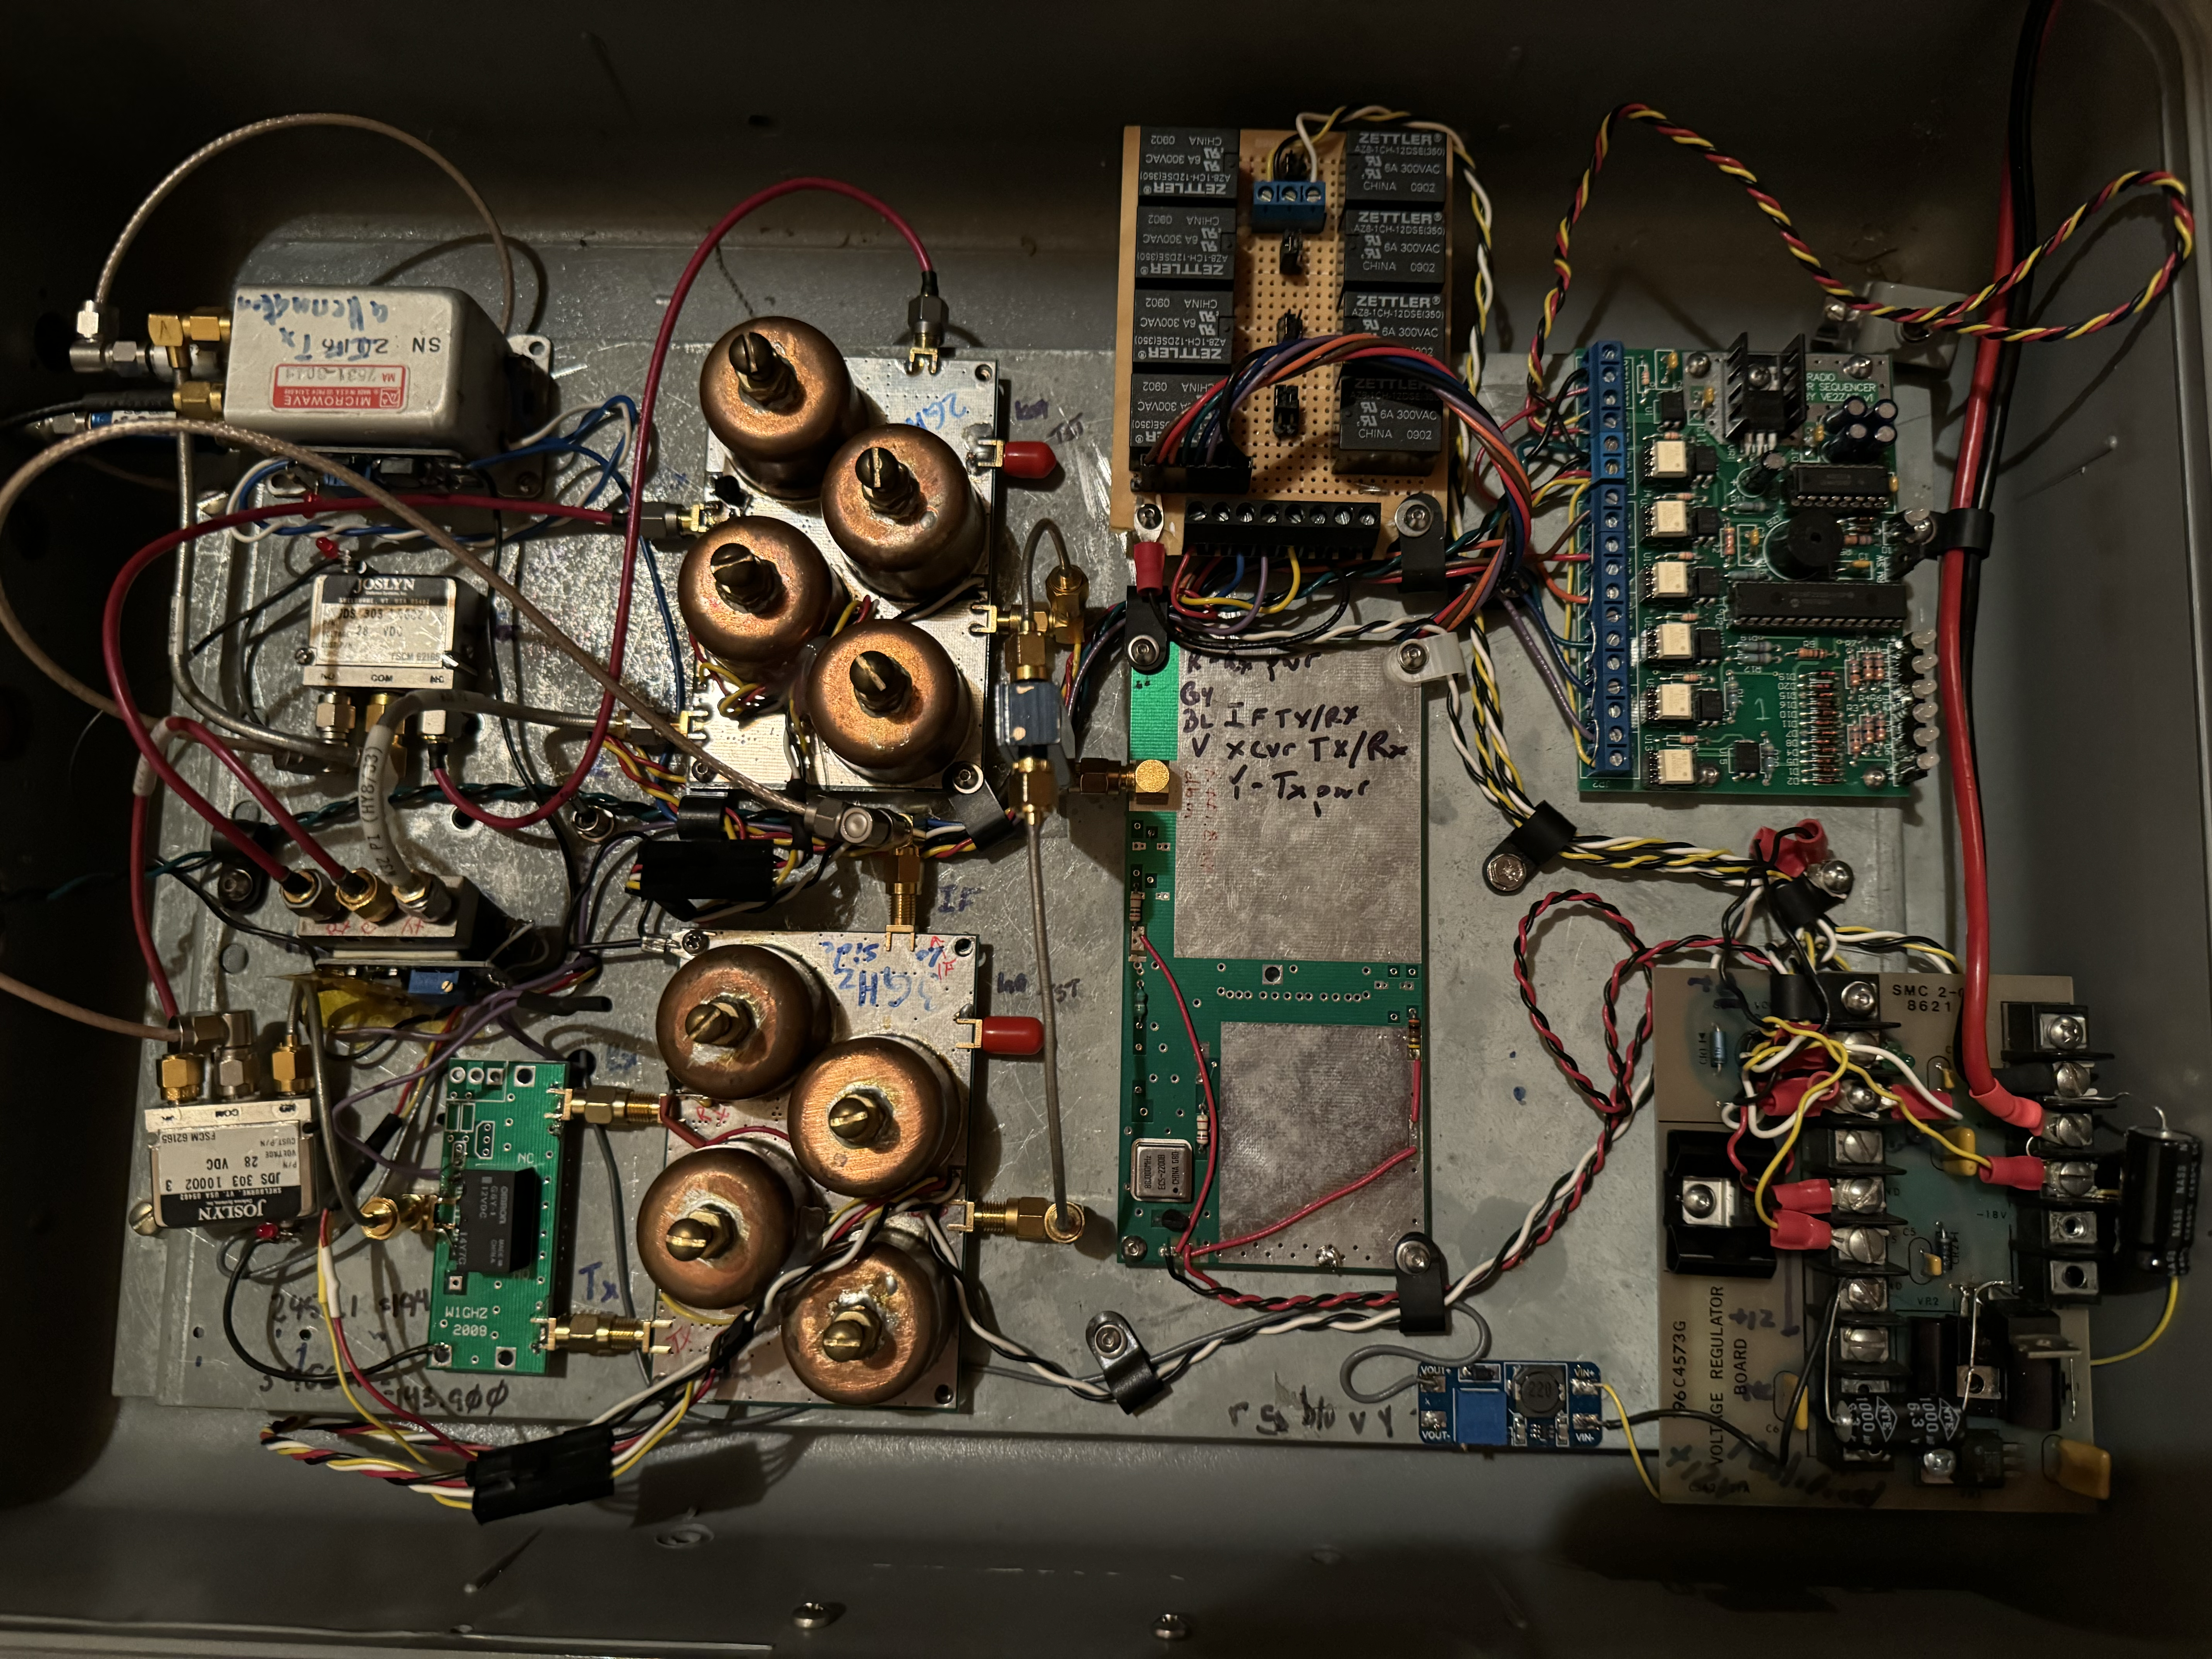
In The Beginning
There were W1GHZ Cheap and Simple Transverters
2 GHz & 3 GHz
=
+

Slide 4
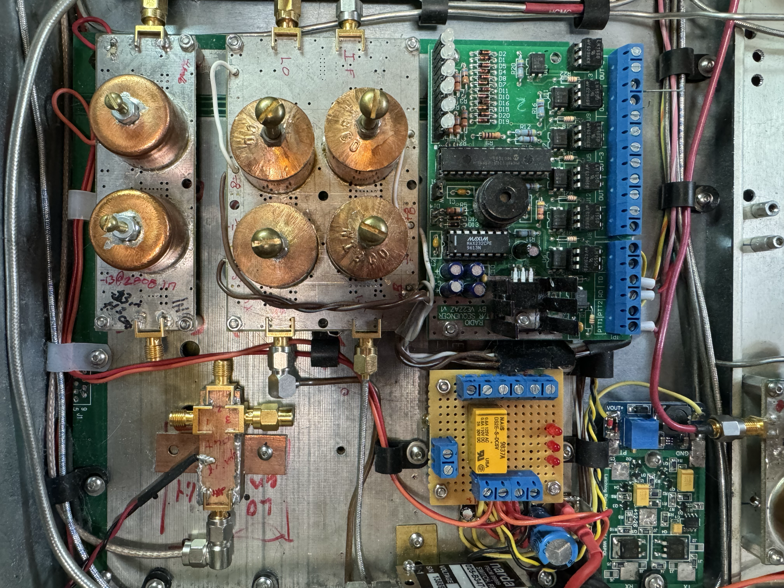
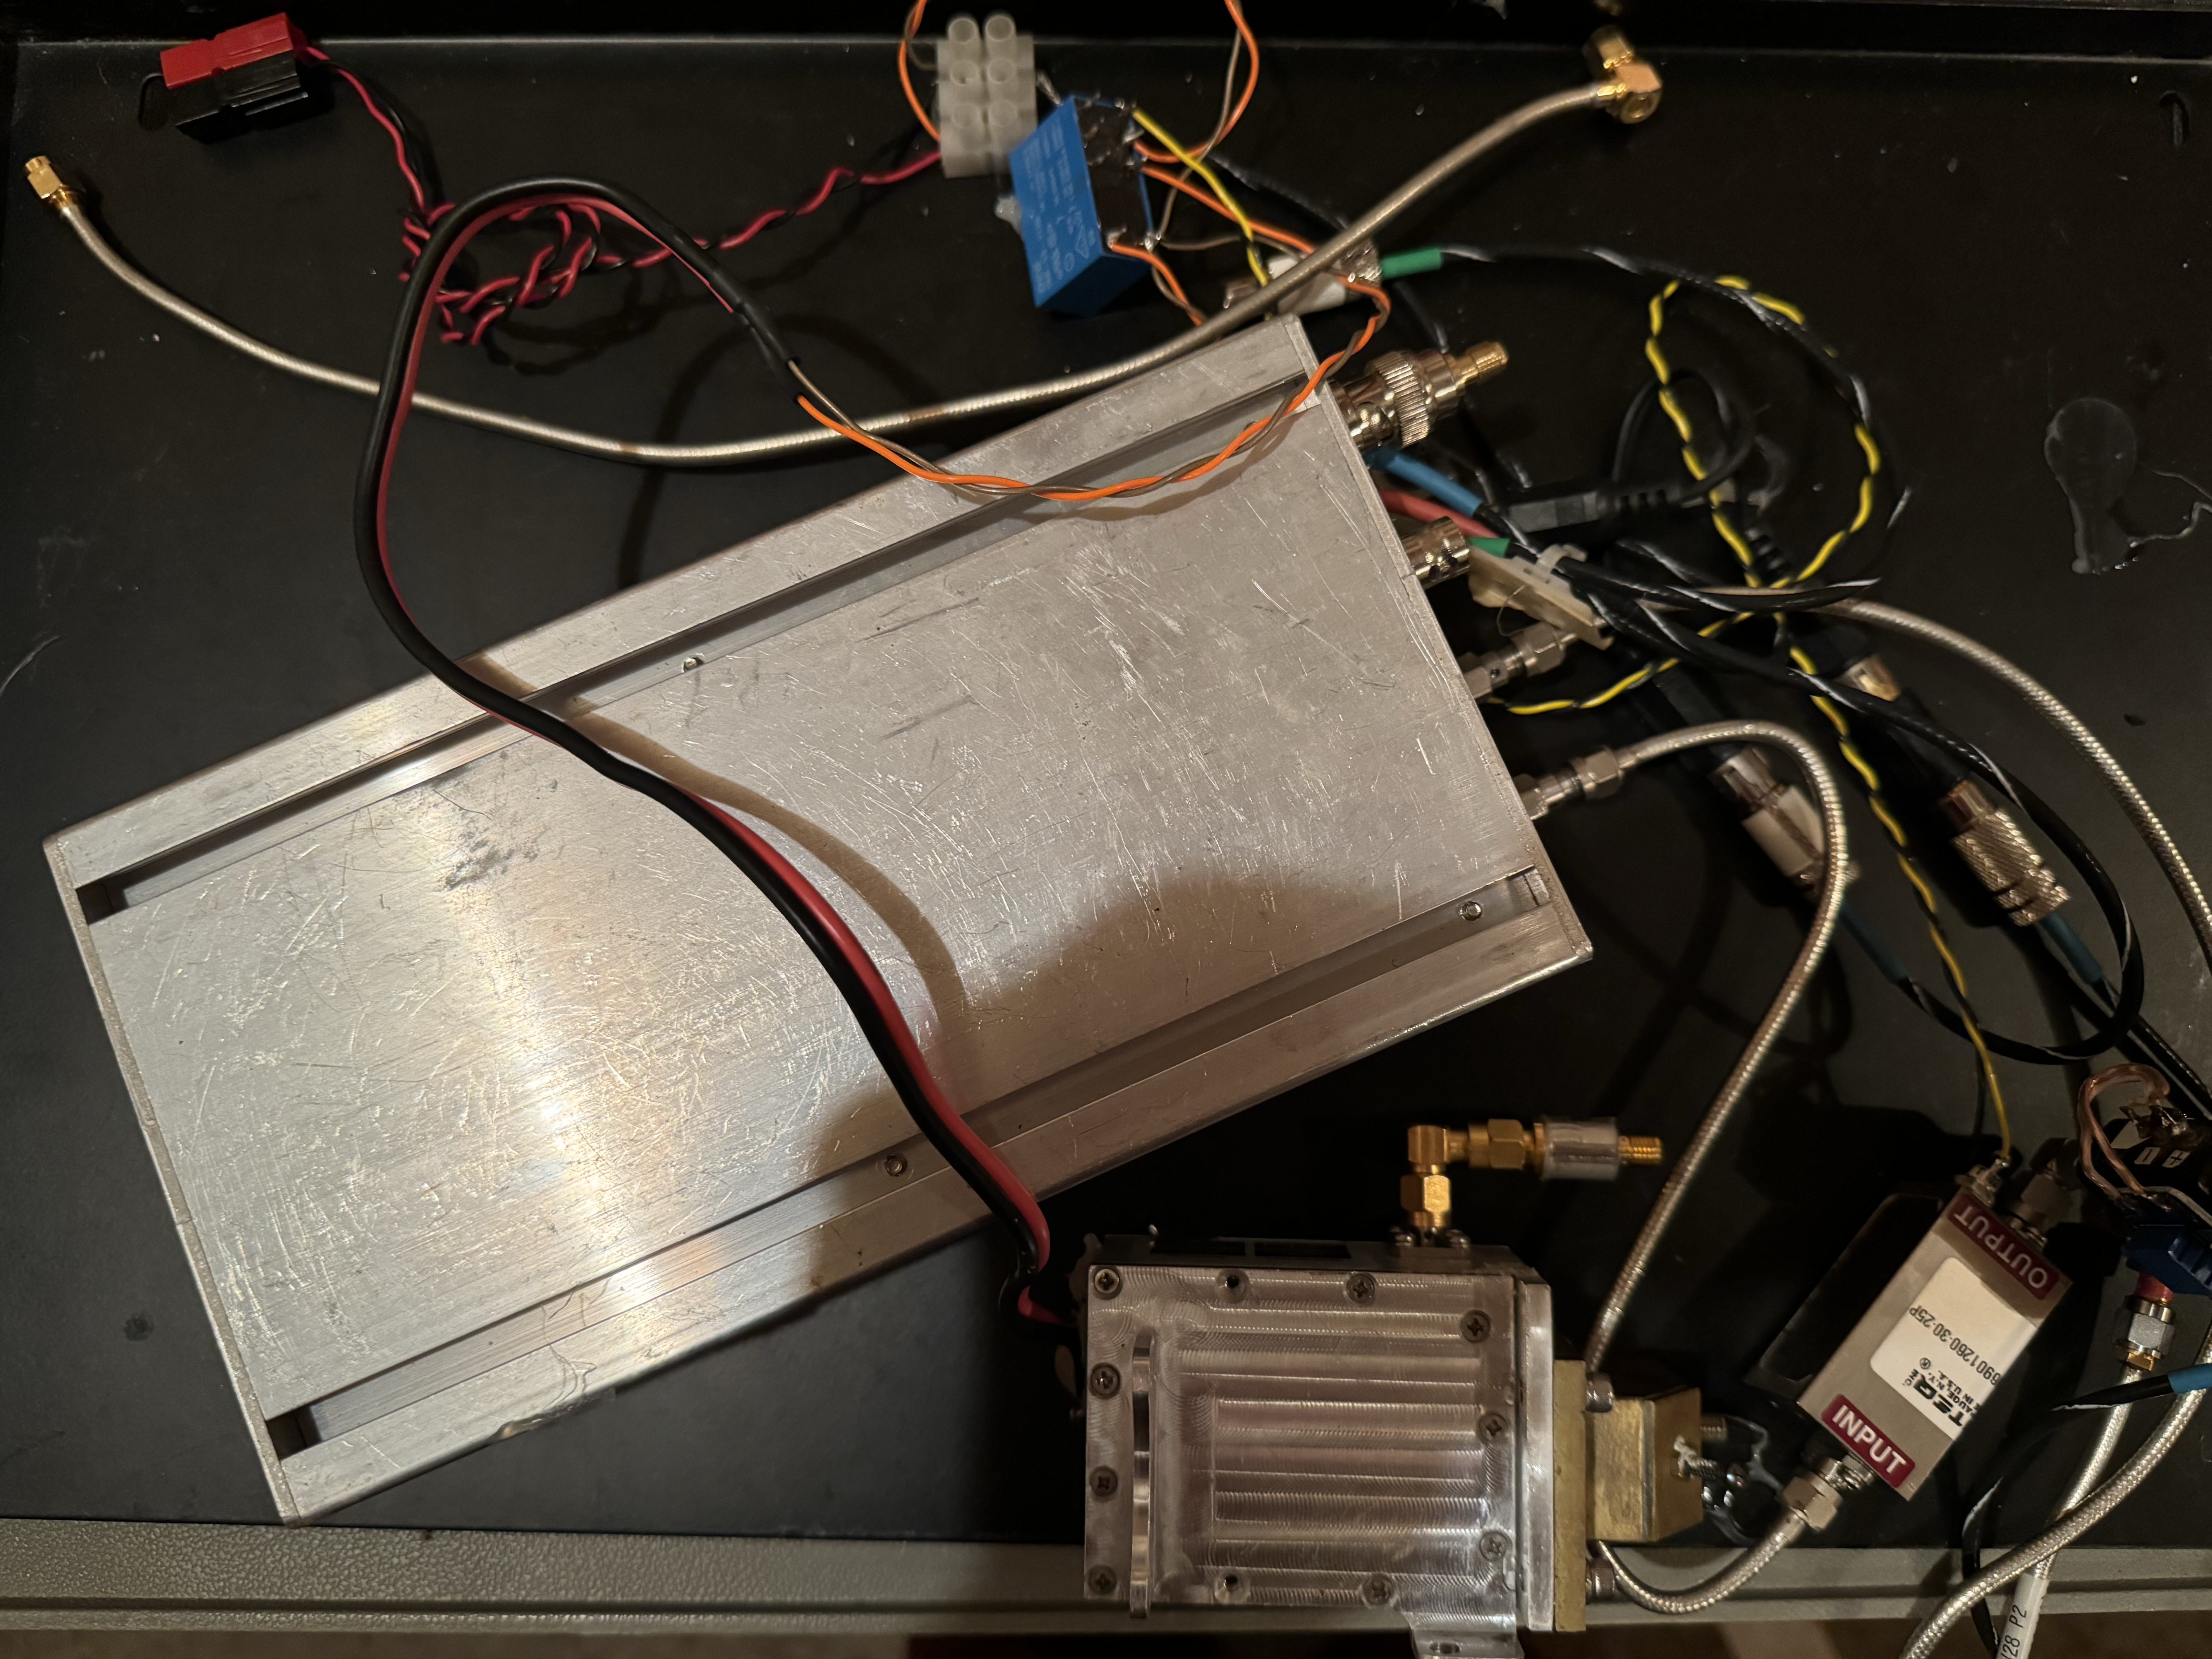
In The Beginning
There were W1GHZ Cheap and Simple Transverters
5 GHz
And a 10 GHz (DEMI)

Slide 5
And a Whole Bunch of Carrying Cases

Slide 6
Time to Consolidate!
Keep the 817 and W1GHZ transverter modules
W1GHZ - 900, 1296, 2 GHz, 3 GHz, 5 GHz
DEMI – 10 GHz
Add in
GPSDO
Frequency flexible PLL
Waterfall / FT8 / Digital subsystem

Slide 7
System Design
900 MHz
Transverter
Sequencer
1296 MHz
Transverter
PTT
USB/TTL
Cat
FT-817
IF
1:6 SMA Relay
2.3 GHz
Transverter
1:6 SMA Relay
RF In/Out
USB SignaLink
3.4 GHz
Transverter
LCD w touchscreen
5.7 GHz
Transverter
GPS Antenna
SPI
Raspberry Pi
GPSDO / PLL
USB
Band Switch
Kbd

Slide 8
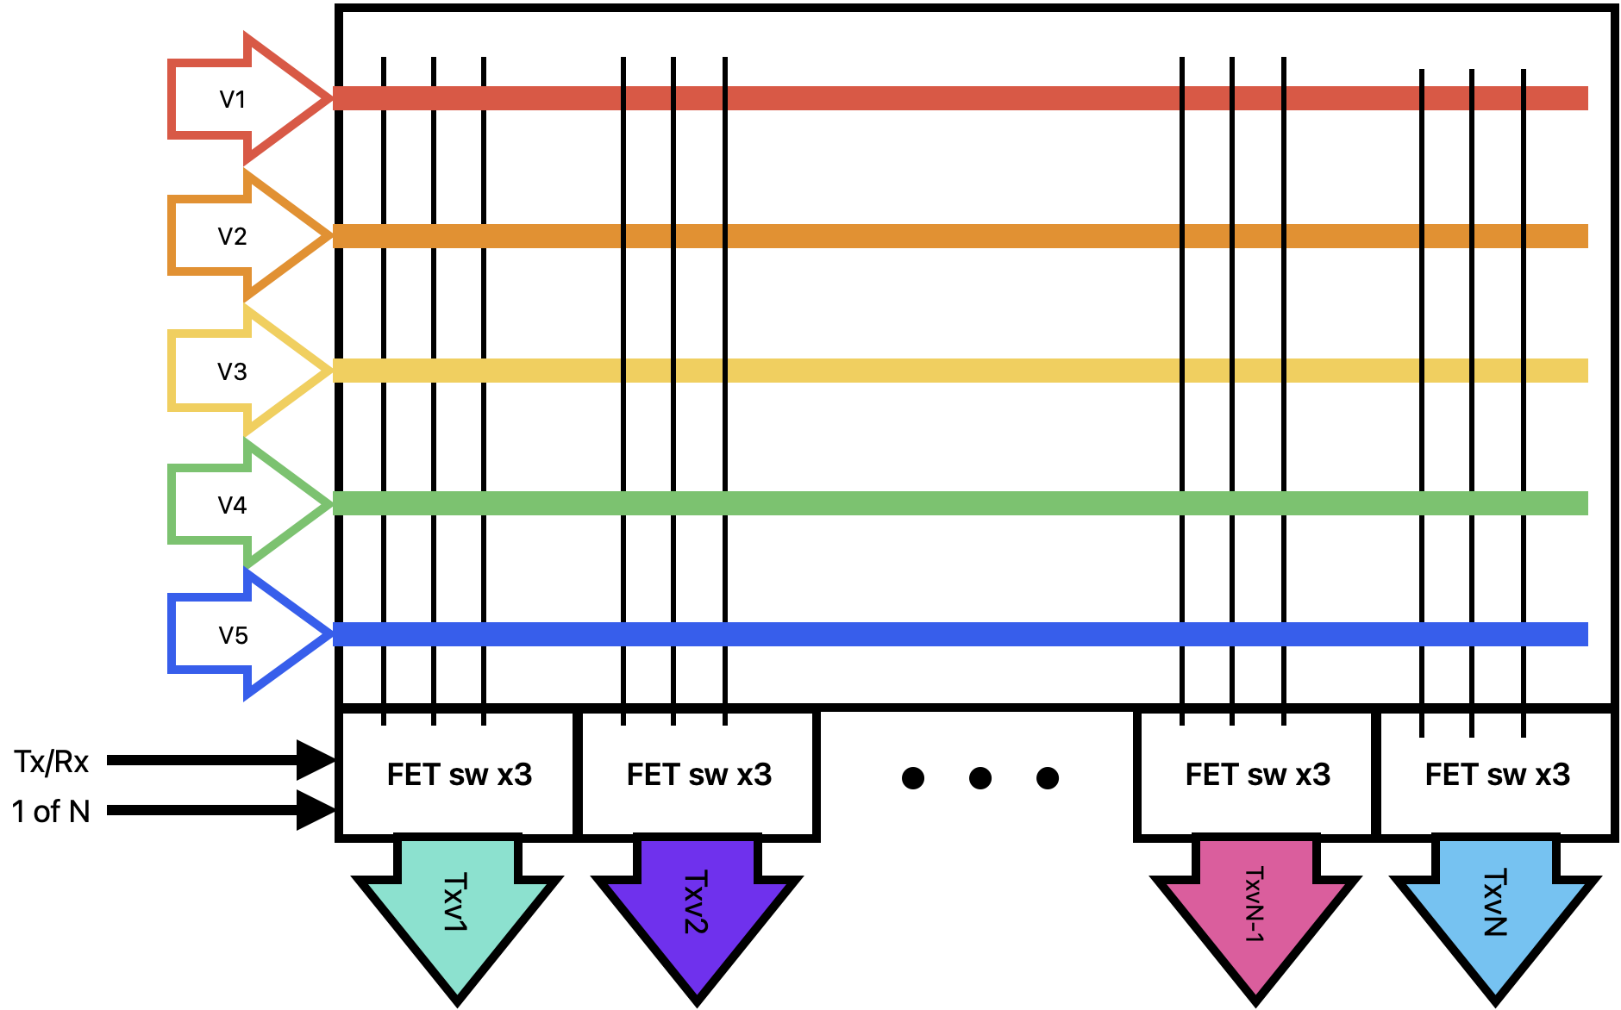
5 Supplies, 3 voltages per transverter, 5 transverters, Tx or Rx mode
Always On
On for RX
On for
TX
Select

Slide 9
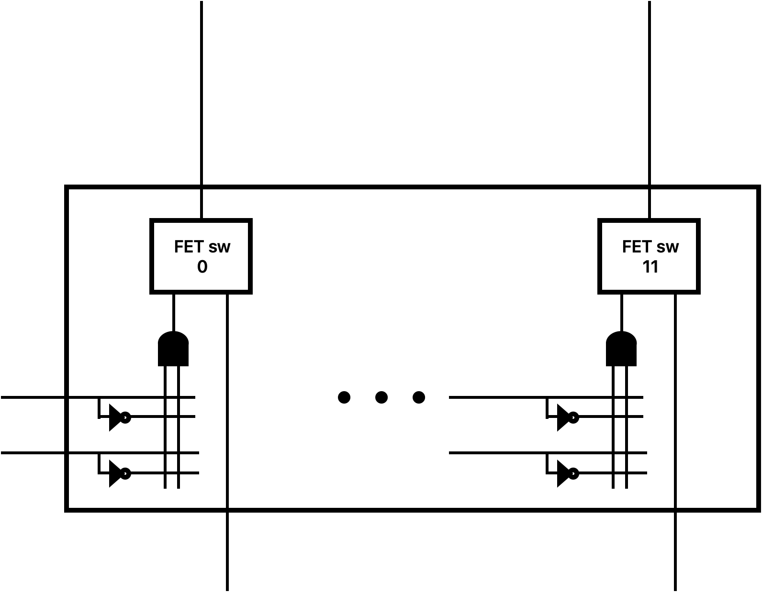
Plus a whole bunch of FET switches with selection logic
TX/RX
…
Select 0 to N

Slide 10
Is one metric &^$%# ton of jumpers

Slide 11
As soon as it was done….
Murphy arrived!
Adding another transverter
Need another voltage
Sequencer complexities
Preamp considerations
Amplifier considerations

Slide 12
Has To Be an Easier WayTM !
Simple FET Switch board
Vin₁
TR/RX₁
Select₁
FET Sw
Vin₂
Out₁
FET Sw
Out₂
Vin₃
FET Sw
Out₃

Slide 13
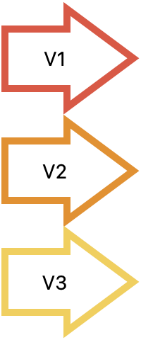
Somewhat simpler
Transverter
TX Out
IF
RX In
TxV
RxV
AoV
Tx/Rx (PTT)
FET Switch
Select

Slide 14
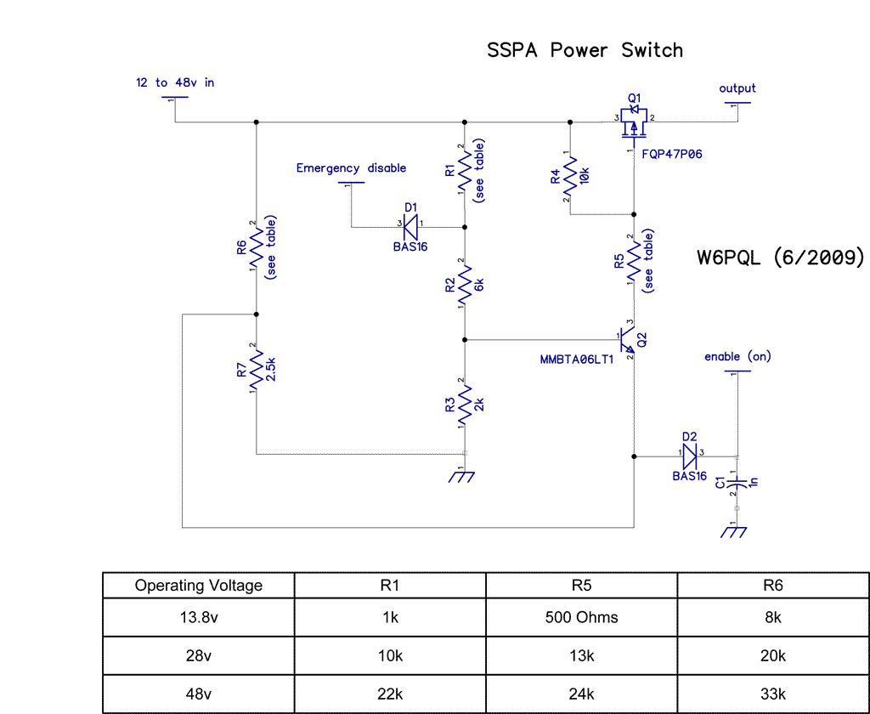
Familiar FET Power Switch
Using a slightly different transistor
F9Z24NS
SMD mount, -55V-2300V
15V V_{GS}
Got a tube of parts @ MUD Banquet!

Slide 15
System Design V2
Tx/RX
Select 1-5
900 MHz
Transverter
T/R
Sequencer
1296 MHz
Transverter
T/R
PTT
USB/TTL
Cat
FT-817
IF
1:6 SMA
2.3 GHz
Transverter
T/R
1:6 SMA
RF In/Out
USB SignaLink
3.4 GHz
Transverter
T/R
LCD w touchscreen
5.7 GHz
Transverter
T/R
GPS Antenna
SPI
Raspberry Pi
GPSDO / PLL
USB
Band Switch
Kbd

Slide 16
GPSDO + PLL + RasPI
LARS GPSDO 10MHz reference
Arduino
Common off the shelf GPS module – RS232 interface
ADF4351 PLL Synthesizer - 35MHz to 4.4 GHz
Arduino reference designs available
RasPI reference design available
https://github.com/davecrump/RPiADF4351

Slide 17
GPSDO + PLL
LARS GPSDO 10MHz reference
Arduino
Common off the shelf GPS module – RS232 interface
ADF4351 PLL Synthesizer - 35MHz to 4.4 GHz
V1.0 Arduino based
V2.0 RasPI
ADF4351 reference design available
https://github.com/davecrump/RPiADF4351

Slide 18
GPSDO + PLL
Lars GPSDO
Arduino + GPS module + cheap 10 MHz OXCO
Code and schematics
https://www.eevblog.com/forum/projects/lars-diy-gpsdo-with-arduino-and-1ns-resolution-tic/
Built as stand-alone without display. Modified code to pass status to 2nd Arduino

Slide 19
GPSDO
Lock
PLL
FTDI
USB/
RS232
Arduino
COTS GPS Module
1pps
/10 – 1MHz
Counter
/2 – 5MHz
USB
(optional)
10MHz OXCO
DAC1 out
10 MHz

Slide 20
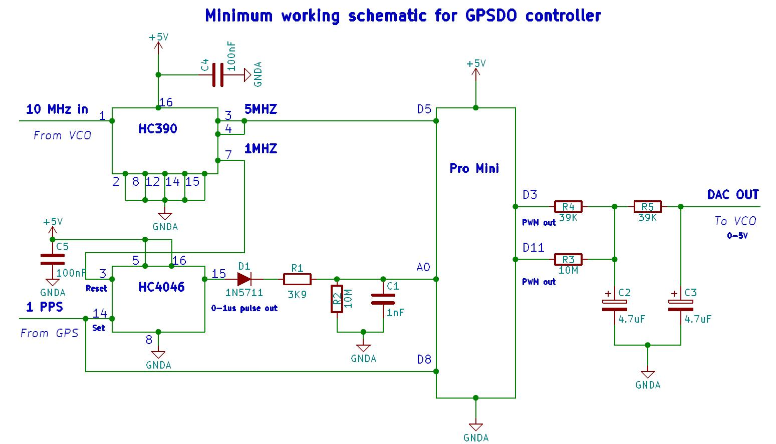
GPSDO

Slide 21
PLL V1.0
Lock
FTDI
USB/
RS232
Arduino
COTS ADF4351 Module
I2C
35MHz – 4.4 GHz Out
Frequency
Select
USB
(optional)
2 line x 16 char
LCD Display
I2C
Interface
10 MHz
10MHz OXCO

Slide 22
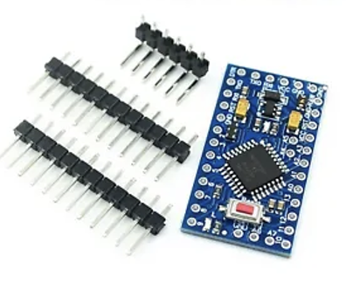
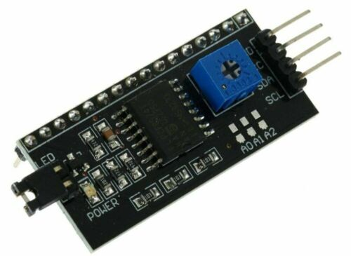
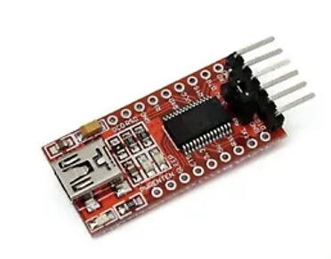
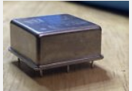
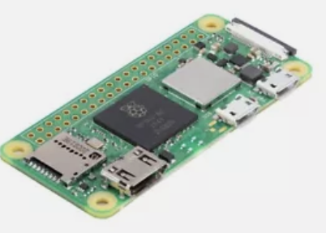
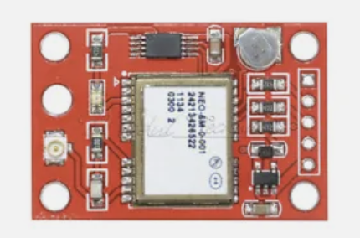
PLL V1.0
Arduino Mini Pro
eBay - $3.13
I2C LCD Display interface
eBay - $1
FT232RL FTDI Serial Adapter Module
eBay - $1.25
10MHz VCOCXO Module
eBay - $12
Raspberry Pi Zero 2 W
eBay - $22
GPS Module
eBay - $2.79

Slide 23
PLL V2.0
Lock
USB
Pi 3 or 2W
COTS ADF4351 Module
I2C
35MHz – 4.4 GHz Out
Keyboard
Band
Select
Touchscreen
10 MHz
10MHz OXCO
HDMI

Slide 24
Future work
Tidy up before June & train user
Post June 2024
Dish/Feed switch to demultiplex the feed line
Preamplifier Deck – Need to put in drop/insert ports
Amplifier Enclosure – Won’t fit in road case and be portable
220 MHz transverter
24 GHz narrow band?

