Slide 1

Audio Switching and Control for SO5R operation
Too Many Radios, not enough ears!

Slide 2
VHF/UHF Contesting @ KC2GDG January 2001
  Yaesu FT-530
Not Much Complexity
  1 microphone, 2 bands FM, no power, no clue
  Apartment on a hillside in CM87
  Work 4 grids!
  Can’t tell who’s calling on what band
  Can’t hear the weak ones over the noise

Slide 3
VHF/UHF Contesting @ KC2GDG June/Sept 2002
Contest Gear 2002
  FT847 for 2m, 432 sideband
  Dual band mobile for 2/440 FM
  Roving in 1985 MR2 with 3 element 2/432 yagi and 6m dipole
  Worked ~12 grids from 4 grids, of note, KH6HME on 2m ssb phone CM97 to BK39 w 100w!
Complexity only slightly increased
  2 microphones, 2 speakers
  Can’t tell who’s calling on what radio
  Always grab wrong mic
  Only allowed to work one band at a time
  Can’t hear the weak ones over the noise

Slide 4
VHF/UHF contesting Spring of 2003
Gear little changed
  FT847 for 2m, 432 sideband
  FT736R for 6m sideband
  Dual band mobile for 2/440 FM, single band for 900FM
Complexity grows again slightly
  3 microphones, 3 speakers (900 only on demand)
  Can’t tell who’s calling on what radio
  Always grab wrong mic
  Only allowed to work one band at a time
  Can’t hear the weak ones over the noise
Unhappy GF!

Slide 5
VHF/UHF contesting Fall of 2003
VHF/UHF Contest gear in 2003 (Fall)
  Headphones!
  4 band audio mixer
  FT847, FT736R, 2 x Multi band mobiles for 6/2/440 FM
Complexity grows larger
  4 microphones, 5 audio channels,
  Audio levels can be adjusted too many places
  Still can’t hear 2m/432 sideband at the same time
  Band switches on radios
  Ground loops
  Still grab wrong mic
  Only allowed to work one band at a time but voice keyer implementation keys multiple radios! (Oops!)
  Can’t hear the weak ones over the noise!
happy GF!
Annoyed K1SIX

Slide 6
VHF/UHF contesting Fall of 2008
Gear has increased again.
  Headphones!
  16 band audio mixer
  FT-2000 for 6m SSB, FT847 for 2m/432, FT736 for 220/1296, 2 x Multi band mobiles for
  6/2/440 FM
  Foot switches for SSB radios
Complexity grows substantially
  5 microphones, 7 audio channels
  Still can’t hear 2m/432 sideband at the same time, now can’t hear 220/1296
  Band switches still on radios
  Ground loops better but still troubling
  Still grab wrong mic, now step on wrong switch or key wrong mic
  Voice keyer goes to a single radio
  Can’t hear the weak ones over the noise!
Now happy Spouse!

Slide 7
VHF/UHF contesting ~2010 Now KI2L
Gear mostly unchanged, added one band
  16 band audio mixer
  FT-2000 for 6m SSB, FT847 for 2m/432, FT736 for 220/902/1296, 2 x Multi band mobiles for
  6/2/440 FM
  Transverter for 902
  Foot switches for SSB radios
Complexity grows!
  3 microphones, 7 audio channels
  Consolidated 3 SSB mics to single mic
  Hummmmmm
  Still can’t hear 2m/432 sideband at the same time, now can’t hear 220/902/1296
  Band switches still on radios, 902 fully manual cable movement, etc.
  Still grab wrong mic, now step on wrong switch or key wrong mic
  Voice keyer goes to a single radio selected by switch
  Can’t hear the weak ones over the noise!

Slide 8
VHF/UHF contesting Somewhere in the late teens
Mostly contesting from W2SZ/1 on Mt. Greylock June/Sept, home January
Gear mostly unchanged, removed two bands
  16 band audio mixer
  Rack mount 6 channel splitter/mixer Rane SRM 66 – 6 channels in, 6 chan out.
    Mic mixing / level balancing
    Remote controllability
  FT-2000 for 6m SSB, FT847 for 2m/432, FT736 for 220/1296, 2 x Multi band mobiles for 2/440 FM
  3 Foot switches for SSB radios, mics for FM
Complexity lowered!
  One less audio channel (6m FM), one less band (902)
  Mic levels are set and forget
  No more hummm!
  Still can’t hear 2m/432 & 220/432 sideband at the same time
  Band switches still on radios, 902 integration fail
  Still grab wrong mic, step on wrong switch or key wrong mic
  Voice keyer goes to splitter/mixer, routes to one or all radios with a switch. But keying doesn’t.
  Can’t hear the weak ones over the noise!

Slide 9
VHF/UHF contesting Somewhere in the Twenty Twenties
Still mostly contesting from W2SZ/1 on Mt. Greylock June/Sept, home January
Gear mostly unchanged, removed two bands
  16 band audio mixer gone – Using individual volume controls
  Still using foot switches for SSB radios
  Audio isolation transformer boards for SRM66 available.
Complexity lowered!
  Need keying integration. Single footswitch runs to common controller which can key any radio individually or all bands simultaneously (single mode)
  Need digital integration – Used primarily for level control

Slide 10
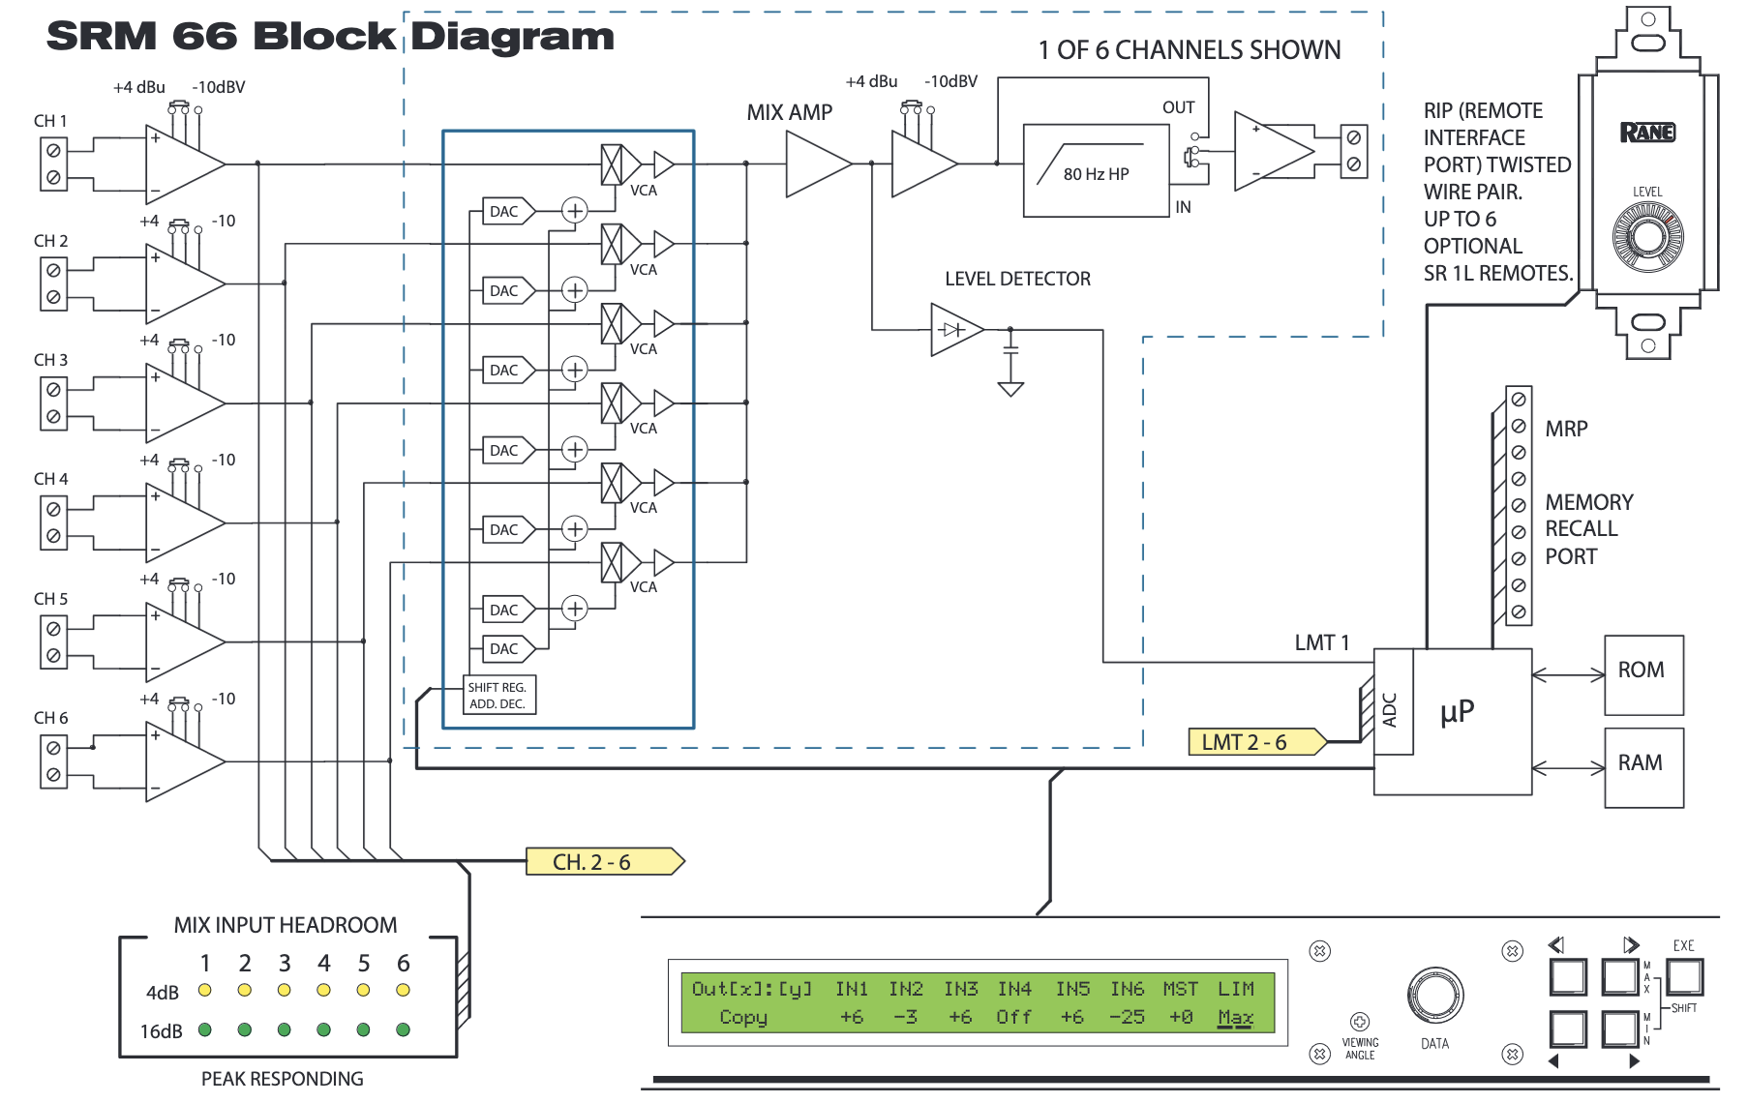
Rane SRM-66 Splitter/Mixer

Slide 11
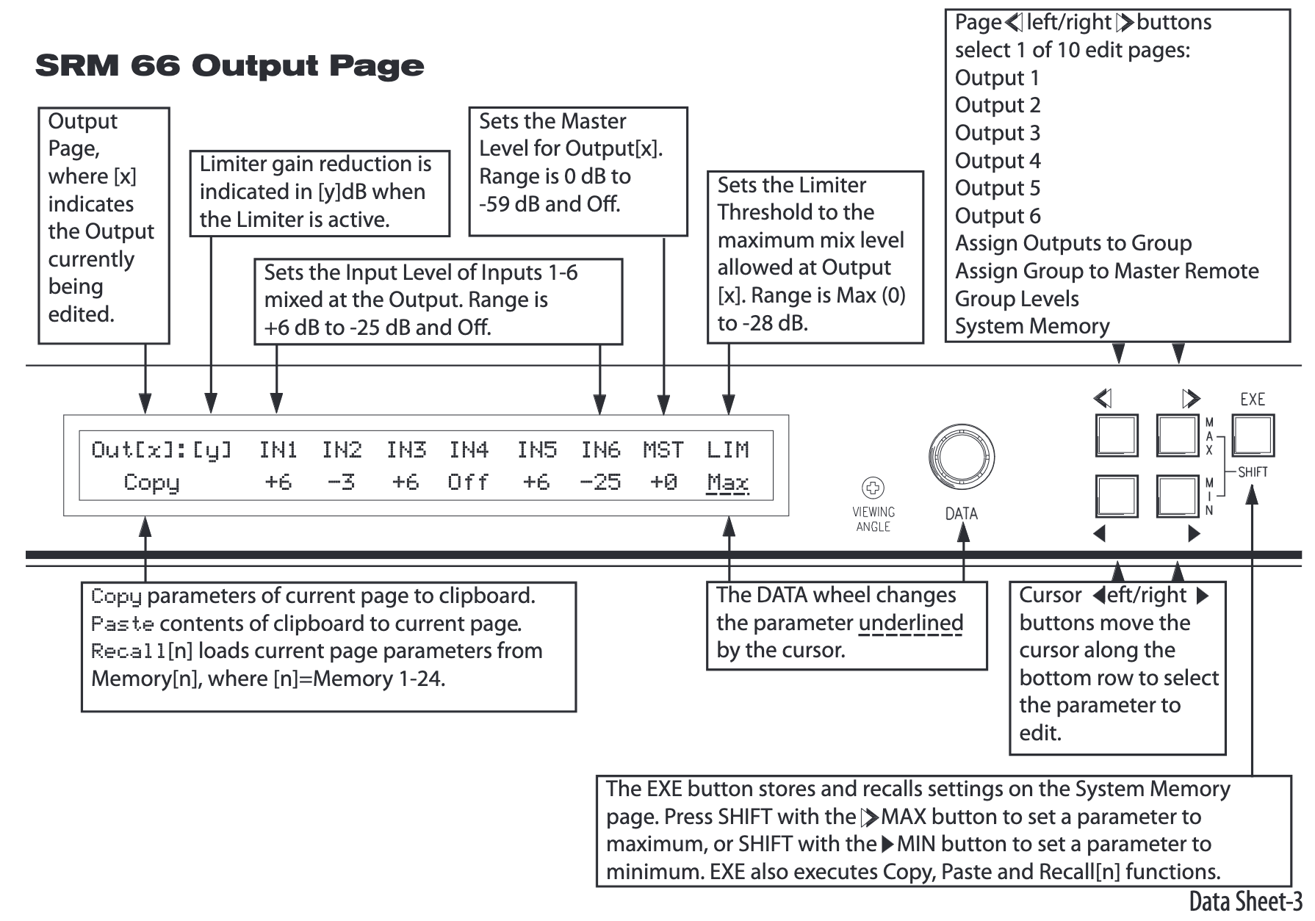
Rane SRM-66 Splitter/Mixer

Slide 12
VHF/UHF contesting Somewhere in the Twenty Twenties
SRM-66
Arduino
USB
Voice Keyer
Radio 1
Radio 6

