Slide 1
ARRL Contest/Operating Events Update 47th Eastern VHF/UHF Conference
Presented by
Bart Jahnke, W9JJ ARRL Radiosport Manager Paul Bourque, N1SFE ARRL Contest Program Manager
Image Courtesy dxmaps.com

Slide 2
World’s Largest Radiosport Program
15 Primary Contests * Plaques Awarded + Affiliated Club Competition January – RTTY Roundup * + January – VHF Contest + February – International DX Contest, CW * + March – International DX Contest, Phone * + June – ARRL International Digital Contest + June – VHF Contest * + July – IARU HF World Championship August – 222 MHz and Up Distance Contest + August/September – 10 GHz & Up Contest September – VHF Contest + Sept, Oct, Nov, Dec – EME Contest November – Sweepstakes, CW * + November – Sweepstakes, Phone * + December – 160 Meter Contest + December – 10 Meter Contest +
9 other operating events January – Straight Key Night January – Kids Day February – School Club Roundup April – Rookie Roundup – Phone June – Kids Day June – Field Day (not a contest) August – Rookie Roundup – RTTY October – School Club Roundup December – Rookie Roundup–CW
Plaques are available to be sponsored for the June VHF and other contests (see events at left with an asterisk). Cost is $95 each. Contact the ARRL Contest Manager at contests@arrl.org if interested.

Slide 3
What’s NEW in ARRL On-Air Operating Events?
Limited Antenna Overlay added to ARRL HF Contests – Available to Single Operator and Single Operator Unlimited (assisted) entrants. Operation is limited to the use of single-element antennas such as a single vertical, end-fed wire, or a single dipole antenna no more than 50 feet above ground at its highest point.
Youth Overlay in All Contests – The contest log uploader asks entrants who are 25 or younger to supply their age. In contests where youth competition is evident, Youth participants will be mentioned in the full results article.
Overlays added to Certificates – The Limited Antenna, All Enclosed Antenna (ARRL Digital Contest only), and Youth overlays are now noted on the downloadable certificates at contests.arrl.org.
10 GHz and Up Contest Rules Changes – A change in the start and end times of the event to UTC from local time. The contest period will change to 0900 UTC Saturday through 0759 UTC Monday of each of the 2 weekends. Participants may operate a maximum of 42 hours each weekend. More review is ongoing by the ARRL Contest Advisory Committee (VHF Subcommittee) with considerations toward benefitting the event.
Proposed 2025 EME Contest Dates released – Discussion on Contest Exchange and Multipliers is ongoing by the ARRL Contest Advisory Committee (VHF Subcommittee).

Slide 4
Who’s behind the curtain?
For each contest, outside authors create the QST and online results. You have seen their names in QST, and you have worked them on the bands. But here’s their names by event (Author/Editor):
January - RTTY Roundup – Jeff Stai, WK6I
January VHF Contest – James Duffy, KK6MC / Doug Grant, K1DG
February/October – School Club Roundup – Lew Malchick, N2RQ
February - International DX Contest, CW = Mark Beckwith, N5OT; Phone = Chris Tate, N6WM (Kelly Taylor, VE4XT)
April/August/December – Rookie Roundup (online scoring by Bruce Horn, WA7BNM)
June - ARRL Digital Contest – open
June VHF Contest – Jim Wilson, K5ND
July - IARU HF Championship – Bob Raymond, WA1Z (Doug Grant, K1DG)
August - 222 MHz and Up Distance Contest – open
August/September - 10 GHz & Up Contest – Rus Healy, K2UA
September VHF Contest – open
September/October/November - EME Contest – Skip Paulsen, W1PV
November - Sweepstakes – CW = Kelly Taylor, VE4XT; Phone = Scott Davis, K5TA
December - 160 Meter Contest – Mark Beckwith, N5OT (Doug Grant, K1DG)
December - 10 Meter Contest – Andrew Goss, AA5JF
When you see the above contributors at conferences, hamfests, DX or HF conventions, please consider thanking them extraordinary work they do behind the scenes to provide these great write-ups in QST and on the ARRL web!

Slide 5
More unsung heros:
You’ve also heard these folks in the contests, and have seen their names in print as well, but honorable mention is deserved to these extraordinary contest branch contributors and volunteers:
Ward Silver, NØAX – while he has in recent years begin a graceful retirement from his generous efforts helping the ARRL Contest Program (in addition to writing a bounty of material for QST and other ARRL Publications), what you may not know is that for many years Ward has helped Contest Branch Managers orchestrate the complex ebb and flow of contest data, log checking, and results authoring and editing. Many thanks, Ward!
Trey Garlough, N5KO and Bruce Horn, WA7BNM – Trey is the man behind the scenes for database and contest tables operations, while Bruce has created the many web apps for uploading ARRL (and CQ and other event) logs. Including: Contests, Field Day, HPM/150, 3830-Scores, etc. Bruce also hosts the ARRL event web pages for Frequency Measuring Tests and Rookie Roundup.
We’ll withhold the names, but we deeply appreciate the volunteer efforts of our volunteer log checkers, and volunteer paper-log entry folks.
Please thank these folks (when you see them in person, have email exchanges with them, or hear them on the air) for the tireless efforts of these contributors to our contest community!

Slide 6
All Events - Contest Logs Received by ARRL 2017-2023

Slide 7
VHF + Contest Activity (Logs) Reported to ARRL 2017-2023

Slide 8
June VHF Contest- All Mode vs Analog Only Entries

Slide 9
September VHF Contest- All Mode vs Analog Only Entries

Slide 10
Three Keys to Contest Success
Get on the air!
Have fun!
Send in your event logs!

Slide 11
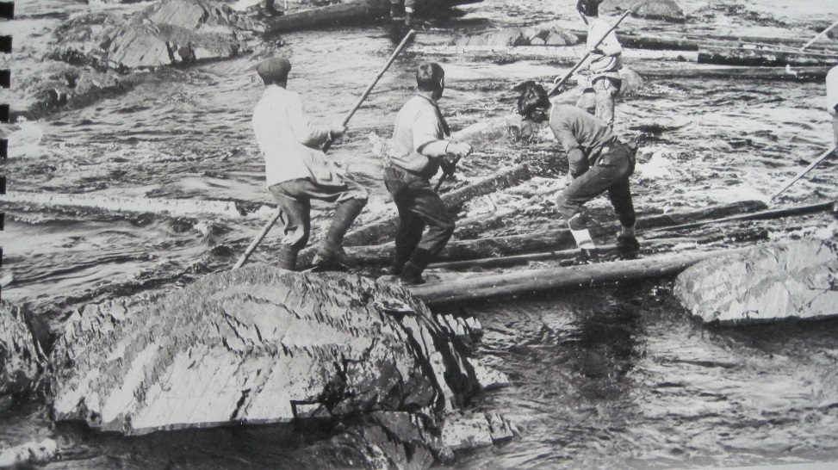
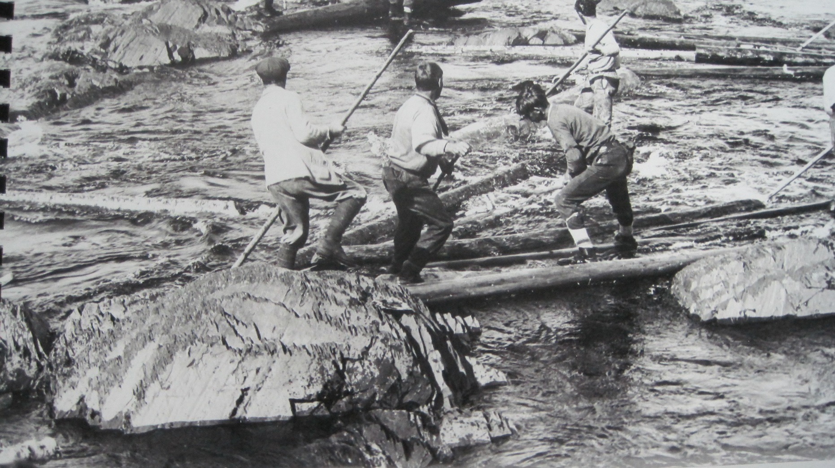
Keep your logs coming after each event…
Go with the flow… Thank you for participating!

