Slide 1
SDR – Working the entire Band

Slide 2
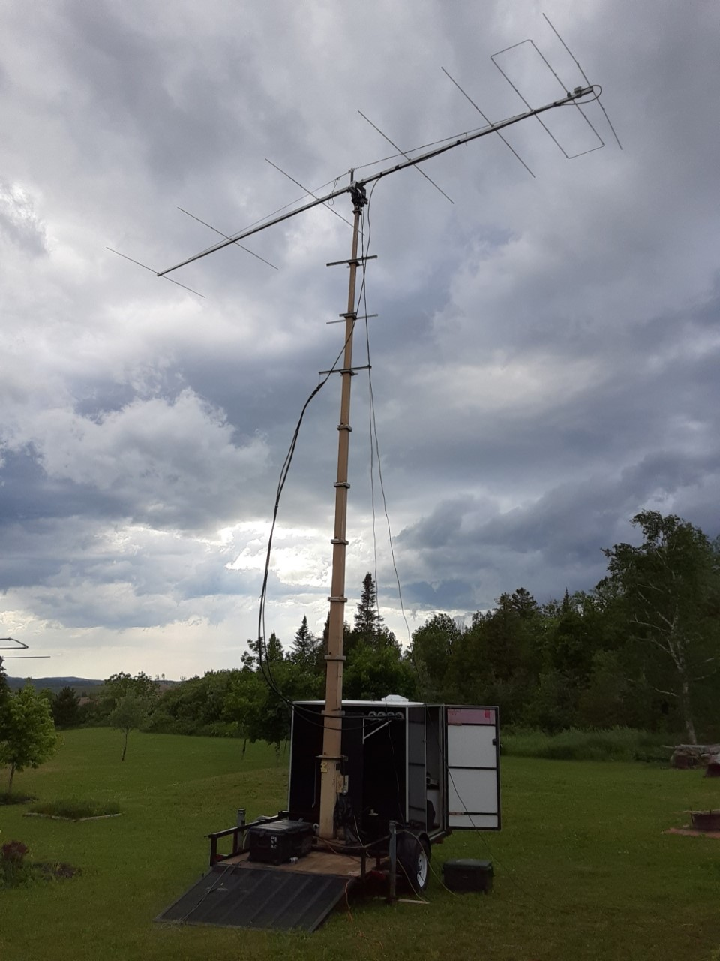
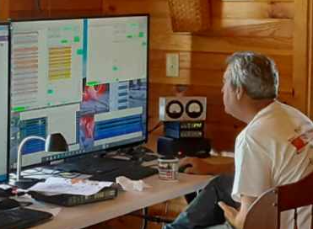
A Flex at N4EME

Slide 3
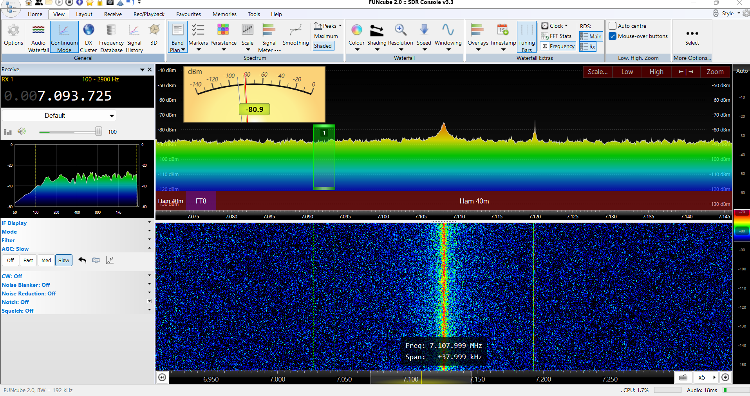
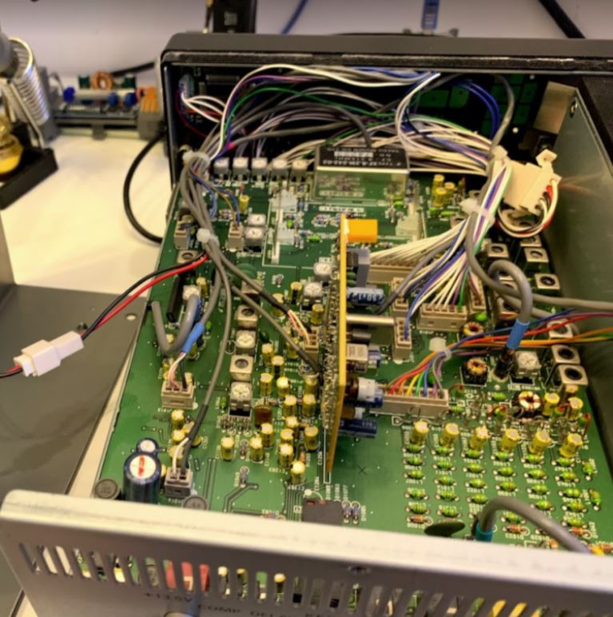
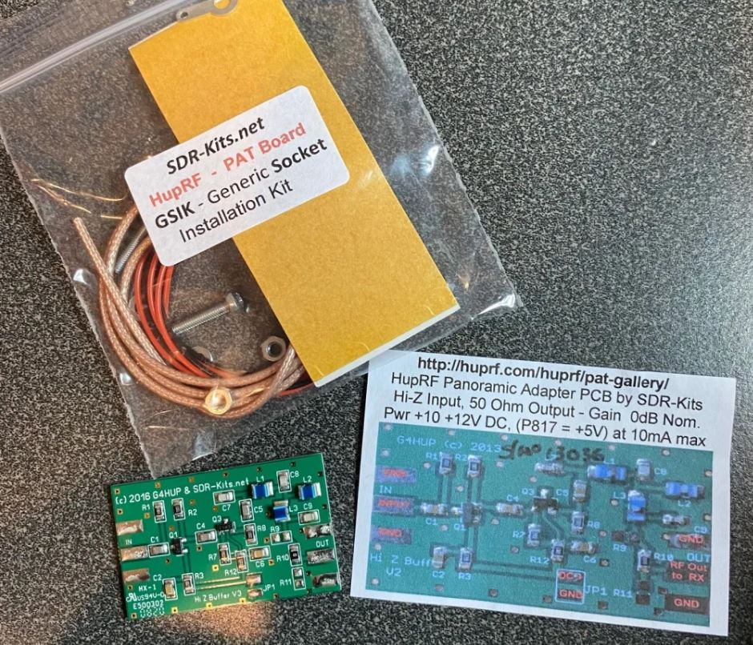
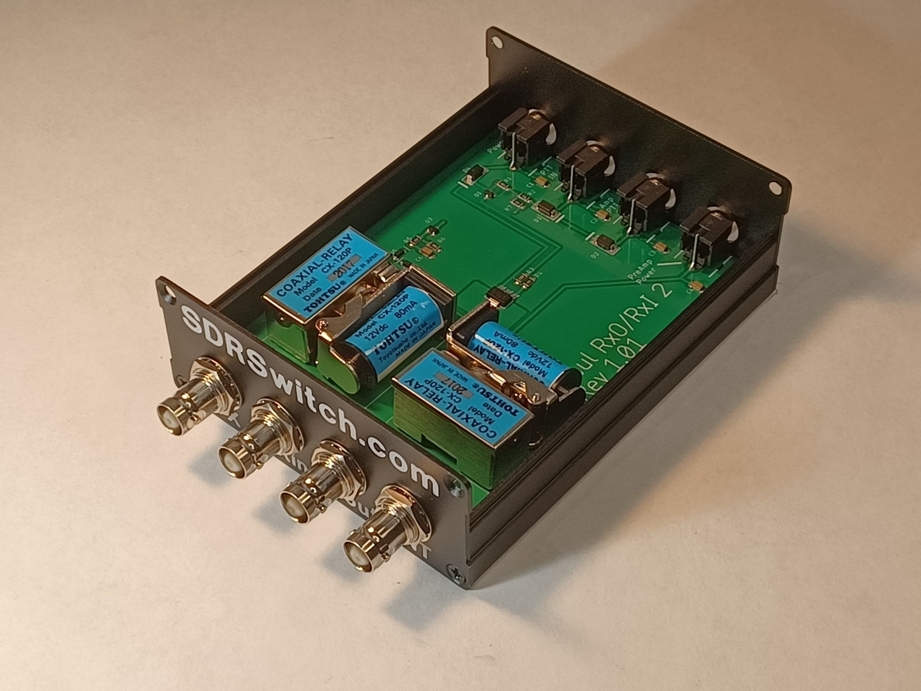
Panadapter, IF Tap or a Receiver. What’s the difference.

Slide 4
CW, SSB, MSK, Q65, FT8 USA, FT4, FT8 EU

Slide 5
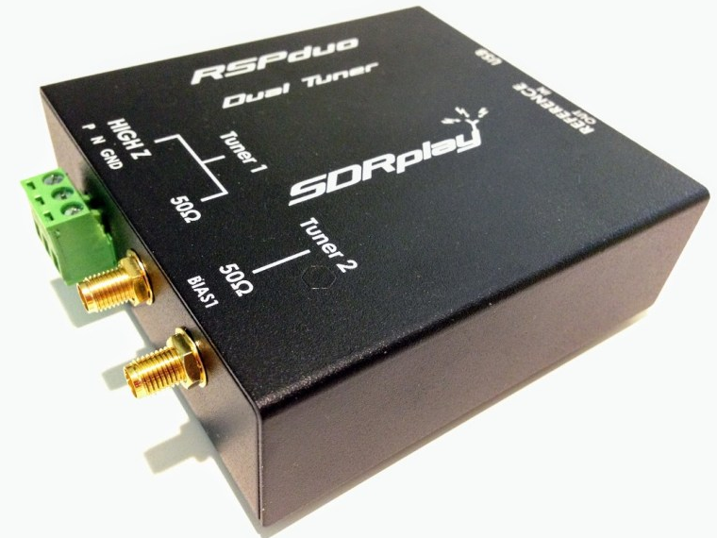
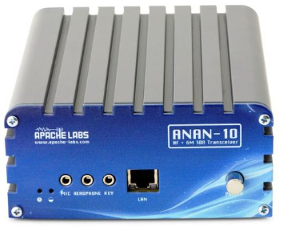
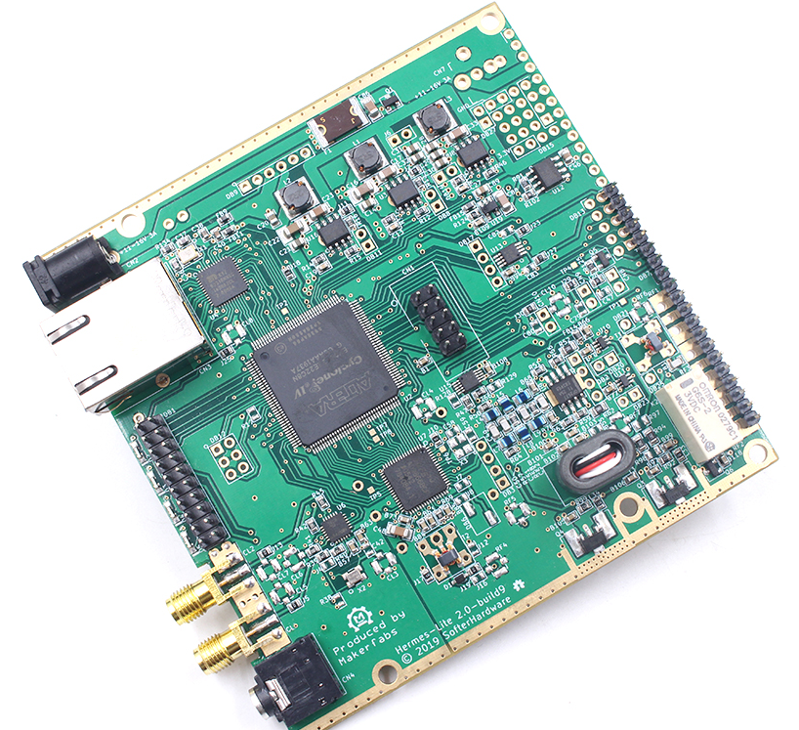
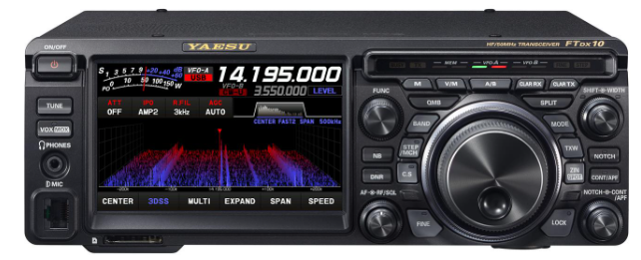
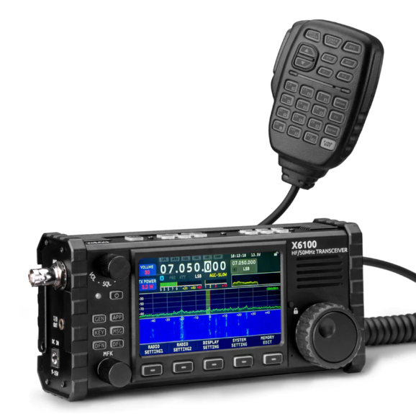
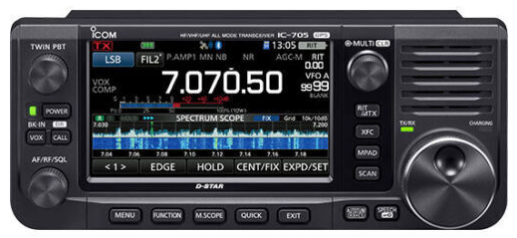
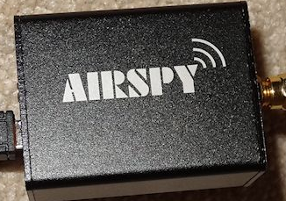
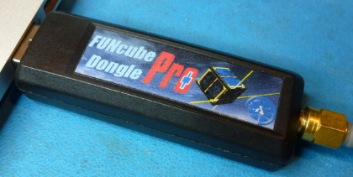
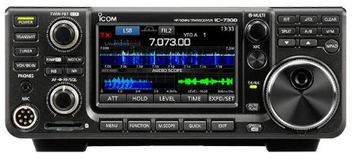
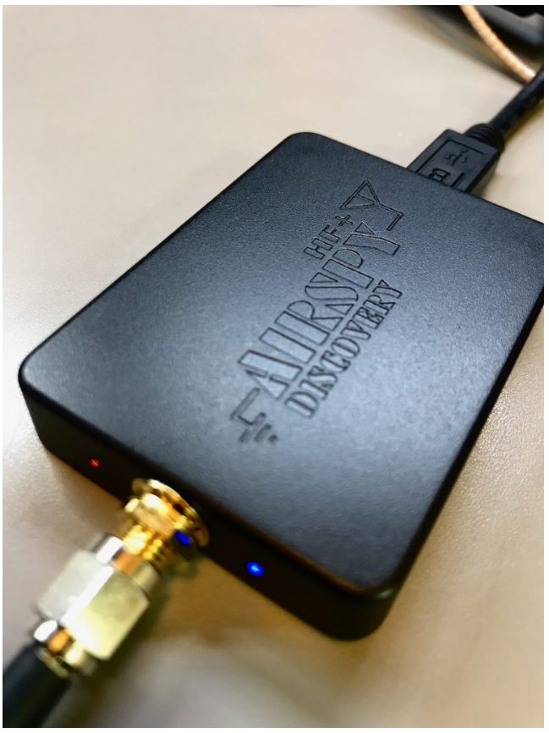
Software Defined Radio 3 different types.
RX Only TX-RX Radios Stand alone SDR Radios

Slide 6
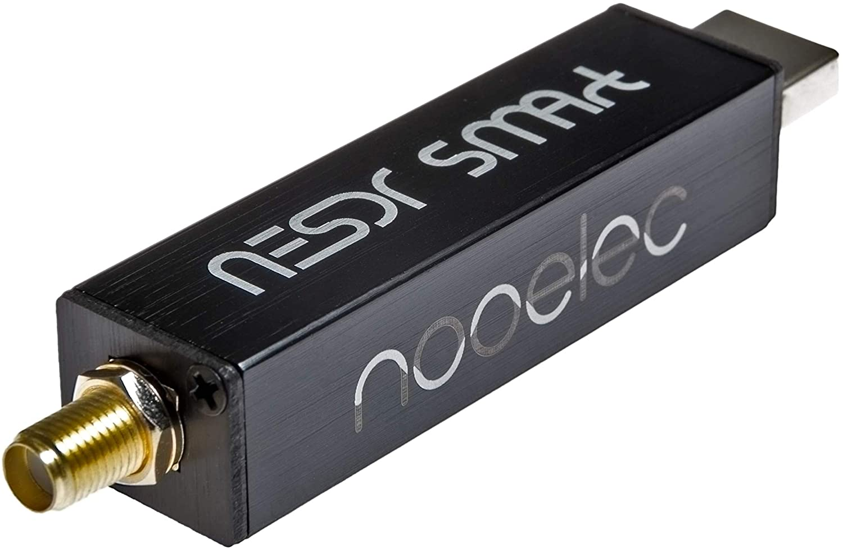
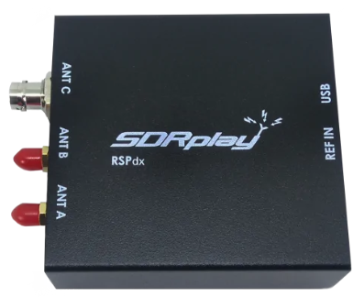
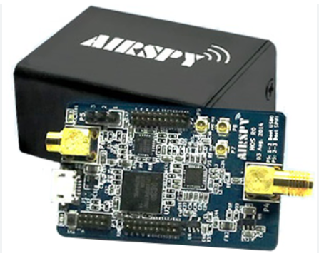
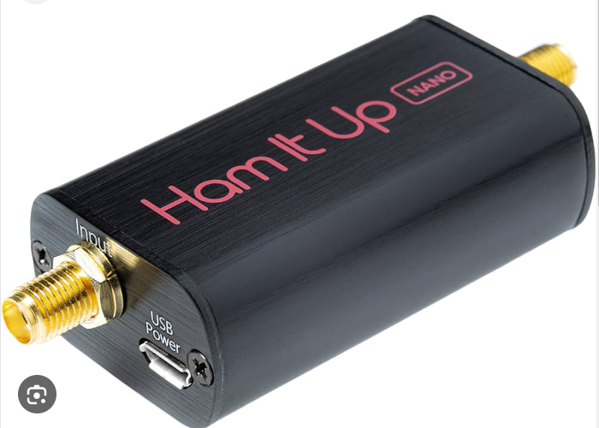
Which RX only SDR to choose?
HF
VHF
UHF
uW
????
Which SDR depends on which
frequencies you want to work.
SDRs can RX 50Hz thru 3GHz
But just as with your current transceiver one SDR will not work effectively for all of them.

Slide 7
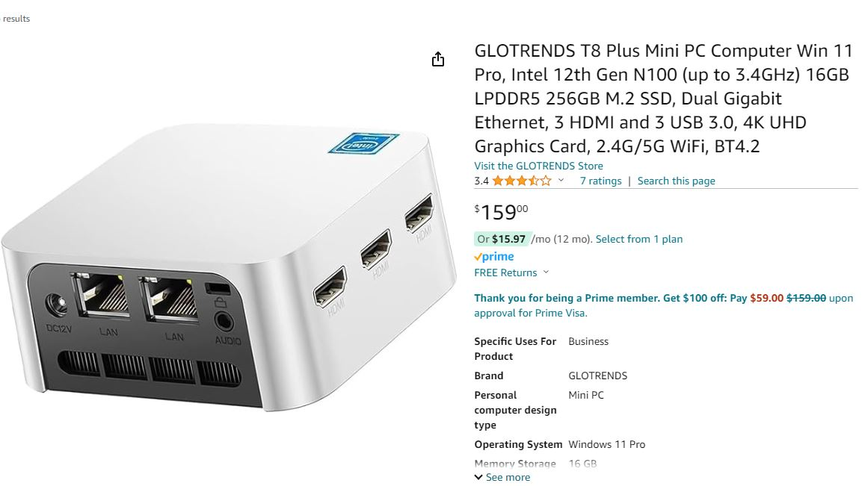
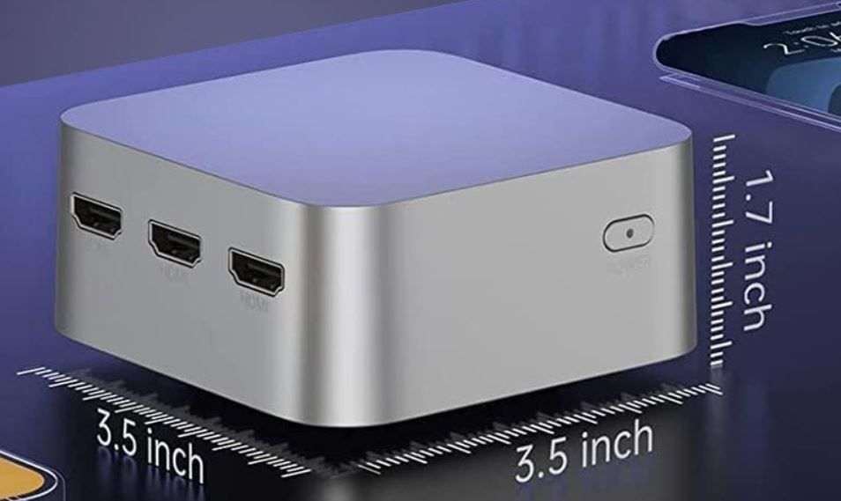
A simple computer

Slide 8
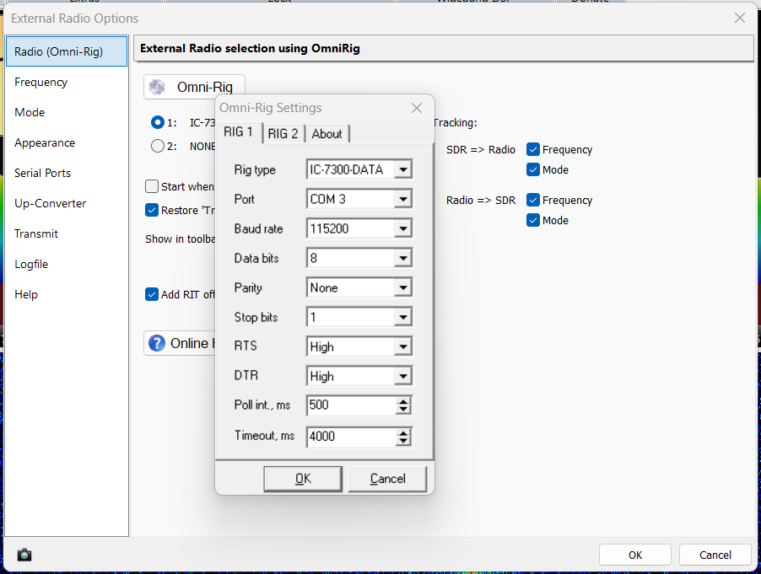
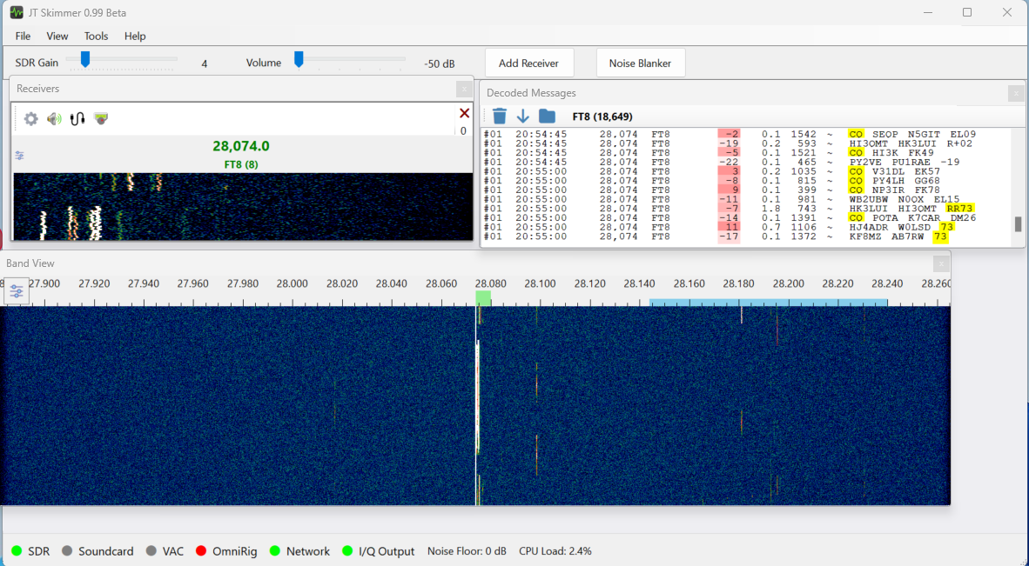
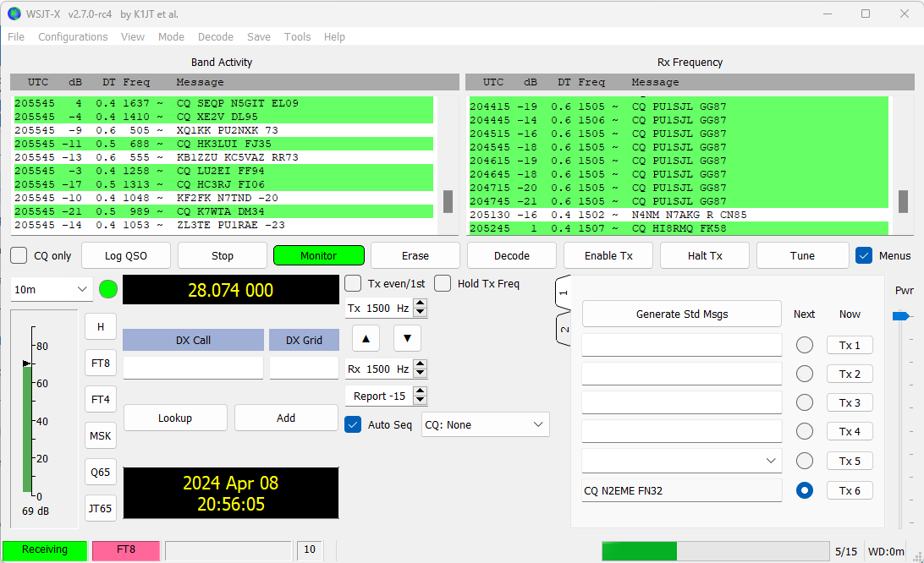
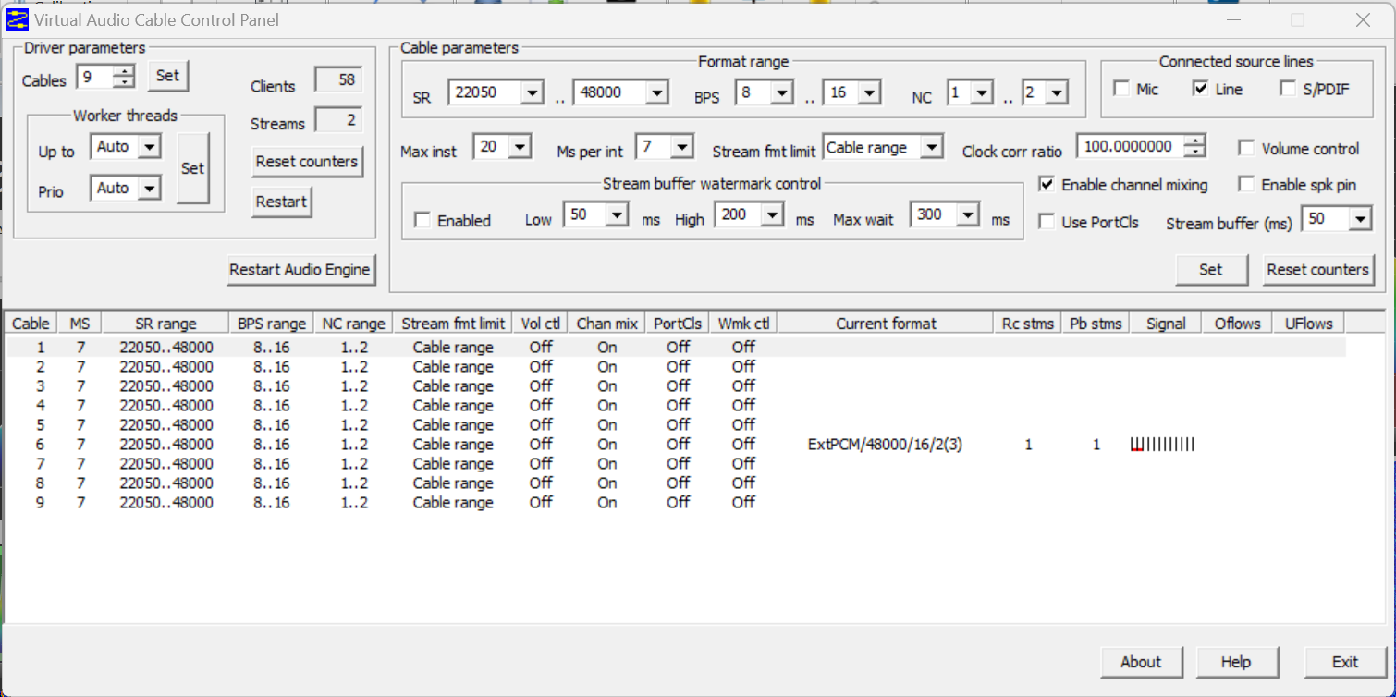
Software
Do not worry.
All the information on the software is available at SDRSwitch.com

Slide 9
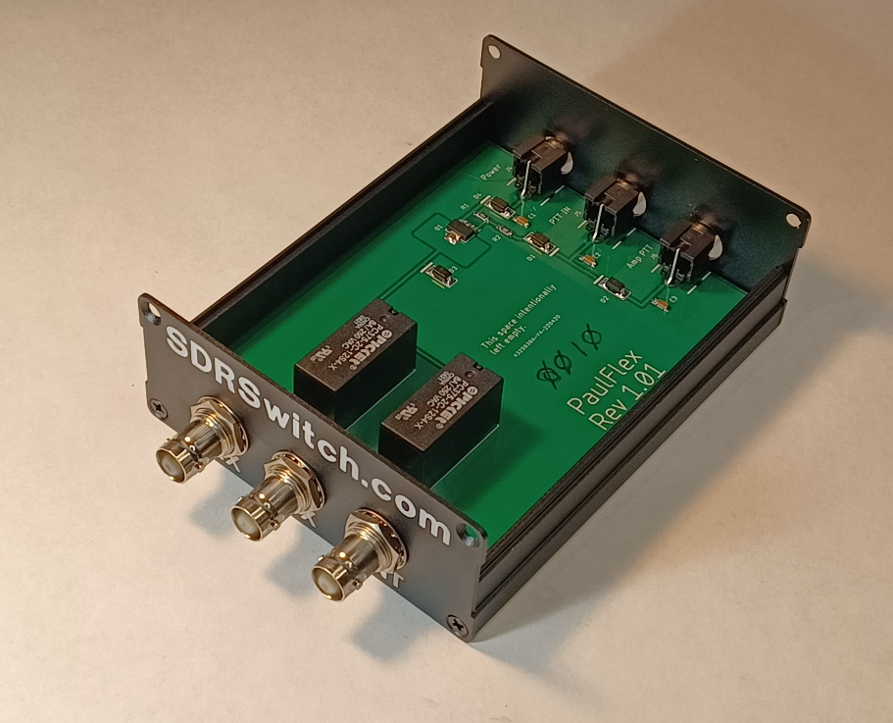
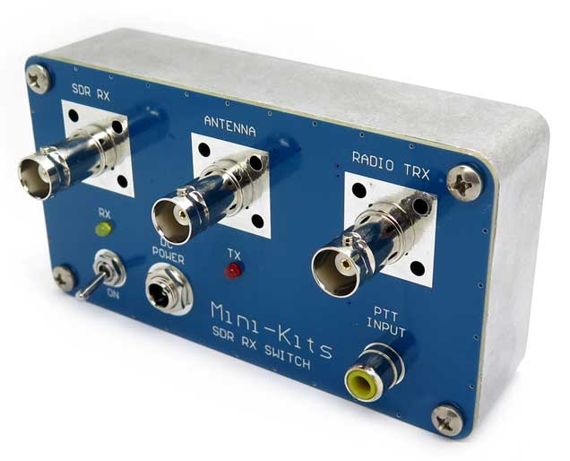
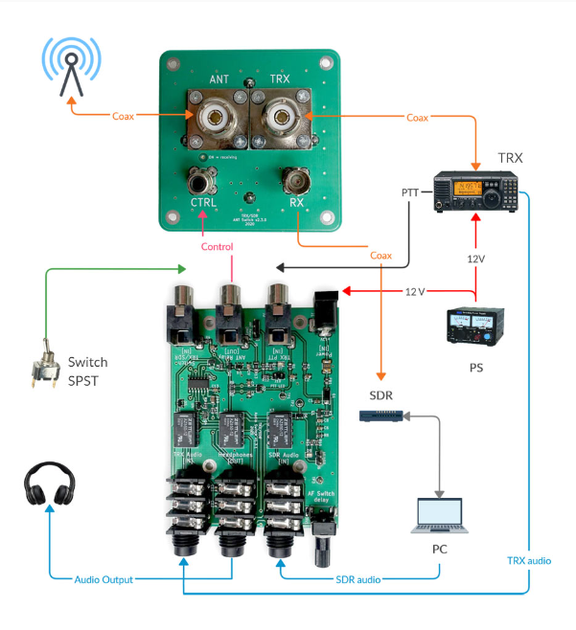
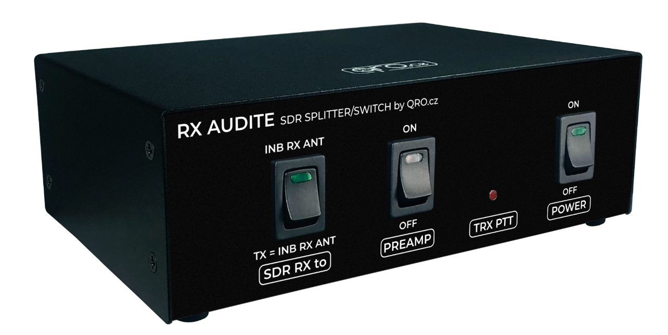
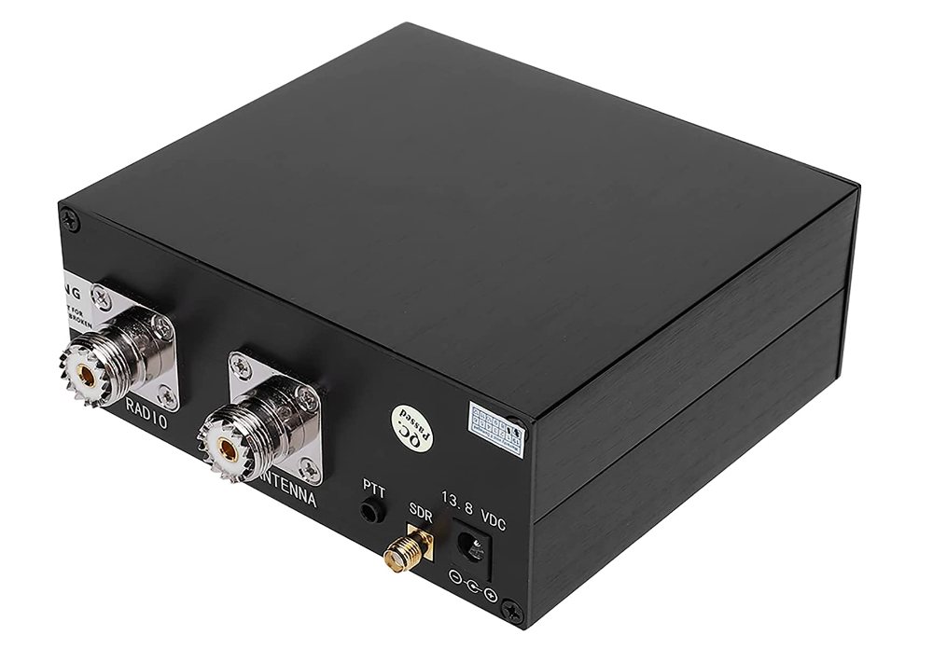
An SDRSwitch. Please pay attention to the Insertion loss.

Slide 10
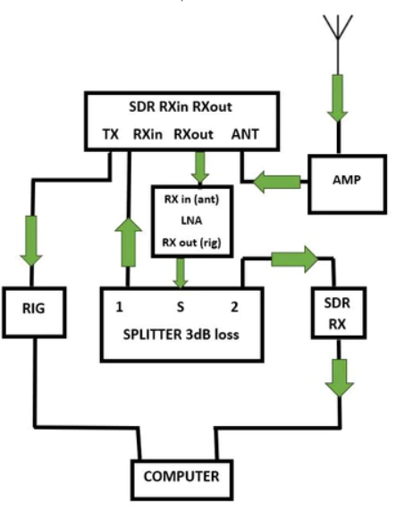
IC-9700 + Block Dig

Slide 11
SDR Console
Do not worry.
All the information on the software is available at SDRSwitch.com

Slide 12
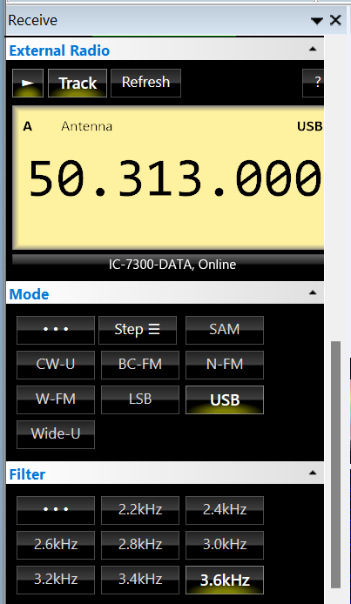
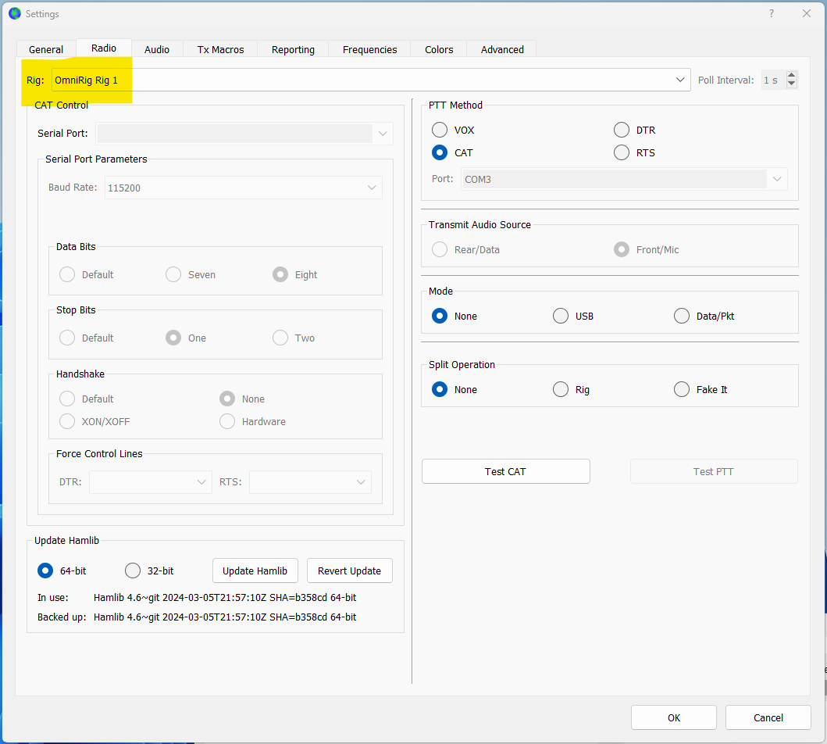
Omnirig

Slide 13
VAC

Slide 14
WSJT-x

Slide 15
All talking to each other….

Slide 16
Add more RXs

Slide 17
2M all at once. CW, SSB, Digi and beacons.

Slide 18
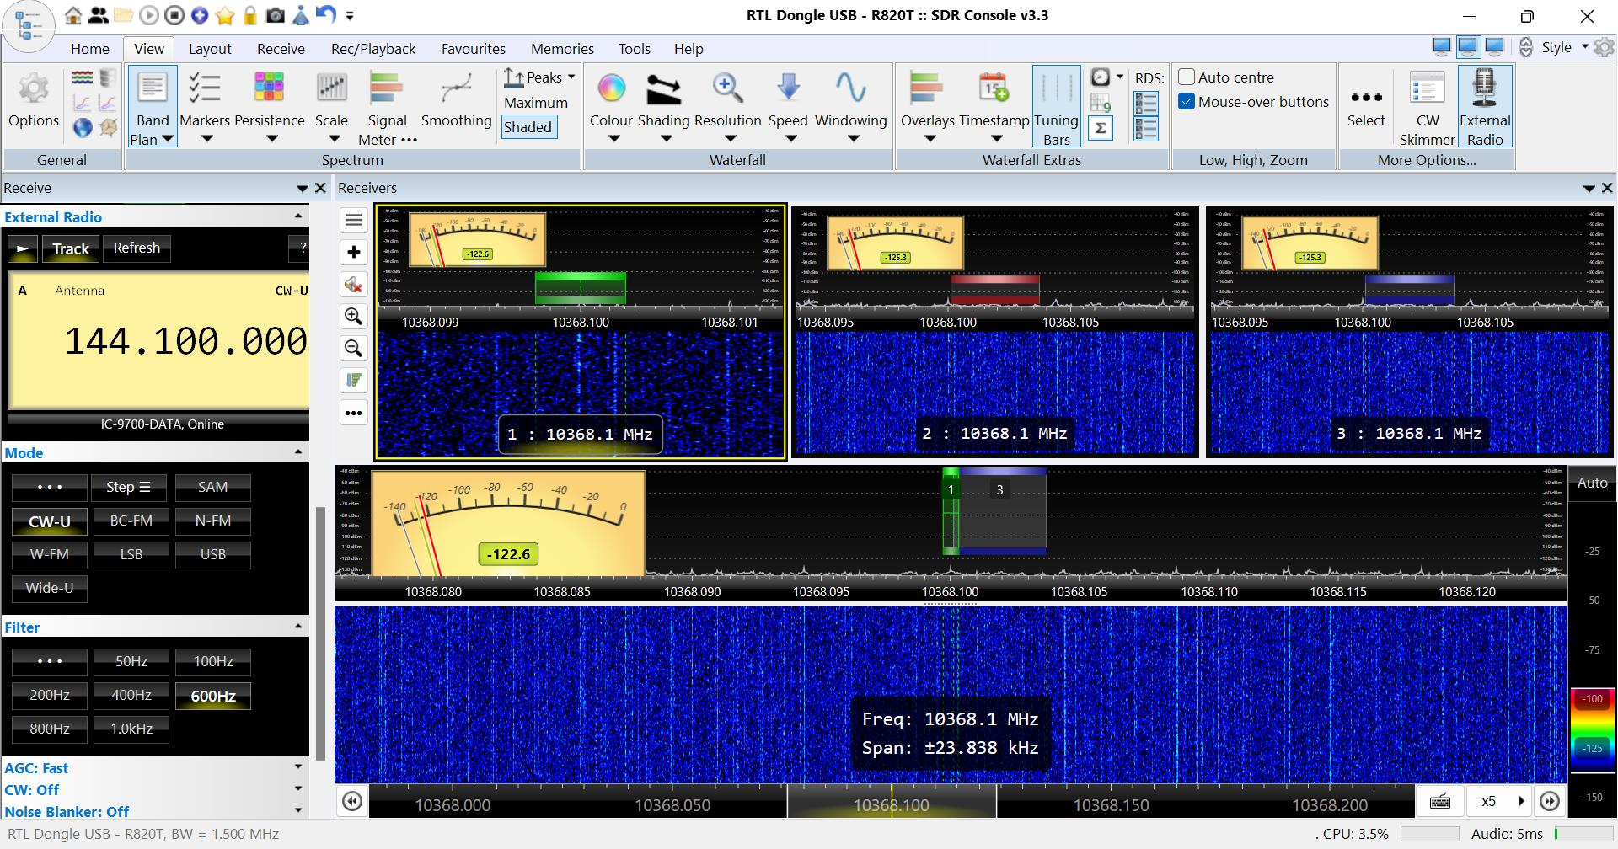
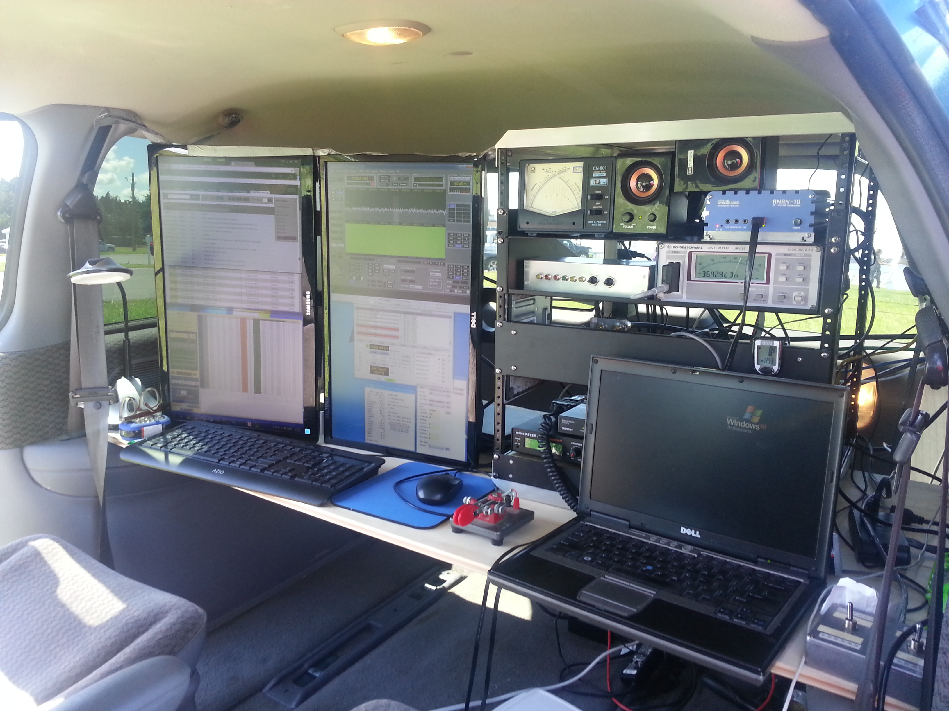
10 GHz

Slide 19
SDRs for EME.

Slide 20
2M EME SDRC with WSJT-x

Slide 21
JTSkimmer

Slide 22
An idea for the HF guys….

Slide 23
An SDR is a Receiver
It works in tandem with your current transceiver setup.
It is not just a Panadapter for pretty pictures.
The software will offer more RX options than your rig alone.
It is multimode. CW, SSB, AM, FM, Digi……
It is broadband so it will need help just like your rig does.
It integrates smoothly with popular software such as WSJT-x.
You will see signals long before you can hear them.

