Slide 1
A USB Journey It’s History Evolution Insights & my Applications
VE3CZO

Slide 2
When was USB1 introduced?
How many versions of USB 3 are there?
How much power can each version of USB deliver?
What is USB OTG all about?
How do I tell which version of USB I’ve got?
Are all versions of USB still supported
What does USB4 offer?
What’s in a USB-C cable and what do all those wires do?
What is USB BC?
What is USB PD all about?
What’s the difference between versions of USB 3?
Is USB type-C just a connector spec?
What does USB PD do for USB4?
How many different connectors support USB 3?
Can the tiny USB-C connector really deliver 240 watts of power?
Notes:
I began this presentation journey by wanting to create a breakout printed circuit board for USB-C adding it to my collection of USB breakout boards.
I soon discovered that USB-C was not a protocol spec, its just a specification for a connector that can accommodate a series of communication and power delivery protocols.
If I wanted to create a USB-C breakout board I quickly came to realize its complexity. With it’s 24 pins and multiple high speed data channels I’d probably need a fine pitch 6 layer PCB and that wasn’t going to happen any time soon.
So I backed off the original idea and set out to determine what if anything I could build for USB-C with a 2 layer low cost board.
I began rummaging though specs and quickly came to grips with the realization that the USB family had evolved quite a bit past my understanding. I felt that this might also be true for a lot of folks and that lead to this presentation.

Slide 3
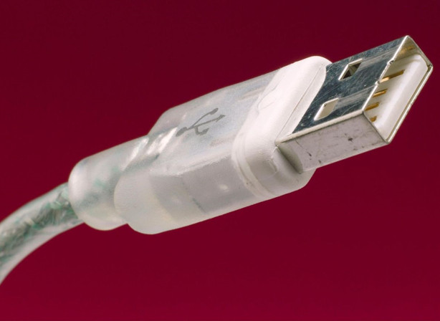
USB is over 30 years old!
USB was launched in 1993 by Intel to simplify computer peripheral attachments
In 1992 Intel’s Ajay Bhatt formed a consortium with Compaq, Digital Equipment Corp. (DEC), IBM, Intel, Microsoft, NEC and Nortel to develop a plug-and-play scheme for PC peripheral connection
It took until 1996 to see wide adoption.
Key goals
Inexpensive
User-friendly
Lots of bandwidth
Able to power peripherals
Notes:
I remember the era before USB. It was often a pain to connect computer peripherals. You typically had a choice between serial and parallel ports, and the computer most often didn’t have enough of either so users often had to open their computer to add-in hardware to give them the communications port needed then arduously configure the port for use. Most often a wall wart power supply was also needed for the new device.
And then USB came along. It was conceived in 1992 by a group of 7 companies, was launched thirty one years ago in 1993 as an inexpensive, user friendly, high bandwidth solution to easily connect peripherals to a PC.

Slide 4
A Few USB Terms
Host – a PC or other computer that enumerates and communicates with a device
Embedded Host – products like set top boxes, game consoles – have some capabilities of a PC host
Device – a peripheral such as a mouse, keyboards flash drive, or a printer – execute commands from a host
Dual-Role – a component that can act as an embedded host or a device
Enumeration – the process by which a USB host learns about a USB device that has just been connected to the buss before an application is able to start running. The host queries the device to determine what type of device it is, what device driver it needs to load for the device and what power requirements the device needs.
Notes:
Throughout this presentation I’m not going to focus on any detail about how USB accomplishes it’s tasks but rather only the features it provides.
Here are a few USB terms that will pop-up.
A host is a PC or other computer that enumerates and communicates with a device.
Embedded Hosts are products like set top boxes and game consoles. They a subset of the capabilities of a PC host.
A device is a peripheral such as a mouse, keyboard, flash drive, or printer that executes commands from a host.
Dual-Role are components that can act as either an embedded host or a device.
Enumeration is the process by which a USB host learns about a USB device that has just been connected to the buss before an application is able to start running.
The host queries the device to determine what type of device it is, what device driver it needs to load for the device and what power requirements the device needs.
You may notice a pop-up widow on a computer that identifies that a USB peripheral has been connected and offers the user options for accessing it.

Slide 5
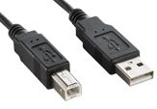
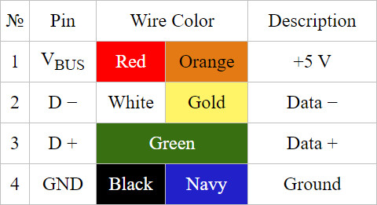
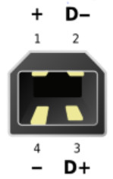
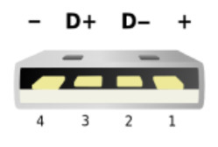
USB 1.0 & USB 1.1
USB 1.0
First design release 1995 commercial release 1996
Data transfer 1.5 Mb/s half duplex
Power delivery – 2.5Watts (5V 500mA)
Maximum cable length 5 meters
Connectors have white separator
Cables used type A connectors for PC & type B for peripherals
USB 1.1
Released in 1996 & saw widespread manuf in 1998
Data transfer rate 12 Mb/s half duplex
Same power delivery and cable lengths as USB 1.0
USB type B Plug
USB type A Plug
NB Plugs (m) are on cables, receptacles (f) are on hosts & devices
Pinouts throughout this presentation orient looking directly into plugs NOT receptacles!
Notes:
USB1.0’s design was completed in 1995 and it saw commercial release in 1996. The data transfer rate was 1.5Mb/s half duplex and it could deliver power, 0.5A at 5V from host to device. The maximum cable length was 5 meters. Connectors have a white separator and typically used type A for the host and a type B for the device.
A 4 conductor cable delivered data and power between host and device. The wire colors in most cables became standard.
USB1.1 was released in 1996 but didn’t see widespread use until 1998. It retains the white separator, delivers 12Mb/s half duplex data and has the same power delivery and cable lengths as version 1.0
Microsoft Windows 98 was the first operating system to support USB
Just so connector pinouts don’t get reversed note that because the connectors are almost asexual, plugs are defined as being on cables, while receptacles are located on hosts & devices

Slide 6
USB 2.0
USB version 2.0
Introduced 1998
Data transfer 480 Mb/s half duplex Unicode named Hi-Speed
Maximum cable length 5 meters
Connectors have black separators
Power delivery – 5V 100 mA on connection 500mA when requested on enumeration
USB 2.0 additionally introduced
Different cable connectors
USB OTG (On the Go)
Battery charging specifications V1.1 & 1.2
Link Power Addendum adding a sleep state for power conservation
Notes:
USB 2.0 was introduced in 1998, had a data transfer speed of 480Mb/s so was known as USB HI-SPEED
The maximum cable length remained at 5m so was the same as USB1.
USB2 connectors have a black separator rather than the white used with USB1.
DC power delivered to a peripheral was reduced to 100mA @ 5V until enumeration was completed then increased to 500mA.
USB 2 also introduce several other things.
More cable connectors
USB OTG or On The Go
And Battery Charging specs
Let’s look into those…

Slide 7
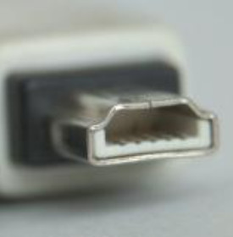
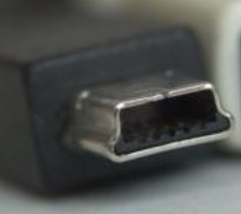
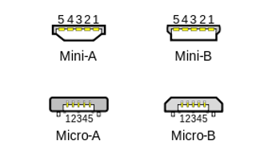
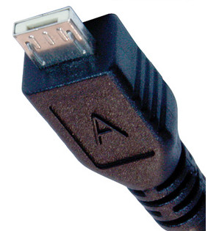
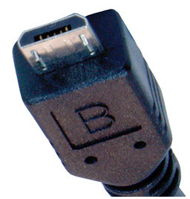
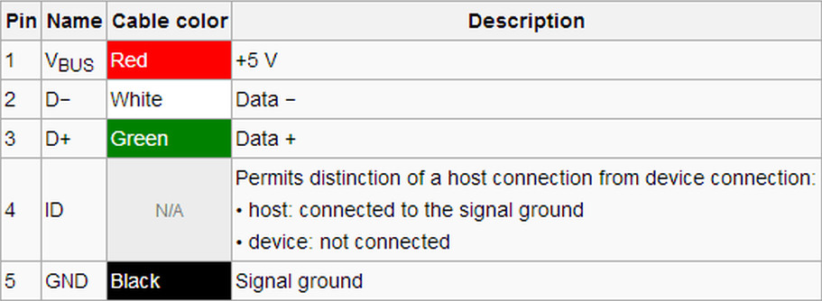
USB 2.0
Connectors
USB 2 reuses USB 1 type A and B connectors
And…adds four new connectors
Mini-A
Mini-B
Micro-A
Micro-B
USB mini-A and micro-A are no longer in general use and may not be compatible with USB-OTG
Notes:
USB2 reuses USB1’s type A and B connectors and additionally introduces the mini and micro connectors.
While mini-B and micro-B are still in wide use mini and micro A are not longer used
USB mini and micro cables add an ID pin and cable conductor for use with USB On the Go

Slide 8
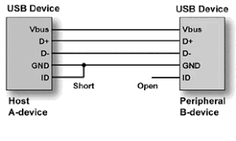
USB On The Go
Referred to as USB OTG or just OTG
Enables non PC host communication with peripherals (slave)
Printer hosts camera
Cell phone hosts memory stick, camera or a
second cell phone
USB On-The-Go and Embedded Host Supplement
Revision 2.0 added to USB 2.0 in 2001
Revision 1.1 added to USB 3.0 in 2012
Requires cable mode detect (ID, pin 4, on mini & uUSB), plus additional USB interface hardware & firmware in the host and peripheral
Cable ID pin is shorted to ground at one end (defines host) and open at the other (defines peripheral)
Enumeration with ID pin defines roles
Firmware in the standard supports host-peripheral role reversal
Micro USB cable example
Notes:
USB On The Go enables non PC host communication with peripherals.
For example a printer can host a camera to print pictures, a cell phone may host a memory stick, camera, or even a second cell phone.
USB OTG was added to the USB2 spec in 2001, and was included in the USB3 spec in 2012.
On The Go uses the ID wire, shorted to ground to define the host and the other end will be open to define the device. Roles are determined during enumeration.
Host / Device role reversal capability is also incorporated into the spec.

Slide 9
USB BC the battery charging spec
Designs began to appear for battery charging using USB but a lack of a specification lead to major interoperability issues as the popularity of battery charging increased.
The USB-IF (Implementers Forum) Introduced BC 1.1 as an Engineering Change Notice (ECN) to USB 2.0 delivering 4.5W (5V @0.9A)
BC 1.2 followed in 2010 increasing USB power delivery to 7.5W (5V@1.5A)
Standard Downstream port (SDP) remains USB 2.0 compliant, 2.5W (5V@500mA) after enumeration
Charging Downstream Port (CDP) introduced allowing for currents up to 1.5A without enumeration
Power flow is unidirectional host to device
Focused on battery charging so solutions did not always include data transport
Not all equipment manufacturers correctly labeled SDP’s & CDP’s so users didn’t know why devices weren’t charging quickly
Didn’t get wide adoption as it was pretty much superseded by USB PD (Power Delivery) spec developed about the same time as USB 3.1
Vendors began delivering 2A solutions now common on battery banks and wall warts
Notes:
Designs began to appear for battery charging using USB but a lack of specifications lead to major interoperability issues as the popularity of charging increased.
The USB Implementers Forum introduced a battery charging spec version 1.1 providing for 5V @ .9A or 4.5 watts then shortly after introduced a version 1.2 spec enabling 5V @1.5A or 7.5W.
This resulted in 2 classes of hosts. A Standard Downstream Port retained the USB2’s 0.5A or 2.5W spec. A Charging Downstream Port could deliver 1.5A or 7.5 Watts without enumeration.
Power flow was unidirectional from host to device.
As the spec was focused on battery charging it did not always include data transport.
It’s downfall was that not all manufacturers correctly labeled Standard and Charging devices so users didn’t understand why their components weren’t charging quickly.
The Battery Charging option didn’t get wide adoption as it was superseded by the USB3 Power Delivery spec.
Many vendors settled on solutions delivering up to 2A to the device now commonly seen on may battery banks and wall wart supplies.

Slide 10
USB 3
In 2019 USB-IF (Implementers Forum) redefined revisions to USB 3 Gen Y x Z where Y is the speed and Z is the number of lanes.
USB 3.2 Gen 1x1 (also called USB 3.0)
Released Nov. 2008
SuperSpeed 5Gb/s single lane full duplex (4 wires)
8b/10b encoding to maintains 0/1 balance so raw data throughput is 4 Gb/s in each direction
Maximum cable length 2m with power delivery 4.5 Watts (5V 900mA)
USB 3.2 Gen 2x1 (also called USB 3.1 or USB 3.1 Gen2)
Released July 2013 increases SuperSpeed to 10 Gb/s
A single 10Gb/lane full duplex using 128b/132b encoding - raises raw data throughput to 9.7 Gb/s
Supports USB power delivery profiles up to 15 Watts
Maximum passive cable length 1m
Able to advertise each side’s capabilities during link training & settle on a combination both sides support
Notes:
USB3’s evolution got confusing, so to minimize it the implementers forum introduced the Gen Y by Z nomenclature in what I believe was a futile attempt to de-confuse things.
USB 3.0 later called USB3.2 Gen 1x1 was released in 2008 with a single full duplex data lane with a raw data speed of 5Gb/s. 8b/10b encoding maps 8-bit words into 10-bit symbols to achieve DC balance for a net throughput of about 4Gb/s in each direction.
USB 3.2 Gen 2x1 released in 2013 introduced a faster 10Gb/s full duplex lane using 128b/132b encoding realizing a raw data throughput of 9.7 Gb/s in each direction.
This version also supported the initial USB Power Delivery spec which was capable of delivering up to 15 Watts to devices.
The maximum cable length reduced to 1m
As there are now multiple speeds, for backward compatibility protocol and enumeration enhancements were added. These included the ability for a host and device to advertise capabilities so that the pair can settle on a combination that both sides can support.

Slide 11
USB 3 (cont’d)
Notes on USB 3 revisions
USB 3 is backward compatible with USB 2 but the protocol requires that if a USB-3 connection is established USB 2 is turned off.
All USB 3 revisions are backward compatible with previous USB 3 versions
Notes:
USB3 is backward compatible with USB 2 but the protocol requires that if a USB-3 connection is established USB 2 is turned off
All USB 3 revisions are backward compatible with previous USB 3 versions

Slide 12
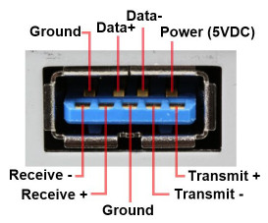
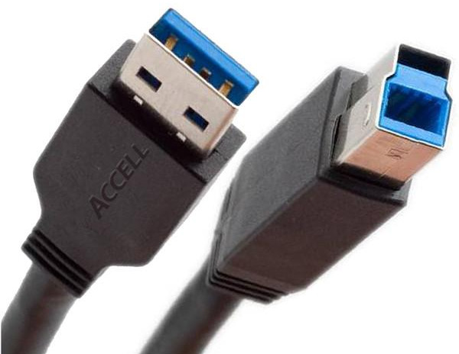
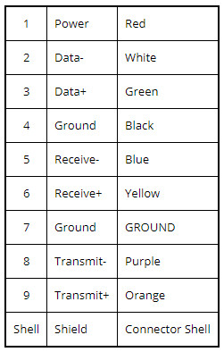
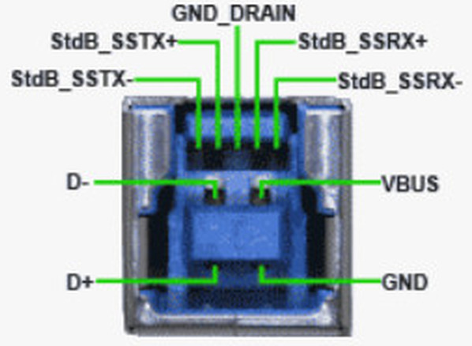
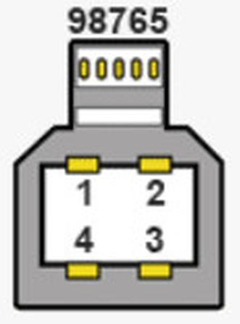
New Connectors supporting USB 3
Nine pin USB-A and USB-B
Notes:
New connectors are introduced to support USB3.
A blue separator typically identifies a cable as USB3 capable.
USB A and USB B plugs and receptacles add 5 pins for the full duplex super speed channel
The nine pin USB ‘A’ plug will mate correctly with a 4 pin USB ‘A’ receptacle but the ‘B’ plug has a higher nose to accommodate the additional 5 pins so will not mate with a USB2 ‘B’ receptacle.

Slide 13
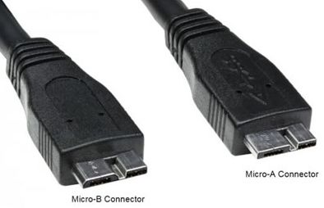
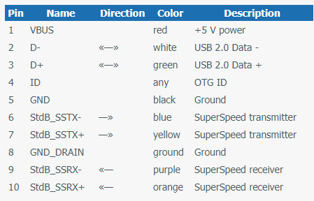
New Connectors Supporting USB 3 (cont’d)
Micro A & B
Adds 10th lead for OTG
Pinout shown looking into the plug
Notes:
Micro A and B connectors are introduced although the micro A is not very common
These connectors support a tenth lead for On The Go applications using the same connection techniques developed for USB2 On The Go.
The pinout shown is a plug viewed looking into the connector, NOT the receptacle

Slide 14
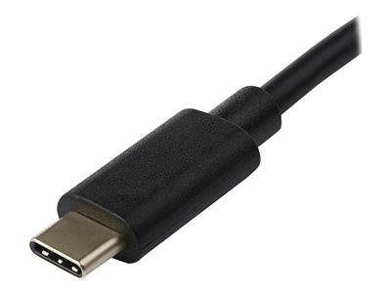
The Next Steps for USB
All subsequent releases of the USB spec incorporate three components
A USB-C connector
Power Delivery
Transport protocol changes
Speed enhancements
Additional functions
Notes:
As we follow the USB development history, all subsequent releases of the USB spec incorporate three components simultaneously.
The adoption of a single connector, the USB-C
A set of standards for power delivery.
Transport protocol changes typically enhancing speed and enriching capability to perform additional functions
The USB-C plug and receptacle has remained unchanged since its introduction but the transport and power delivery specs are continuously evolving.
Well examine each aspect individually. Let’s begin by continuing with the protocol’s evolution.

Slide 15
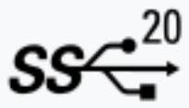
USB 3
USB 3.2 Gen 2x2 (also called USB 3.2)
Released Sept. 2017
Used only with USB-C connector and approved cabling
Supports two full duplex lanes (8 wires) providing 10Gb/s each, 20GB/s total
Maximum passive cable length 1m
Active cables enabled by the new spec can increase cable length
Notes:
USB3.2 Gen2x2 released in 2017 is the first point at which a USB-C connector becomes mandatory because the standard now supports two full duplex data lanes. The two data lanes can be bonded to provide a total 20Gb/s data transfer rate.
The maximum passive cable length is 1 meter. Active cables, enabled by the USB-C connector standard, can be used to increase that length.

Slide 16
USB4
USB4 Version 1.0
Spec released August 2019. Products started shipping about 18 months after release date.
Uses USB type-C connectors exclusively – cable length .8-1m passive 4m active
Backward compatible with USB 3.2, USB3.1, USB 3.0, USB 2.0
Two lane operation with up to 40 Gb/s over certified cables transport uses PAM-3 encoding
Tunneling & dynamic BW allocation used for a variety of protocols enabling bandwidth sharing
Includes support for alternate modes Thunderbolt 3, DisplayPort 2.0, HDMI 2.0, PCIe,10GbE
USB4 Version 2.0
Spec released September 2022.
Delivers data transfer speeds of 80 Gb/s (9.6 GB/s) on cables rated for 40 Gb/s
Asymmetric transport enables unidirectional 120Gb/s (14.4 GB/s)
Notes:
USB4 was released in 2019 and product started appearing in 2021. Logos on packaging and cables no longer show version numbers just speed, a marketing change promoted by the USB Implementers Forum.
USB4 uses USB-C connectors exclusively Maximum cable length for full data rate is reduced slightly to 0.8 meters but more recent information indicates that 1 meter is possible and active cables can be as long as 4 m.
USB4 provides backward compatibility with USB 3.2, 3.1, 3.0 and 2
Feature two lane data transport using PAM3 encoding to enable transport speeds up to 40Gb/s when both lanes are bonded.
Tunneling and dynamic bandwidth allocation is introduced. Tunneling simply bundles up a protocol in a faster data stream for transport and is unpacked at the receiving end. This means that several protocols could be transported in the USB4 data stream and allocated a specific portion of the available bandwidth. Tunneling is now used for variety of protocols including USB3.2, DisplayPort, and PCIe. For example if a computer uses a USB4 dock to connect a display monitor and external drive, USB4 can allocate a portion of its 40Gb/s stream, say 10Gb/s to the display and 30Gb/s to the drive.
USB4 also supports the use of alternate modes, data streams that would not normally be handled by USB. For example Thunderbolt3, DisplayPort2 which is capable of 8k resolution at 60 frames per second, HDMI, PCIexpress, and 10 Gb Ethernet are all supported.
USB4 Version 2 increases the data delivery speed to 80Gb/s over the same cable lengths.
It also introduces asymmetric data streams, so for example if streaming video, all lanes can be unidirectional to deliver up to 120Gb/s.

Slide 17
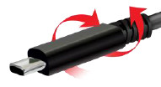
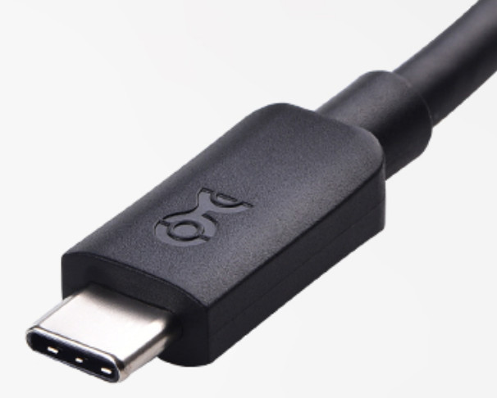
USB-C connector
USB Type – C
Developed by the USB Implementer’s Forum (USB-IF) introduced 2014
Evolved to provide a single form factor replacing many USB connectors
The receptacle is symmetrical so the plug can be inserted either way
Removes the need for different connectors on host & devices
Supports all USB data standards from 2.0 to 4.
Supports USB PD (power delivery) up to 240W
Supports powered cables as part of USB PD standard
Supports a variety of alternate modes.
The standard receptacle has 24 pins but cables have fewer conductors depending on application
Notes:
The USB-C connector was developed by the USB Implementers Forum and introduced in 2014 as an evolution to provide a single form factor replacing many USB connectors.
The receptacle pins are symmetrical so the plug can be flipped around and inserted in either orientation.
Its flexibility can remove the need for different connectors on host and devices
The connector supports all USB data standards, along with USB power delivery, powered cables, and a variety of alternate modes.
The standard receptacle has 24 pins although cables have fewer conductors depending on application.
So let’s take a closer look at this connector.

Slide 18
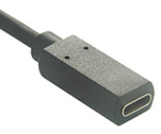
USB Type-C … a closer look
USB-C 24 pin receptacle found on all hosts, peripherals & M-F cables.
Carry supply voltages and currents 4 pins
Uni-directional differential signal lane1 delivering 5, 10 or 20 Gb/s each way
Uni-directional differential signal lane2 delivering 5, 10 or 20 Gb/s each way
Differential signalling for Legacy USB2 delivering 480 Mb/s
Ground
4 pins
SBU supports alternate modes that use the USB-C interface for non-USB functions
Configuration Channel supports USB PD, cable orientation discovery, & exit-entry signaling for alternate modes
USB-C Receptacle
USB-C Plug
Notes:
USB 2 had 4 pins, USB3 nine 9, the USB-C connector sports 24. It certainly delivers more capability at the expense of cost and complexity.
The 24 pin female receptacles are used on both hosts, devices, and in line cables. The USB-C male to male cable is a bit different.
The first thing to note is that the receptacle’s pins are symmetrical so plugs can be inserted in either orientation.
Let’s go around the connector and explore its pin functions starting on the upper left.
TX1+ TX1-, Rx1+ RX1- create a set of uni-directional differential signal lanes delivering 5, 10 or 20 Gb/s each way.
D+ & D- are differential signaling pins delivering legacy USB 2 at 480 Mb/s
Four VBUS pins carry supply voltages and currents delivering up to 240W. Basic cables are required to deliver 3A, that’s 15 watts at 5 volts or 60 Watts at the highest voltage specified by the Power Delivery spec. Special cables with larger supply conductors are required if delivering more power.
Rx2- RX2+ TX2- and TX2+ form a second set of uni-directional differential signal lanes again capable of delivering 5, 10, or 20 Gb/s each way, and can be bonded with lane 1 to double throughput.
The configuration channel is one of the keys to USB-C’s flexibility. It helps to determine cable orientation, defines overall data delivery rates, provides entry and exit signaling for alternate modes and supports USB Power Delivery.
The ‘Sideband Use’ pins SBU1 & SBU2 provide signaling that supports alternate modes. They use the USB-C interface to deliver non-USB protocols like DisplayPort, Thunderbolt, HDMI, PCI-e, 10Gb Ethernet.
And lastly there are 4 ground supply return pins.

Slide 19
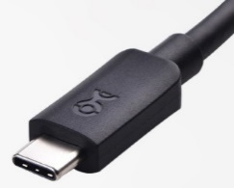
USB Type-C … a closer look
USB-C Plug & Cables
USB cables contain as many as 16 wires
The eight ground and VBUS terminals connect to 2 of the 16 wires
Only one CC pin
CC2 becomes VCONN Provides power to active cables or adaptors
No second set of leads needed for Legacy USB2 so left blank
USB-C Receptacle
Notes:
USB-C cables use plugs that are a bit different than the receptacles.
There are 16 wires if a fully featured cable, the 4 Vbus and 4 ground pins are connected to two cable wires.
There is only one CC pin, CC1 becomes CC and only one CC wire runs in the cable. The other CC pin becomes VCONN. It’s used to indicate a need for and can supply power to active cables or adapters.
Only two wires are needed for legacy USB2 so connections B6 and B7 are not used.

Slide 20
USB-C Configuration Channel (CC)
CC1, CC2 (receptacle) – CC, V_{CONN} (plug) pins are key to managing connections
One CC pin and cable wire so the cable can be used to…
Detect the attachment of a USB port
Resolve the cable orientation and manage connection establishing data bus routing establishing lane 0 for the two data lanes specified for USB 3.2 and 4
Lane 0 determined as one closest to CC pin on the plug
Discover and configure V_{CONN} - a plug is able to supply power (up to 1.5 Watts) for active cables to the “unused” CC1 or CC2 receptacle pin
Establish data roles between two attached ports
Establish source and sink roles between two attached ports
Discover and configure optional alternate modes i.e. DisplayPort, Thunderbolt, HDMI etc.
Discover and enter USB4 operation using USB PD protocol
Discover, manage, and configure VBUS for power delivery
No leading power pins on USB-C so by default VBUS power is off until authorized by CC
Notes:
The configuration channel is a key part of USB-C. In this presentation I’ll not go into how tasks are accomplished but just highlight the number of functions performed.
As noted in the previous slide the cable has only one CC pin and CC2 becomes VCONN so the cable can be used to…
Detect cable insertion
Resolve the cable orientation, establishing data bus routing. Lane 0 of the two lanes will be the one closest to the CC pin on the plug.
Discover and configure V_{CONN} - active cables can be supplied with up to 1.5 Watts. Power is routed though the receptacle’s “unused” CC1 or CC2 pin to cable’s V_{CONN} PIN.
The configuration channel also establishes data roles between ports
It also establishes source and sink roles between two attached ports
It discovers and configures optional alternate modes
It discovers and enters USB4 operation
It will also discover, manage, and configure VBUS for power delivery
The USB-C plug has no leading power pins as was used with previous USB connectors to insure power is applied first. So by default VBUS power is off until authorized by CC
Let’s now take a look at USB-C Power Delivery

Slide 21
USB-C Power Delivery & CC Pins
More about Power Delivery & Channel Configuration pins… but first a few definitions
DFP – Downstream facing port – sends data – sources power –mostly hosts
UFP – Upward Facing Port – receives data –sinks power – mostly devices
DRD – Dual Role Data – port can act as either DFP or UFP
Role is determined by the port’s power role at attach, if sourcing it becomes a DFP if sinking it becomes a UFP, Roles can be dynamically changed using USB PD’s data swap function
Examples – laptops – tablets – cell phones
DRP – Dual Role Power- operates as either a source or sink - role is determined by power flow
Sink ports when attached draw power from VBUS and are most often a device
Source ports when attached provide power over the VBUS
When a DRP initially operates as a source it also takes the data role of a DFP
When a DRP initially operates as a sink it also takes the data role of a UFP
PPS – Programmable power supply
Notes:
Before diving into power delivery here’s are a few acronyms that we’ll encounter.
DFP is the Downstream facing port. It sends data, sources power, and is associated mostly with hosts
UFP is an Upward Facing Port. It receives data, sinks power, and is mostly associated with devices
DRD – Dual Role Data defines a port that can act as either Downstream Facing Port or Upward Facing Port
A role is determined by the port’s power role at attach, if sinking it becomes a Upward Facing Port, if sourcing it becomes a Downward Facing Port.
Roles can be dynamically changed using power delivery’s power swap function
Dual Role Power means the port operates as either a source or sink. Its role is determined by power flow
Sink ports draw power from VBUS and are most often a device.
Source ports provide power over the VBUS.
When a Dual Role Power device initially operates as a source it also takes the data role of a Downward Facing Port
When a Dual Role Power device initially operates as a sink it also takes the data role of an Upward Facing Port
PPS is a programmable power supply

Slide 22
USB-C PD (Power Delivery)
USB PD (Power Delivery)
Goal – provide a single standard for all USB devices
Developed along with USB3 initial for battery charging…but grew!
USB power delivery is only available with USB-C to USB-C cables using CC channel
Maximum power delivery is 240W (48V @ 5A)
Standard USB cables must support currents up to 3A, special cables are needed for higher currents.
Power delivery is negotiated - means power users must define required voltage and current
Power direction is no longer fixed roles can be swapped i.e. peripheral could supply power to host
Data bus is not involved in power negotiation so data and power flow can be simultaneous
Notes:
The original goal of USB power delivery was to provide a single standard that could be used across all USB devices.
USB power delivery was developed in parallel with USB 3. Initially it was focused on battery charging but evolved to a more comprehensive power distribution scheme in a ‘green’ effort to eliminate multiple power supplies.
USB power delivery is only available with USB-C to USB-C cables as it requires the configuration channel.
Maximum power that can be delivered is 240W that’s 48V @ 5A.
Standard USB cables must support currents up to 3A, special cables are needed for higher currents.
Power delivery is negotiated. This means power users can define their required voltage and current.
Power direction is no longer fixed, roles can be swapped i.e. a device could supply power to host.
The data bus is not involved in power negotiation so data and power flow can be simultaneous.

Slide 23
USB-C Power Delivery (cont’d)
USB PD V1.0
Introduced 2012 enables power deliver up to 100W with 6 fixed power profiles.
10W (5V,2A) 18W (12V, 1.5A) 36W (12V, 3A) 60W (12V, 5A & 20V, 3A) 100W (20V, 5A)
Enables power role swapping i.e. Computer can be powered through USB while still being coms host
USB PD V2.0
Released 2014, stipulates the use of USB-C
V2.0 rev1.2 revised in 2015 with the release of USB 3.0 adds safety features for device authentication
Rev 1.2 stipulates 5 power profiles defining normative voltages and currents
up to 15W (5V 3A) - >15W up to 27W (5 & 9V up to 3A) ->27W up to 45W (5,9&15V up to 3A) ->45W to 60W (5,9,15,20V up to 3A) & 100W provided by 20V up to 5A.
Source sends 32b CC msg advertising it’s capabilities and sink replies with request for V/I
Notes:
Let’s begin with version 1 which was Introduced in 2012
It enables power deliver up to 100W and had 6 fixed voltage and current profiles.
10W (5V,2A) 18W (12V, 1.5A) 36W (12V, 3A) 60W (12V, 5A & 20V, 3A) 100W (20V, 5A)
This version also enabled role swapping i.e. Computer can be powered through USB while still being communications host
Version 2 was released in 2014, must use the USB-C connector
Subsequently Revision 2.2 of the spec released in 2015 adds device authentication and refines power delivery stipulating 5 power profiles. Sources providing up to 15 watts use 5V. Above that power supplies add additional voltages, for power delivery up to 27 watts 9 volts was added, up to 45 watts 15 volts was included and for 60 watts 20 volts was added. A provision was also made for up to 100 watts using 20 volts with up to 5 amps.
Power delivered from a source to a sink is negotiated. The source sends a 32 bit message over the configuration channel to the sink which responds with a message indicating its desired source voltage and current.

Slide 24
USB-C Power Delivery (cont’d)
USB PD V3.0 with Programmable Power Supply (PPS)
2015 - Enhancements added to power delivery
More detailed description of the characteristics of a device’s built-in battery
Housekeeping functions included device HW & SW version ID, software updates via PD communication, and digital certificate & signatures for enhanced security
Fast role swapping
2017 – Programmable Power Supply (PPS) introduced optimizes charging conversion losses
PPS voltage ranges 3.3V-5.9V, 3.3-11V, 3.3-16V, 3.3-21V all at 3A and 3.3-21V 5A.
Enables voltage increments in 20mV steps from 5V to 21V. Sources must have constant current
Real time mods (10 sec) to power delivery voltage & current based on device’s charging status
USB PD V3.1
2021 – Adds additional extended power range (EPR) to 3.0
changing options with 28, 36 & 48V up to 5A (240W max)
EPR voltages are adjustable in 100mV steps 15-28V, 15-26V & 15-48V @5A
Sink must request EPR, source cannot force it, and maintain keep-alive messages every 500mS.
Notes:
Power Delivery 3.0 introduced in 2015 provided a more detailed description of a device’s built-in battery
Housekeeping functions included device HW & SW version ID, software update capability, and digital certificate & signatures for enhancing security
3.0 also introduced introduces fast role swapping
Power Delivery 3.0 PPS introduced in 2017 modifies the supported voltage ranges, and introduces the ability for the sourcing supply to increment it’s output voltage in 20mV steps. Also if the supplied current exceeds that requested by the sink, the supply must enter a constant current mode and can change current in 50mA steps.
Changes to the supply are made in real time about every ten seconds.
Power Delivery 3.1 introduced in 2021 adds Extended Power Range.
This provides additional changing options with higher voltages , 28, 36 and 48 volts with currents up to 5A for a maximum of 240 Watts.
Extended Power Range voltages are adjustable in 100mV steps from 15 to 48 volts
As a protection measure the sink must request the extended power range, the source cannot force it, and the sink must send a keep-alive messages to the source over the control channel every 500mS.

Slide 25
USB-C Power Delivery Variants
Many USB-C implementations don’t use all the spec’s capabilities or use them in what may seem like unexpected ways…here are a few examples
USB-C power delivery only, no data
Default power delivery up to 15W (5V @ 3A) may only use V_{BUS} and ground pins & not PD compliant
Power only up to 240W – must be USB PD spec compliant, configuration uses CC1 & CC2
USB 2.0 UFP or DFP without PD and Super Speed data – essentially USB 2 with a USB-C connector (at least on one end)
Anything that is USB powered requiring less than 15 Watts (5V @ 3A) and is ok with USB 2 data speeds - Keyboards - mice – wearables – single board computers
Notes:
Many USB-C implementations don’t use all the Power Delivery specs capabilities or use them in what may seem like unexpected ways. Here are a few examples.
A USB-C connector is used only for power delivery, no data. In this case the source may deliver up to 15 watts, 5V @ 3A without using the CC channel so only use the Vbus and ground pins. This type of application is commonly used for charging with cables that have USB-C on one end and the 4 pin USB-A on the other.
Applications exist that deliver only power, and can deliver up to 240W. These applications will be USB Power Delivery spec compliant and will use the configuration channel to negotiate between source and sink.
Applications exist for a USB-C connection at USB2 speeds with a maximum of 15 watts power, so the application does not use the Power Delivery spec nor high speed data. Items that fit this category include mice, keyboards, wearables, and single board computers.

Slide 26
USB-C Data and Power Applications
Notes:
USB is now quite flexible so can fill a variety of data and power roles.
The slide shows a variety of devices having varying data and power roles.
DRP – dual role power
DRD - dual role data
UFP – upward or upstream facing port
DFP – downward facing port

Slide 27
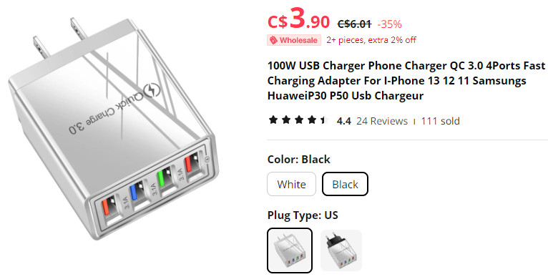
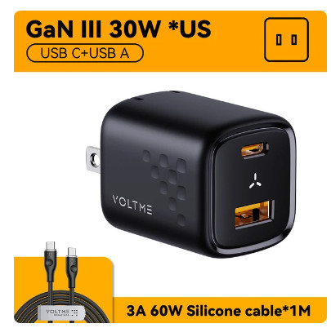
Choosing USB Components
USB Chargers
Before you buy define your specs and research
Some things to watch for
If it’s really cheap beware…100W charger with 4 USB-A ports will never deliver 100W
USB charger with multiple outlets
Total power is usually shared between ports, i.e. a 30W charger will deliver 30W shared between all outlets, not always equally
USB A outlets will deliver up to 3A
USB power delivery will NOT work with a USB-A plug, it doesn’t have CC capability
Look to products that are USB-IF certified
Notes:
Let’s take a look at two components that are often purchased, charging supplies and cables.
So here’s a few examples of items that can’t possibly deliver on advertised specs
A 100W 4 port USB-A phone charger with 4 at most 3A ports. (60W)
A dual USB-A USB-C charger that advertises Power Delivery voltages. You can’t possibly do PD on a USB-A connector, it doesn’t have the CC channel required to negotiate supply voltages and currents.

Slide 28
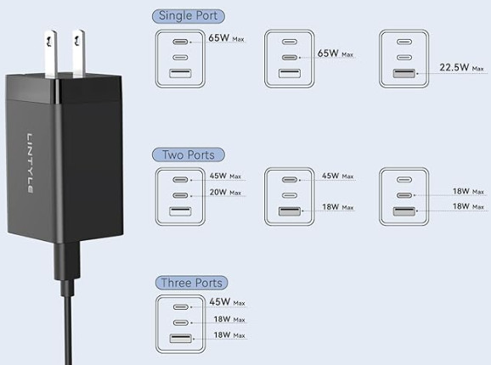
Choosing a USB Components
USB Chargers
Look for chargers that clearly spell out their total power and shared power capabilities.
Notes:
Look for chargers that clearly spell out their total power delivery and individual outlet capabilities
This Lintyle charger is a good example. It’s advertised as 65 watts and shows how much power can be delivered to each outlet when multiple outlets are in use.
Note that the USB-A can’t deliver more than 3.6A (18W)

Slide 29
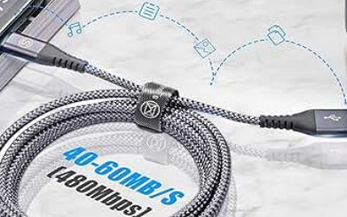
Choosing a USB Components
USB Cables
USB 3 and USB4 speeds range from 5 to 120 Gb/s, power delivery complexity, accommodating alternate modes, CC communications - all mean USB is more complex and costly.
Some things to watch for
Not all cables with a USB-C plug will support speeds greater than USB 2
USB cables advertised for power delivery may not deliver data
USB cables with a USB A connectors will at most deliver around 15 watts
For data Black separator = 480Mb/s blue separator = 5-10Gb/s
Look to products that are USB-IF certified
USB4 device certification label
USB4 cable certification label
Notes:
USB 3 and USB4 open a whole new world of cable selection.
Meeting USB’s 40-100Gb/s data speeds and high power PD delivery specs is costly.
If a cable is cheap it is so for a reason…so here are some things to watch for
Not all cables with a USB-C plug will support speeds greater than USB2…here’s a picture of a cable that proudly advertises it can deliver up to 480Mb/s…well at least it’s likely honest.
USB cables advertise for power delivery may not deliver data.
Cables with USB-A connectors won’t deliver more than about 15 Watts power. Data delivery will depend on the A connector. If it’s USB2, (black separator) expect 480Mb/s, if it’s got a blue separator it will have USB 3 capabilities with one duplex high speed lane, so between 5 and 10Gb/s.
Look to cables that support USB Implementers Forum certification logos

Slide 30
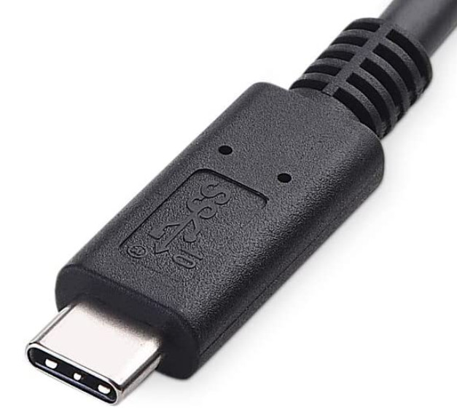
Choosing USB Components
A bit more about USB-C cables
Connecting a USB-C cable between two components will work in most cases but performance may not be optimum
Mixing cables & chargers can drastically alter charging speeds. Keep chargers and cables that were shipped with a device together
For optimum performance know the capabilities of the UFP, DFP, and cable
A list of USB IF certified products can be searched here: https://www.usb.org/products
Certified cables now typically sport speed and power info on connectors
Transport rate stamped on connector
Superspeed 10Gb/s
Club3D CAC1576 1M cable
Notes:
Connecting a USB-C cable between two components will work in most cases but performance may not be optimum
Mixing cables and chargers can drastically alter charging speeds. Keep chargers and cables that were shipped with a device together
For optimum performance know the capabilities of the UFP, DFP, and cable
A list of USB IF certified products can be searched here: https://www.usb.org/products
Certified cables now typically sport speed and power info on connectors. Here’s an example of a USB IF certified cable manufactured by Club3D available at many vendors including Canada computers, Walmart, Amazon. Staples, New Egg and others.

Slide 31
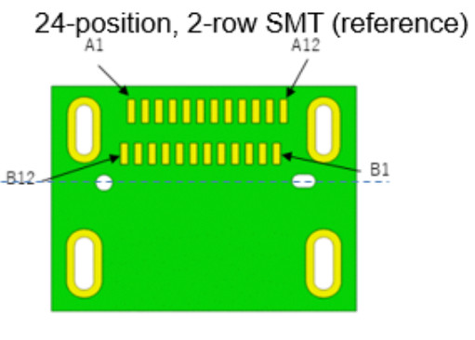
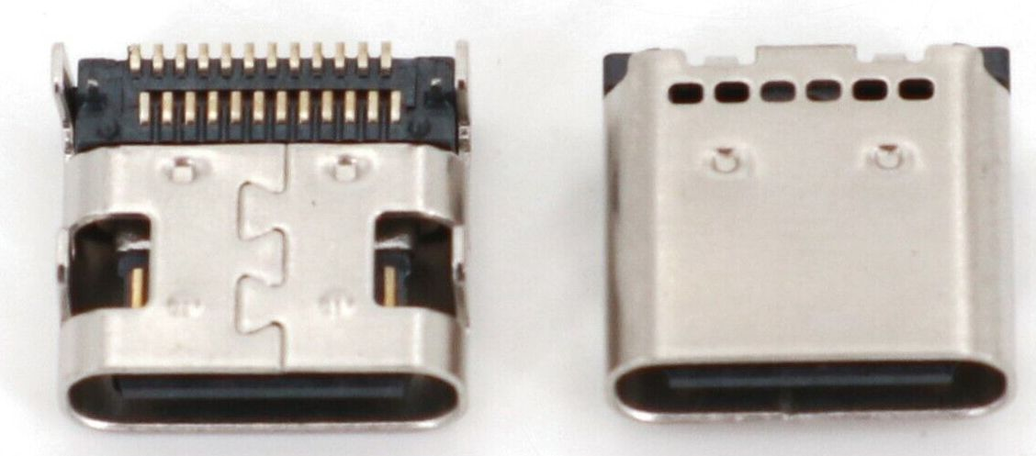
USB-C Receptacle Variants
Three Common USB-C receptacles
24 Pin for full power and data delivery
USB4 device certification label
Notes:
There are three common USB-C receptacle types. The 24 pin receptacle has two rows of SMD pads A1 to A12 closest to the rear of the connector and B12 to B1 closest to the front.
Variants of this 24 pin connector have through-hole mounting pins for B12 to B1. Mid mount versions are also made for PCB edge mount applications with 12 pads each side of a PCB.

Slide 32
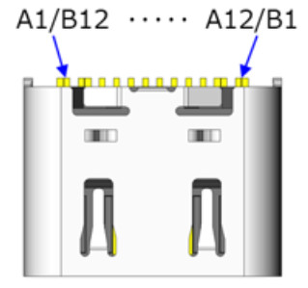
USB-C Receptacle Variants
Three Common USB-C receptacles
16 Pin for Power Delivery along with a USB2 data channel
Removes pins for the two high speed lanes and SBU buss
Notes:
The 16 pin USB-C receptacle variant enables full power delivery, but limits data to a single USB-2 lane.
The connector eliminates pins associated with both high speed channels and the SBU bus.
It’s easier to solder than the 24 pin devices, and can be successfully designed using single or double layer PCB’s

Slide 33
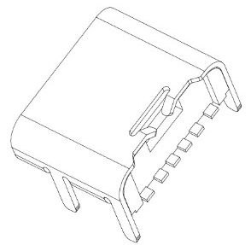
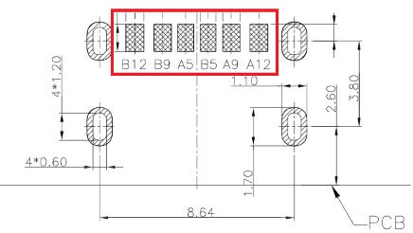
USB-C Receptacle Variants
Three Common USB-C receptacles
6 Pin for power delivery only
No data transport
Notes:
The USB-C six pin version is used only for power delivery, as it eliminates all data channels and the SBU bus
The six wider leads make it the easiest USB-C connector to solder.

Slide 34
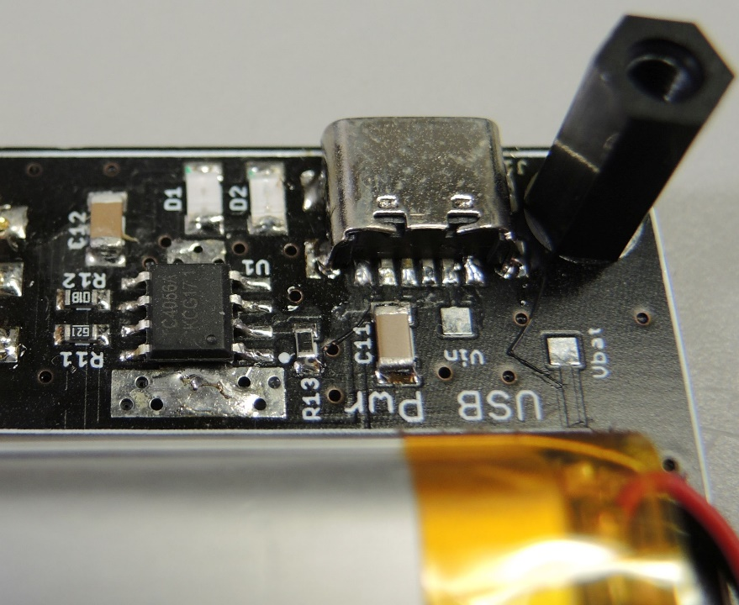
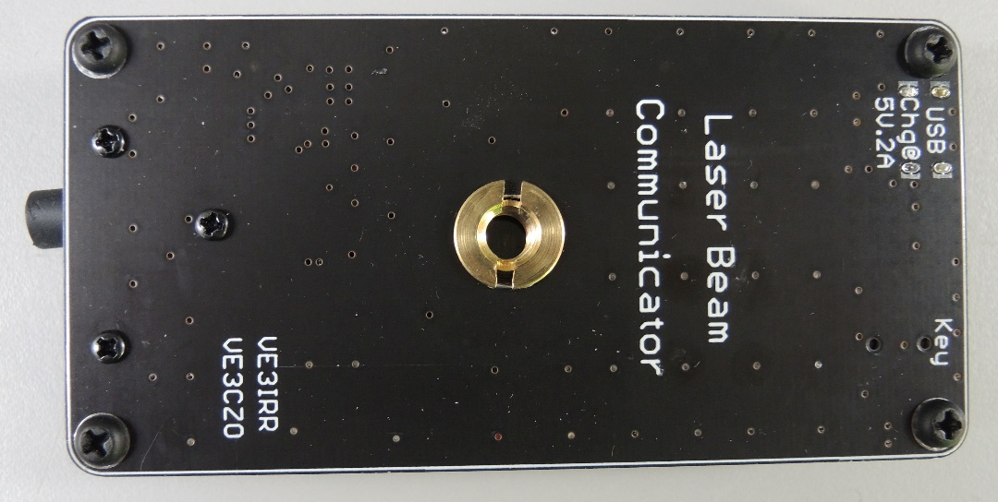
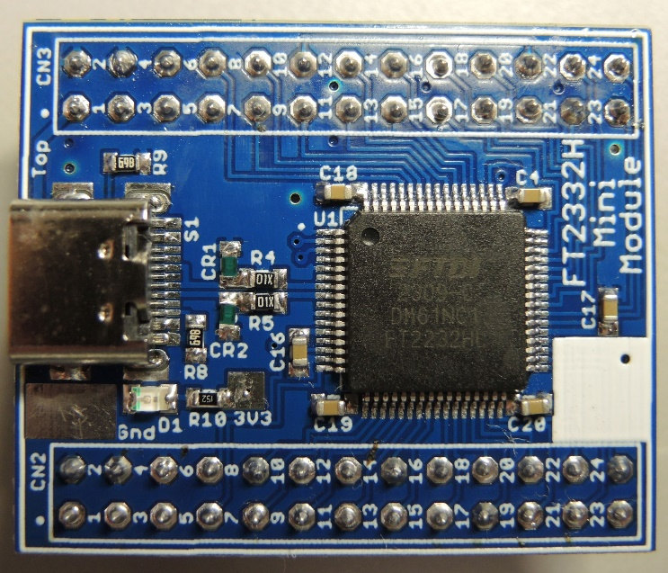
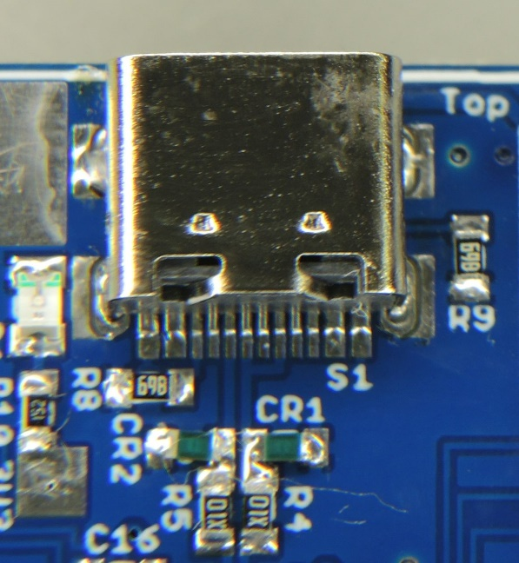
Using USB-C connectors in a design
USB-C Apps
Laser beam communicator uses a 6 pin power only connector
FT2332 USB2 Mini Module
Notes:
Here are a couple examples of projects I’ve done with 6 and 16 pin versions of the USB-C connector.

Slide 35
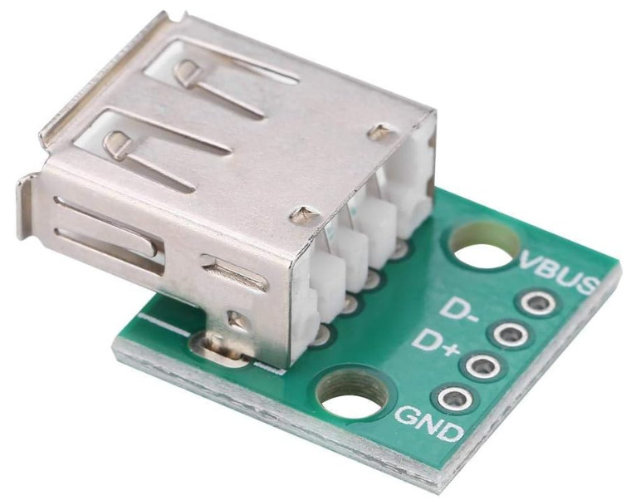
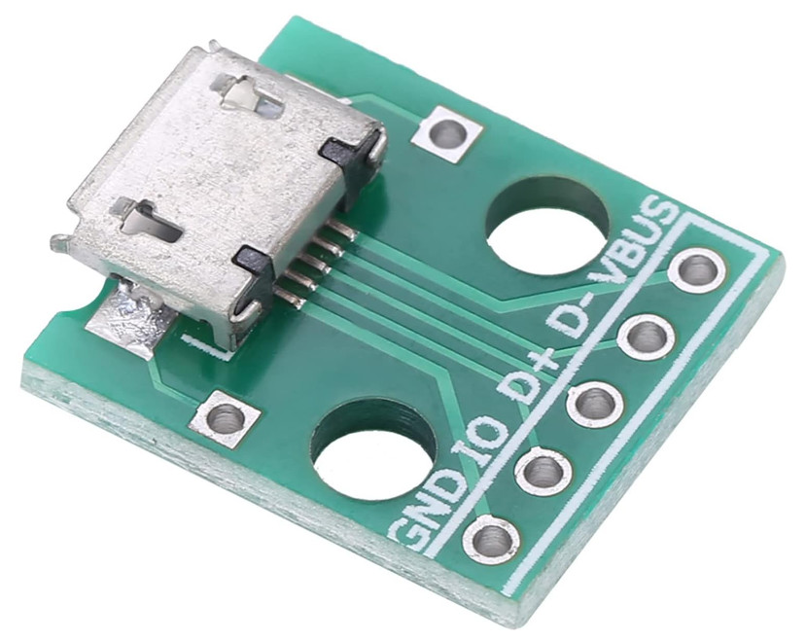
A bit a bout USB Breakout Designs
Typical Commercial offerings
Single USB connector with header pins
Ok for testing continuity through a connector but lacked pass-through capability so can’t be used to measure terminated pass-thru signal voltages or VBUS currents
So I made a set for USB2
Notes:
I started this journey wanting to add a USB-C breakout board to my collection so let’s talk a bit about breakout boards.
Most commercial breakout PCB’s feature a single connector tracked to a header. This type of board can be used to measure pin voltages or continuity from the breakout through a connector on a PCB.
I wanted a pass-through design that not only enables continuity measurements but would also have the capability of measuring VBUS supply current as well as supply and signal voltages.

Slide 36
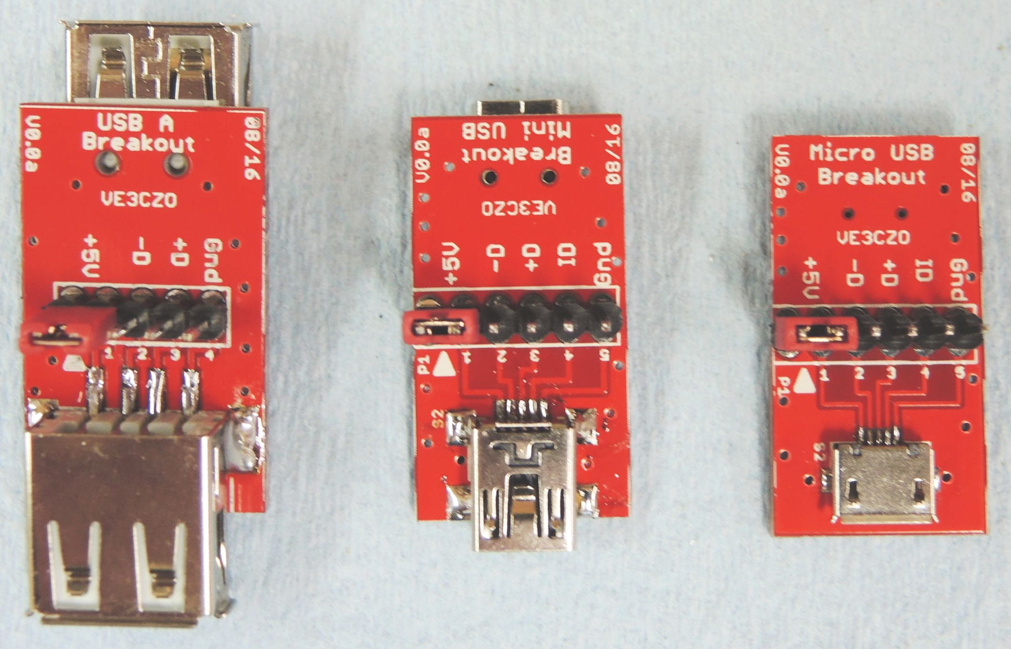
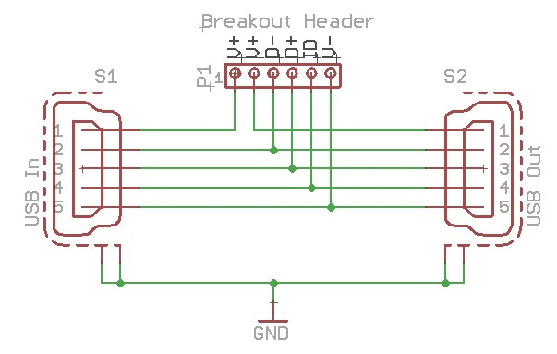
USB Breakout Designs
Pass-thru breakouts
PCB’s for A, mini, & micro
2 receptacles
0.1” headers for measurements
VBUS jumper (5V) enables current measurement
Notes:
I built pass-through PCB’s for USB A, mini, & micro connectors
They featured a row of 0.1” header pins placed between an input and output receptacle that allowed voltage measurements, and also featured a jumper on the VBUS line that could be used to monitor supply current. When not used, a jumper shorts the VBUS input to output.
The data line is not impedance matched but is quite short.

Slide 37
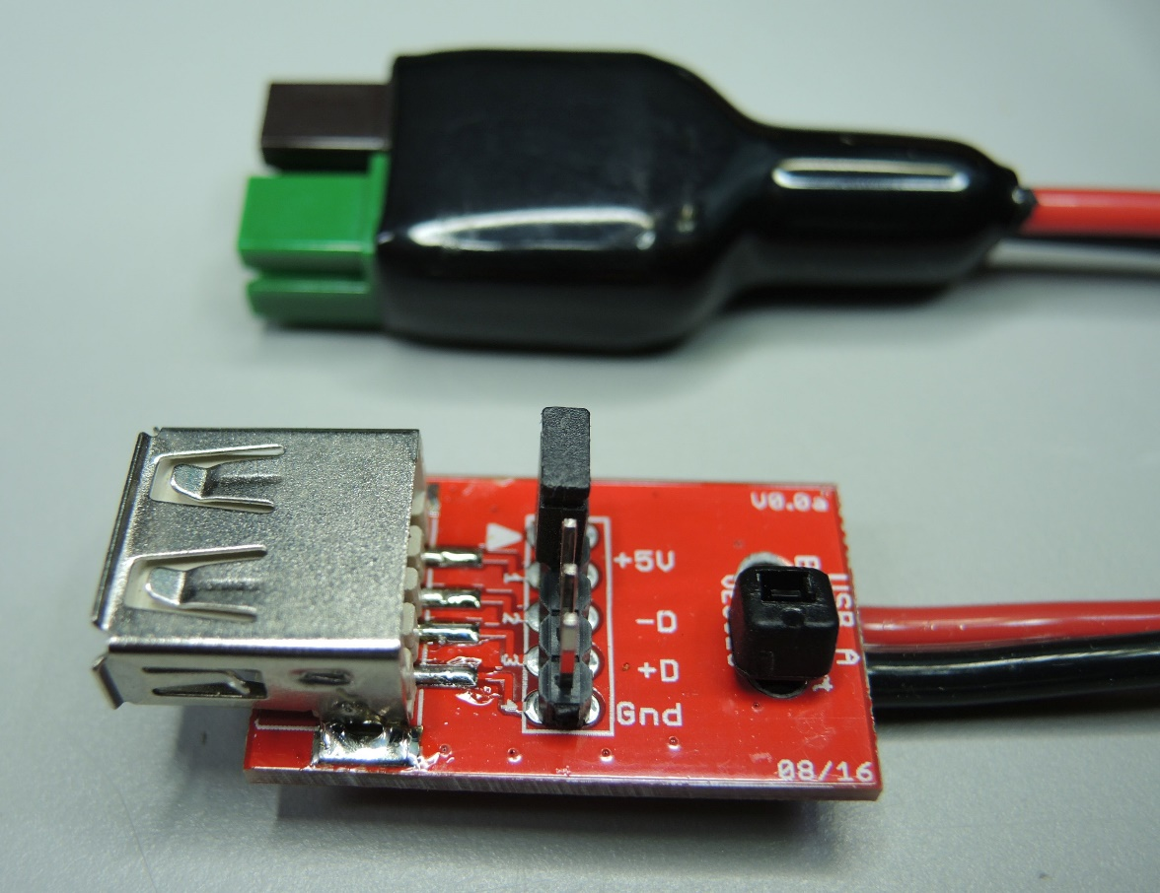
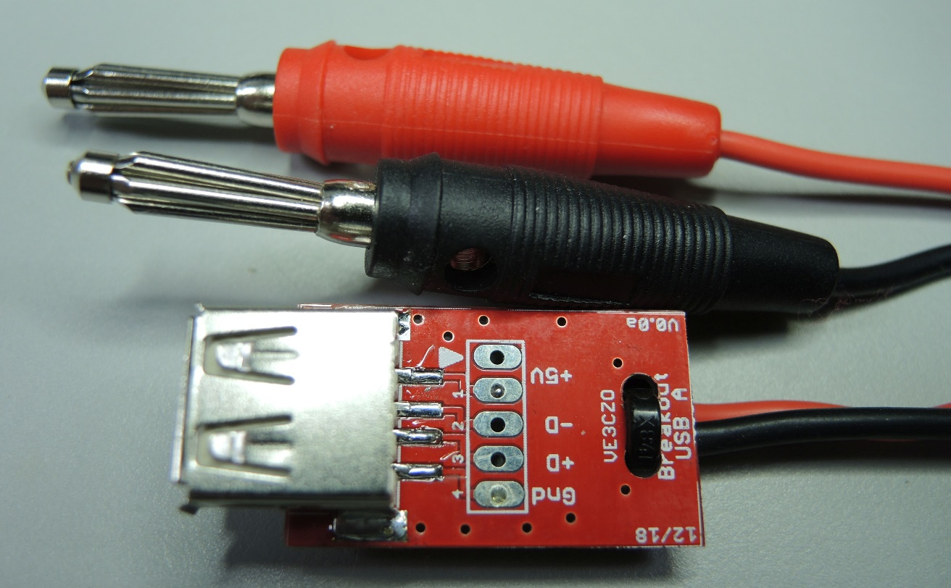
USB Breakout Designs
Other useful breakout implementations
USB to banana plug
For changing devices from regulated supplies
USB to power pole
For powering devices from 5V sources
Notes:
I’ve also used this PCB to provide power only connections using both banana plugs and Powerpole connectors. Note that the Powerpole connector is green (5) and black in an attempt to tell me not to connect it to supply higher than five volts. So far it’s worked.

Slide 38
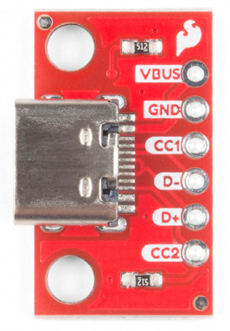
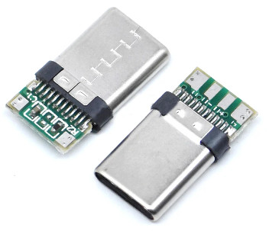
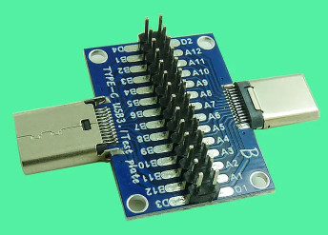
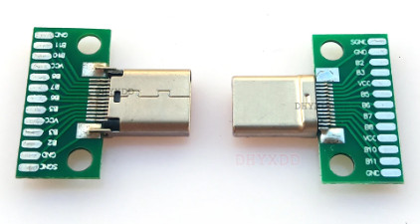
USB-C Breakout Designs
Typical Commercial USB-C offerings
Single USB connector with header pins
Found one pass-through design m-f but…
No high speed lane impedance or track length matching
Most use narrow tracks for VBUS
Notes:
The USB-C breakout designs I’ve come across are primarily single connector types that again, provide the ability to measure continuity. The SparkFun PCB, (the one in red), uses a receptacle, has terminating resistors for the CC bus and wider tracks for higher current for the VBUS.
The only thru connector I have found has a plug on one side and receptacle on the other. It treats all leads alike, so does not consider super speed lane track length or impedance matching and has narrow tracks for the VBUS.

Slide 39
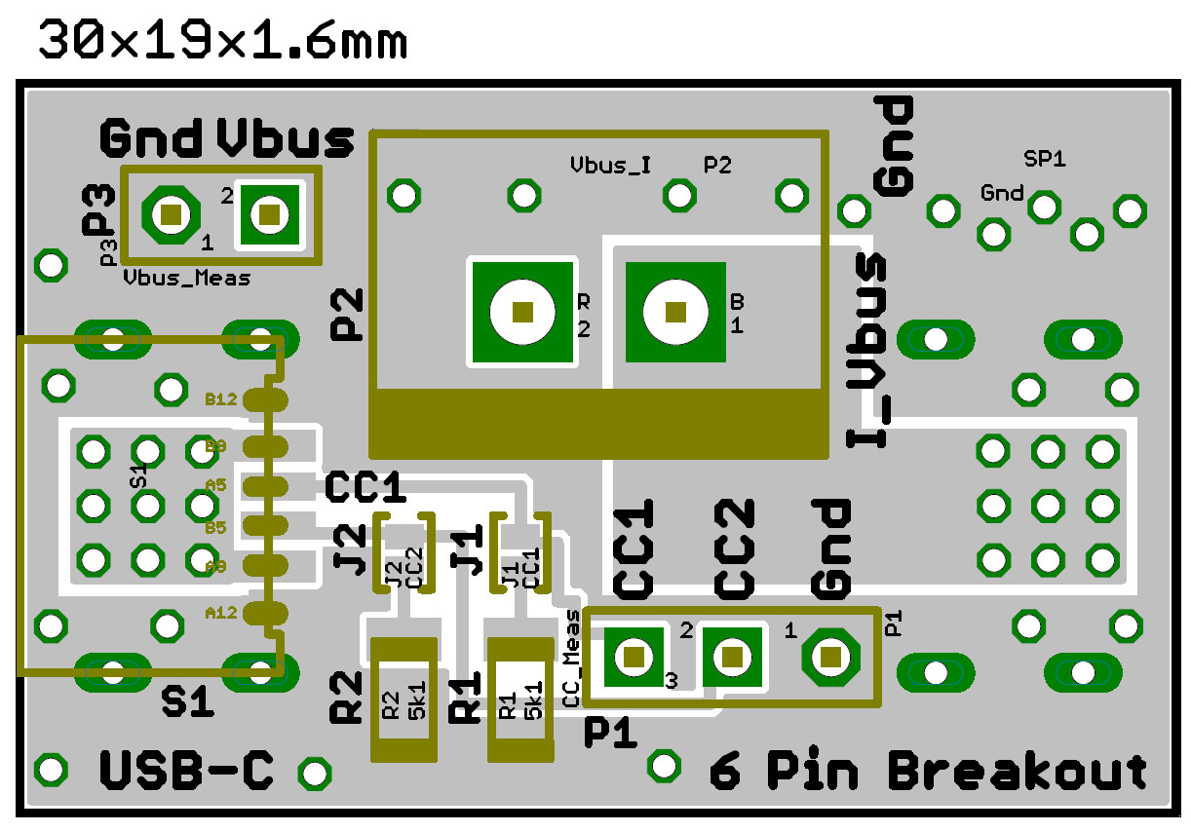
USB-C Breakout Designs
Pass-thru breakout 6 pin
VBUS current monitor via JST VH series (10A) socket & shorting plug P2
Jumpers enable CC channel termination
.1” stakes for voltage monitoring - VBUS and CC
Notes:
USB C breakouts get a little more complex. This six pin pass-through connector has no data lanes so is used only for power delivery, and works well for a two sided PCB.
This breakout is capable or monitoring the VBUS current using a JST VH series plug and socket. This connector is capable of handling 10A, and a shorting plug is used to provide continuity when not monitoring current. the PCB tracks are quite wide for negligible voltage drop at high currents.
Solder jumpers are provided to terminate the CC channel for applications where no device is attached.

Slide 40
USB-C Breakout Designs
Pass-thru breakouts 16 pin
Vbus_I monitor JST VH series socket & shorting plug P2
DnDp for USB2 diffZ=90ohms tacks match to 1.25mm
Jumpers enable CC channel termination
.1” stakes for voltage monitoring - Vbus CC, SBU & DnDp
Notes:
The 16pin breakout adds a USB2 data lane. Attempts were made to control the differential impedance, to 90 ohms and match the track lengths to under 1.25mm to minimize data skew.
VBUS current is monitored using a two pin JST VH socket and plug. The plug just shorts the VBUS track between input and output when current isn’t measured. The tracks are quite wide for negligible voltage drop at high currents.

Slide 41
USB-C Breakout Designs
Pass-thru implementations
16 pin with USB2
6 pin power only
Notes:
And here’s the way they look. The picture on the left shows the 16 pin breakout, the one in the middle the 6 pin and the picture on the right shows the 16 pin from a slightly different angle to show the input and output receptacles.

Slide 42
USB Summary
USB-C
USB 3 and USB4 speeds range from 5 to 120 Gb/s, power delivery complexity, accommodating alternate modes, CC communications - all mean USB is more complex and costly.
Not all USB-C computer ports will have full USB 3 or 4 capabilities
Expect to live with a range of data speeds of 5Gb/s up
Not all cables with a USB-C plug will support speeds greater than USB 2
USB power delivery capabilities will vary widely, and some charging cables won’t deliver data
How to deal with the variety and complexity
Research to become aware of the data and power needs for your specific application
Read product specs carefully, if you need a specific power or speed and the manufacturer does not specifically advertise it it’s probably not on offer
Don’t buy more performance than you need (unless you’re filthy rich)
Look to products that are USB-IF certified
USB4 device certification label
USB4 cable certification label
Notes:
USB 3 and USB4 speeds range from 5 to 120 Gb/s on one or two data lanes, power delivery has become very versatile and as a result complex. Accommodating alternate modes, and configuration channel and sideband communications all mean USB has become significantly more complex and therefor costly.
Supported data rates range all the way from 480mB/s to 120Gb/s on dual lane unidirectional devices.
Power delivery started off with a simple 5 volt supply providing half an amp to a much more sophisticated programmable voltage and current supply capable of being set from 5v to 48v handling currents up to 5 amps.
Will all features and capabilities be available on all ports? Of course not, it would be too costly. Will suppliers try and cut features and performance corners to reduce cost without telling consumers? Guess you can easily answer that question.
Not all USB-C computer ports will have all USB4 capabilities
Expect to live with a range of data speeds of 480Mb/s up
Not all cables with a USB-C plug will support speeds greater than USB 2
USB power delivery capabilities will vary widely
So what does a consumer do?
Before you buy, do a bit of research and become aware of what your application needs and the options available.
Read product specs carefully, if you need a specific speed or power and a product doesn’t advertise it, it’s probably not on offer.
Don’t buy more performance than you need unless you’re filthy rich.
Look for products that are USB-Implementers Forum certified. Both cables and devices are beginning to sport labels that spell out their capabilities.

Slide 43
Questions?
ve3czo @ gmail.com
Link to USB-A mini & micro breakouts
https://drive.google.com/file/d/1bbADurxjXE143yGZ6FTew1h8s1q81dXm/view?usp=drive_link
Link to USB-C 6 and 16 pin breakouts
https://drive.google.com/drive/folders/1oSOIzrGtlikaQA1oGeggcIL9SGAhX4t-?usp=sharing

Slide 44
Other stuff that maybe of interest
Improving your chances of inserting a USB connector the right way the first time
USB A and mini and micro connectors are going to be around for sometime
Every plug and receptacle has (or is supposed to have)
one side labeled with the USB symbol
Plug pins should be exposed towards the labeled side
Devices with horizontal USB ports should have receptacles
oriented so that the symbol points up
Receptacles should be labeled so when inserted, plug and
device symbols are on the same side
It’s often useful to look at the receptacle and plug before inserting
Note the orientation of the separator in USB-A connectors
Look to match the widest flats on USB mini and micro connectors
Notes:
As we’re going to be living with legacy USB connectors for some time so here’s a bit of a guide to help insert the connector the right way the first time.
Every plug and receptacle has (or is supposed to have one side labeled with the USB symbol
Plug pins should be exposed towards the labeled side
Devices with horizontal USB ports should have receptacle oriented so that the symbol points up
Receptacles should be labeled so when inserted, plug and device symbols are on the same side
It’s often useful to look at the receptacle and plug before inserting
Note the orientation of the separator in USB-A connectors
Look to match the widest flats on USB mini and micro connectors

Slide 45
USB A Separator colors…their meaning
White
USB 1.x (1.5 or 12Mb/s)
Black
USB 2.0 (480Mb/s)
Blue
USB 3.0 or SuperSpeed (5Gb/s)
Teal
USB 3.1 Gen1 or SuperSpeed+ (10Gb/s)
Red, Orange, Yellow
Can be either USB3.2 or USB 3.1 Gen 2 (20Gb/s) or high current or sleep and charge. Yellow is mainly found on laptops where the port is always on so it will continue to draw power even if the laptop is off or in sleep mode
Specialty Stuff
Purple used by Huawei for Supercharge ports, Green is used by Qualcomm for Quick Charge
As you might expect not all manufacturers adhere to these color codes
Notes:
The separator color on a USB – A connector can often indicate it’s speed and function.
White was almost universally used for USB 1 versions and black for USB2.
USB 3 is typically blue, but the faster 3.1 gen 1 or superspeed+ is often teal.
Red, Orange, and Yellow are often used with high current or sleep and charge ports, but have also been used to represent USB3.2 or USB3.1 Gen2. The yellow version is mostly found on laptops that can feed power even if the laptop is off or in sleep mode.

Slide 46
USB Non-Standard Connectors
Mini-USB 8 Pin
Used on many digital cameras
Pins other than USB signals may vary depending on camera model
Notes:
Before ending it should be mentioned that there are several non-standard USB connectors that have become common. Here’s an example of one used by many digital cameras.

Slide 47
Thunderbolt
Thunderbolt 1
Developed by Intel adopted by Apple introduced with MacBook Pro 2011
Transfer speed 10Gb/s DC power transfer up to 10W (5V@2A)
Mini DisplayPort connector
Thunderbolt 2
Introduced in 2013 & is backward compatible with Thunderbolt 1
Offers 20Gb/s transfer rate using 2 full duplex channels
Continues use of Mini DisplayPort connector
Thunderbolt 3
Developed by Intel & released 2015
Adopts USB-C connector so not backward compatible with previous versions
Transfer rates of 40Gb/s and power delivery up to 100 watts with approved cables
Will not work in a USB3 Gen2x2 port; host & peripherals need Thunderbolt firmware/software
Notes:
I mentioned Thunderbolt several times as one of the USB-C supported alternate modes Here’s a short summary of its evolution
Lower adoption rates plague this format as only Apple support it so lower manufacturing volumes result in higher peripheral price points.
Intel gave the USB implementers forum the full spec so that they can implement Thunderbolt as a alternate mode.

Slide 48
USB Summary
USB Evolution
Credit
https://juicedsystems.com
Notes:
Very nice chart showing USB Evolution Credit https://juicedsystems.com/

Slide 49
USB Summary
USB Connector Gallery
Credit
https://juicedsystems.com
Notes:
Very nice chart showing USB connectors Credit https://juicedsystems.com/

Slide 50
Bibliography
For further reading…
USB Overview – better than reading the spec but does not include anything beyond USB OTG https://www.beyondlogic.org/usbnutshell/usb2.shtml
USB-IF library www.usb.org/developers/docs/devclass_docs/
USB-Implementers Forum www.usb.org
Battery charging overview https://www.maximintegrated.com/en/design/technical-documents/tutorials/5/5936.html
USB-C overview https://www.allaboutcircuits.com/technical-articles/introduction-to-usb-type-c-which-pins-power-delivery-data-transfer/
USB-C cable info https://www.pshinecable.com/article/usb-c-cable-wiring-diagram.html
USB Alternative Modes TI Slly021 app note.
USB overview & a source for certified products https://juicedsystems.com/en-ca/blogs/news/know-your-usb-a-practical-guide-to-the-universal-serial-bus
Have fun exploring but… pay attention to the date information was published… things change!

