Slide 1
ICOM IC-905
Getting on the microwaves – is it the right rig for you?
Disclaimer – I have absolutely no connection to ICOM
Terry Price – W8ZN
Directive Systems and Engineering

Slide 2
Rig overview
Covers 2m, 70cm, 23cm - 10W output (12.5W measured)
13cm and 6cm – 2W output
Optional 10 GHz transverter (2400 MHz I.F.) 0.5W output (Rumors of a 24 GHz module !!!!!)
Control head links to remote RF unit via Ethernet cable – CAT5 or CAT6 – shielded preferred
Utilizes standard POE+ to power remote RF unit (pins 4,5,7 and 8 on the RJ45)

Slide 3
Rig overview (cont.)
Female SMA’s for 13cm, 6cm, 3cm and I.F. link for 10 GHz transverter
Female type N for 2m, 70cm and 23cm (combined)
RJ45 for Ethernet – can be used with RS-BA1 remote control software(if they ever update RS-BA1 !!) Unlike the matching IC-705, there is no WiFi or Bluetooth interface
Has USB C interface for CAT control and digital audio
Creates two virtual serial ports, one for CAT and one for CW keying and PTT

Slide 4
Rig OVERVIEW (CONT.)
Rig operates off 13.8VDC @ 2ish amps (no internal battery like the IC-705)
Built in step up power supply for POE+ which is 48VDC
Like the IC-705, there is a ¼-20 threaded hole in the bottom to mount it to a camera tripod (or the aluminum protection frame from Amazon)
BNC cable included for 10MHz connection to 10GHz transverter
Tiny GPS antenna included**
36V, 30W LDMOS FET’s for 2m, 70cm and 23cm
Per band power output control

Slide 5
Rig OVERVIEW (CONT.)
Uses 2.5mm TRRS for mic input and PTT and 3.5mm TRRS for speaker
Uses 3.5mm TRS for PTT out/in and ALC input – ALWAYS USE A BUFFER ON THE PTT OUTPUT !!!!!
Video in and out for FM ATV (is that even used any more??)
ICOM finally added the ability to accept USB audio and live mic audio and audio by mode
Built in GPS receiver with 10 MHz output to lock all bands
GPS information is available – LAT/LON, elevation, speed, 6 digit grid square

Slide 6
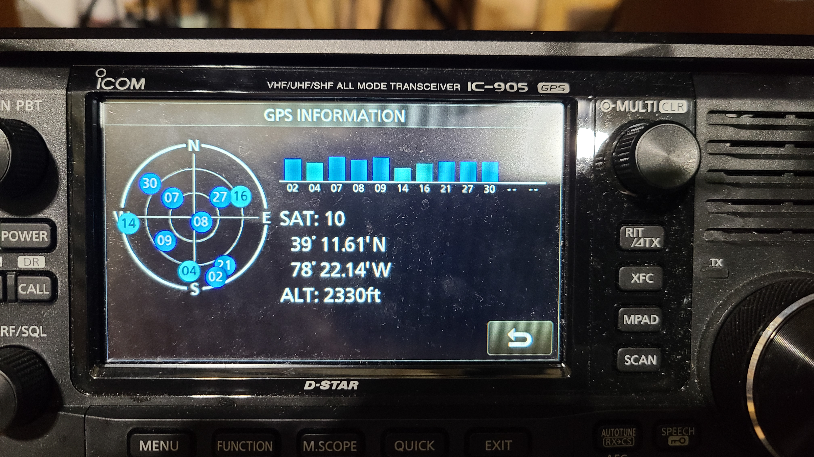

Slide 7
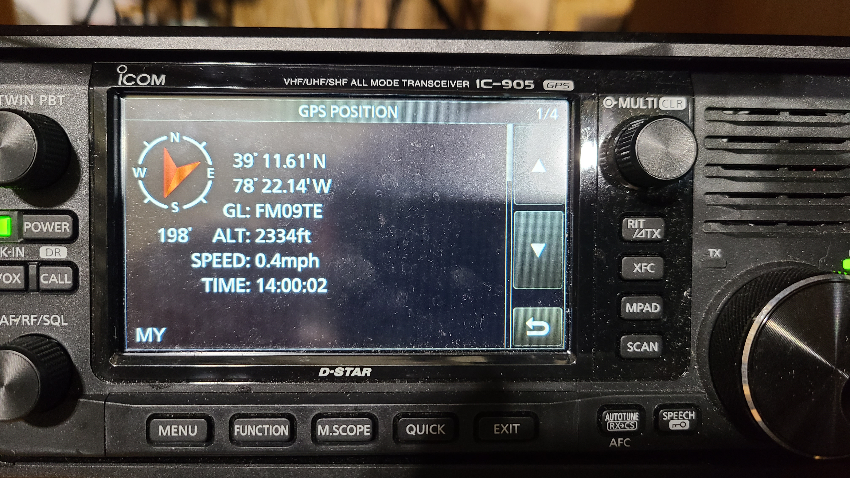

Slide 8
Pro’s - Subjective
VERY easy way to get on the microwave bands
Very well engineered and amazingly intuitive menu system for setup - yes, I was SHOCKED at this!!!!
Great for mountain-topping or roving.
Mounting brackets for the remote RF units are by far the best I’ve ever seen. 1/8” thick stainless steel with more mounting holes than you know what to do with. There are slots where the modules mount so you mount the brackets first to your mast, then the modules just slip in and then you tighten the screws.

Slide 9
Pro’s - Subjective
For folks that don’t have the time, expertise or desire to “roll your own”
I picked up the 3cm transverter on my way to the Dayton Hamvention. With a DSE 60cm dish and dual band feed @ 25’, Mike KA8ABR made the first contact with with W8BYA @ 105km at midday !!
Rock stable, fast GPS lock up. The rig takes less than 15 seconds from power on to be stable listening to the W3IP beacon.

Slide 10
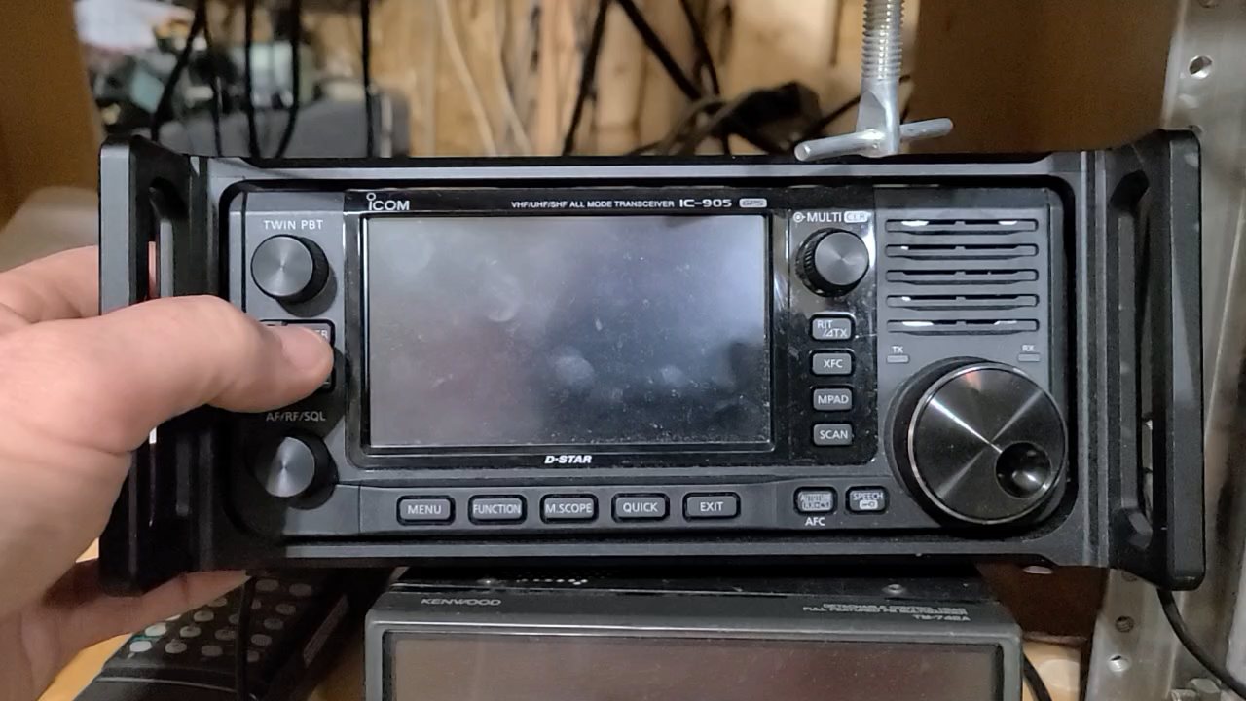

Slide 11
CON’s – At least as I see them
COST – YIKES !!!!! $4500 for a fully loaded unit with the 10GHz module
No direct access to the CI-V buss to acquire operating frequency to roll your own. A USB interface using the USB-C would null the use of digital audio. This IC-705 can give CAT info via WiFi at the same time as the USB interface. The old IC-9100 had both USB and a serial CI-V jack
While POE+ is a great way to power remote items, I’m concerned about 48V+close spaced contacts on an RJ45+moisture = BANG !!!! I’ve had several POE cameras arc the contacts just due to condensation!!

Slide 12
Con’s – cont.
Of course there is no 135cm, 33cm and strangely no 9cm although probably during the development of the rig, the FCC hadn’t ruled on the 9cm band change.
MO’ power would have been nice but more than adequate for what the rig was intended for ?
Fragile mic input connector and complicated interface – same as the IC-705 mic audio is muxed with function buttons

Slide 13
Con’s – cont.
Not a big fan of SMA’s. Extra care needs to be taken to ensure they are wx-proof and they are fragile and can be snapped off.
Individual connectors for 2m, 70cm and 23cm would have been nice
The 3cm module will NOT operate without the 10MHz reference.
No band data output or PTT per band ???

Slide 14
Thoughts on expansion
I’m working with Andy, K1RA, to build a Ethernet interface to provide a per band output for amplifier keying and/or transverter keying for 33cm and 6cm
10Mhz output is VERY low, I measured -3dBm compared to my shack GPS with a DEMI 10-4 @ +13dBm and an old HP distribution amp @ +18dBm. Running the output of the 10MHz reference through a BNC tee then to the 3cm module and the other to a DEMI 10-4, locked the 3cm transverter and a DigiLO, so locking other devices is no problem

Slide 15
Thoughts on expansion
Currently, I’ve built an add-on unit with an SG-LABs 144-902 transverter and an SG-LABs 430-3400 transverter using a Comet Triplexer to split out the 2m, 70cm and 23cm signals. The SG-Labs transverters both put out 3w and both have RF-sensing for PTT. I use a piece of RG8X as the power cable to supply 12V to this box. Using the 10 MHz reference from the IC-905 and a DEMI 10-4 distribution amp, I phase lock both the 902 and the 3400 transverters.

Slide 16
Thoughts on expansion

Slide 17
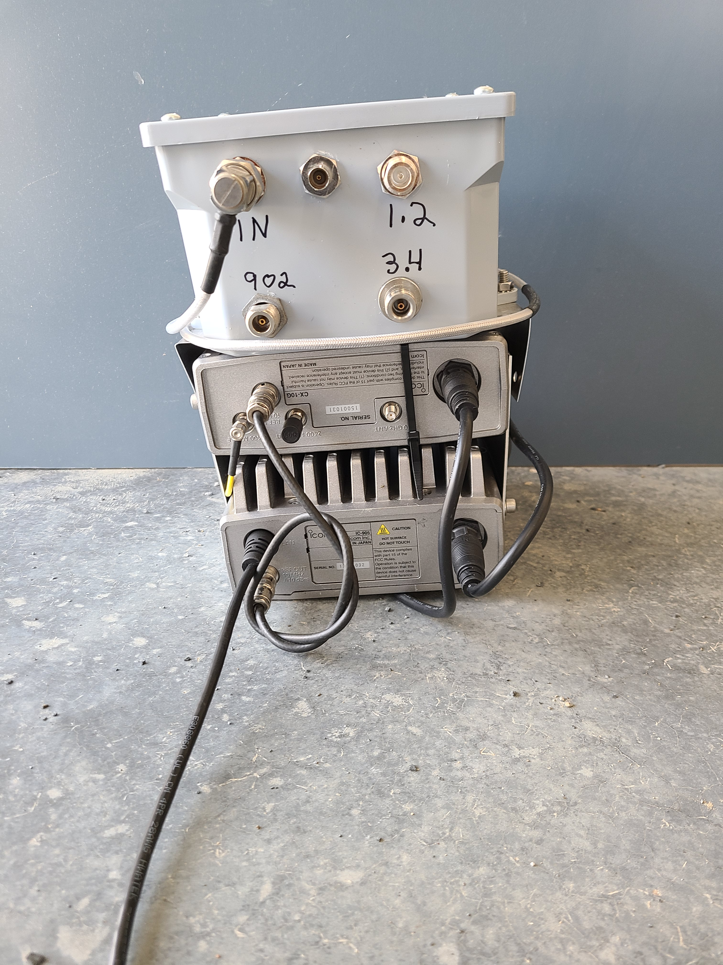
Completed add-on 902/3400 transverter box.

Slide 18
LET’s do the math - Roll your own
2m IF rig – FT817? $500
Q5 1296 transverter - $600 (25w)
DB6NT 13cm transverter - $525 (1w) covers 4 MHz at 2302, 2320, 2400
DB6NT 6cm transverter – $752 (250mw)
DB6NT 6cm 4w amp - $729
DEMI 3cm transverter - $775 (3w)
SMA relays for T/R - $200
SMA relay for I.F. switching - $75
WXPROOF box to put everything in - $200
GPS for 10 MHz reference - $100
Lots of SMA cables for interconnects - $100 hamfest pricing
40+ hours of labor to assemble
Lots of cussing and pissed off XYL for the time you are spending!!
$4556 guesstimate

Slide 19
LET’s do the math - IC-905
Basic rig, 2m, 70cm, 23cm, 13cm, 6cm - $3500 covers entire band segments
3cm transverter - $1000
150ft shielded CAT6 Ethernet cable with 23AWG conductors - $100
Dinner for two at your favorite steakhouse with the XYL - $60
$4660 – take it out of the box, plug it in and make contacts!!!

Slide 20
Thanks and 73 all !!!!

