Slide 1
The following presentation and all materials provided are the intellectual property of The American Radio Relay League, Inc. (“ARRL™”). No part of this presentation may be copied, recorded, reproduced, or distributed in any manner without express written permission from an authorized representative of the ARRL specifically referencing this presentation and material.
Copyright 2025 ARRL™
All Rights Reserved
Notes:
Do not edit this slide. Do not add content to this slide.

Slide 2
ARRL Contest/Operating Events Update Bart Jahnke, W9JJ ARRL Radiosport Manager

Slide 3
What are the benefits of Contesting?
Promote on-the-air activity
Push the boundaries of propagation
Challenge ourselves to build and improve
Provide and encourage competition
Strengthen our readiness for public service
Use our valuable frequency allocations
Enhance international goodwill
Have fun on the air!

Slide 4
World’s Largest Radiosport Program
15 Primary Contests
9 Other Operating Events
Plaques are available in the following ARRL contests:
November Sweepstakes CW
November Sweepstakes Phone
RTTY Roundup
International DX Contest CW
International DX Contest Phone
International Digital Contest
June VHF Contest

Slide 5
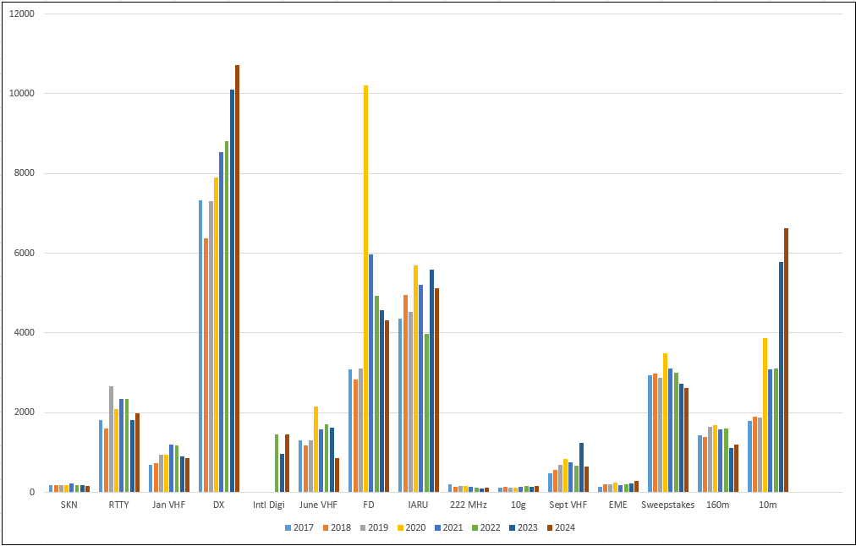
ARRL - All Events - Contest Logs Received by ARRL 2017-2024

Slide 6
VHF + Contest Activity (Logs) Reported to ARRL 2017-2024

Slide 7
Behind the Scenes
In addition to ARRL staff, there’s a team of people all working hard to present the ARRL contest program running smoothly. These include:
Writing and editing of contest results articles
Log checking and contest adjudication
Log collection and database management

Slide 8
Results Authors Needed for the Following Contests:
ARRL International Digital Contest
ARRL 222 and Up Distance Contest
Contact Paul Bourque, N1SFE at n1sfe@arrl.org if you’re interested in authoring the results articles for any of the above events.

Slide 9
What’s NEW in ARRL On-Air Operating Events?
Limited Antenna Overlay added to ARRL HF Contests
Youth Overlay added for All ARRL Contests
Overlay recognitions added to Certificates as applicable
10 GHz and Up Contest Rules Update (more considerations ongoing by the Contest Advisory Committee (VHF Sub Committee))
Proposed 2026 EME Contest Dates released

Slide 10
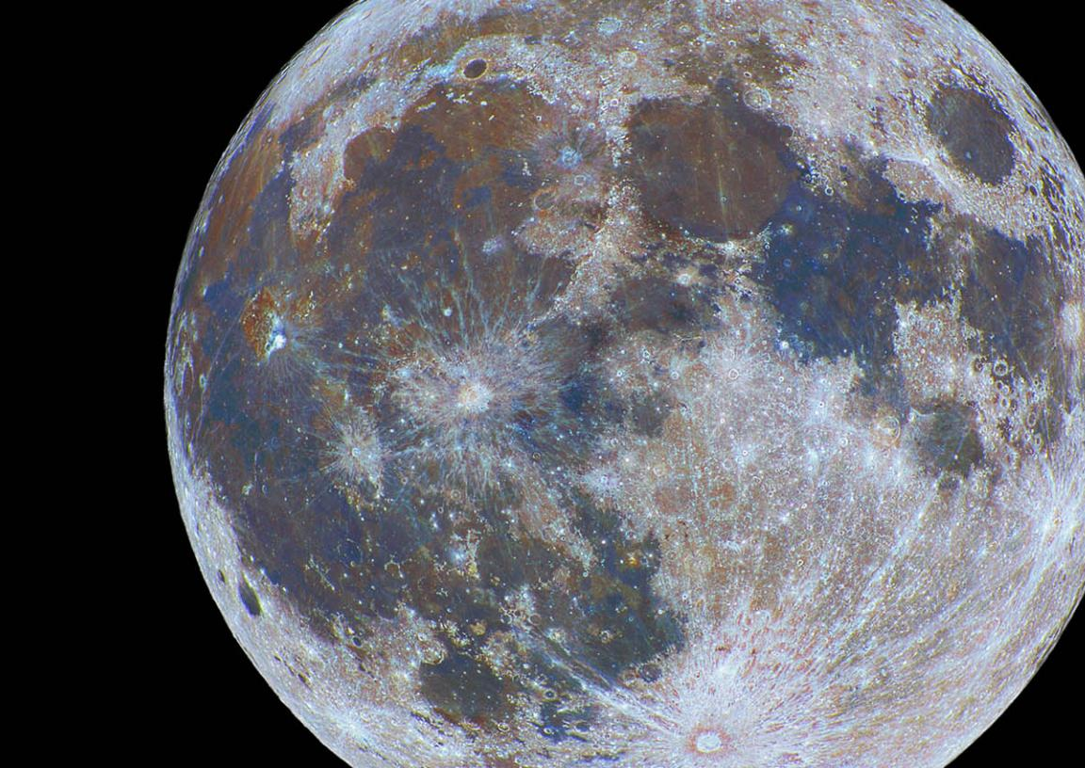
Proposed 2026 EME Contest Weekends
Dates are selected to avoid conflicts with ARI EME Contest (last weekend of Sept) and IARU Region 1 VHF contests (first weekends of Sept, Oct, and Nov), to hopefully have an acceptable high declination weekend each month (while avoiding Winter).
Weekends 1 and 2: 2.3 GHz and up
August 8 - 9
September 5 - 6
Weekends 3 and 4: 50 MHz – 1.2 GHz
October 3 - 4
November 28 - 29

Slide 11
The Three Keys to Contest Success
Get on the air!
Have fun!
Send in your event logs!

Slide 12
Thank You!
Thank you for being an ARRL Member!
www.arrl.org/join

Slide 13
www.arrl.org Copyright © 2025
Notes:
Do not edit this slide. Do not add content to this slide.

