Slide 1
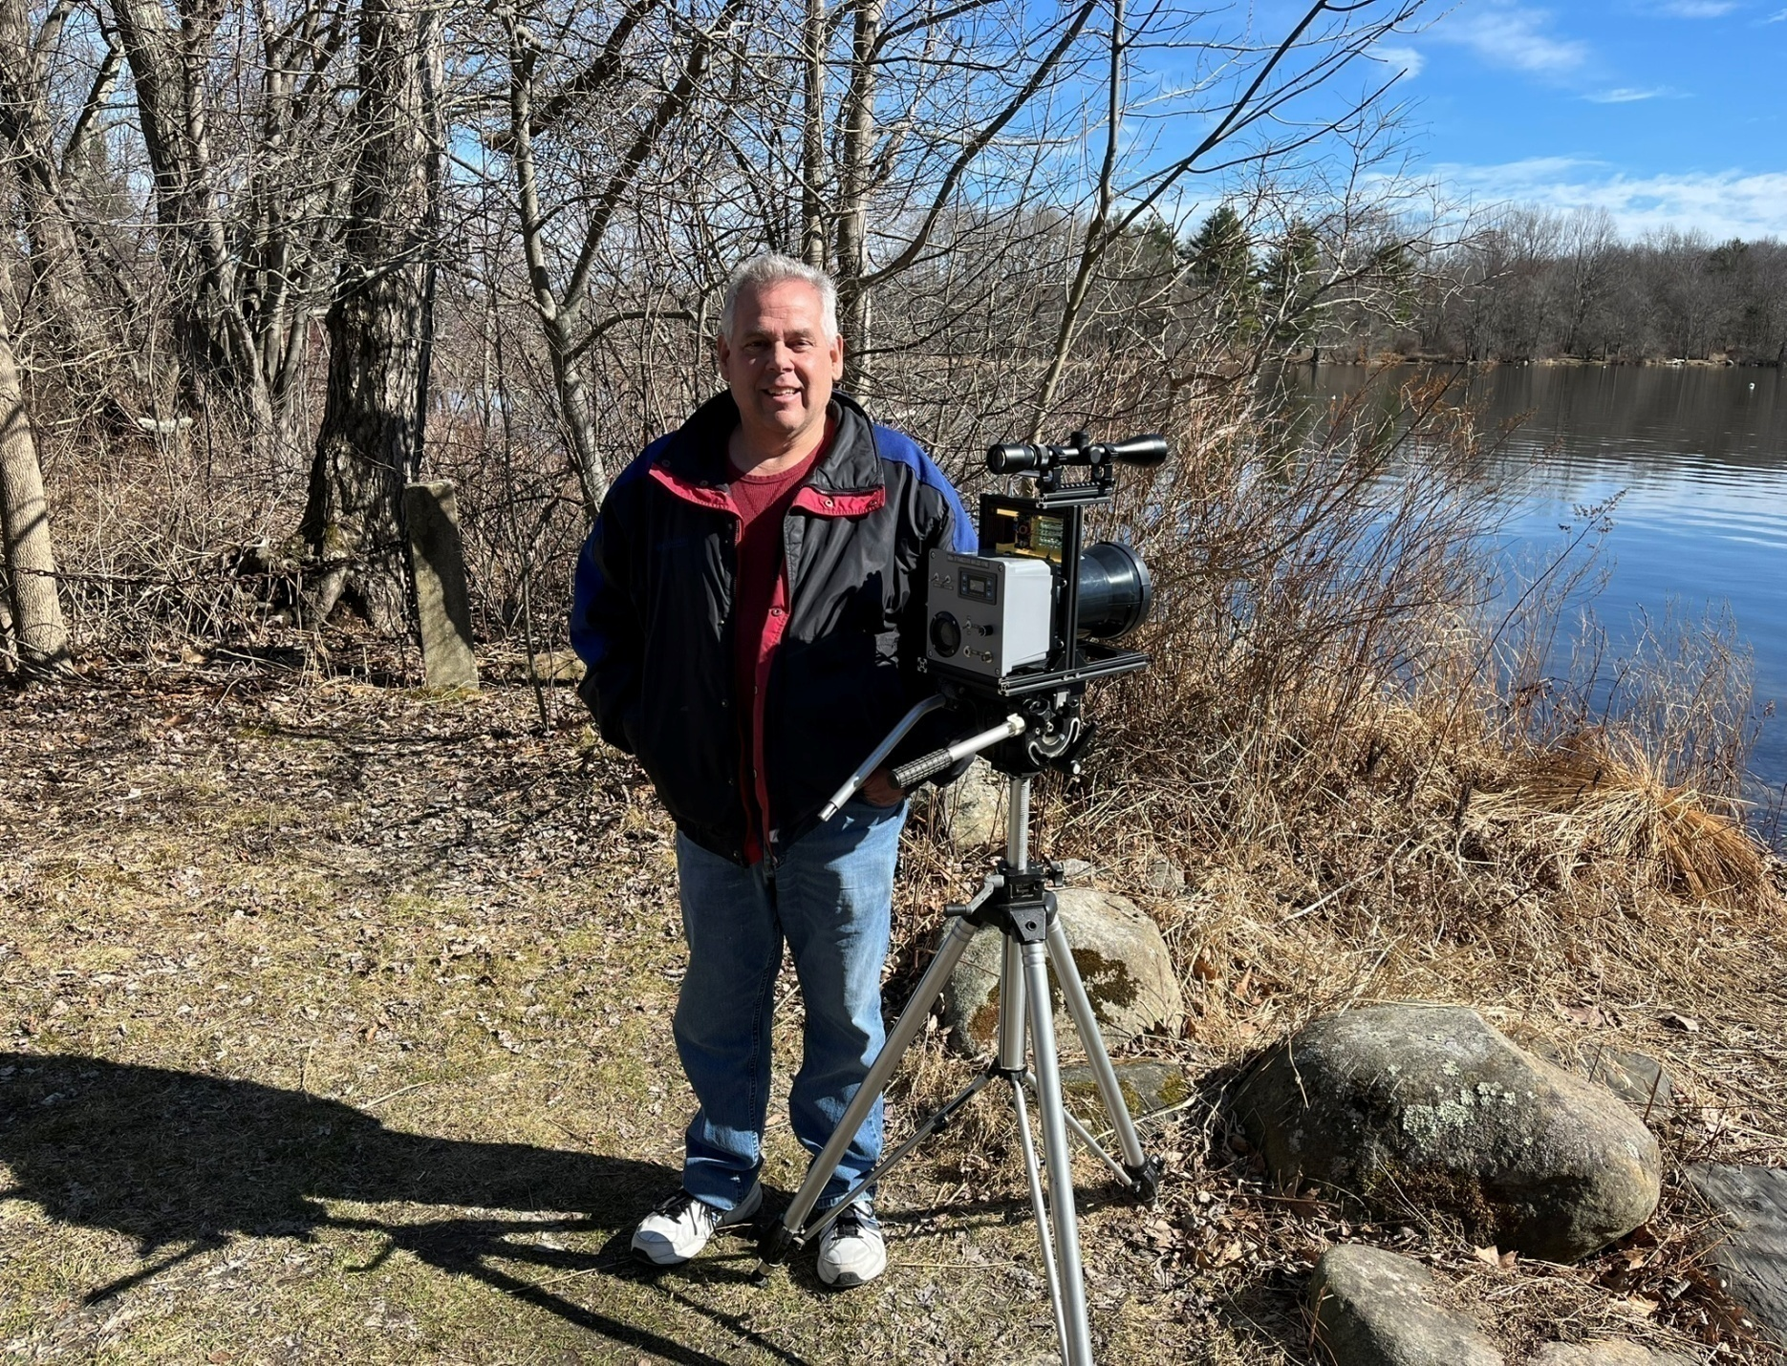
940nm or 319THz de K1FMS

Slide 2
Blame it on W1VLF!
Paul posts on various microwave reflectors.
Paul shows it's not that difficult or expensive.
YouTube videos of his one way experiments.
  2 Miles across Bantam Lake
  4 Miles from Burlington to New Hartford
Paul was VERY helpful with Zoom meetings!
ETC.....
It's Paul's Fault!

Slide 3
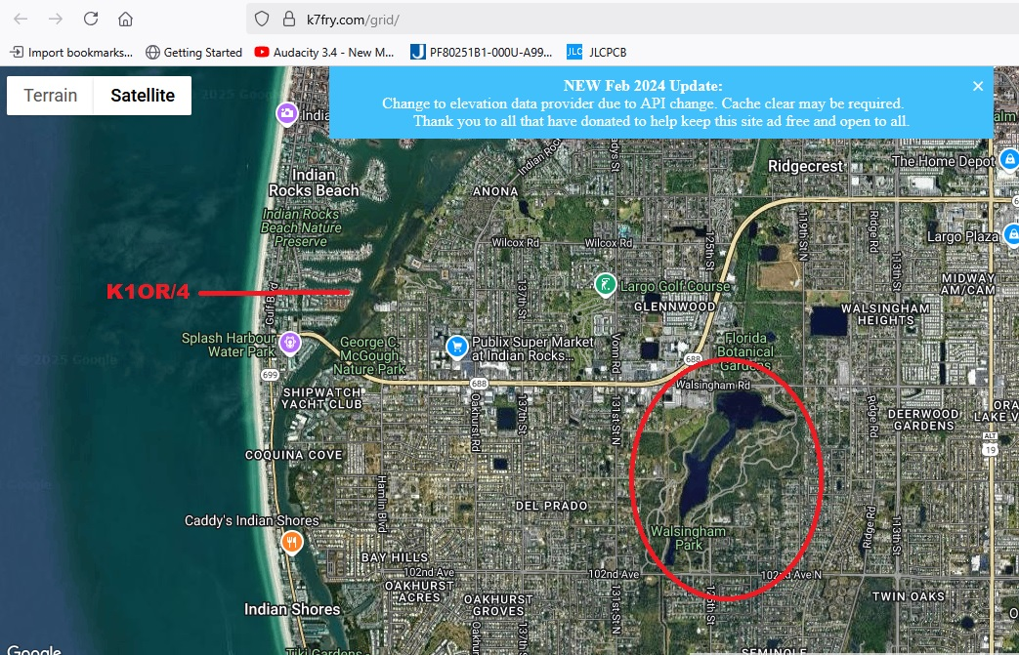
John & Fred's Excellent Adventure!
Walsingham Park, Seminole, FL

Slide 4
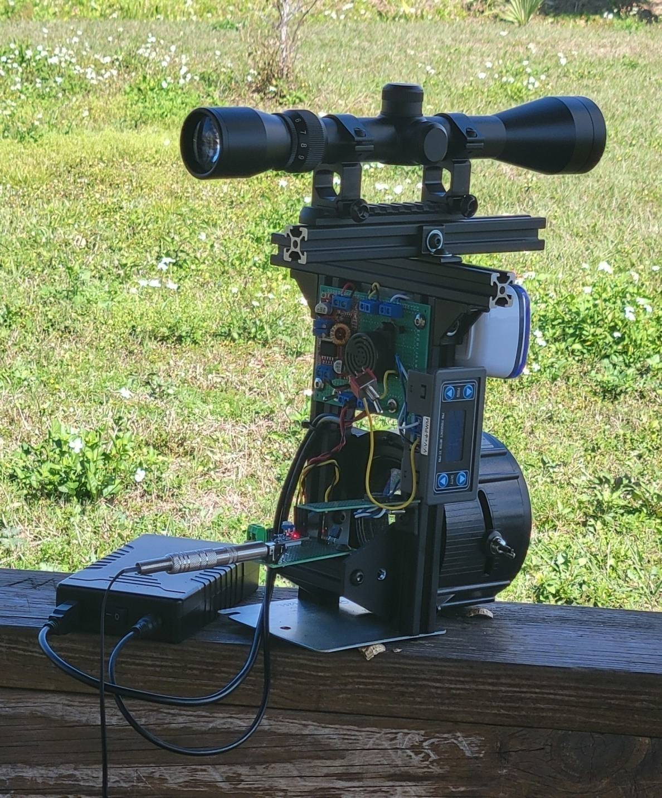
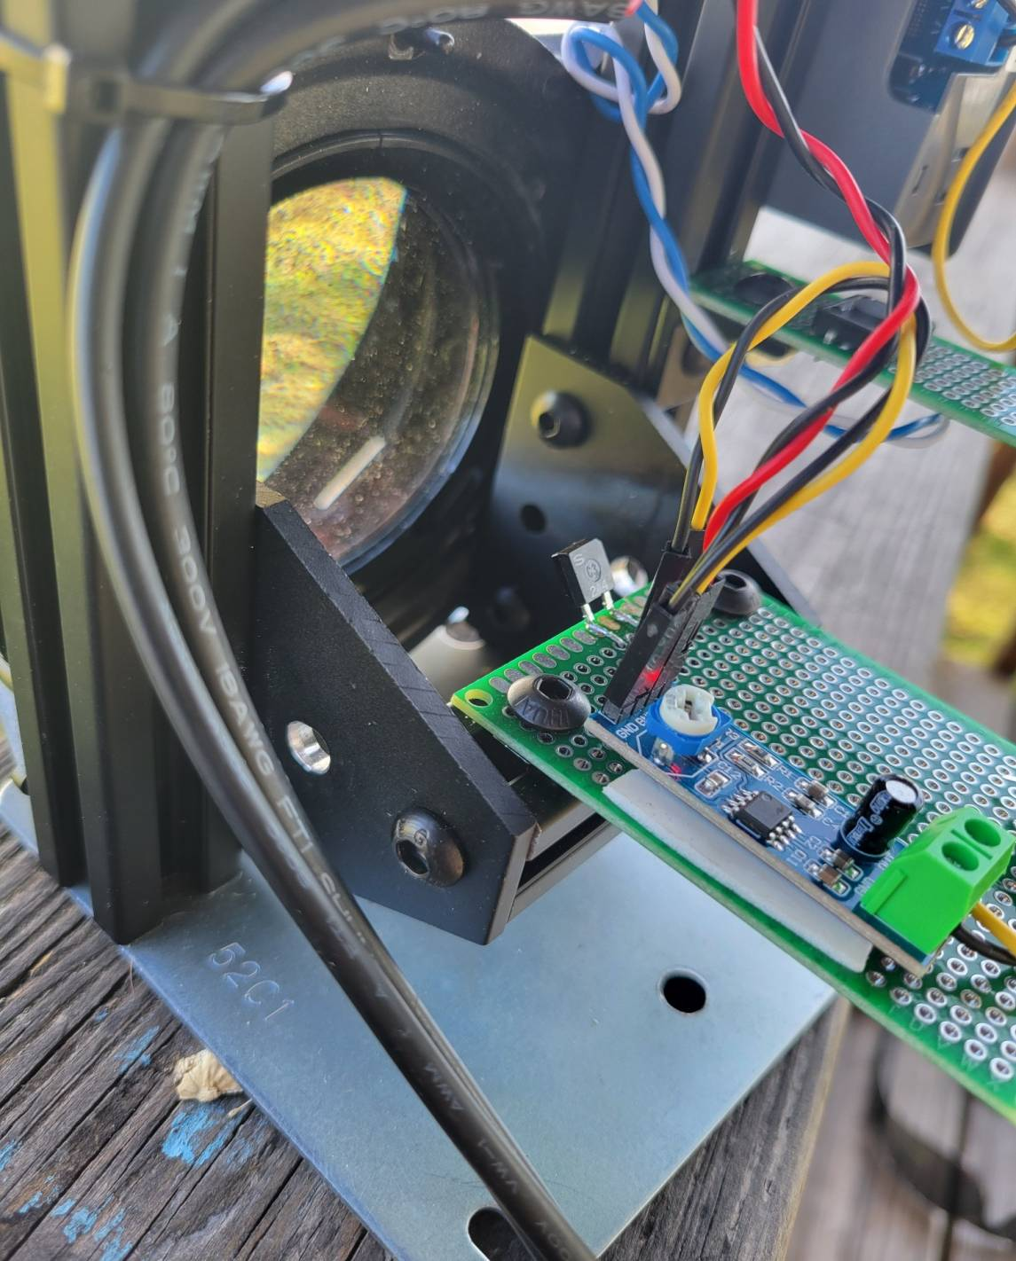
K1OR Rigs

Slide 5
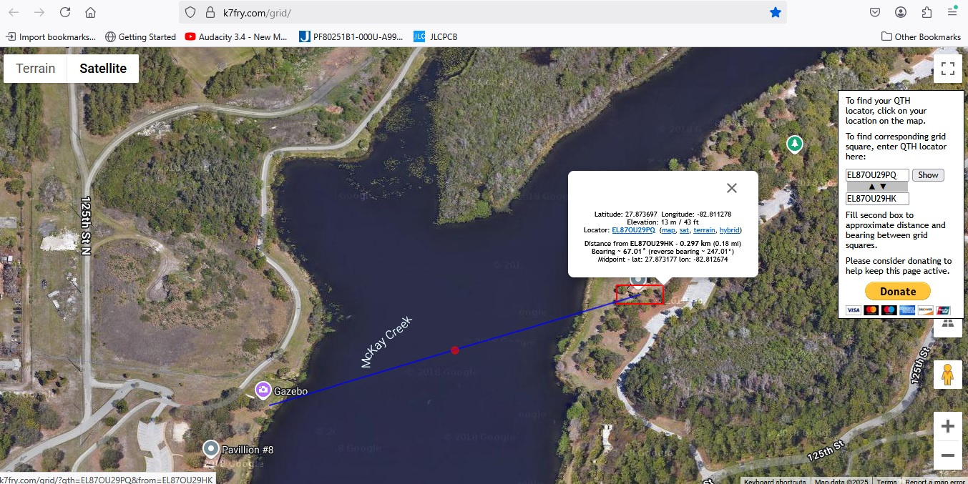
Where to try a QSO?

Slide 6
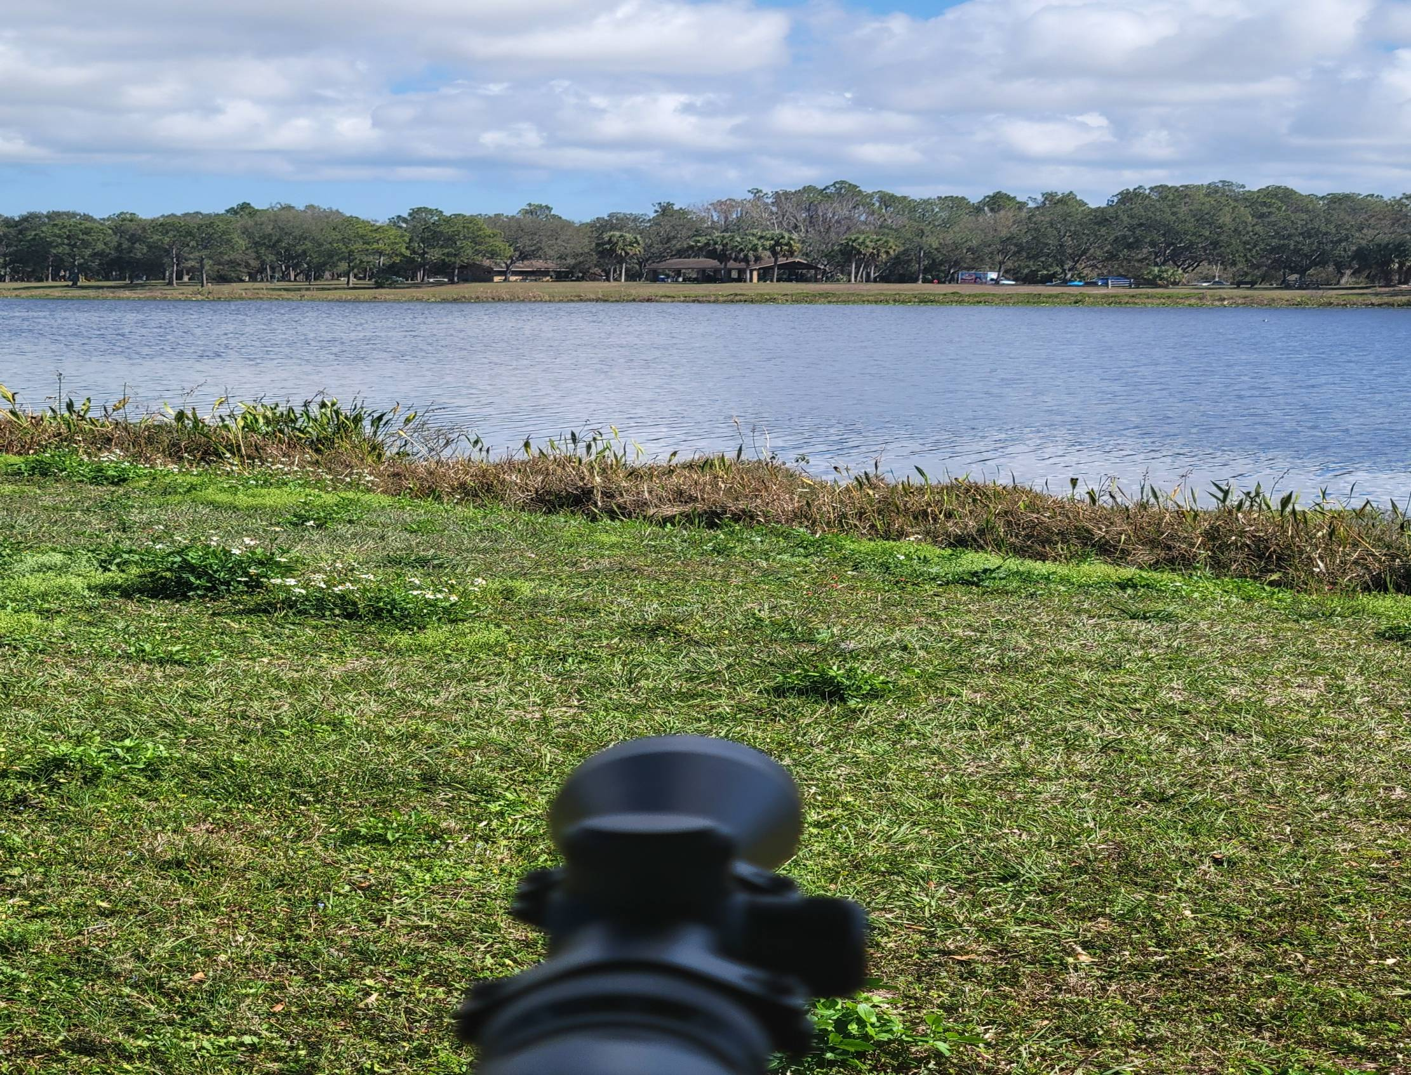

Slide 7
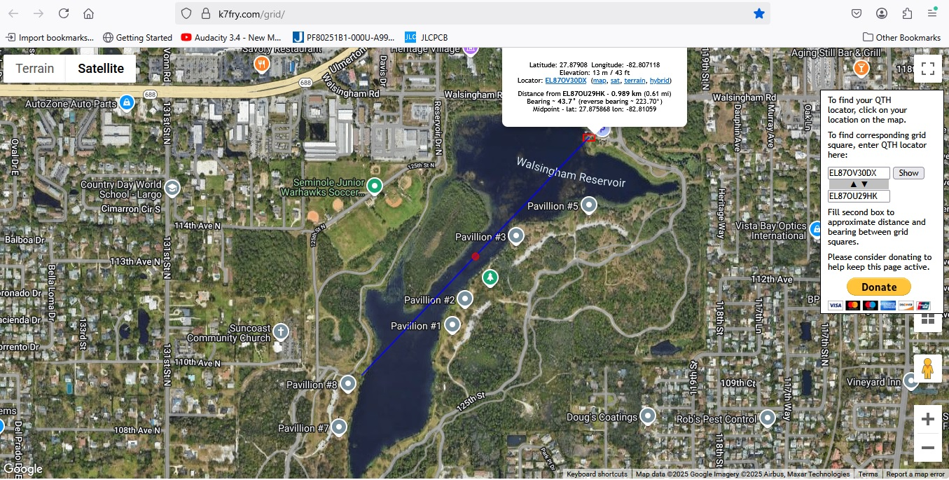
1kM Path

Slide 8
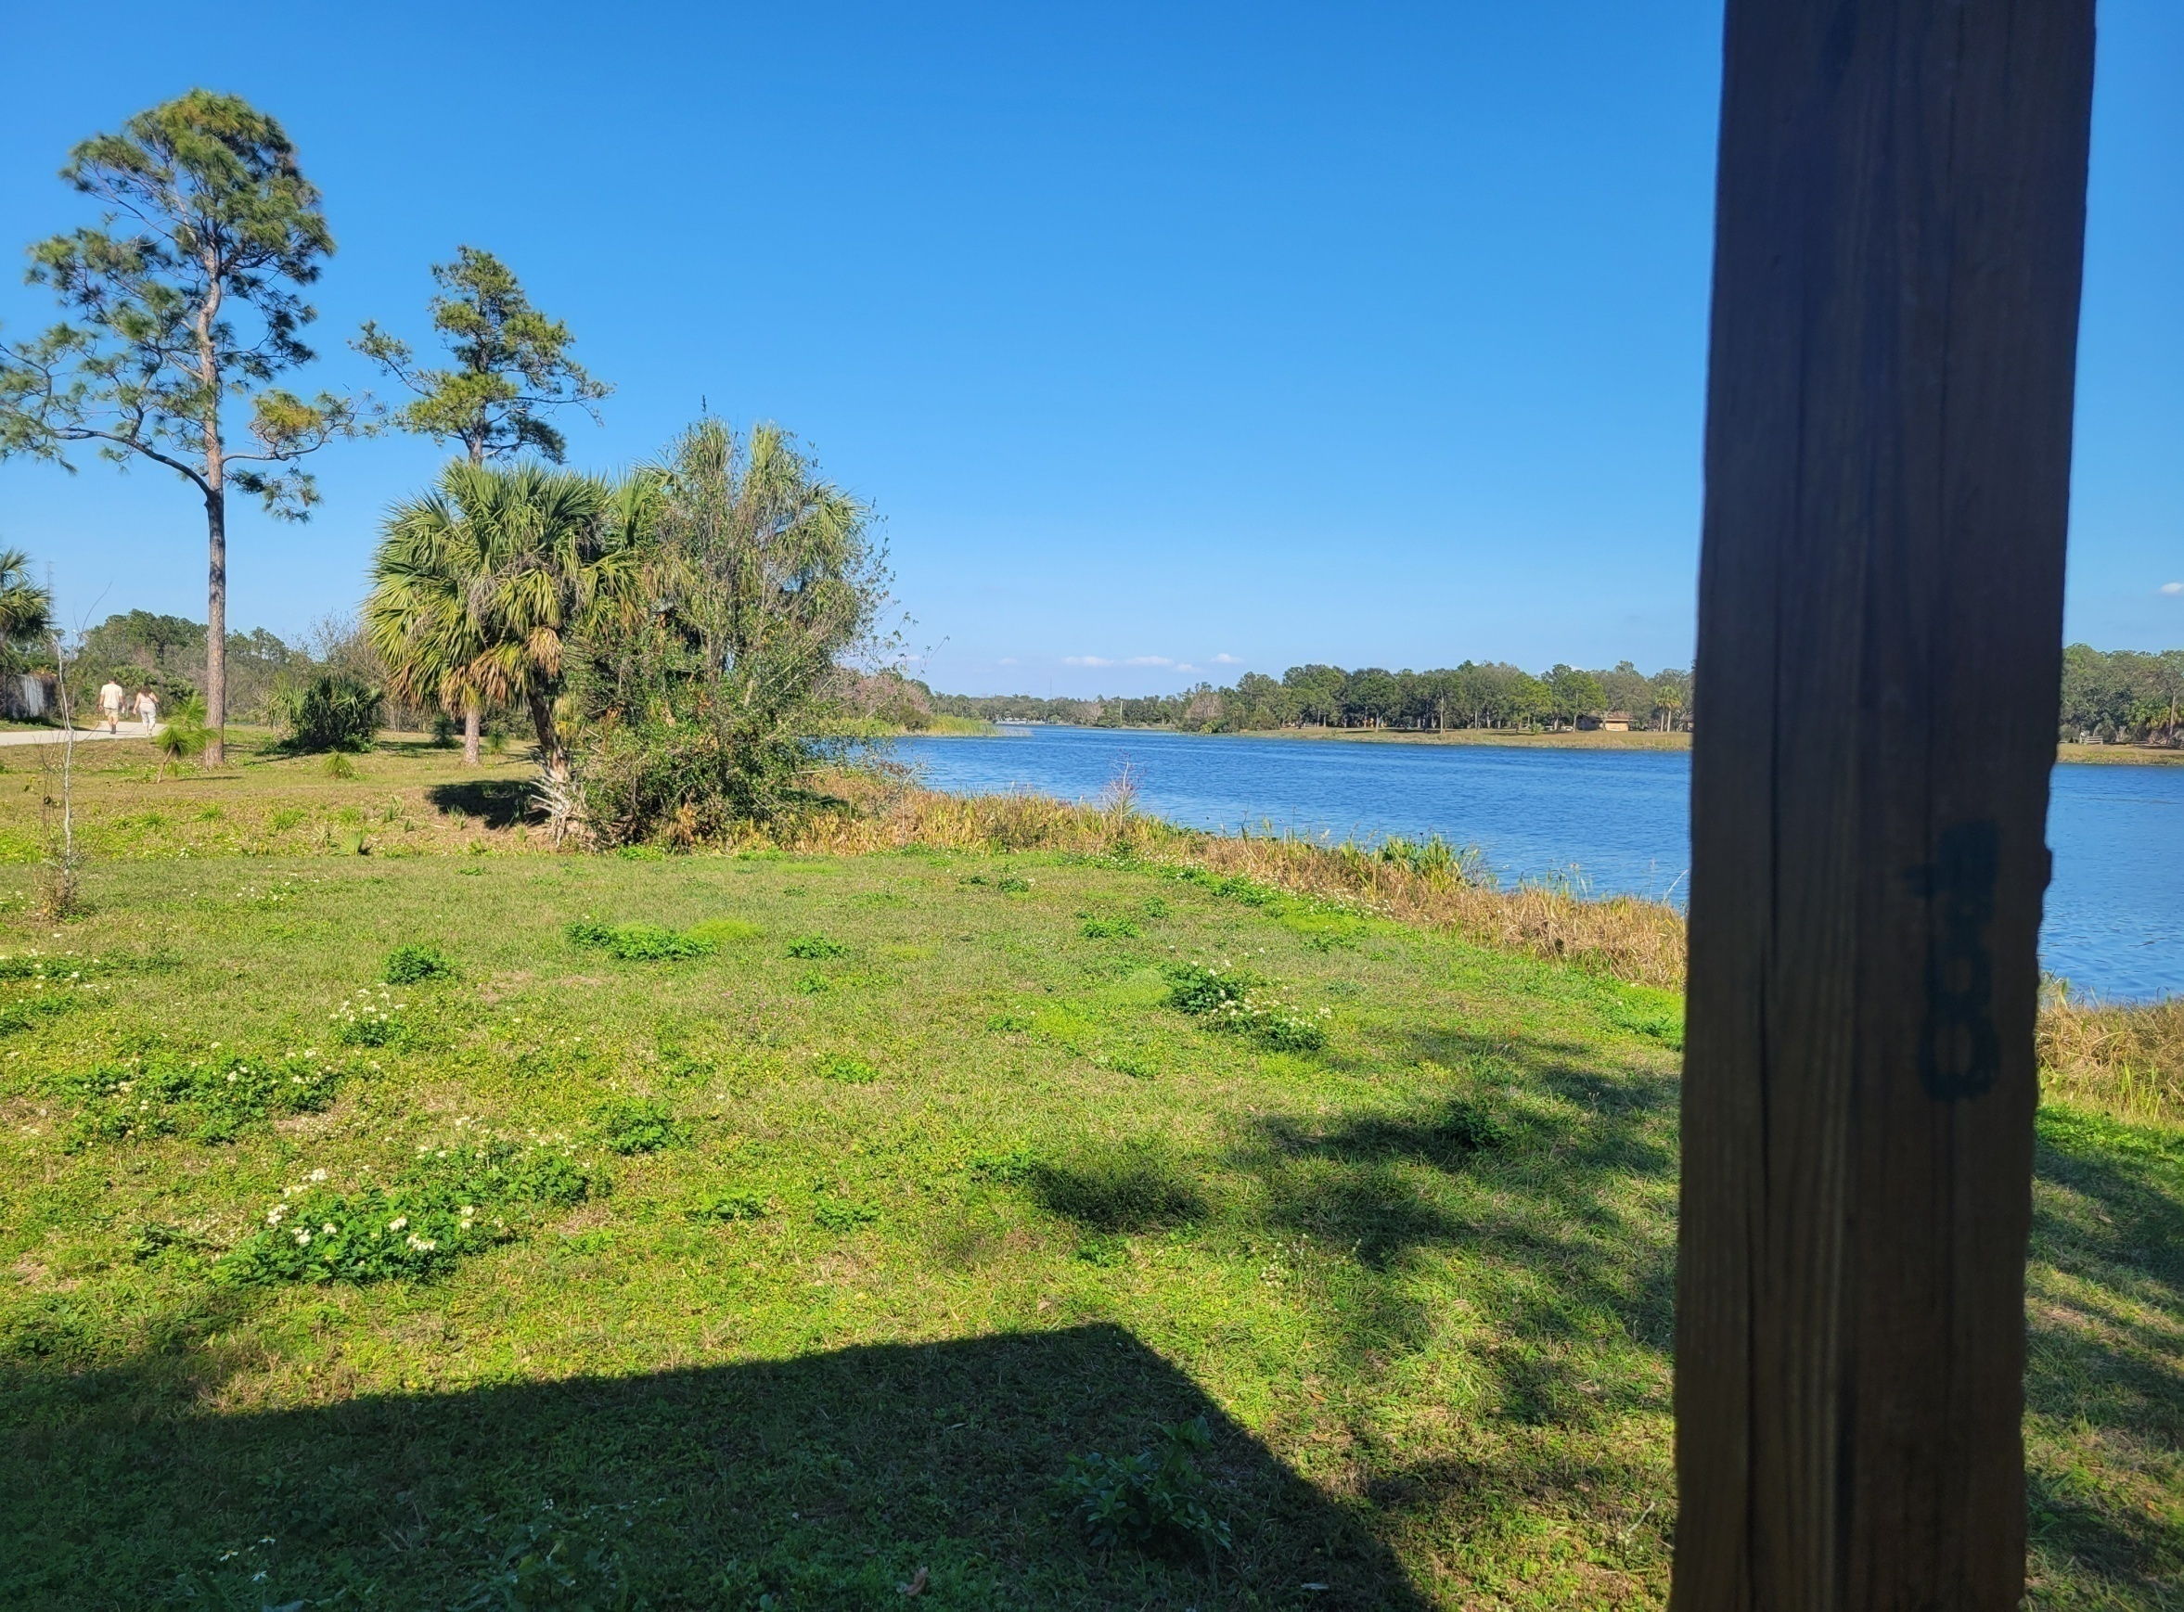

Slide 9
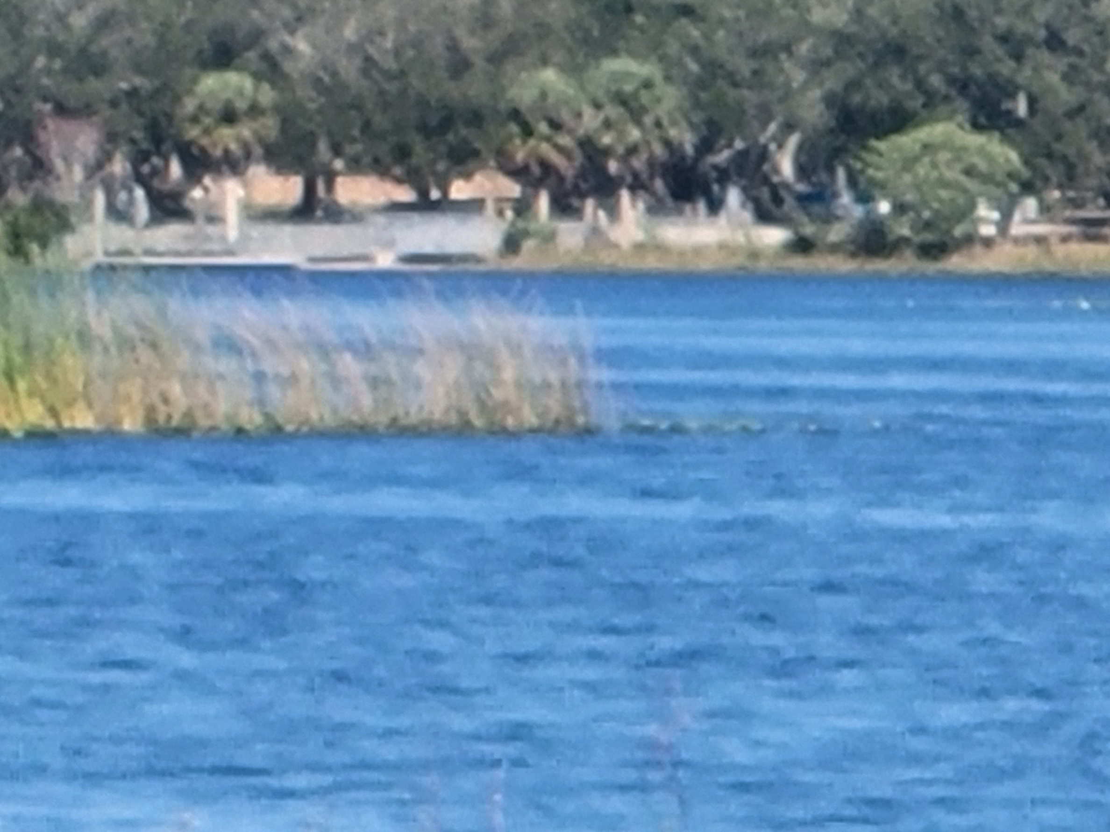

Slide 10
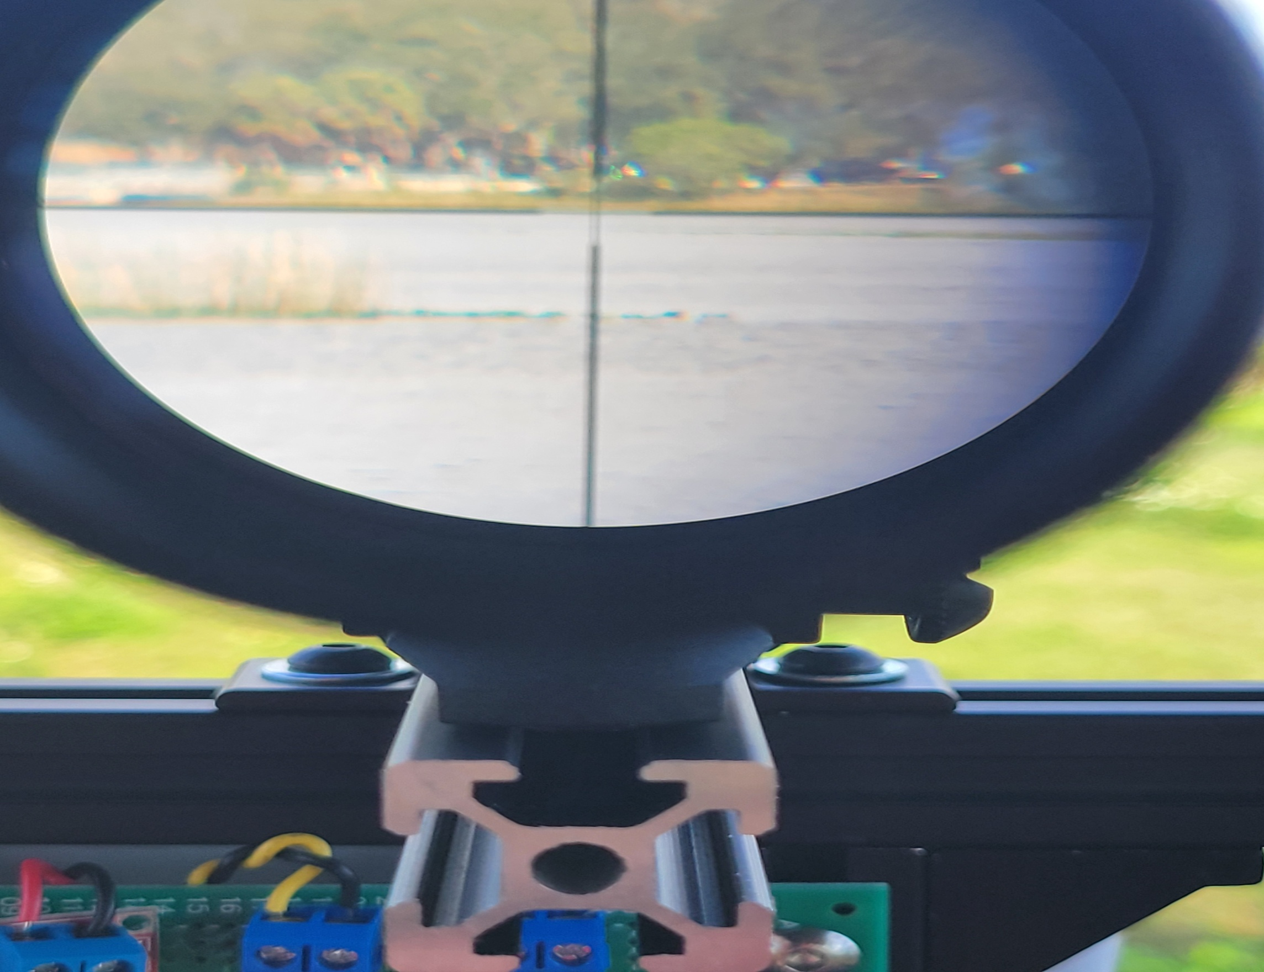

Slide 11
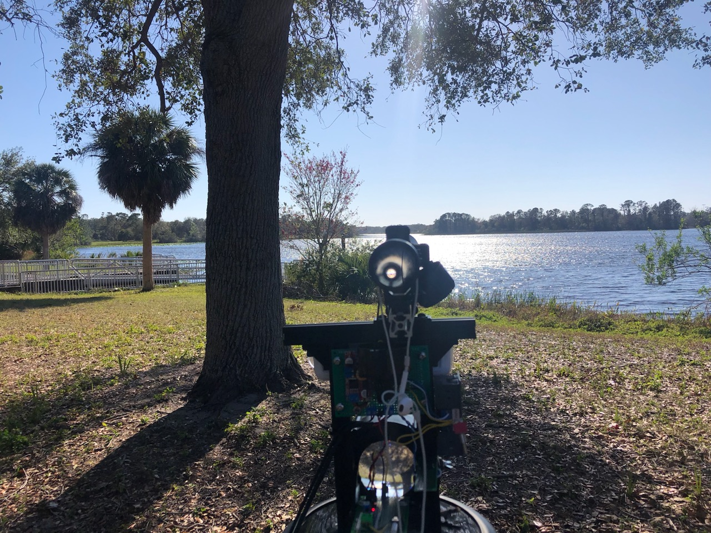
John’s End of the Path

Slide 12
Time To Start Building!!

Slide 13
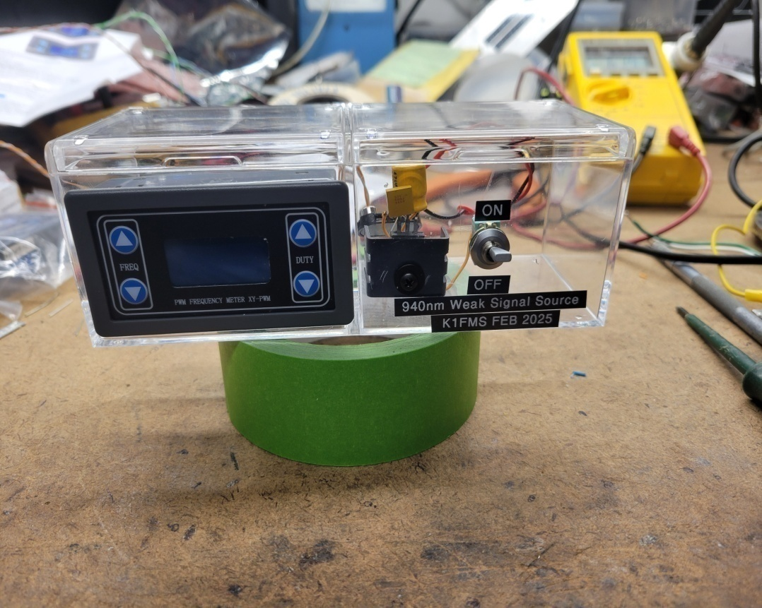
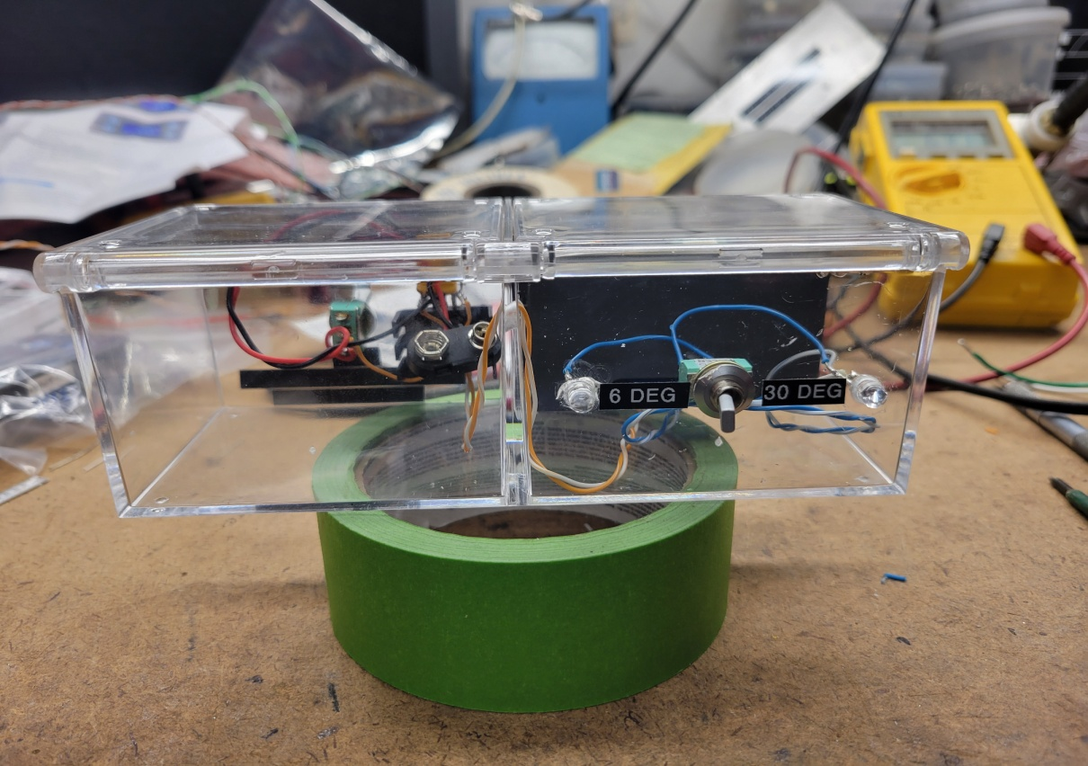
I Need a Weak Signal Source
9V Battery Powered
0 to 100kHz
0 to 100% Duty Cycle
1k ohm resistor in series
6 Degree or 30 Degree LEDs
Built in a $1.99 Tea Case

Slide 14
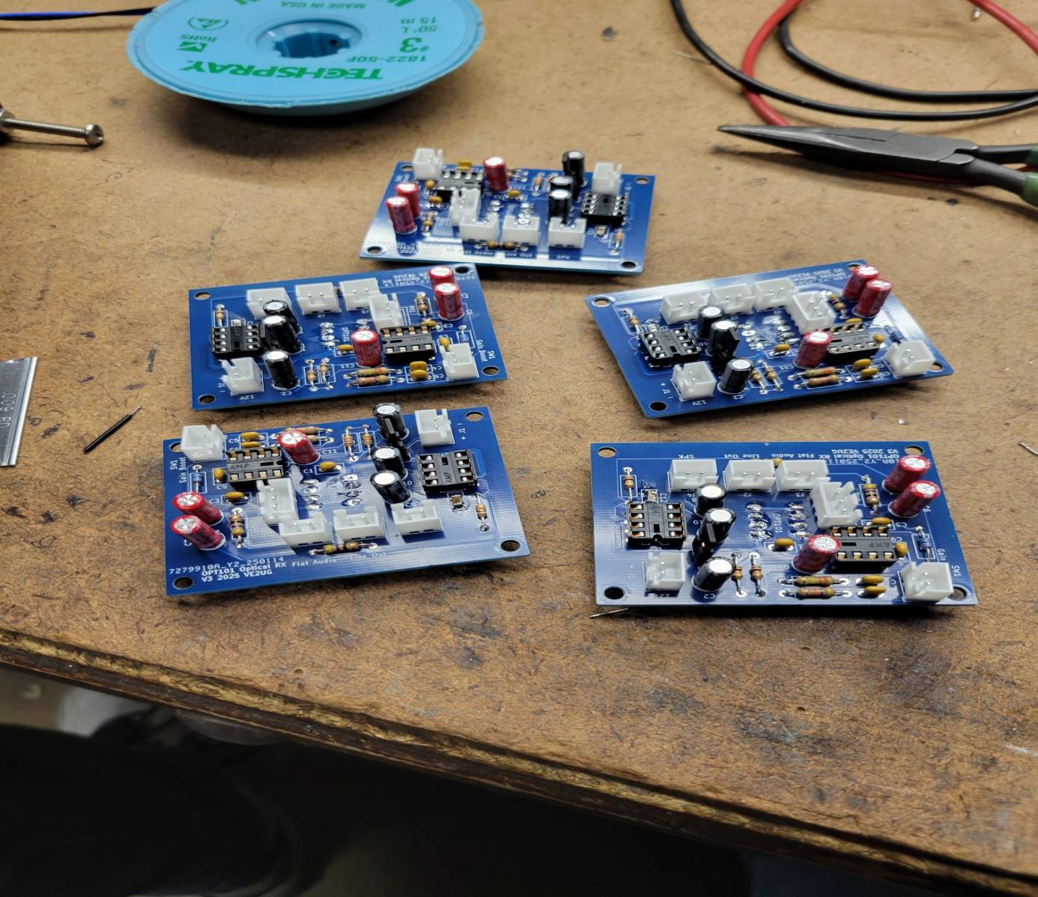
VE2UG RX Boards
Rene’s layout
Based on KA7OEI and K0XL designs
OPT101 Combination Detector / Trans-Impedance Amplifier
OpAmp gain stage and audio speaker driver
Boards from JLC PC Board were CHEAP!

Slide 15
RX Antenna Gain
Eye Loop = ~30dB
3” Projection TV Lens = ~60dB
5” Projection TV Lens = ~66dB

Slide 16
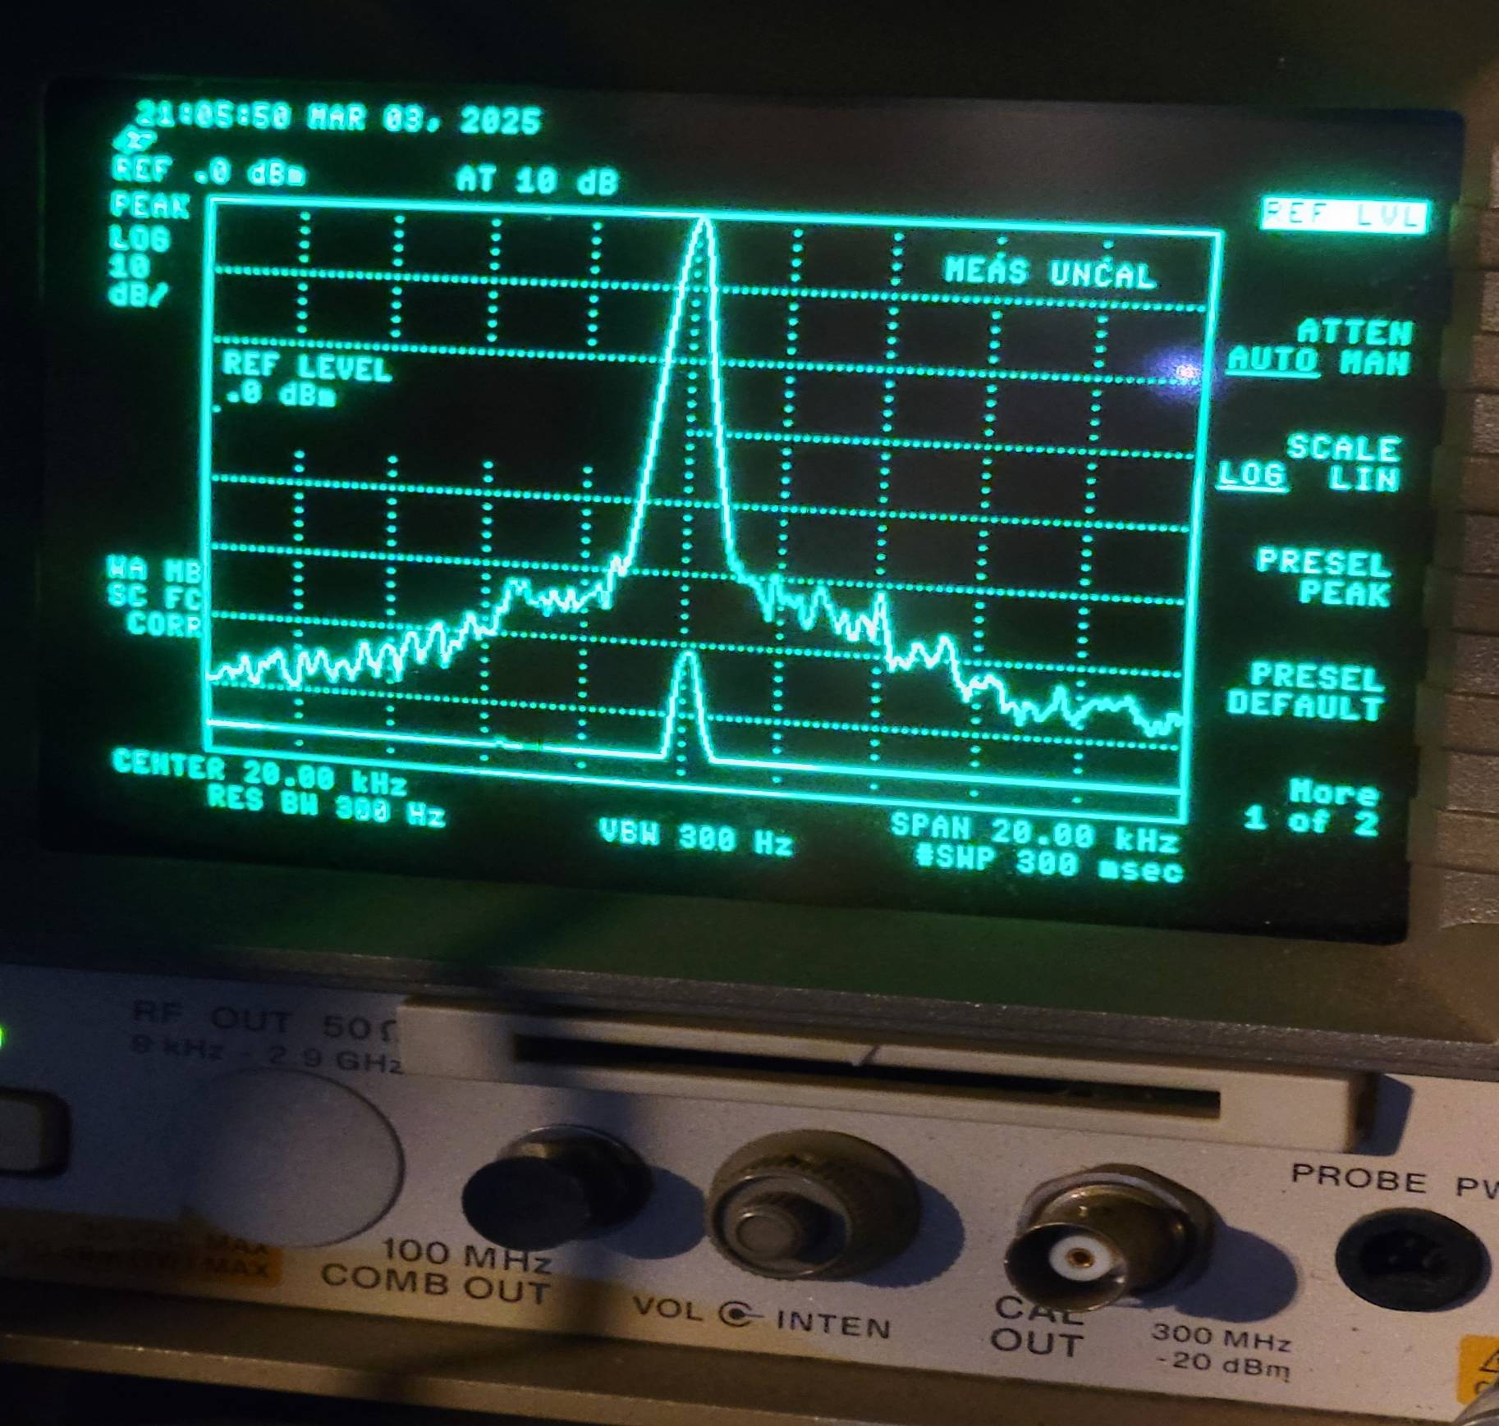

Slide 17
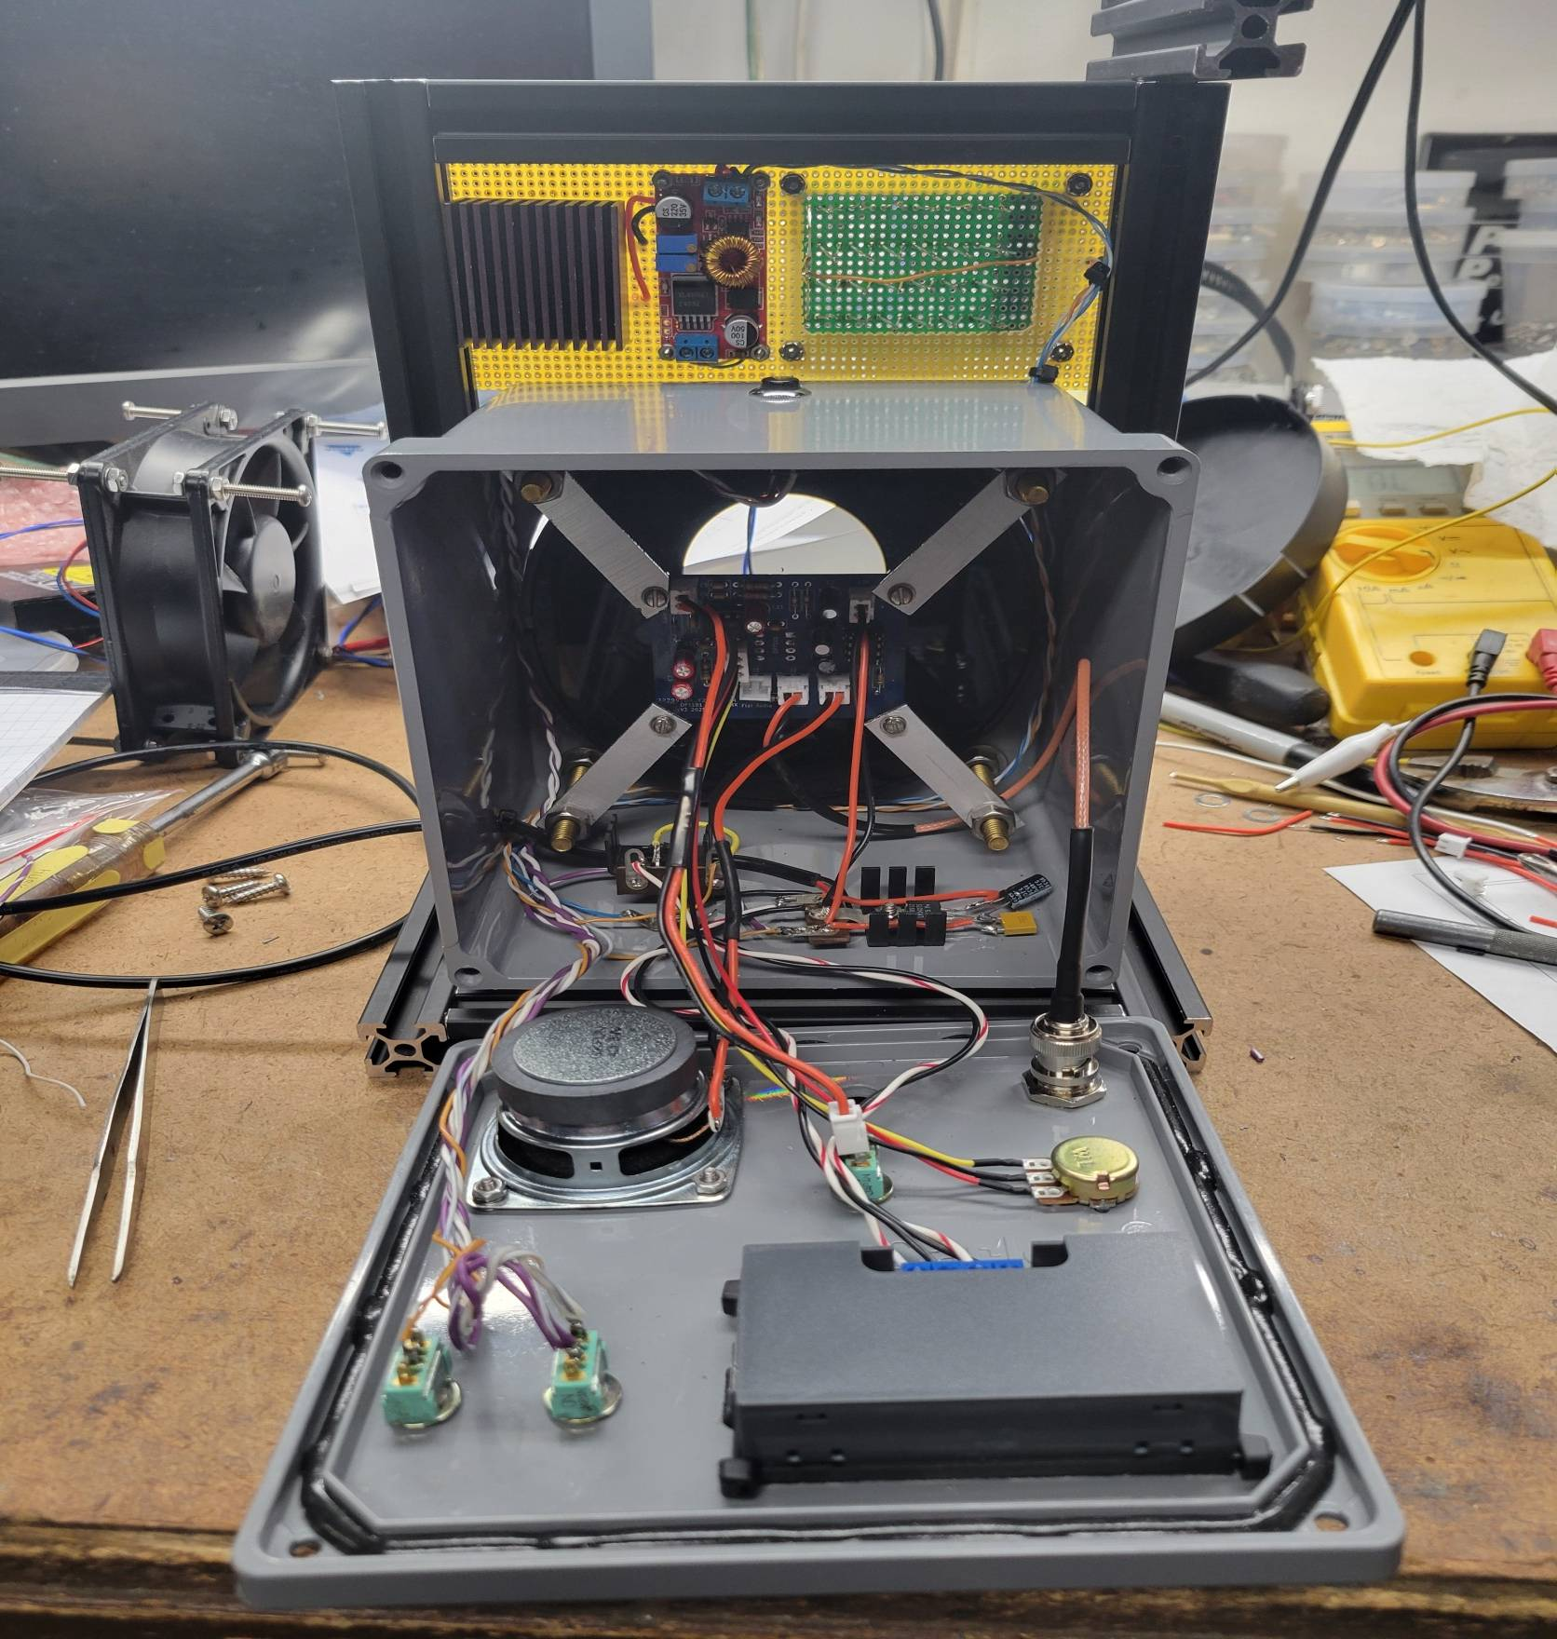

Slide 18
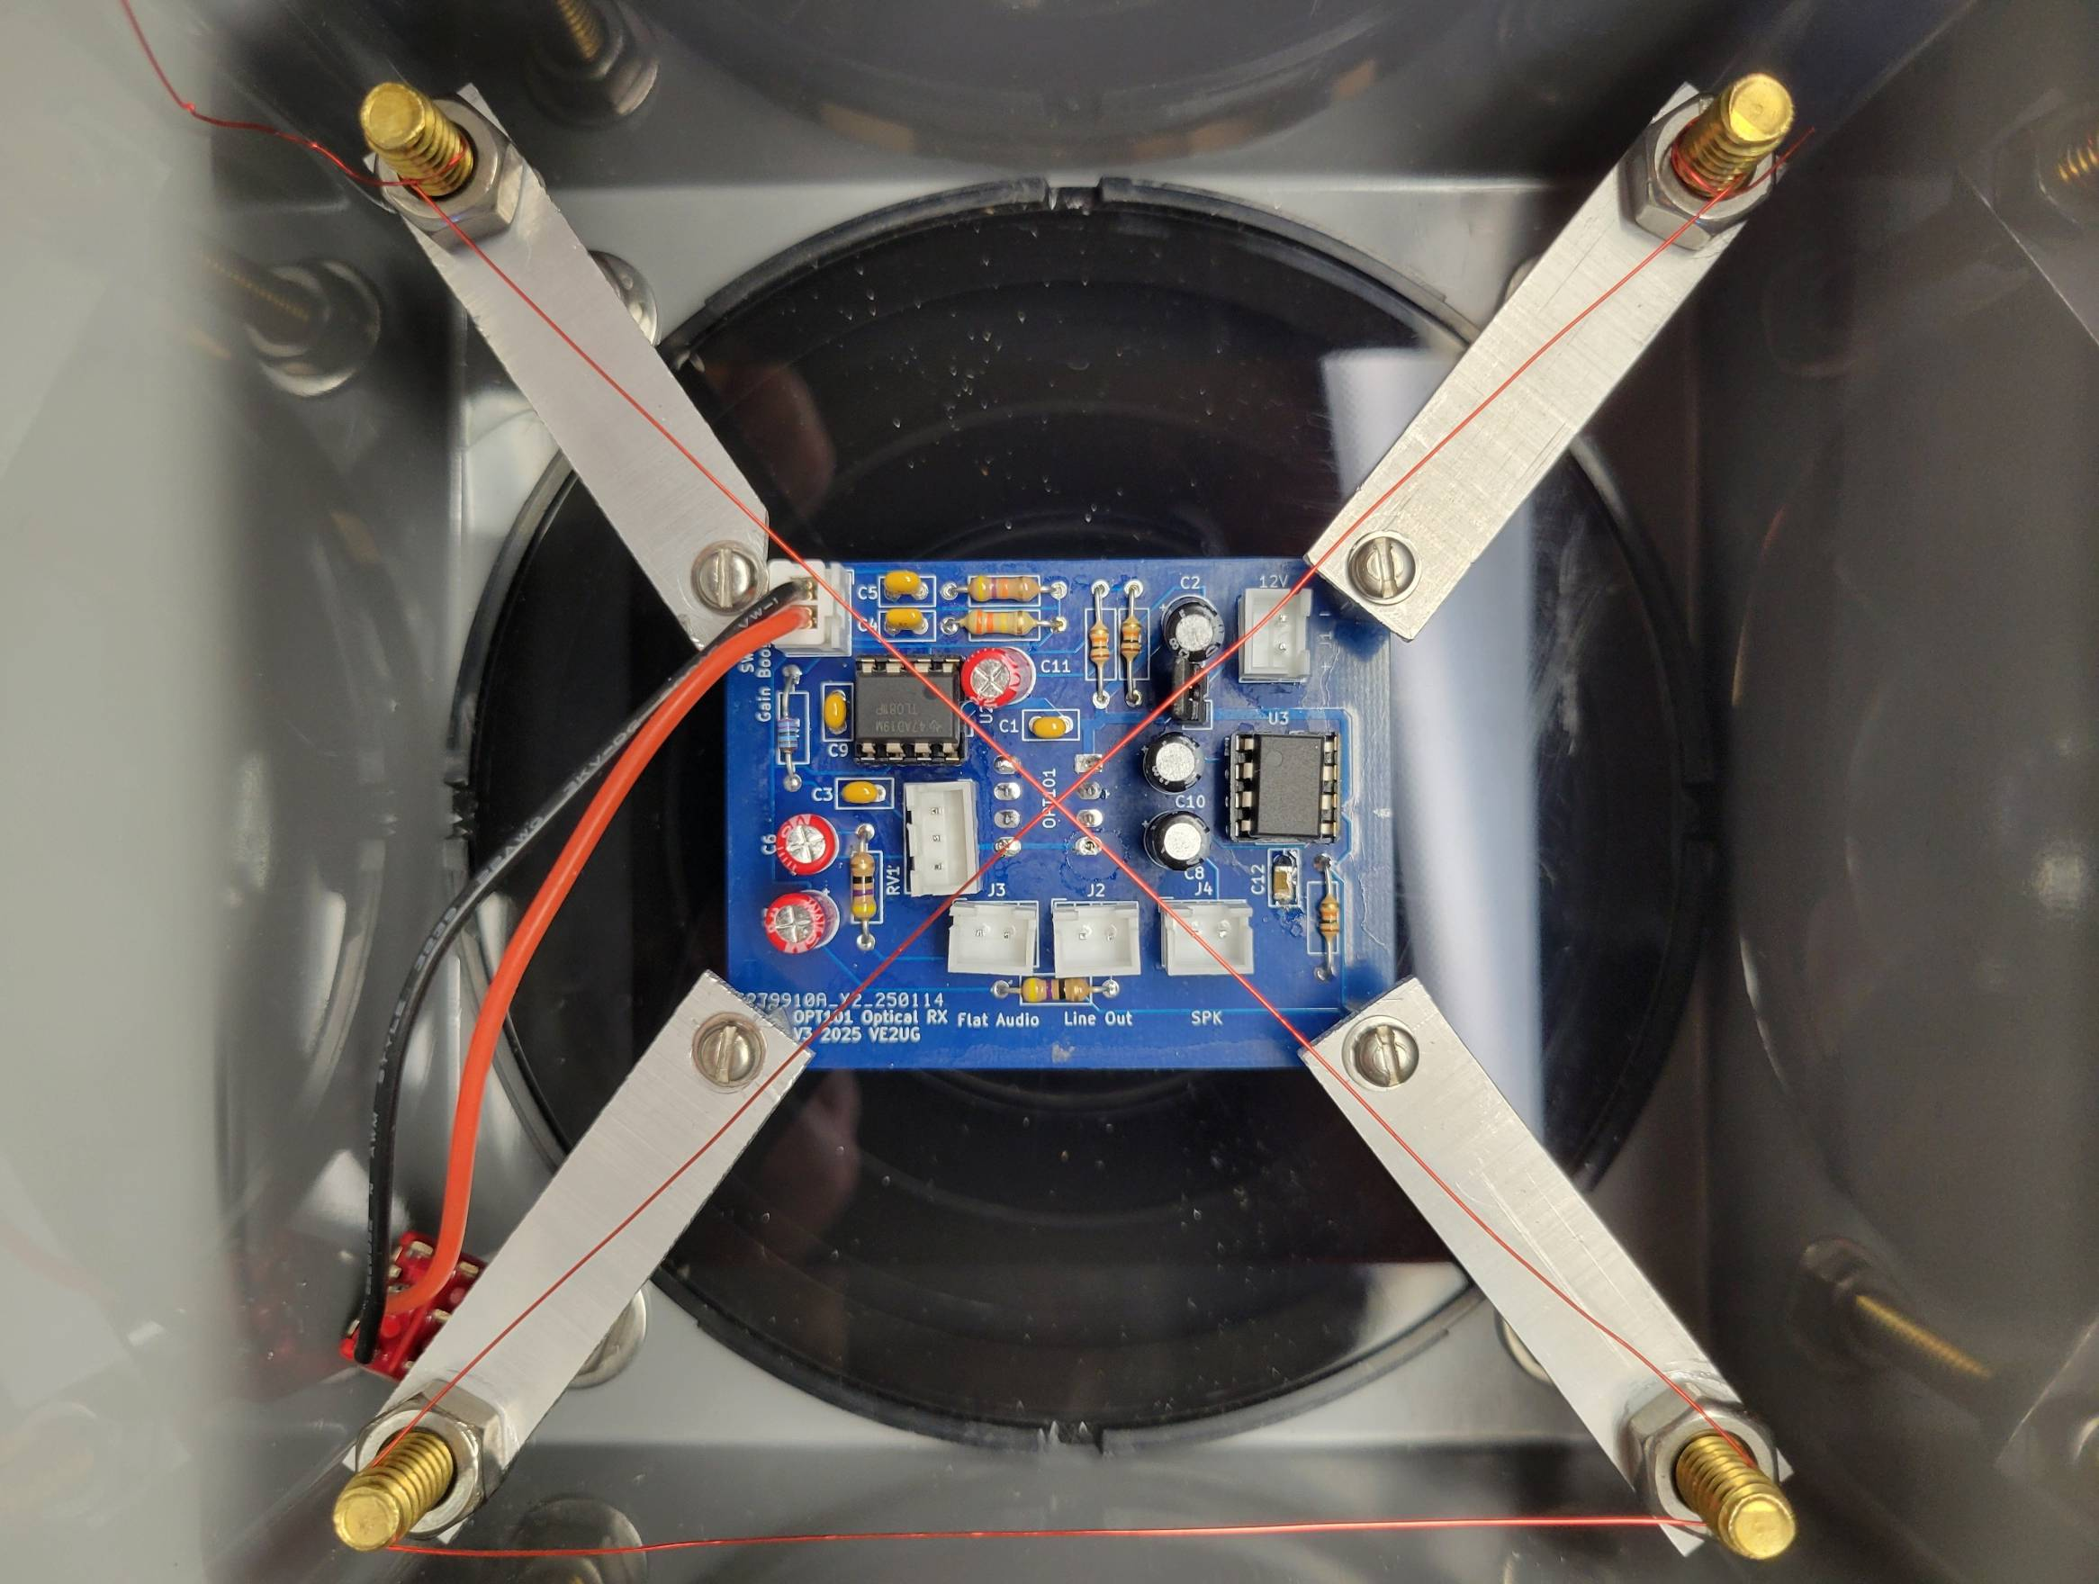

Slide 19
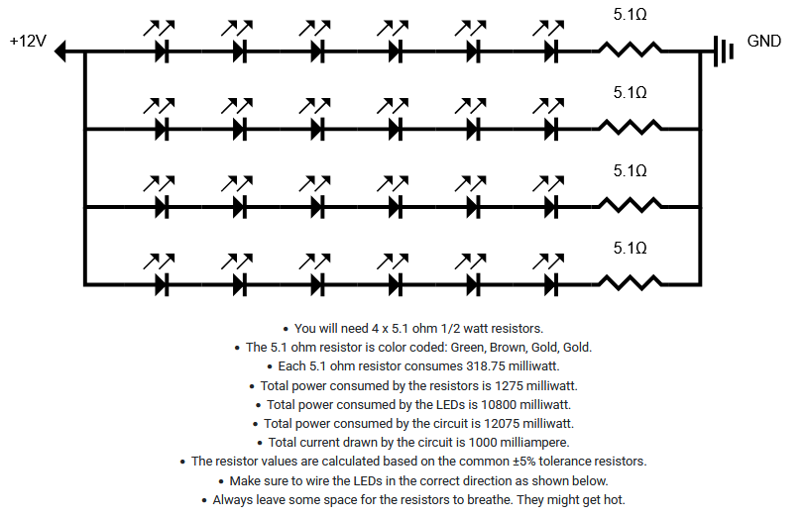
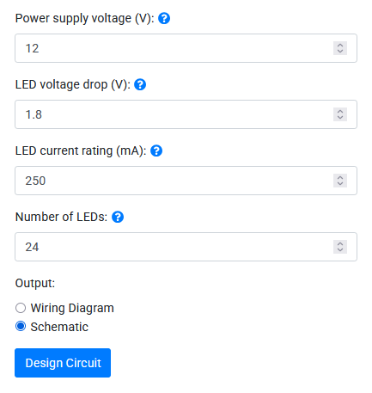
TX Time
How Many LED's?
How to connect them...LEDCalculator.net

Slide 20
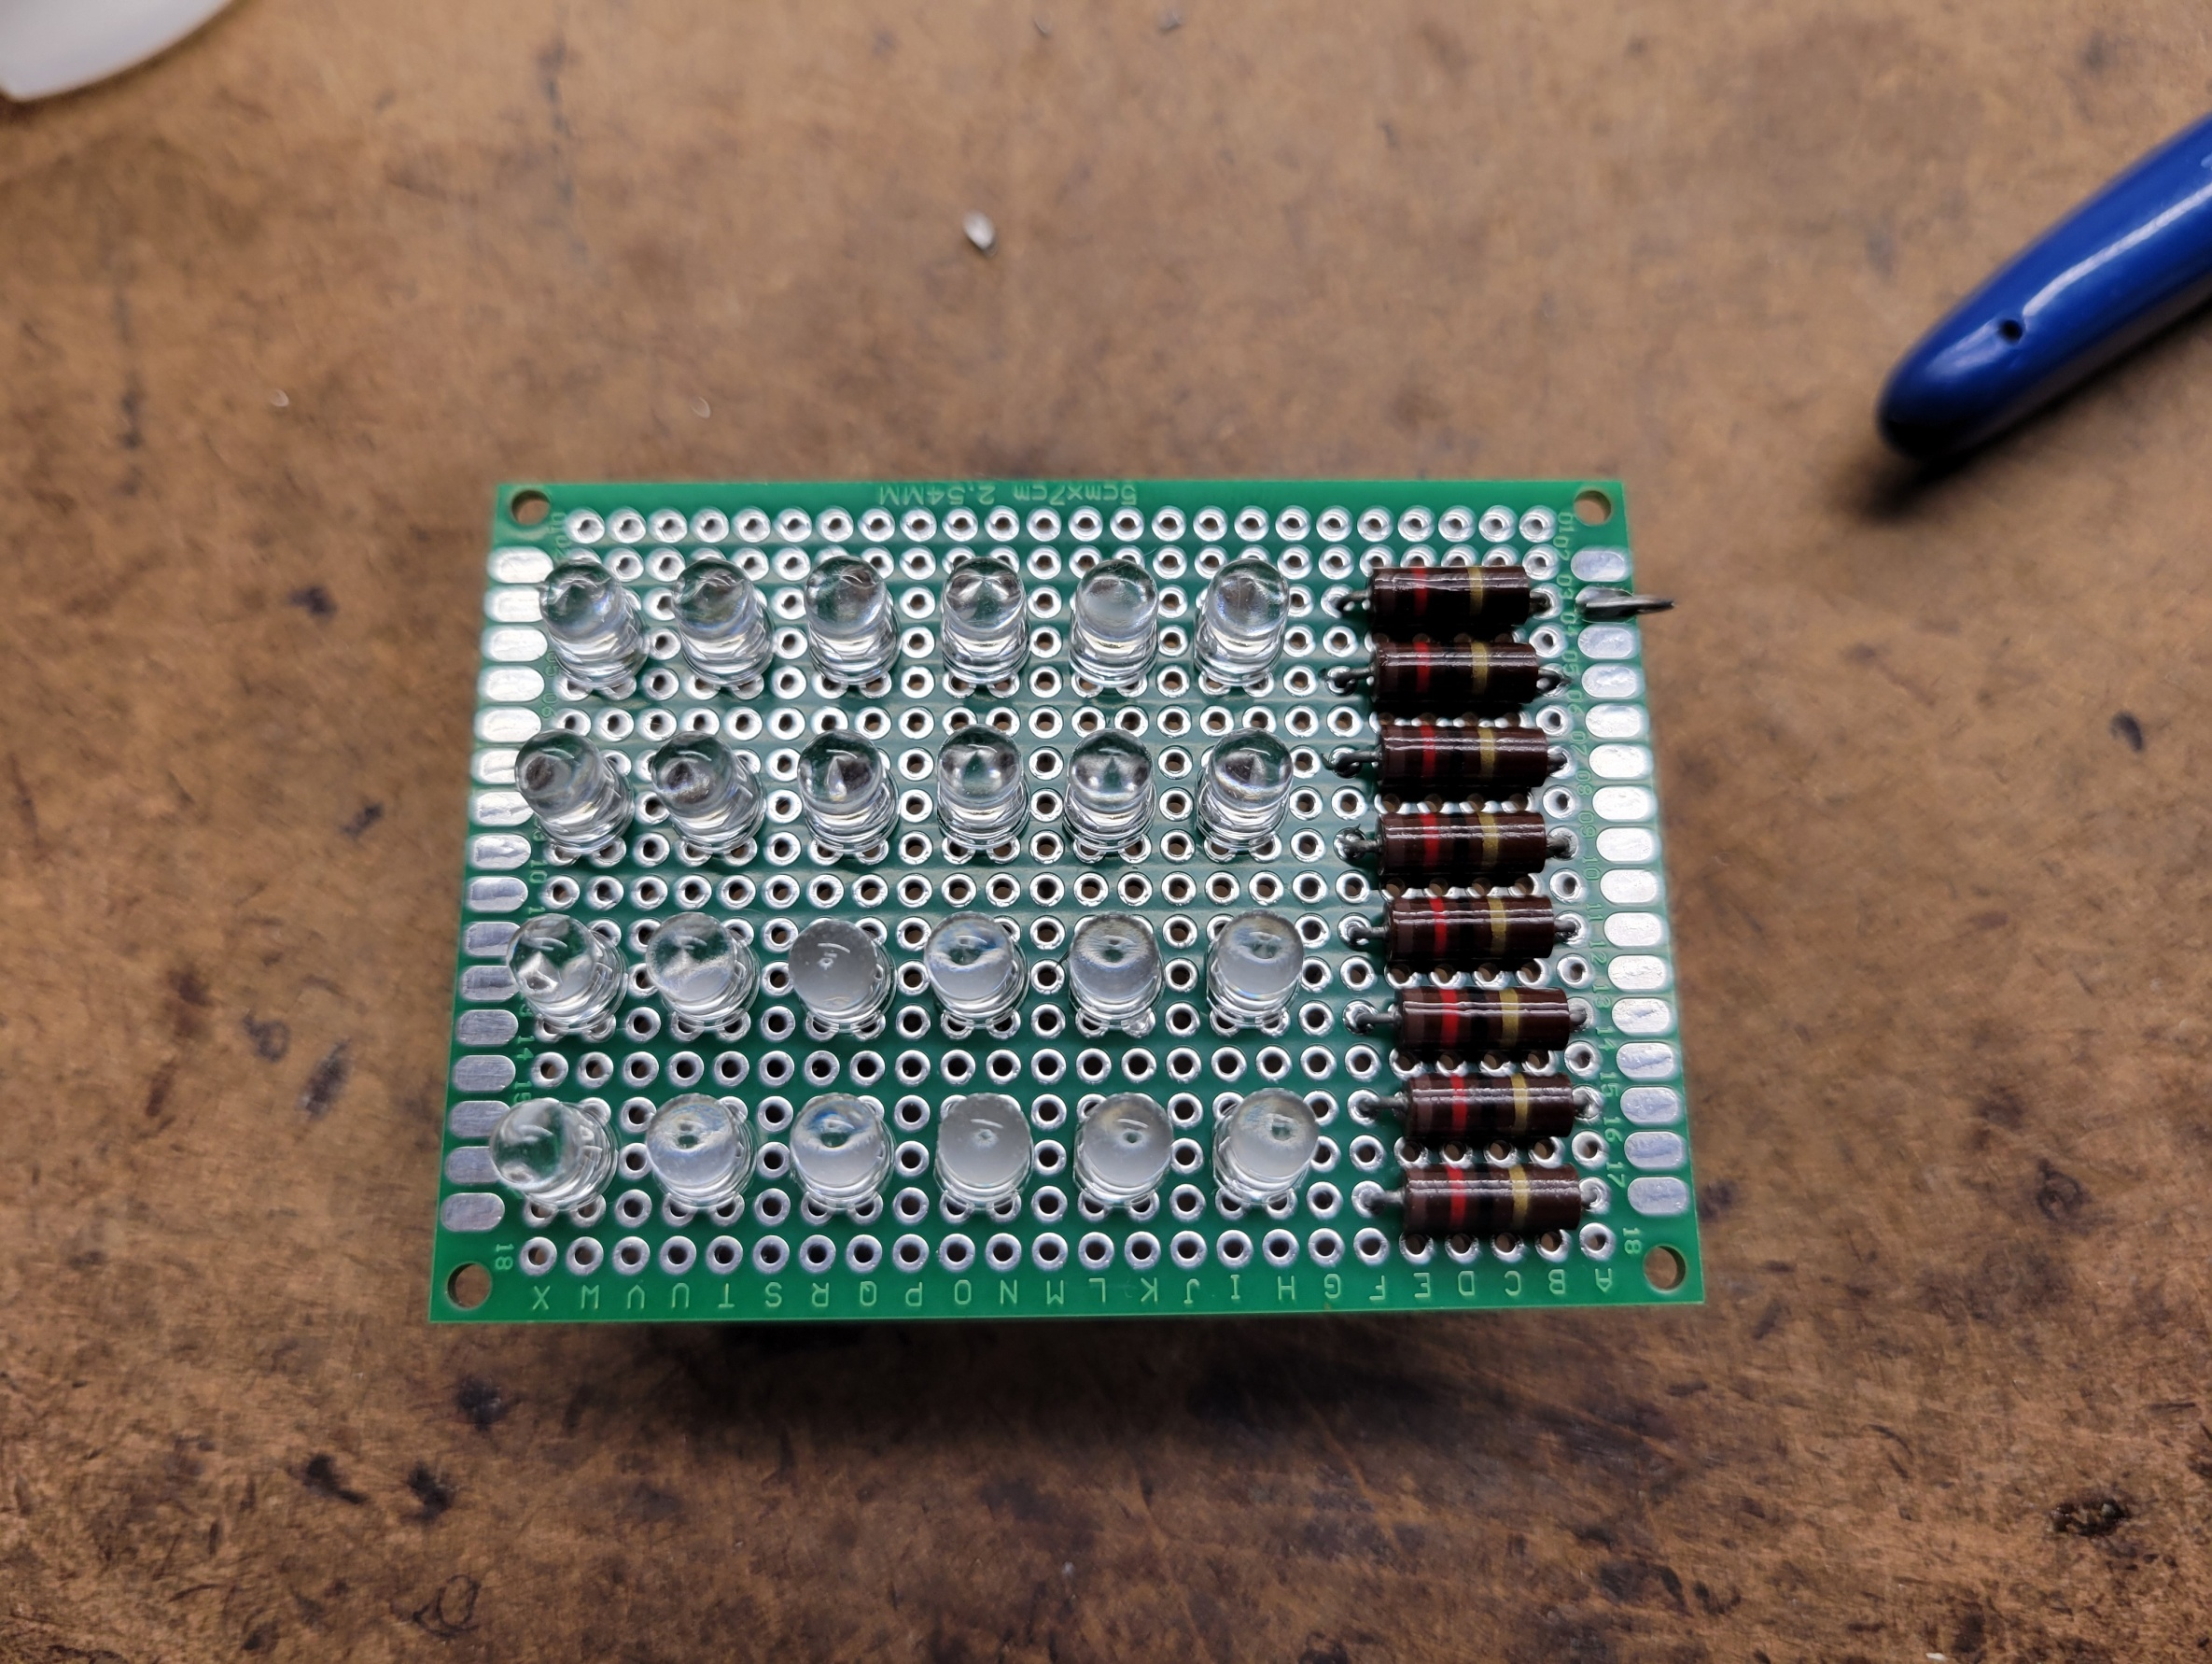

Slide 21
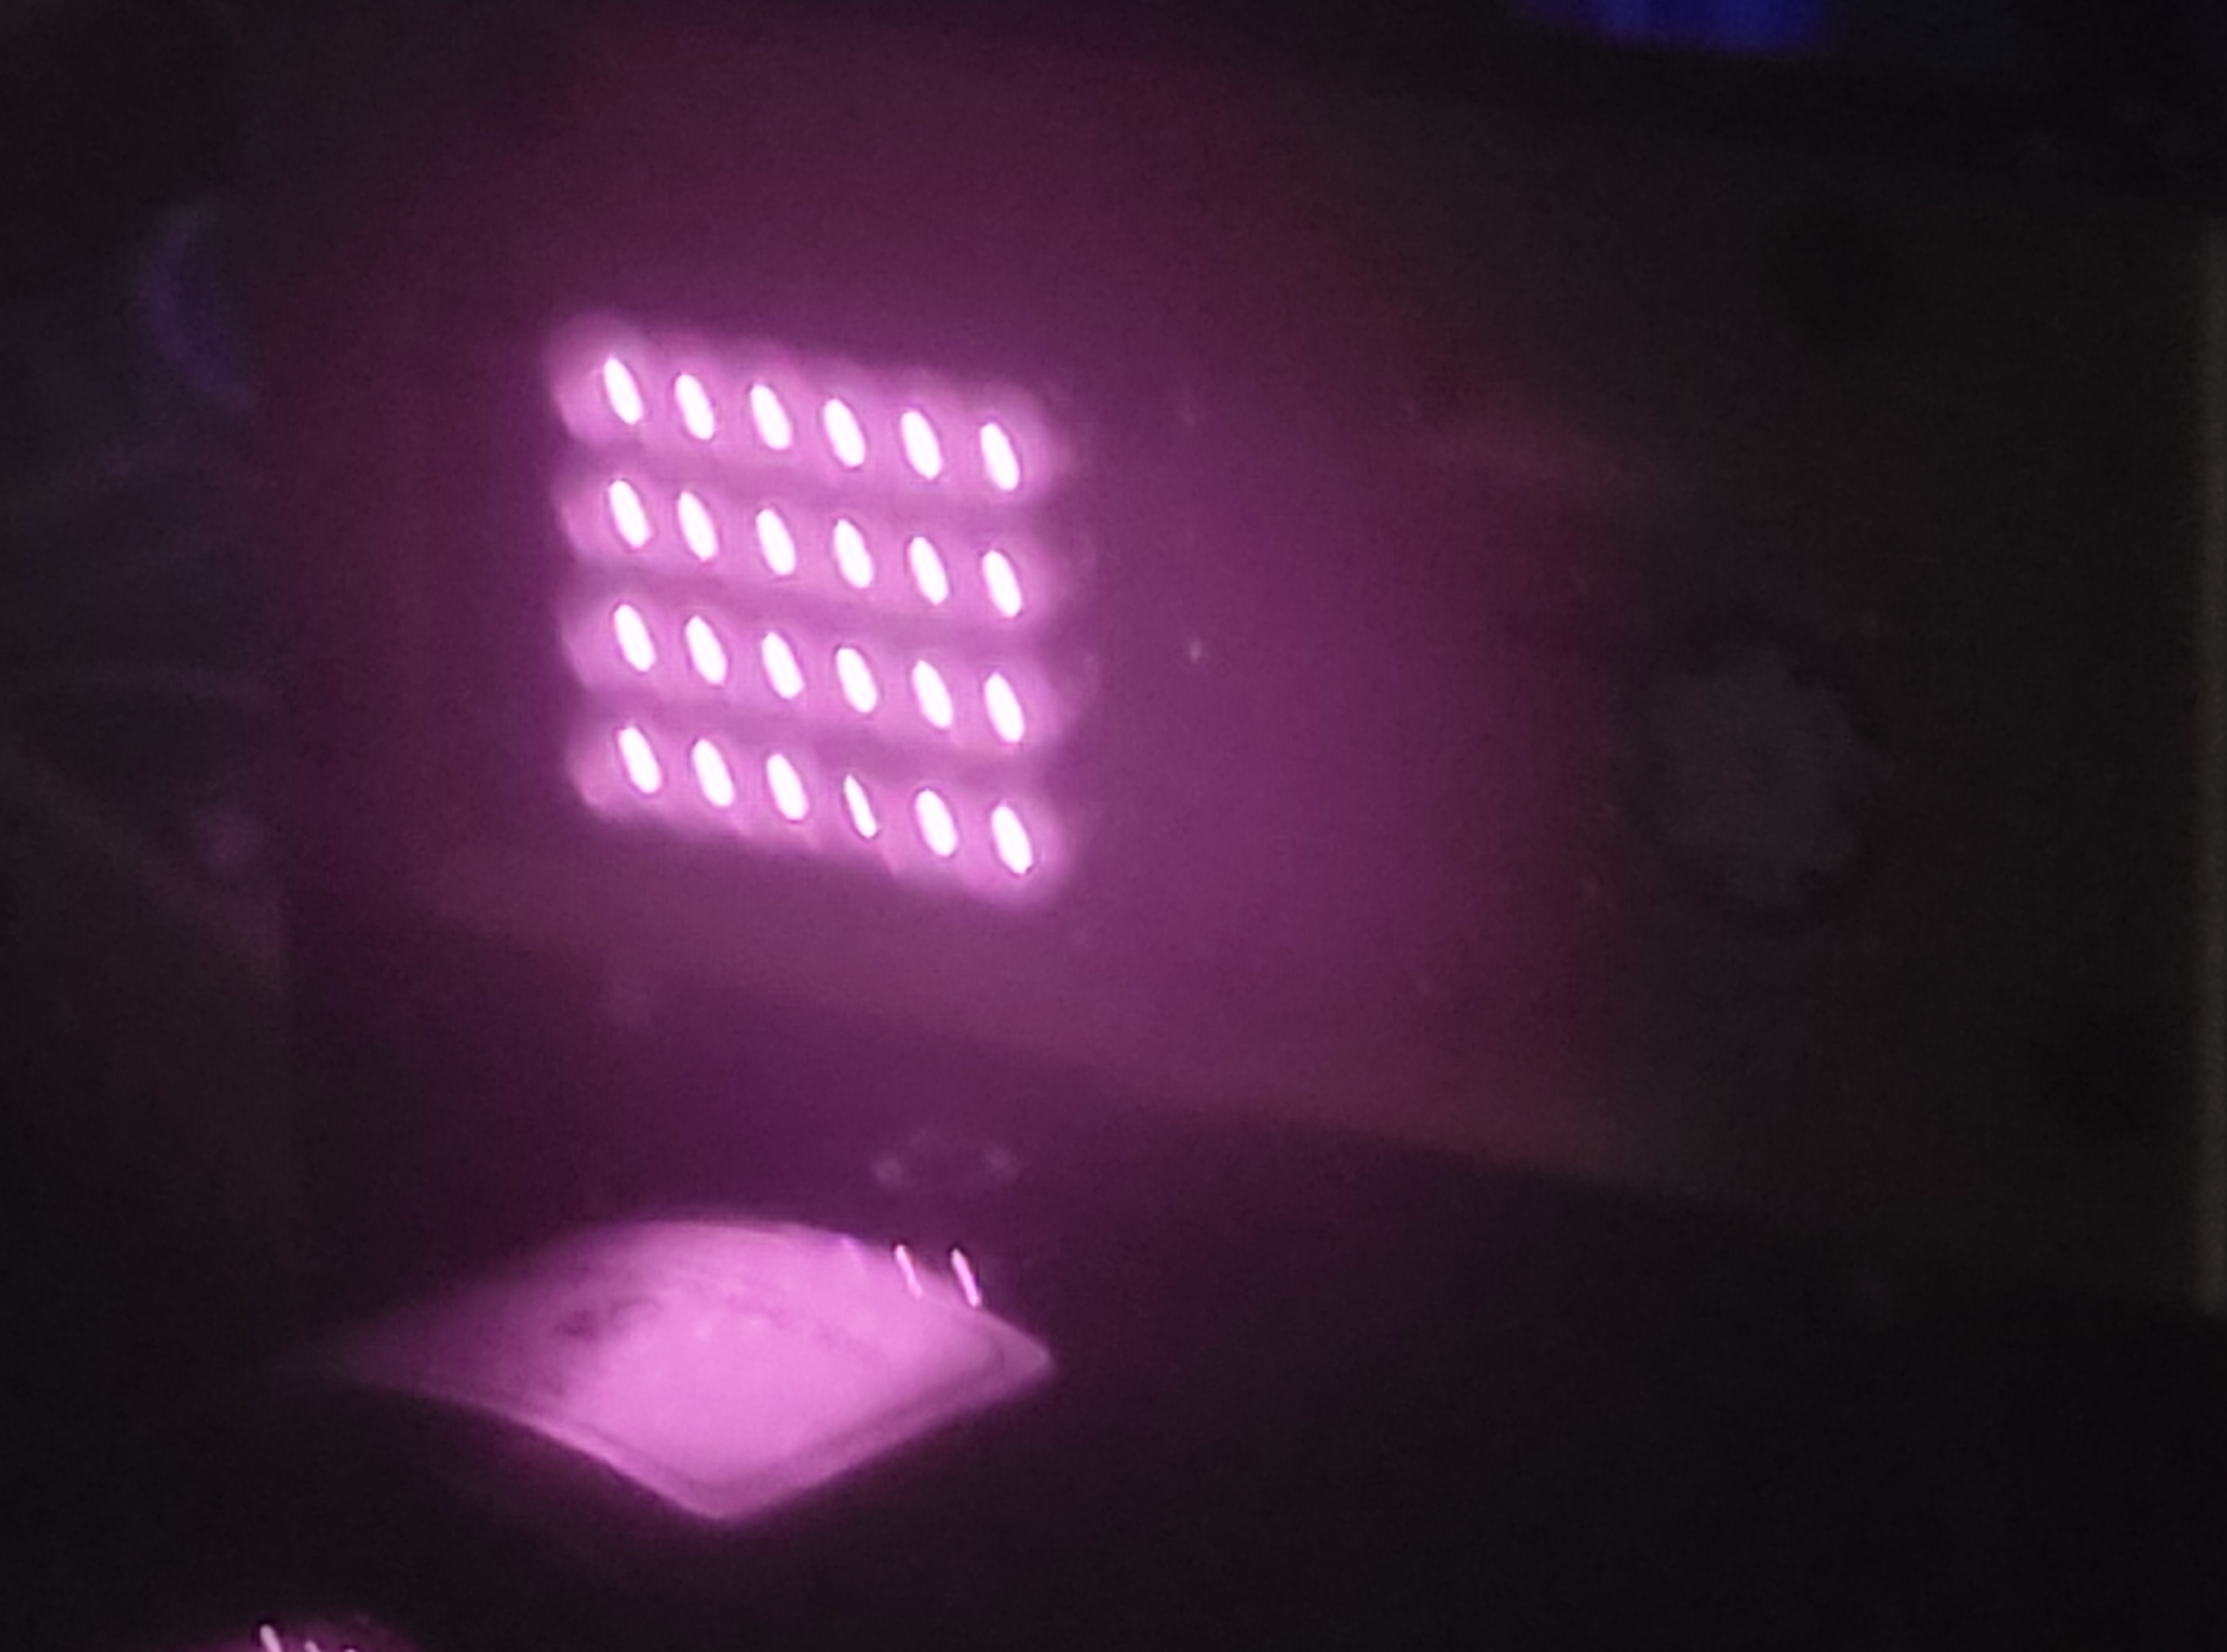

Slide 22
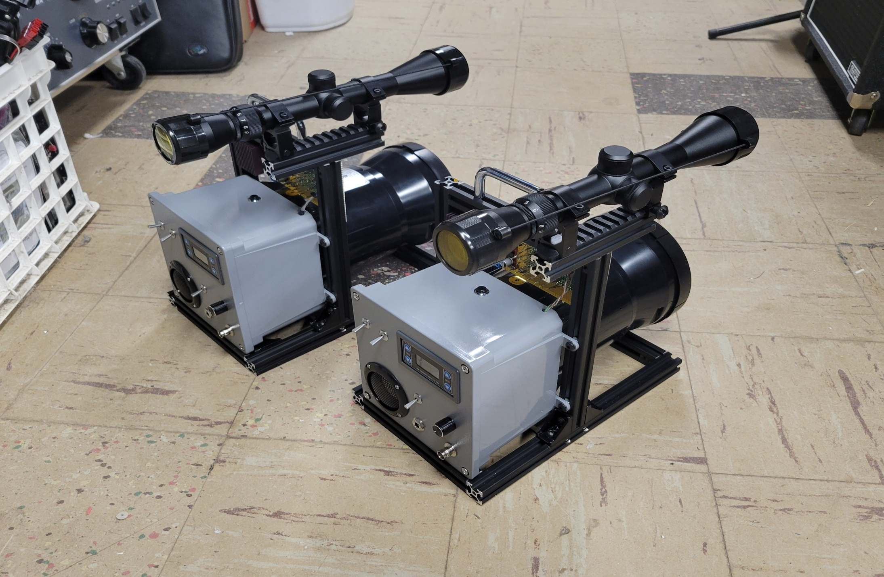
K1FMS Rigs

Slide 23
Time to go try these out!
Get with Paul and do some tests and tweaks at his QTH
Work Paul across his yard about 250 feet.
  Take the lens cap off!
Off to Bantam Lake for a real QSO!

Slide 24
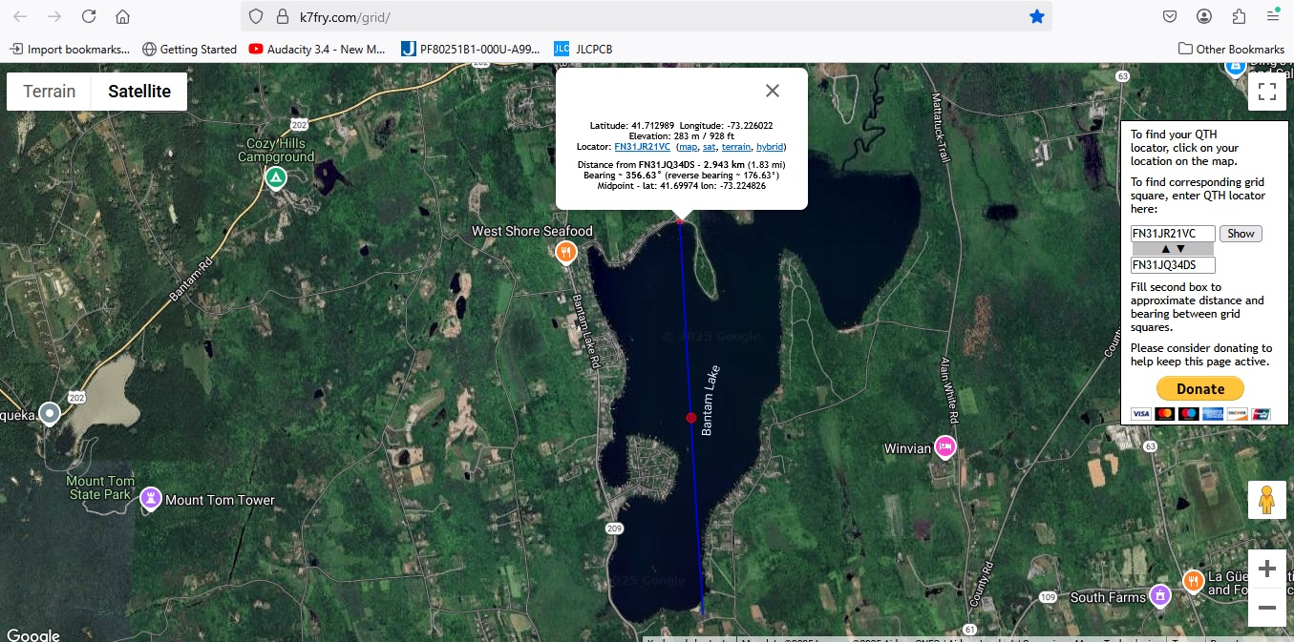
Bantam Lake, Morris & Litchfield, CT

Slide 25
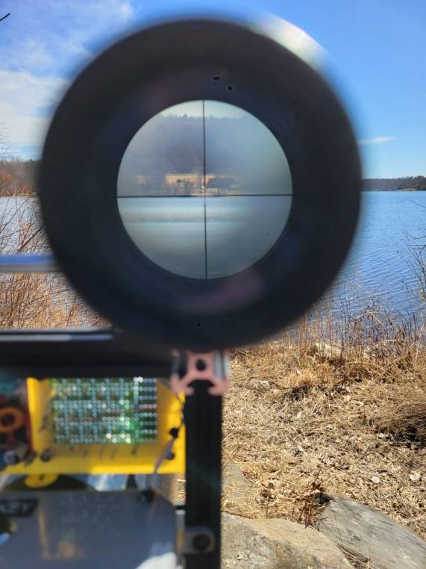
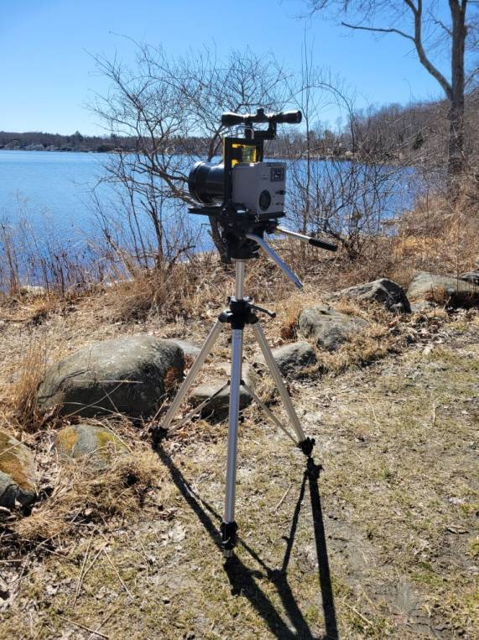
Bantam Lake
Receivers oscillate from too much sunlight.
Need 940nm filters!
Had to cover 80% of lens to calm down
Made the contact anyway!

Slide 26

Bantam Lake Signal

Slide 27
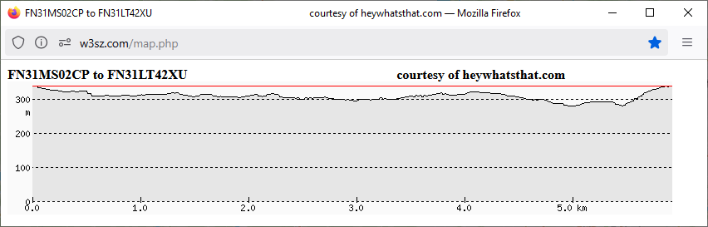
Burlington to New Hartford
4 Mile Path
Sunny Day
Worked pretty easily!

Slide 28
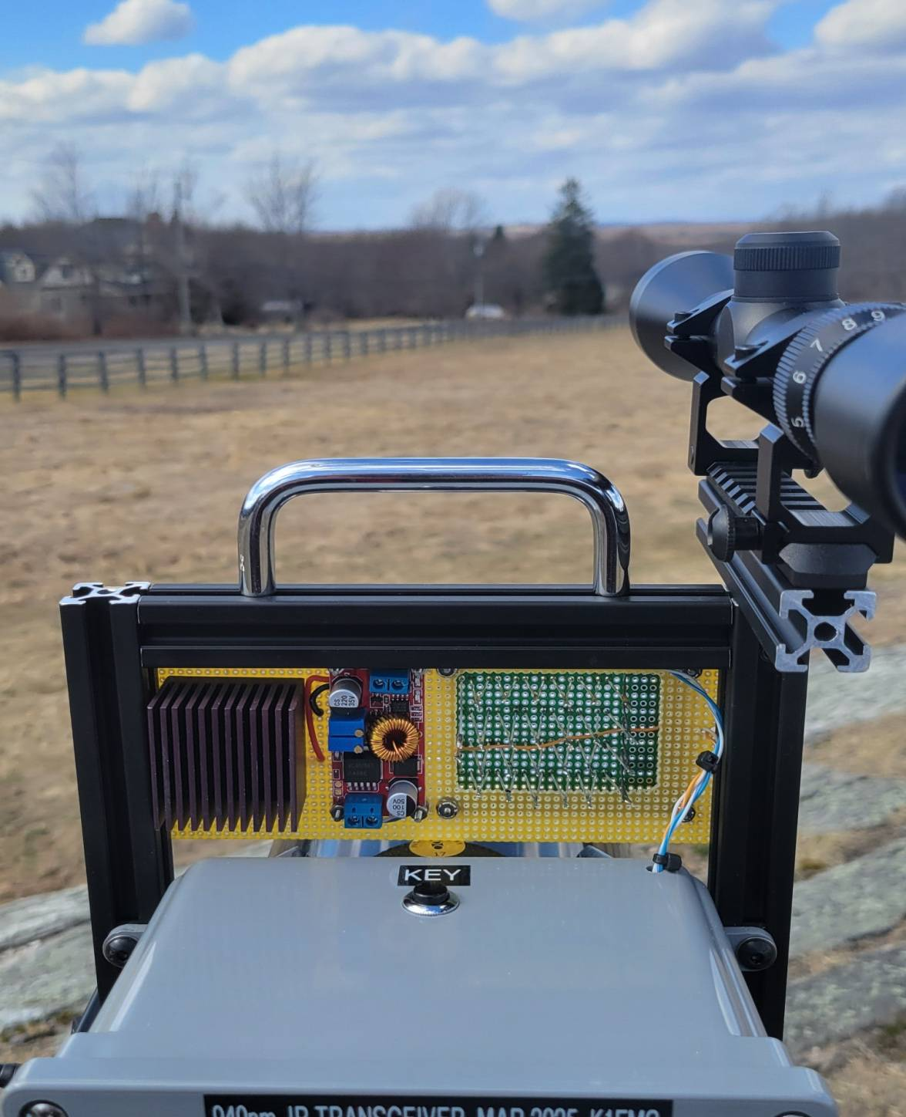
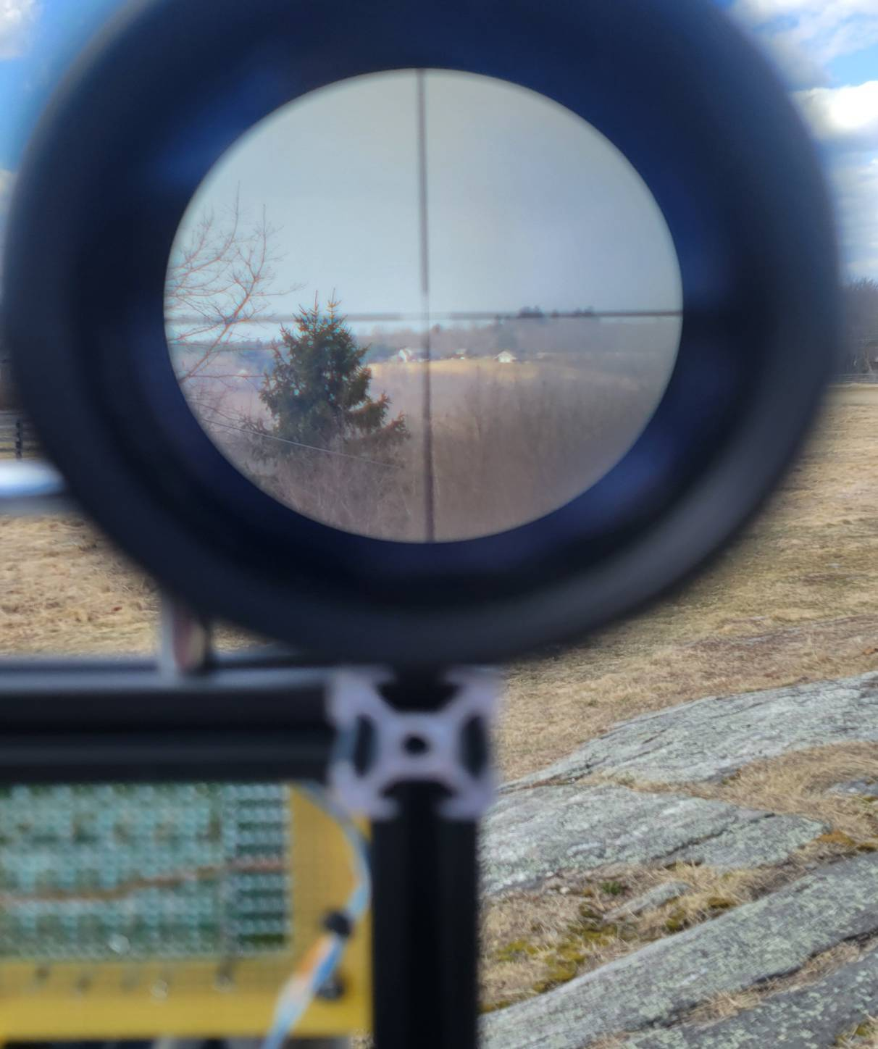

Slide 30
What next? Longer Path!
Looked for about an 8 mile path.
  Didn’t find anything.
Found a 14 mile path!
  FN31SU76MJ to FN32QA65FC
  Fox Hill in Rockville CT to Hill Top Farm in Suffield CT
  10 Digit Grids are IMPORTANT for path analysis!
    You’ll see why…

Slide 31
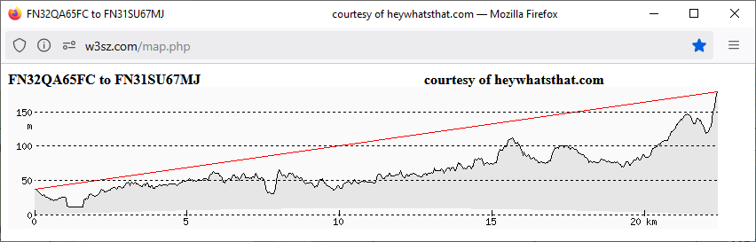
First Attempt…
Path looks good online.
Paul can see my site through binoculars
I can’t see his site and no signals during daytime or night time!

Slide 32
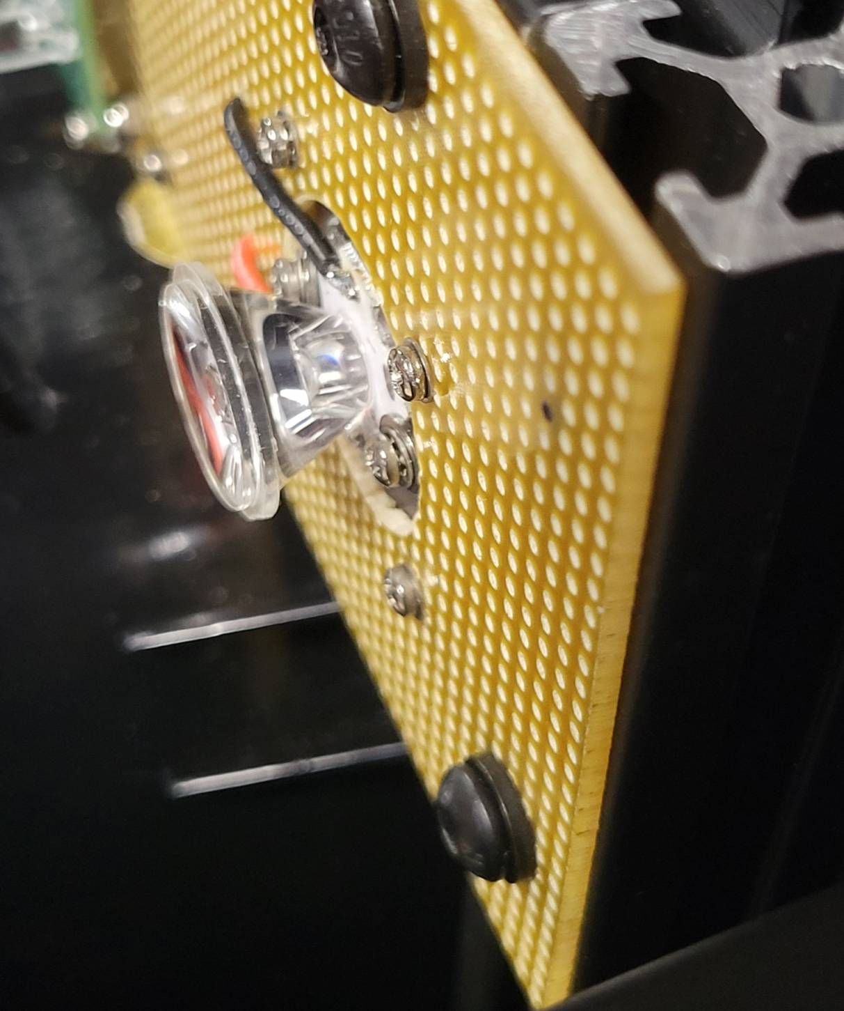
Rig Improvement
Added a 15 degree lens to the green “spotting” LED.
  Make it easier to see at a long distance.

Slide 33
Second try….
Waited until dusk / night.
  Still no signals.
  Can’t see Paul’s green LASER either!
I move on my end from…
  FN32QA65FC to FN32QA65DG
    About 200 feet farther away and about 10 feet higher
    I can see his LASER!
    I can hear his signal!
    We make a QSO!

Slide 34
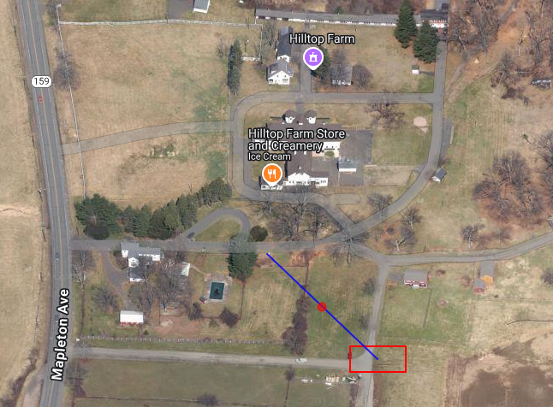
The Big Move!

Slide 35
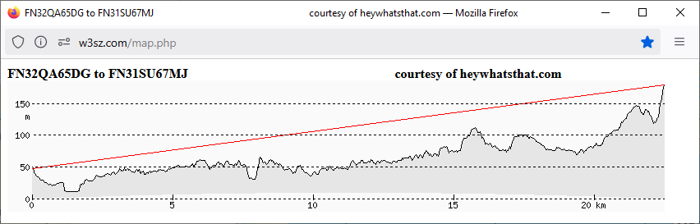
Path Difference

Slide 36
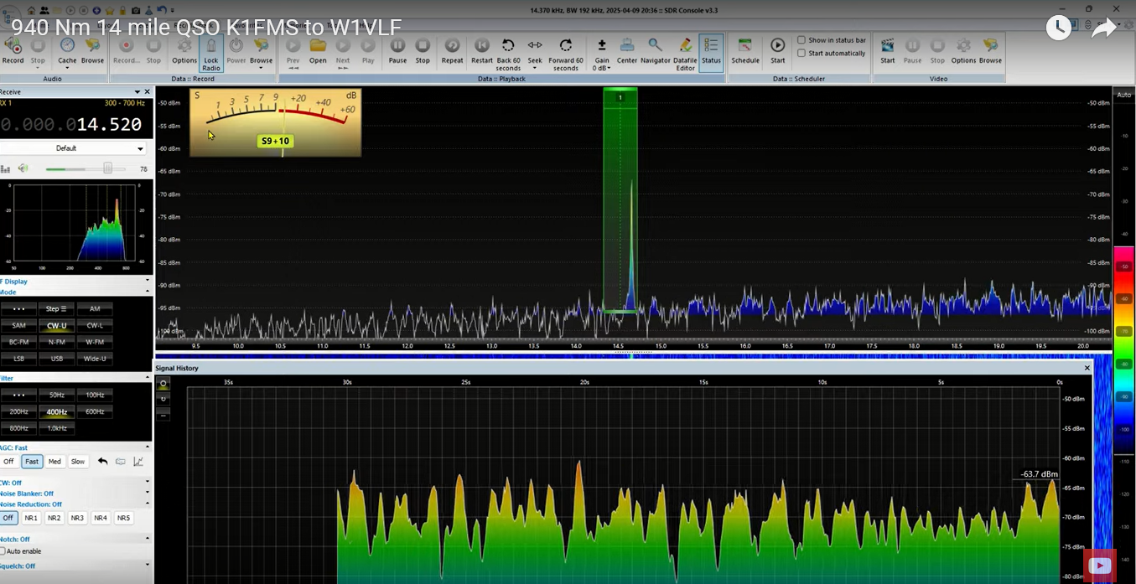
Rapid QSB… 20dB!

Slide 37
Let’s Look Closer
~17m or 55 Feet
Tree branches in the path

Slide 38
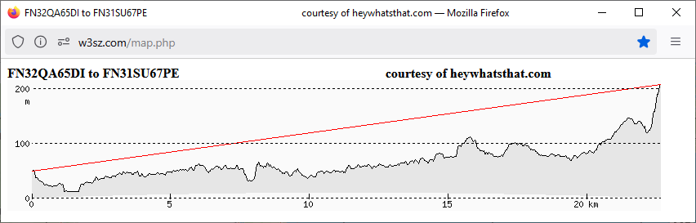
Let’s Try Again!
~30m or 98 Feet
Now we are clearing the trees!
I can see the monument tower on Fox Hill.
I can see the Green LED on my rig at Paul’s end
Way less QSB….no tree branches!

Slide 39
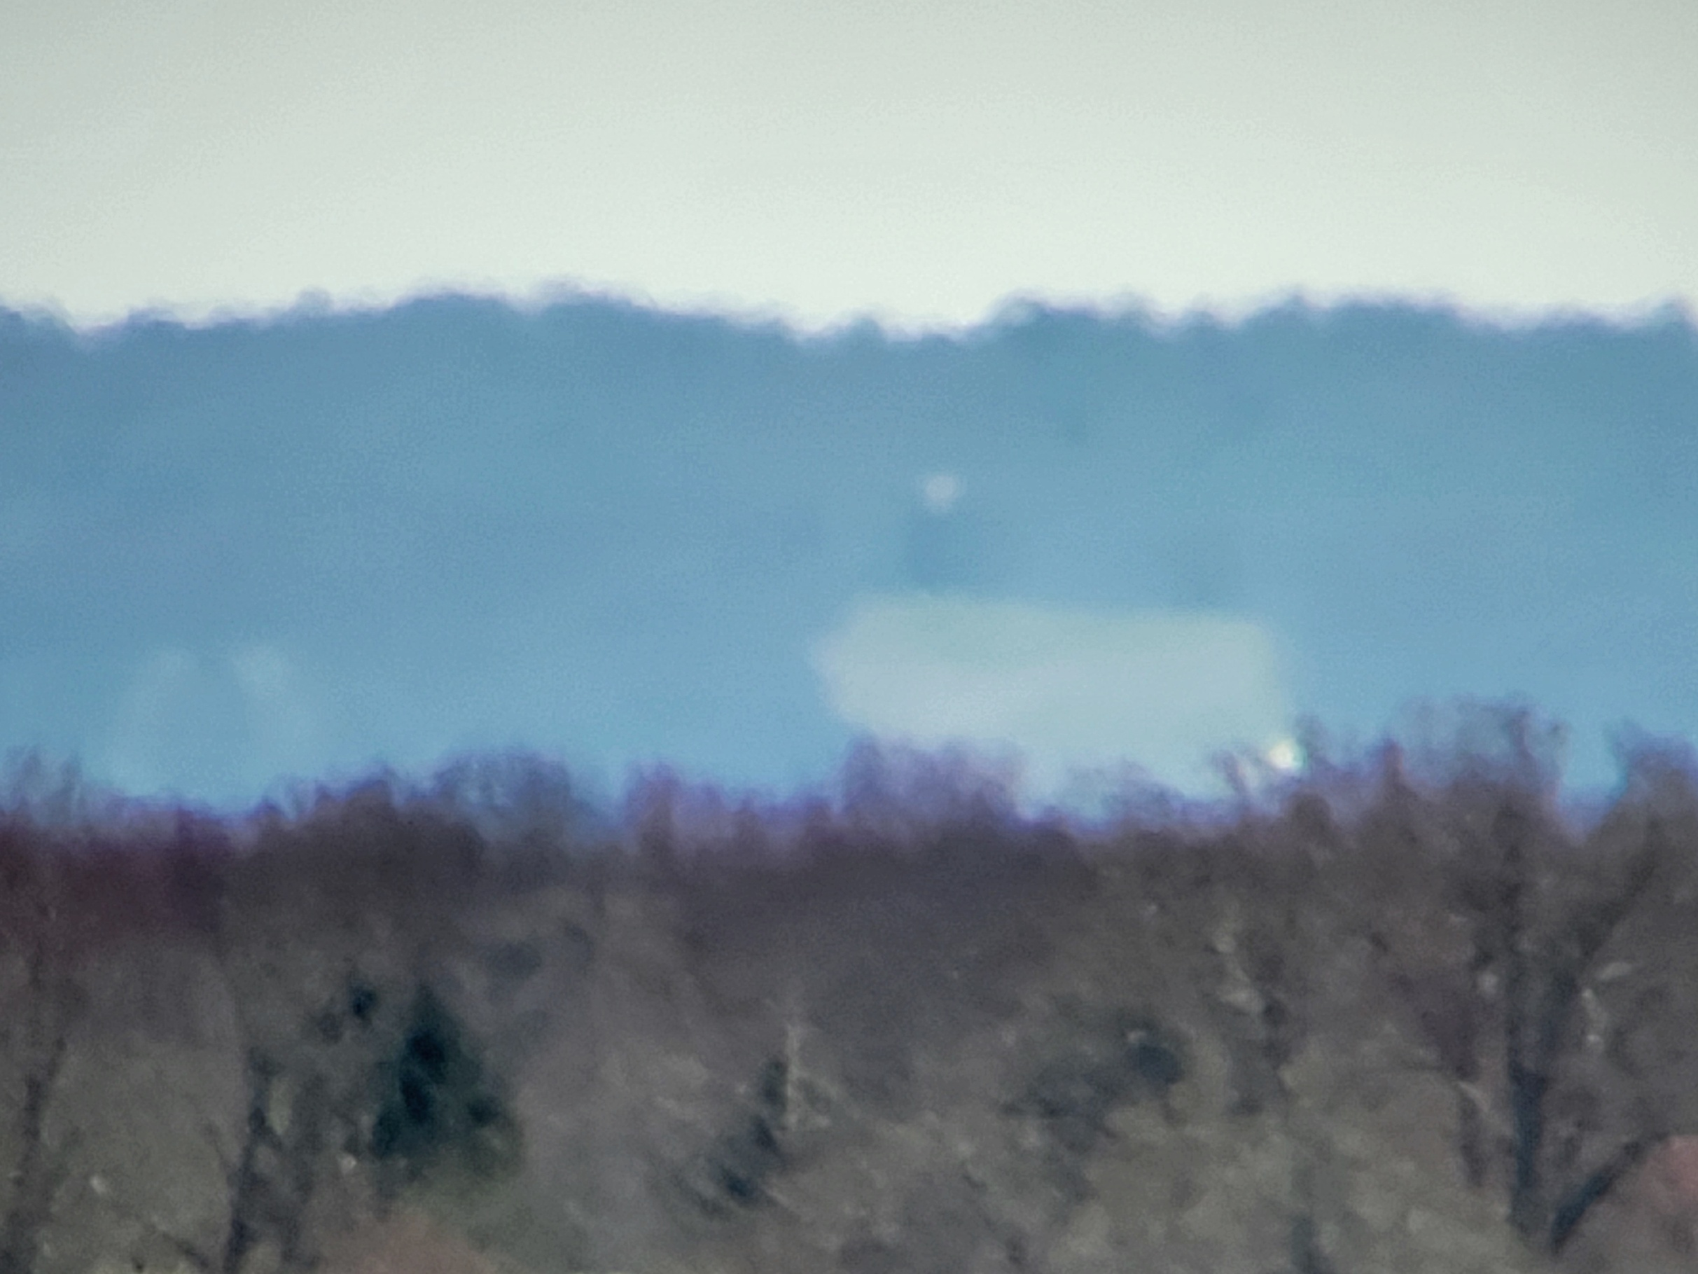
Monument Tower
New Location
Old Location

Slide 40
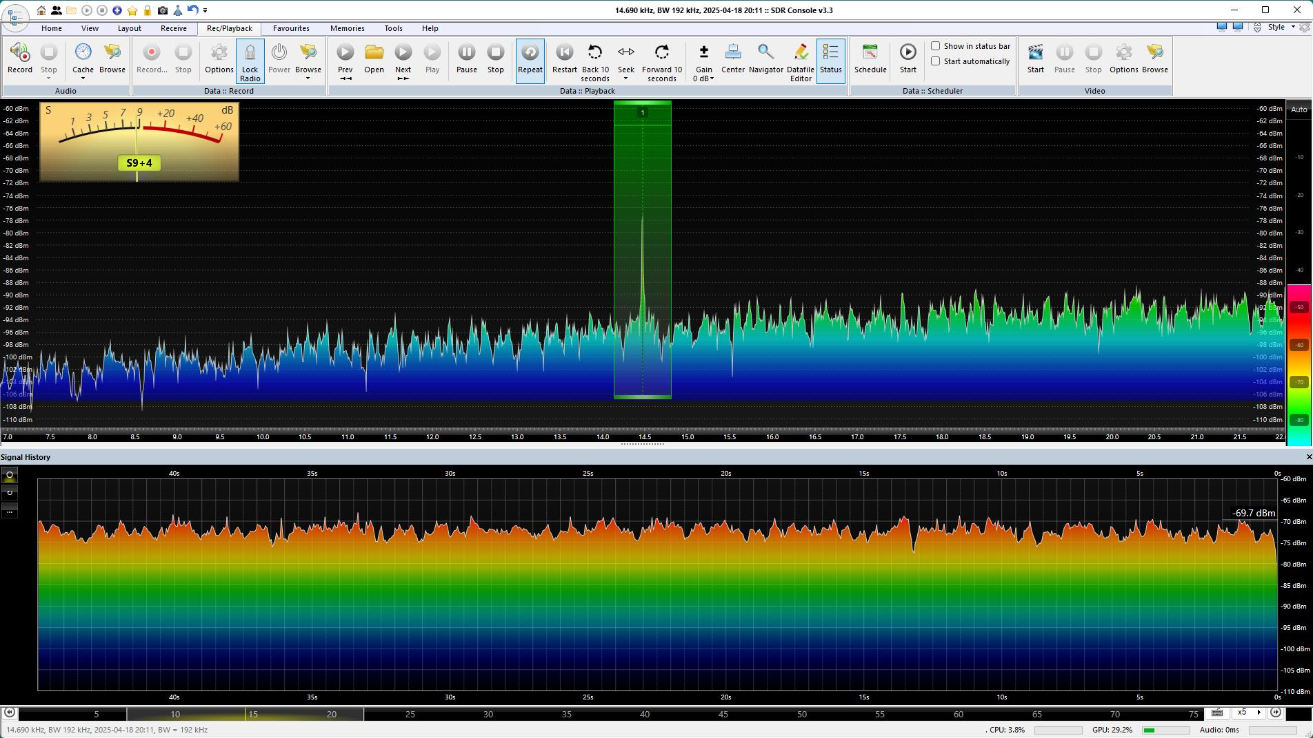
Less QSB ~ 5dB

Slide 41
What’s next? Longer Path!
Did some more looking….
Found a nice 25 mile / 40km path across the valley.
Johnson Memorial Hospital (JMH) Stafford, CT
  FN31TX25XH
Mary Edwards Land Trust (ME) West Granby, CT
  FN31NX68IJ

Slide 42
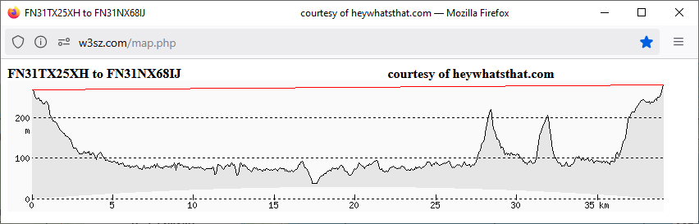
Nice Path!

Slide 43
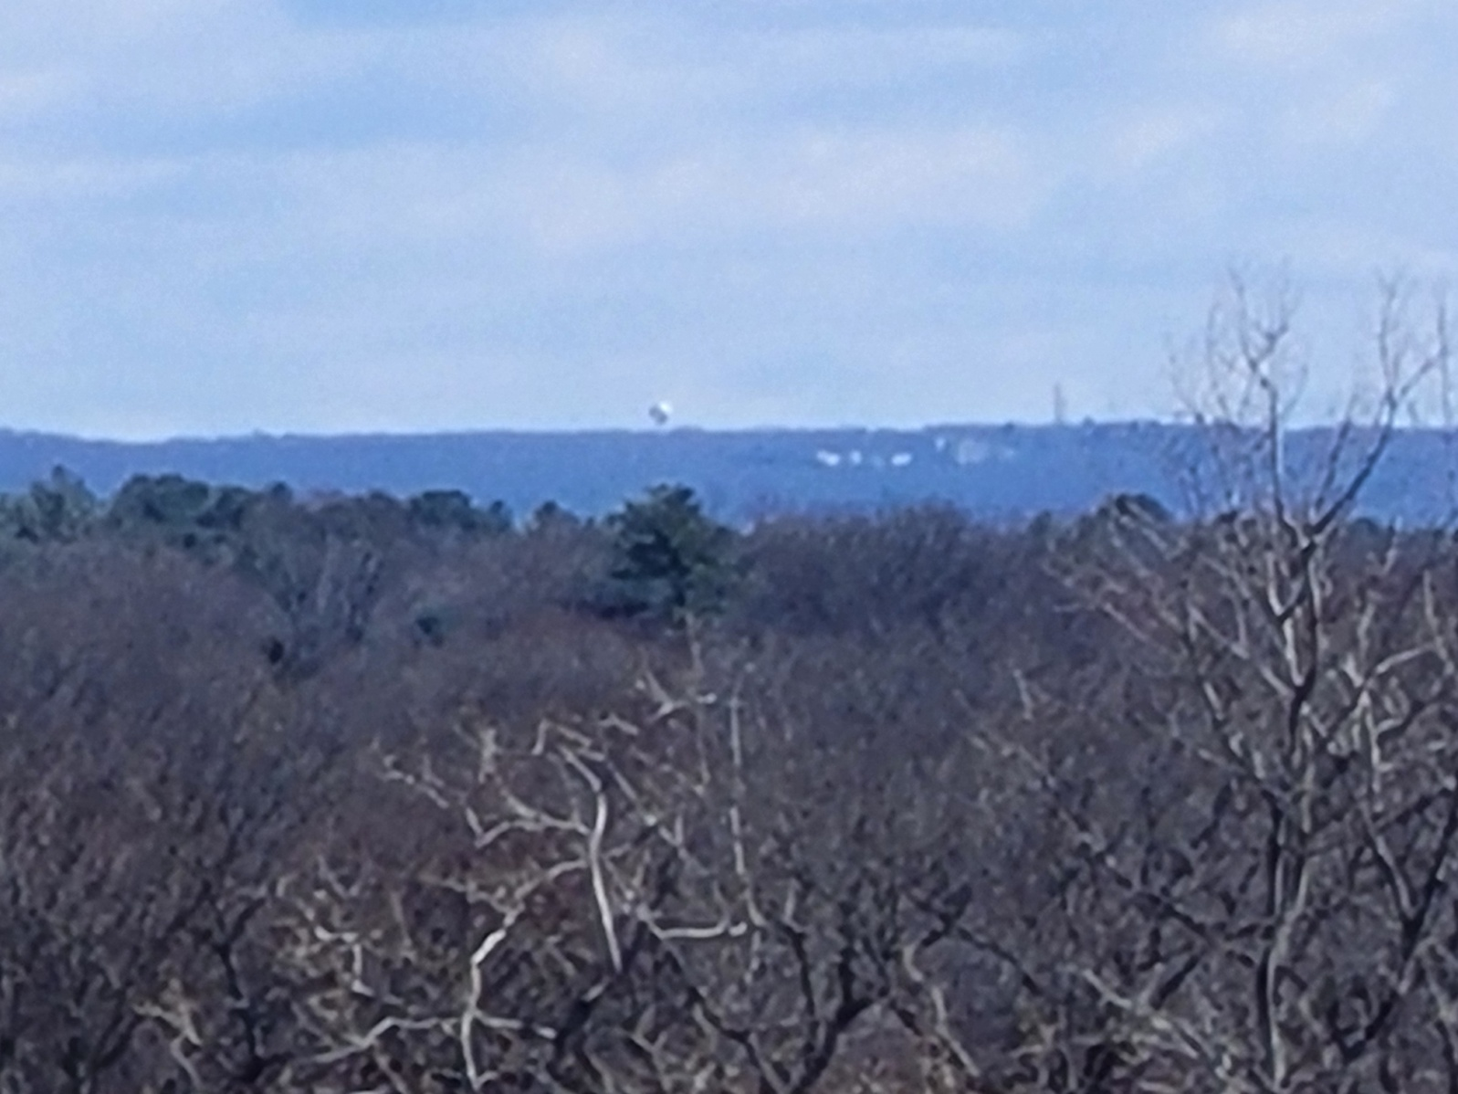
JMH from Mary Edwards

Slide 44
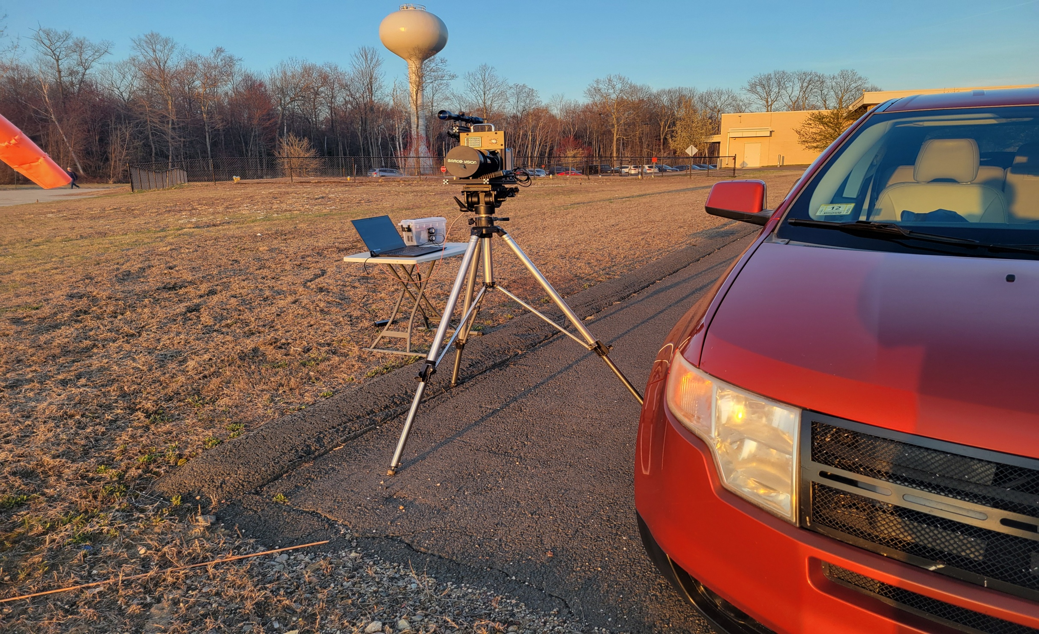
Set Up At JMH

Slide 45
Now We Wait For Sunset
Why??
  Sun produces LOTS of 940nm “noise”.
  Average daylight lens cap off to on shows a noise floor change of about 15 to 20dB!
    That’s a lot of RX sensitivity to give up!

Slide 46
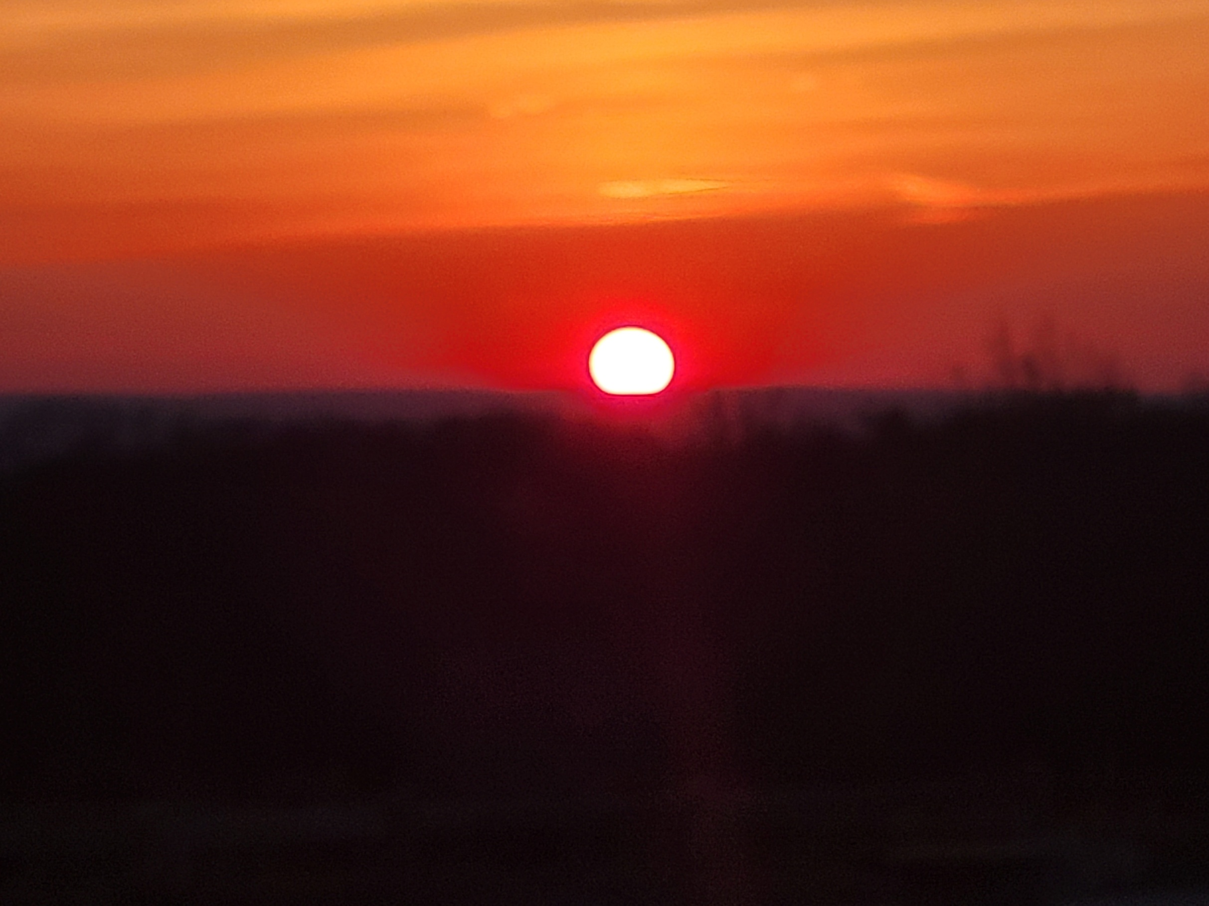
Mary Edwards
FN31NX68IJ

Slide 47
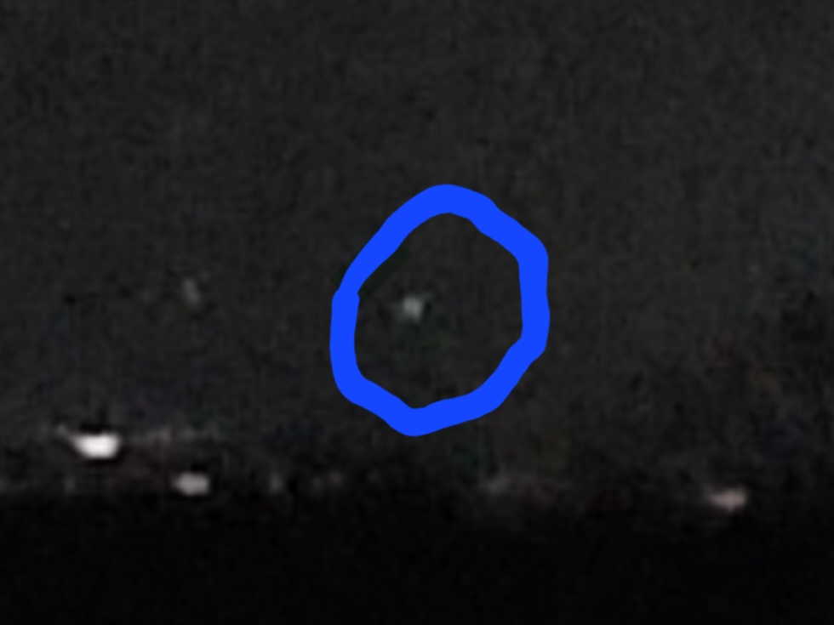
W1VLF Green LED from M.E.

Slide 48
First Attempt
Clear night…dry…dew point about 40 degrees
I start transmitting…
  Paul finds my signal pretty quickly!
  Good signal about 35dB above the noise!
  He’s using his Avalanche Photo Diode RX
    HUGE Advantage!
Paul transmits with his 140 LED array
  I hear NOTHING…No spectrum, No trace, NOTHING!
    My detector is the OPT101 on the VE2UG RX board.
It’s promising though as Paul easily heard me.

Slide 49
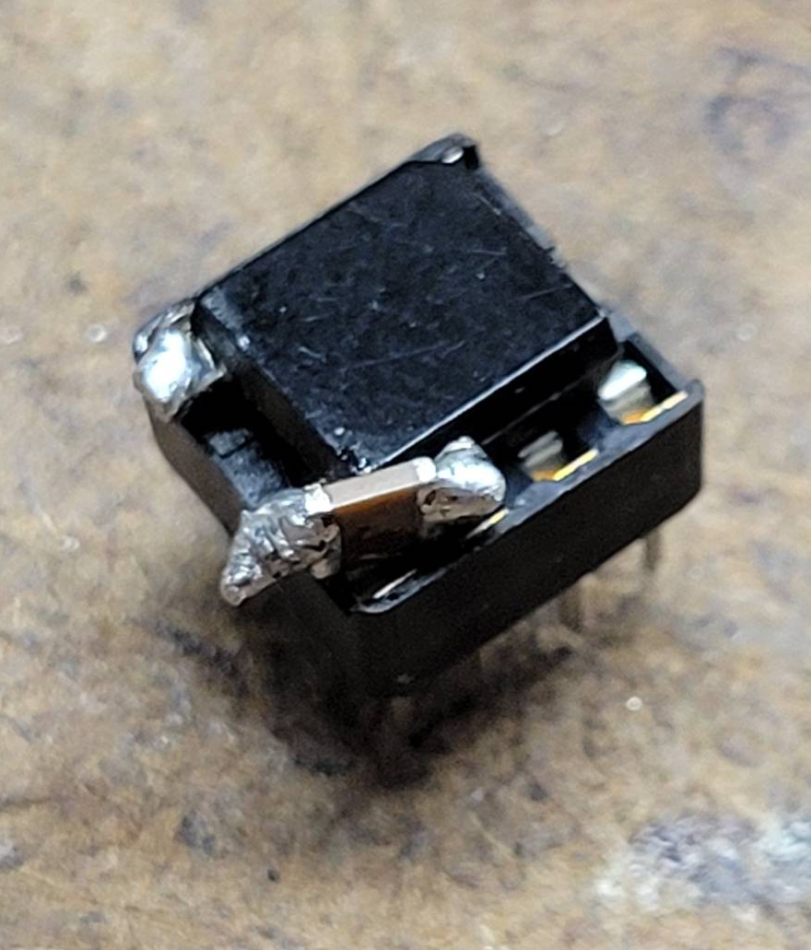
More Rig Improvements
Time to change to the photodiode / trans-impedance amplifier arrangement.
Mount the photodiode on an 8 pin IC socket
  Can replace the OPT 101.
  Add .1uf DC blocking capacitor so daylight doesn’t get to the TIA.

Slide 50
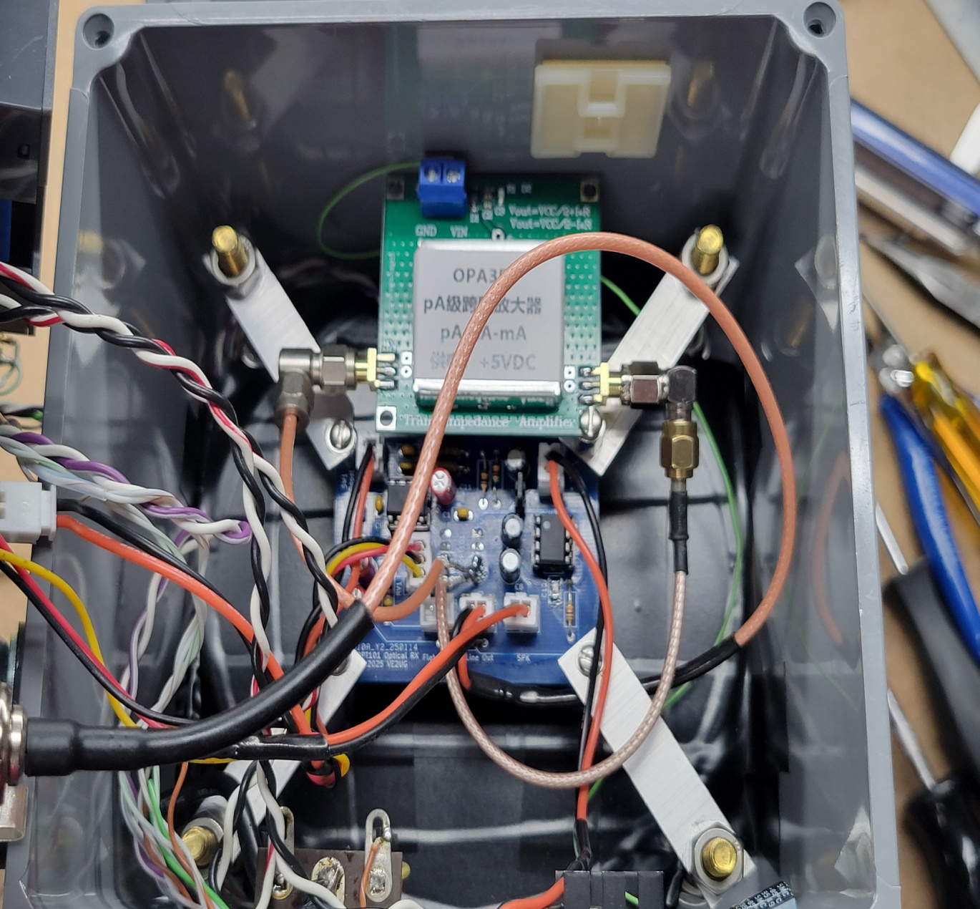
More Rig Improvements
Cut the pin 4 to pin 5 trace on the board.
Wire in the trans-impedance amplifier module

Slide 51
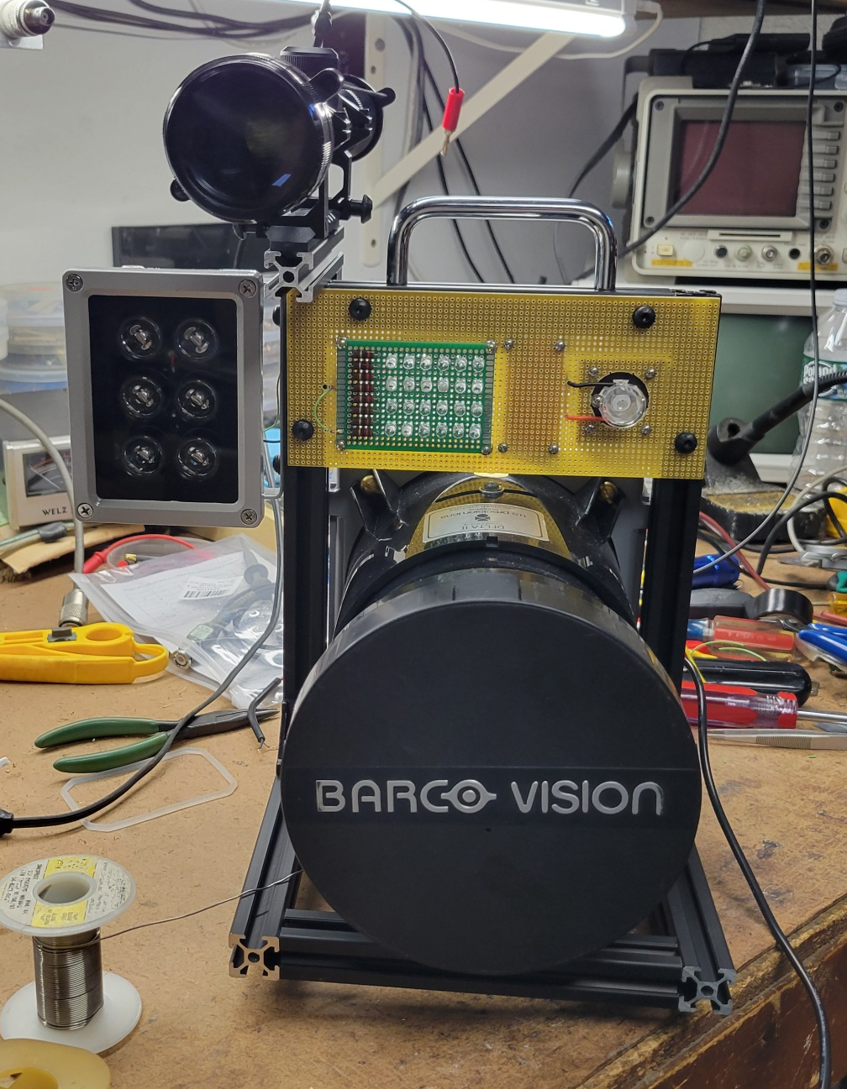
More Rig Improvements
More TX Power!
  Found these security LED “flood lights” on Amazon.
  9 degree beamwidth
  18 Watts / $20
    Amazing how that buck a watt thing works!
  Nicknamed it “The Afterburner”
  QRO is good!

Slide 52
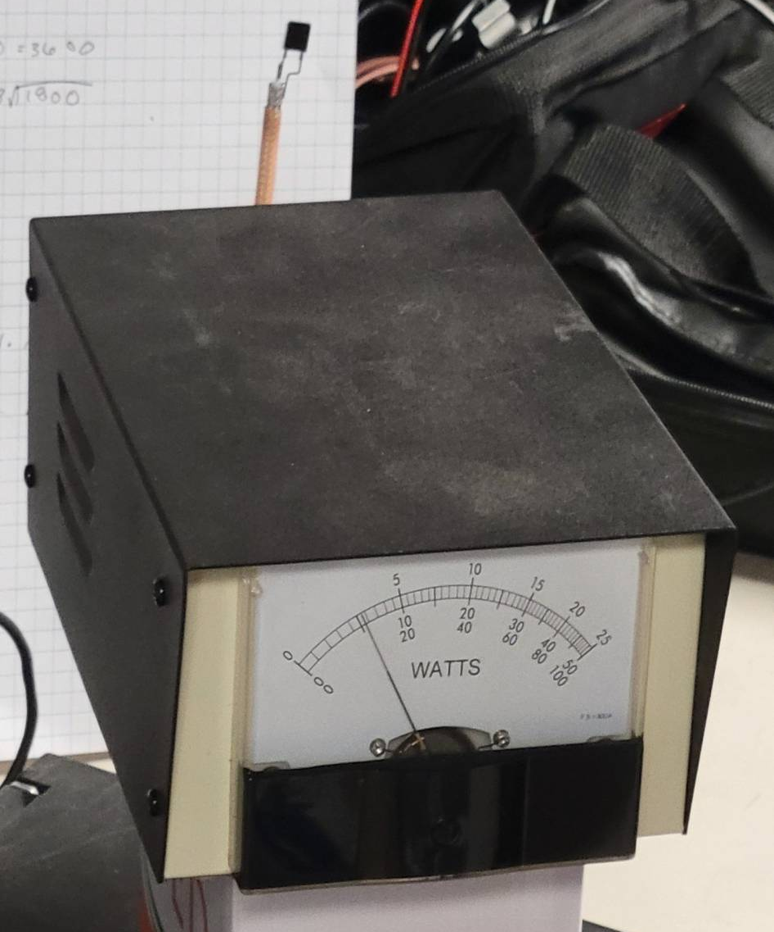
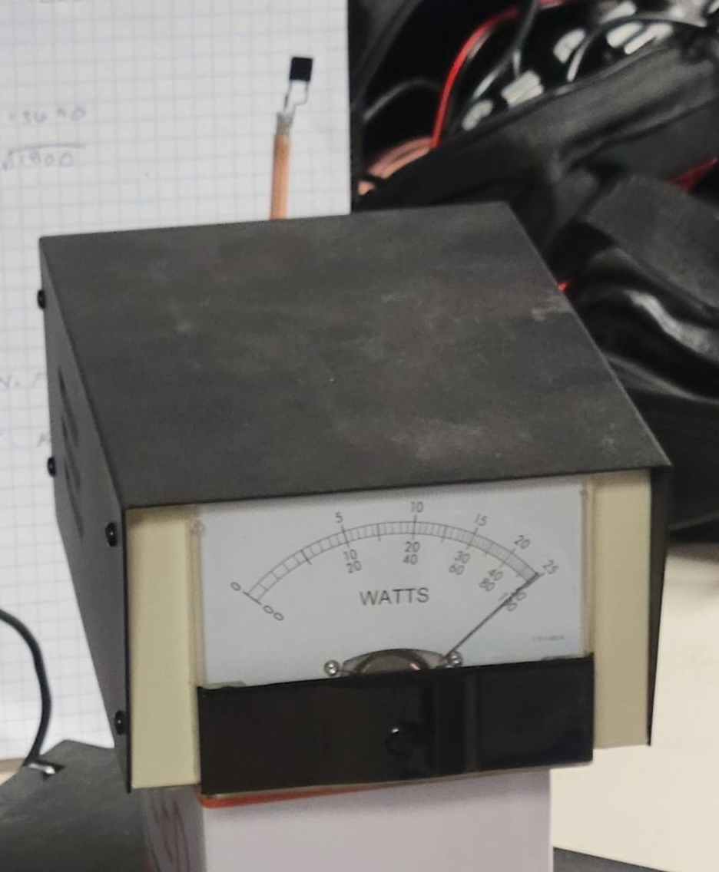
Built A Power Meter
24 LED Array TX
The “Afterburner” +10dB!

Slide 53
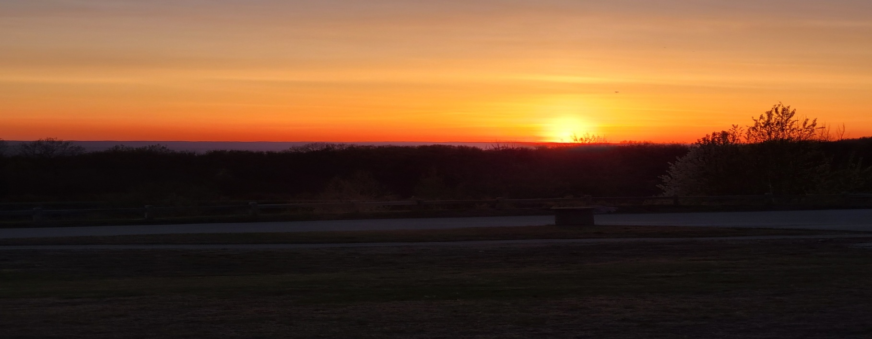
Let’s Try This Again!
Clear night…dry…dew point about 40 degrees
Better RX Sensitivity
More TX Power!
Wait for the sun to start to set.
Paul starts to transmit….

Slide 54
We Have Signal!

Slide 55
Time To Do A Little Peaking s/n ~20dB

Slide 56
Paul’s 140LED Array vs My 24LED Array

Slide 57
QSO Part 1

Slide 58
QSO Part 2

Slide 59
QSO Part 3

Slide 60
45 Min. After Sunset s/n ~35dB

Slide 61
24 LED vs “The Afterburner” at 25 Miles / 40 kM

Slide 62
Thanks To….
Paul W1VLF for getting a bunch of us excited about playing with this stuff.
Rene VE2UG for his board design and other efforts with this
John K1OR for idea exchange and sounding board.
JLC PC Boards, Mouser, Amazon, and EBAY for ALL the required parts!

Slide 63
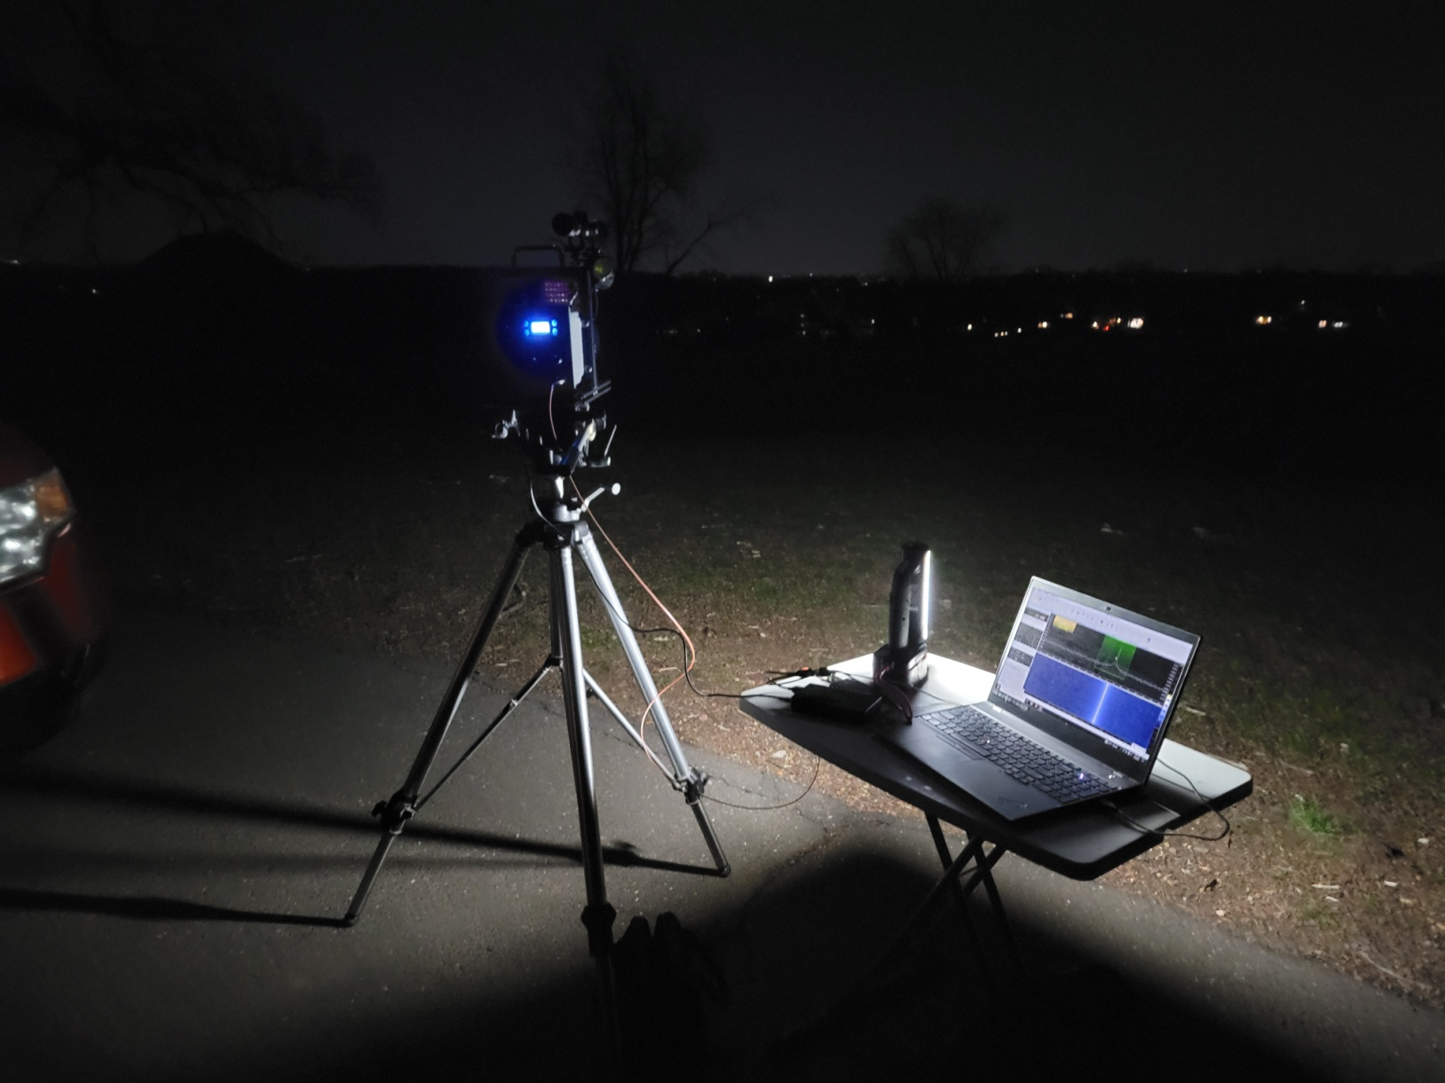
What’s Next??? Longer Path!
Questions????

