Slide 1
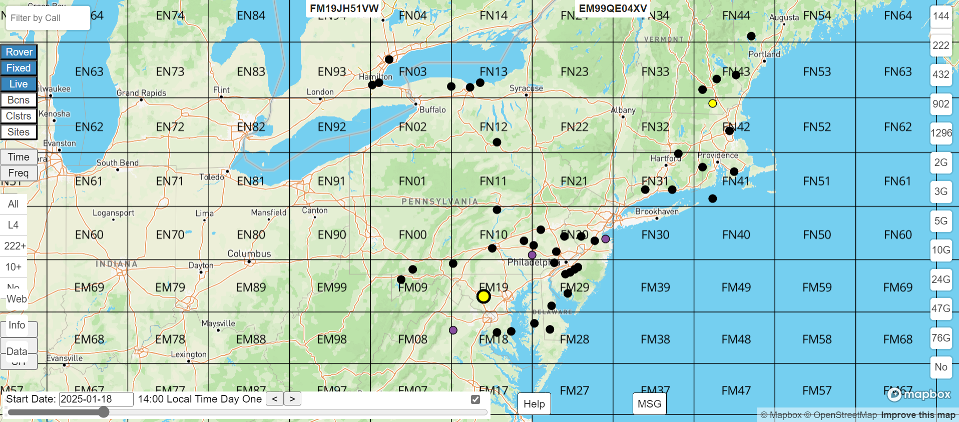
W3SZ/K1RZ Database & Map
48th Eastern VHF/UHF/Microwave Conference
May 10, 2025
Dave Petke, K1RZ

Slide 2
Database & Map Overview
Set up a Data Base Account as a First Time User
Insert Your station data, Liaison Info, Contest Start Date & Time / Stop Date & Time Plans in the Database
Print the Database for this Contest
View the Map in this Contest > “Time Slider”, Select both “Fixed”, “Rover” plus “Live” buttons (“Live” if you have Internet)
Map: assess Path Profiles between you to another station
Map Functions: Watch Map in 2 hour Increments. Rovers Move with their Plans. Help button. MSG button. Filter by Call Window.
Update your Plans for Next Contest > Map Data button to Update DB
References

Slide 3
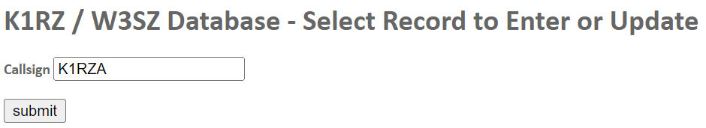
Set-up DB Account as a First Time User
I send an email a few weeks before every ARRL VHF+ contest
DATA ENTRY. The link is at https://w3sz.com/k1rz/getUpdateForm.htm .

Slide 4
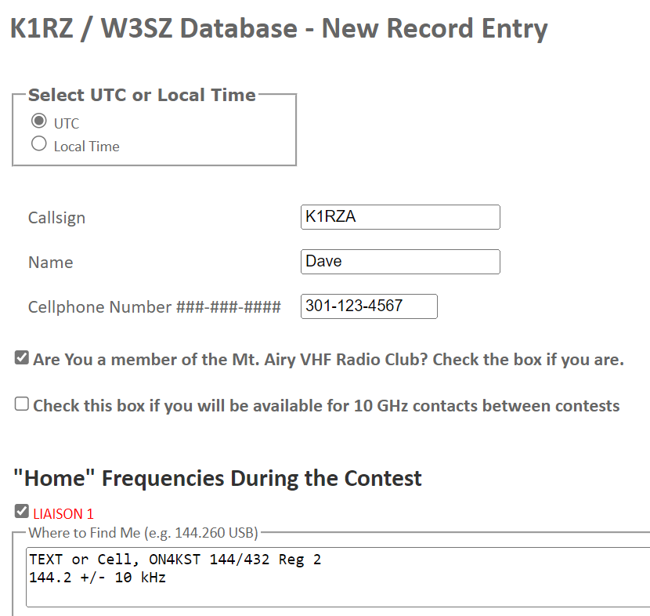
1. Data Entry – Call, Cell Number, Liaison

Slide 5
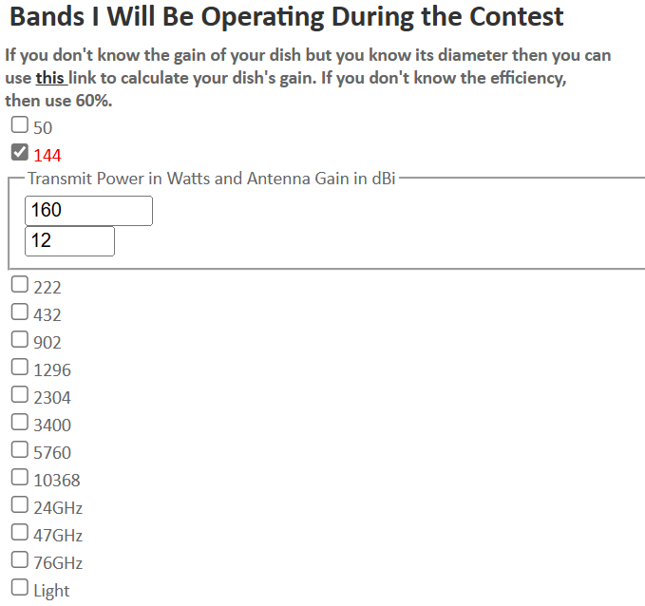
2. Bands I Will Be Operating During the Contest

Slide 6
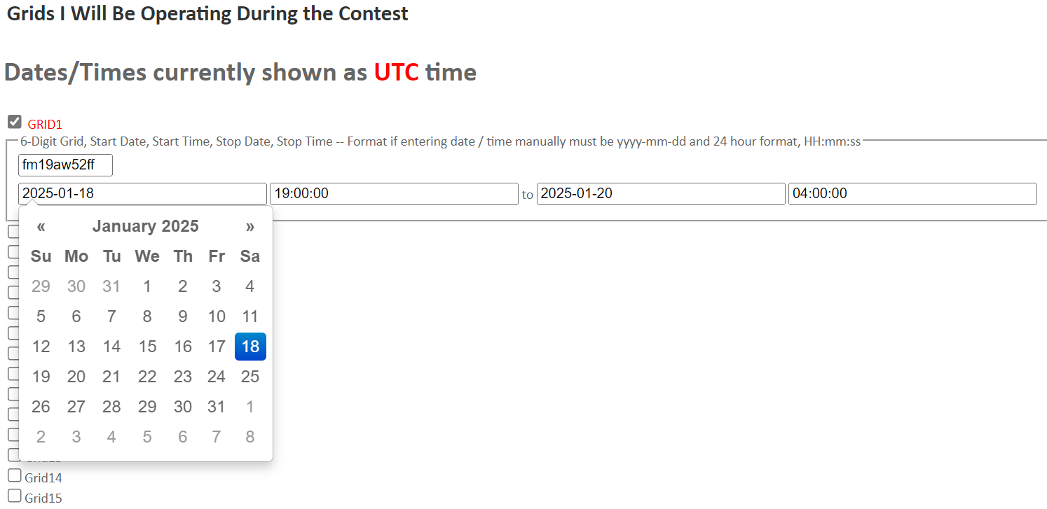

3. Grid(s) I Will Be Operating During the Contest
Be sure to enter Start Date and Time and Stop Date and Time for Each Grid
Insert your Grid in 10 characters to allow a more accurate representation of any Path Profile assessment. Top of Map Right cell shows 10 char grid under the Mouse

Slide 7
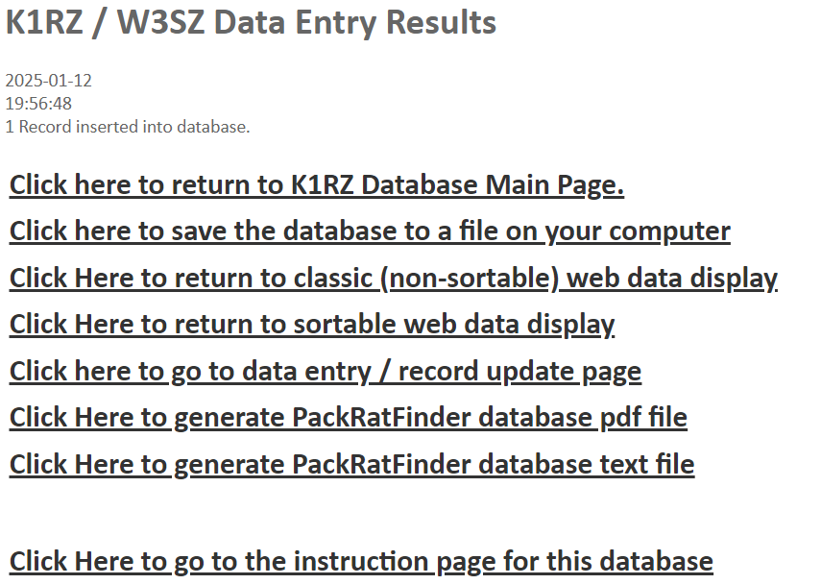
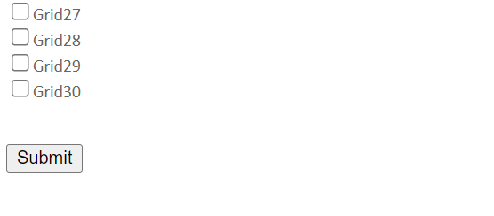






4. Be sure to tap the “Submit” button
Hit SUBMIT and then save the file to your computer

Slide 8
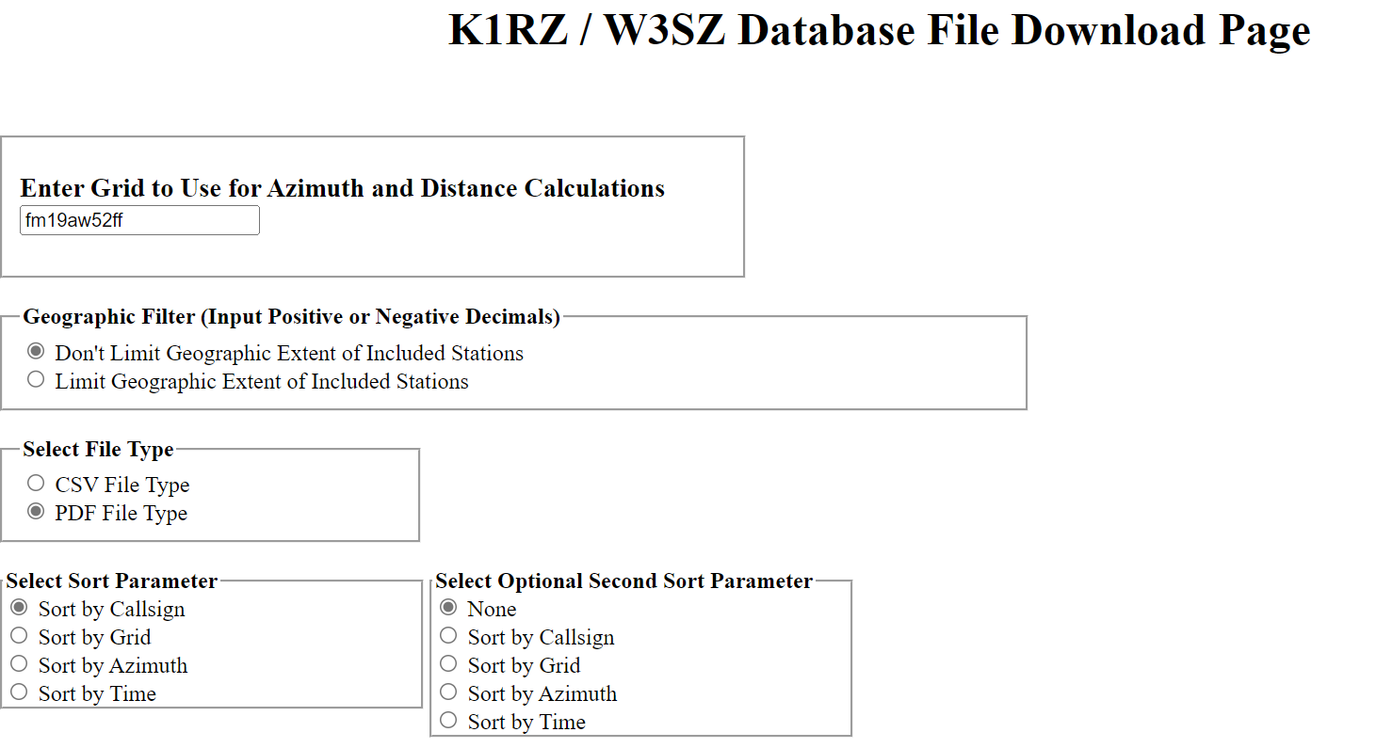
Click here to save the database to a file on your computer

Slide 9
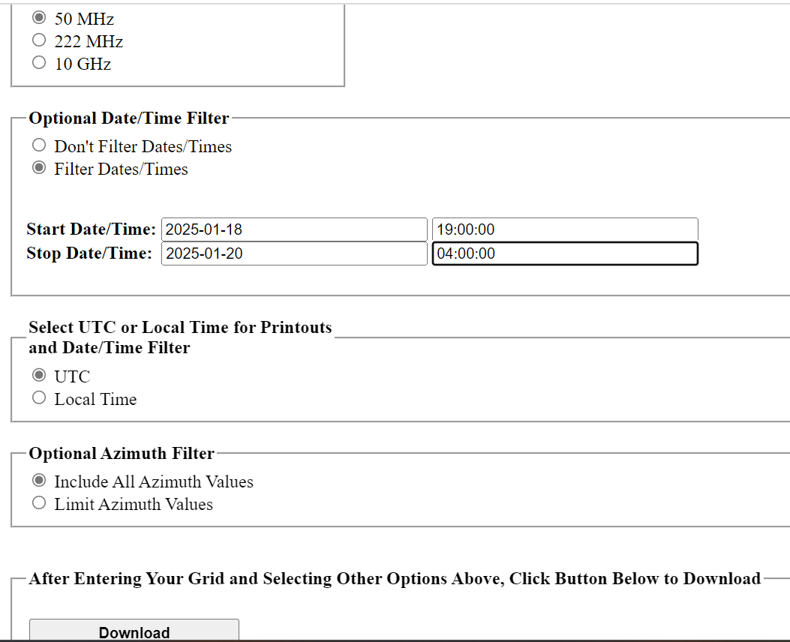
Filter by Date-Time & Save file on your computer
To assure you are ONLY seeing THIS Contest

Slide 10
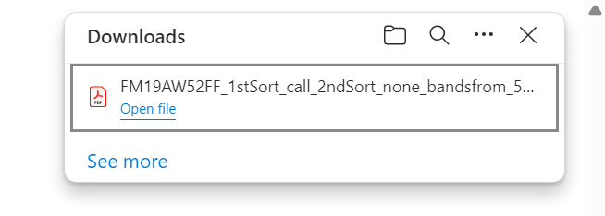

Download indicator

Slide 11
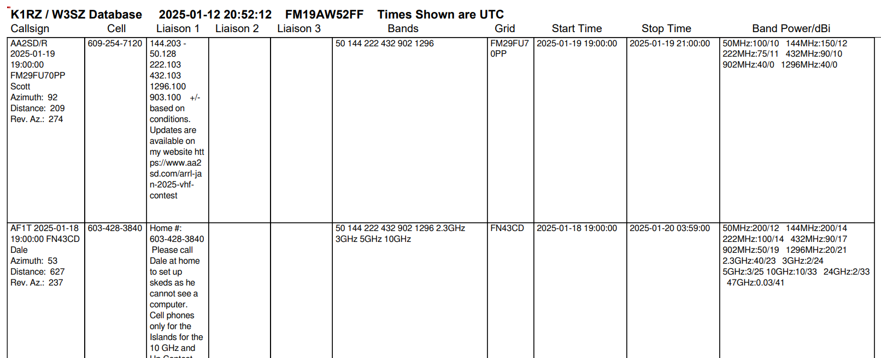
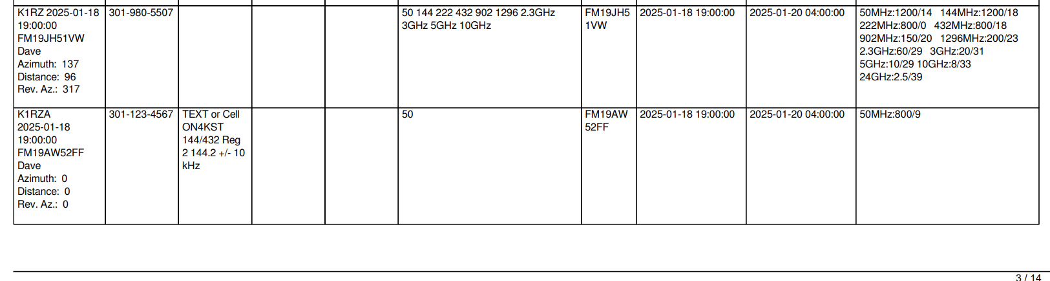
View file on Contest Computer Display or Print hardcopy and check to see who you missed so far. Or bring up the Map on your Contest Computer or Smart Phone

Slide 12
To Display all the stations planning to be on for this weekends Contest, use the Map
DATABASE MAP EXTENSION. You can also get to the Data Entry Page by clicking the "Data" button at the lower left corner of the Map Extension page at https://w3sz.com/map.php Be sure to Use the TIME SLIDER with “2025-01-18” in the date cell to only “see” THIS Contests Plans.
Show a few Basic Map Functions

Slide 13
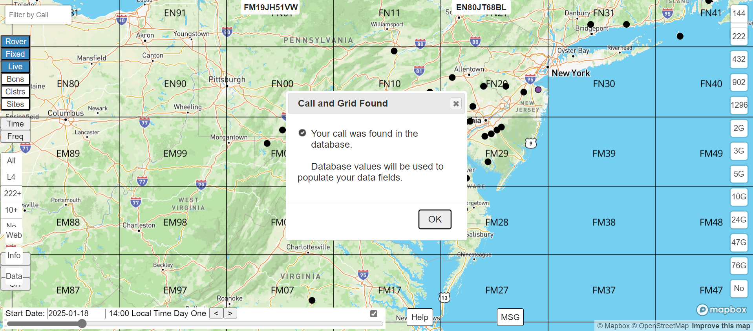

Opening the Map
Each time you enter your plan, you then Reload the Map to ensure you see the latest entries, tap the OK button to get back in the Map

Slide 14
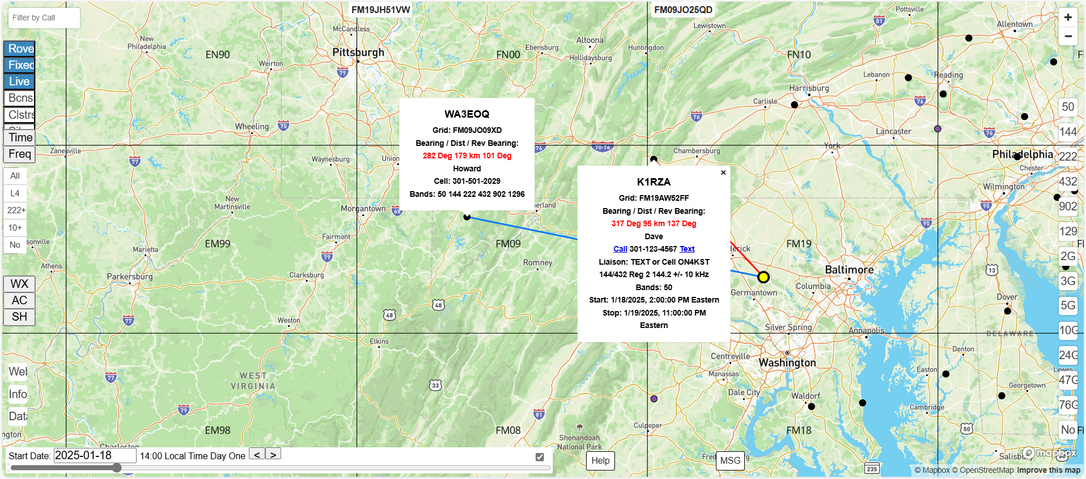

Finding out what band(s) and what Azimuth to K1RZA, plus move mouse to WA3EOQ marker
Mouse pointer to touch a stations Marker

Slide 15
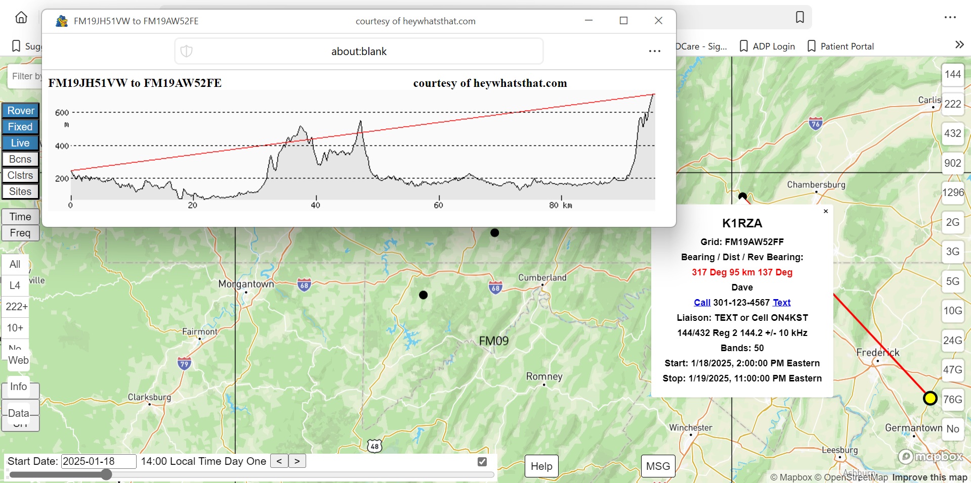


Path Profile between K1RZ and K1RZA plus Az, Distance and Reverse Az
Double click on K1RZA’s Marker shows Path Profile
Single click on K1RZA’s Marker shows Grid, Bearing, Distance, Cell No, Liaison’s, Band(s), Start & Stop times

Slide 16
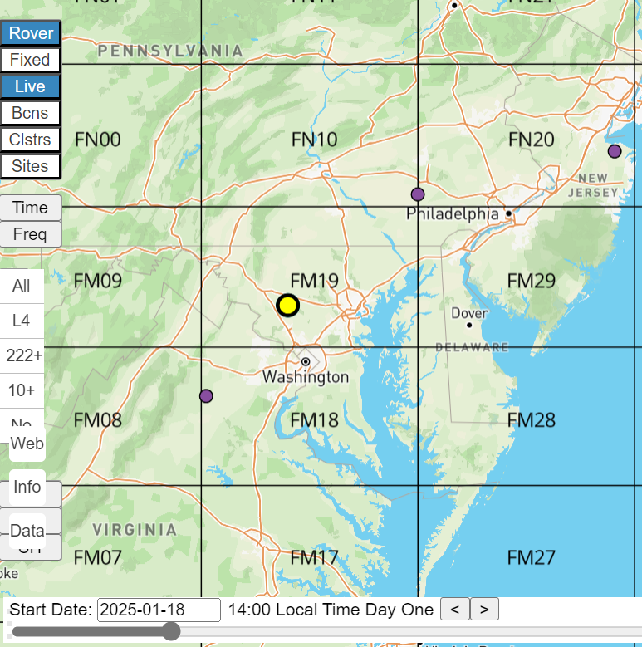
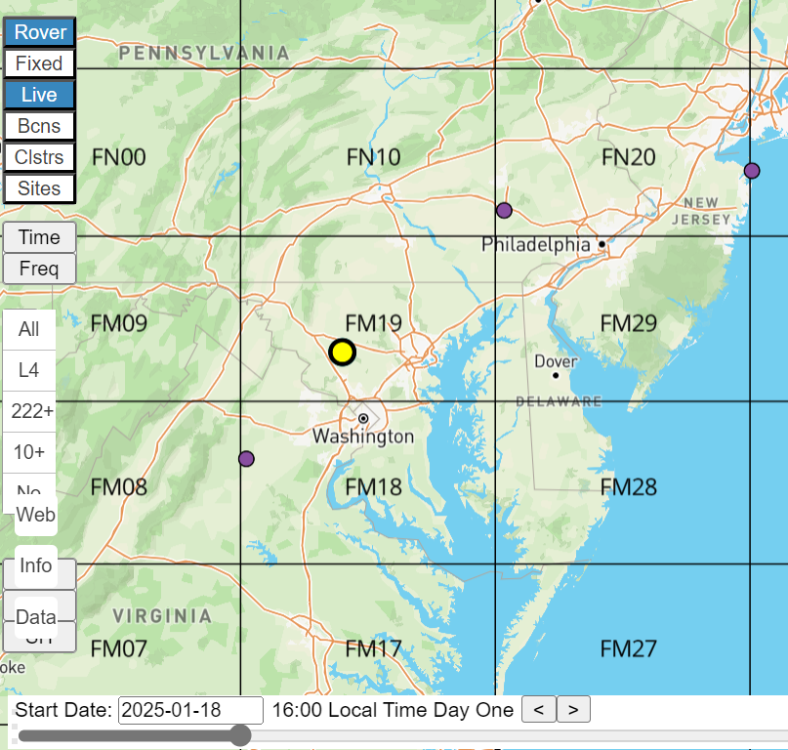
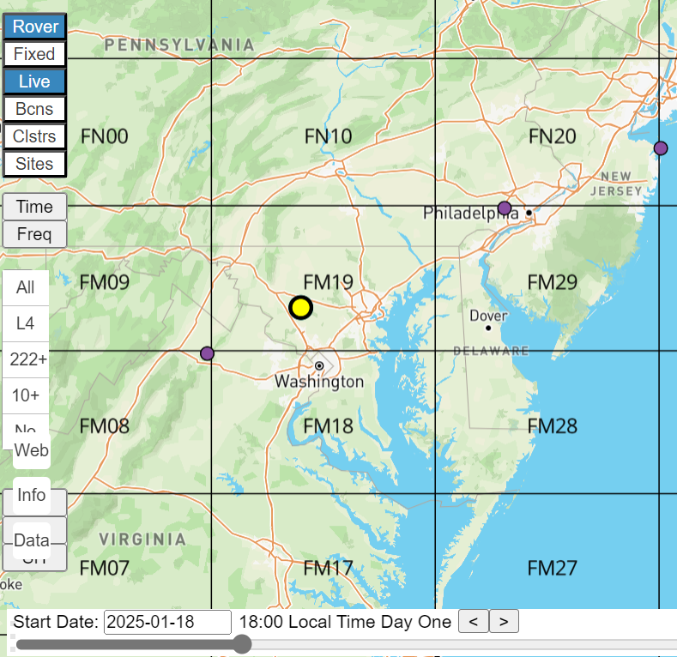


Map Functions: Time-Slide Map in 2 hour Increments. “See” Rovers Move with their Plans.
AA2SD/R
KG6CIH/R
KM4OZH/R
KM4OZH/R
KM4OZH/R
1400
Tap the > to move map data 2 hours forward
1600
1800
Notes:
+

Slide 17
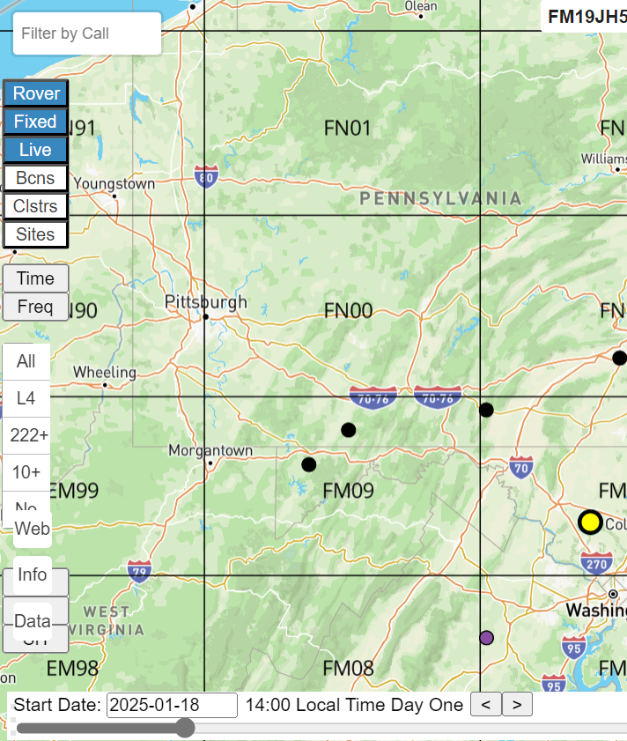
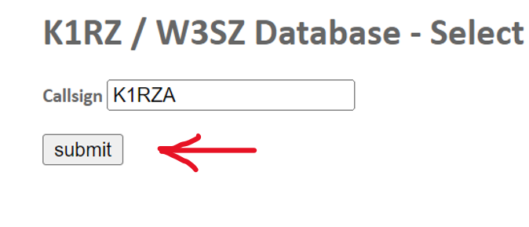
Update your Plans for Next Contest > Map Data button
Map Data button takes you to exactly the same place in the database
As a Rover or Portable station, don’t delete your Grids, just Un-check the check box for any unused Grid in the next contest

Slide 18
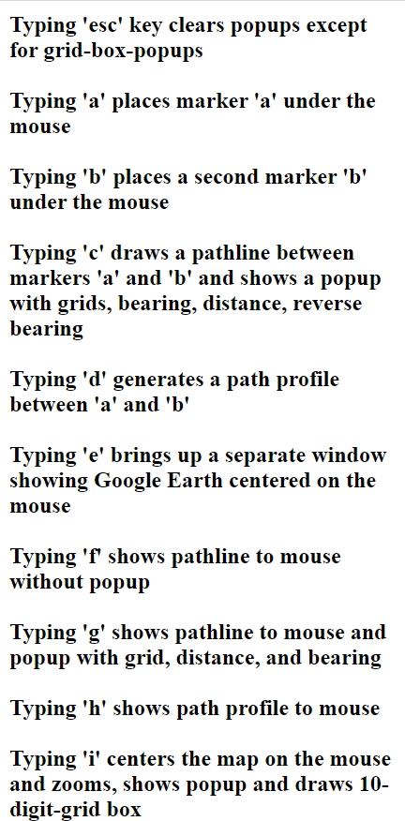
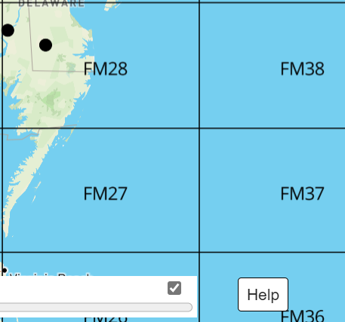
Help button
The Help button brings up an extensive listing of Map Keyboard Functions (1st several Functions shown to the left). Functions are accessed by typing a single letter or keystroke combo while your mouse is on the Map.
Next Page example of Functions a – b – c - d

Slide 19
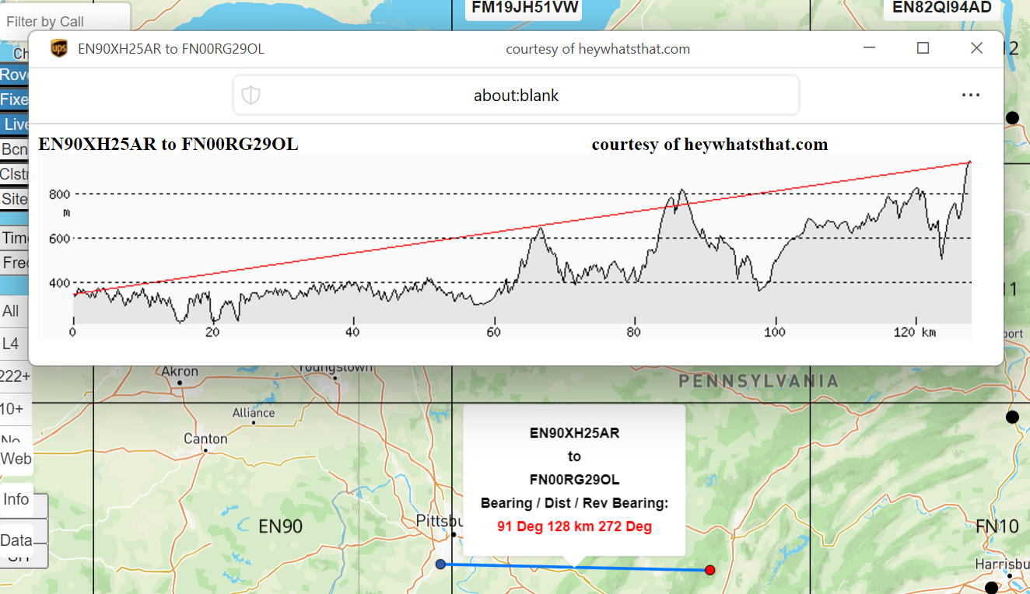
Check the Path Profile between two 10 character Grid sites on the Map > Functions a – b – c - d
Cell indicates 10 char Grid under the mouse
d
1. Roll the mouse wheel to zoom in on the map
2. Hover the mouse over the map 1st site of interest – type “a”.
3. Hover the mouse over the map 2nd site of interest – type “b”.
4. type “c”
c
5. type “d”
If you already know the grids, substitute functions “a” & “b” for “j” & “k”, then follow with “c” & “d”
a
b

Slide 20
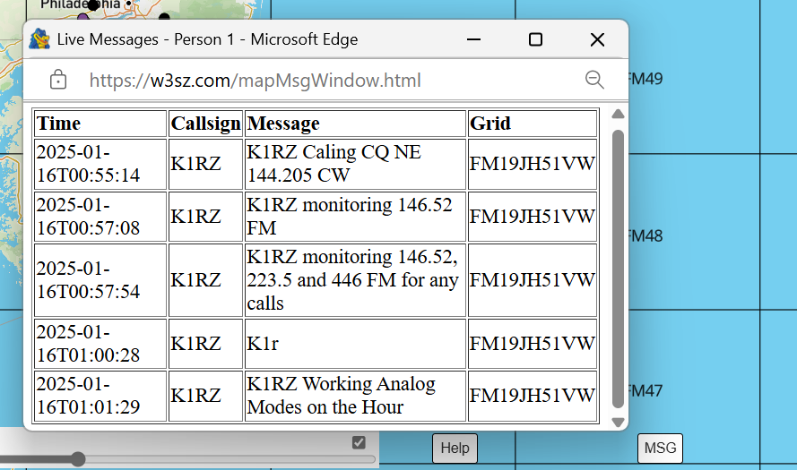
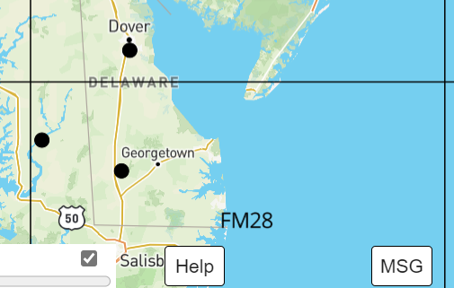
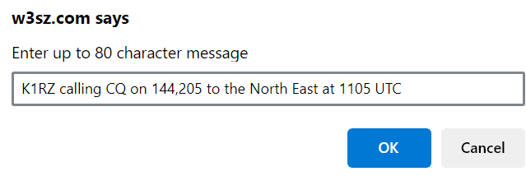




MSG button
1. Tap the MSG Button to send to the Live Messages Page
2. Then Type your message here to those on Live
3. Tap the MSG Button again and the Live Messages Screen will pop-up and show all the messages sent by everyone with Live enabled over the last 6 hours

Slide 21
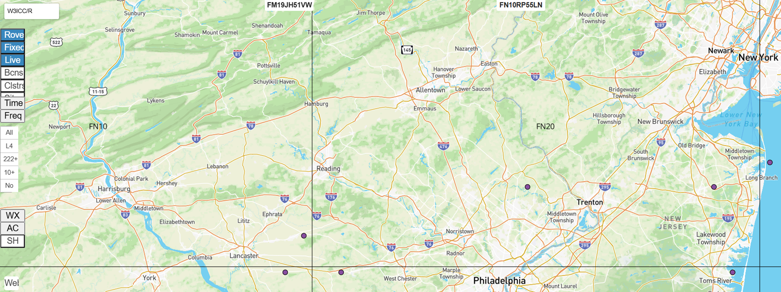

“Filter by Call” window Upper Left– search database for W3ICC/R (or any other call)
W3ICC/R

Slide 22
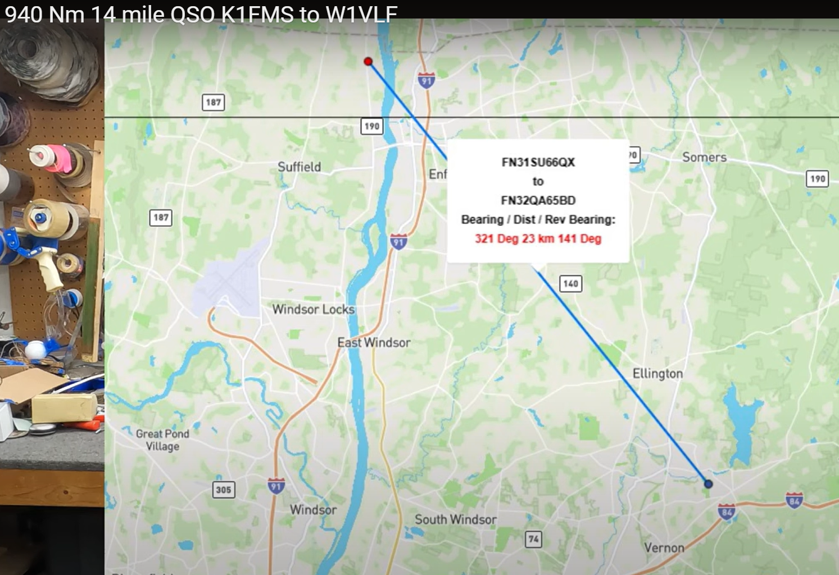
From Paul W1VLF’s video on 940 Nm contact with Fred K1FMS

Slide 23
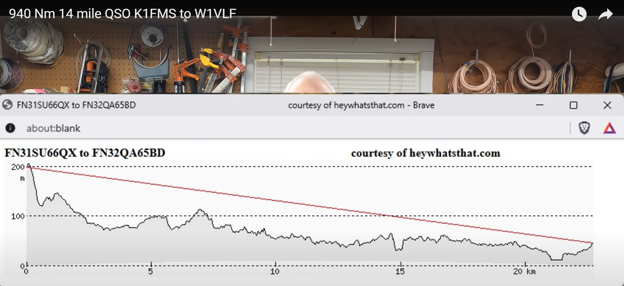
The W1VLF – K1FMS Path Profile

Slide 24
Shorter Printout – Use CSV Spreadsheet format
A CSV file download to your computer initially shows the same info as the PDF format but it is Editable, and it has One Row per station in the database for that weekend. This means 20 pages of PDF can be condensed into 4 or 5 pages of CSV.
The CSV file can be Edited in Excel, Open Office Spreadsheet or Libre applications.
With a spreadsheet application you can Expand or Contract some column Widths and Hide other columns in the CSV file.
Columns to Expand/Contract: Call (contains Start Date & Time, Grid & Name), Azimuth, Liaisons, Bands and End Date & Time.
Columns to Hide: Distance, Rev AZ, Grid, Start Time and Band Power/dBi

Slide 25
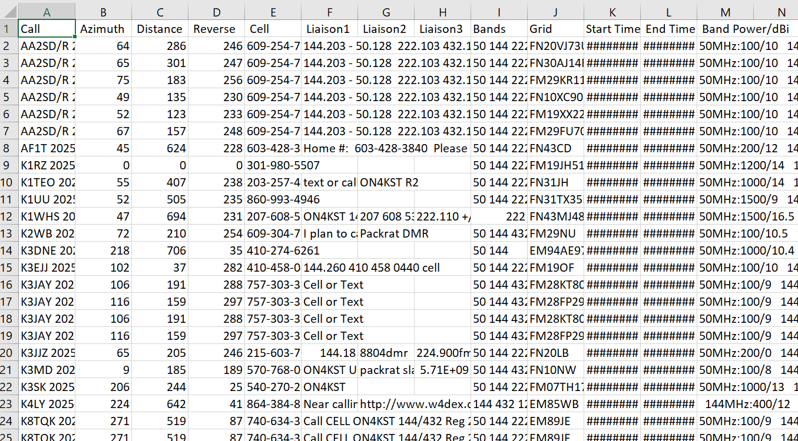
Original Downloaded CSV File

Slide 26
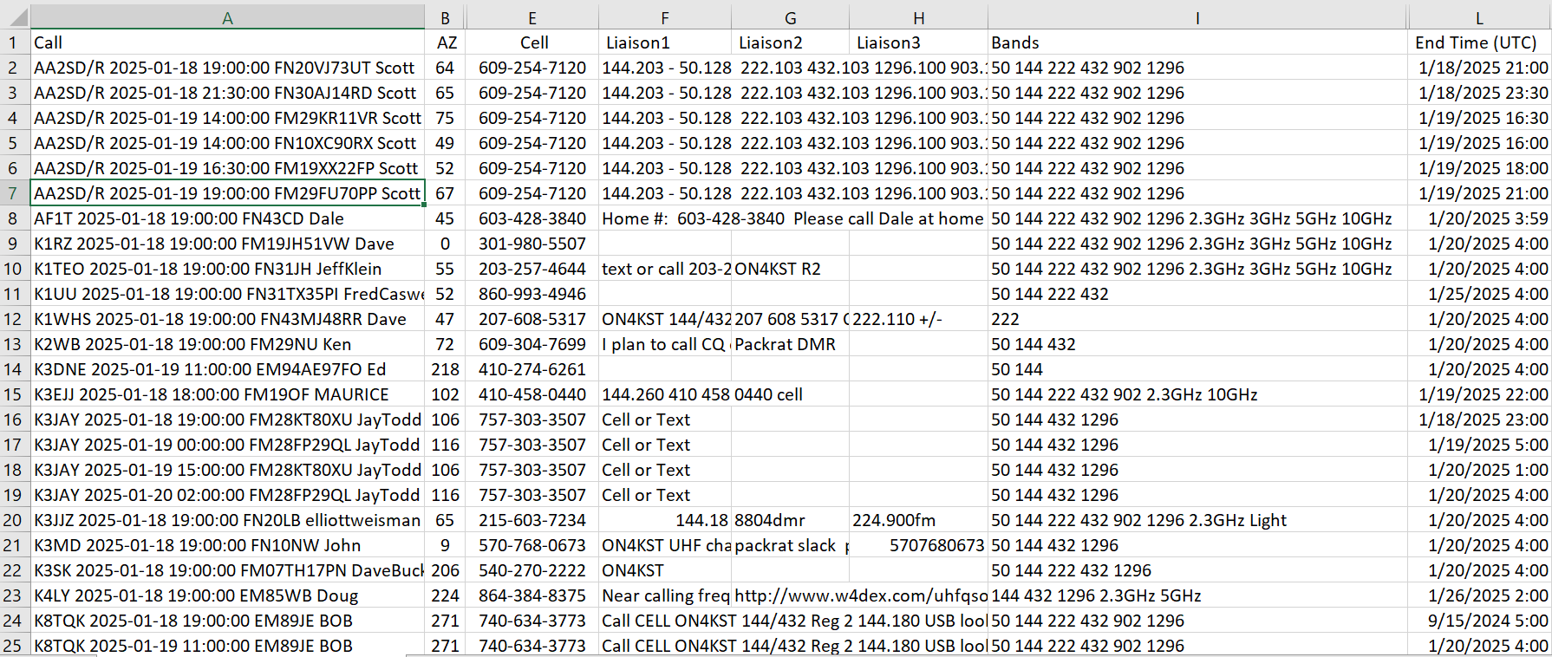
The Edited CSV File

Slide 27
Database and Map Take-aways
The W3SZ/K1RZ Data Base is a Tool for keeping track of who is going to be on for the next Contest. It is valuable to you and others only when you enter your Grid(s) and your Start Date-Time(s) and Stop Date-Time(s)
The W3SZ Map is a Tool for visualizing where everyone is this weekend, and for showing where to point. And for how to Liaison with a given station
Note: I email requests for Contest Plans about 2-3 weeks before each ARRL contest (3 VHFs, 222 and Up, 10 GHz and Up), with a least one follow-up request for plans. I send to PackRats, NEWSGroup, RVHFG, OVHFA, BRMS, Midwest Microwave and 10GHz-Up, plus about 120 Rovers and other Active VHFers.

Slide 28
Questions?
Thanks for Watching. See you in the Contest on the Air, 73
Dave & Roger

Slide 29
References
Tutorial links below take you to VIDEO’s Roger W3SZ made to show ALL the MAP EXTENSION capabilities https://www.youtube.com/playlist?list=PLhcWbjH-CpxrCOdlLEDECRrED18B4NZ9n.
When on the Map type the letter “p” to see the complete list of Map Functions. The Help button at the left end of the Time Slider will also bring up the Keyboard Function List.

