Slide 1
Microwaves
in Quantum Computing
Hisen KD2TAI
05/10/2025

Slide 2
Contents
Quantum Computing: Why?
How: Microwave in a Fridge
System Operation
  Controlling a Qubit
  Readout a Qubit
Challenges

Slide 3
Contents
Quantum Computing: Why?
How: Microwave in a Fridge
System Operation
  Programming
  Controlling a Qubit
  Readout a Qubit
Challenges

Slide 4
Classical vs. Quantum Computing
Iter 0
A
Is it “X”?
0
A
Is it “X”?
0.1%
Iter 1
B
Is it “X”?
0
B
0.1%
Iter 2
C
Is it “X”?
0
C
0.1%
…
…
…
…
Iter n
X
Is it “X”?
1
X
99%
Iter n+1
Y
Is it “X”?
0
Y
0.1%
Classical: Handles one at a time
Quantum: Handles all in once

Slide 5
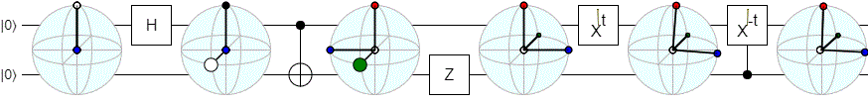
Quantum Computing
Leveraging superposition and entanglement
https://algassert.com/post/1716

Slide 6
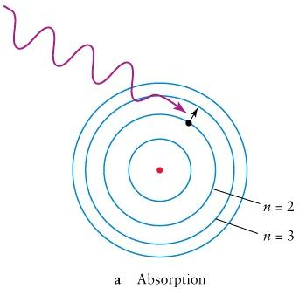
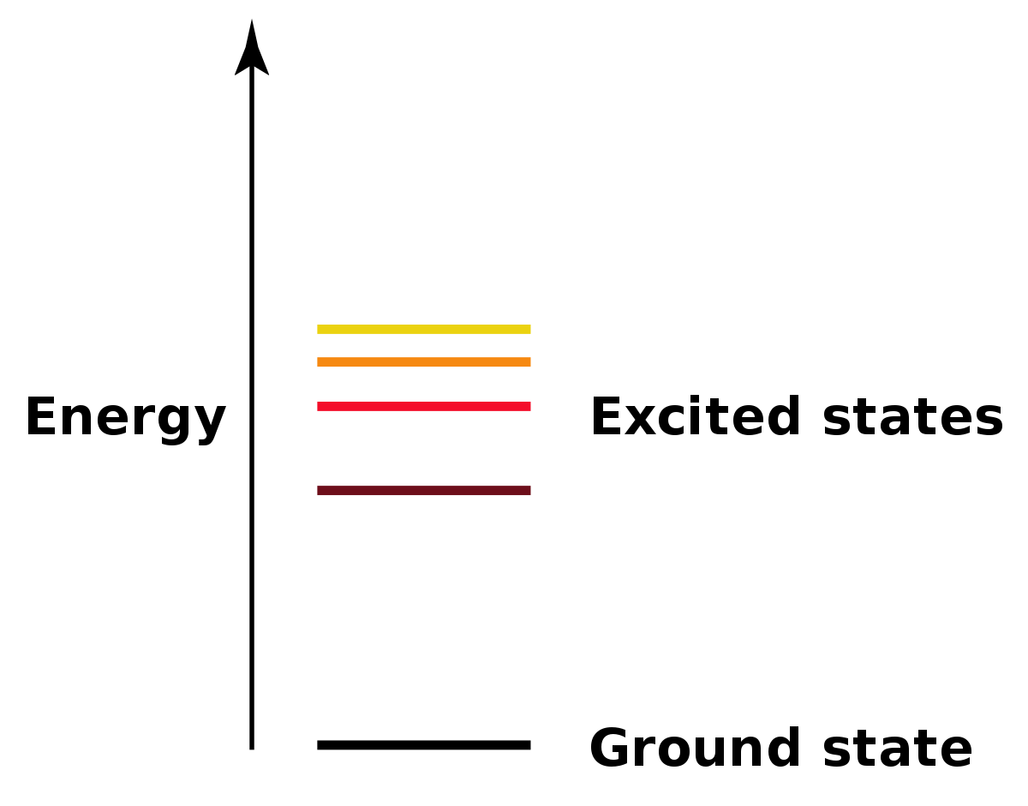
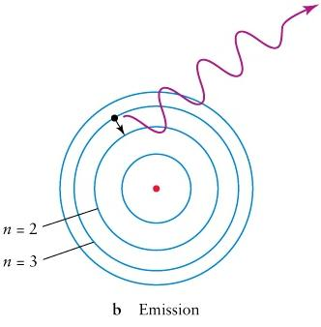
Quantum: Discrete Energy
|1>
ΔE = ħω
ħ (h-bar) = reduced Planck constant = h/2π = 1.055 × 10⁻³⁴ J·s Very small
ω (omega) = angular frequency (in rad/s)
|0>

Slide 7
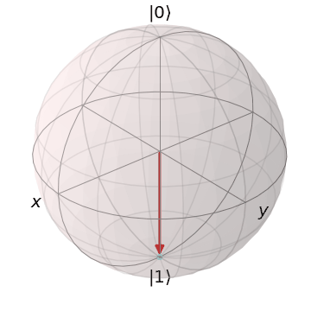
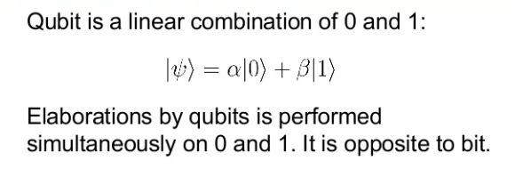
Quantum Bit (Qubit)

Slide 8
Contents
Quantum Computing: Why?
How: Microwave in a Fridge
System Operation
  Programming
  Controlling a Qubit
  Readout a Qubit
Challenges

Slide 9
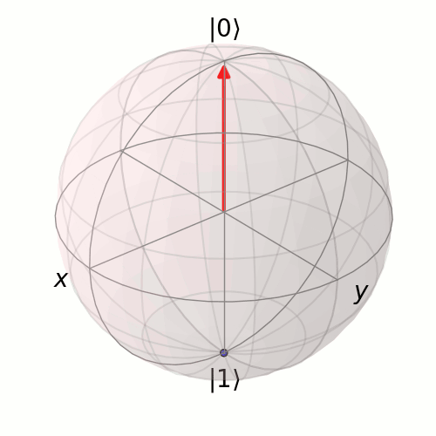
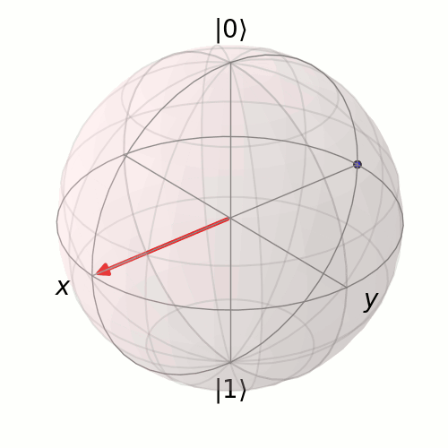
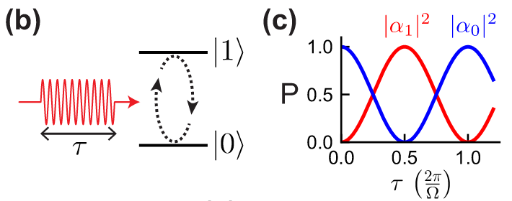
Controlling a Qubit
(b) A microwave pulse of duration τ applied at the qubit frequency drives transitions between the ground state |0⟩ and excited state |1⟩.
(c) The probability of finding the qubit in either state oscillates sinusoidally with the pulse duration, exhibiting Rabi oscillations at frequency Ω (the Rabi frequency), which is proportional to the pulse amplitude.

Slide 10
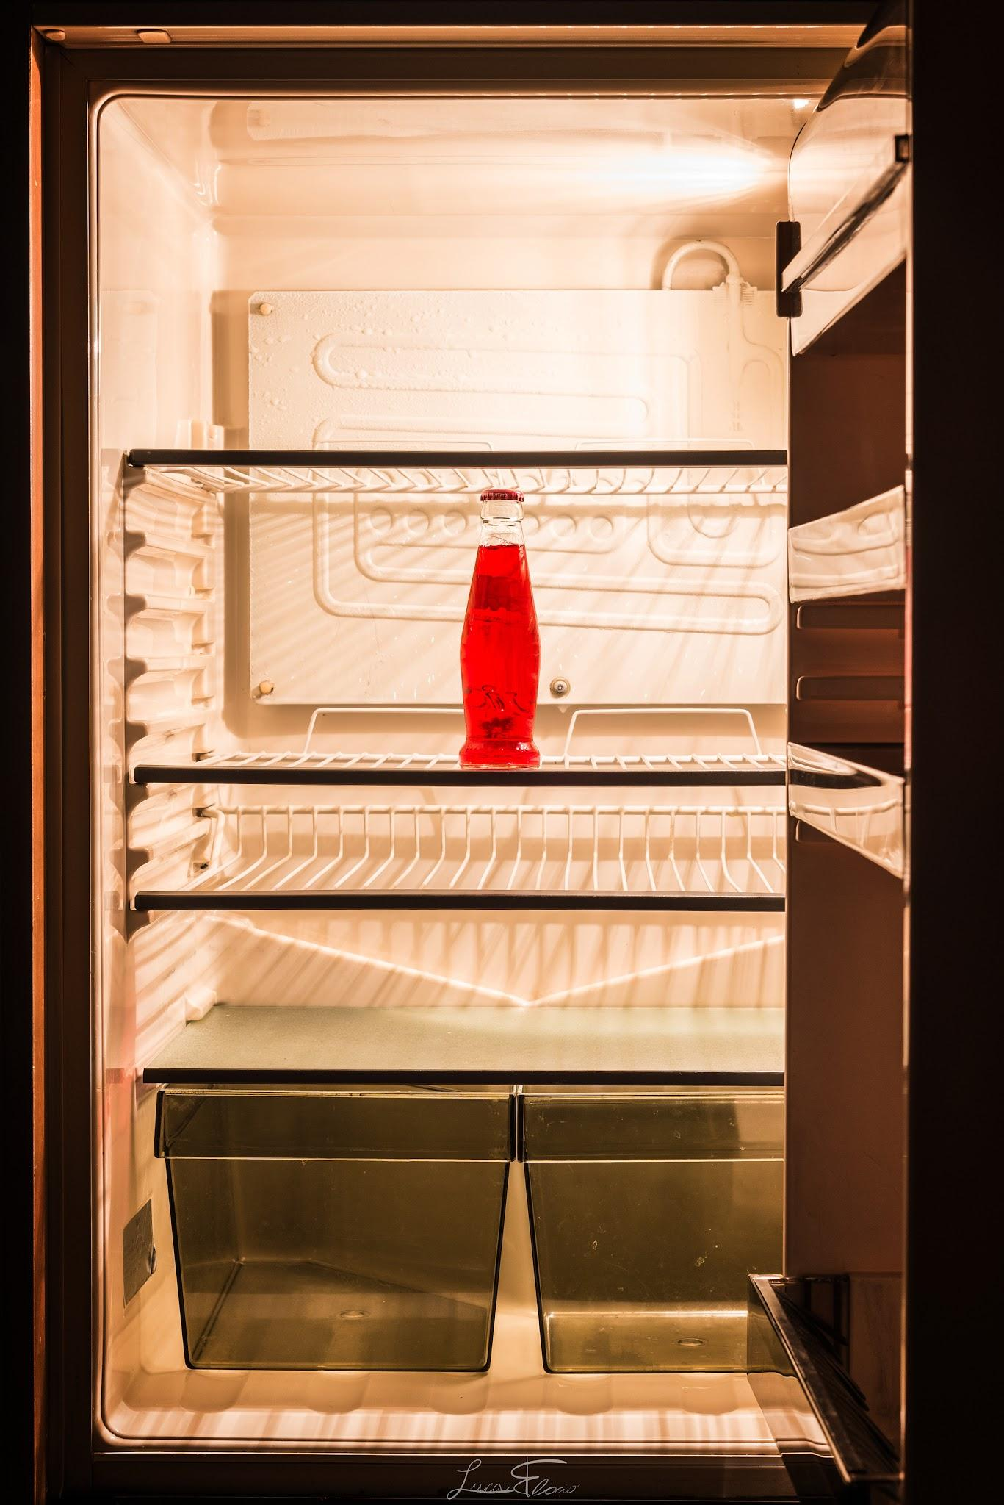
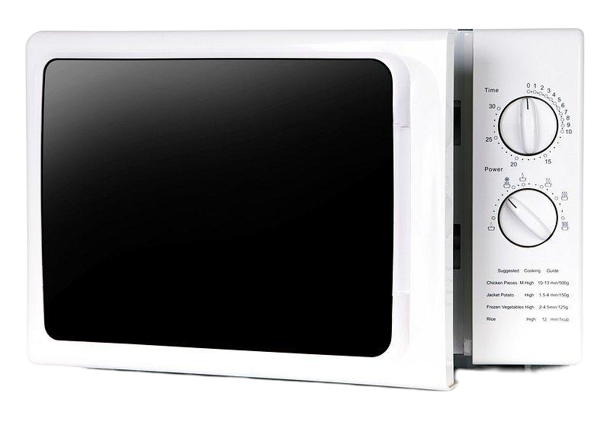
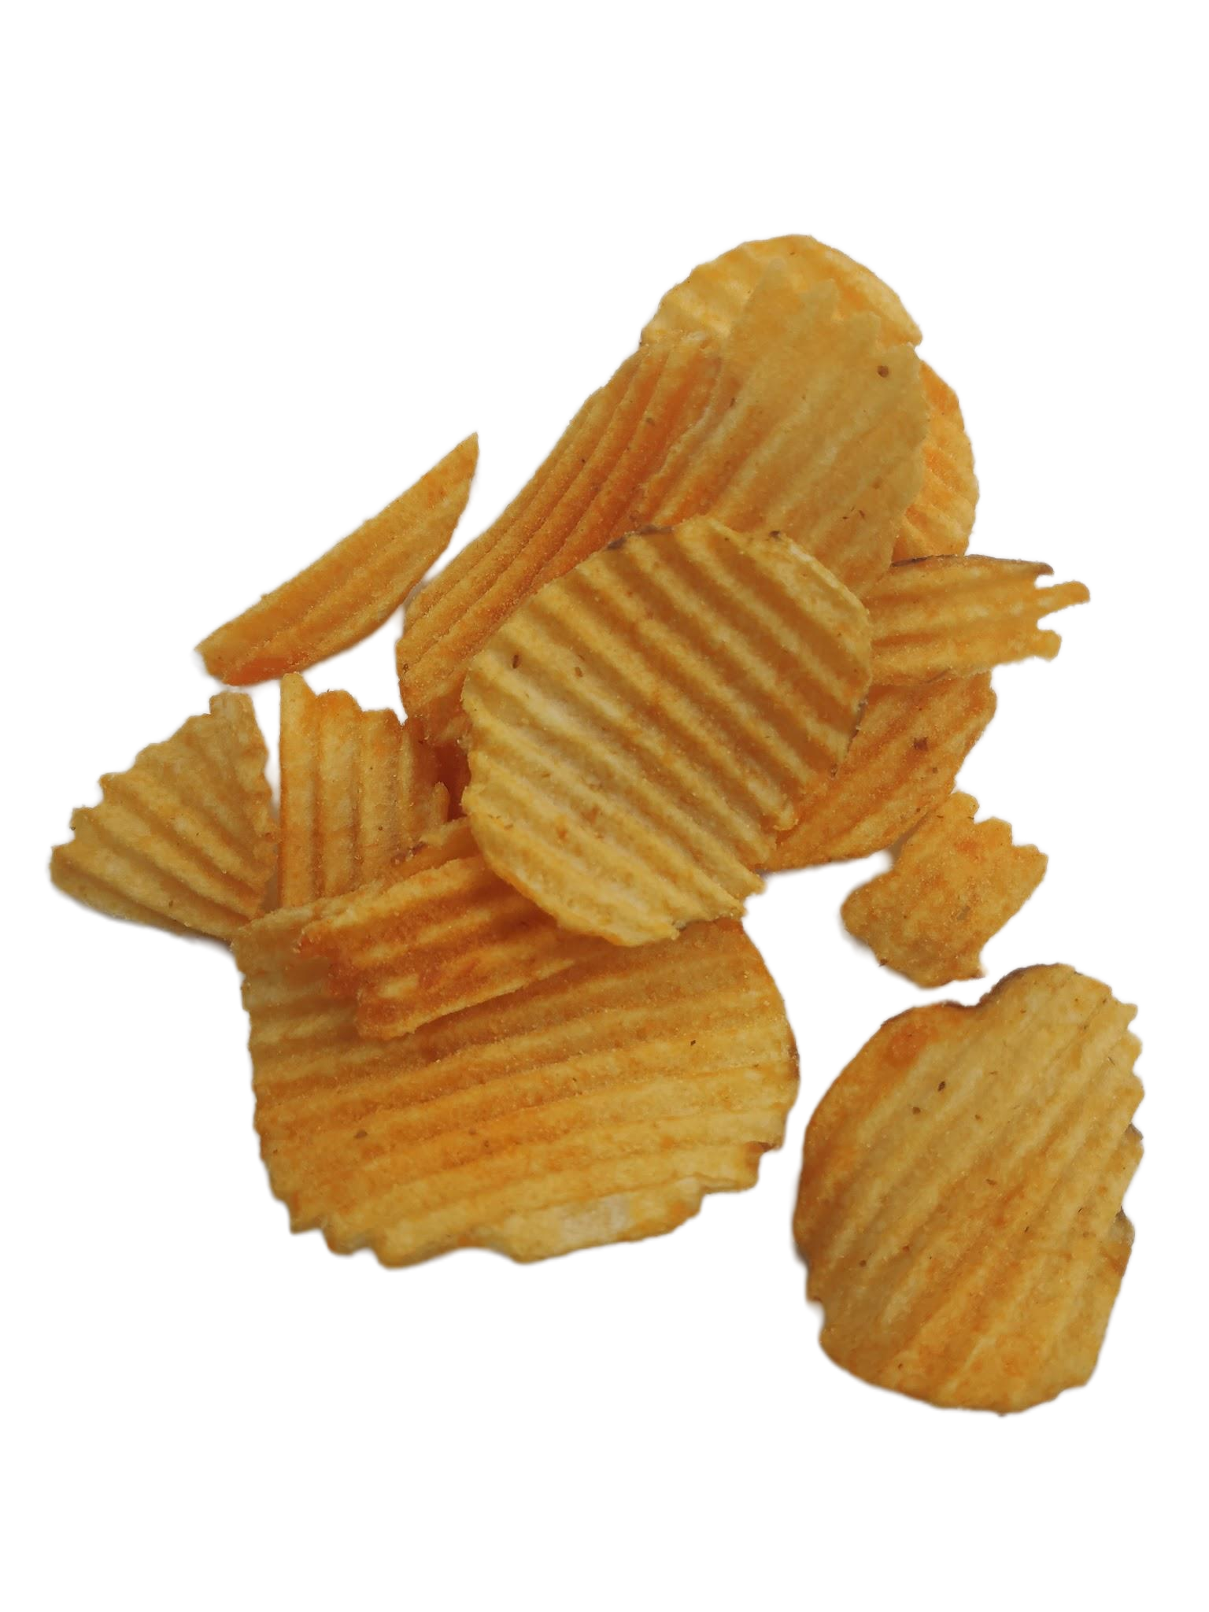
QC Hardware in a Nutshell…
(Home-style Recipe)
Dilution refrigerator
Software Defined Radio
A fridge
containing a microwave
cooking some chips.
Quantum Processing Unit

Slide 11
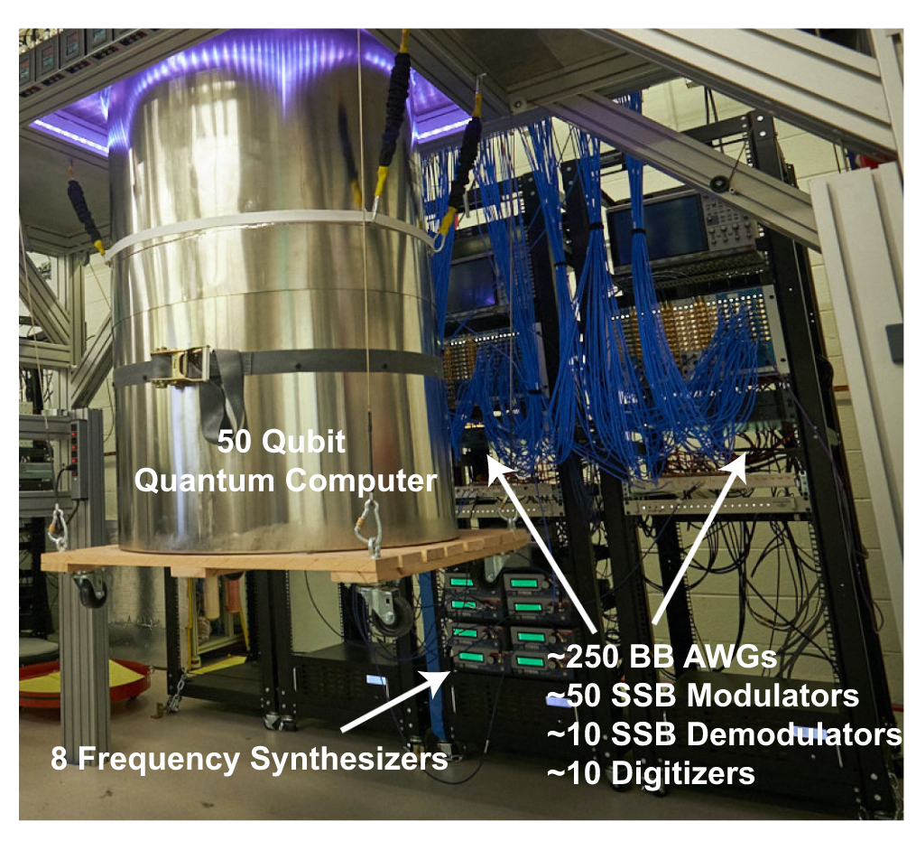
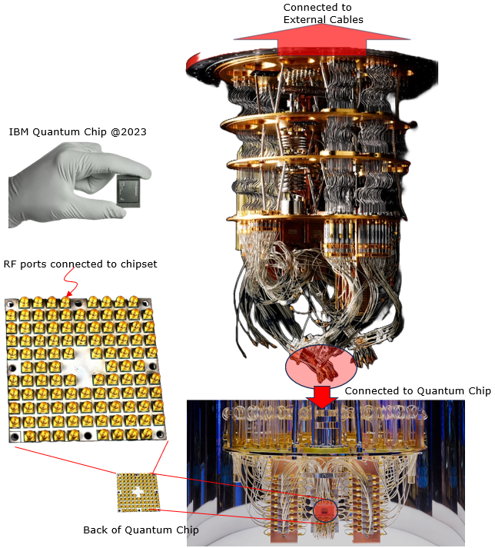
https://www.sharetechnote.com/html/QC/QuantumComputing_HW_Structure.html
Microwave electronics for operating a 50-qubit Google quantum processor. The system generates and receives signals in the 4–8 GHz band, and was used to execute a demonstration quantum computing algorithm designed to be too complex for simulation by even the largest classical supercomputers [7]. Four racks of microwave electronics are required to control and measure the quantum processor. Abbreviations: BB–baseband, AWG–arbitrary waveform generator, SSB–single sideband. Photo credit: R. Ceselin.

Slide 12
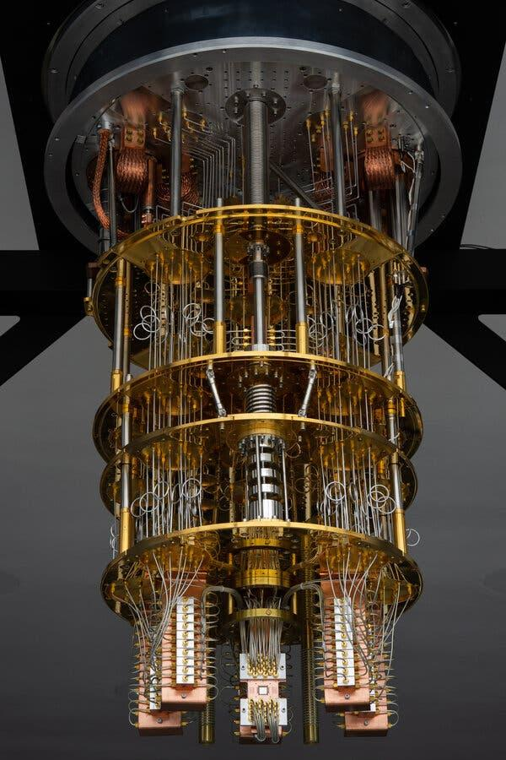
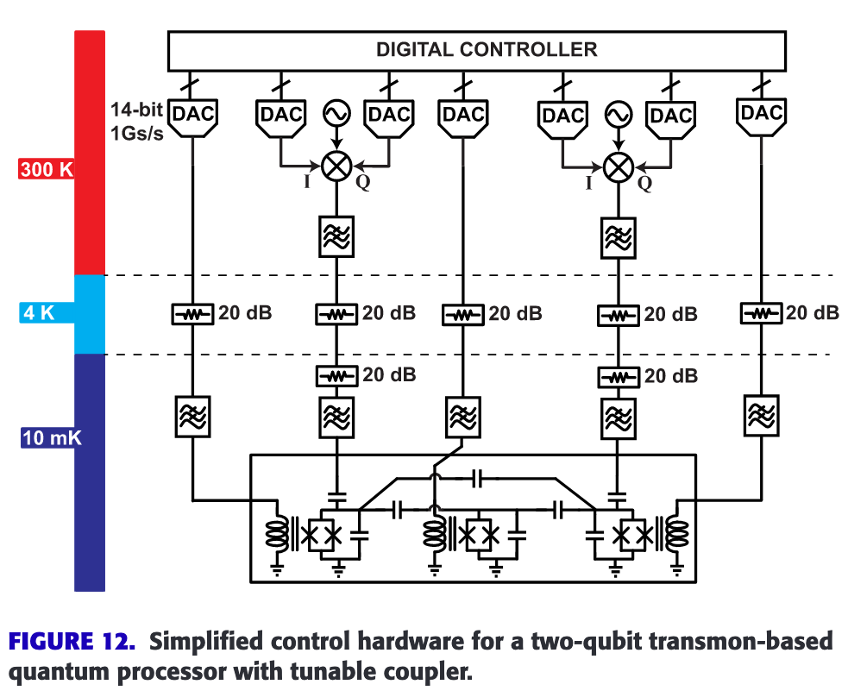
Dilution Refrigerator
Super-conducting Coax
Heat Exchange
Quantum-limited Amp.
Quantum Processor

Slide 13
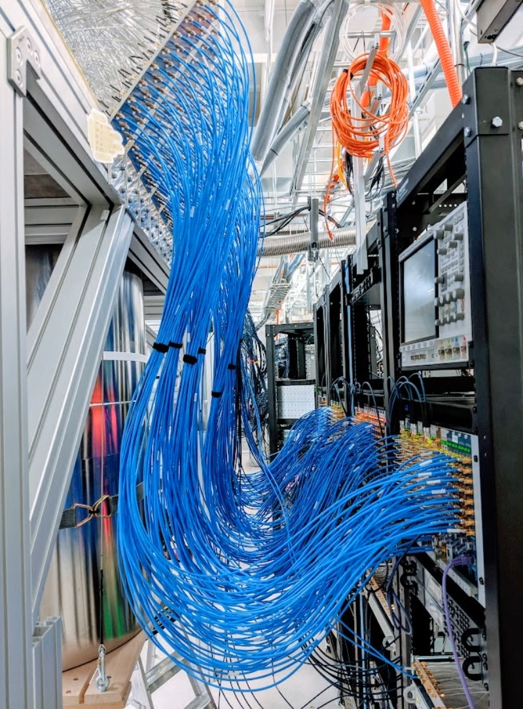
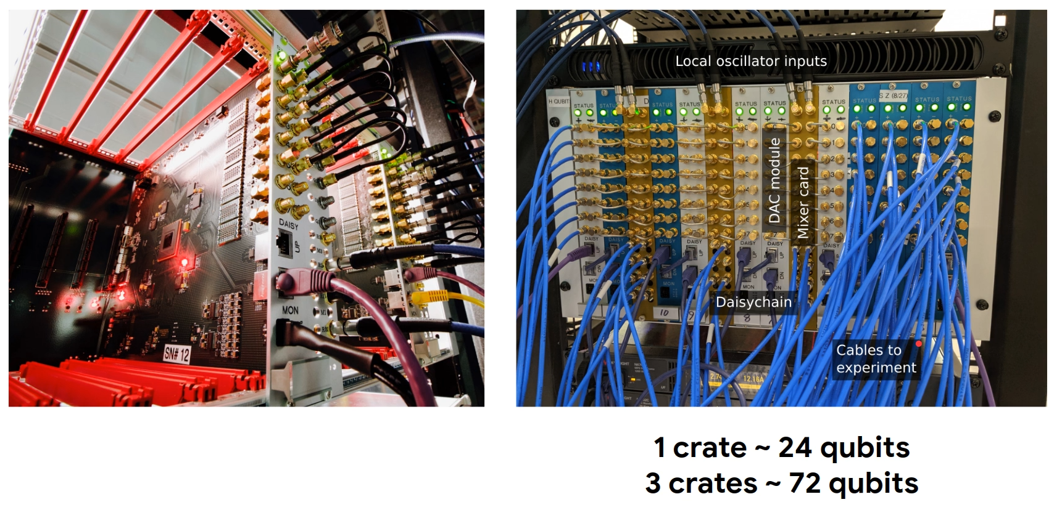
https://www.youtube.com/watch?v=dKTNBN99xLw

Slide 14
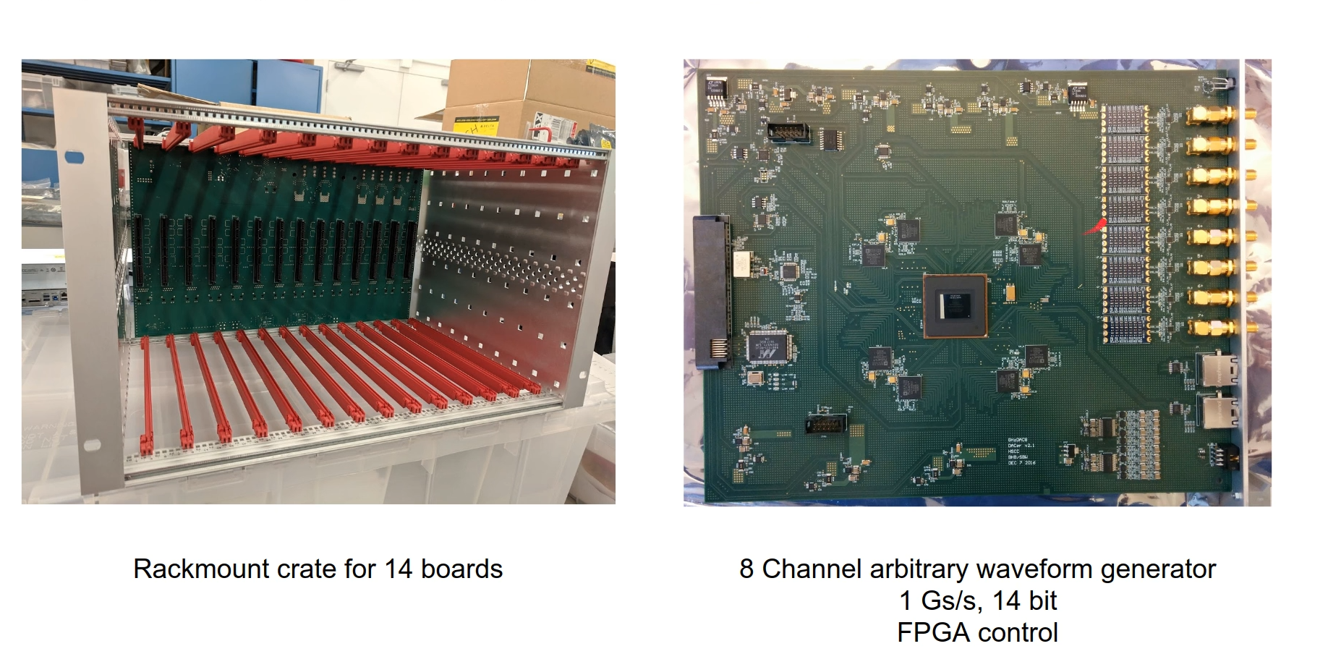

Slide 15
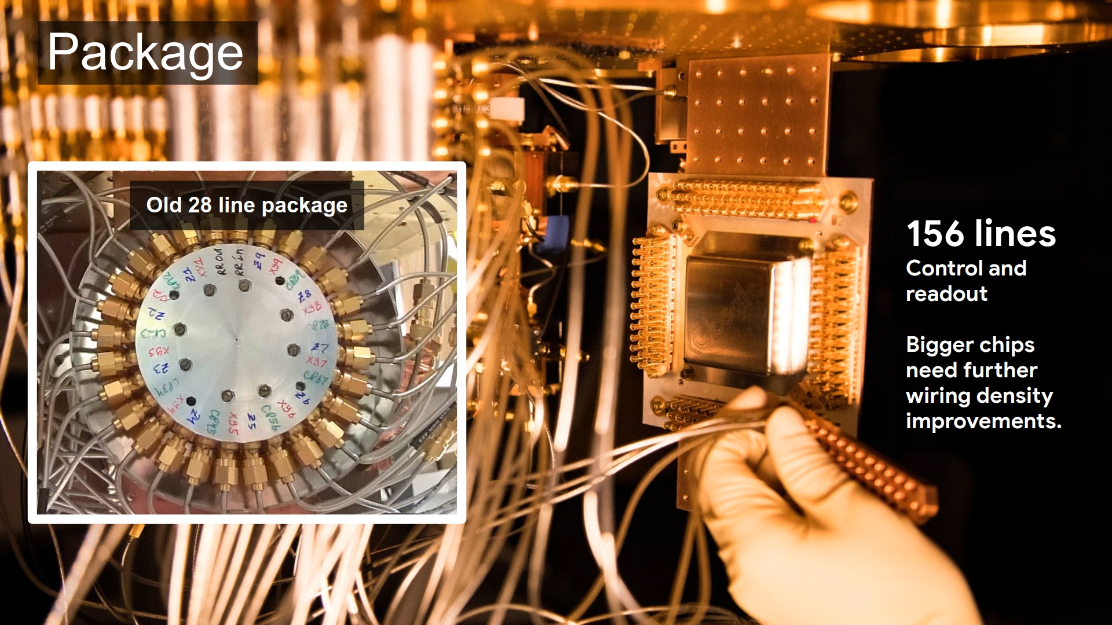

Slide 16
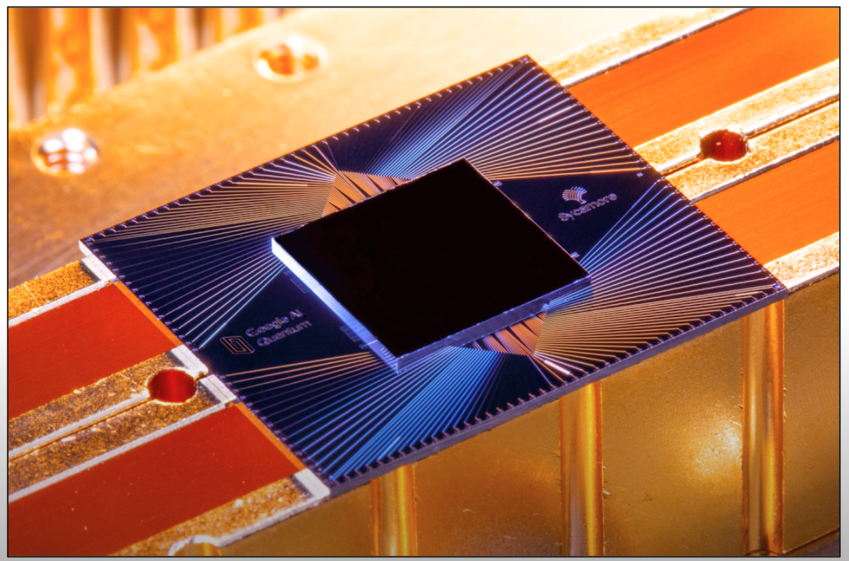
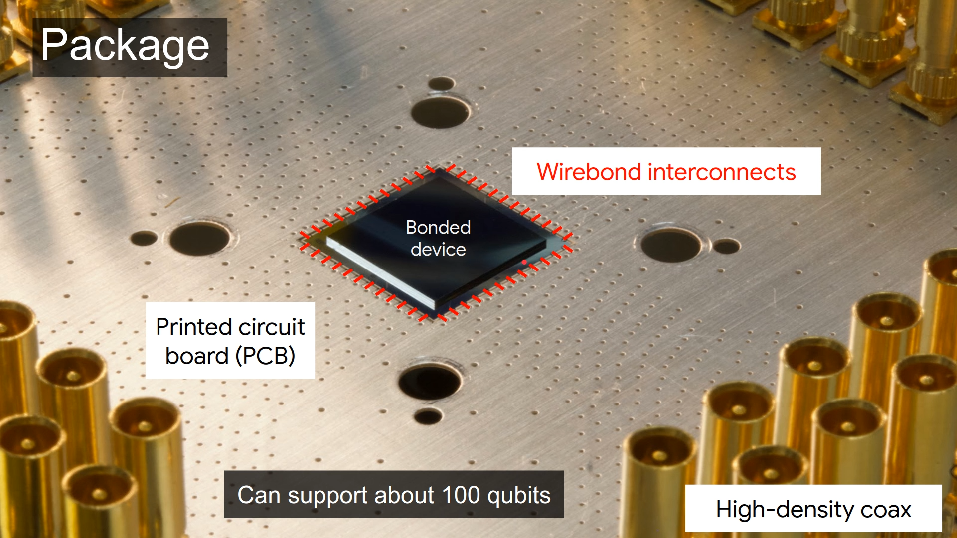

Slide 17
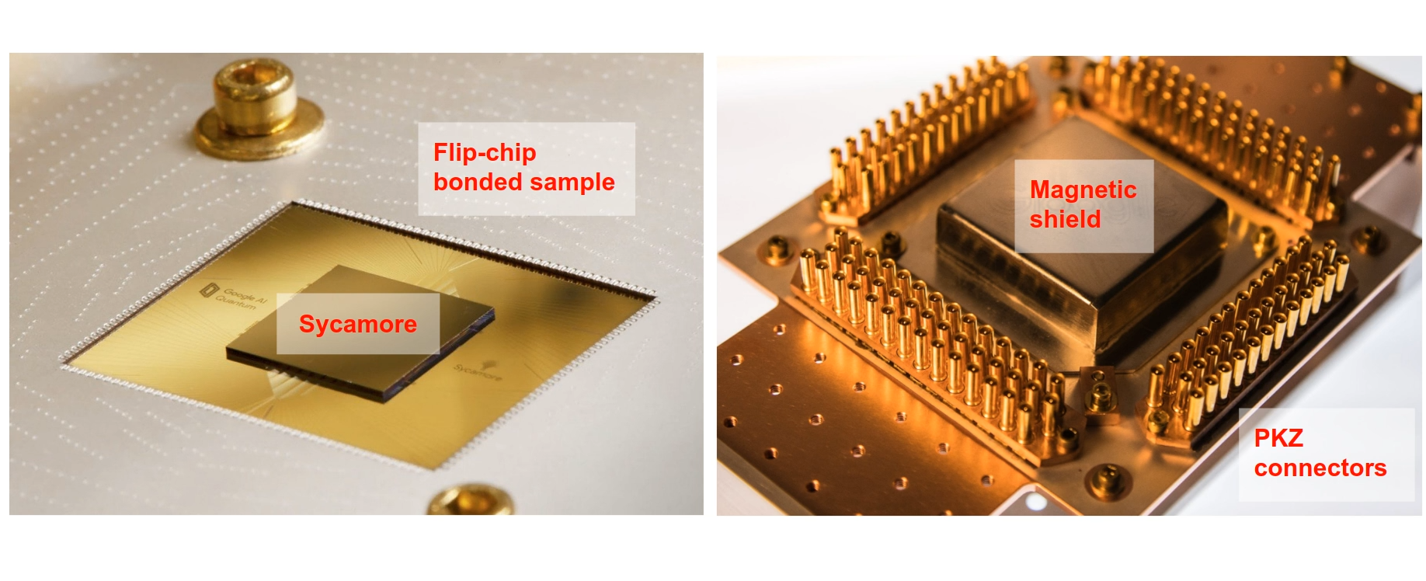

Slide 18
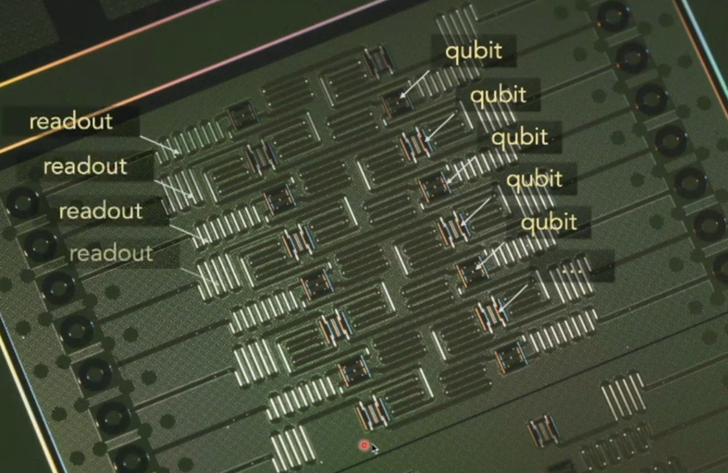

Slide 19
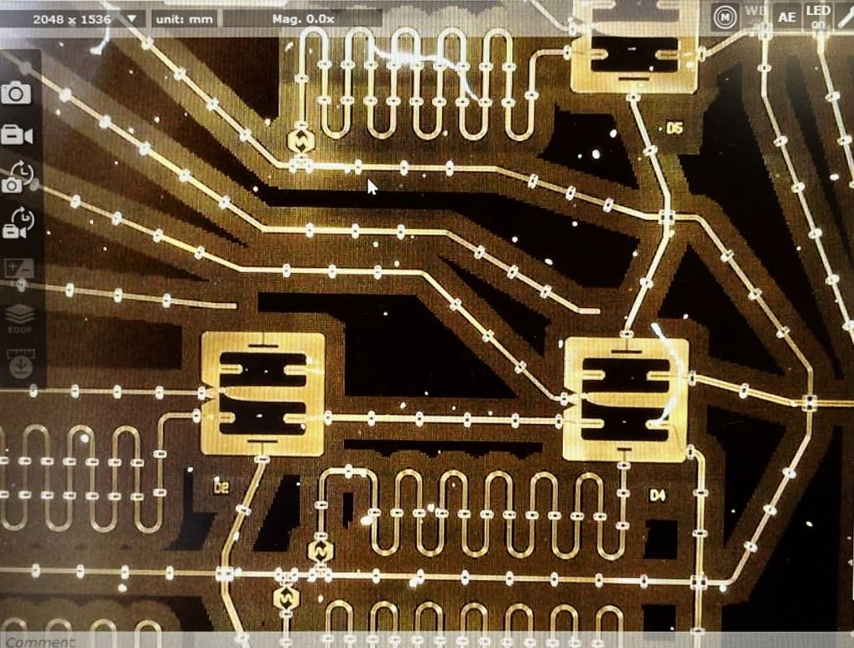
Die shot of a QPU from 2025 APS March meeting

Slide 20
Contents
Quantum Computing: Why?
How: Microwave in a Fridge
System Operation
  Programming
  Controlling a Qubit
  Readout a Qubit
Challenges

Slide 21
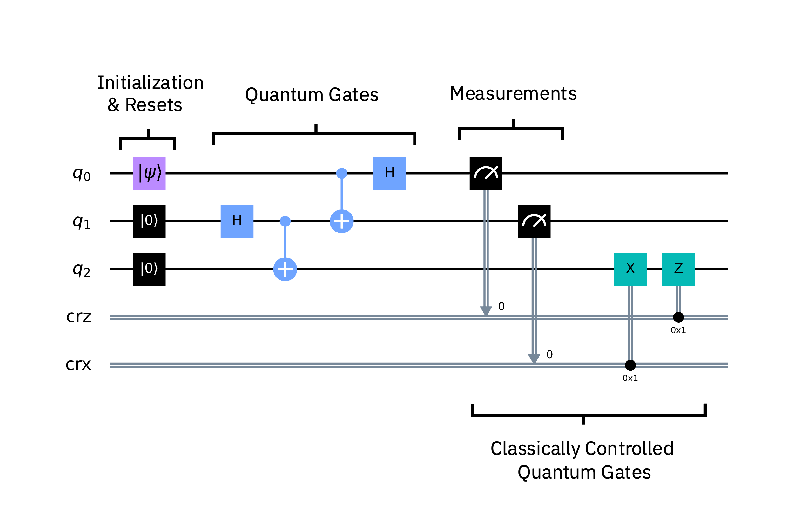

Slide 22
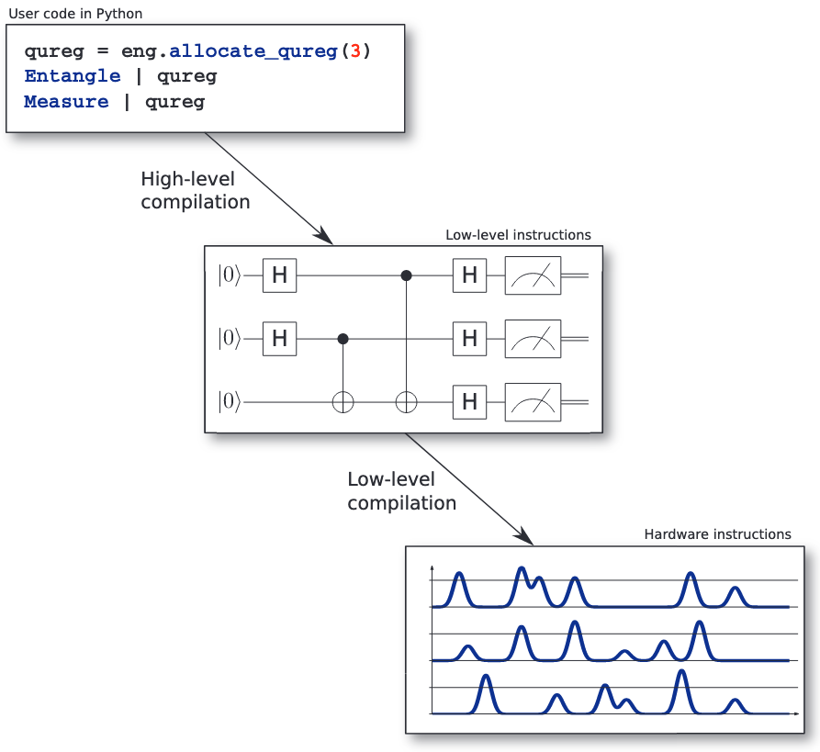
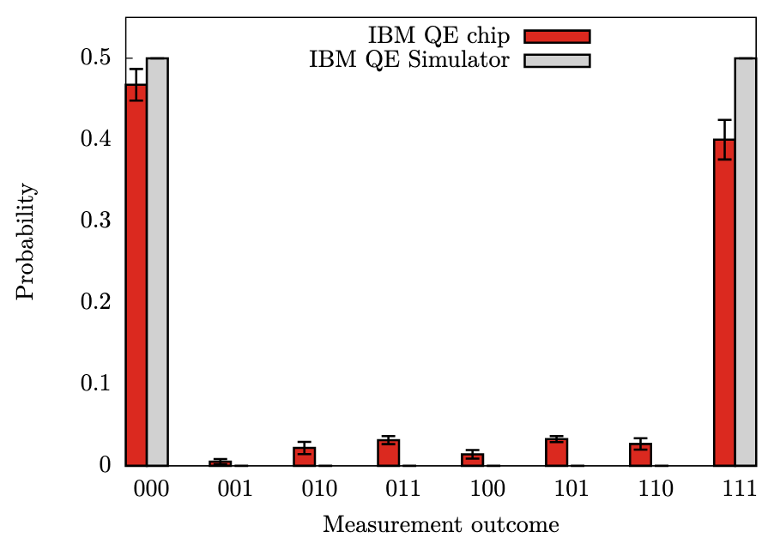

Slide 23
Contents
Quantum Computing: Why?
How: Microwave in a Fridge
System Operation
  Programming
  Controlling a Qubit
  Readout a Qubit
Challenges

Slide 24
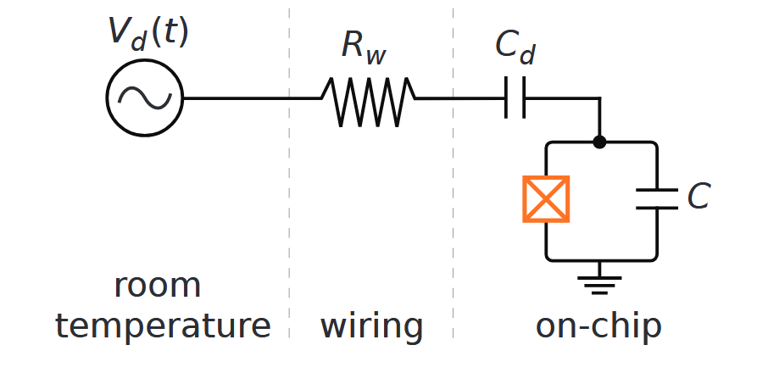
(Over)simplified circuit…
Qubit can be seen as a high-Q resonator

Slide 25
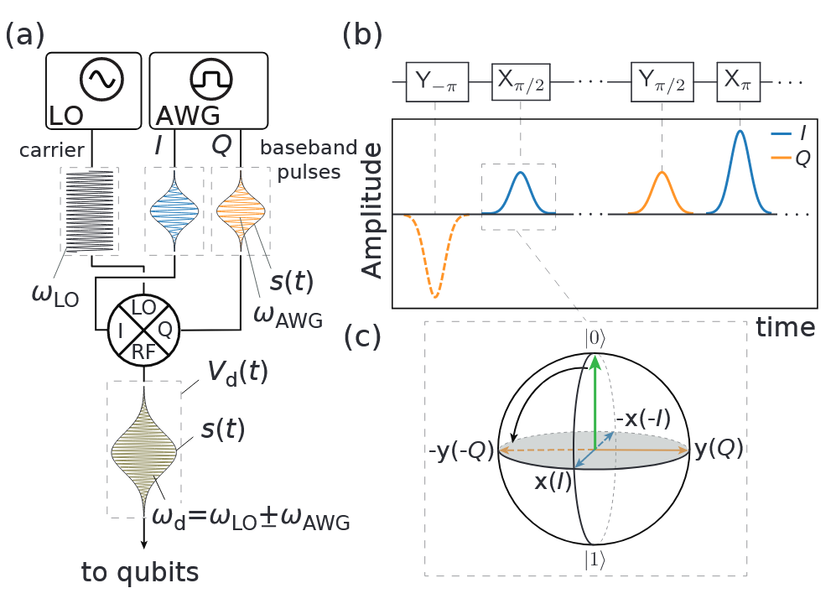

Slide 26
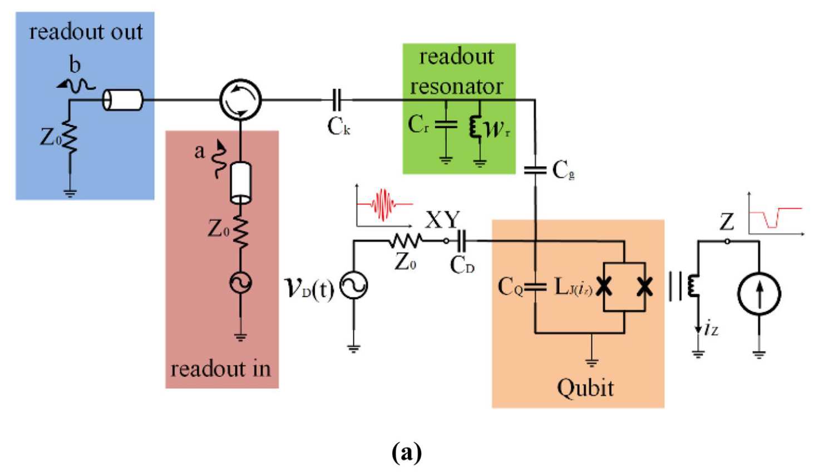
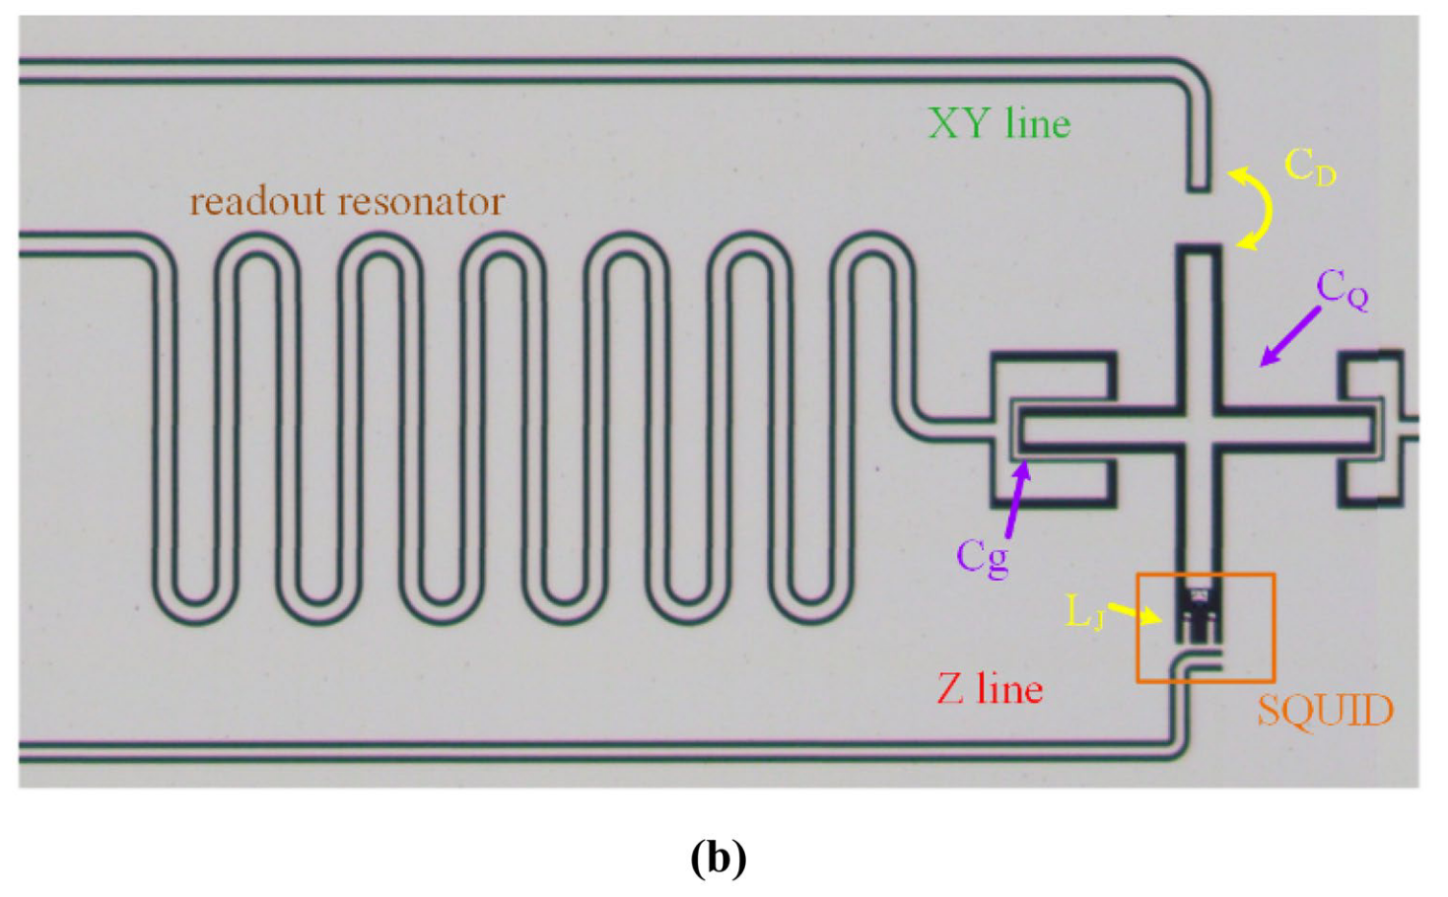
Generic model and the experimental realization of a transmon-based qubit and relevant microwave control system.
a) Electrical circuit.
b) Optical photograph of an Xmon qubit

Slide 27
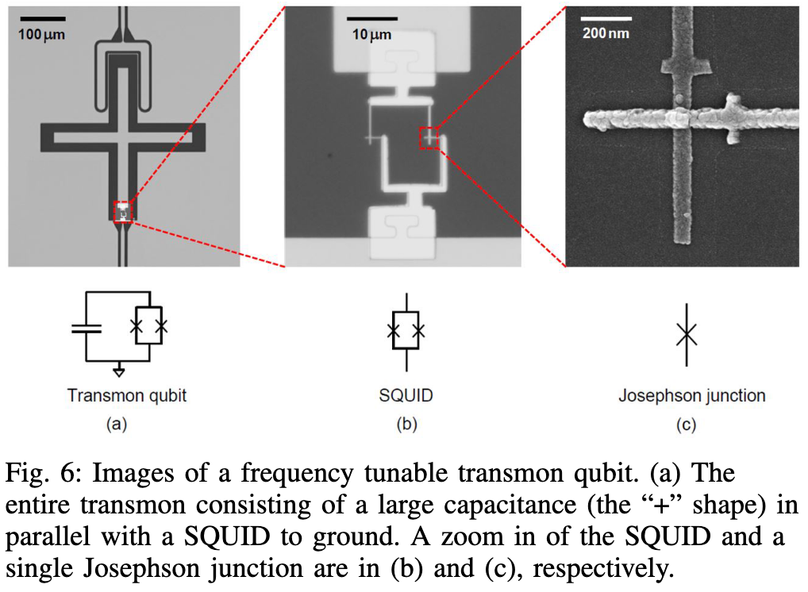

Slide 28
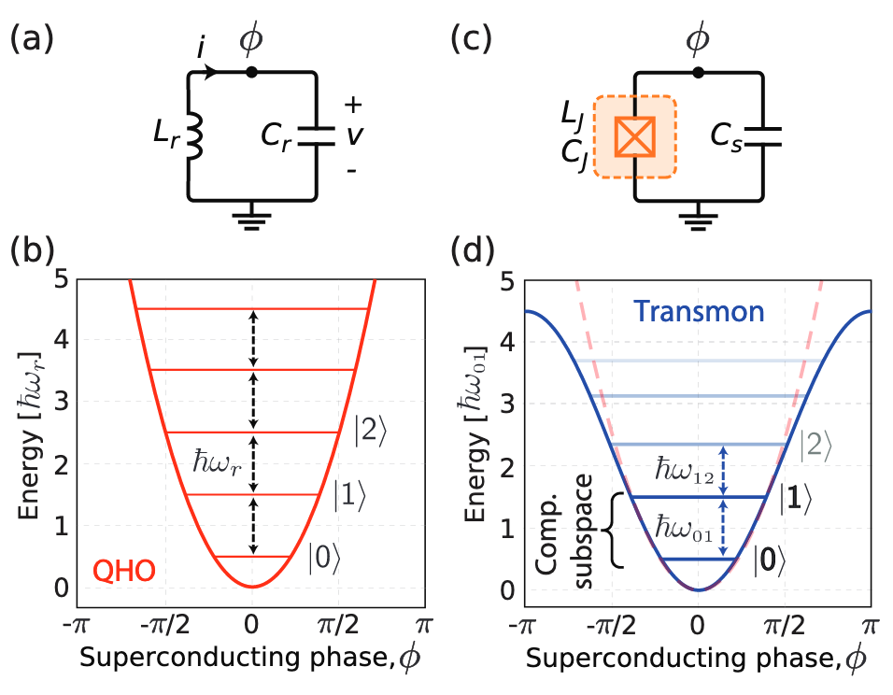
Anharmonicity

Slide 29
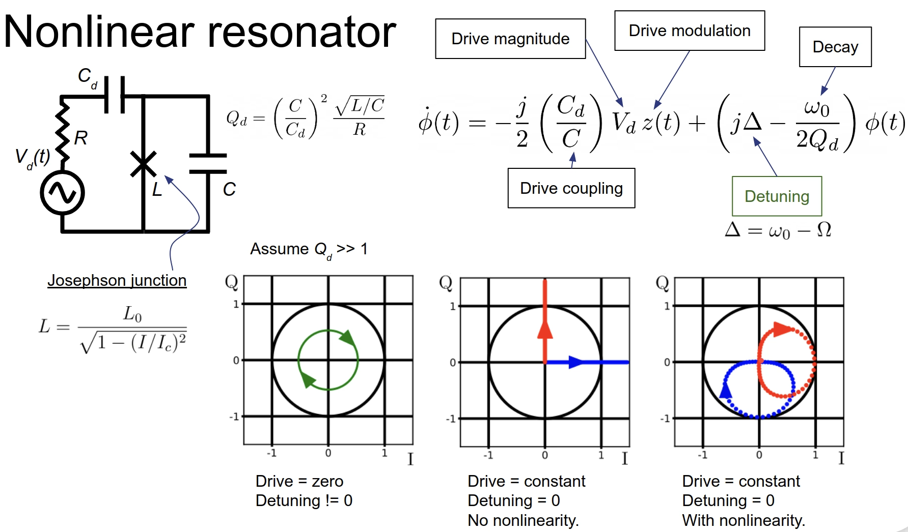

Slide 30
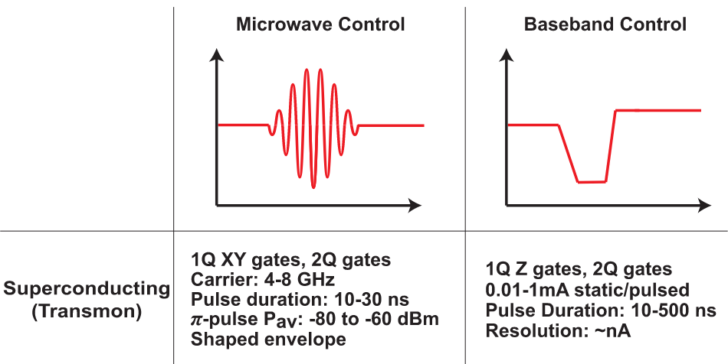

Slide 31
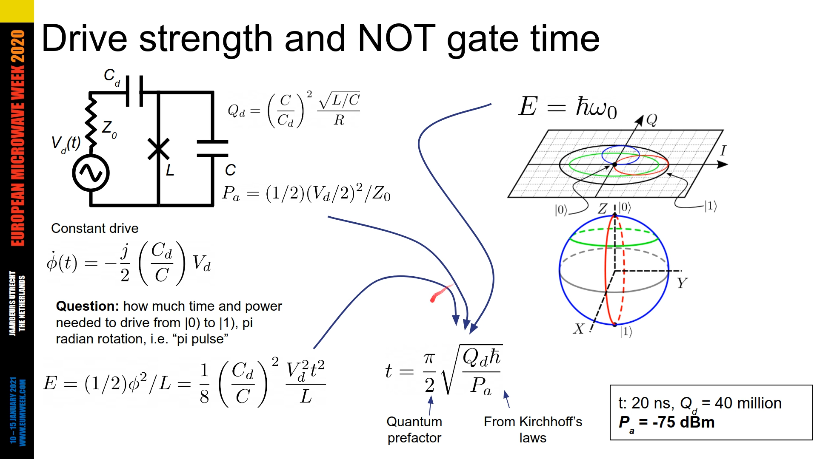

Slide 32
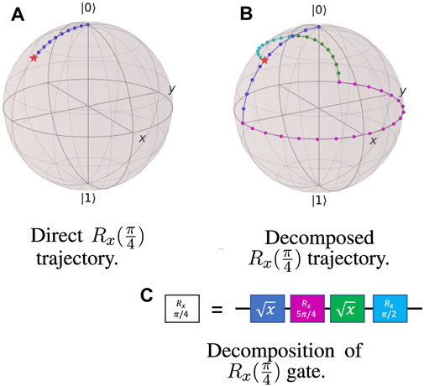
For Non-native Gates

Slide 33
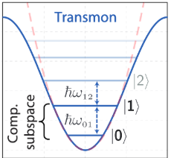
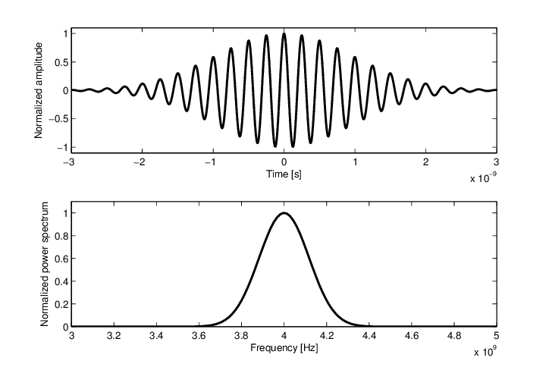
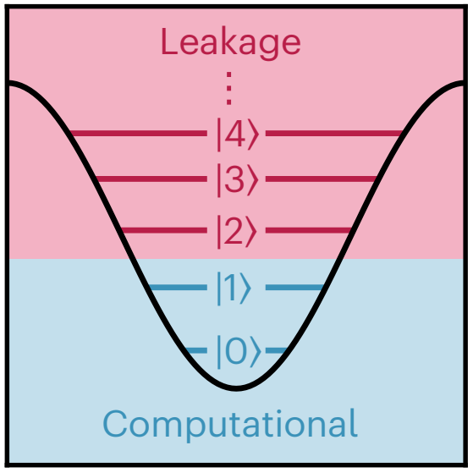
Qubit Leakage

Slide 34
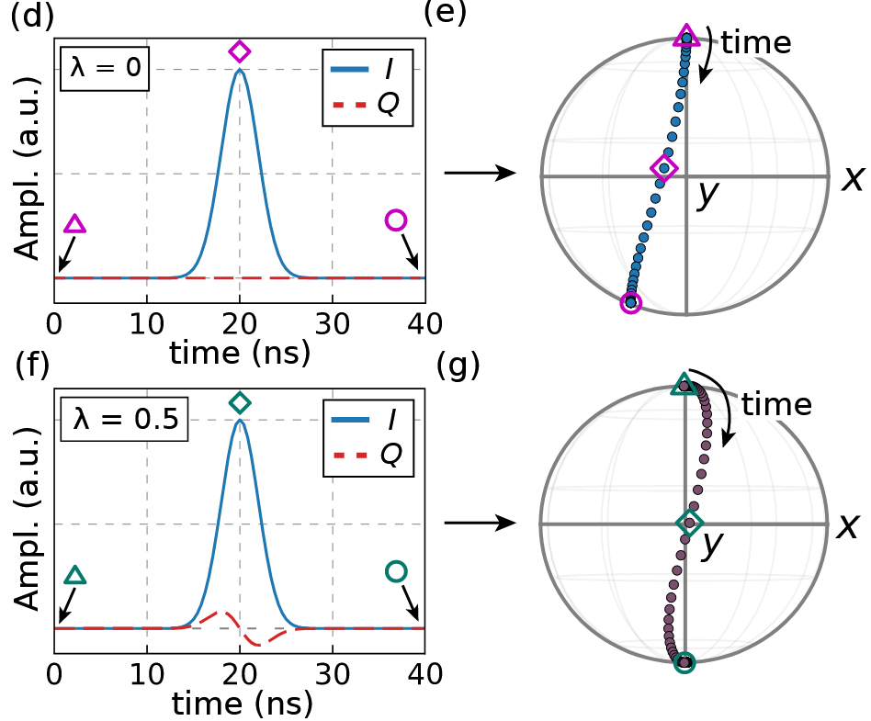
DRAG Pulse: Derivative Removal by Adiabatic Gate

Slide 35
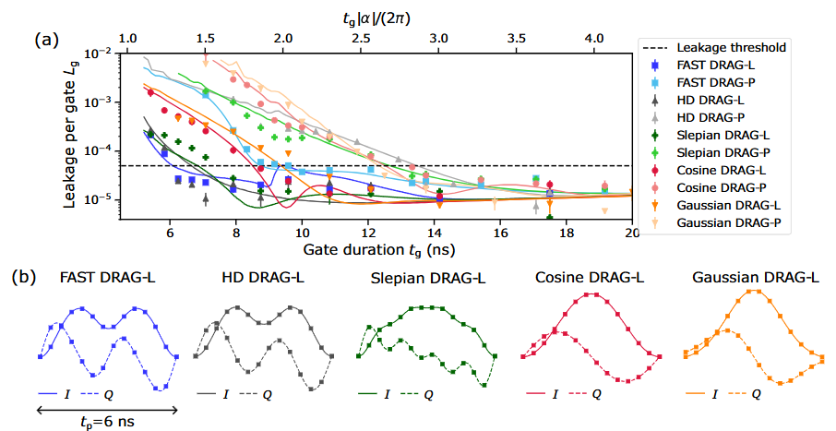
Different Pulse Design

Slide 36
Contents
Quantum Computing: Why?
How: Microwave in a Fridge
System Operation
  Programming
  Controlling a Qubit
  Readout a Qubit
Challenges

Slide 37
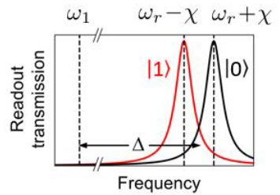
Measuring Qubit State
Resonance frequency change according to qubit state
We can measure resonant frequency shift to tell which state the qubit is in.
BUT… tracing out the resonance curve is slow.
Instead… Measures the phase of a transmitted/reflected signal at a fixed probe frequency
Much faster - just send a single-frequency probe pulse

Slide 38
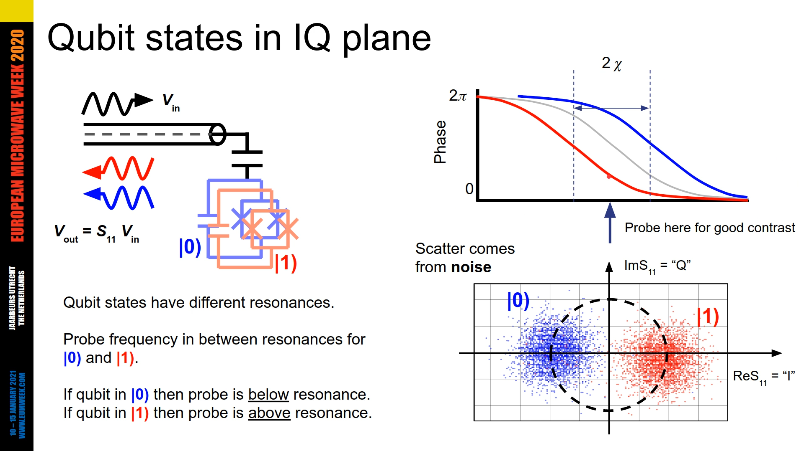

Slide 39
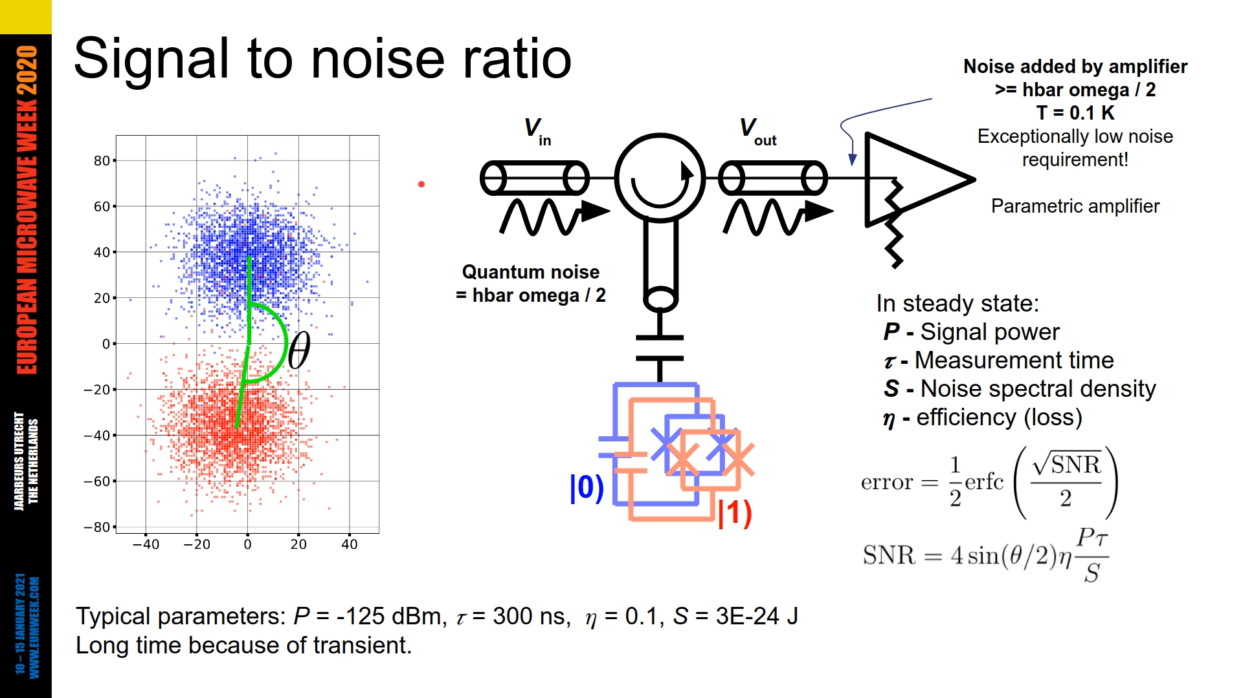

Slide 40
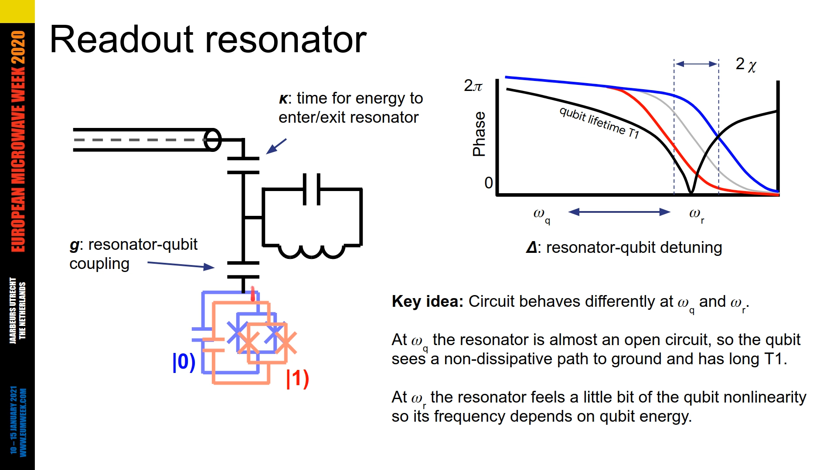

Slide 41
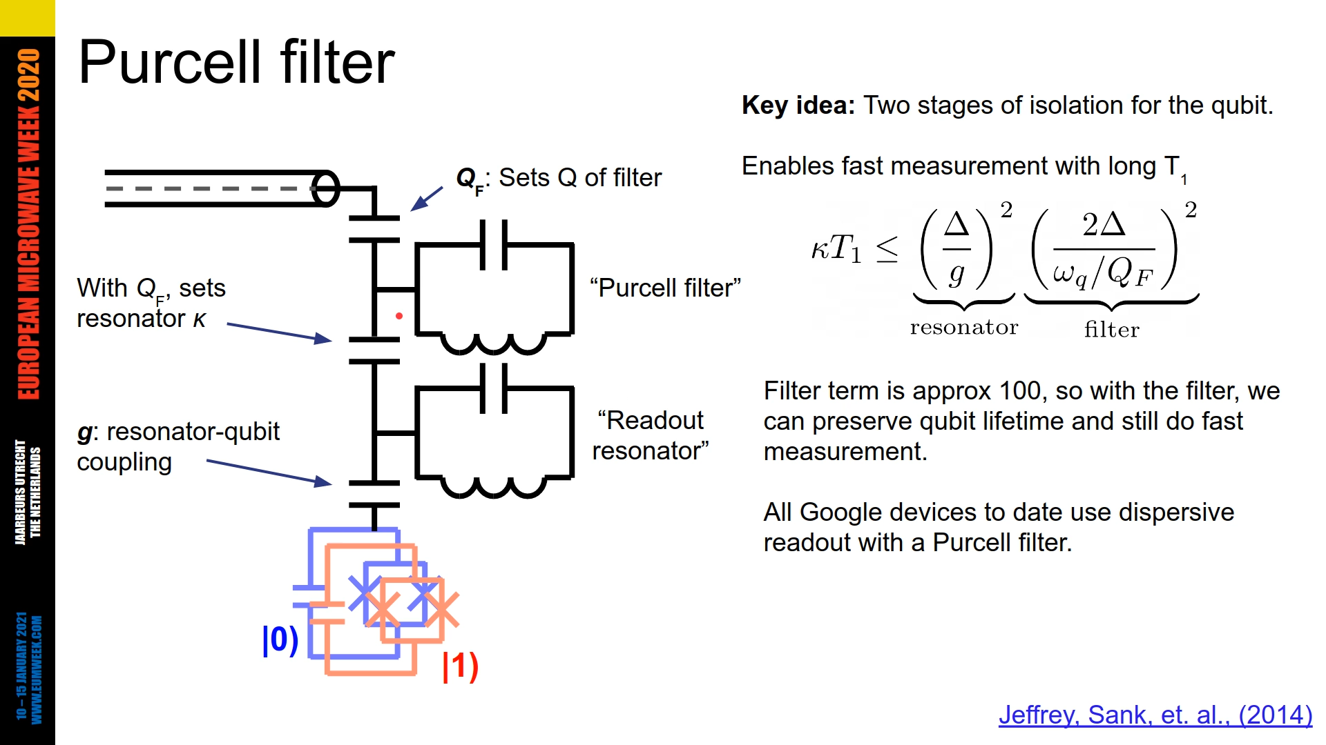

Slide 42
Contents
Quantum Computing: Why?
How: Microwave in a Fridge
System Operation
  Programming
  Controlling a Qubit
  Readout a Qubit
Challenges

Slide 43
Challenges
Temperature extremes (300K to 10mK)
Extreme noise sensitivity
Severe power constraints
Interconnect scaling bottlenecks
Electromagnetic crosstalk
Thermal loading limitations

Slide 44
Further Readings
There’s a proceeding comes with this talk:
Quantum Computing: RF Applications in Superconducting Qubit Control Systems
Other literature surveys:
J. C. Bardin, D. H. Slichter, and D. J. Reilly, “Microwaves in Quantum Computing,” IEEE Journal of Microwaves, vol. 1, no. 1, pp. 403–427, Jan. 2021, doi: 10.1109/JMW.2020.3034071.
P. Krantz, M. Kjaergaard, F. Yan, T. P. Orlando, S. Gustavsson, and W. D. Oliver, “A Quantum Engineer’s Guide to Superconducting Qubits,” Applied Physics Reviews, vol. 6, no. 2, p. 021318, Jun. 2019, doi: 10.1063/1.5089550.
All available at: https://drive.google.com/drive/folders/1c0Fg8onT_xUIR8A8ehaEWEfBhnlyDfaS?usp=sharing

