Slide 1
48th EASTERN VHF/UHF/MICROWAVE CONFERENCE

Slide 2


Slide 3
A Simple Synthesizer Signal Generator
or
Another Personal Beacon

Slide 4
The project was conceived by Colin, G4EML
It is available on Github
It consists of:
  A Controller
  A Synthesizer board
  A GPS module (optional)
The primary use is as a beacon

Slide 5
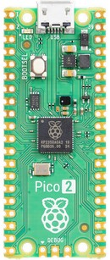
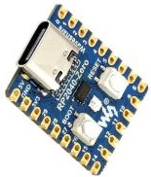
For a controller, there are two recommended boards
Pico or RP2040 Zero
I chose the
less expensive Pico
Hams Like Cheap

Slide 6
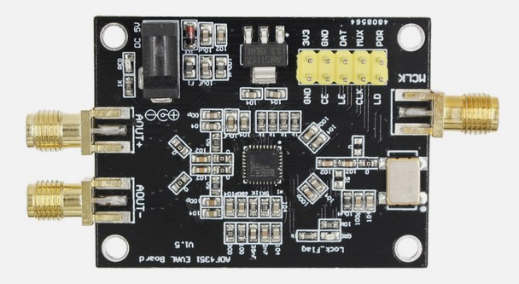
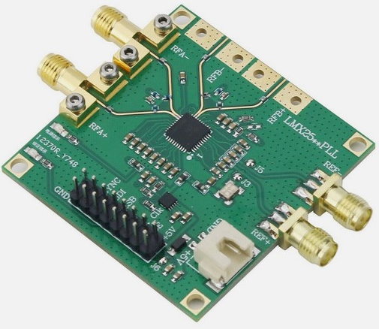
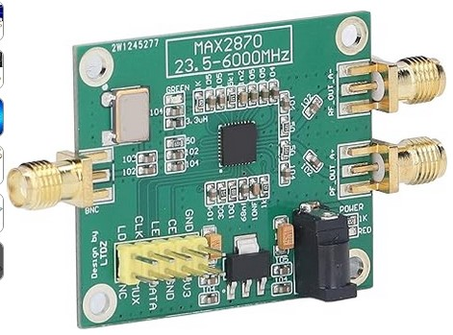
The controller supports 3 different types of Synthesizers:
  ADF4351 – 35 MHz to 4.4 GHz (Analog Devices)
  MAX2870 – 23.5 MHz to 6 GHz (Analog Devices)
  LMX2595 - 10 MHz to 15 GHz (TI)
I used the ADF4351. It is the least expensive! (Hams like cheap)

Slide 7
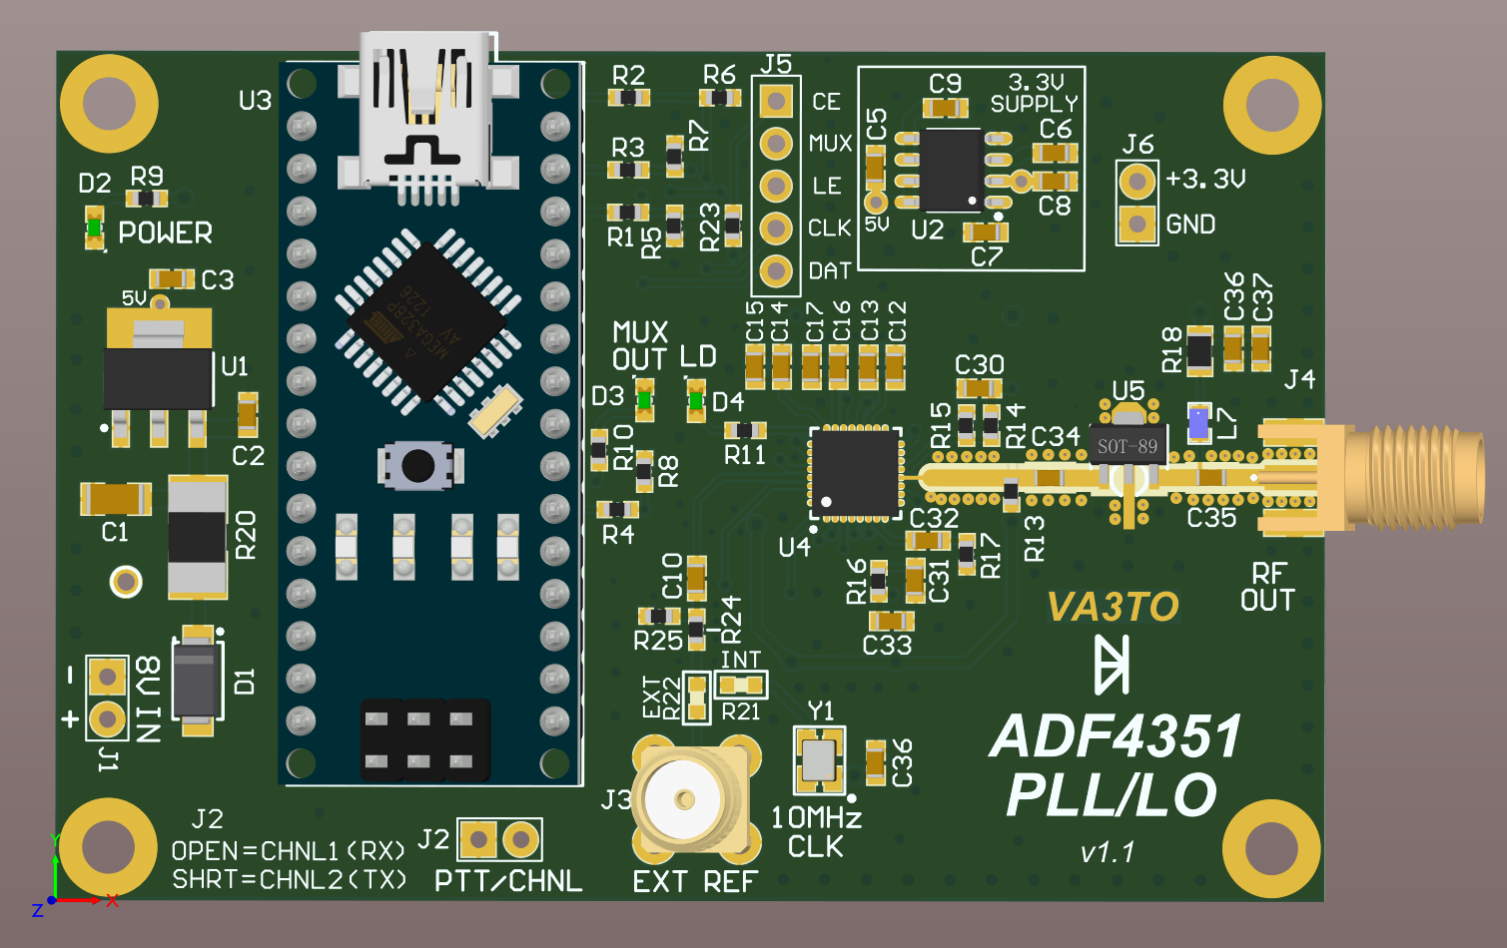
An alternative ADF4351 board only from Hugh, VA3TO
It uses a Nano but that can be removed and then a Pico or Zero could be wired into the board using J5 and J6.
*

Slide 8


Slide 9
FEATURES
(from G4EML’s Github repository)
No special programming hardware or software required.
Serial programming using the RP2040s built in USB serial port and standard boot loader.
Settings can be saved to EEPROM for automatic load on power on.
Support for FSK CW Identification for beacon use.

Slide 10
FEATURES
(from G4EML’s Github repository)
Supports JT data modes for Beacon Identification.
JT4G is available on all 3 chip types.
JT65B and JT65C are only available on the LMX2595.
Note:
The ADF4351 and MAX2870 chips have a limited frequency resolution and may not be
able to accurately set the required tone frequencies, especially when an external
multiplication chain is used. A warning message will be displayed if the tone spacing is
more than 1% in error.

Slide 11
FEATURES
(from G4EML’s Github repository)
Supports a GPS connection for the accurate timing required for JT data modes.
Supports 10 different channels which can be selected by external switches.
Supports External Key Input with independently configurable FSK Shift.
Default register settings can be loaded for all synthesizer types to produce some initial RF output. This is often the hardest thing to do with a new chip type.

Slide 12
FEATURES
(from G4EML’s Github repository)
Supports use with an external frequency multiplier for the higher microwave
bands. Allows frequency entry and display of the final output frequency. Adjusts FSK shifts to compensate for multiplication factor.
Direct output frequency and phase detector frequency entry. Register values are
calculated automatically.
Direct data sheet parameter entry for 'fine tuning' the default settings.
Direct register entry for loading a configuration from another program.
*

Slide 13


Slide 14
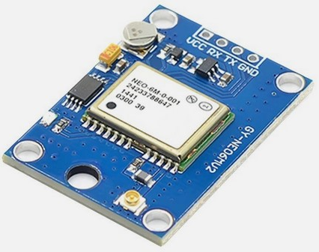
If you plan on running JTxx, you will need a GPS module to meet the timing requirements for the various modes.
For a GPS module, I chose the uBlox NEO-6M. They are inexpensive and usually come with an active patch antenna. The only requirements here are that the module needs to have a 3V3 serial output and will send NMEA sentences at 9600 baud.

Slide 15
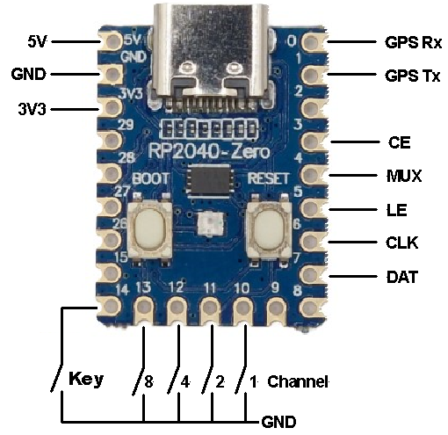
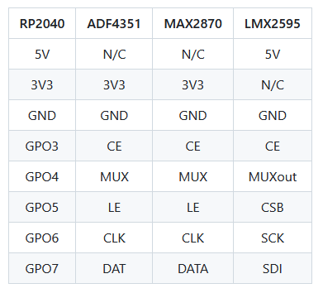
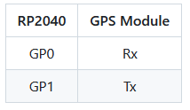
Module Wiring, Alternate Channels and Key Input
*

Slide 16


Slide 17
Firmware Installation In the RP2040:
Locate the latest compiled firmware file 'RP2040_Synth.uf2' which will be found here:
https://github.com/g4eml/RP2040_Synth/releases
The latest version is v1.05. Download and save it to your desktop.
Hold down the BOOTSEL button on the RP2040 module while connecting it to your PC using its USB port. The RP2040 should appear as a USB disk drive on your PC.
Copy the .uf2 file onto the USB drive. The RP2040 will recognize the file and immediately update its firmware and reboot.

Slide 18
Firmware Installation In the RP2040:
Once the Firmware is installed, you can begin setting up the controller.
Under Windoze, Device Mangler should show you the correct COM port to use. Then use PuTTY, Tera Term or your favorite telnet program set to 9600 N-8-1.
PRESS RETURN and you will see the Main Menu.

Slide 19
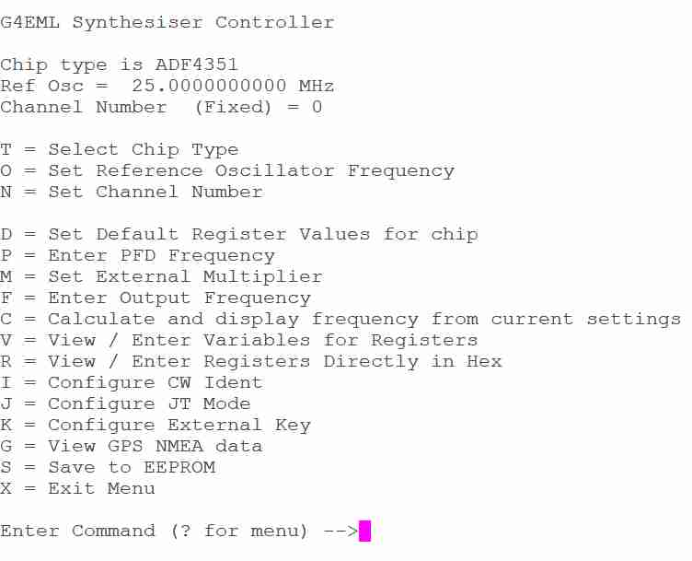

Slide 20
Commands are entered by a single key press. Text and numbers require a carriage return to enter. Pressing ? will usually give more detailed help. Changes to registers and parameters will be applied immediately so you should be able to observe the result of the change in real time.
The first three Menu Items are common to all channels.
T = Select Chip Type. Allows the Synthesizer chip type to be selected. Normally only needed the first time you configure the firmware. This will also clear all memories and reset them to the default settings.
O = Set Reference Oscillator Frequency. Sets the Reference Oscillator Frequency. Enter the actual frequency of your reference including any frequency error. The firmware will attempt to adjust for this.
N = Set Channel Number. Enter the channel number from 0 to 9. This channel will then be loaded and you can adjust the settings using the menu. This overrides the channel selected by any external switches. if you wish to use external switches to select a channel then you must change this setting to 255 before saving to the EEPROM. A setting of 255 enables external channel selection.

Slide 21
The following menu settings are applied to the currently selected channel. Each channel may have different settings.
D = Restores the Default Register Values for chip. Sets default values to all registers. Tries to program a 10Mhz PFD and requests a frequency. After this your Synthesizer should start to output RF.
P = Enter PFD Frequency. Set the required PFD frequency. The firmware will attempt to get as close as possible to the requested value but not all values can be achieved.
M = Set External Multiplier. If the Synthesizer is followed by a multiplier for higher frequencies this option allows you to specify the multiplication factor. Final Multiplied Frequencies can then be entered and viewed.
F = Enter Output Frequency. Set the required output frequency. The firmware will attempt to calculate the closest register values to achieve this. Changing the PFD may improve the result.
C = Calculate and display frequency from current settings. The firmware will calculate the expected output frequency from the current register settings. Useful to check after you make manual changes.

Slide 22
V = View / Enter Variables for Registers. Allows viewing or entry of parameters using the same names as defined in the chip datasheet. Press ? for a full list of the available parameter names.
R = View / Enter Registers Directly in Hex. Allows direct entry of register values in Hexadecimal. Useful when transferring values calculated by another program.
I = Configure CW Ident. Allows entry of CW Ident, CW Speed, Ident Period and FSK Shift. A shift of -800Hz is a typical value. Ident period is only valid for a CW only configuration. If a JT mode is also enabled, then the CW ident will be sent every odd minute.
J = Configure JT modes. Allows entry of a 13-character message. This would normally be the Callsign and Maidenhead locator. The JT ident will be sent every Even minute. Accurate timing requires a GPS module to be connected.
K = Configure External Key. An External Morse key can be connected and used to frequency shift the signal. The FSK Shift can be entered and is separate from the CWID shift.

Slide 23
G = View GPS NMEA data. This is used to test the GPS connection. when selected it will echo all GPS data to the screen. Press any key to exit this mode.
One note on using the GPS, if you use an active antenna with a very short coax, keep it away from the Pico/Synthesizer otherwise interference can cause the GPS to not lock!
S = Save Registers to EEPROM. Saves the current Synthesizer settings to EEPROM. They will then be automatically loaded on the next power cycle. You must do this at least once.
X = Exit Menu. Exits from the menu, re-initializes the Synthesizer and starts the CW Ident.
The ADF4351 can accept an external reference such as a GPSDO. This is selected in the ‘O’ menu item.

Slide 24
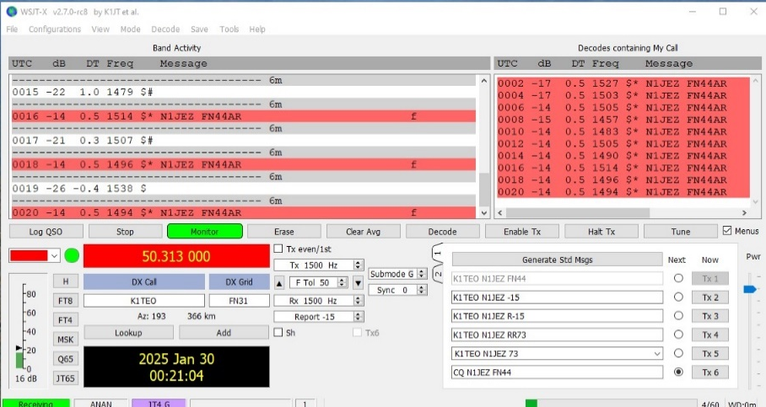
You can see from the menus that use as a signal generator would be pretty straight forward by not programming a CW Ident or JT mode. There should also be no offset.
I set up JT4G and WSJT-X decoded it easily.

Slide 25
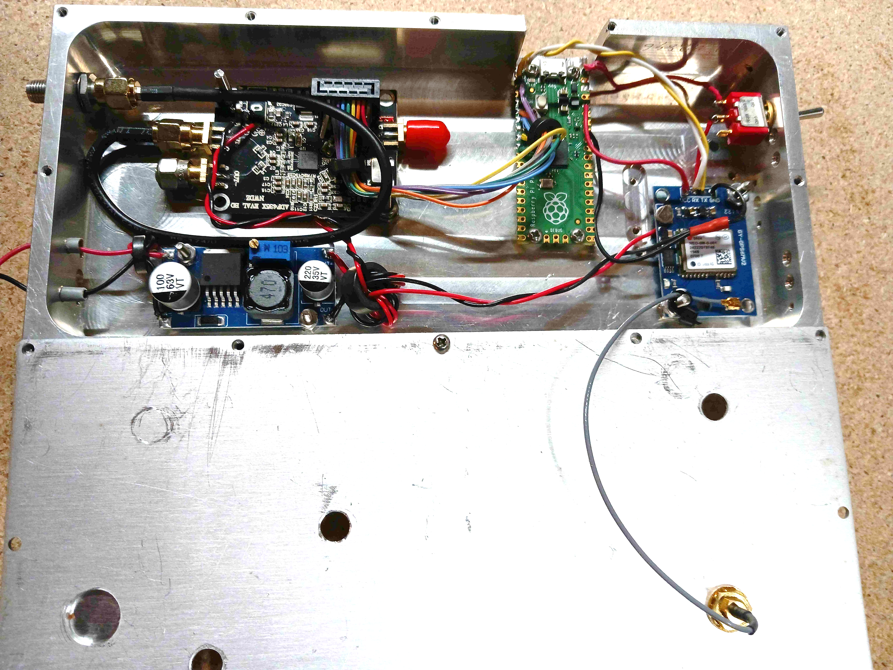

Slide 26
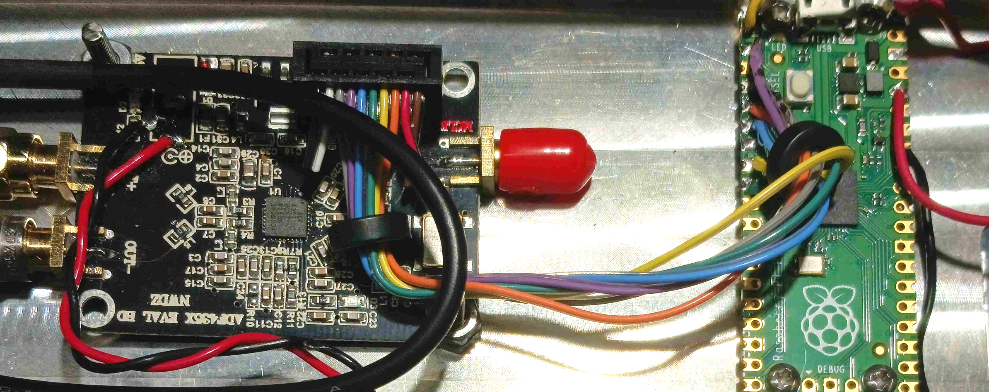
*

Slide 27
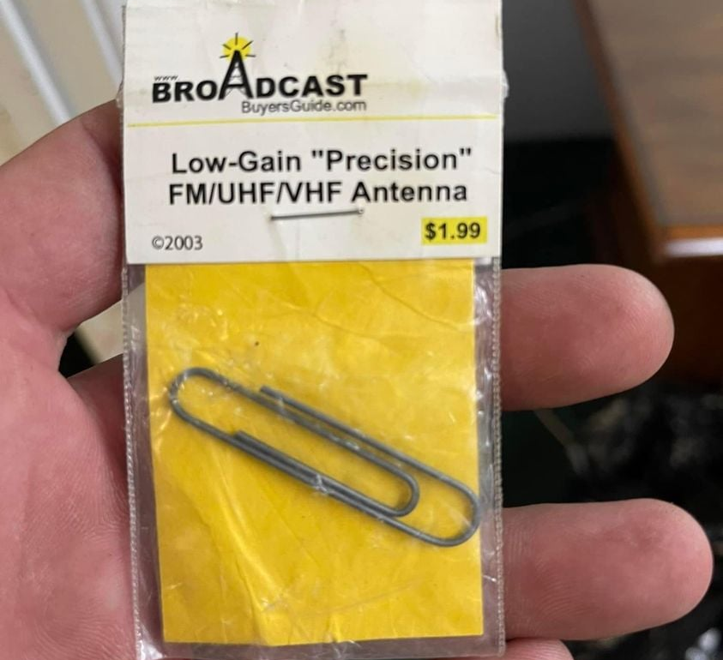

Slide 28
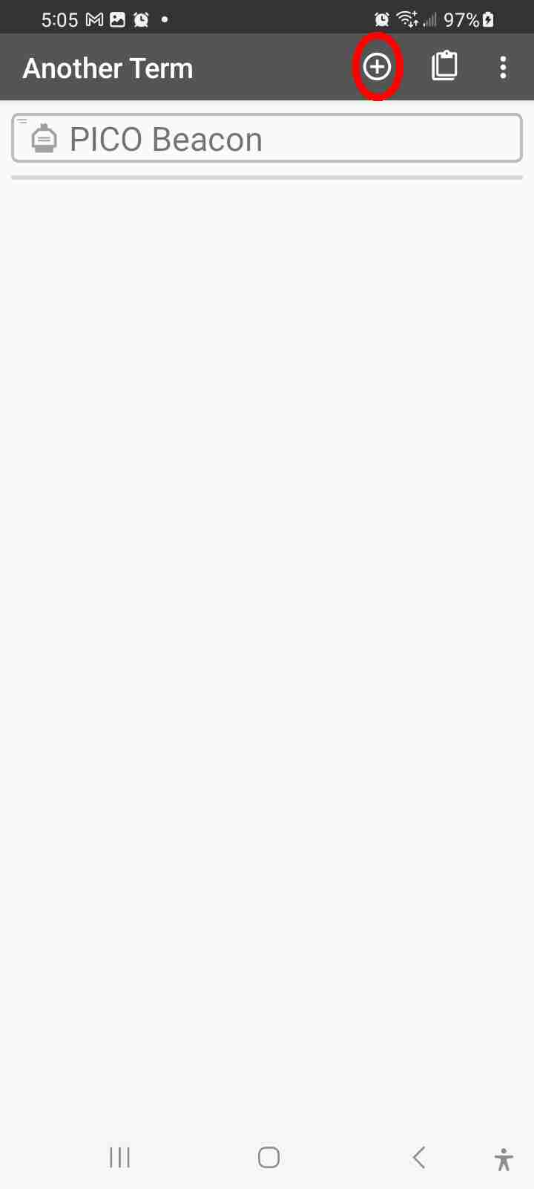
ALTERNATE PROGRAMMING:
Up to now, it is assumed that you are using a PC to program the Pico/RP2040 Zero. There is another way. It can be done with your trusty Android Cell Phone.
To be able to talk to the Controller, an OTG (On the Go) cable and terminal program like Tera Term or PuTTY is required.
I searched for quite a while trying to find a suitable terminal program to run on my Android. I finally settle on ‘Another Term’ available for free at the Play Store. It is quite powerful.
Once downloaded and installed, launch it. You will be greeted with an opening screen. In this one, there is an entry named PICO BEACON. This is a shortcut I set up to access the controller through its USB port. To set one up, follow these instructions.

Slide 29
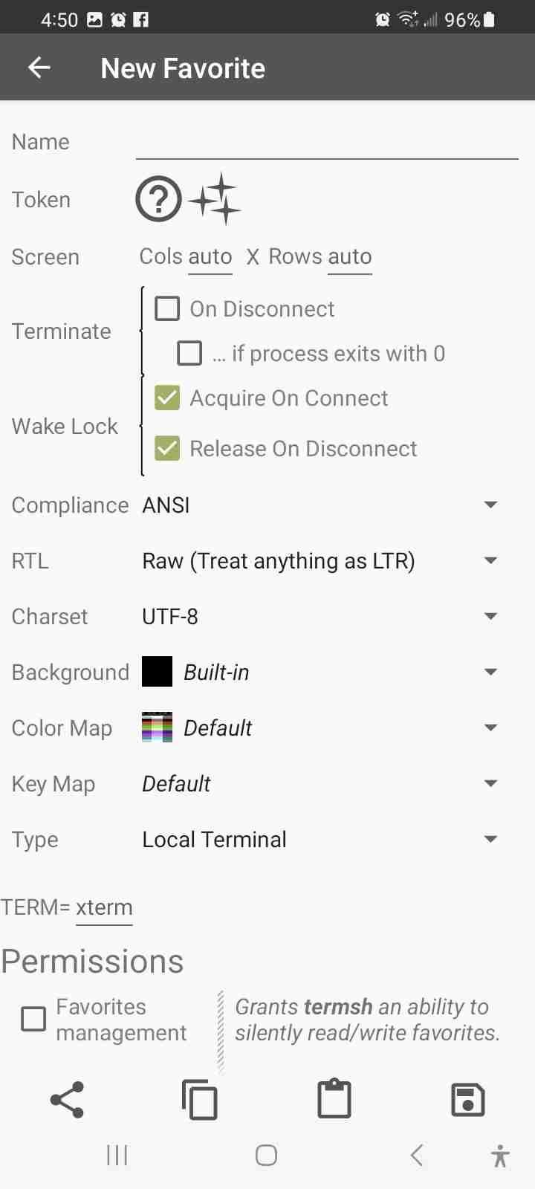
First add a New Favorite by pressing the + circled below.
This will open a default configuration page.
We need to modify it.
First name the Favorite.
For Terminate, select ‘On Disconnect’ and deselect ‘if process exists with 0’.
For Wake Lock, deselect ‘Acquire on Connect’ and select ‘Release on Disconnect’.
For Compliance, select ‘VT52 Compat’.
For Type, select ‘UART’ This will bring up additional parameters.
For Baud – 115200
For Data Bits – 8
For Stop Bits – 1
For Parity – No Parity
For Flow Control – No Flow Control

Slide 30
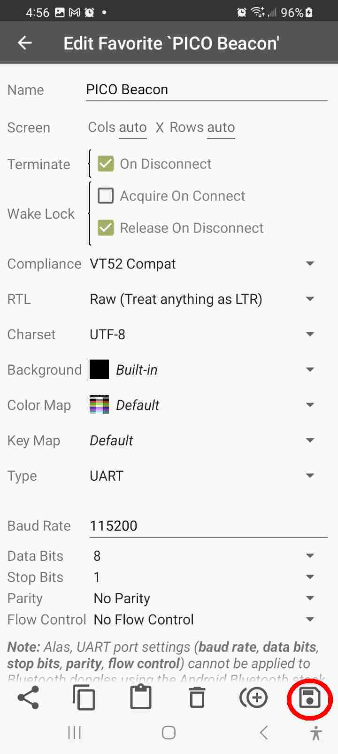
The screen should look like this:
Press the floppy icon in the lower right to save your changes.
Then press the back arrow. This will take you to the home screen where your Favorite should be listed.

Slide 31
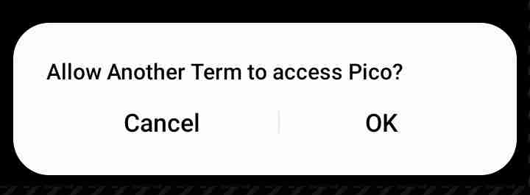
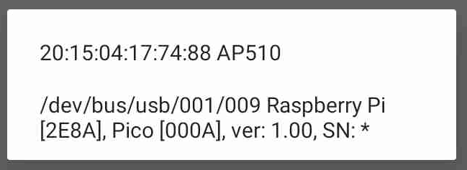
Make sure you have the OTG and USB cable hooked up. It is not necessary to power the controller from an external source as your cell phone will power it thru USB. Press the Favorite. A screen should pop up like this.
Next you will be greeted with a screen showing a keyboard. Press Enter and the controller menu will be displayed. From here you can change the controller configuration.
Press that pop-up. This will put up a message about letting Another Term mess with your phone to access the Controller. Select ‘OK’ to continue.

Slide 32
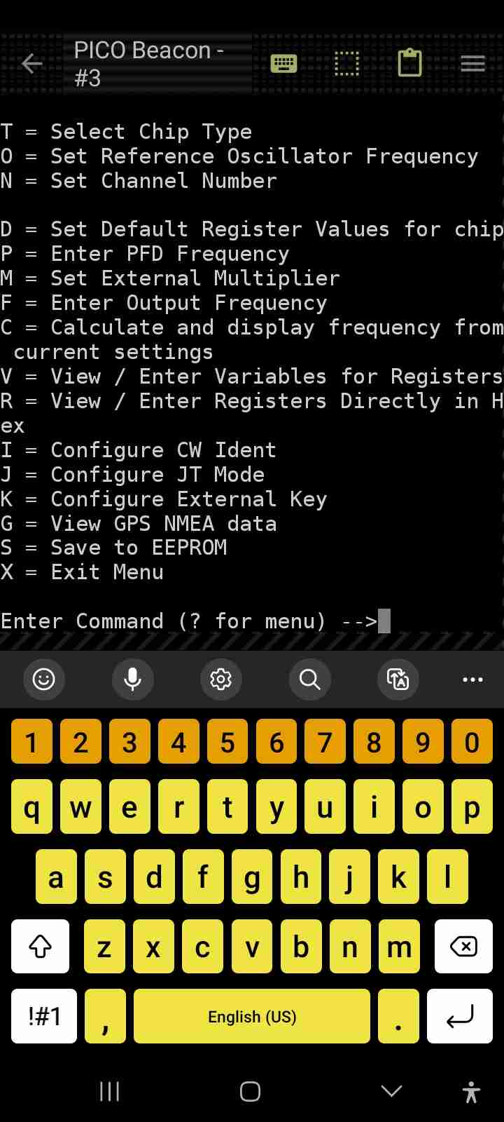
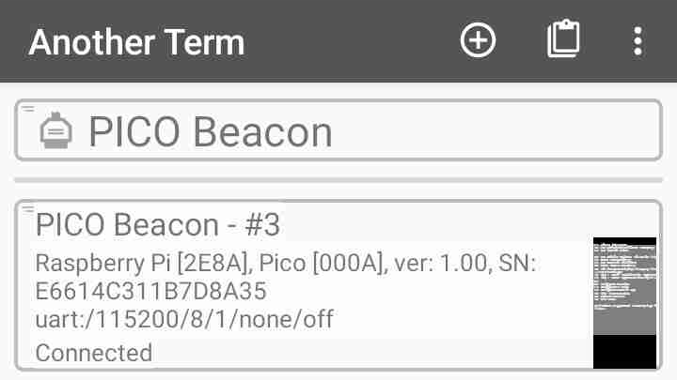
Once you finish your edits, press the down arrow to dismiss the keyboard, then press the back arrow. This will take you to the Favorites screen. You will see there is an active connection. In this case, it is my Favorite named PICO Beacon #3.

Slide 33
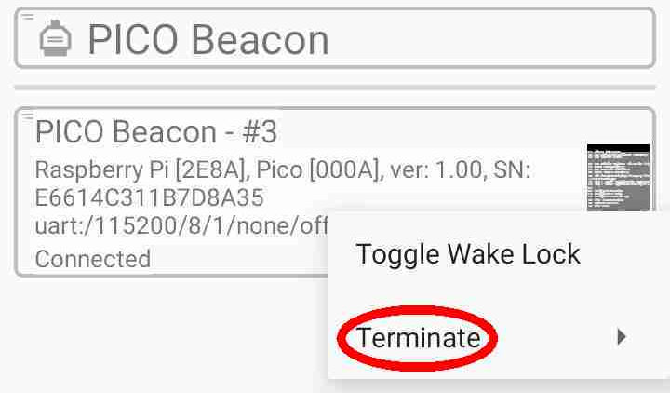
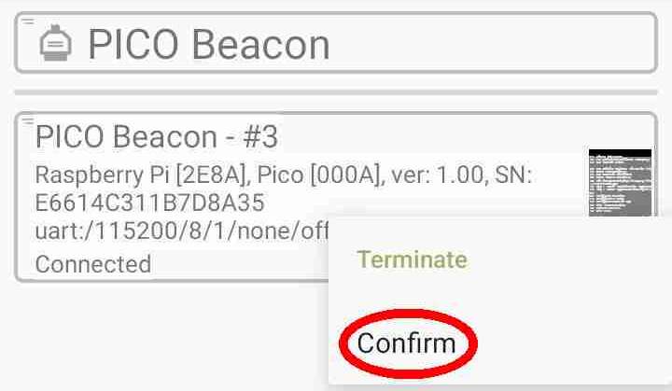
To terminate the connection, long press the active connection, then select ‘Terminate’ and then ‘Confirm’.

Slide 34
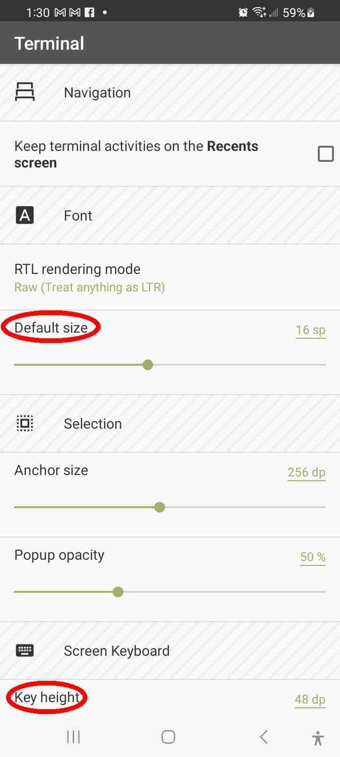
You may have noticed that the on-screen fonts for the controller menu are quite small. You can change that by going to ‘setup’.
Press the three vertical dots in the upper right corner of the ‘Favorites’ screen and select ‘Settings’. Then select ‘Terminal’. Under ‘Font’, change the size using the ‘Default Size’ slider. You can also modify the keyboard ‘Key height’ to suit your preference.

Slide 35
THE END
Questions
..
..
--

Slide 36
