Slide 1
Simple FMCW Radar
Jack Carrozzo, NA1C

Slide 2
Starting Goals: Ecology
Measure heart and breathing rates of multiple animals in a group / flock
  Trivial with high SNR and animal sitting still
  Can soft PLLs be used to recover periodic signals like heart beats or flapping?
  Can a number of soft PLLs lock onto individuals of a group within one signal?
Find and display tiny movement “sums” vs angle and range
  Snakes in rock wall, turtles in tall grass, active bird nests in thick woods
  Look for and sum tiny changes vs baseline of phase in FMCW phased array responses

Slide 3
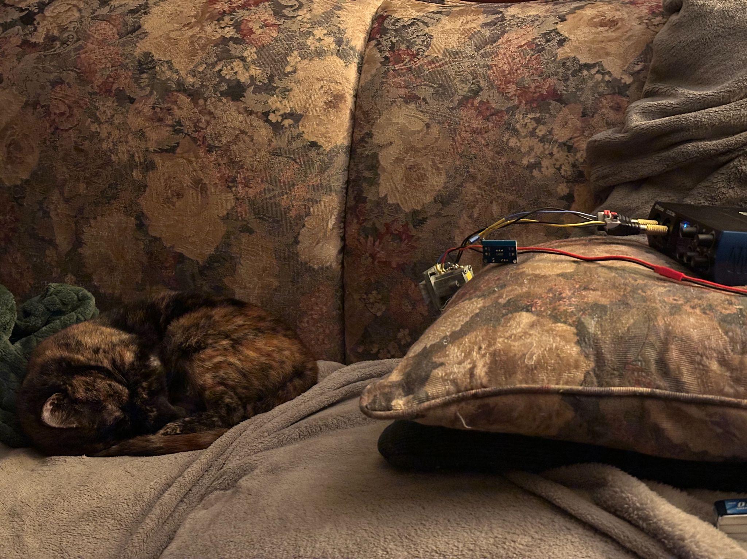
USB Audio
“Gunnplexor”
Test cat in
“High SNR”
configuration
10.525GHZ Gunn osc + mixer

Slide 4
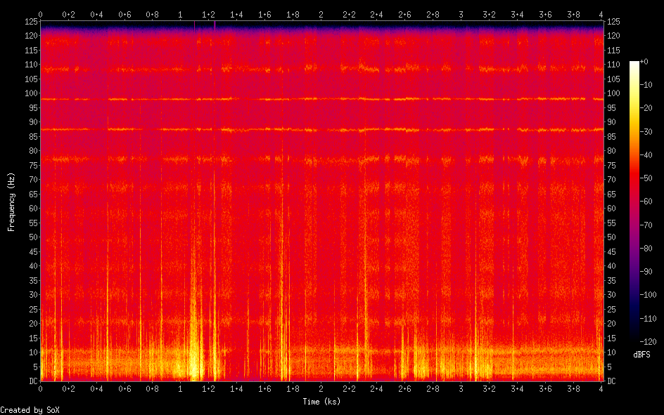

Slide 5
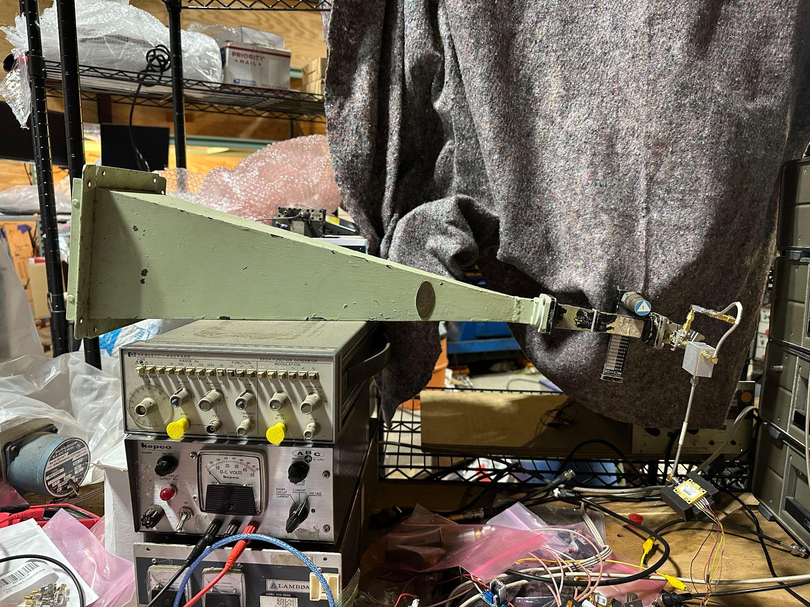
Legoplexor ft.
My largest horn
Yig Osc

Slide 6
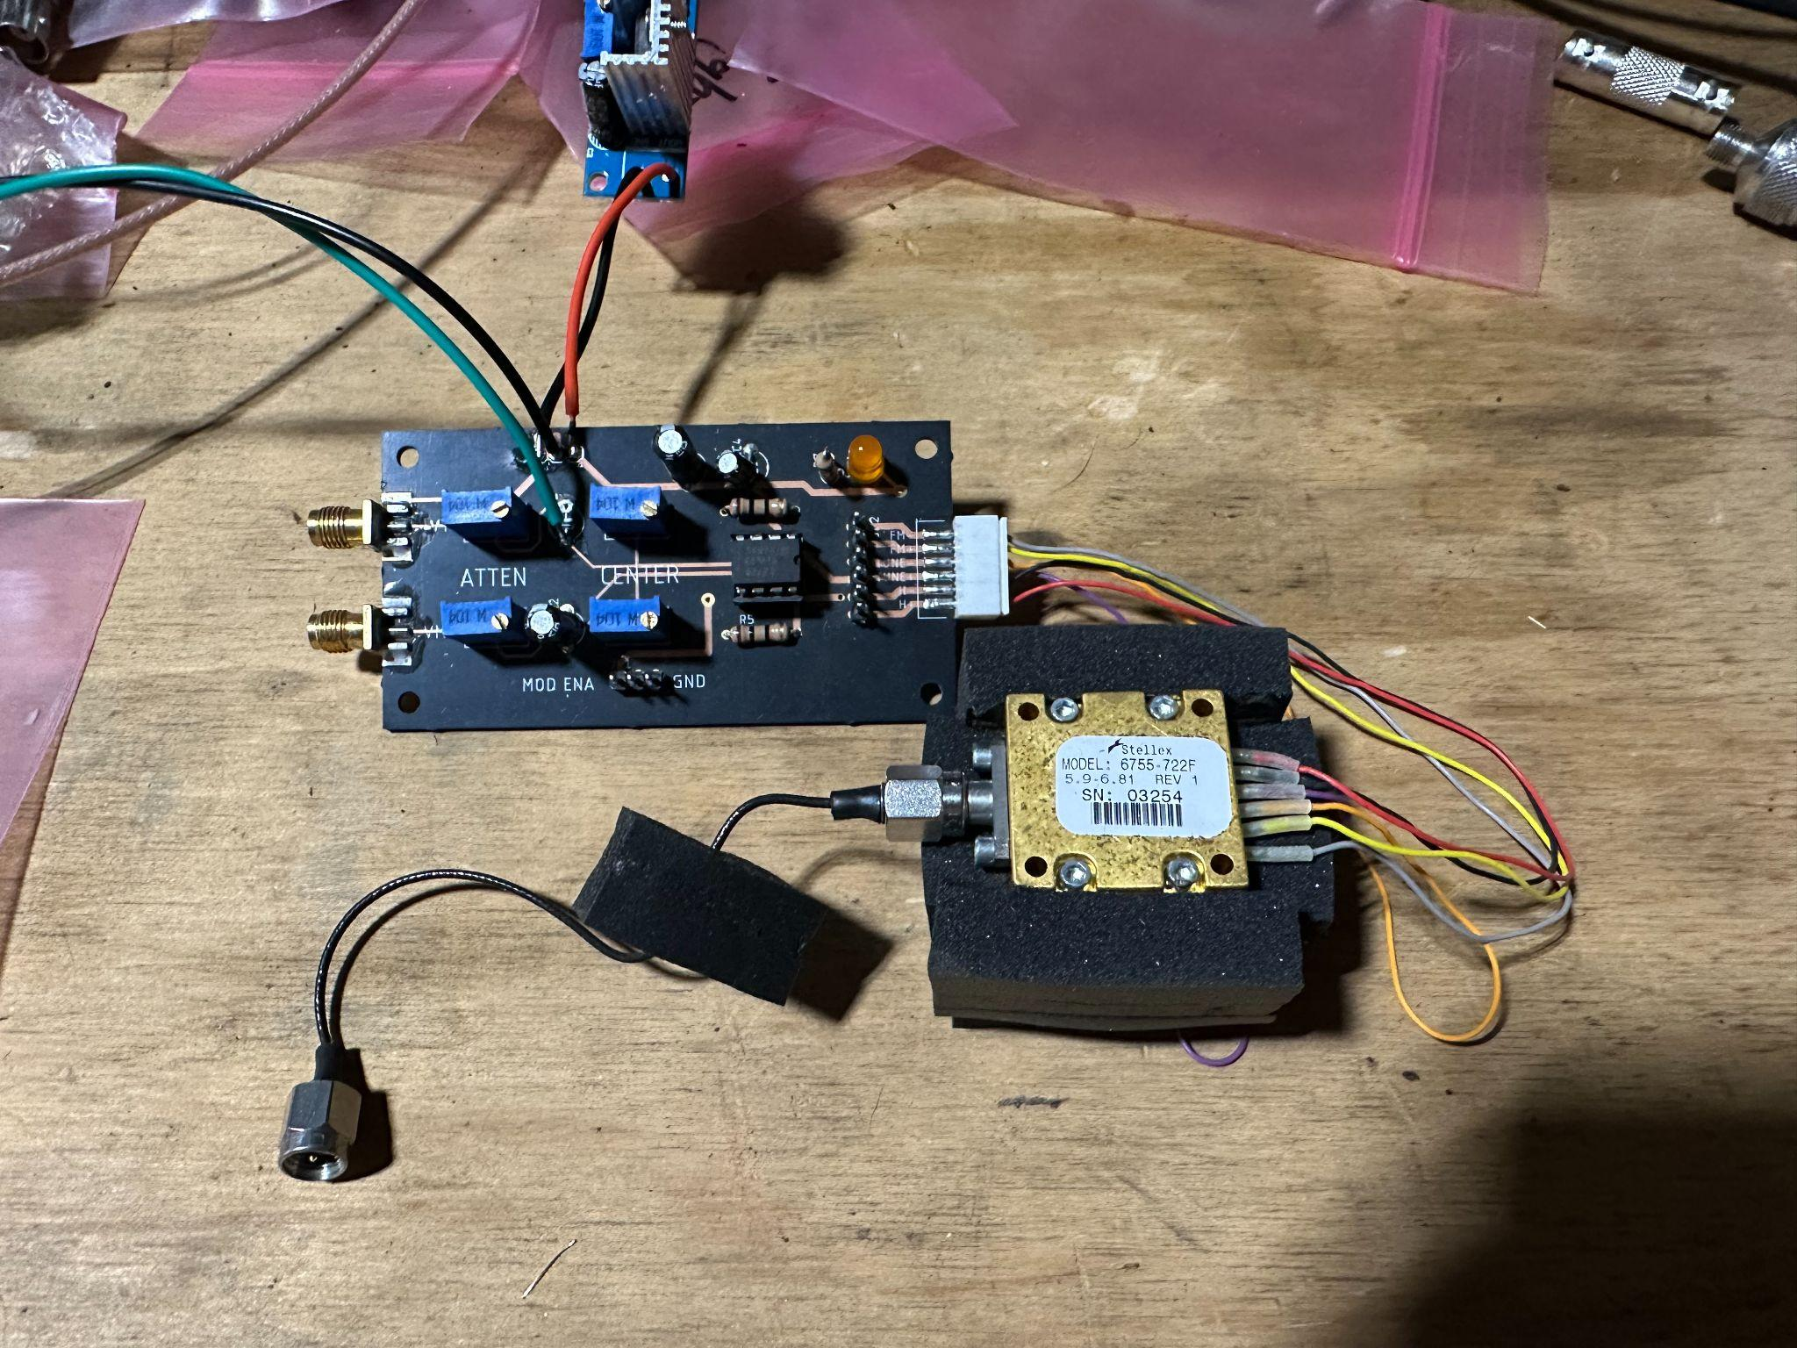
L272 Power Op Amp YIG Driver
Stellex YIG

Slide 7
OK, let’s build a phased array FMCW radar
TX
-3dB
~
Sweep gen
RX
DBM
Frequency Modulated Continuous Wave

Slide 8
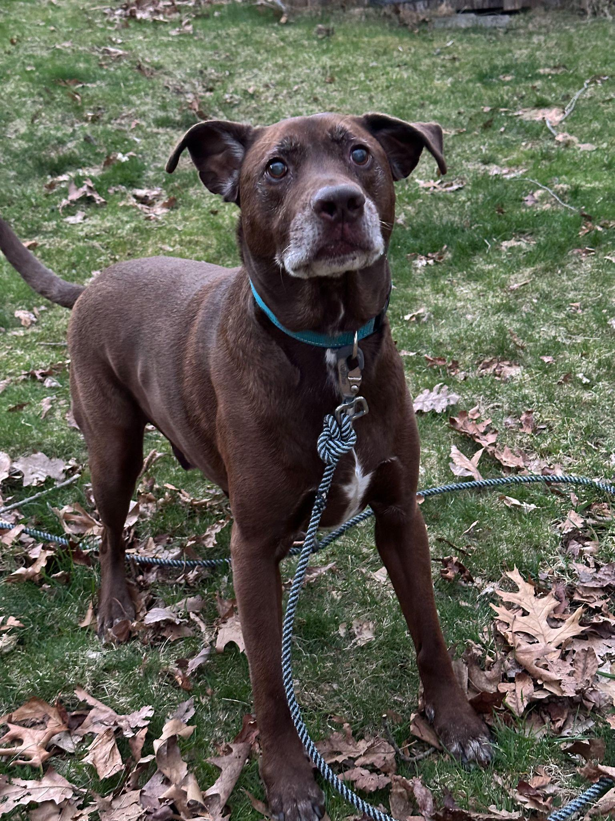
Frequency == Distance
IF freq = TX freq - RX freq
TX sawtooths from eg 5.5 - 6ghz
TX signal delayed
~
By path travel
Returning RX signal now x kHz slower
than instantaneous TX freq

Slide 9
Why do we care about FMCW
Most complexity is in software
Analog front end is simple and low-BW
High-speed comparisons taking place in RX mixer instead of FPGA / computer, so sampling rate can be quite low
Results are encoded in the frequency of the signal vs timing

Slide 10
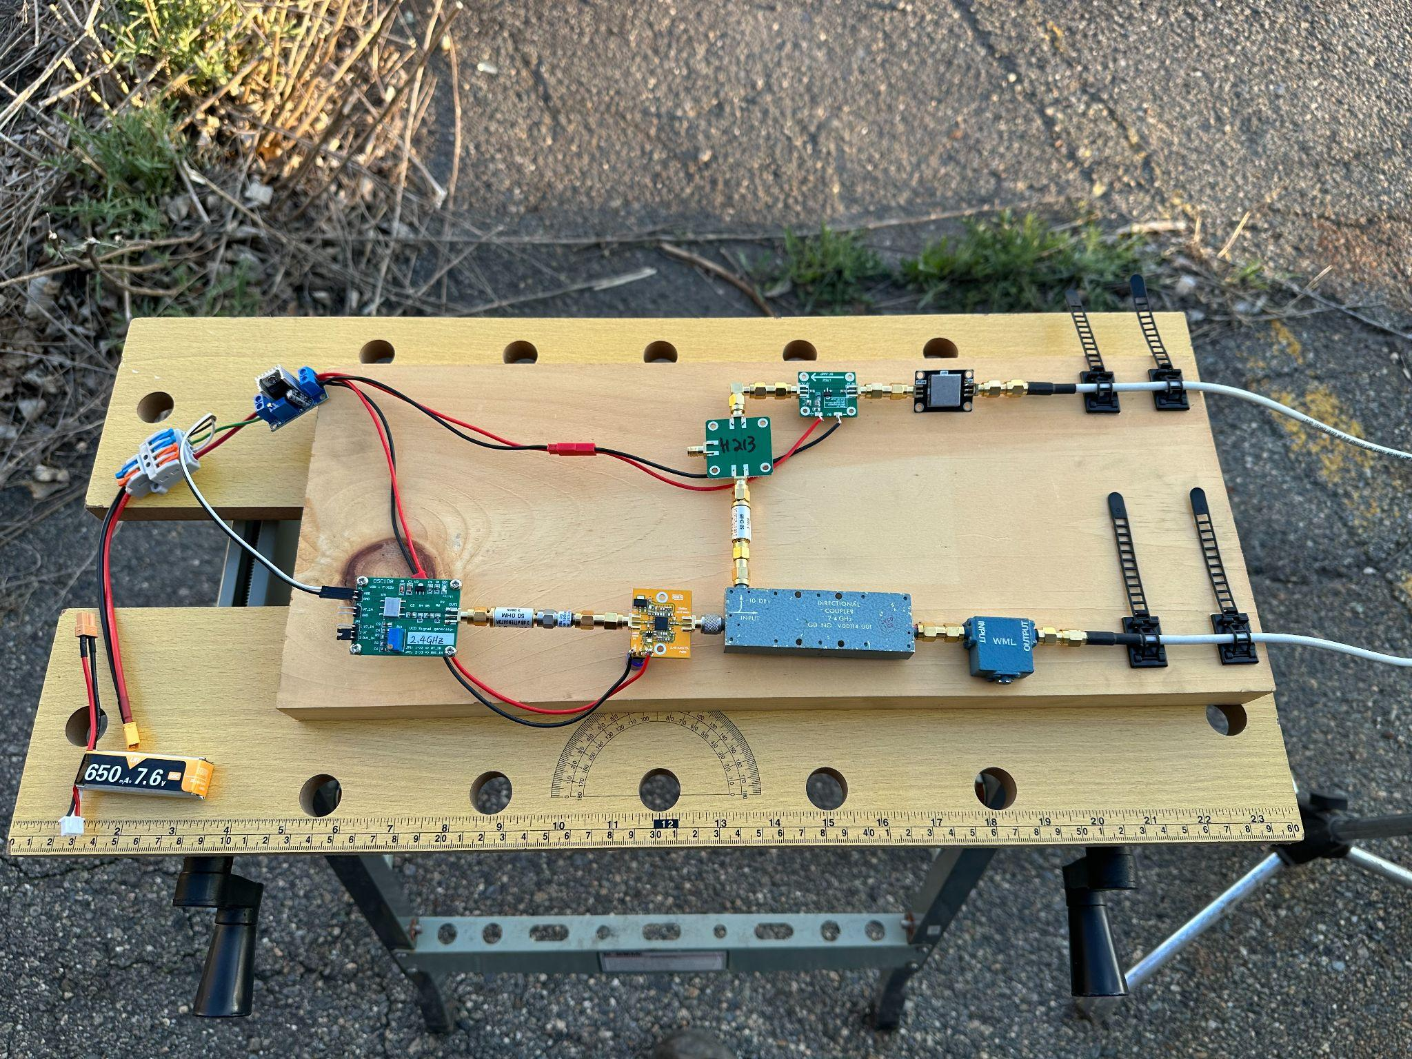
LM317
HMC213
Mixer
Pre
BPF
PA
Circulator
VCO
-10dB

Slide 11
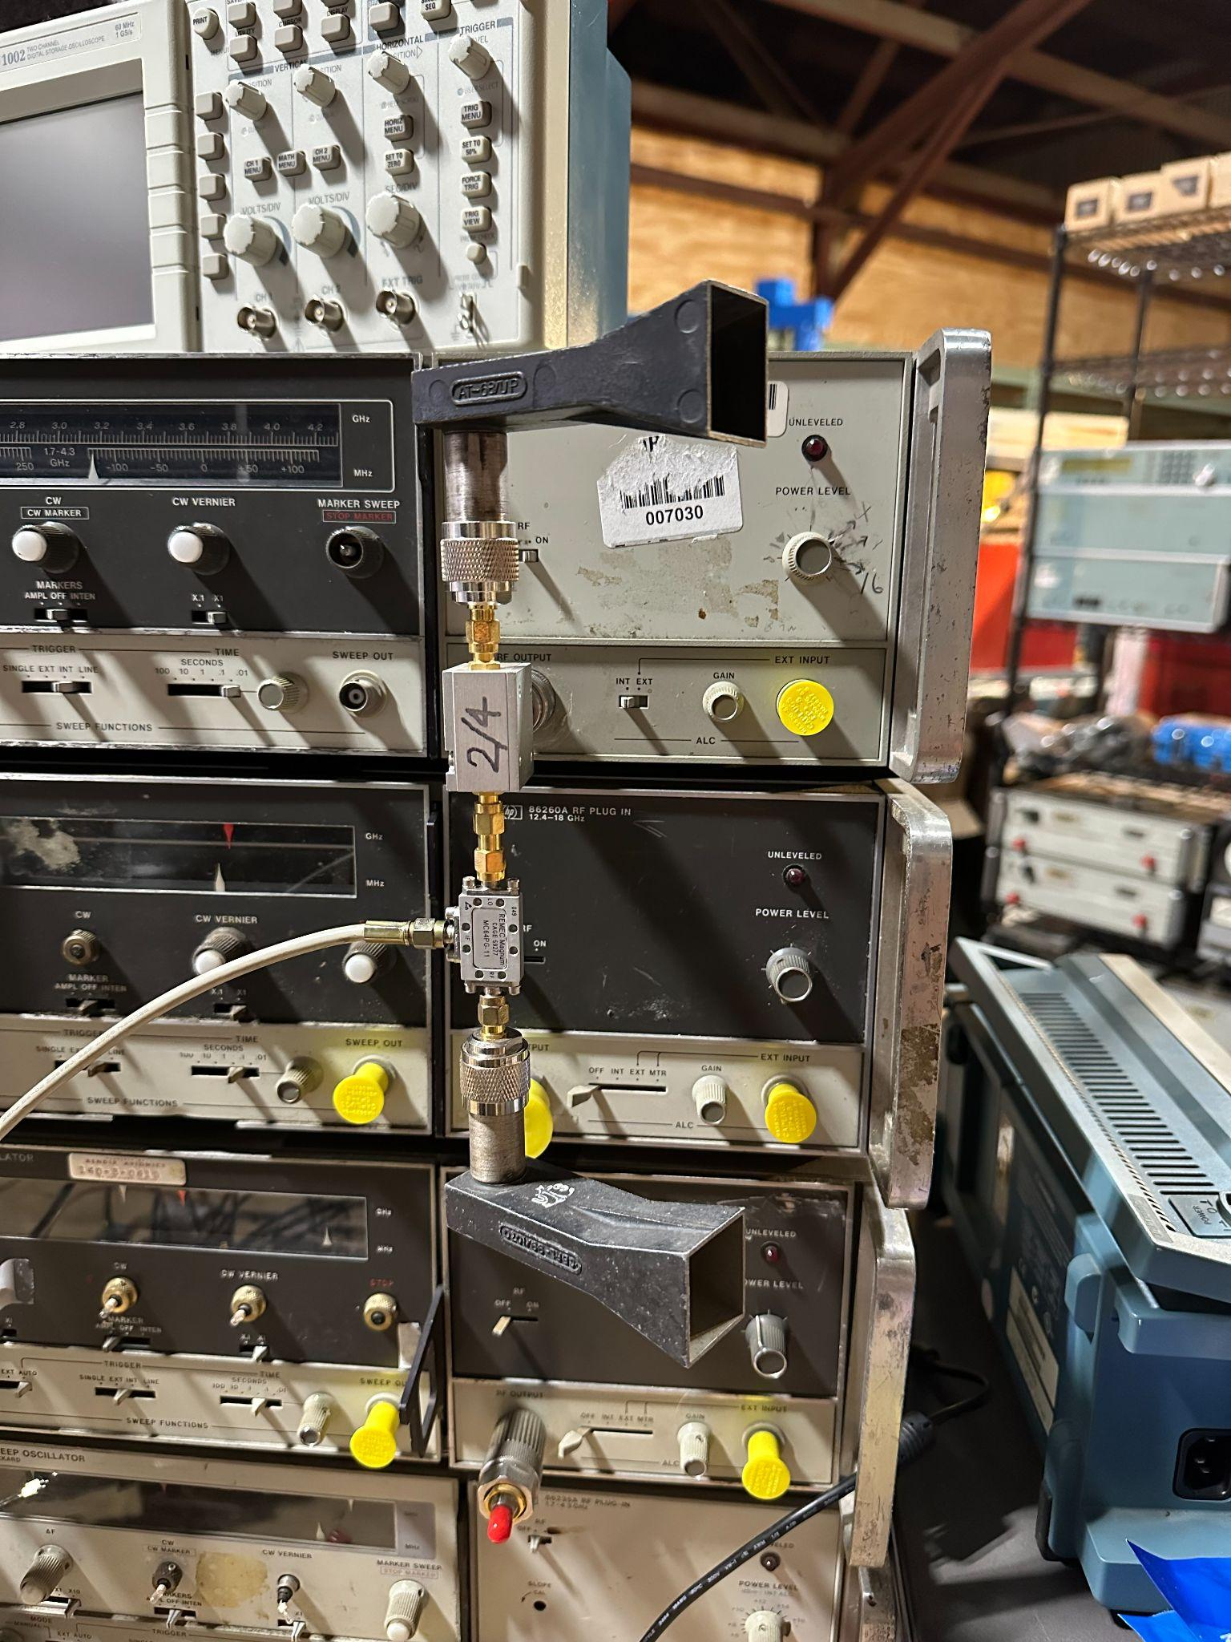
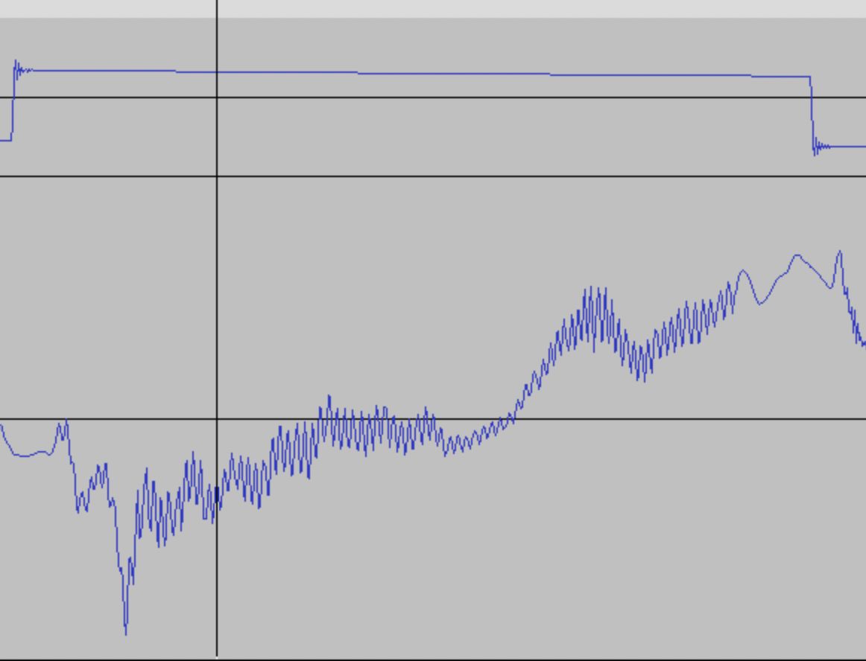
First try:
+16dBm from sweep gen
No PA or preamp
No IF impedance matching
TX
Mixer
RX

Slide 12
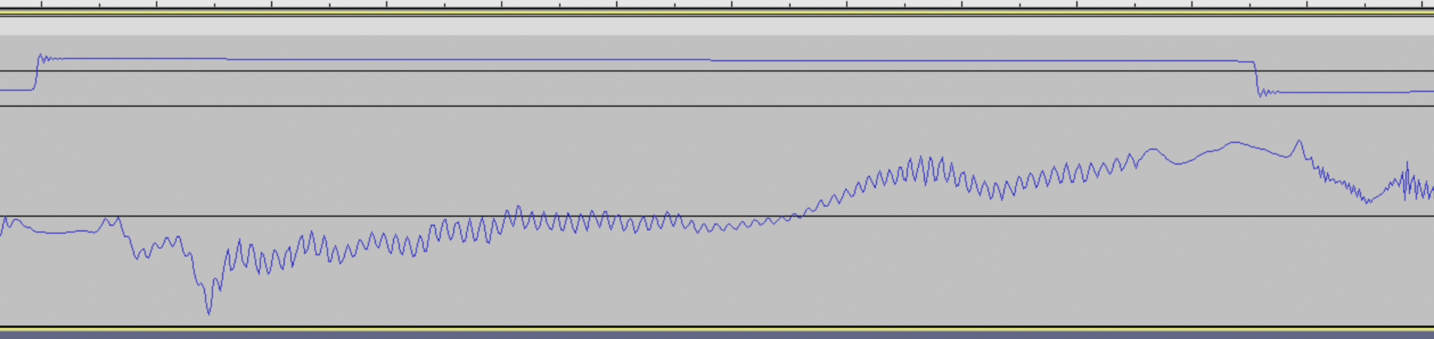
What are these squiggles?
Bonus pt: what stands out about that wave*?
Sum of sines whose:
Magnitude represents “brightness” of a particular response
Frequency represents distance
  As TX sweeps positively in frequency, the mixer compares instantaneous TX freq with “all” past TX freqs
  The longer in time a particular response component spent “in flight”, the higher its difference frequency will be with the TX by the time it arrives back to us
Ends, dip; padding
*

Slide 13
Magnitude and frequency? This sounds like a job for…
The
Discrete Fourier Transform

Slide 14
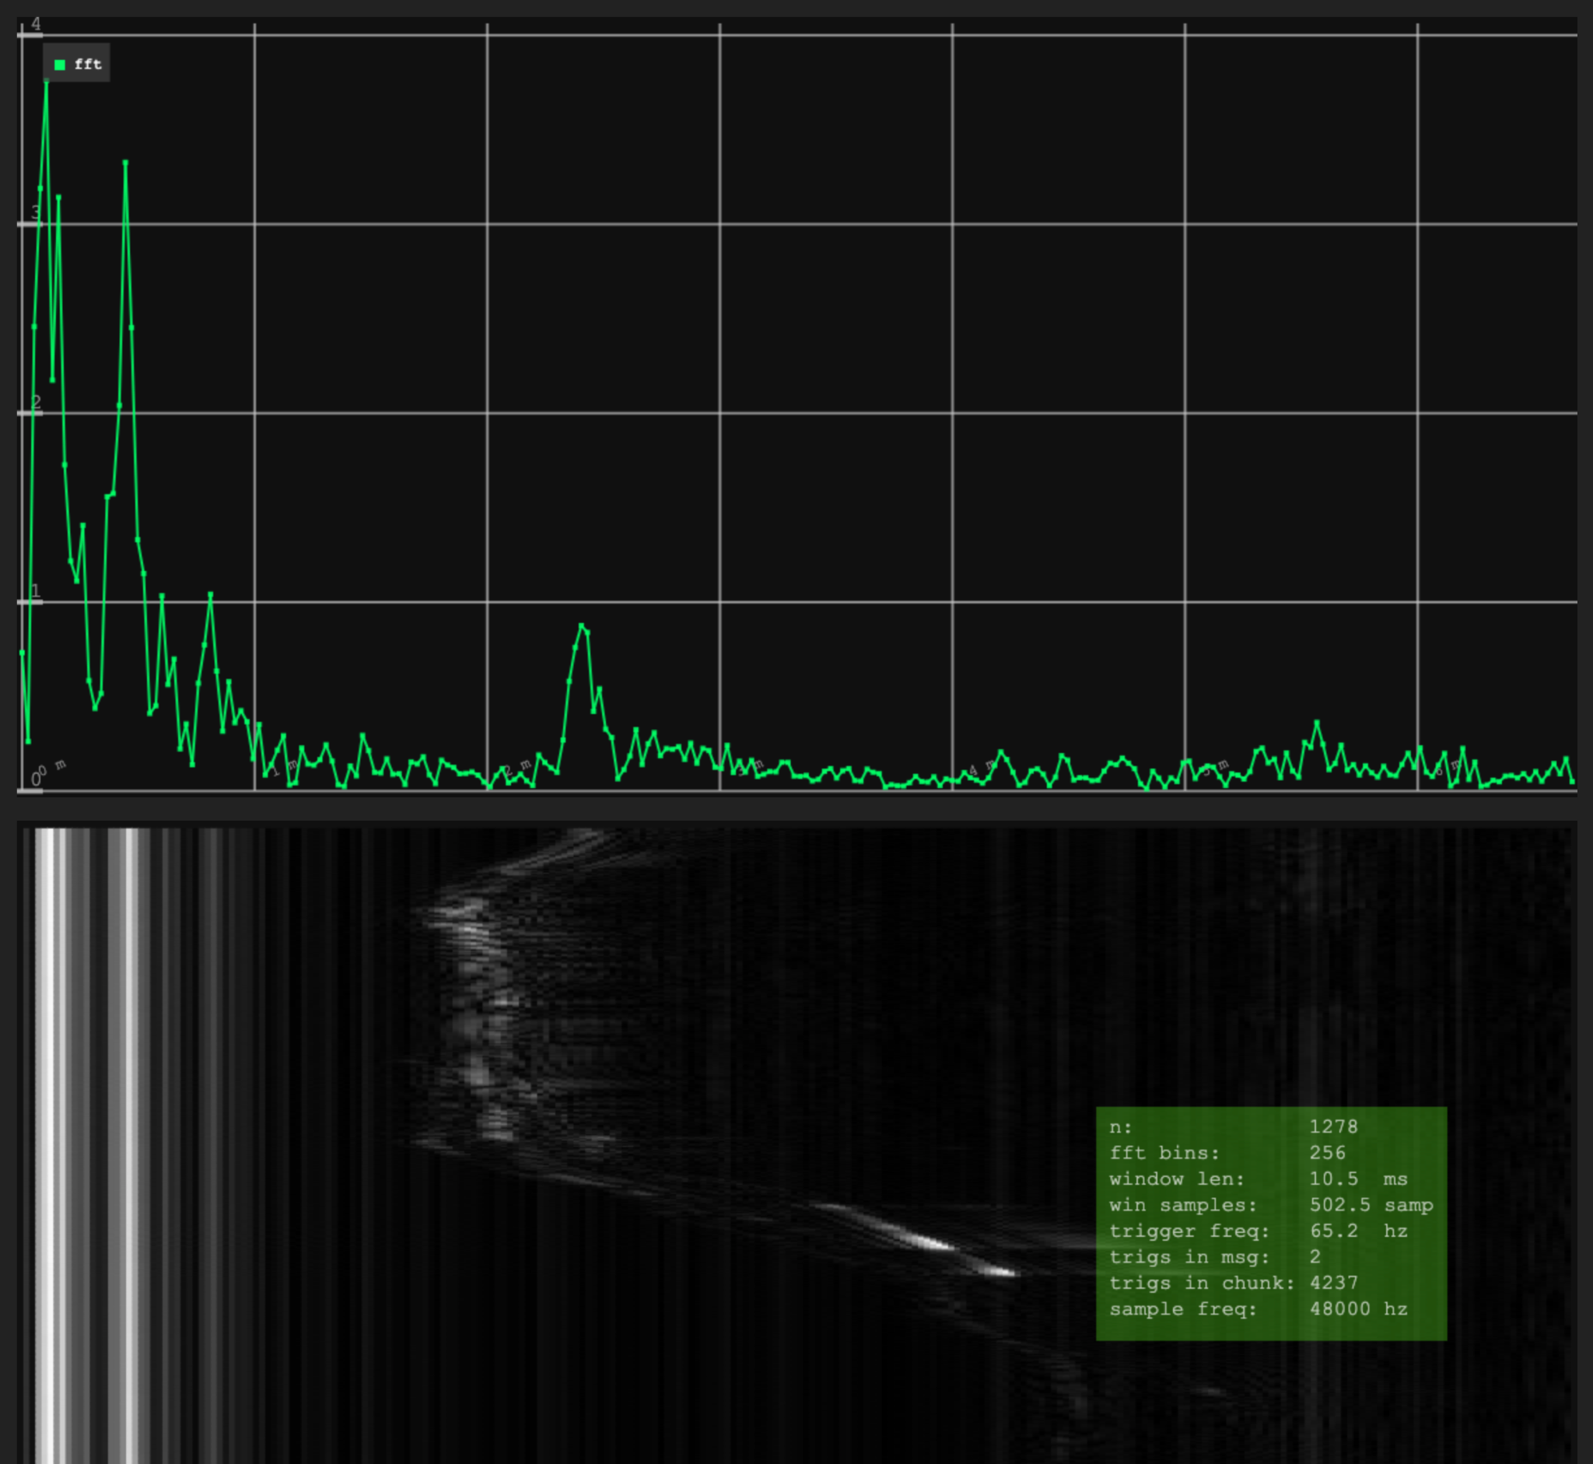
Boring old USB soundcard as input:
Left ch: trigger from sweep generator
Right ch: direct output from mixer
48khz, ~ 65 sweeps/s,
“overlap”/slice sum of 2

Slide 15
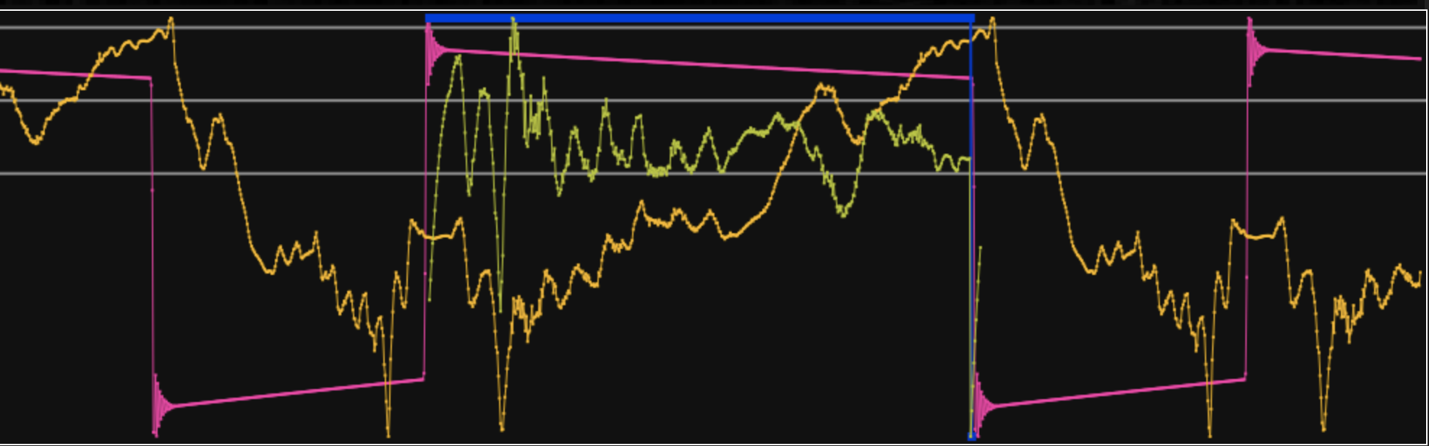
Framing!
Can’t just jam the audio stream into DFT- data is only valid inside trigger window
Raw trigger samples in: pink; Processed 0/1 trigger: purple
Raw IF samples in: orange; FIR highpassed and sliced: yellow

Slide 16
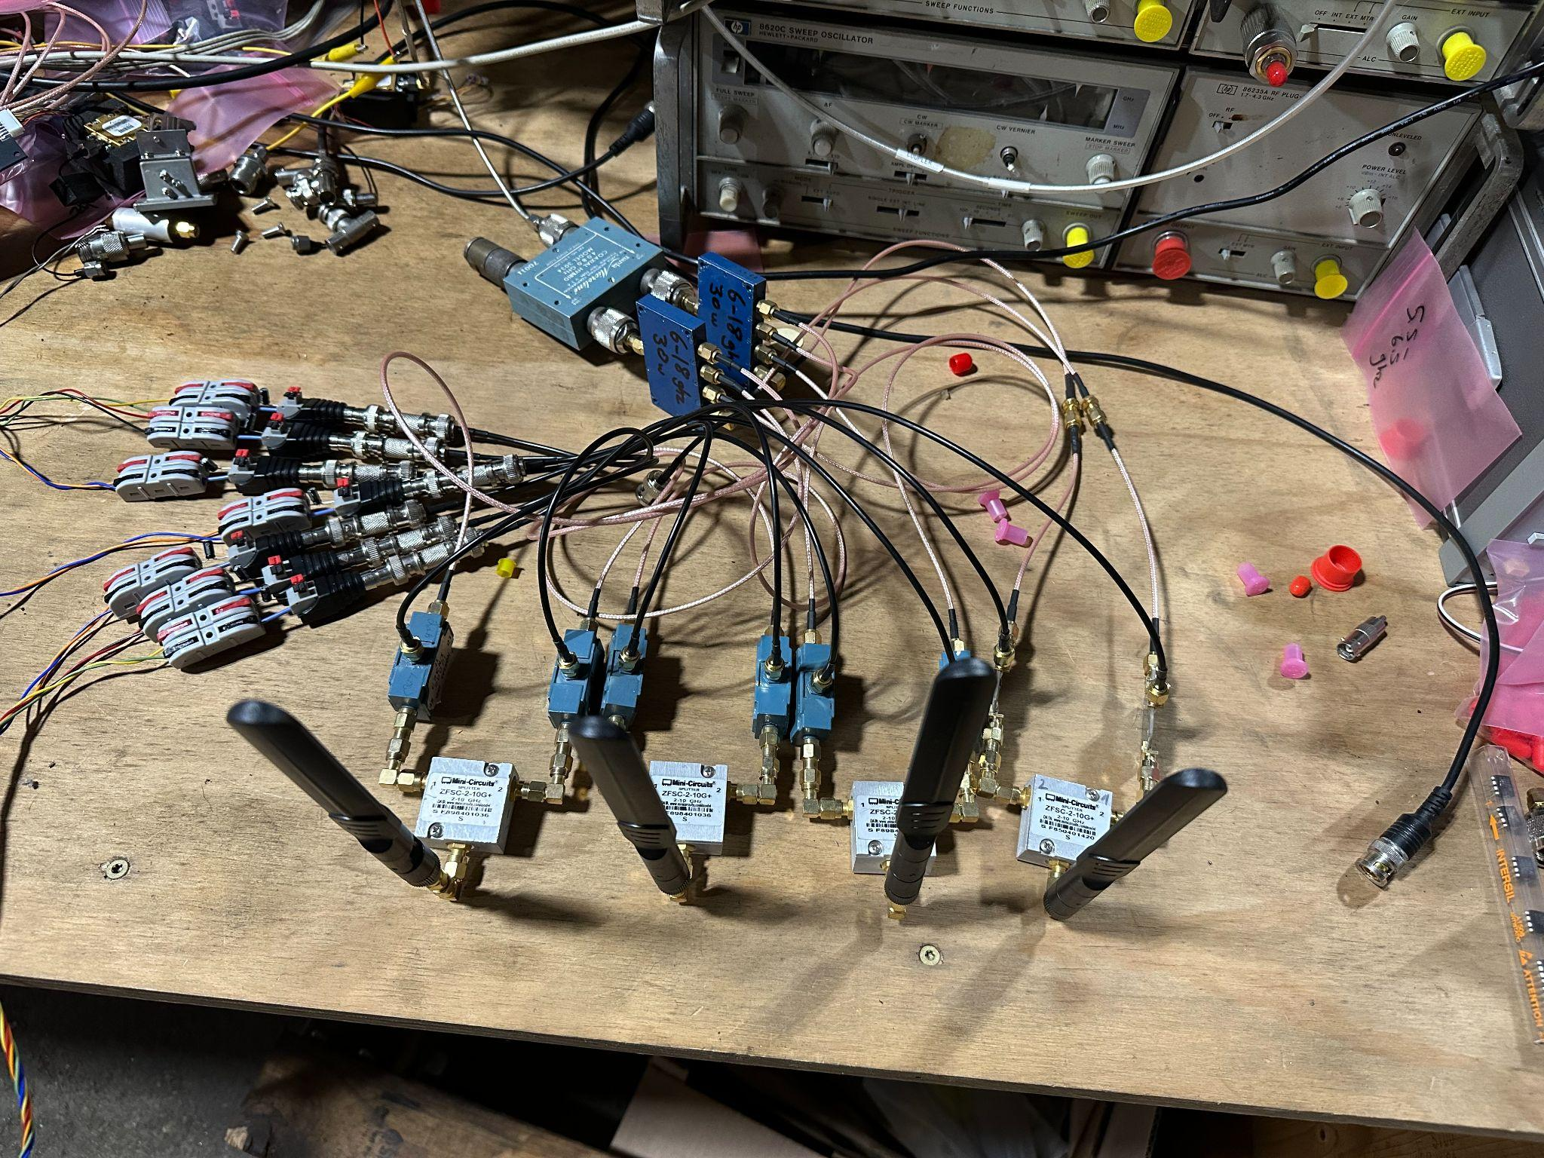
4-port splitters for I and Q
90-deg coupler
IFs
I and Q
DBMs

Slide 17
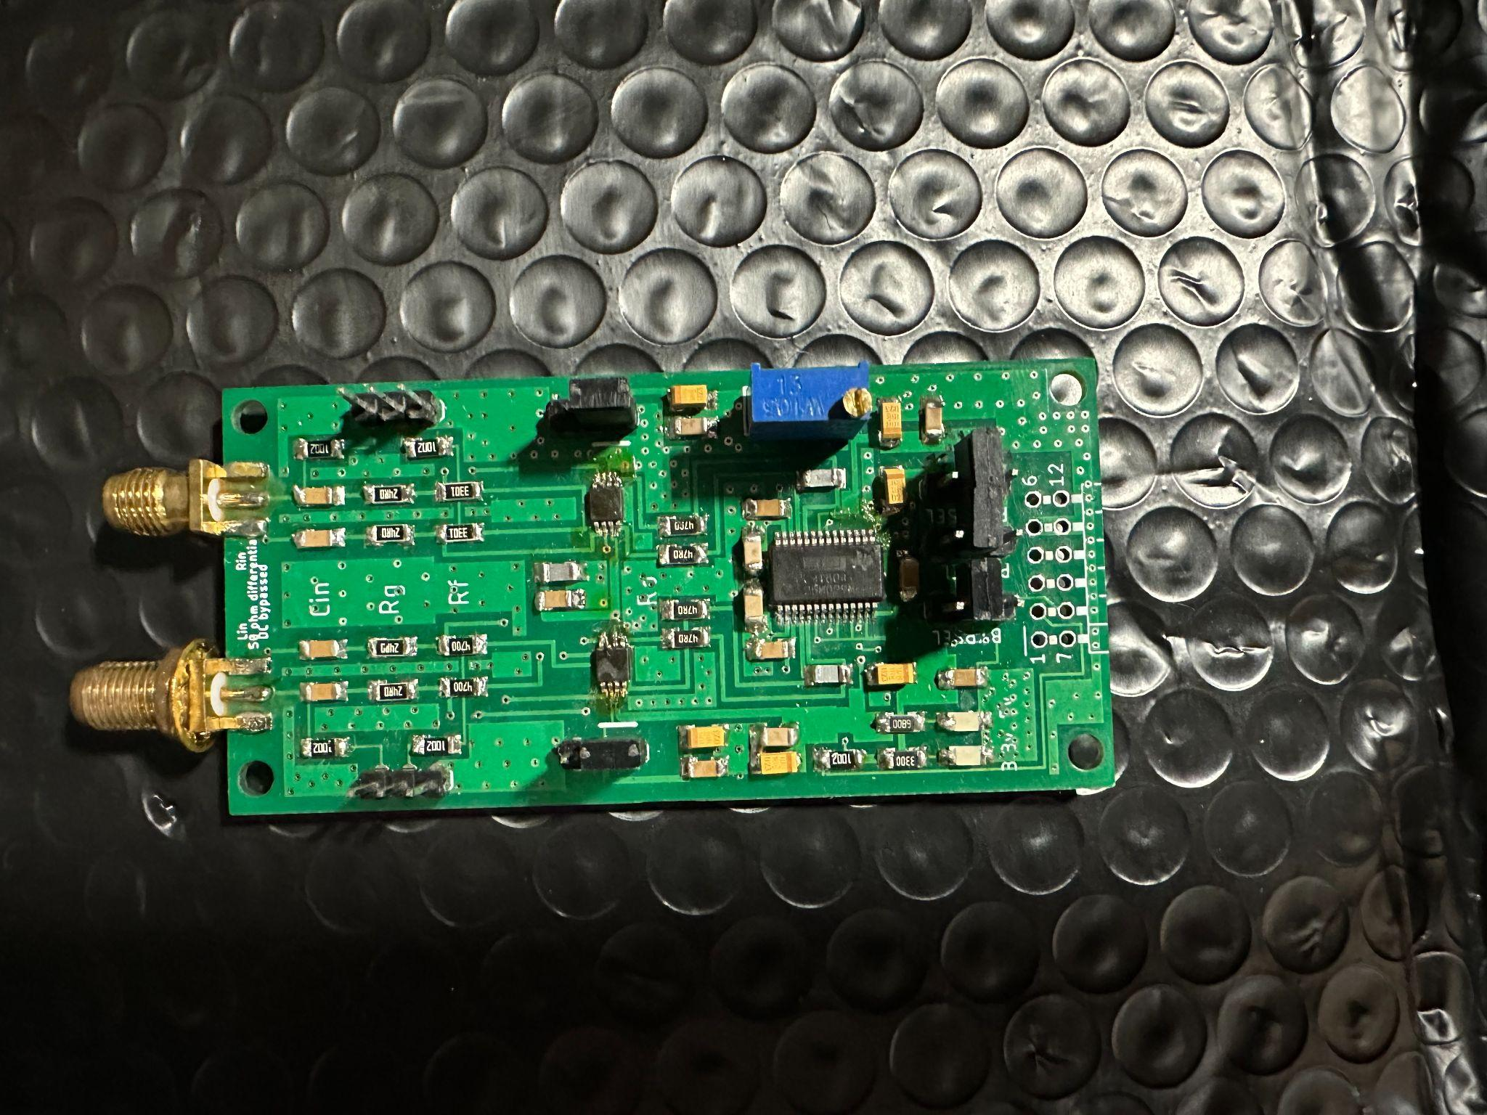
OK, more channels please
2x “Active Balun” configuration
Impedance xfmr +
Balanced drive
LMH6551
PMOD Interface
PCM1804
192-khz 24-bit 110 dB DNR

Slide 18
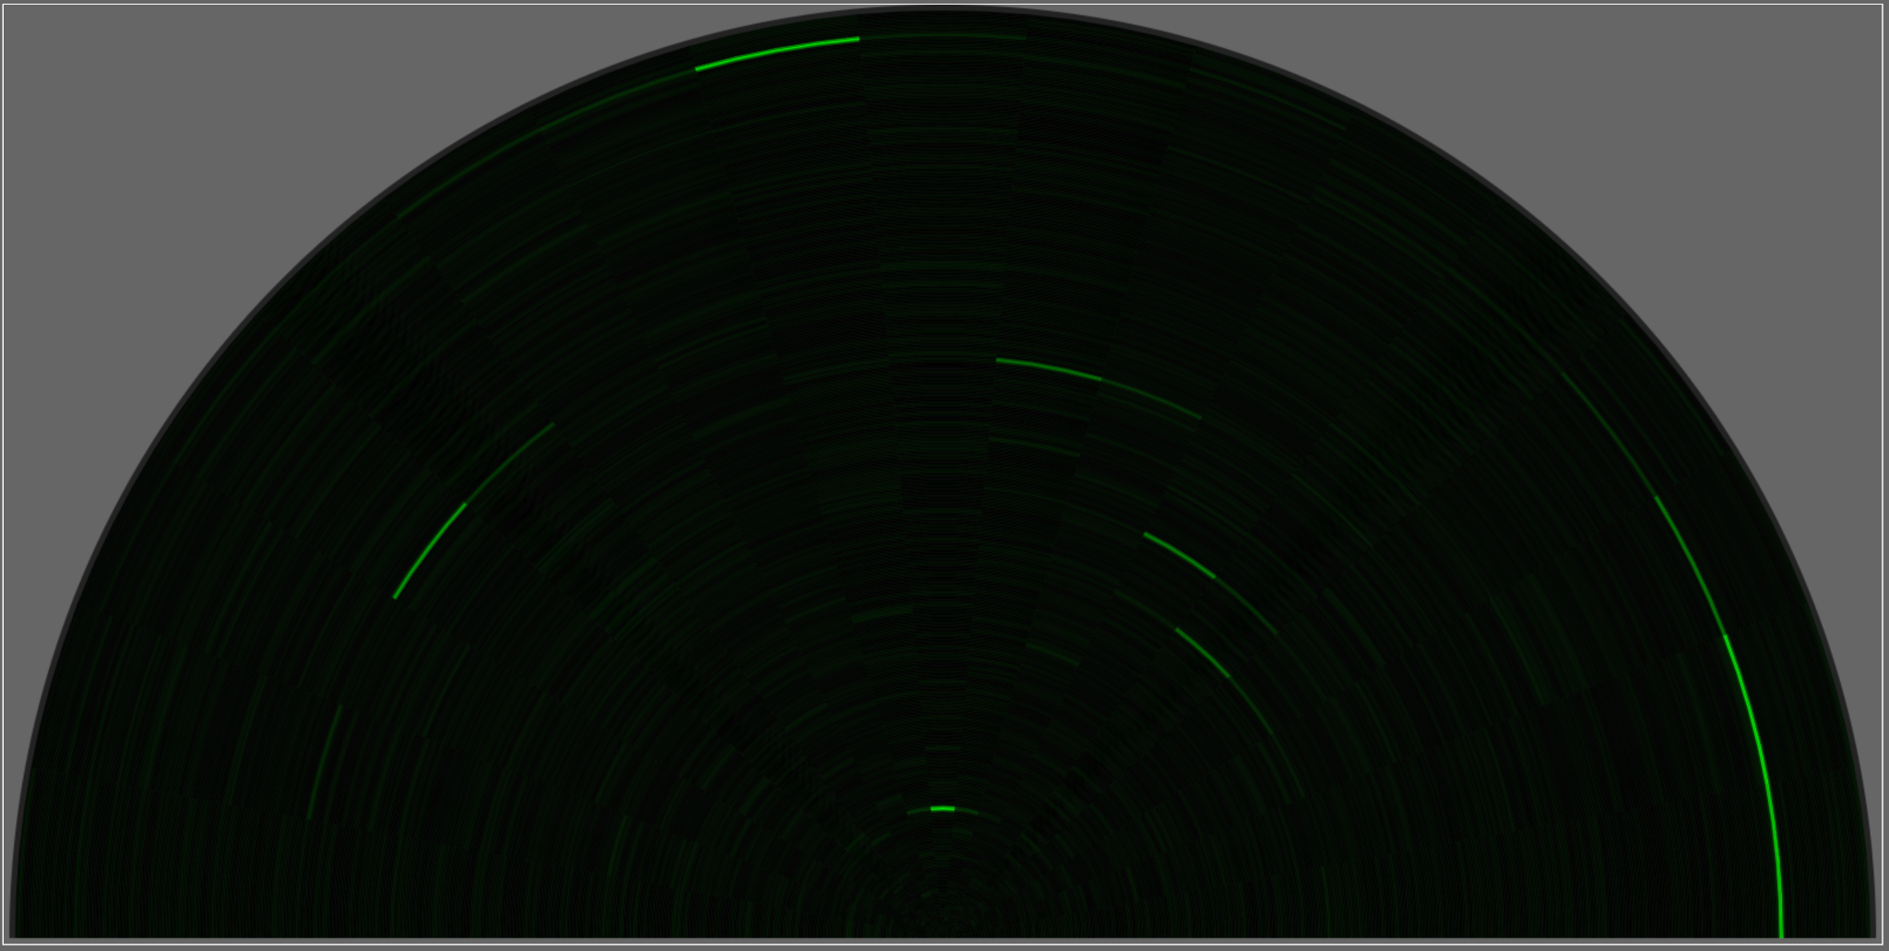
Times that by 64, linear array style
Linear array-
how many?
64!!

Slide 19
How is this related to the original goals again?
Soft PLLing animal hearts and breathing requires great SNR-
64 element linear array gives about ~18 dB over isotropic
Target loop:
Identify bright spots of interest in “radial display” mode
Run soft PLLs / correlators against stacked / beamformed sample vectors
Allow soft PLL to include target state tracking, doppler, etc etc

Slide 20
Ongoing / future work
Bats, frogs
Cheap coherent ISM-legal GPSDO PPS-synchronous CDMA-like transmitters and receivers for measuring and monitoring ionospheric microwave bounce / radar comet entries and LEO satellites at the right angle
  80 mhz wide, +33 dBm into antenna, seconds to minutes of integration time
  50+ dB of processing gain
  GPSDO lock hasn’t been all it’s cracked up to be thus far - 20ms vs 1000ms periods
Jack Carrozzo, NA1C
jack@crepinc.com http://crepinc.com @jackcarrozzo

