Slide 1
10 GHz Preamp
Simple & Cheap plus 5760 Preamp
Paul WaDE W1GHZ ©2025

Slide 2
Simple and Cheap 10 GHZ Transverter needs a preamp (or LNA)
Good ones cost > $100
How about an OK one?
Can it be done for $10?
GOAL:
  NF ≤ 1.5 dB
  Easy to build
  Simple tuning
  You hear me better!

Slide 3
Low Noise Device
CEL CE3512K2-C1
For Ku band LNB
0.3 dB NF at 12 GHz
Mouser
  $1.67
  26000 in stock

Slide 4
Design Process
No fancy software
S-parameters
Plot on Smith Chart with Ansoft Designer SV
Guess at a transmission line circuit
Add T-lines
Plot again on Smith Chart
Fiddle and repeat
Draw T-lines on PCB layout

Slide 5
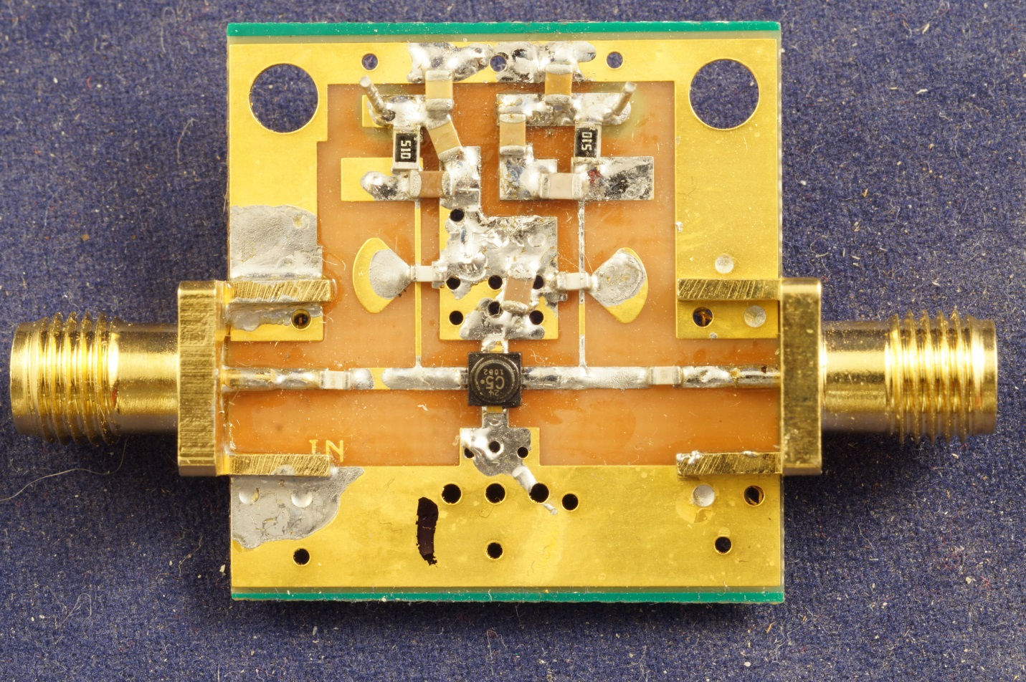
Simple PC board
Ordinary PC board (cheap)
Thin – lower loss & radiation

Slide 6
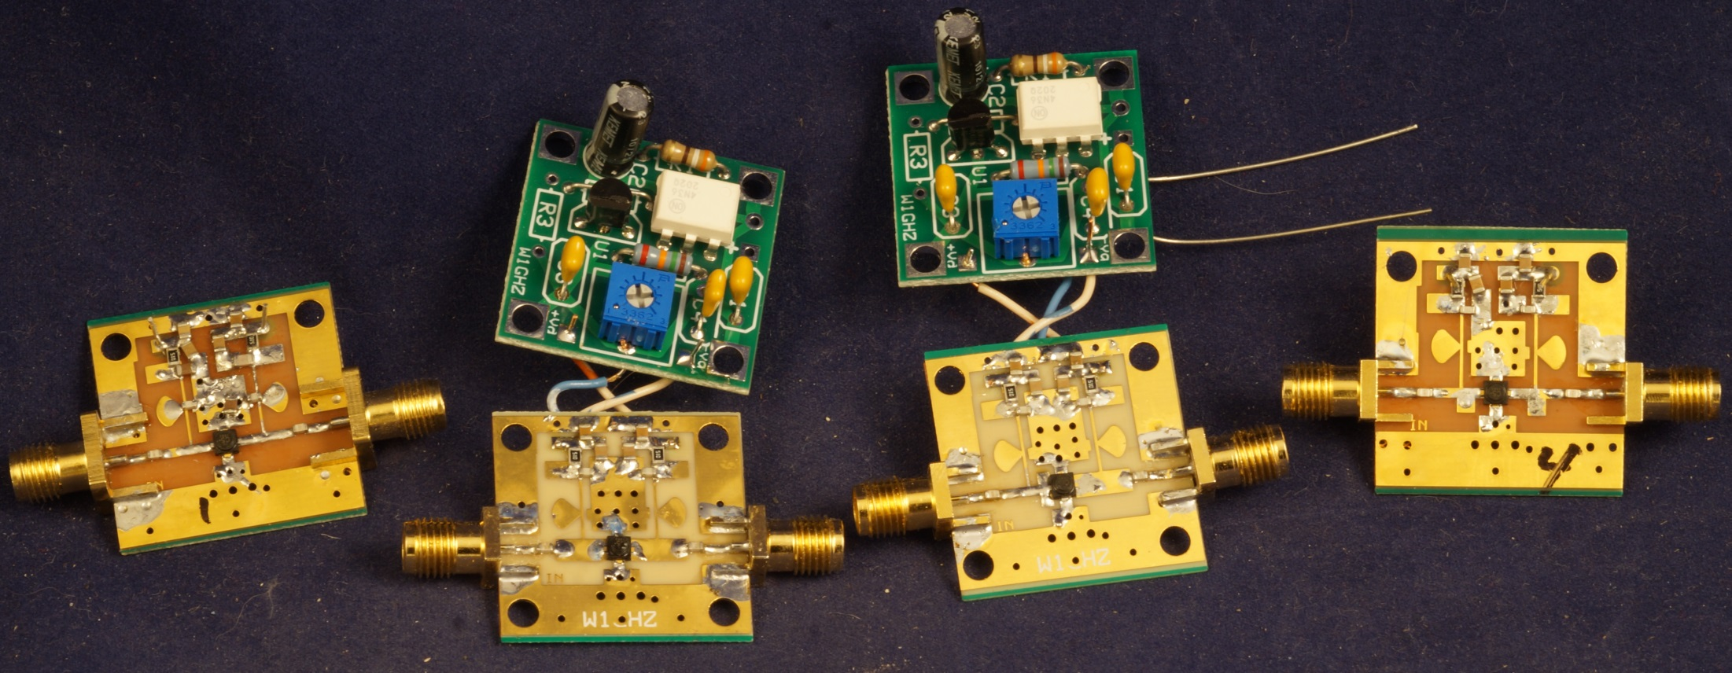
Several Trial Designs
All work, good gain, NF 2 to 3 dB

Slide 7
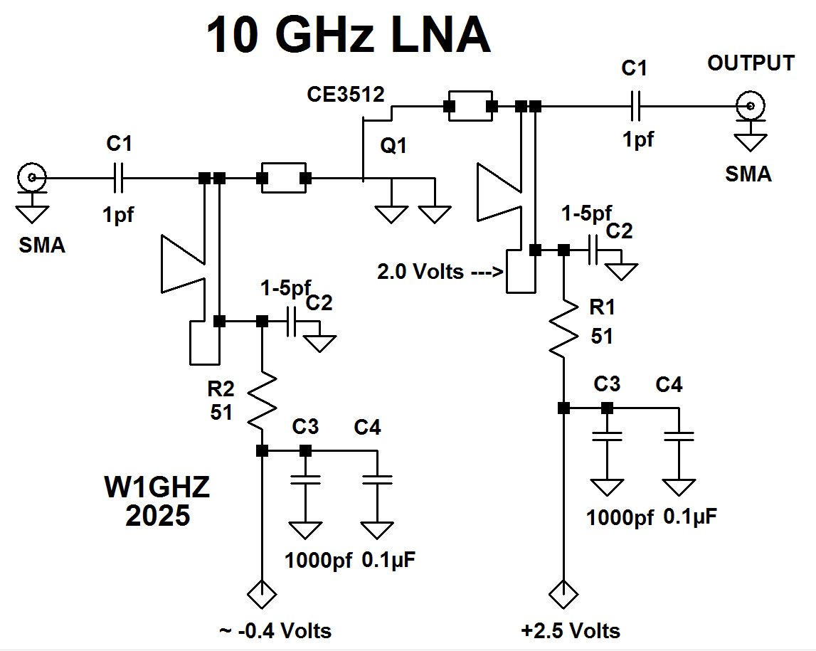
Schematic

Slide 8
Negative Bias Board
Uses Optoisolator to generate negative voltage
Shine light on an LED and it produces voltage
Same with a transistor
Optoisolator has LED lighting transistor
Transistor produces floating voltage
  About 0.4 volts at 50 microamps
  Enough to bias a GaAsFET
Circuit is fool-resistant
  Maximum voltage and current safe for FET
  Wrong connections also save

Slide 9
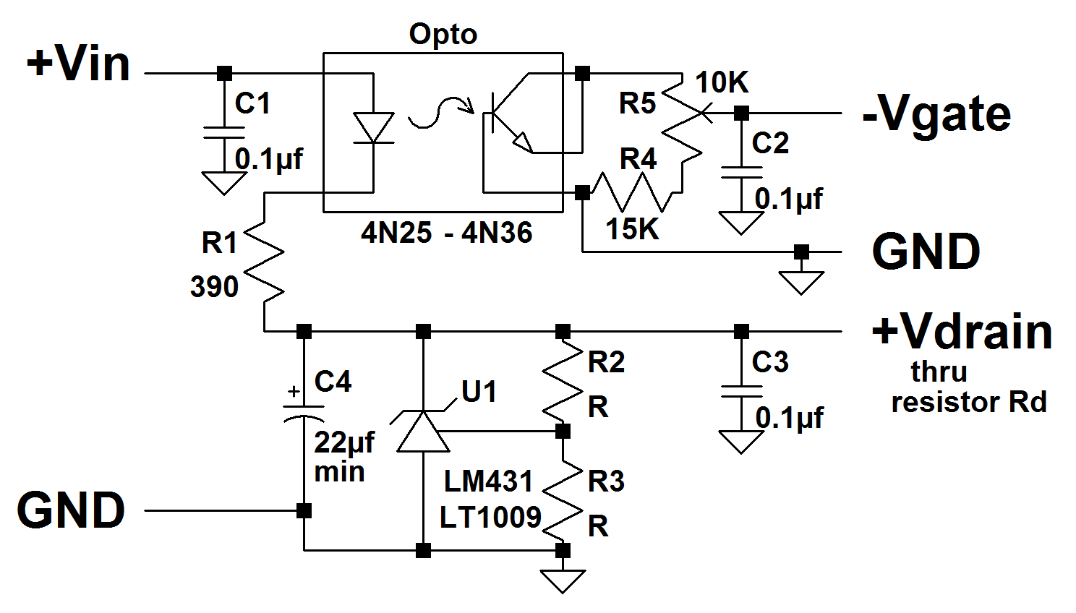
Bias Board
Fool-resistant – Drain current powers optoisolator to produce negative bias

Slide 10
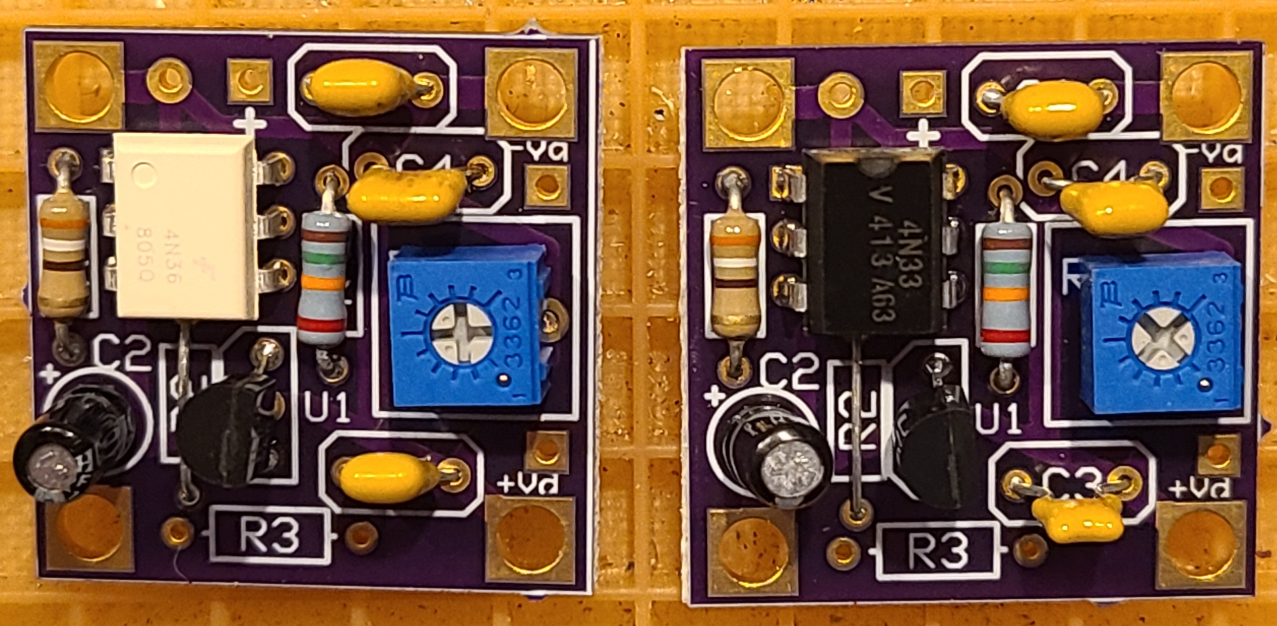
About $2 in parts

Slide 11
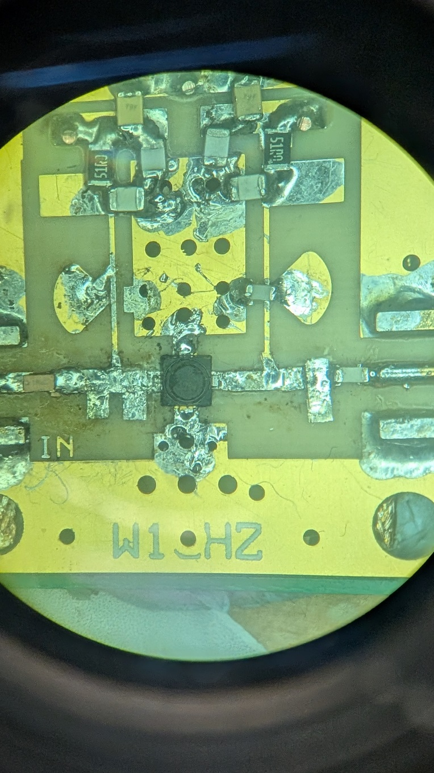
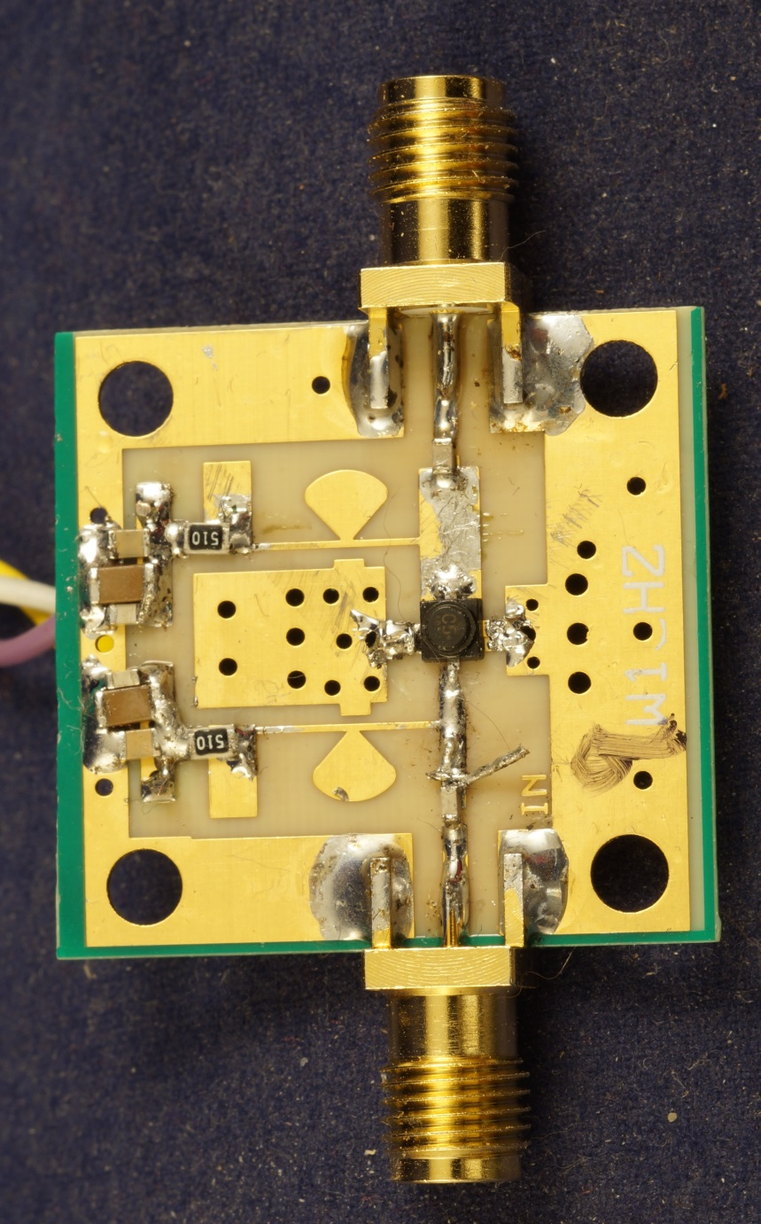
Fine Tuning - Snowflaking

Slide 12
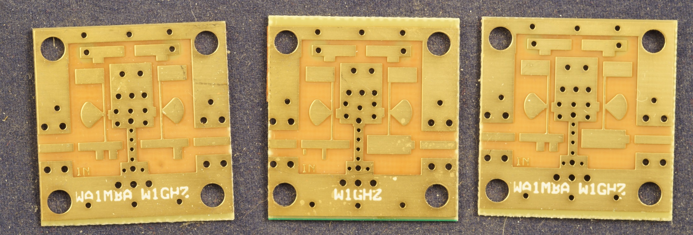
Three New Designs
WA1MBA W1GHZ Combo

Slide 13
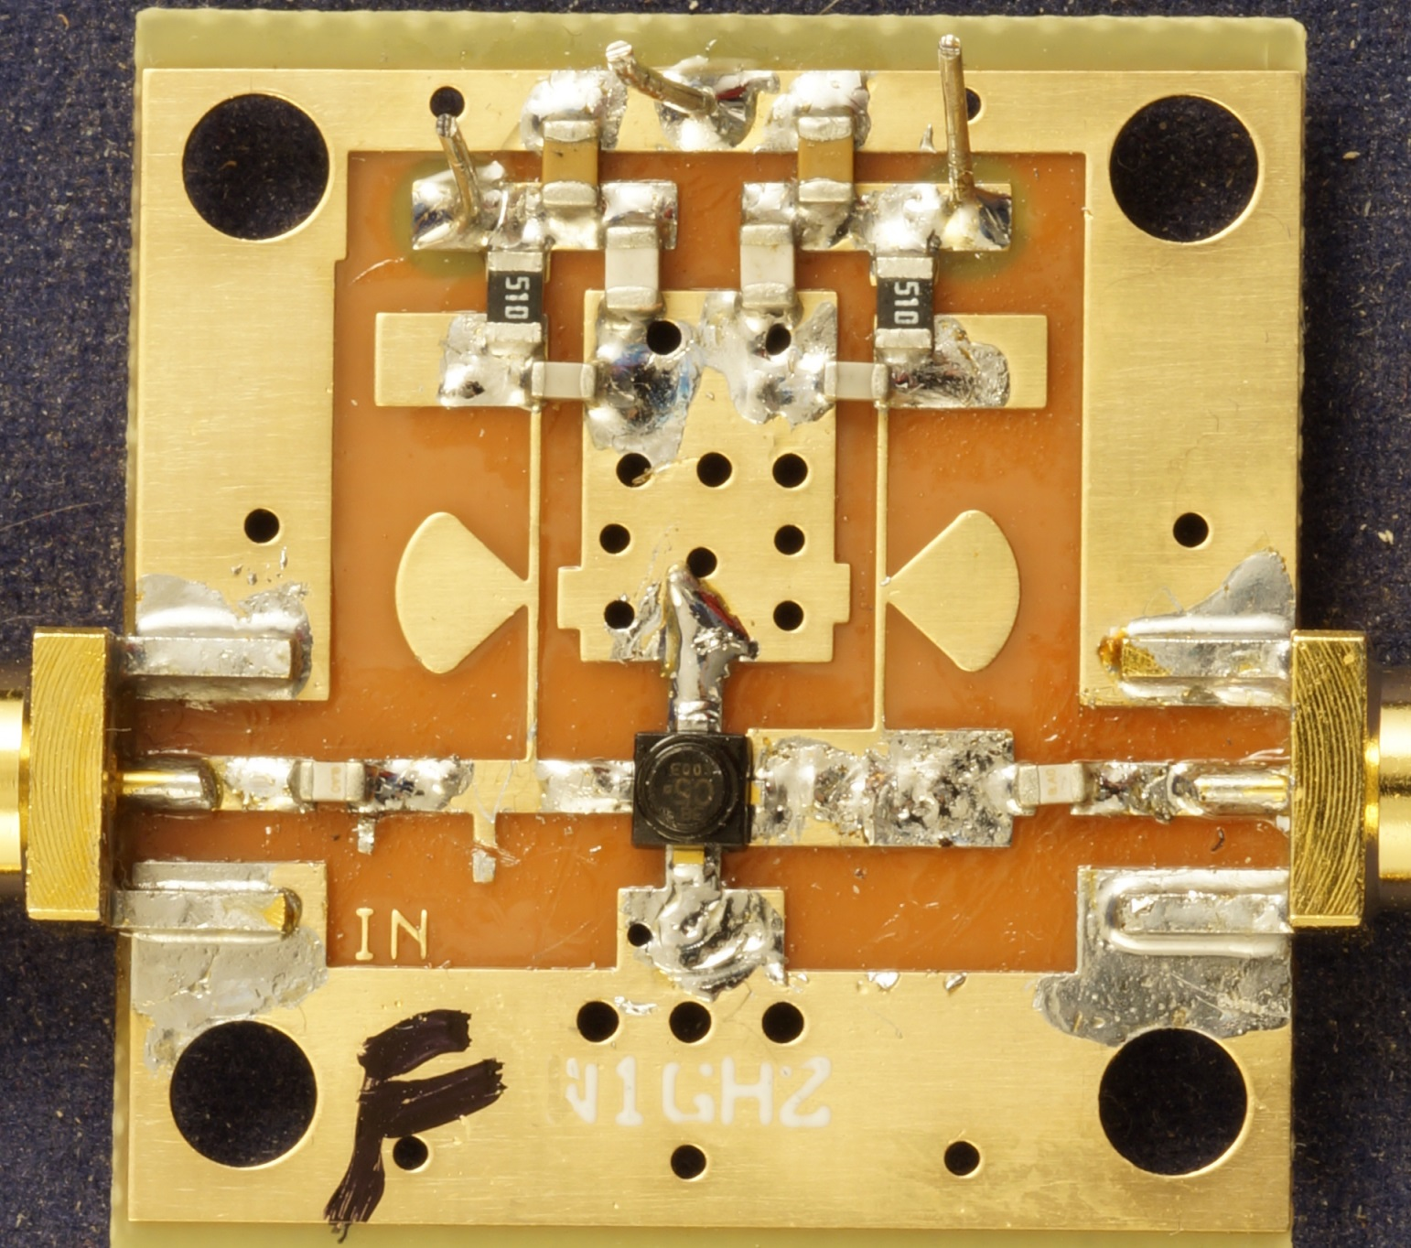
Simple Tuning – X-Acto knife

Slide 14
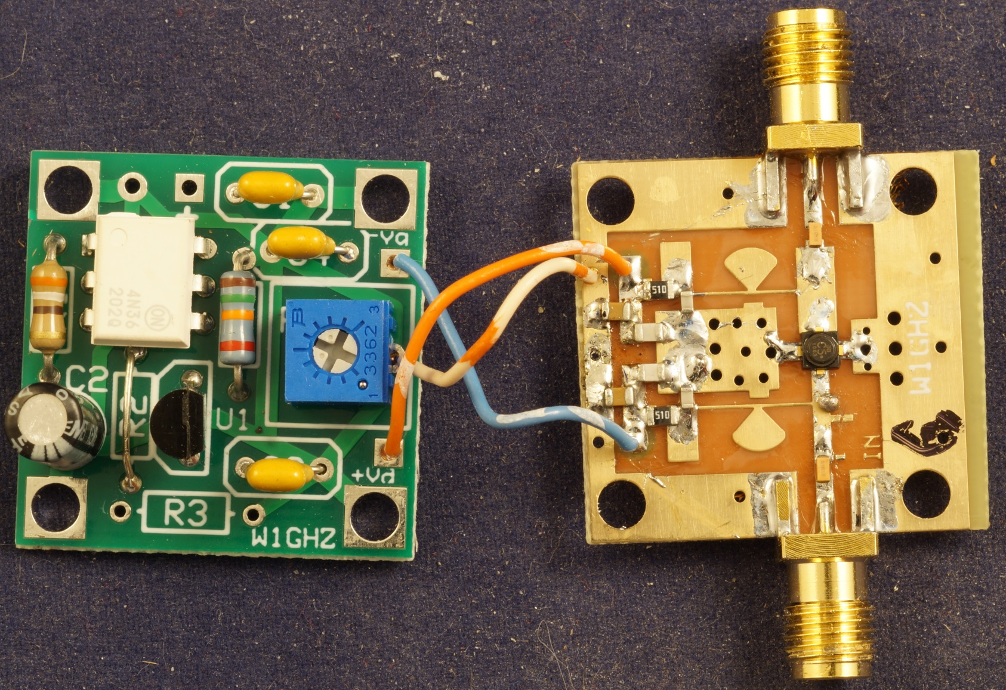
With Bias Board

Slide 15
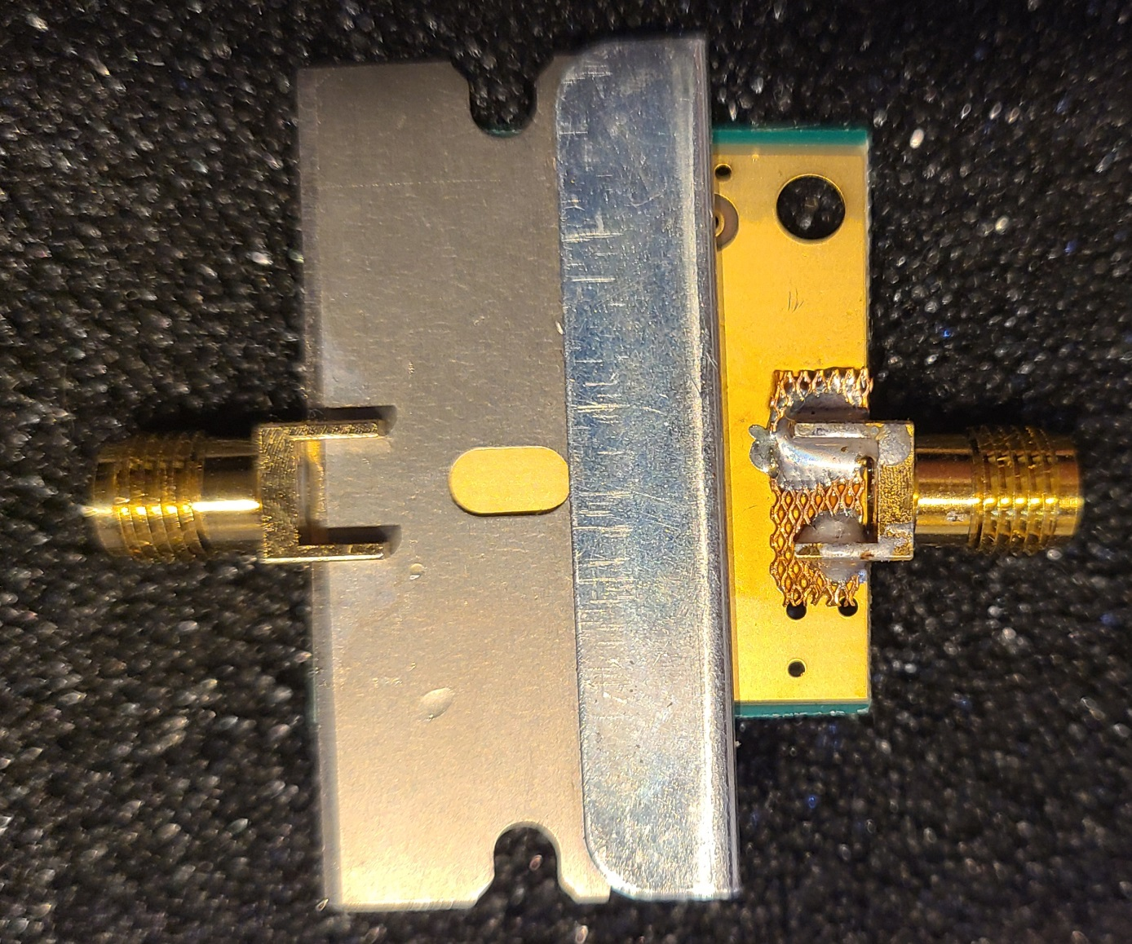
SMA Connectors – Thin PC board
0.8mm SMA on 0.6mm board

Slide 16
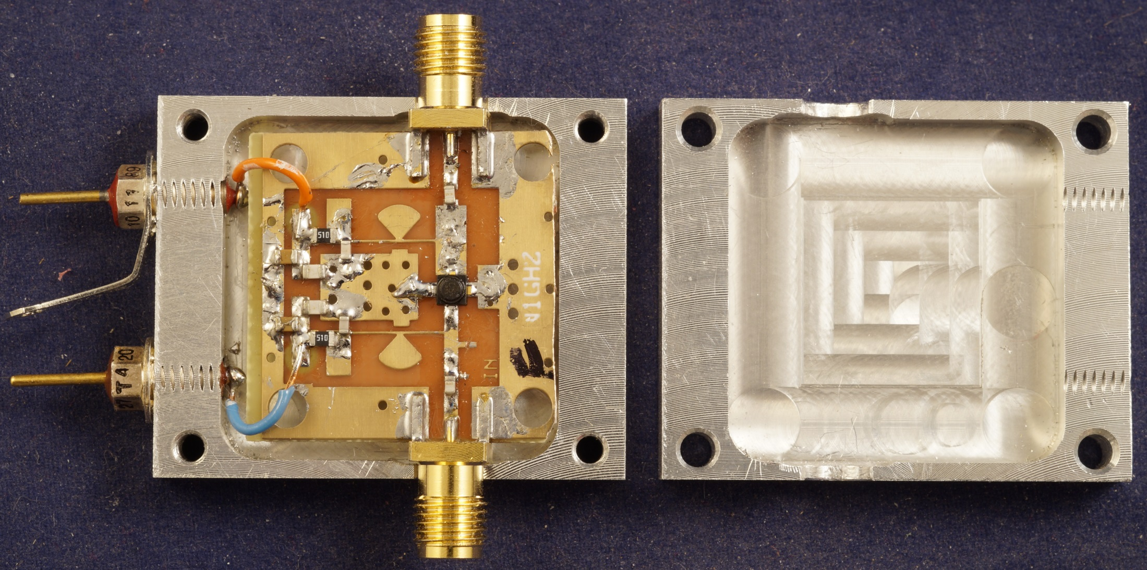
Robust Clamshell Housing
Clamp SMA to reduce flexing

Slide 17
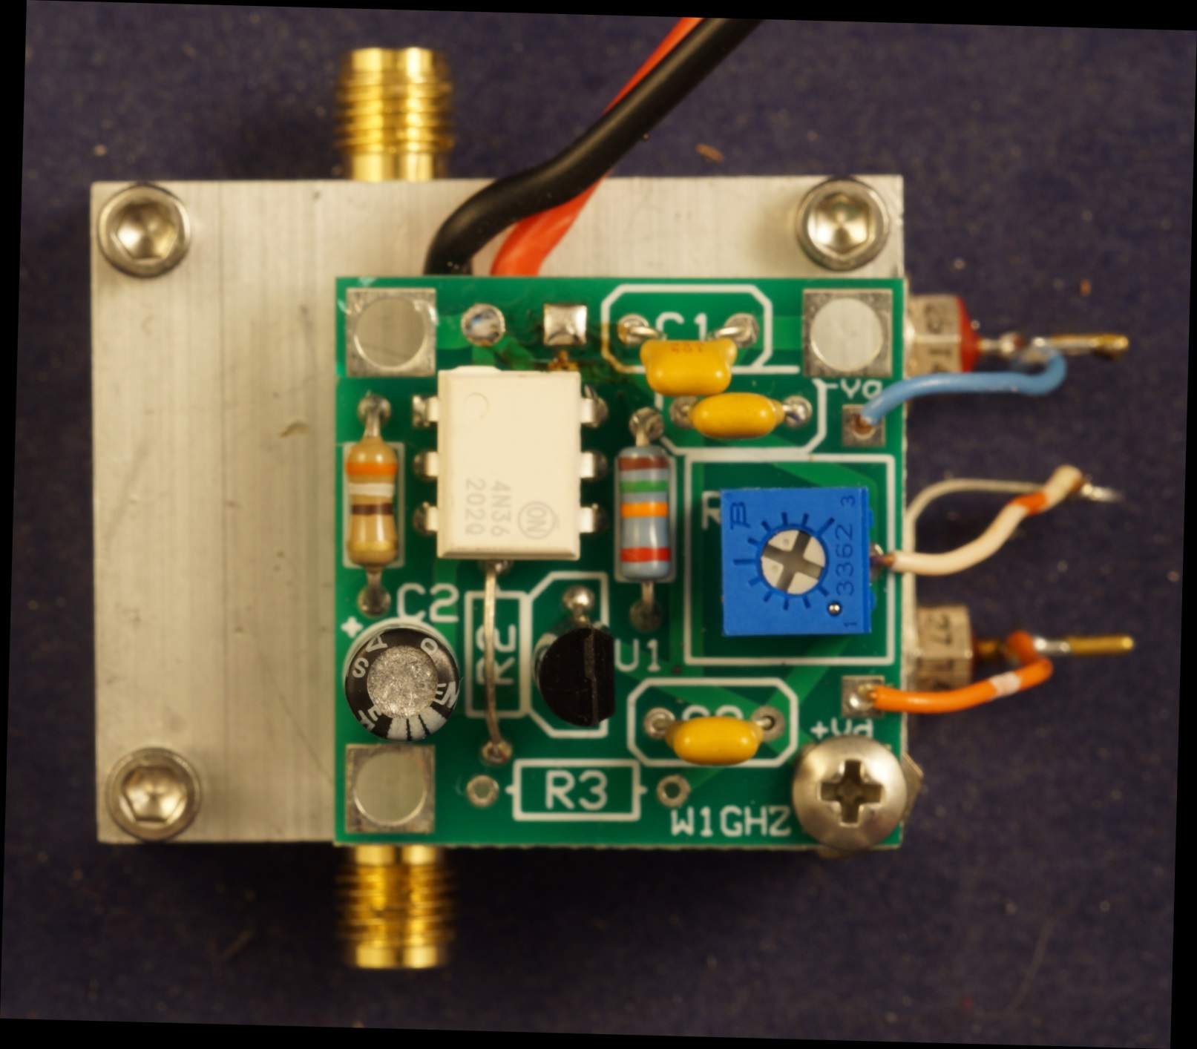
Preamp Completed

Slide 18
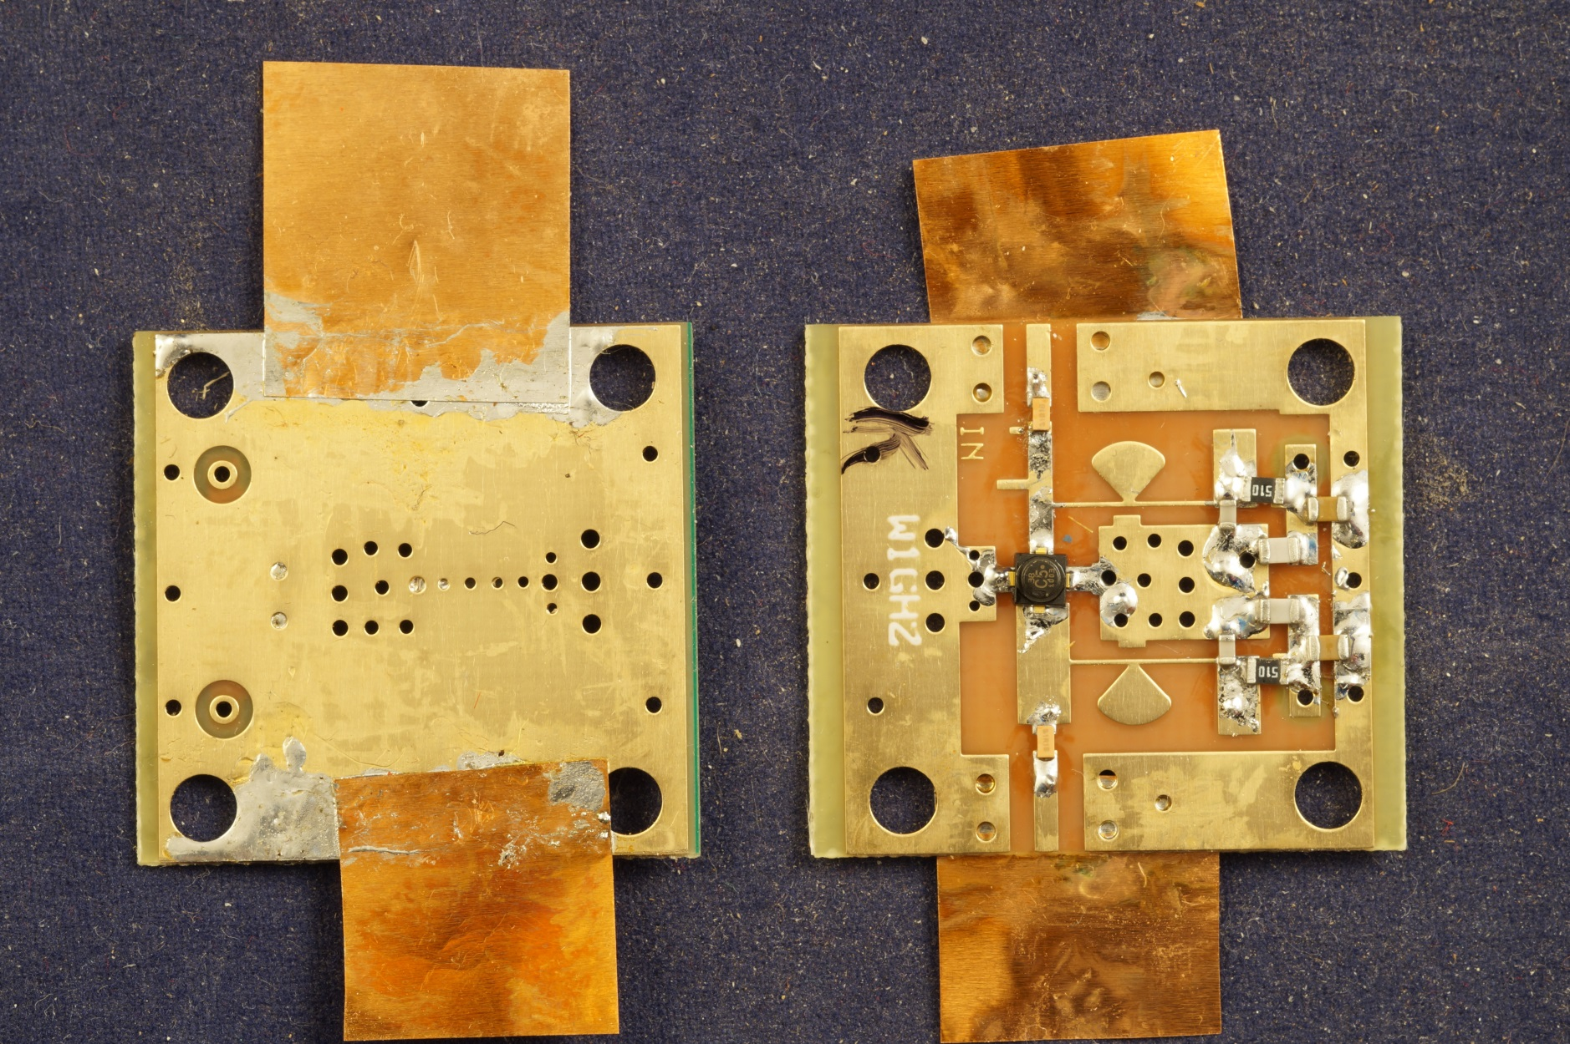
Alternative – Foil under SMA

Slide 19
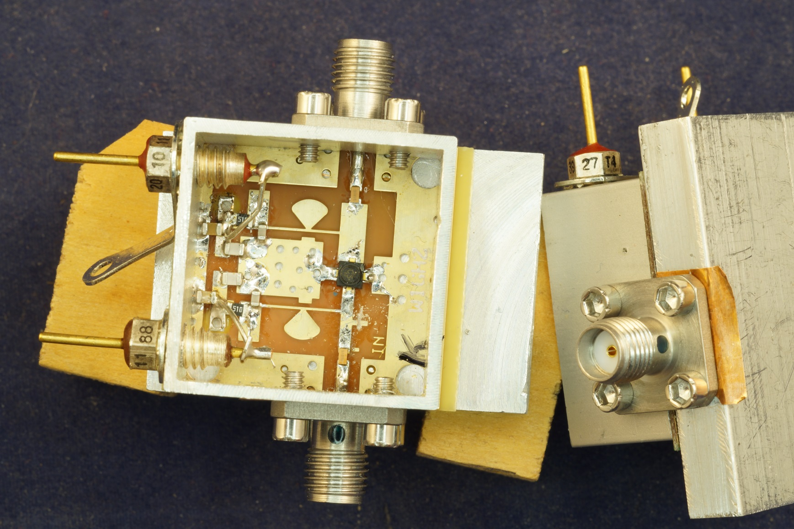
Foil Assembly

Slide 20
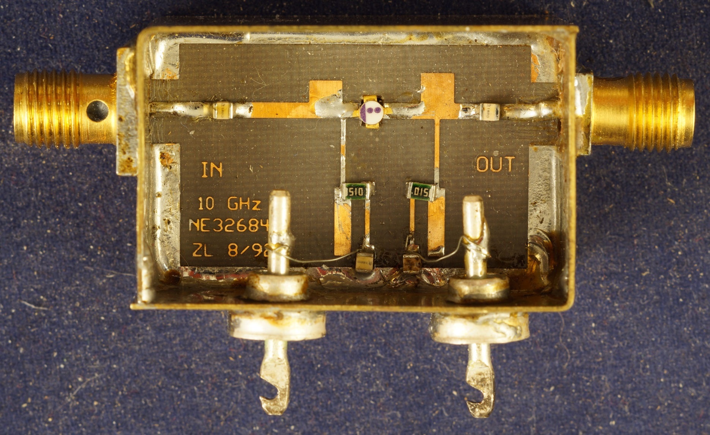
Traditional Soldered Brass
(Zack Lau W1VT)

Slide 21
Blocking Capacitors - IN and OUT make a difference
Good 0603 chips work well, solder easily
  AVX (was ATC) S500 1.0 pf
  ~0.1 to 0.2 db better
  Fragile
  Hard-to-obtanium (sample kits?)
AVX (was ATC) S600 1pf – nearly as good
AVX (was ATC) S500 2.0 pf – nearly as good
  Modest quantity available

Slide 22
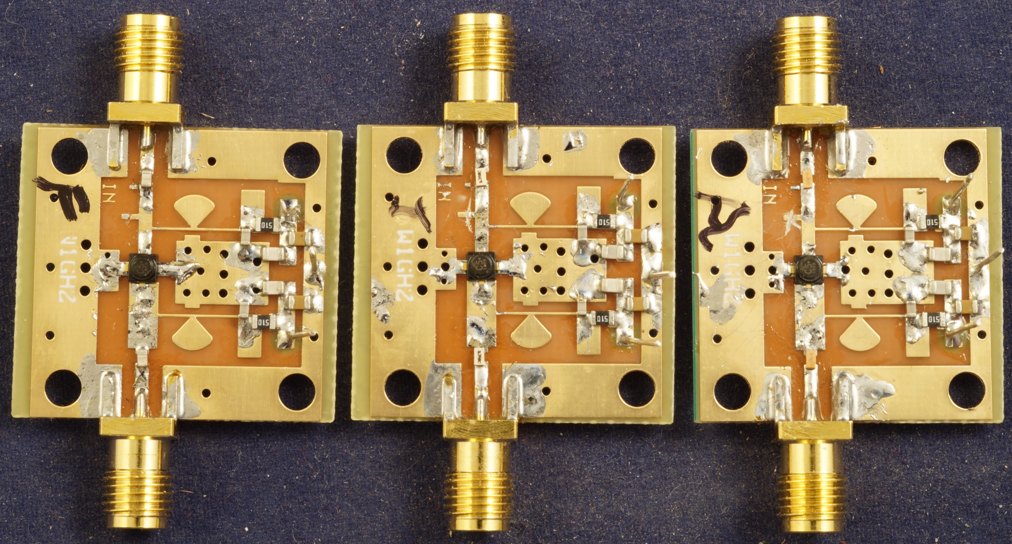
Capacitors
AVX 600S 1.0pf AVX 500S 2.0pf AVX 500S 1.1 pf

Slide 23
Noise Figure
HP 8970A
  12 Preamps read ~ 1.5 dB before tuning
  1.2 to 1.5 dB after tuning – simple stub trim
CS/G – cold sky to ground
  3 preamps measure 1.24 to 1.52 dB
  Slightly better than NF meter
Test by EB3FRN on Agilent E4407B
  Measured 1.50 dB vs my 1.30 dB

Slide 24
System Noise Figure
Preamp with ≤ 1.5 dB NF, 12 to 13 dB gain
Simple and Cheap Transverter NF ~8dB
Together about 2 dB NF
Plus cable loss
Put the preamp at the feed

Slide 25
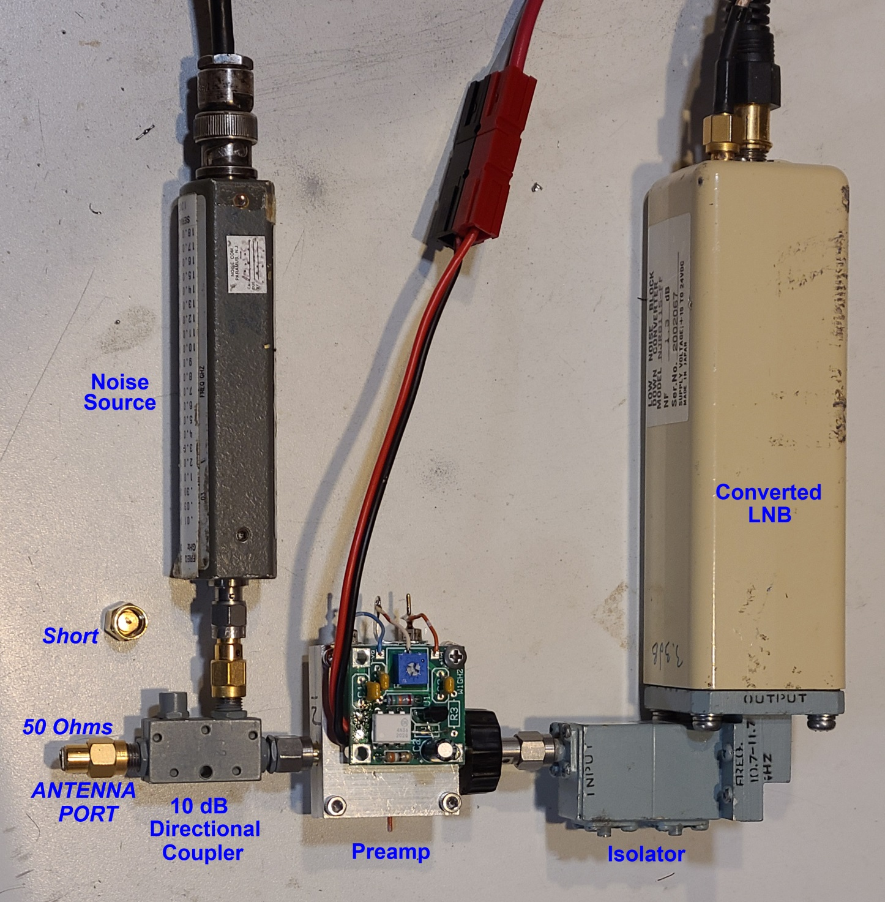
Stability Test
Antennas are not broadband terminations
Inject Noise Source thru 10 dB Coupler
NF 10 dB higher
Put SHORT and OPEN on Antenna port
No oscillation
Sliding short would be better test

Slide 26
Maybe not $10
GaAsFET CE3512 (0.3 dB NF) $1.67
SMA Taoglass $3.50 x 2 $7
PC board $4
ATC capacitors $1 x 2 $2
Chip resistor and caps $0.50
Negative bias board & parts $2
=====
How about ~$15

Slide 27
Summary – 10 GHz
Simple and Cheap 10 GHz Preamp
Good performance
Easy to build
Simple, repeatable tuning
PC boards available
Parts from Mouser

Slide 28
5760 Preamp or LNA

Slide 29
5760 MHz Preamp
Follow 10 GHz example
Same Device - should be better performance
Same Design Process – mostly snowflaking
Lower Cost
  0.8mm (1/32”) thick PC board – more common
  Cheap SMA connectors
  Ordinary 0805 capacitors (selected type)
Same bias board

Slide 30
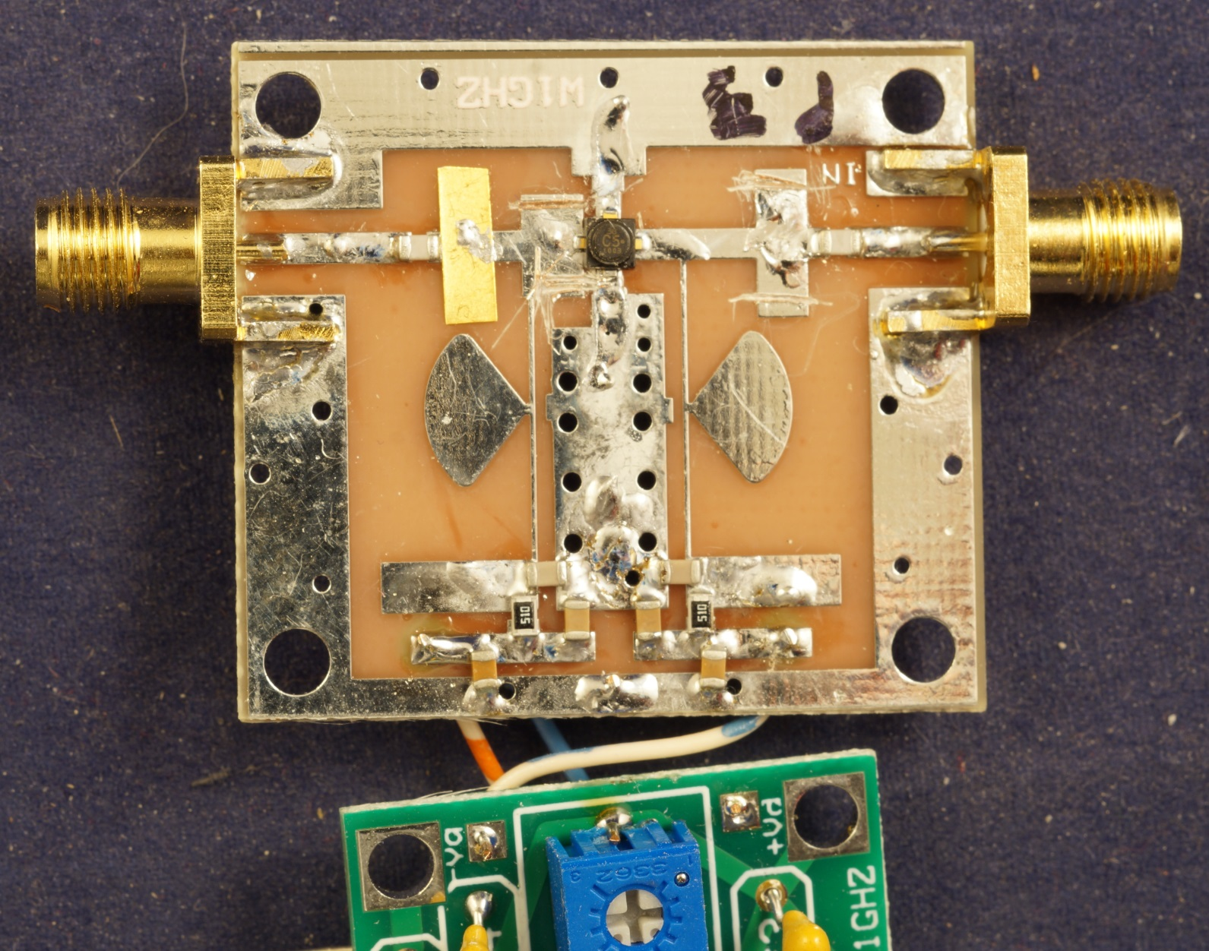
Tuned Prototype
Three copies same tuning → artwork

Slide 31
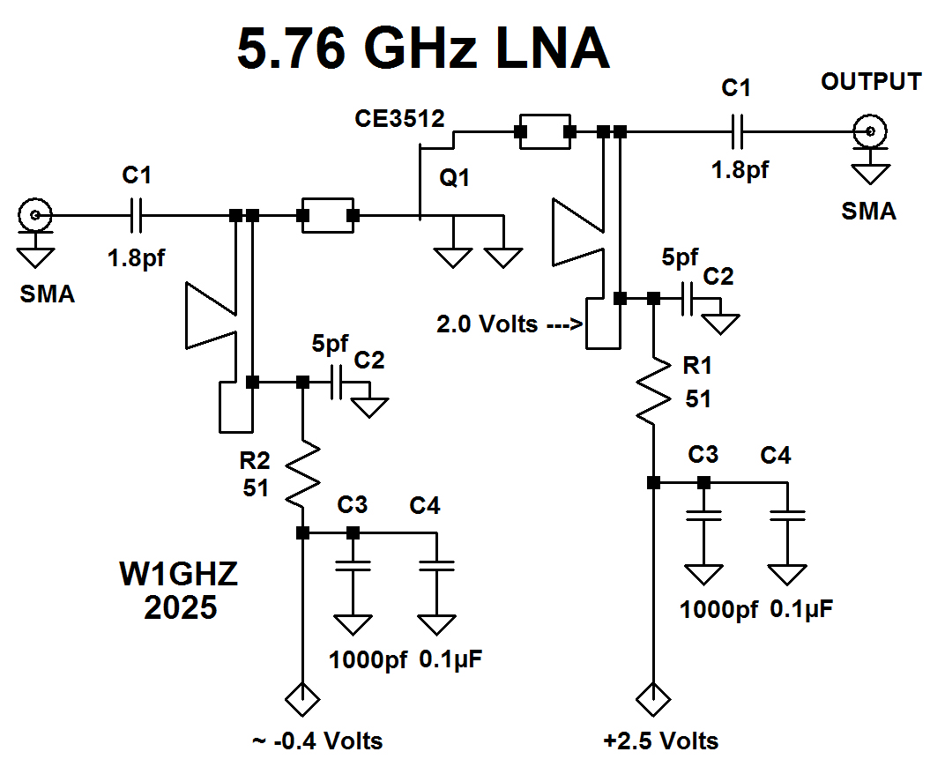
Schematic

Slide 32
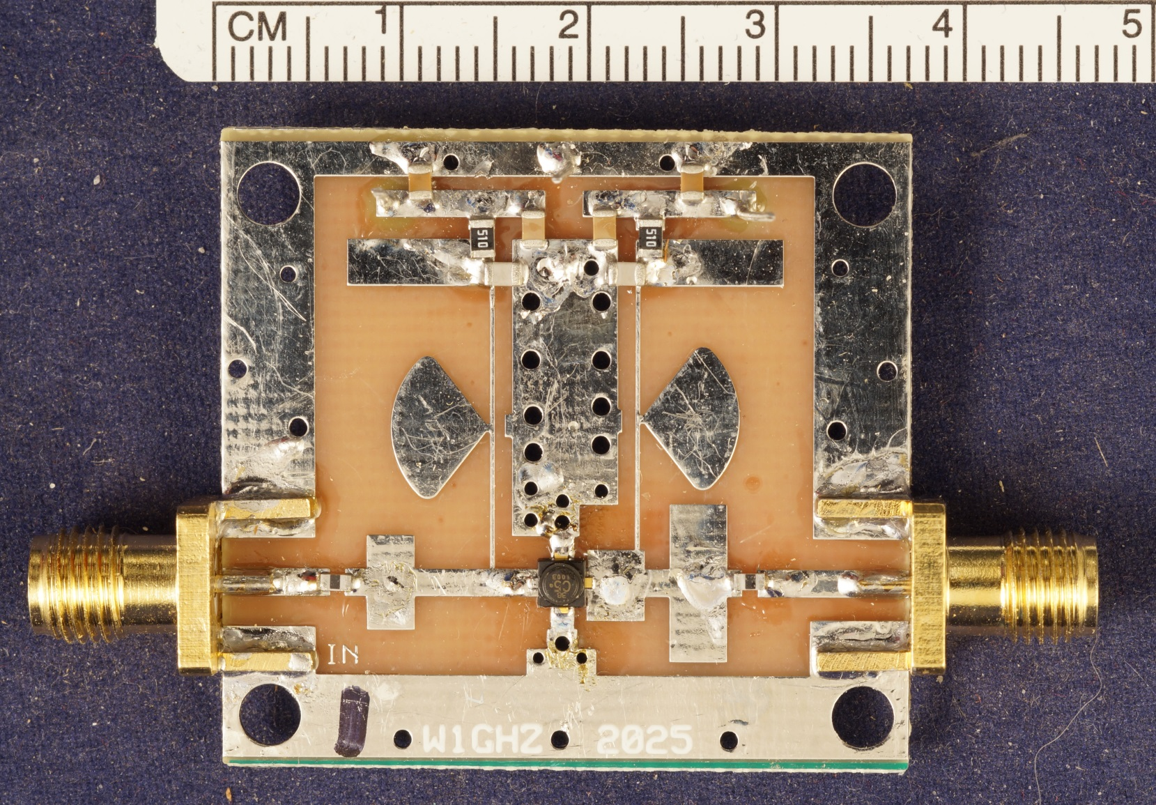
NO Tuning needed

Slide 33
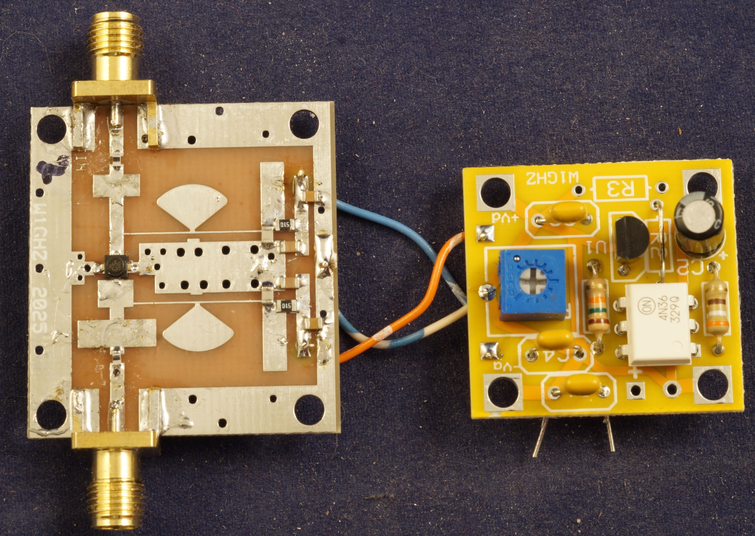
Same Bias Board as 10 GHz

Slide 34
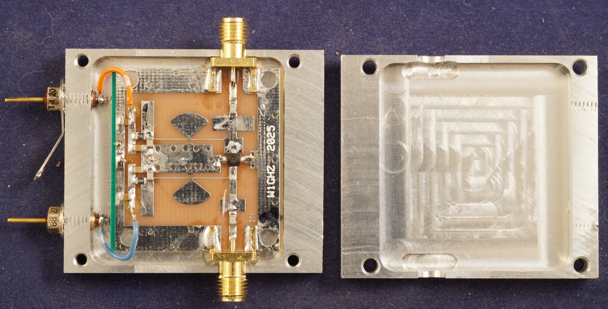
Robust Clamshell Housing

Slide 35
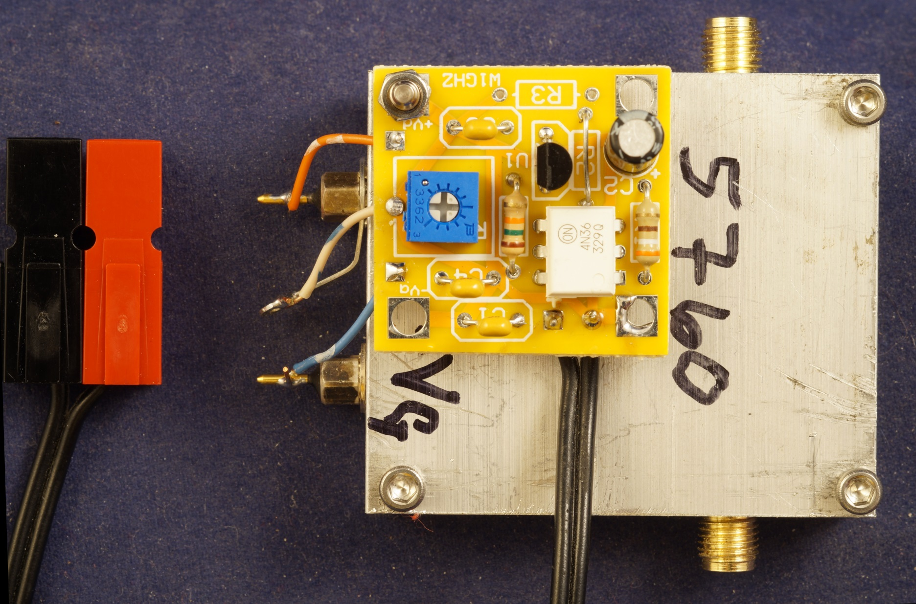
Preamp Complete

Slide 36
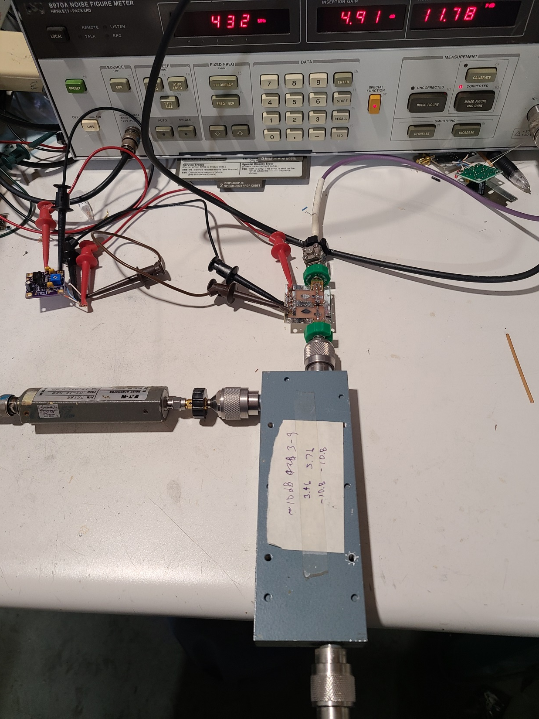
Stability Test

Slide 37
Noise Figure
HP 8970A reads 0.7 to 1.2 dB
CS/G under 2 dB
  Hard to find Cold Sky
Better measurements at conference

Slide 38
Summary
Good preamps for 10 GHz and 5760 MHz
Inexpensive
Easy to build
Parts & PC boards available
Simple Tuning
Fool-resistant negative bias circuit
Improved performance for Simple & Cheap Transverters

