Slide 1
Synthesizers for Amateur Radio
NEWS Conference 2025 - WA1MBA
RECENT EXPERIENCE WITH SYNTHESIZERS

Slide 2
Talk Outline
Which Synthesizers ?
Synthesizer Innards
Tests performed
Results
Summary

Slide 3
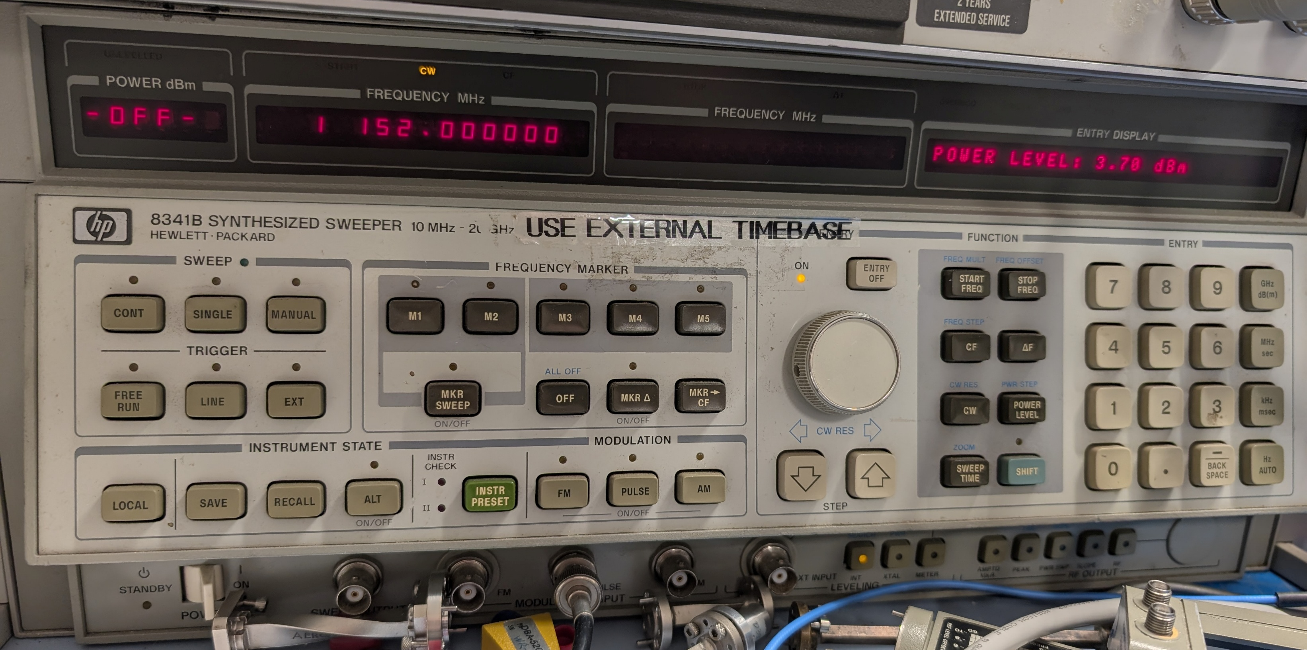
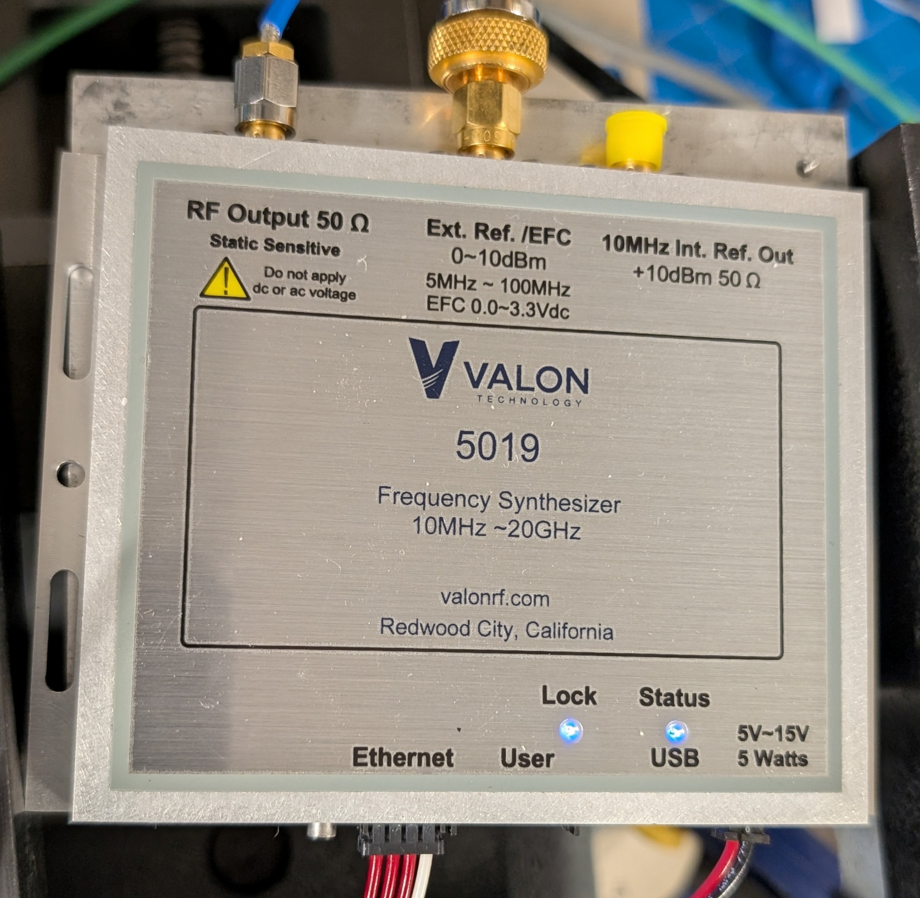
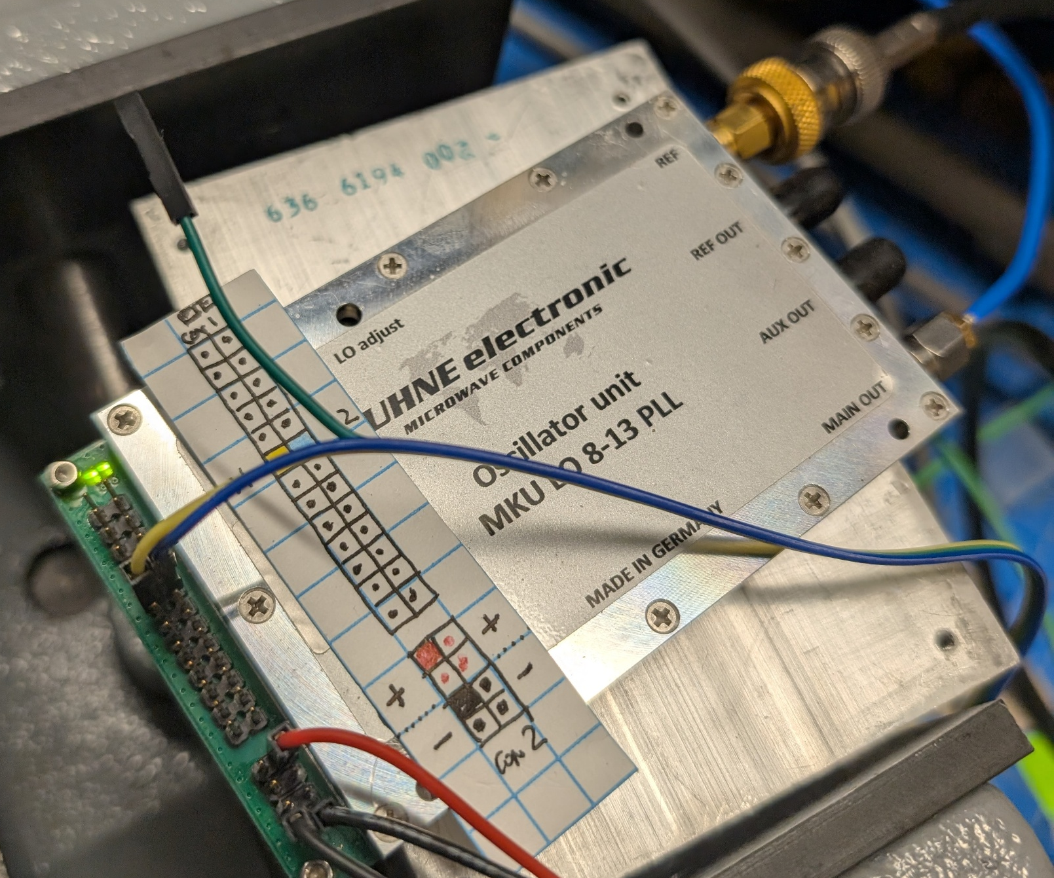
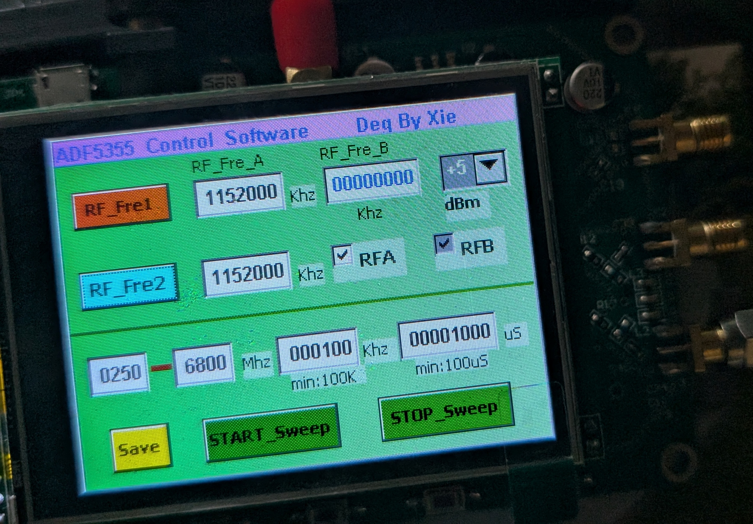
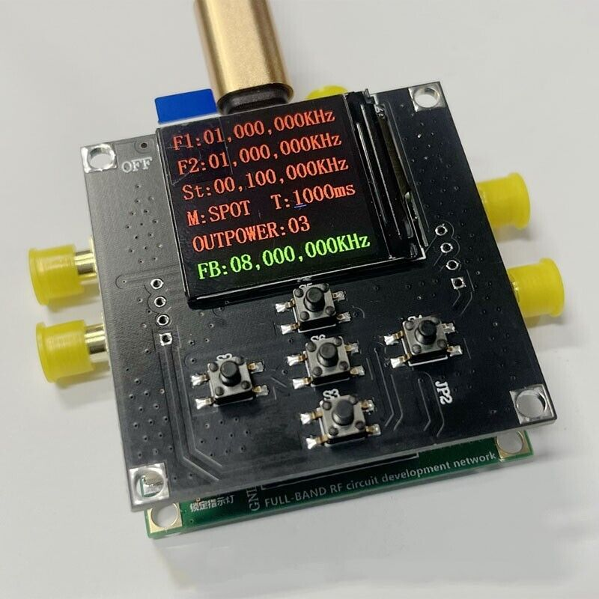
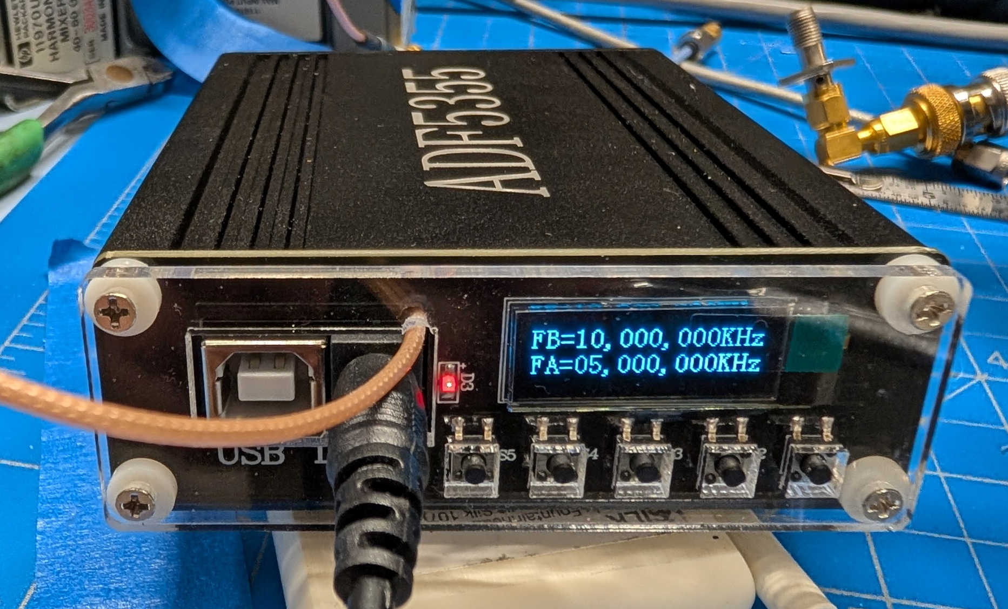
Four Synthesizer Groups
Cost pre Tariff
Source
Specs
HP
Used
8341B
10 M to
20 G
$20K New
$2+K Used
Valon
Tech
5019
10 M to
20 G
$2.5K
New
Kuhne
MKU
8-13
AD5355
54 M
To 13+G
€490
New
CH3
CH1
CH2
China
Ebay
AD5355
54 M
To 13+G
$ 120
To $170
New

Slide 4
There are others
AD 4351 and 5355 “Eval Boards” with and without controllers, HMC833, TI, Linear etc.
Home Brew boards by Hams, with and without controllers (SV1AFN and others)
Other companies similar to Valon Tech
The big boys who rightfully get big bucks, state of the art, bullet proof, supported
  Keysight (Agilent, HP)
  Rhode & Shwarz
  Anritsu (Wiltron)
  Tektronix…

Slide 5
The Chinese devices had no Instructions or Labels (Except One)
On the first Chinese unit, I measured what was coming out of the ports and figured out which was the fundamental (and could do division) and which was the multiplied (doubled) output
The other Chinese units had similar arrangements, so I quickly found those ports
10 MHz Reference input?
  One took the 10 MHz reference as-is
  One required removal of a solder bridge
  One required removal of a zero ohm resistor but still did not lock, even at the original 125 MHz

Slide 6
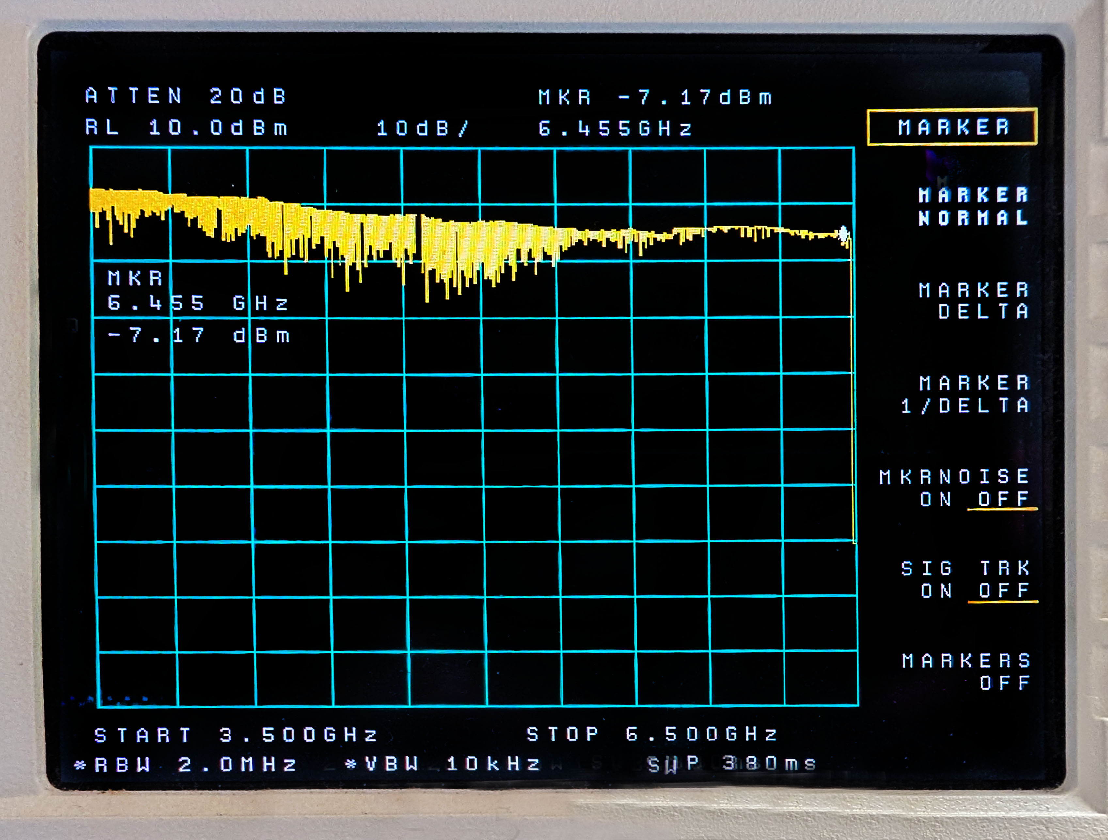
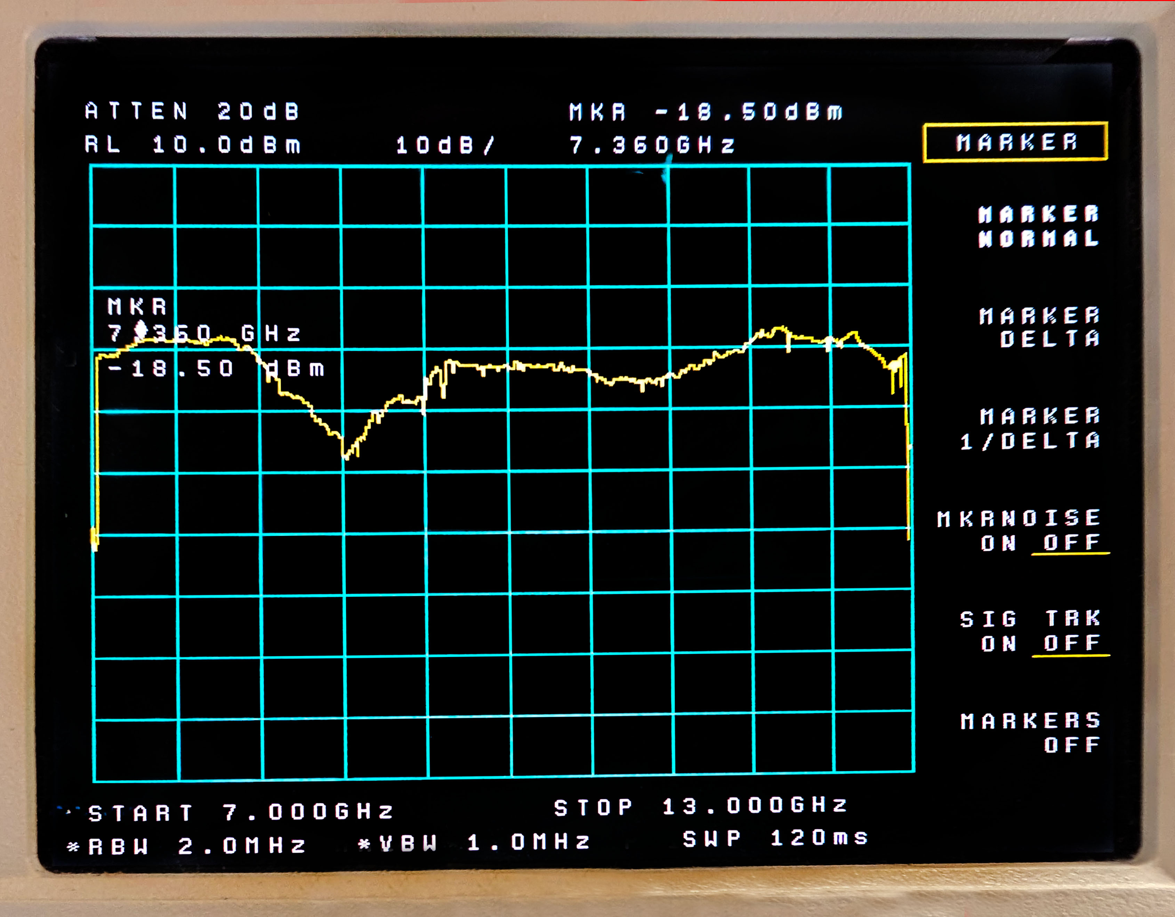


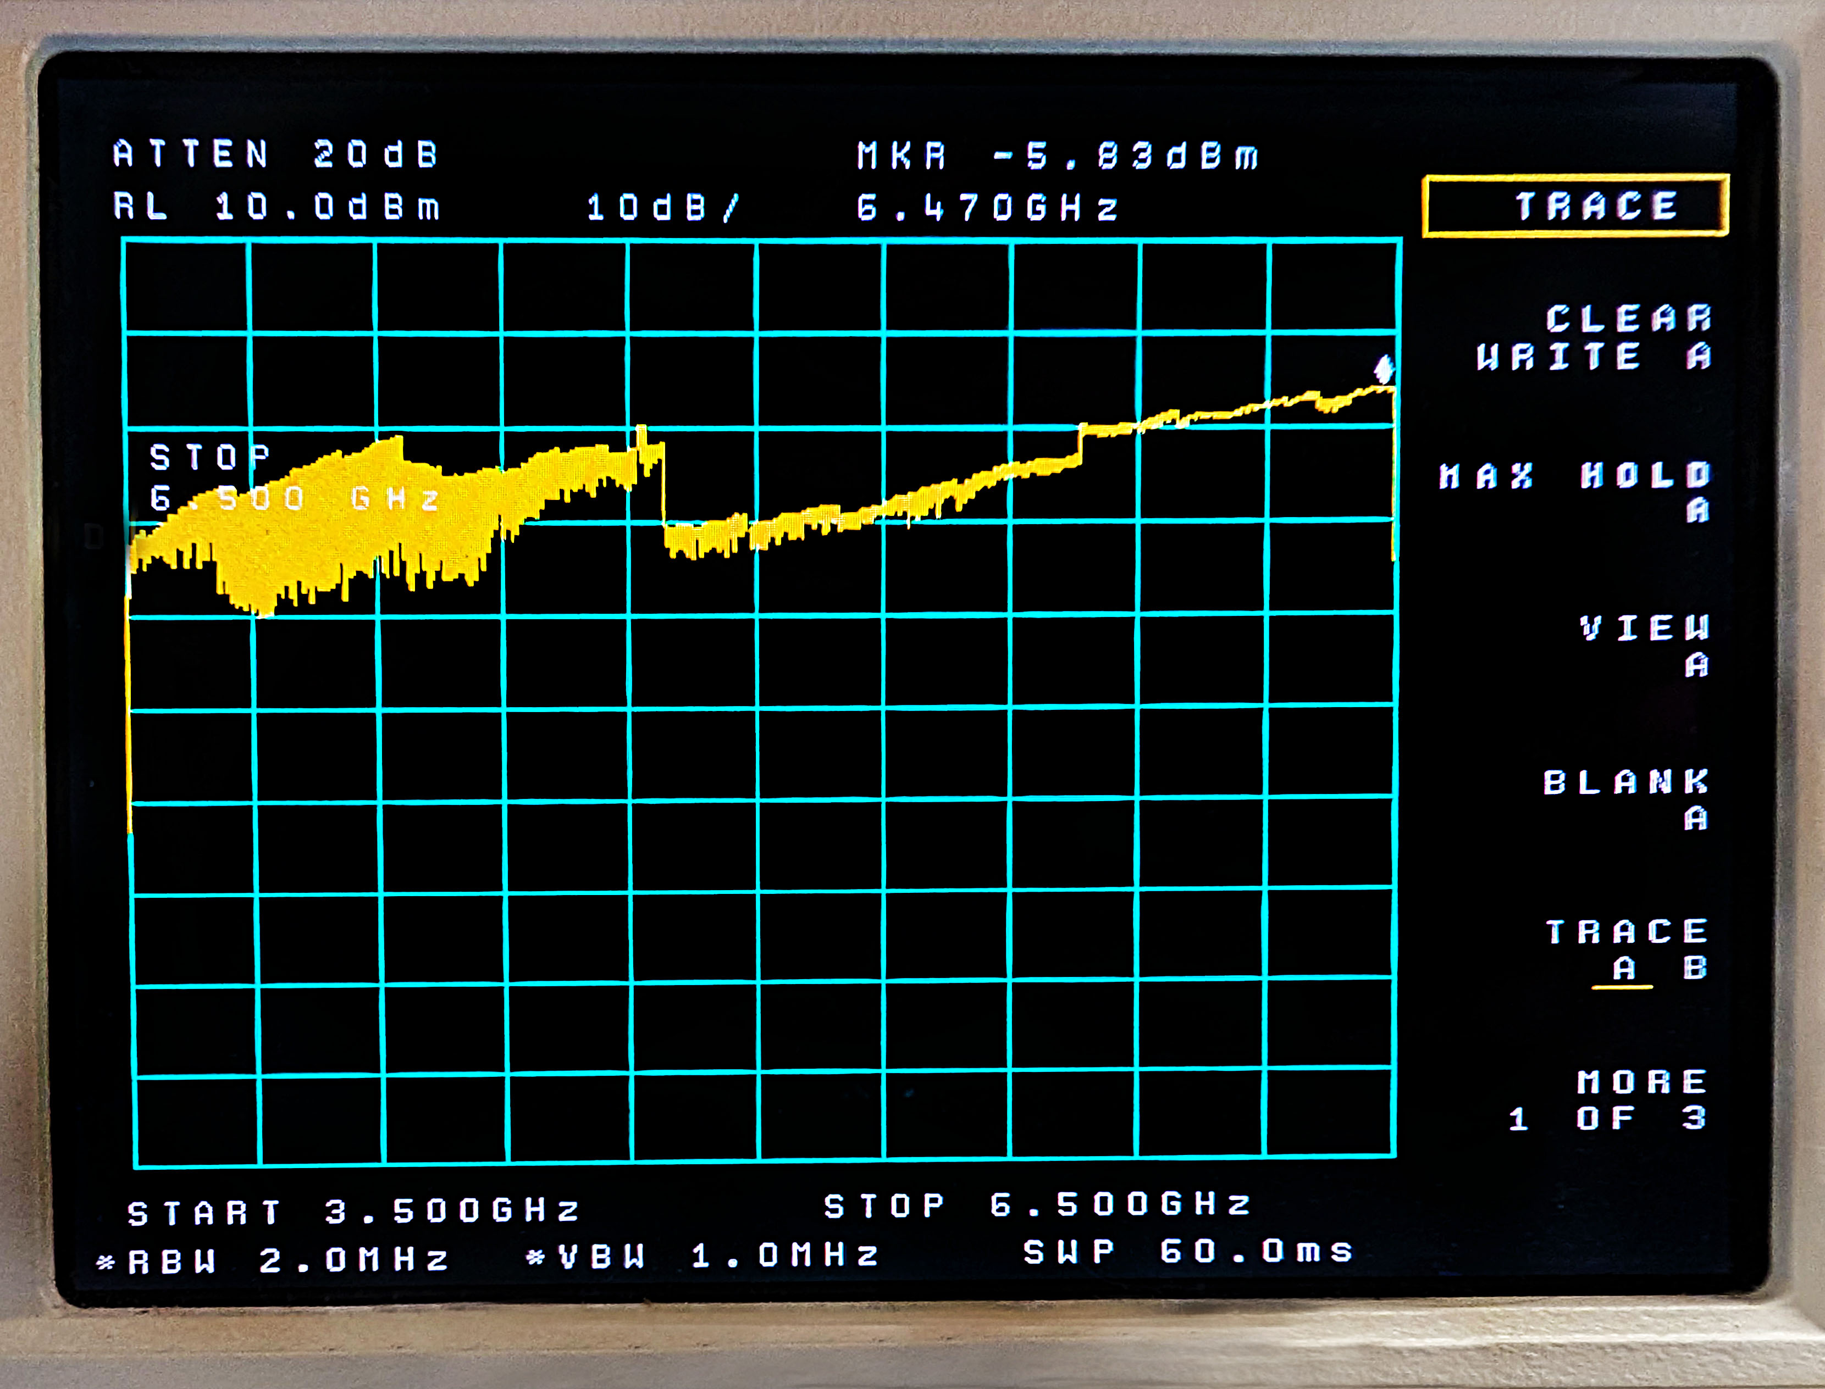
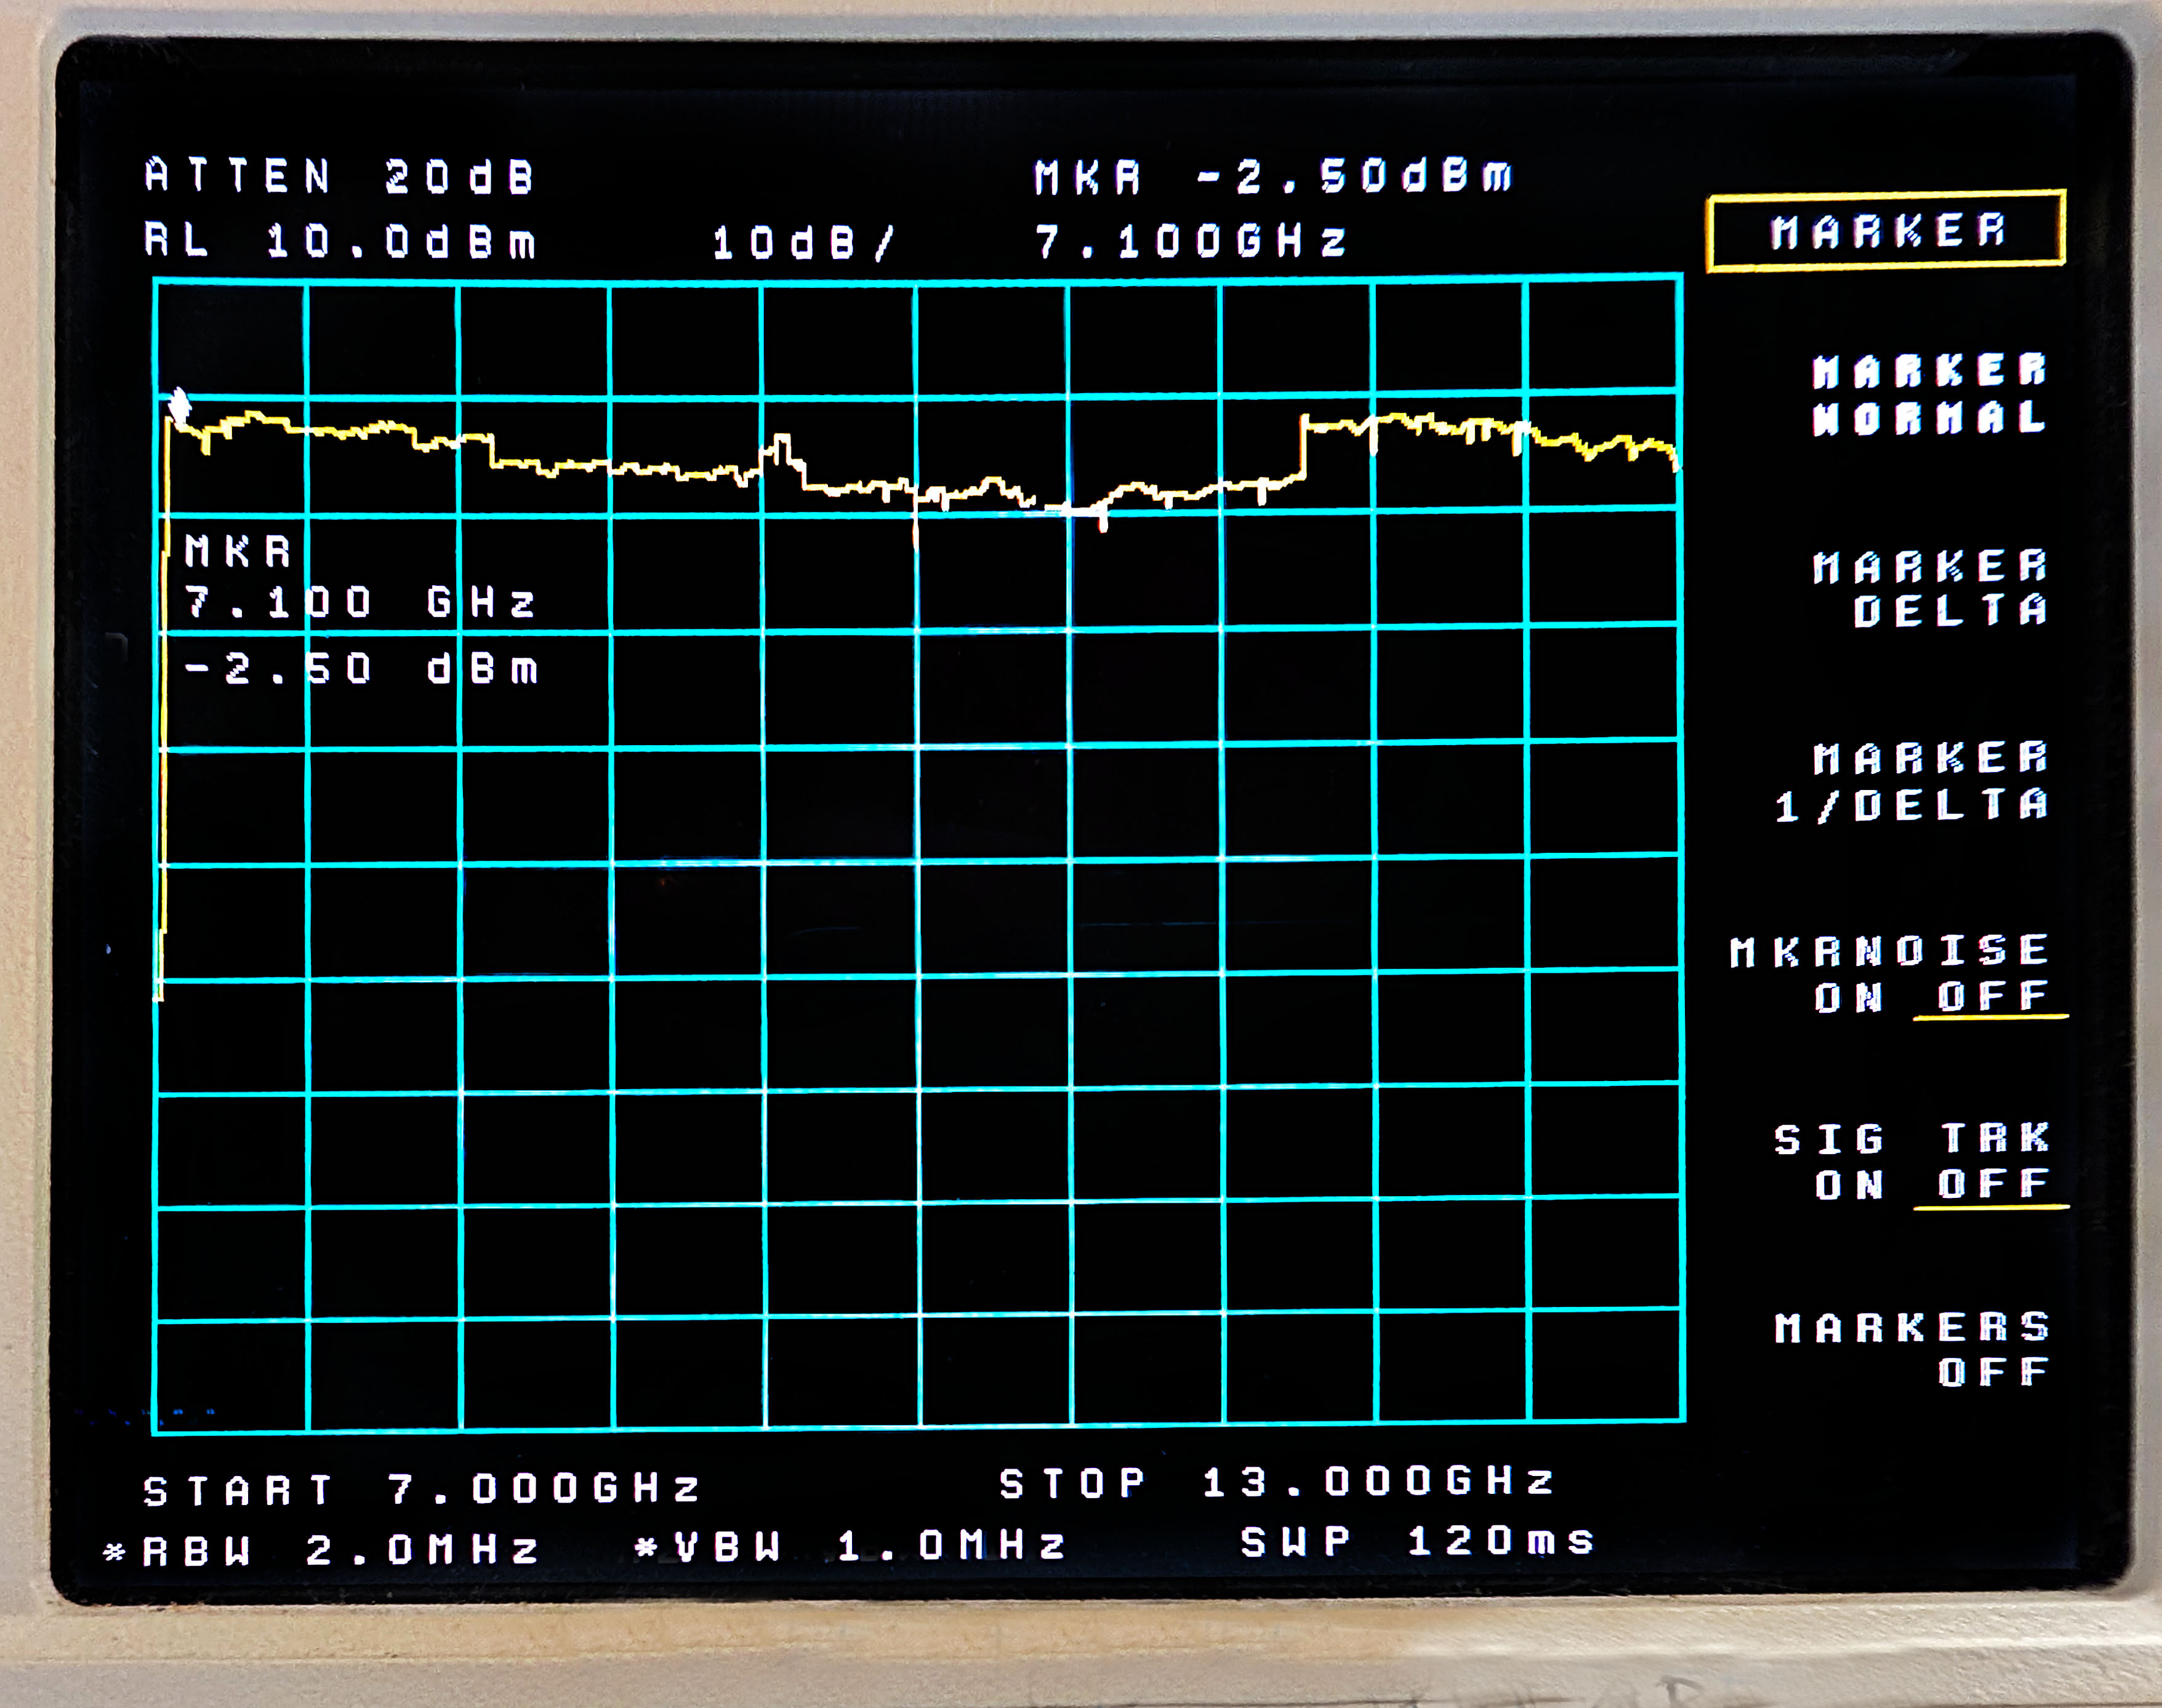
Port and Frequency (CH1)
3.5 to 6.5 GHz
7 to 13 GHz
A
B

Slide 7
Connections, Control (CH1)
“ADF5355 V3 13.6 GHz RF Signal Generator Core Board Sweep Frequency +STM32 Board”
OUTPUT
PORT B
Doubled
US $145 Ebay 4/2025
USB C
OUTPUT
PORT A
Fundamental
And Divided
Ref -
Leave Open
OUTPUT
PORT A
Terminate
REF A
10 MHz In
SEE MOD
DC In
6 V
Change Value
Move Cursor L R

Slide 8
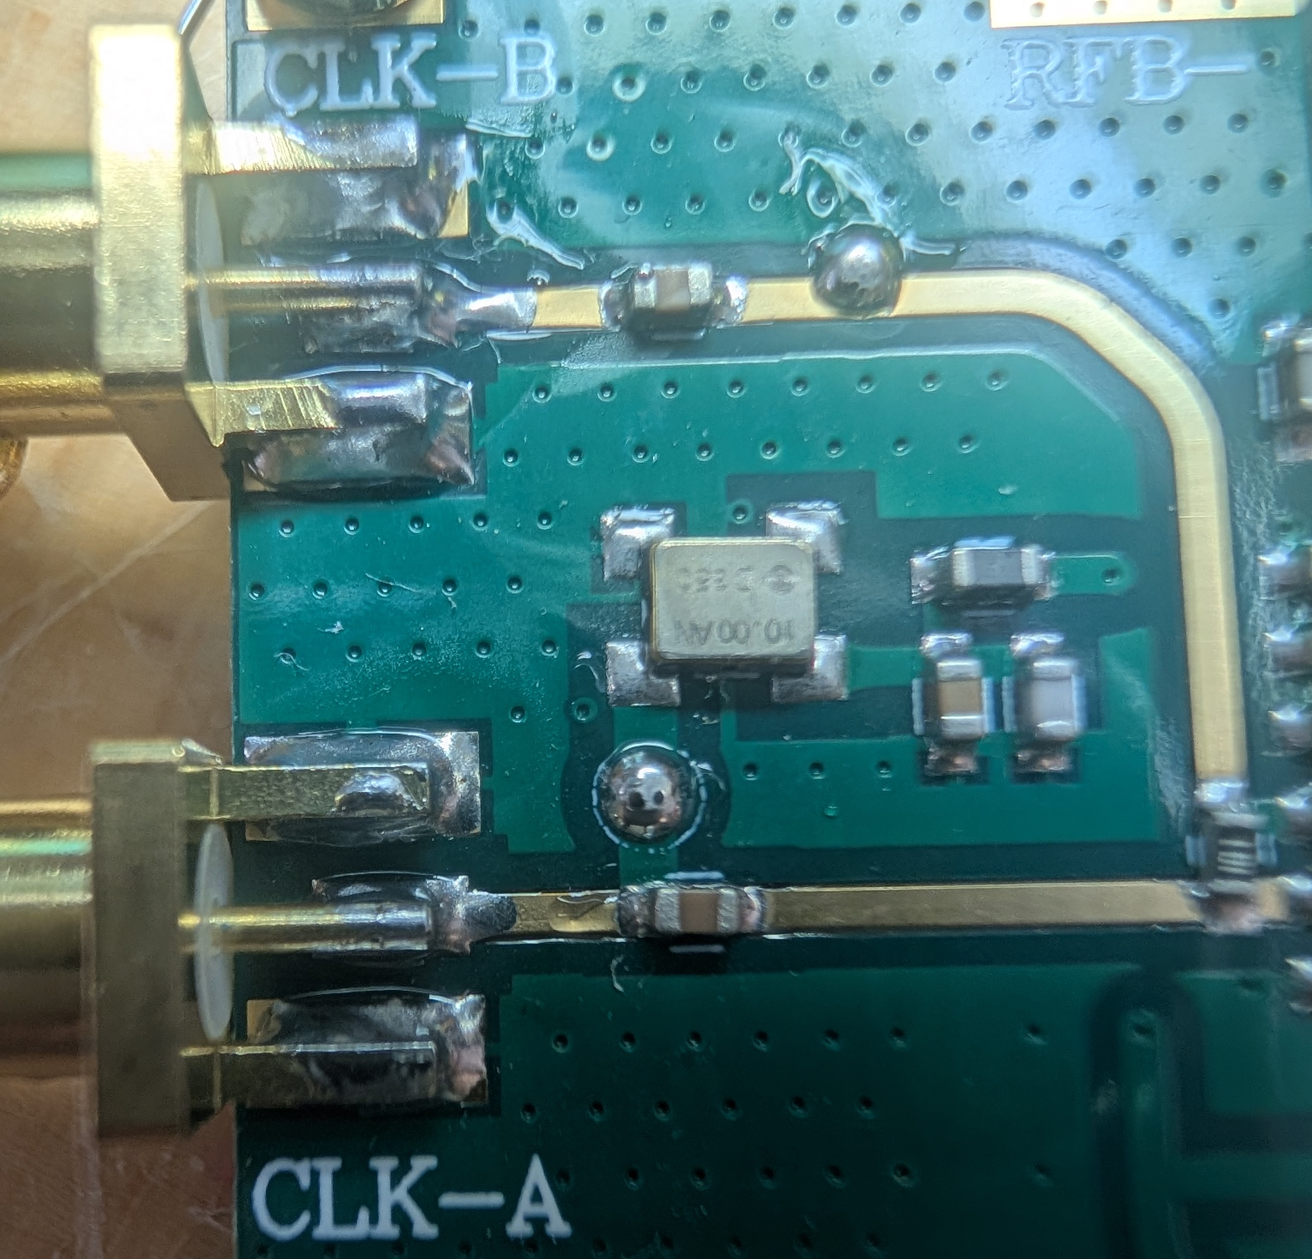
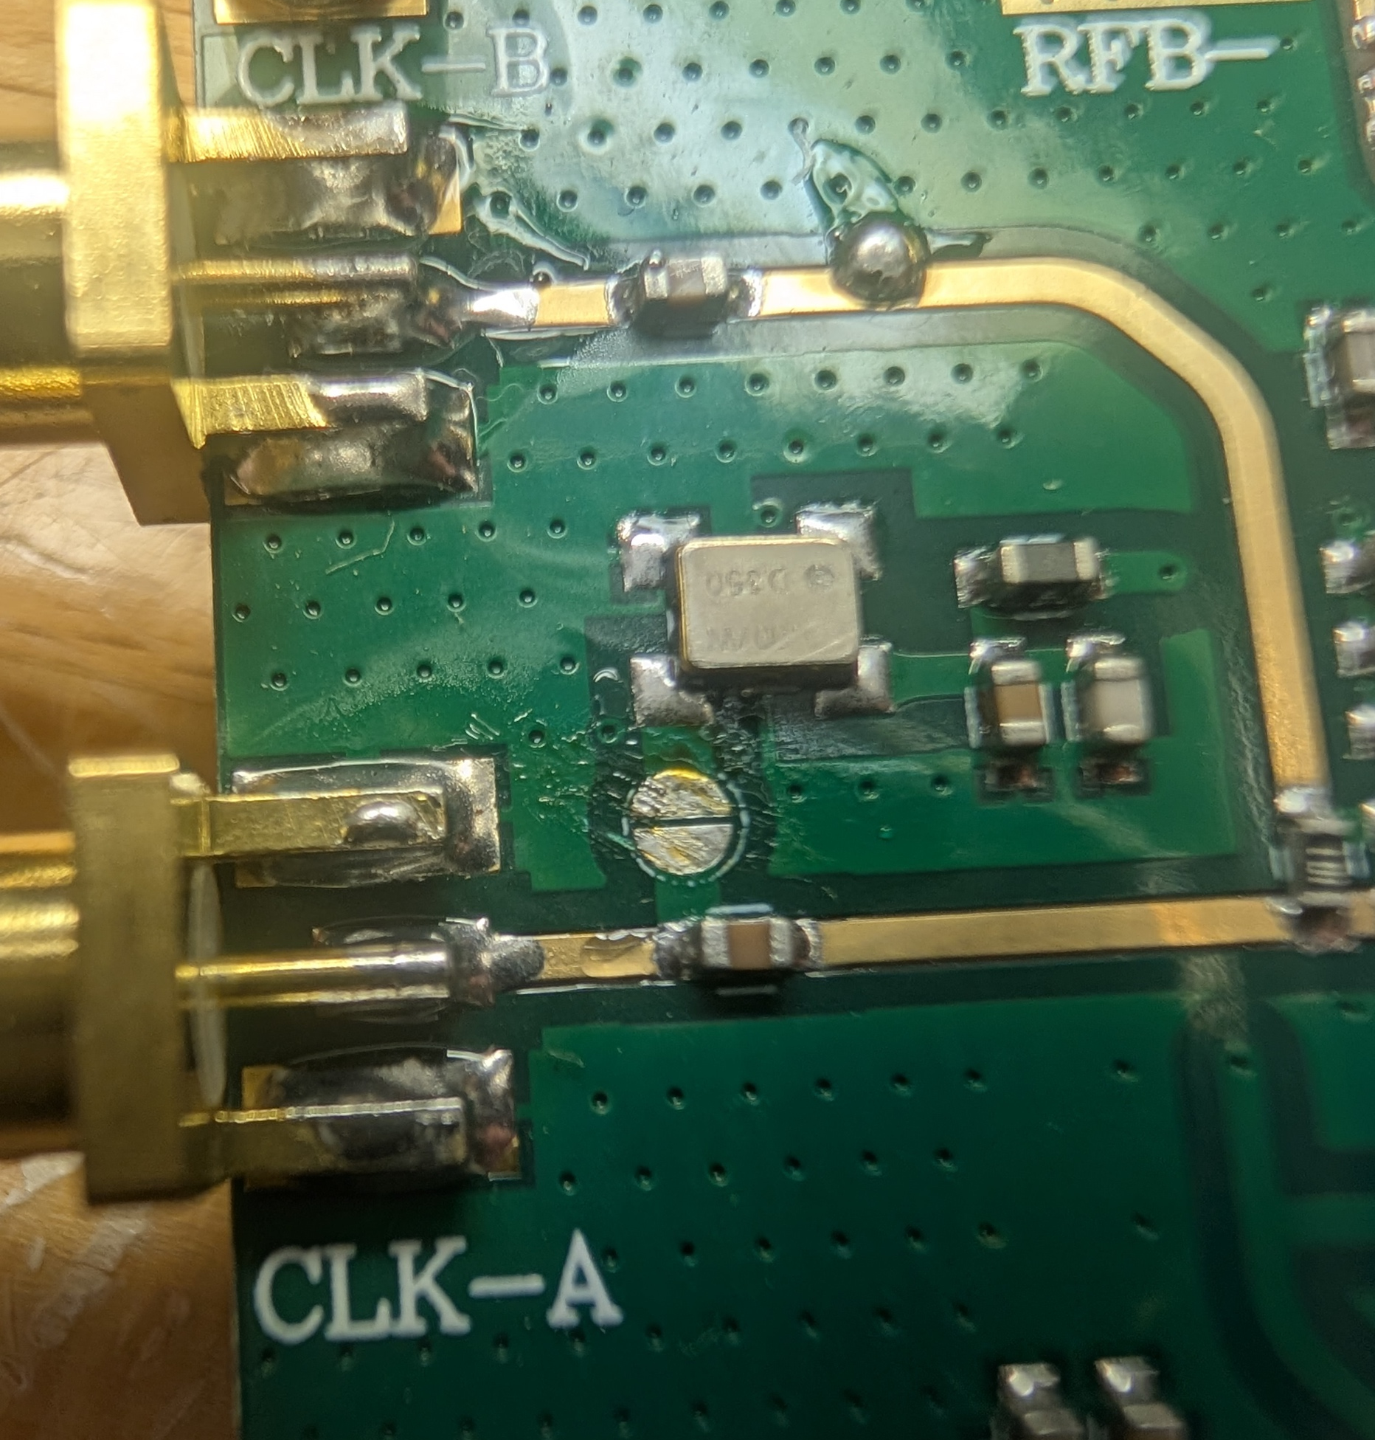
Remove Solder Bump from jump to enable external Ref on this Board
10 MHz works great into “CLK-A”

Slide 9
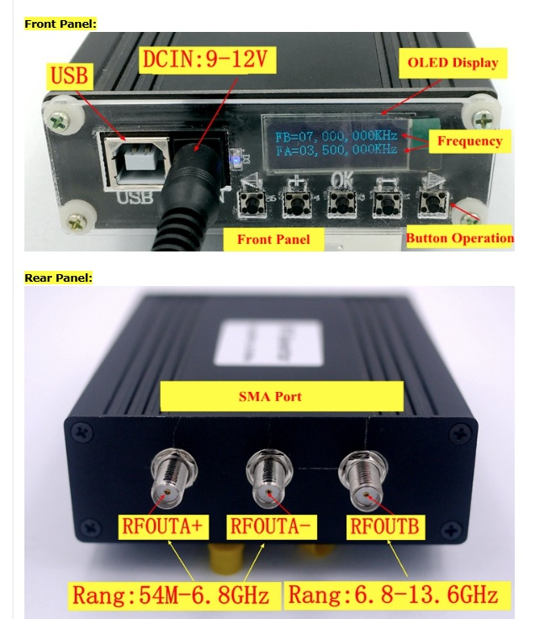
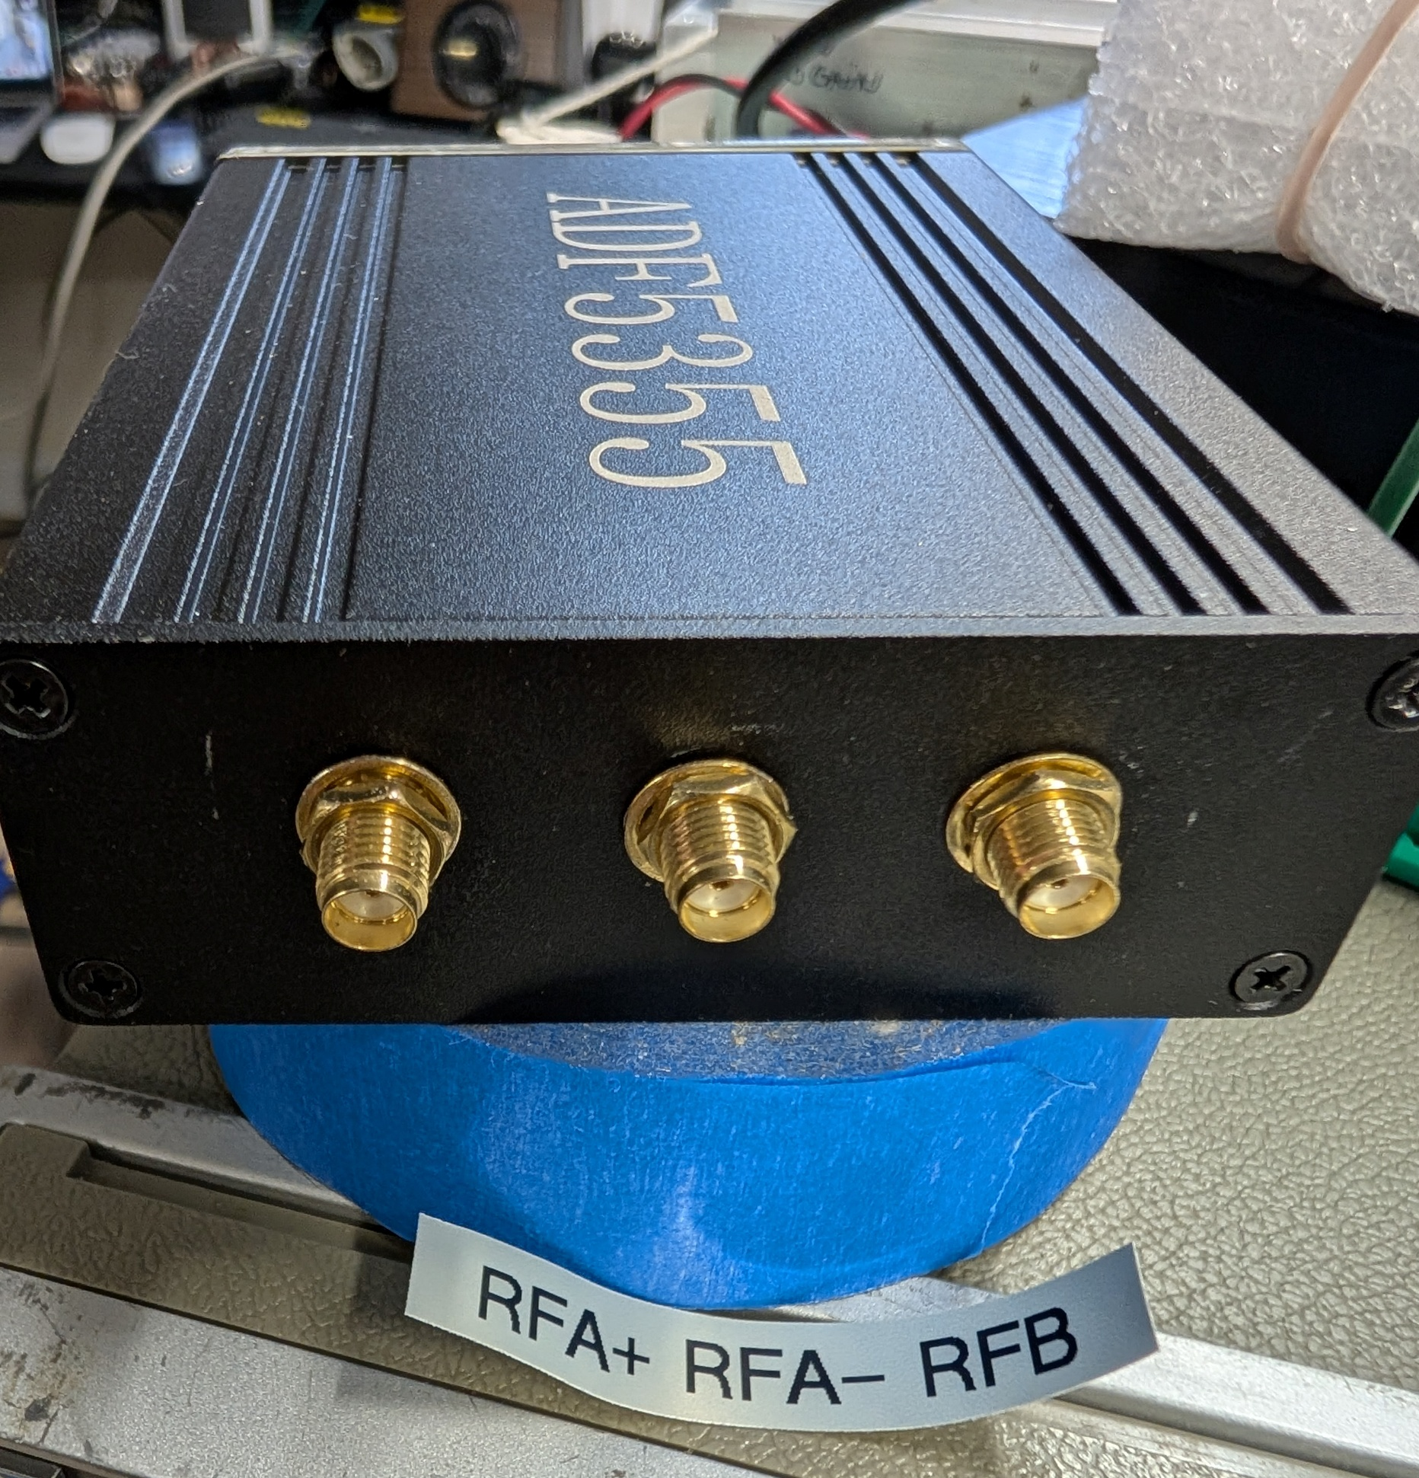
Another Ebay Chinese Model (CH2)

Slide 10
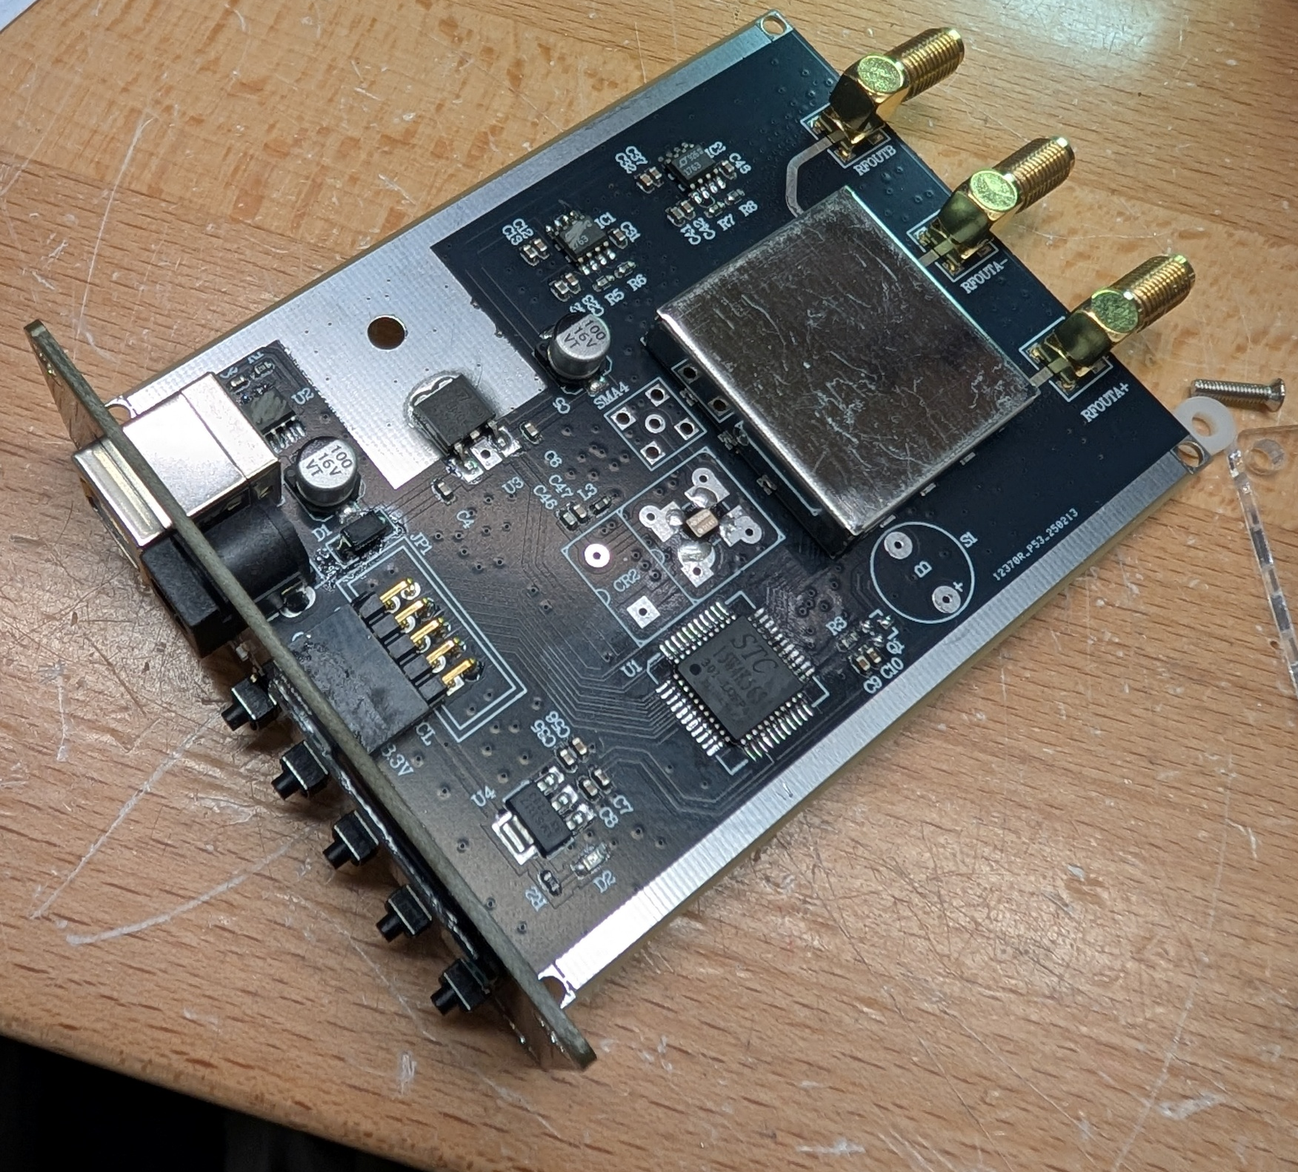
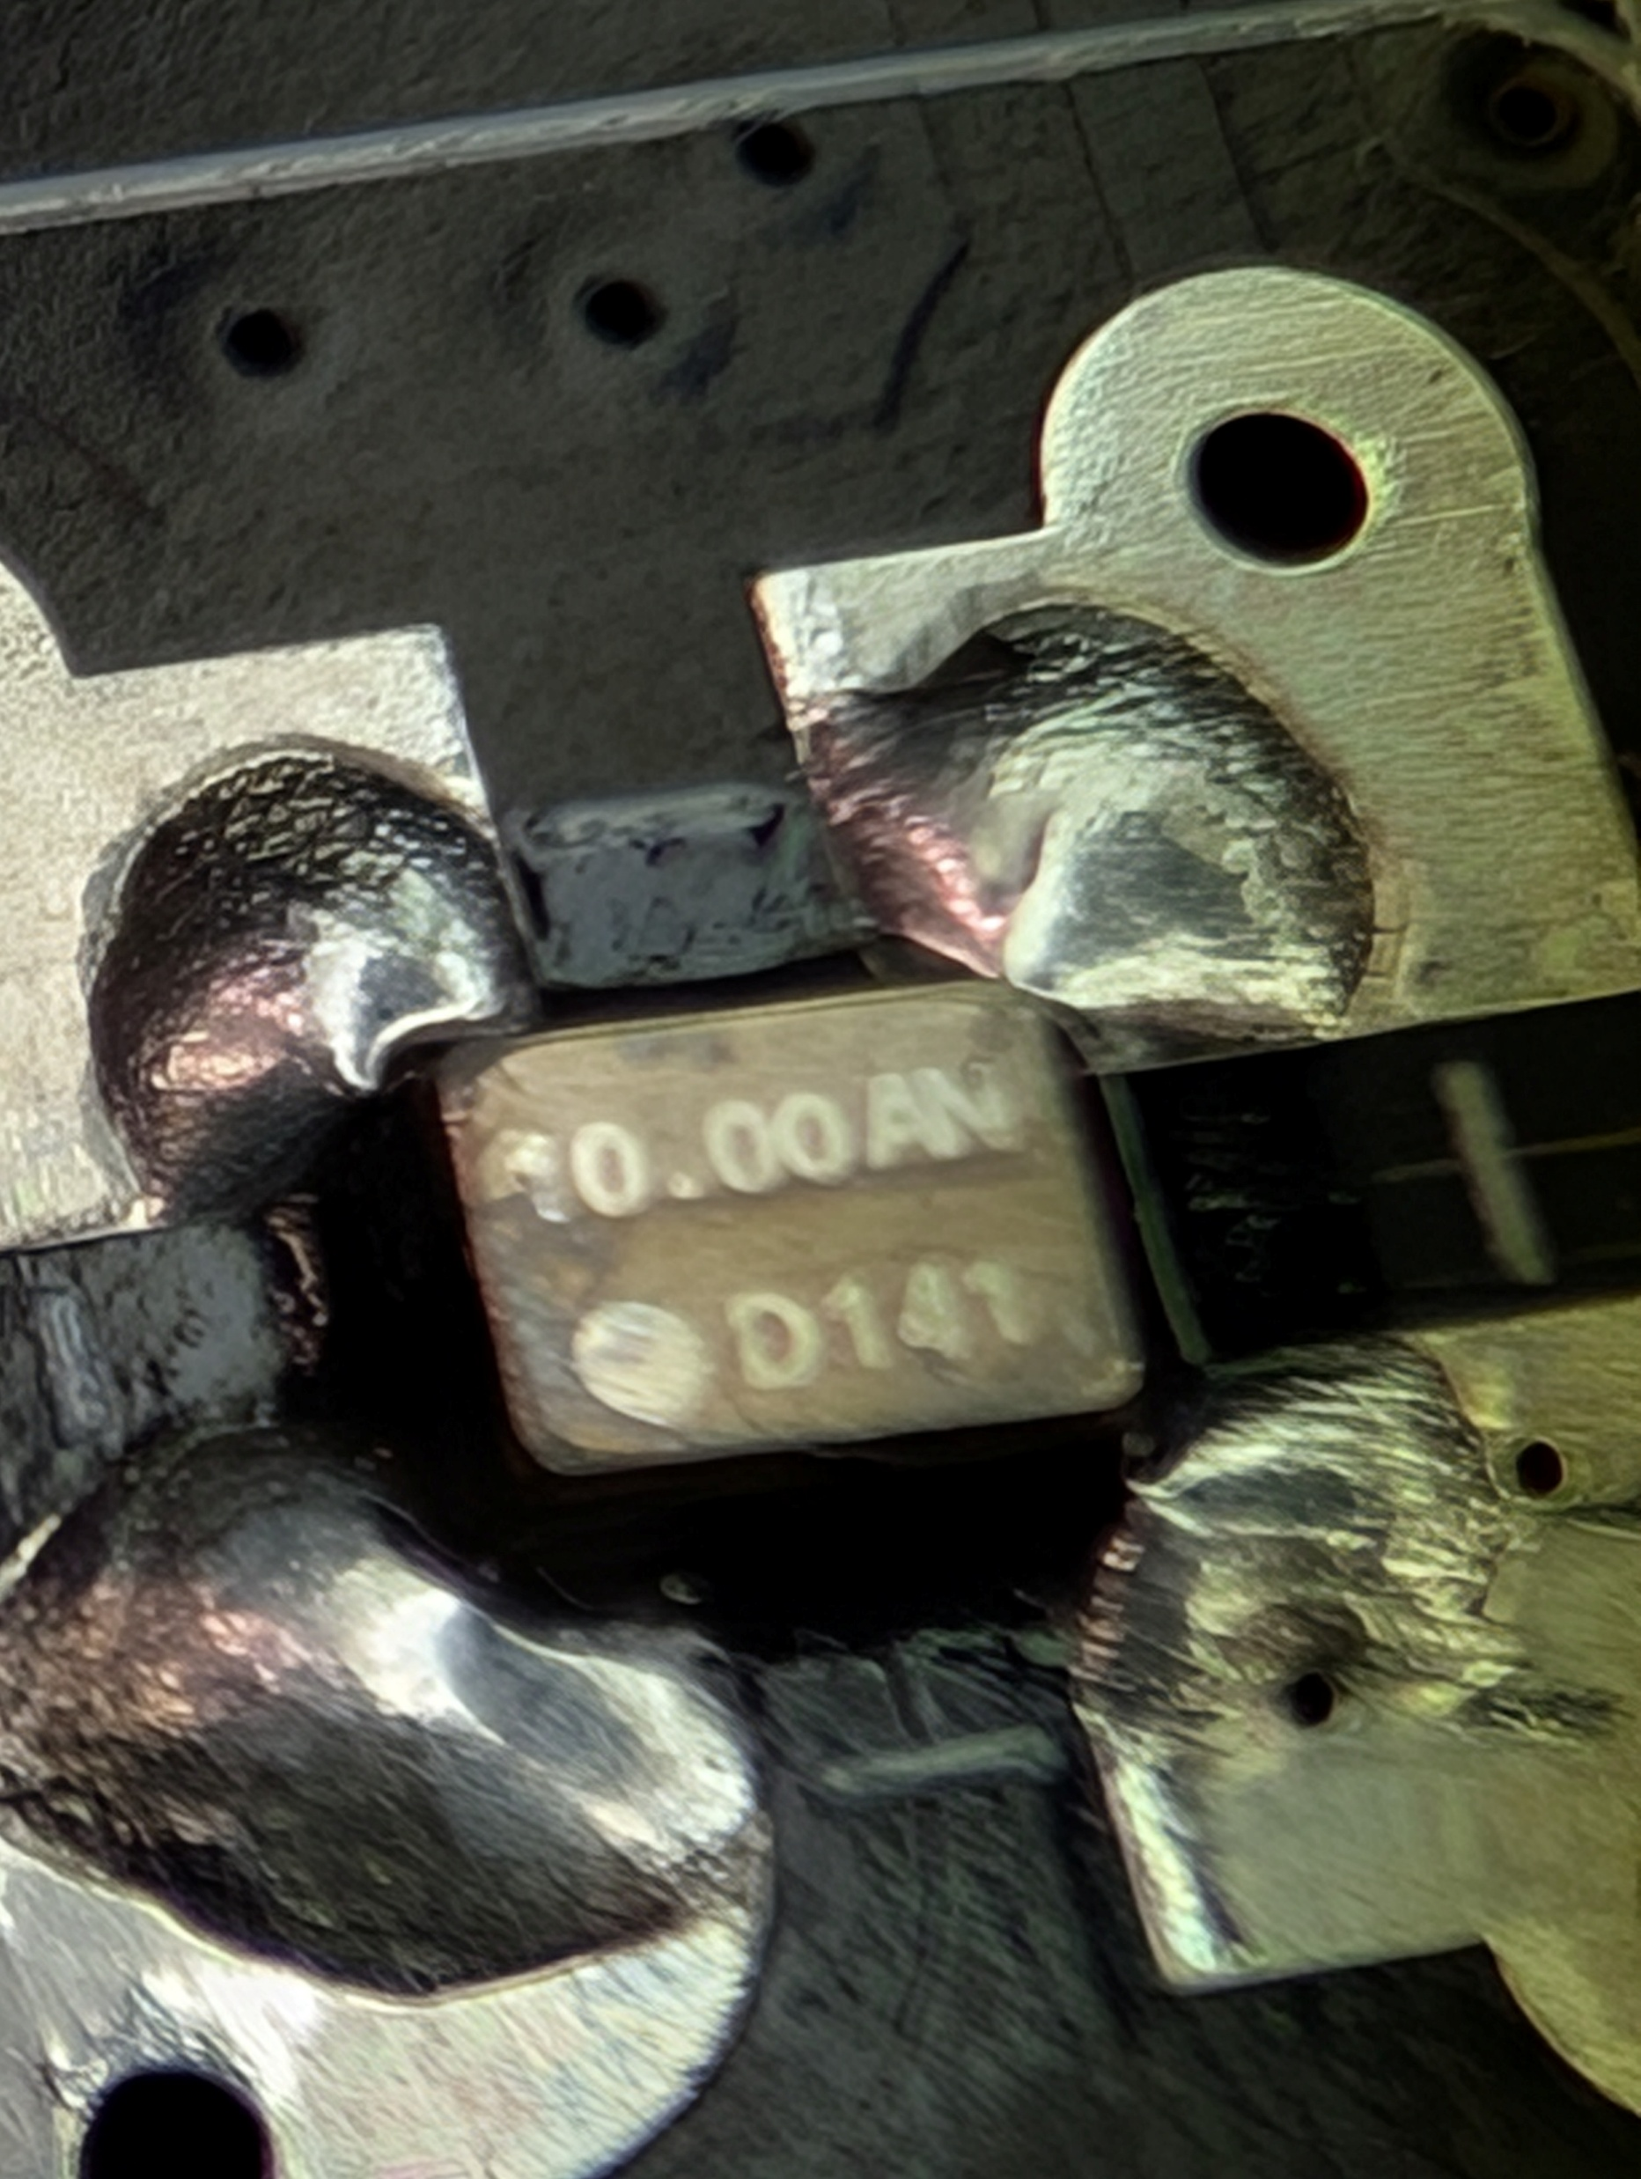
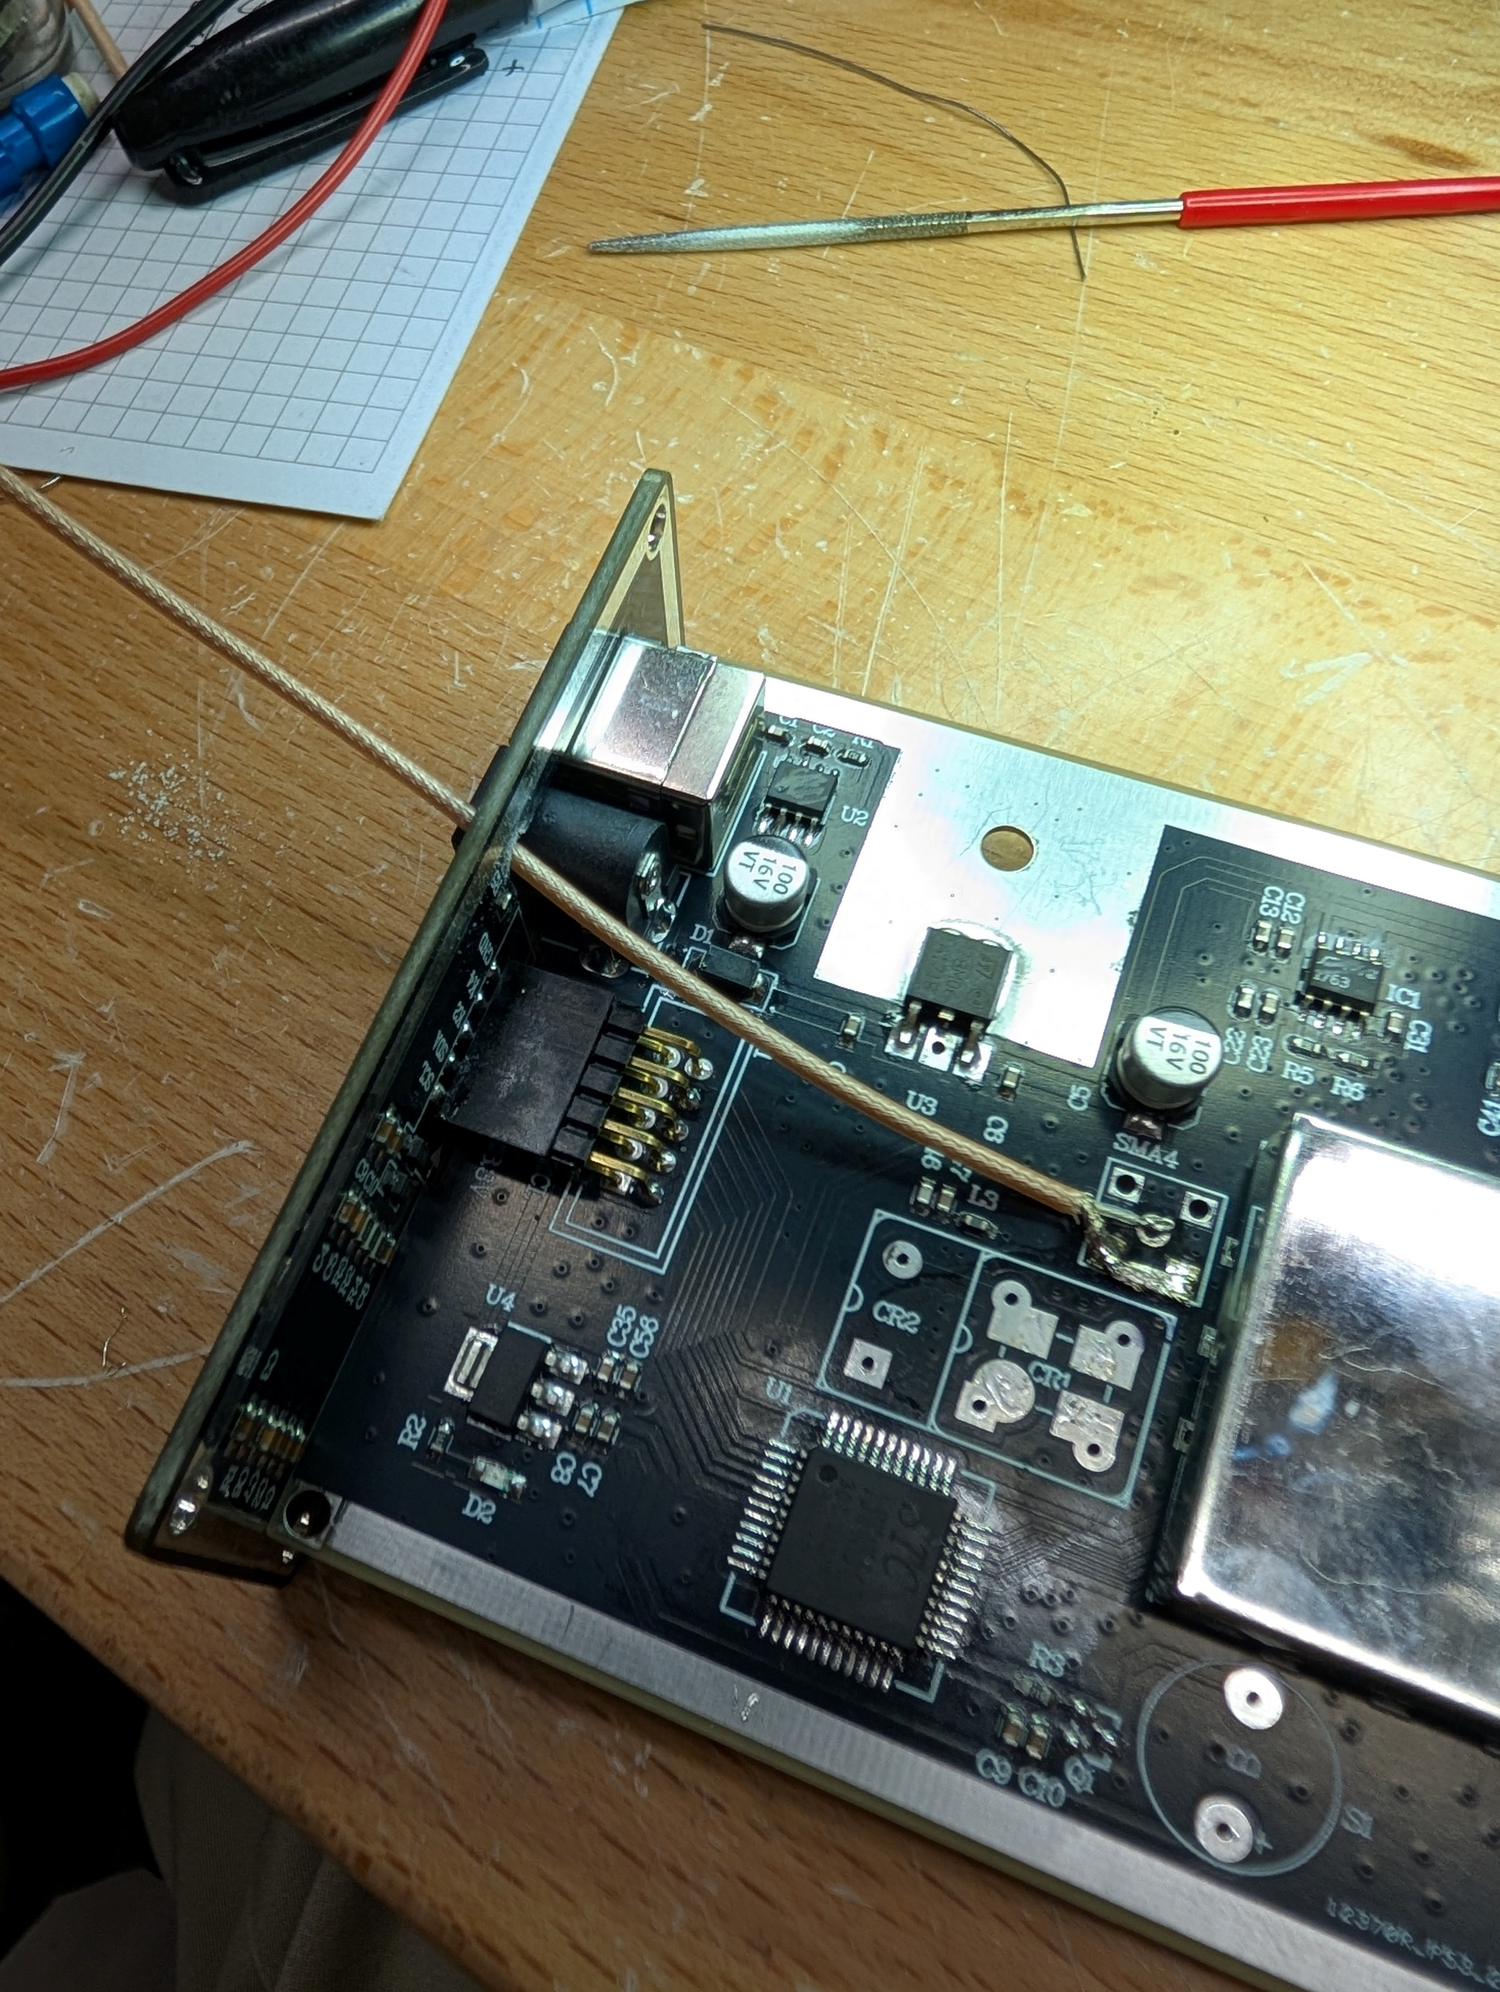
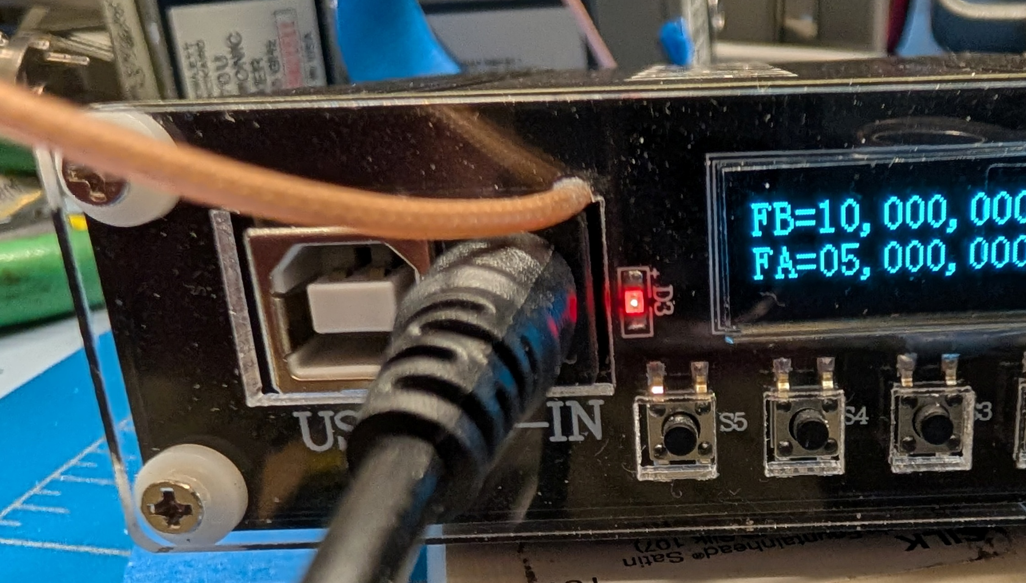
Remove Internal 10MHz Osc and Wire to Internal Socket
File hole above DC to let thin coax out to SMA for 10 MHz
REMOVE
ADD

Slide 11
Talk Outline
Which Synthesizers ?
Synthesizer Innards
Tests performed
Results
Summary

Slide 12
Architecture
All these synthesizers are meant to cover up to either 13.6 or 20 GHz
With one exception (the HP 8341B), they are based on modern PLL VCO IC’s
What is a PLL VCO Synthesizer IC?
What is important about them?
How are they controlled?

Slide 13
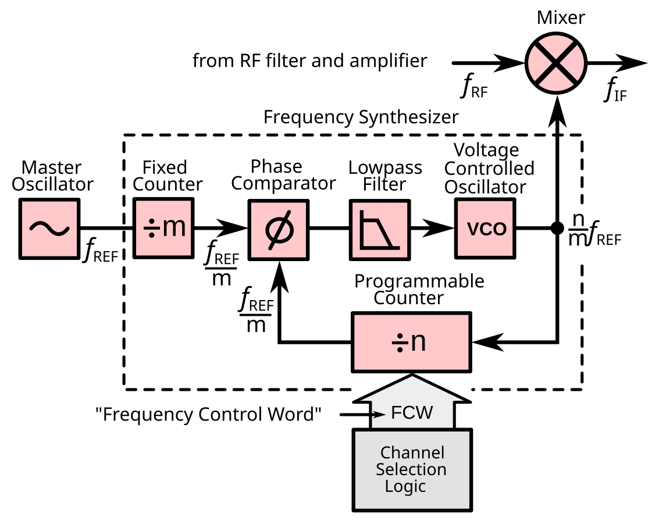
PLL Synthesizer

Slide 14
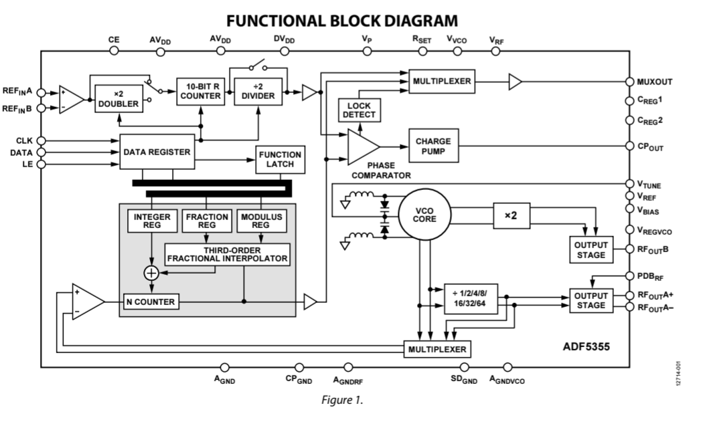
The AD 5355 PLL Synthesizer

Slide 15
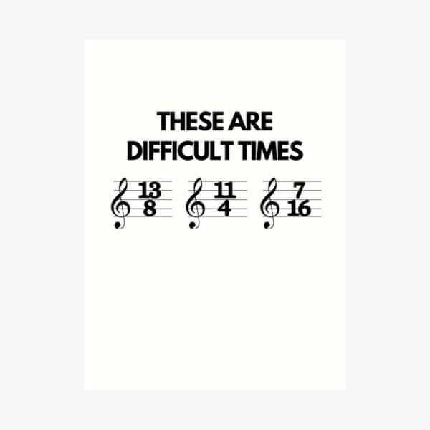

Slide 16
Talk Outline
Which Synthesizers ?
Synthesizer Innards
Tests performed
Results
Summary

Slide 17
Tests to Understand these Synthesizers
Tried to lock them to 10 MHz
Looked at several frequencies
  Wide span
  Close span
  Very Close
  Can see total Phase & Amplitude noise)
Looked at some of the sub harmonics and harmonics
Did not perform Phase Noise Plots
  Only looked down -50 to -100dBc on Spectrum Analyzer
You may look up phase noise online if you want

Slide 18
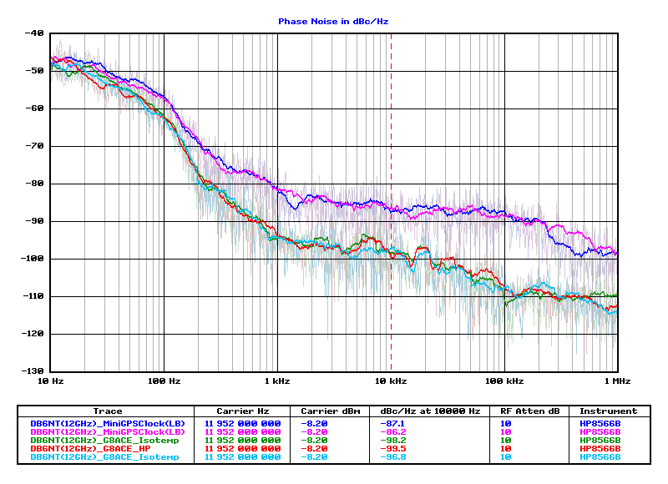
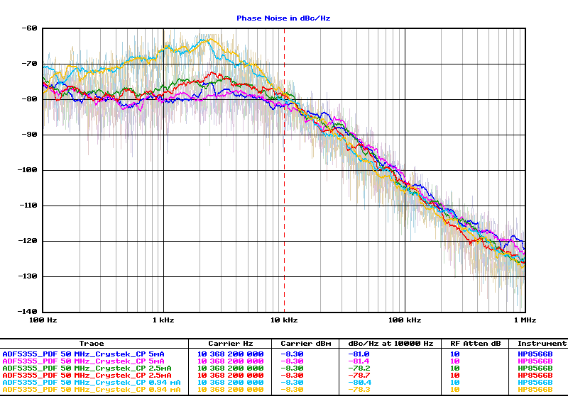
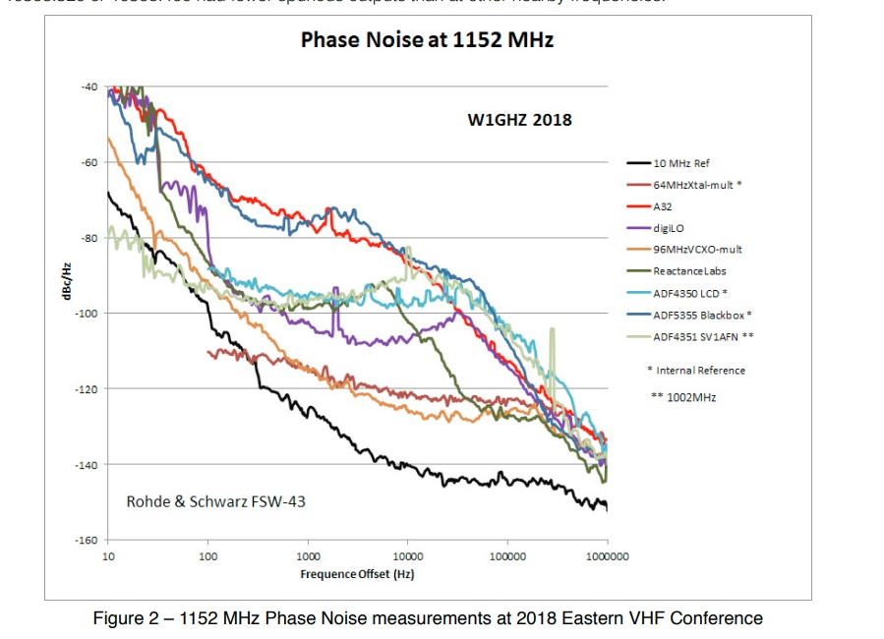
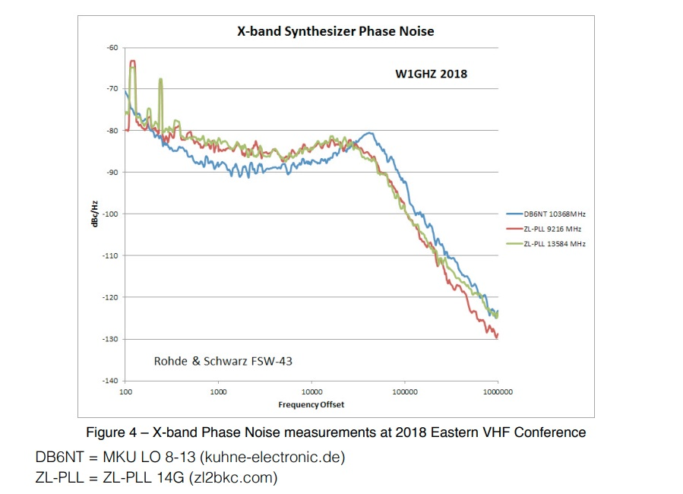
Did NOT Test for Phase Noise
Find them on the web
W1GHZ, Dubus, Others

Slide 19
Compared Across Synth’s for Each Test
 | HP 8431B | MKU 8-13 PLL LO | VALON 5019 | Ebay Small “ CH1” | Ebay Large “CH2”
12960 Wide and Close |  |  | *
8 GHz Wide and Close
1152 Wide and Close
Sub Harmonics
Harmonics

Slide 20
Talk Outline
Which Synthesizers ?
Synthesizer Innards
Tests performed
Results
Summary

Slide 21
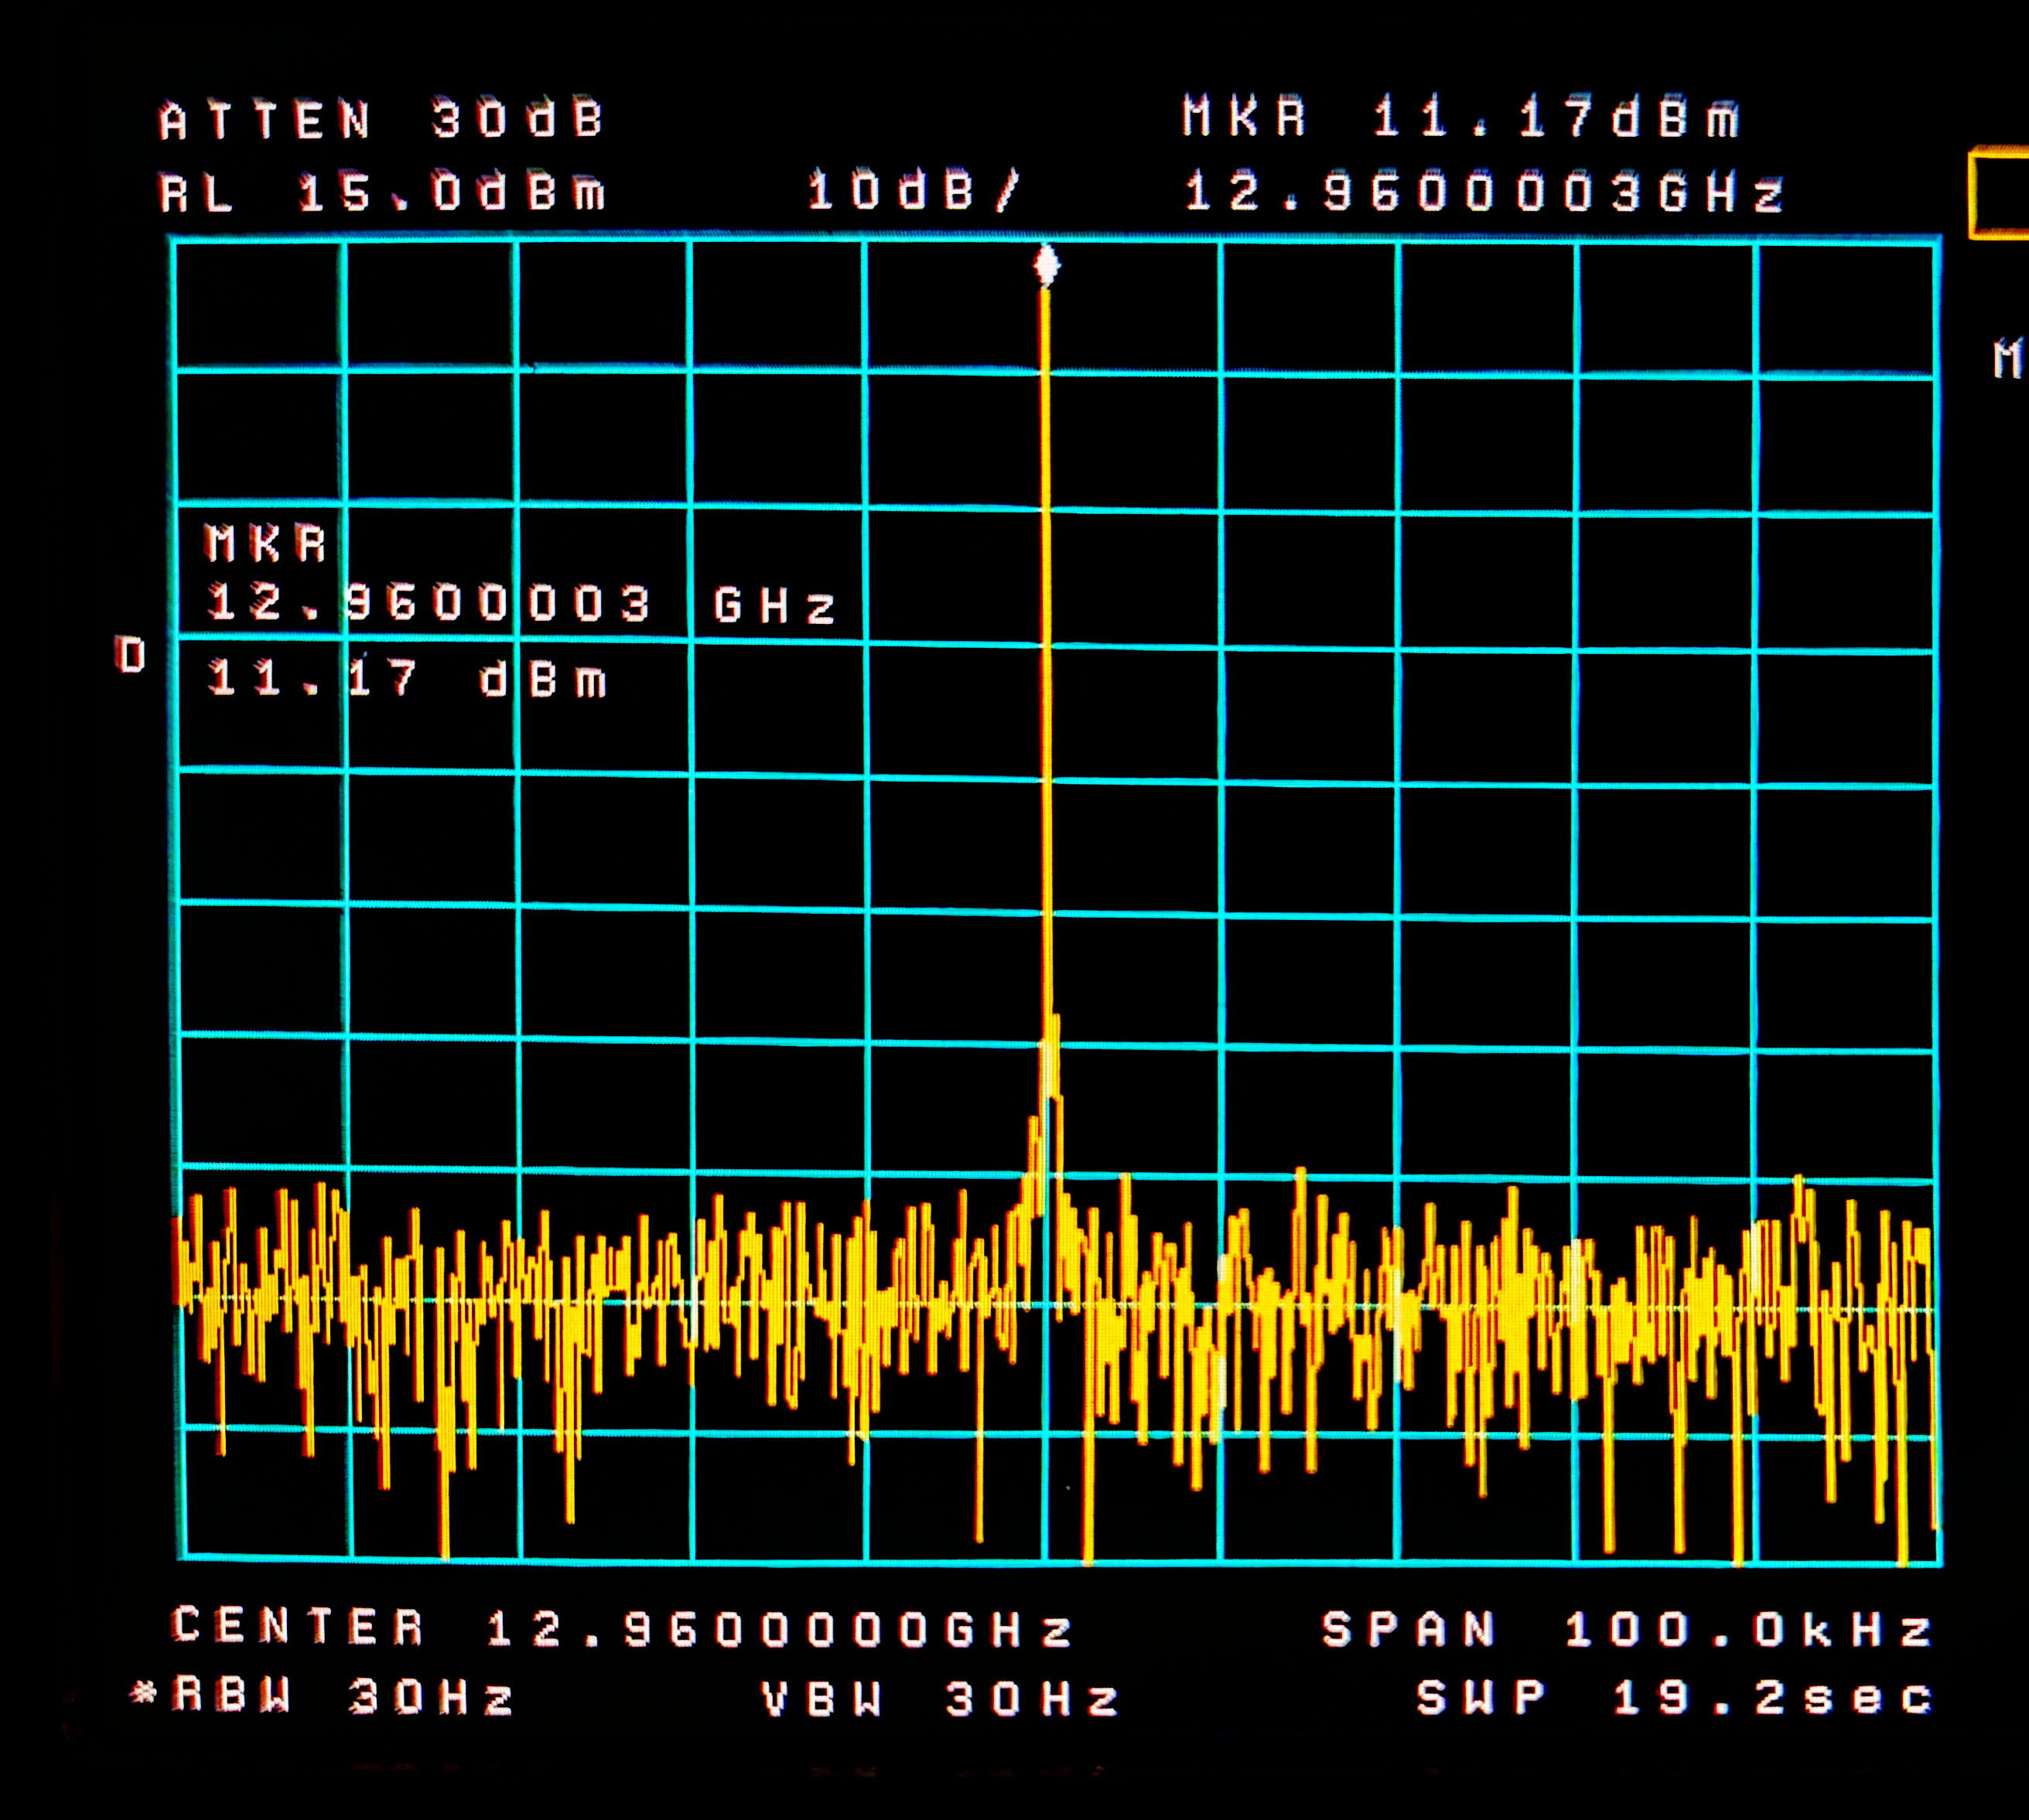
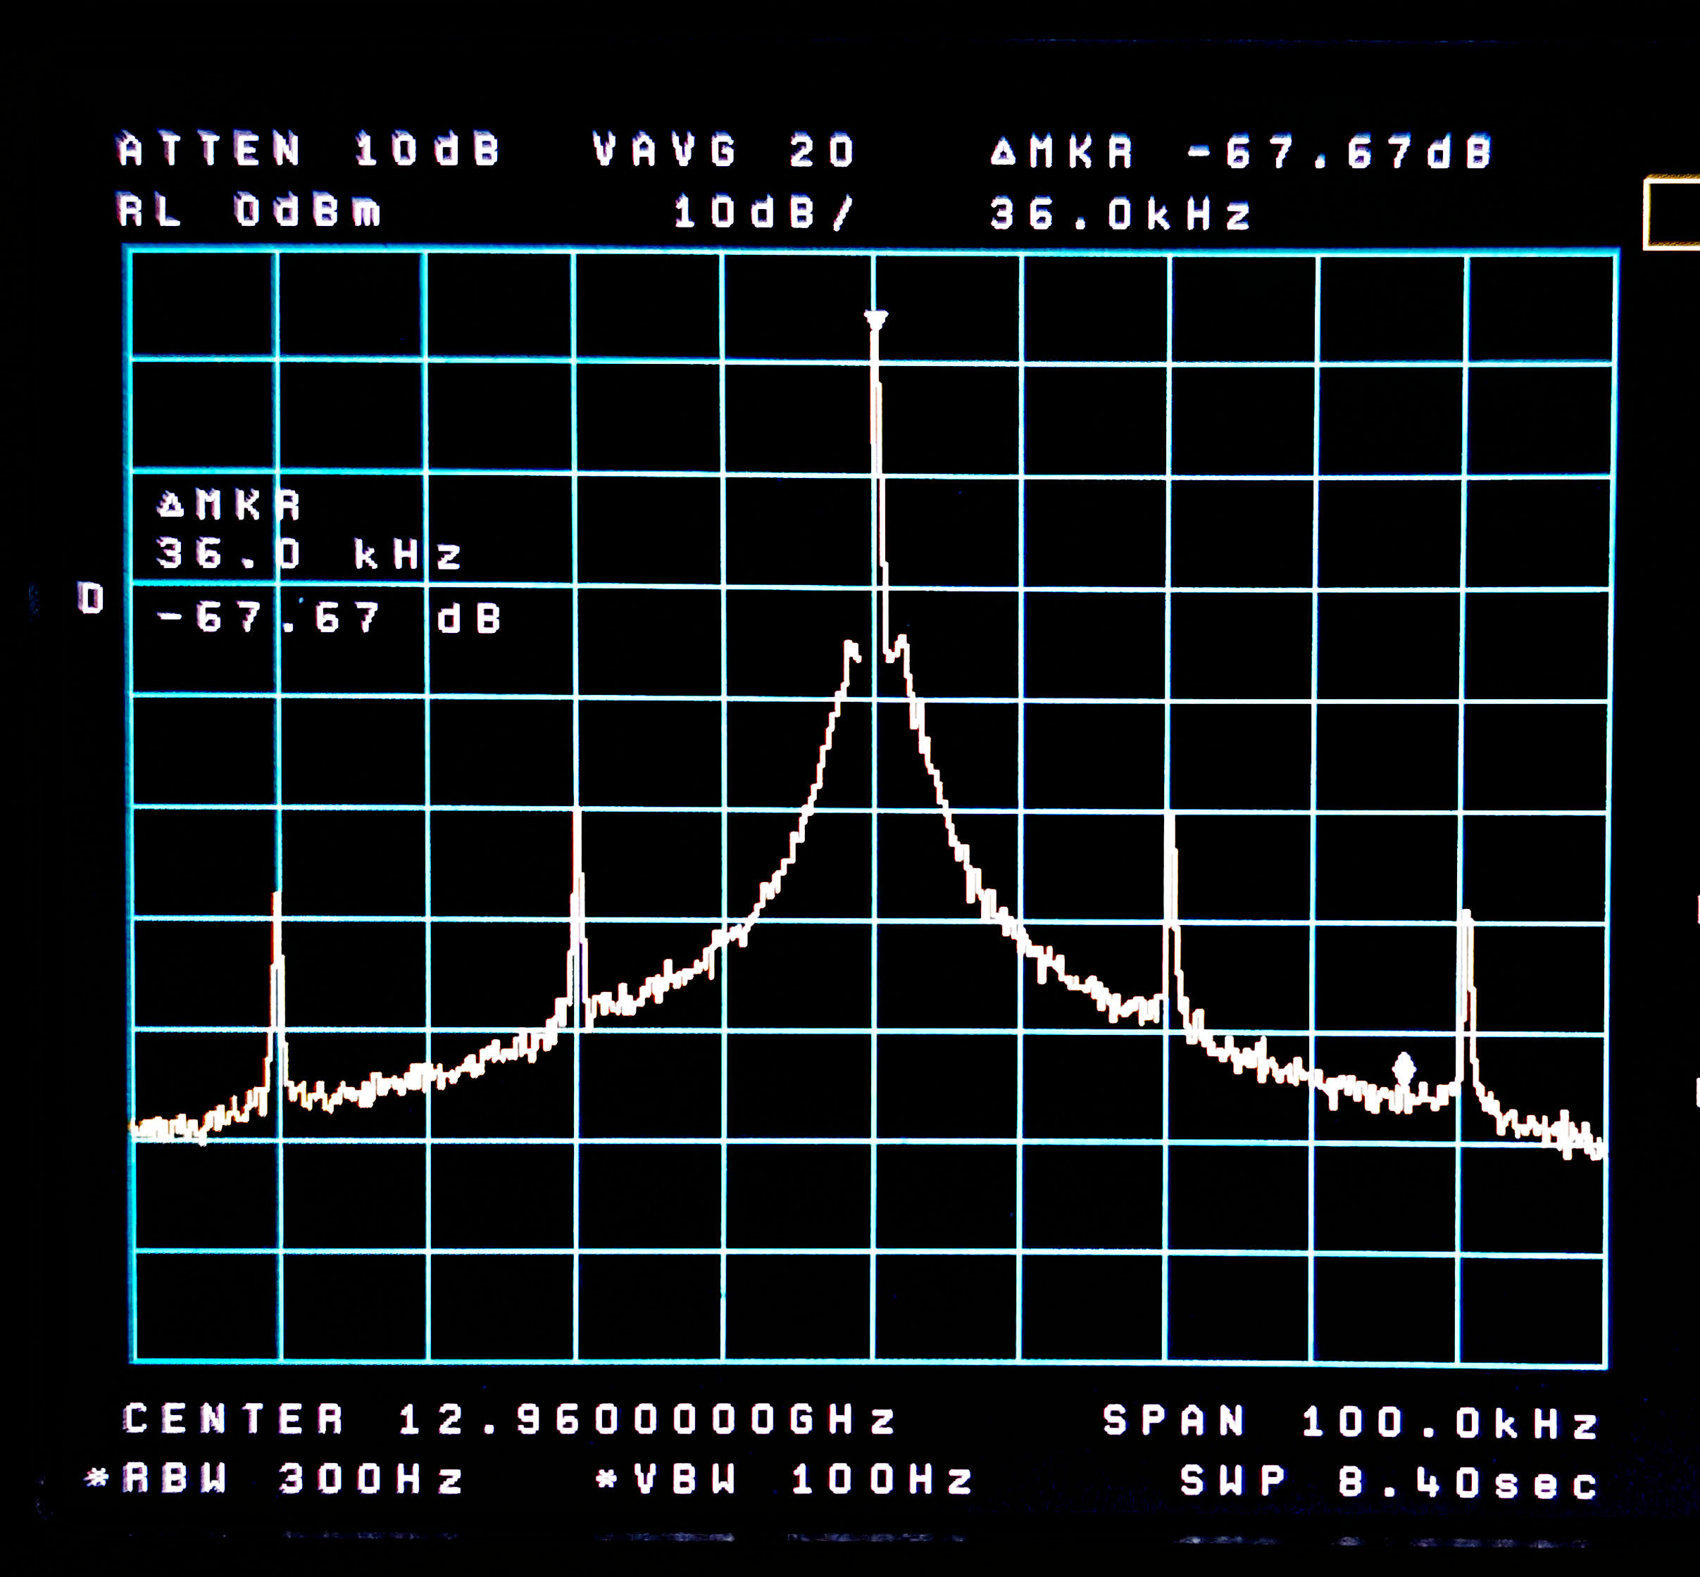
12,960 Wide
MKU
CH1

Slide 22
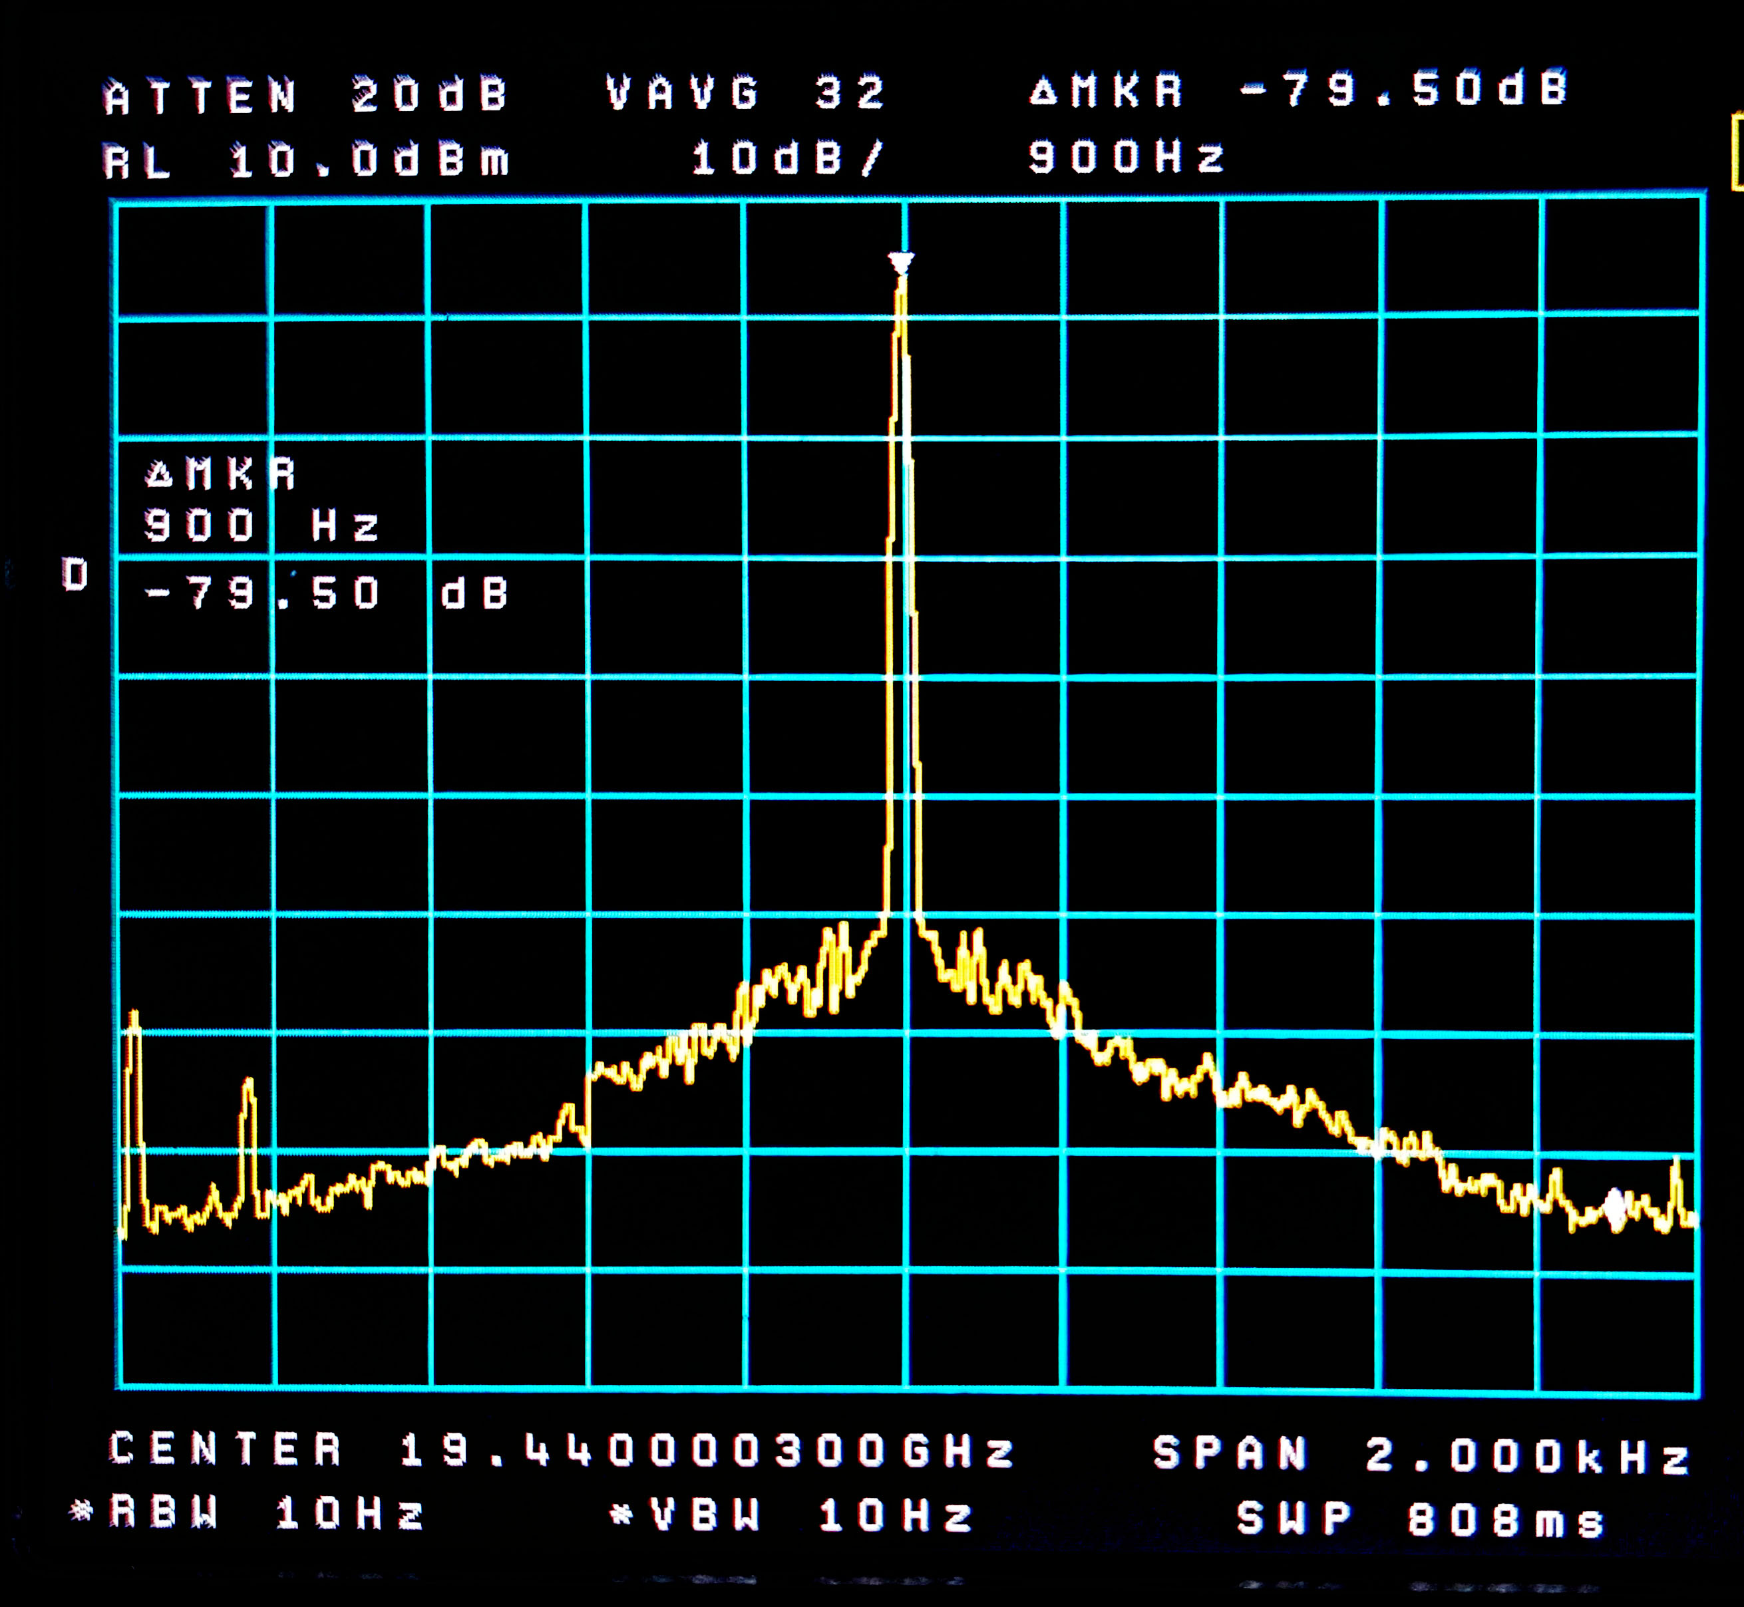
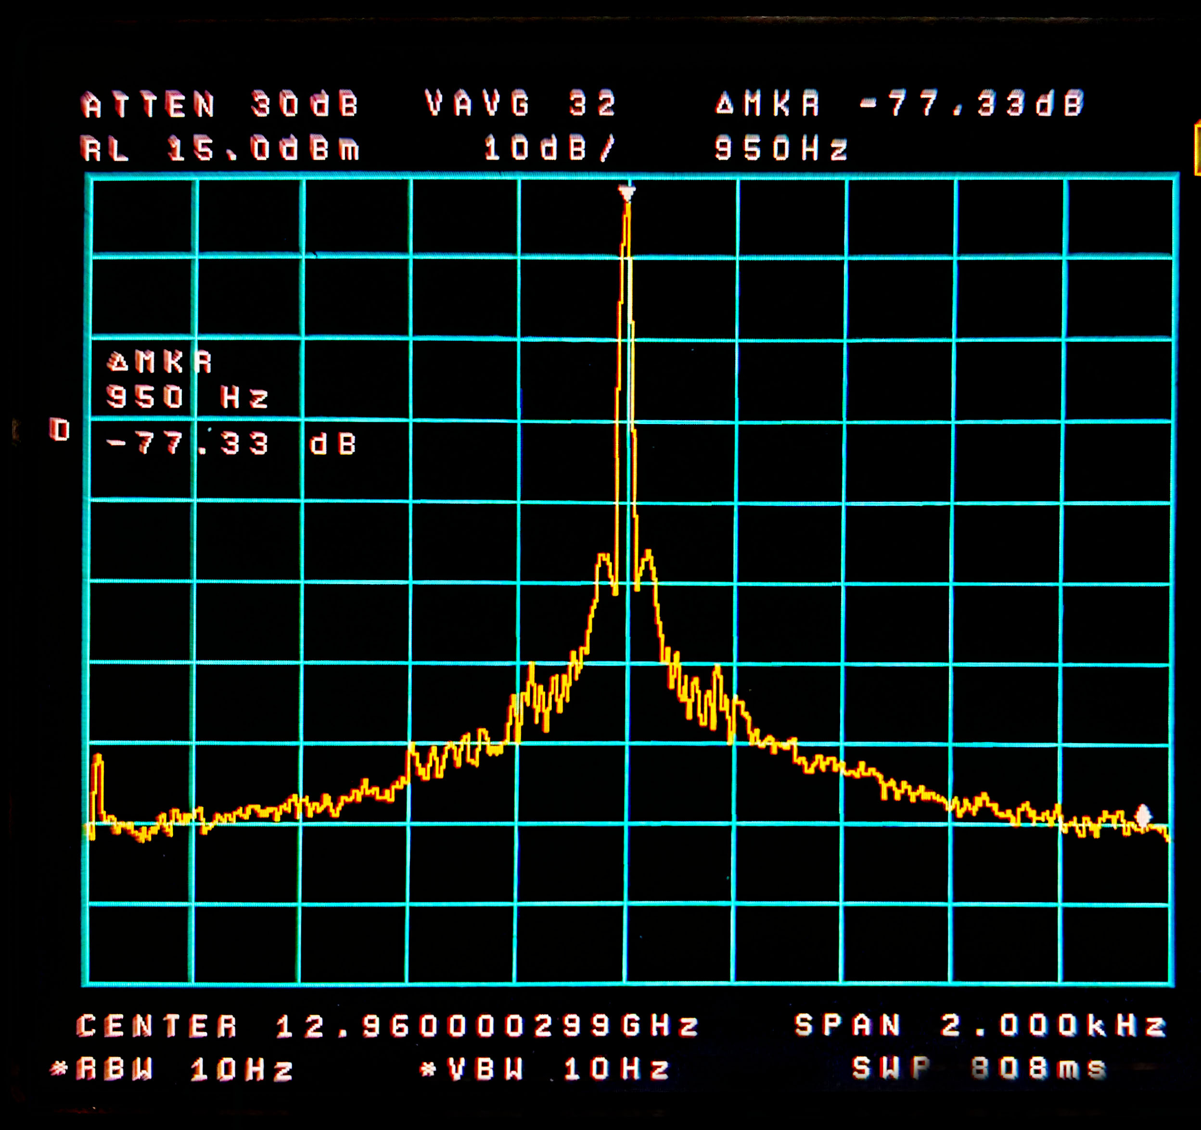
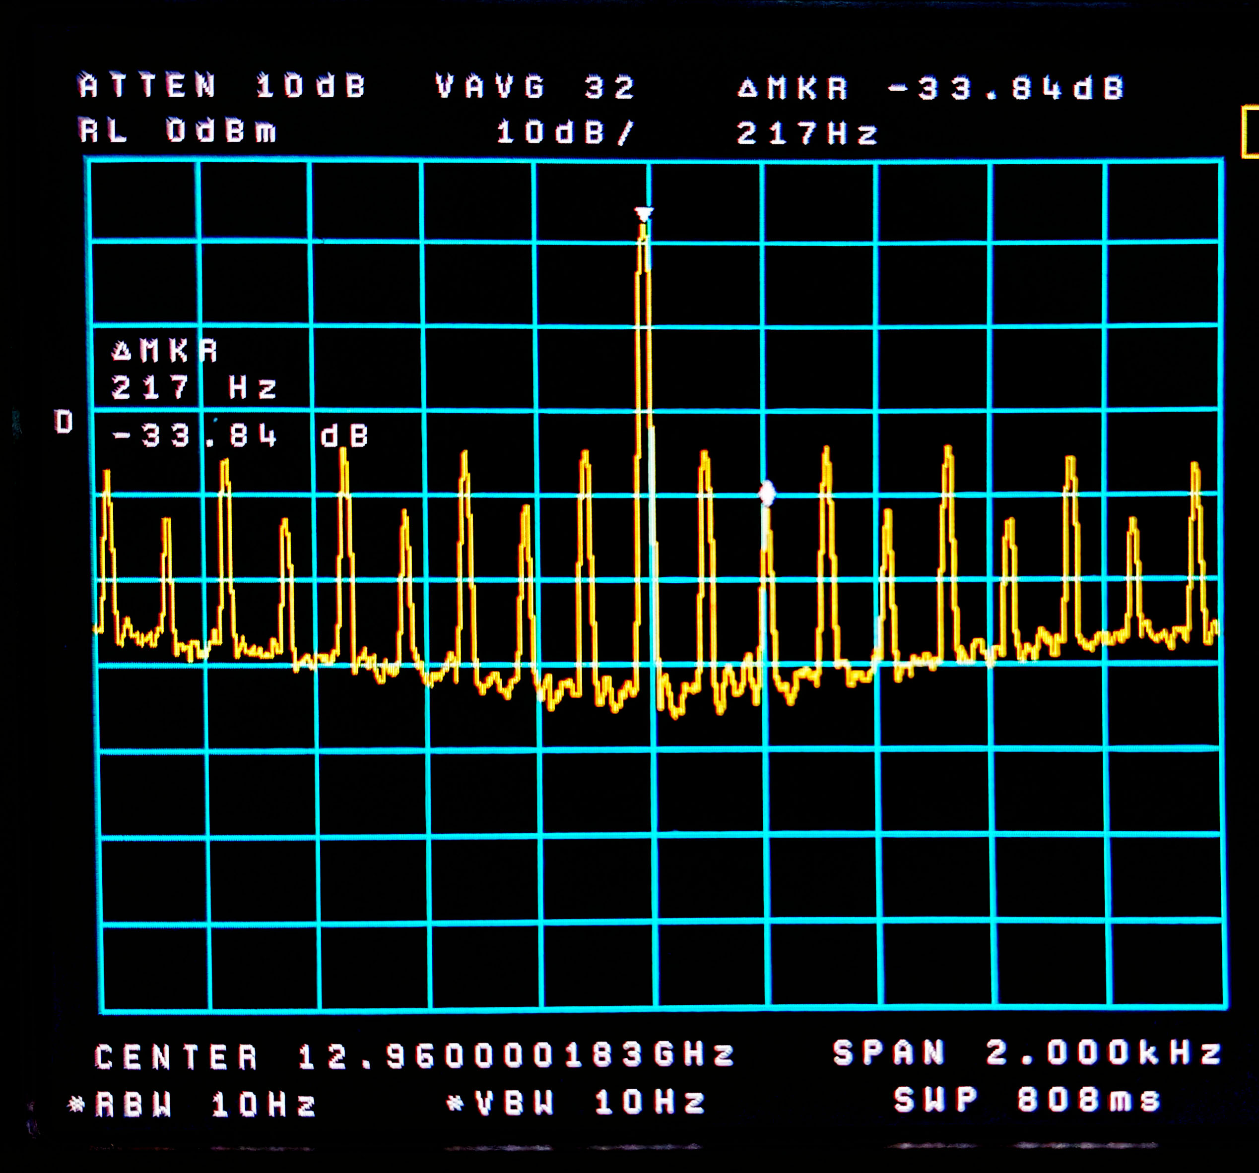
12,960 (and 19.4*) Closeup
Valon 19.4
MKU 12.9
CH1 12.9

Slide 23
12,960 Closeup
CH1

Slide 24
12,960 Closeup
MKU

Slide 25
19,440 Closeup
Valon 19.9

Slide 26
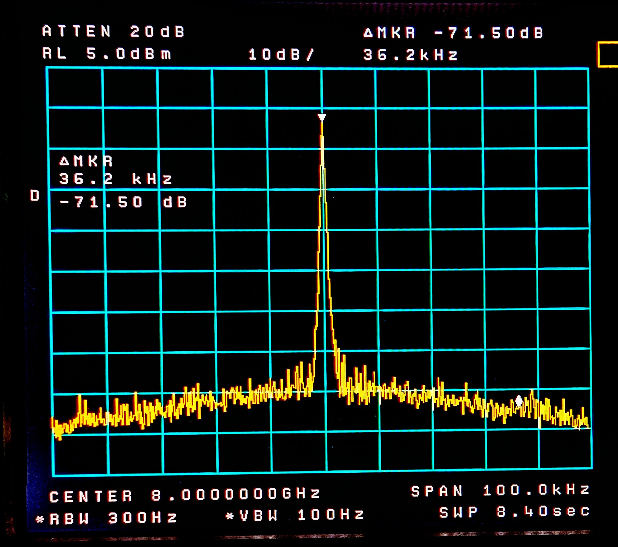
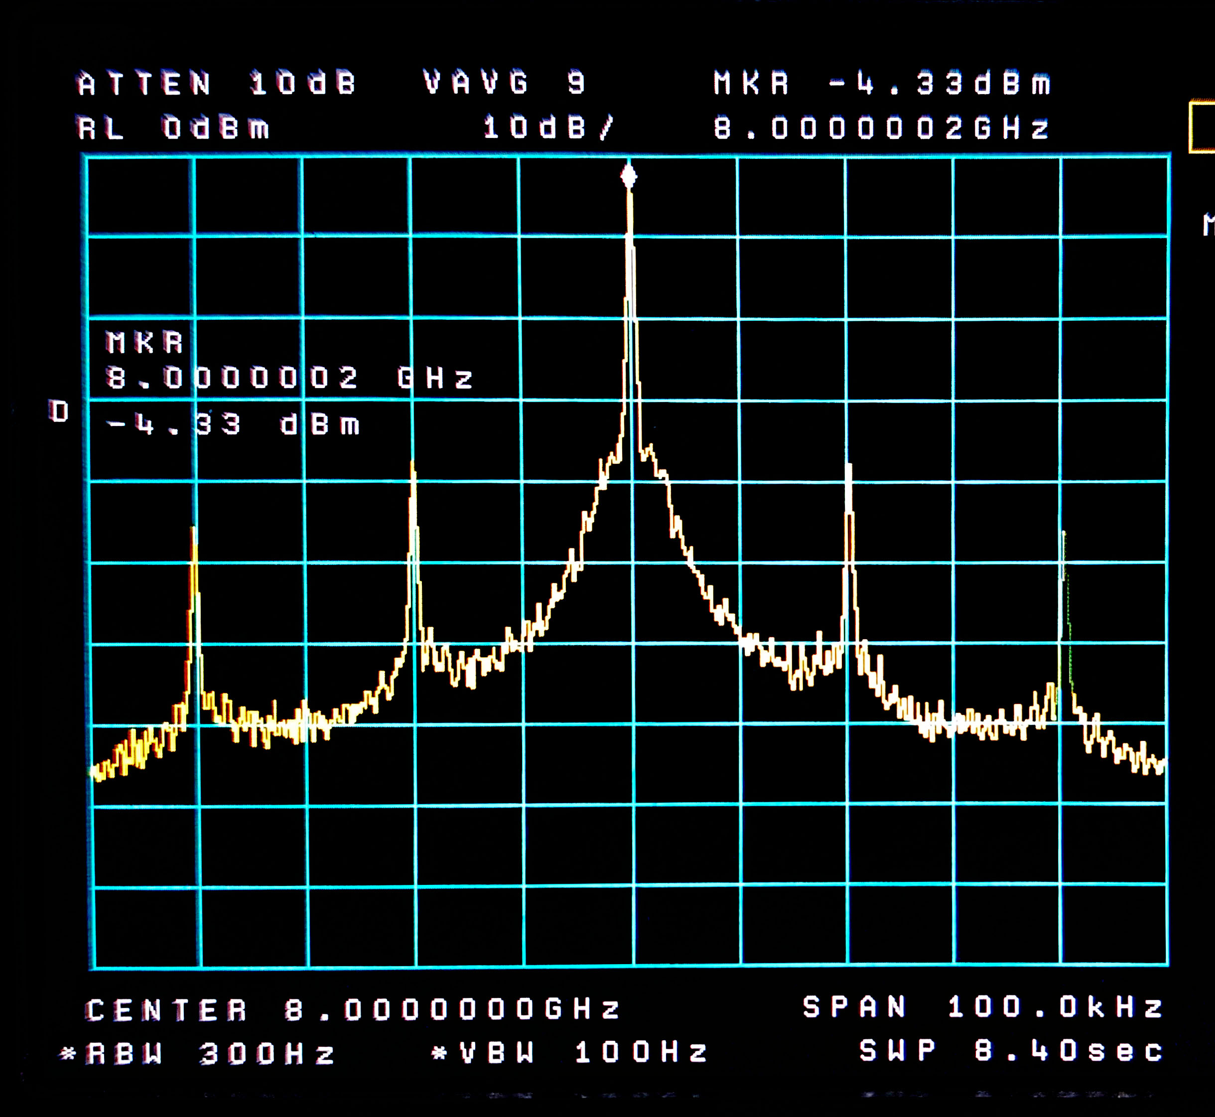
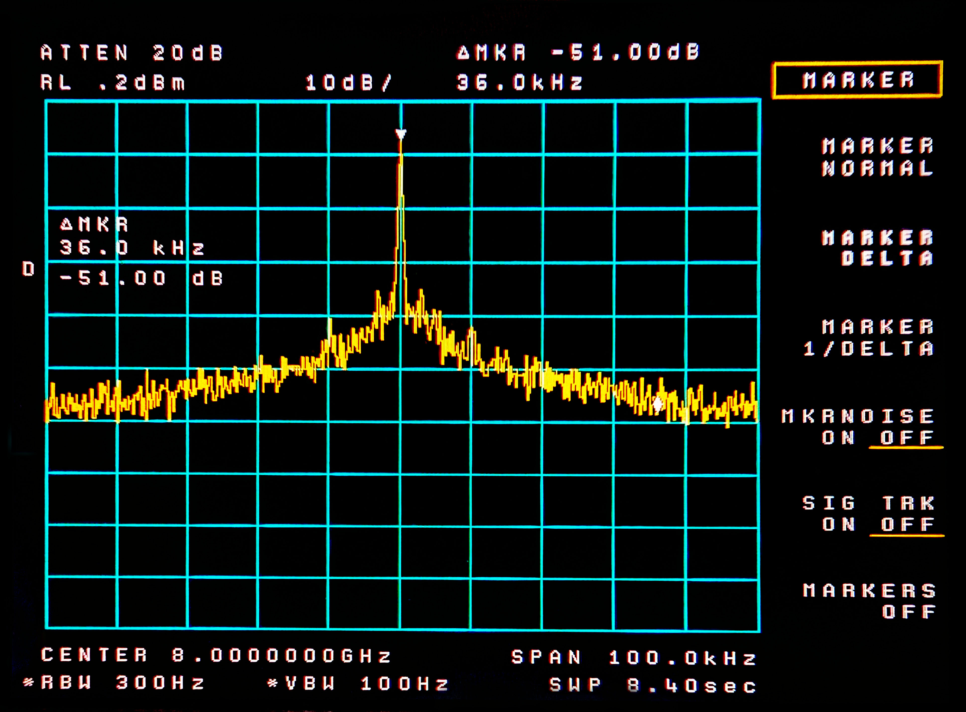
8 GHz Wide
HP
CH1
CH2

Slide 27
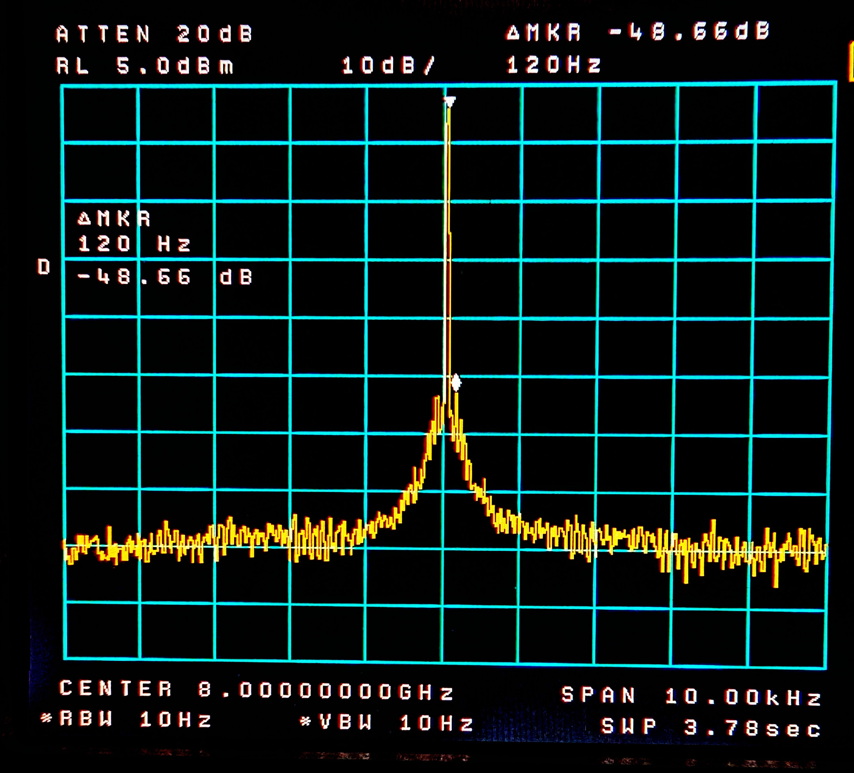
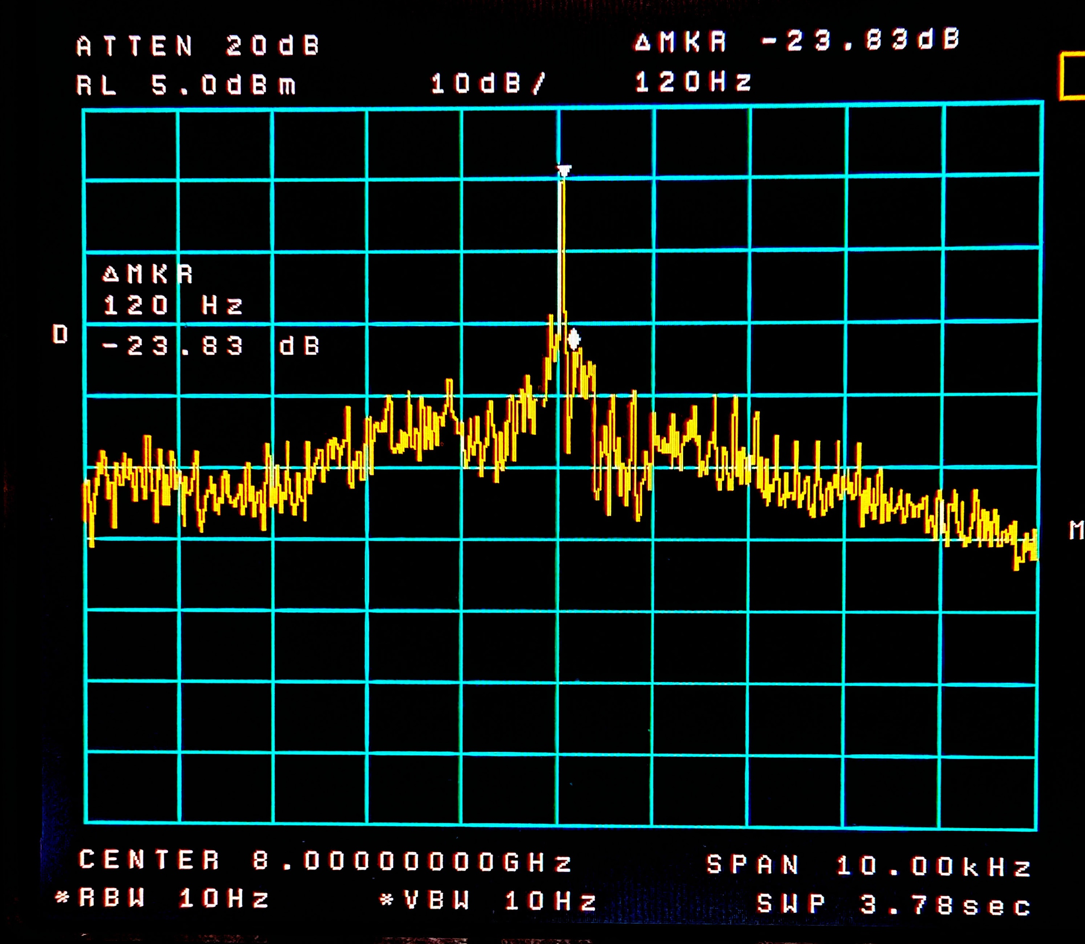
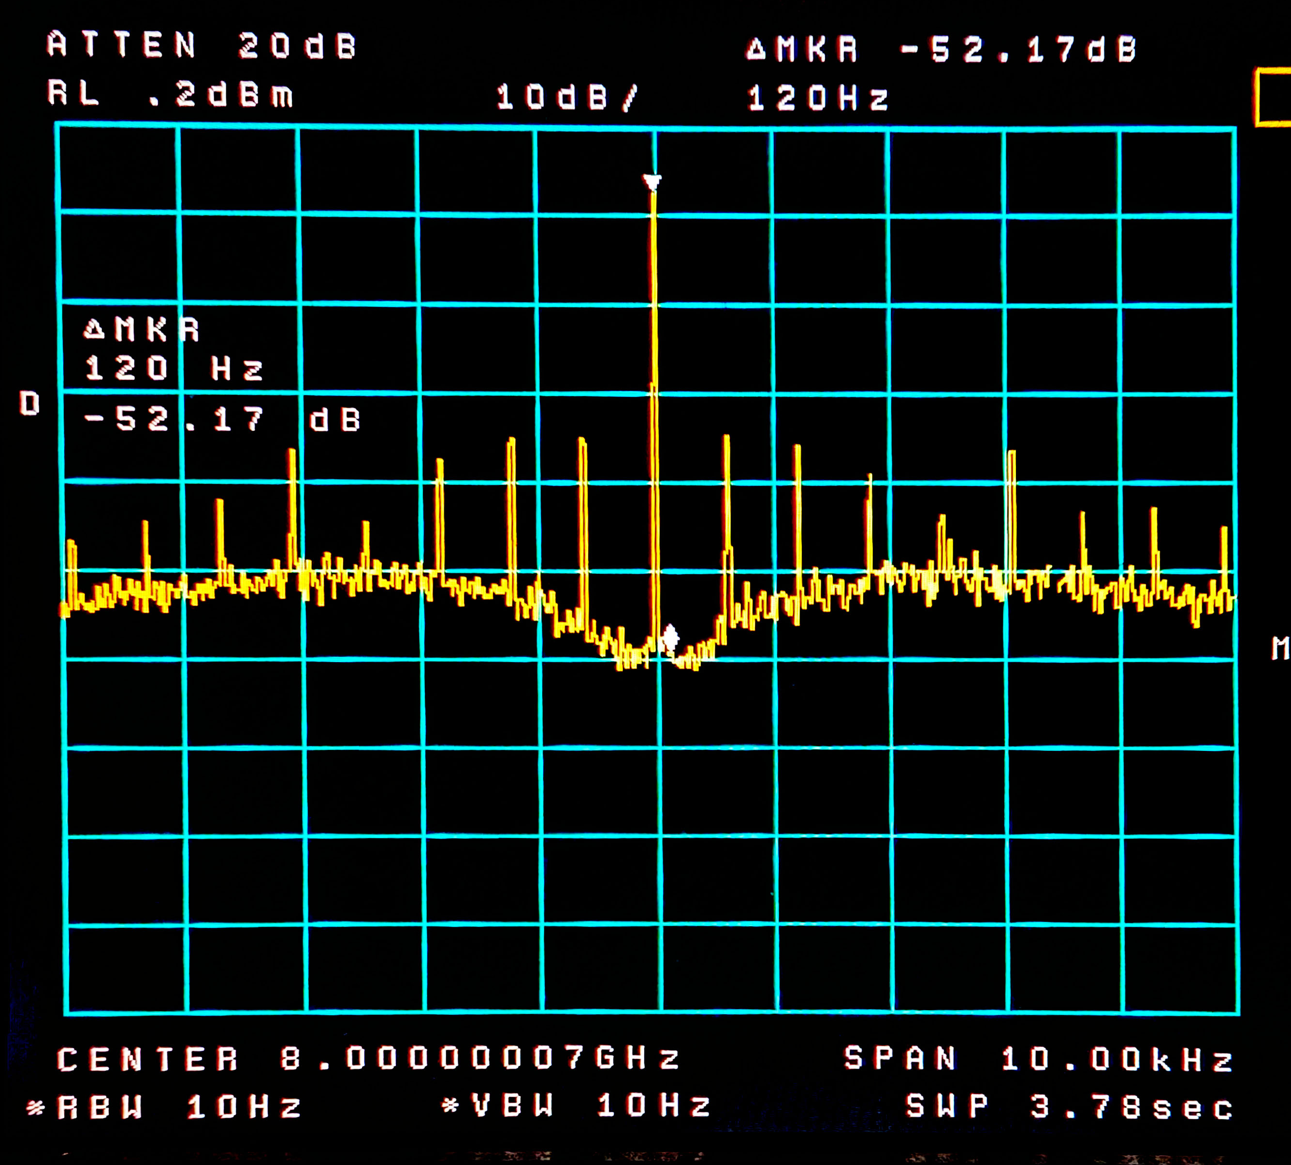
8 GHz Closeup
HP
CH1
CH2

Slide 28
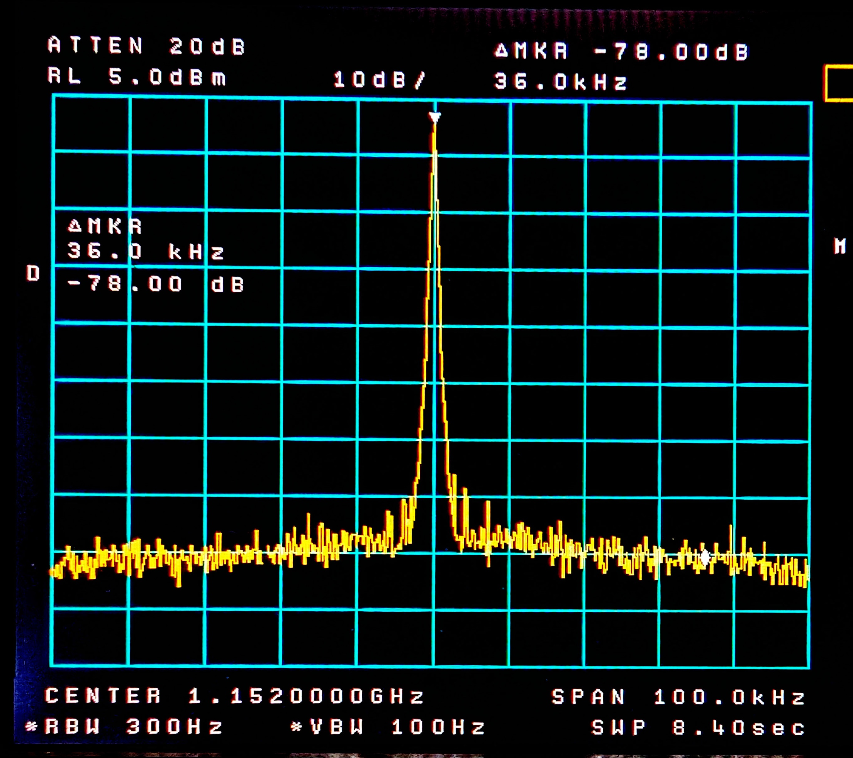
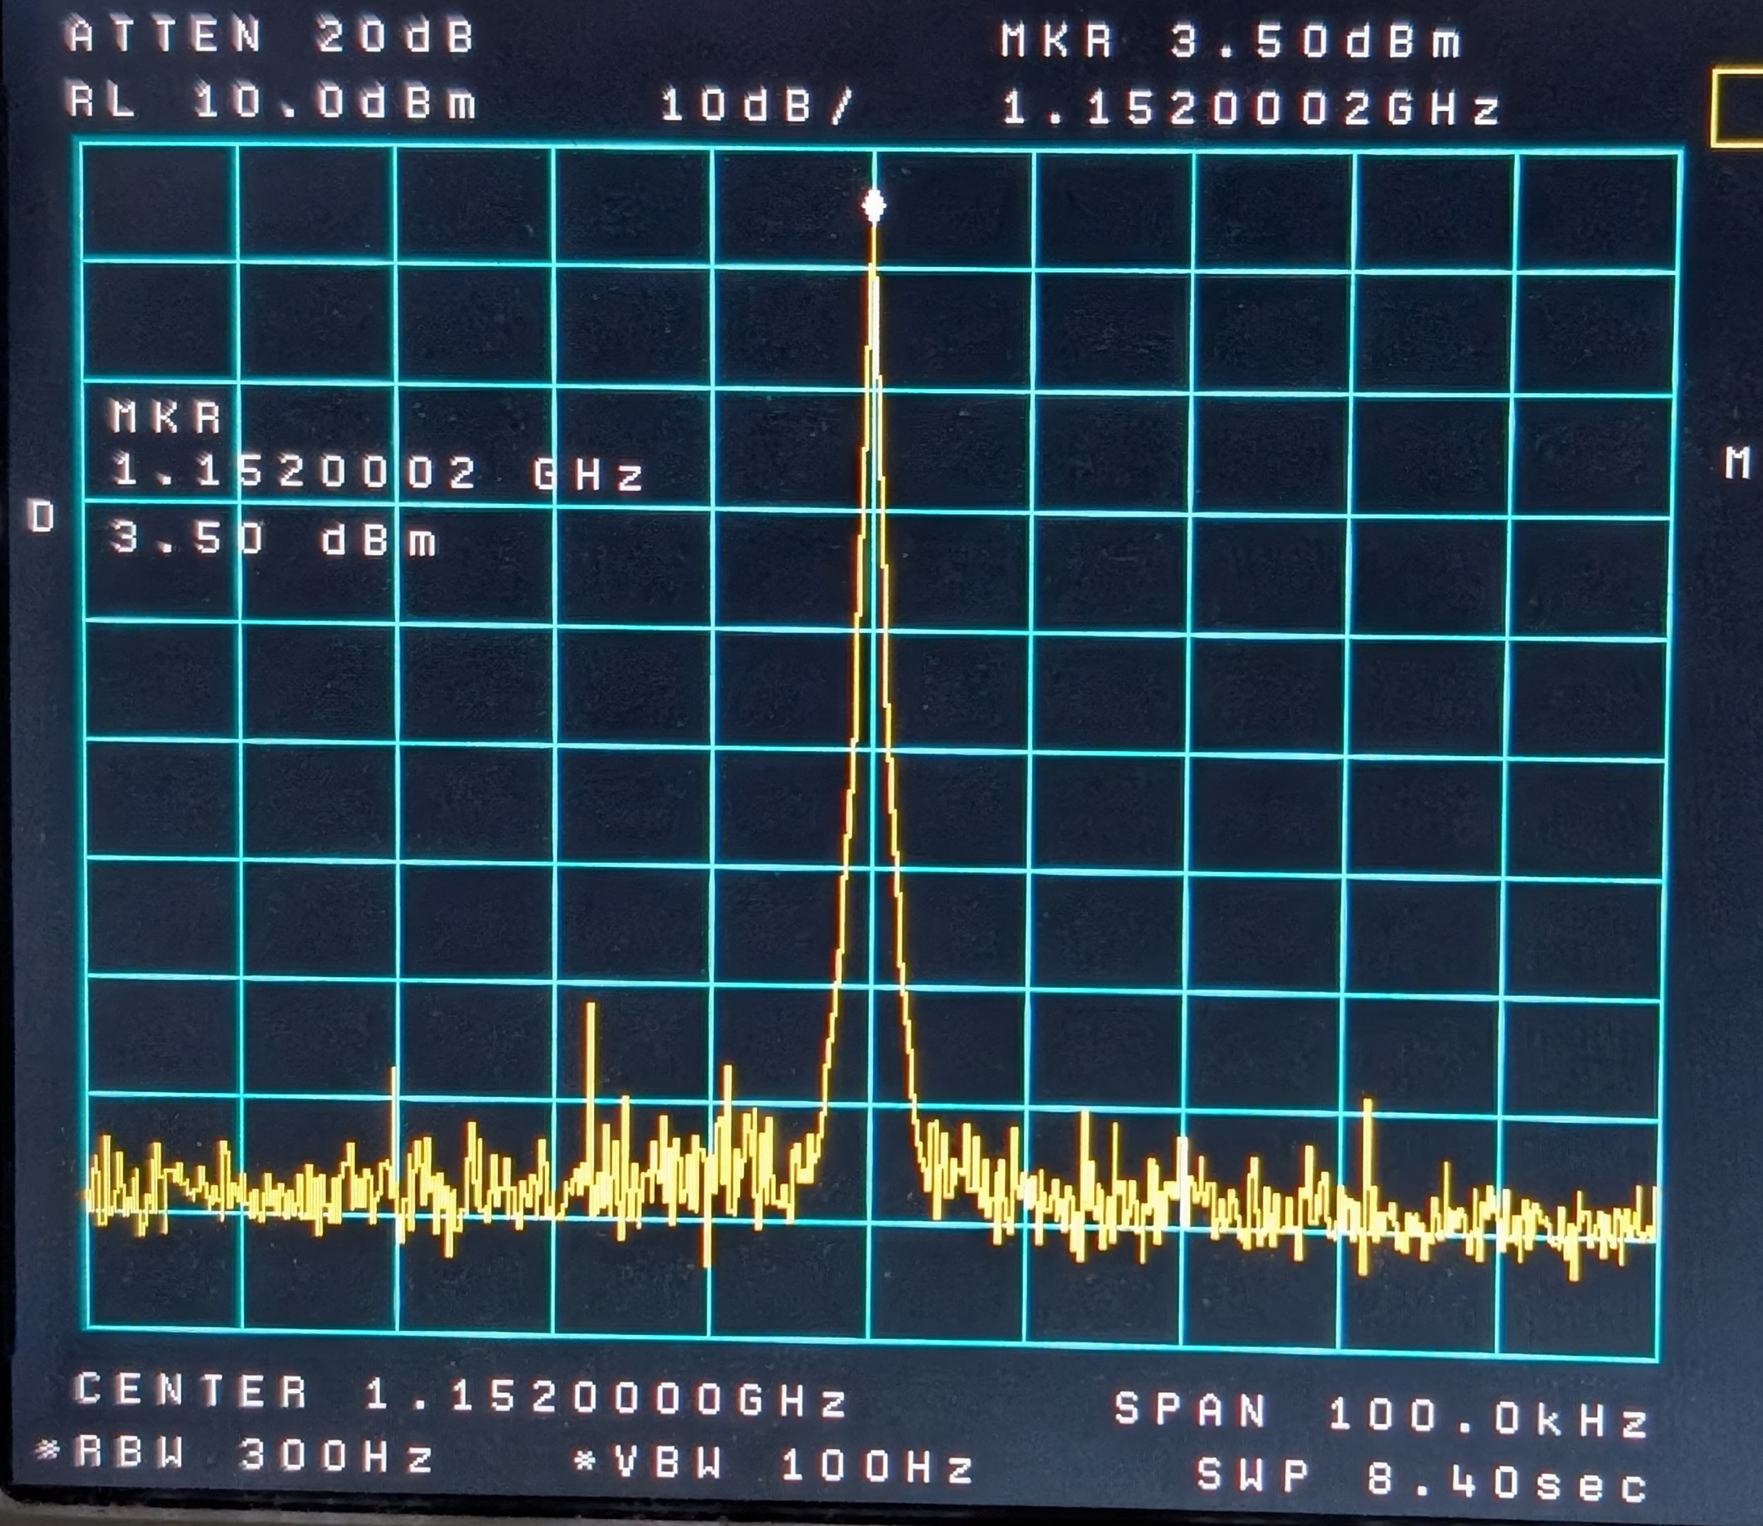
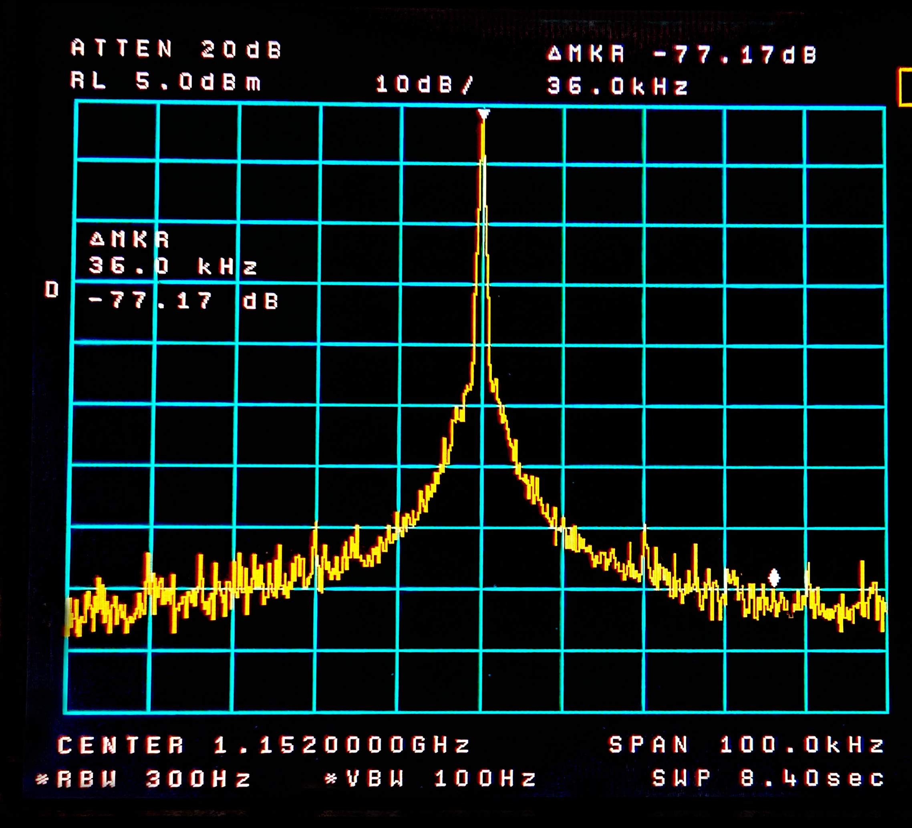
1152 Wide
HP
MKU
CH1
CH2

Slide 29
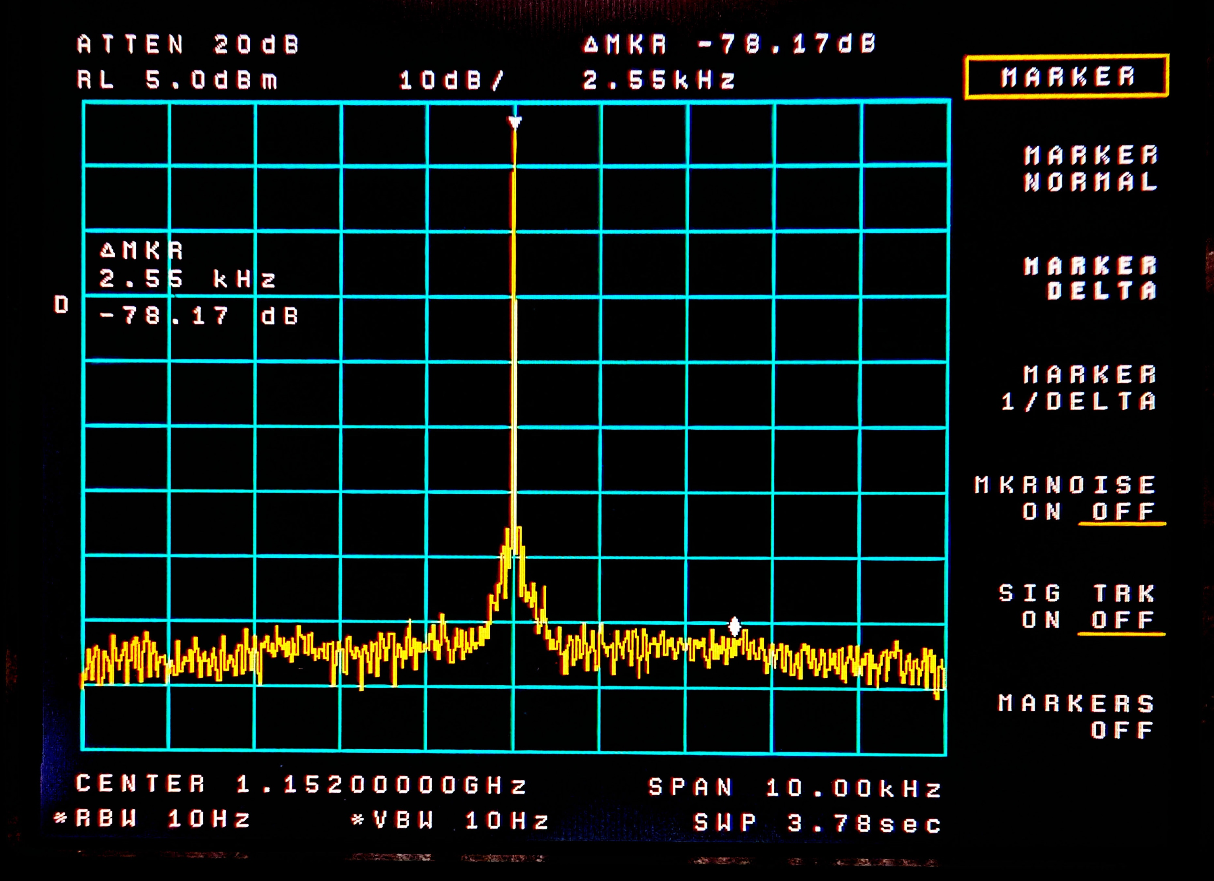
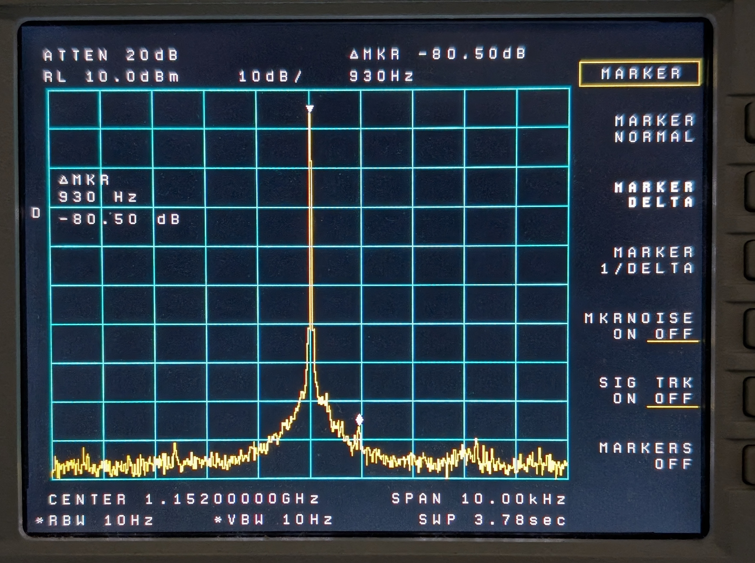
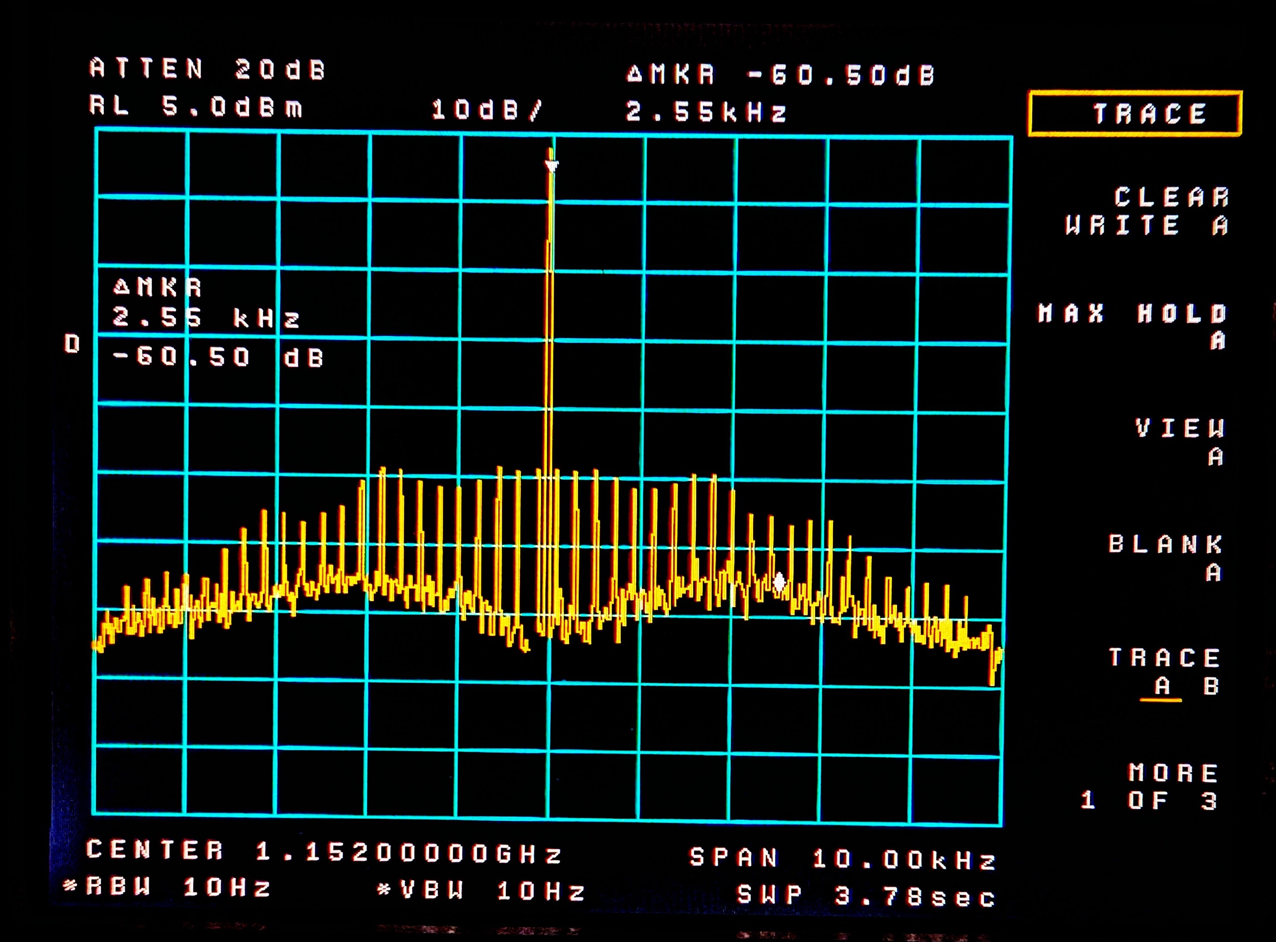
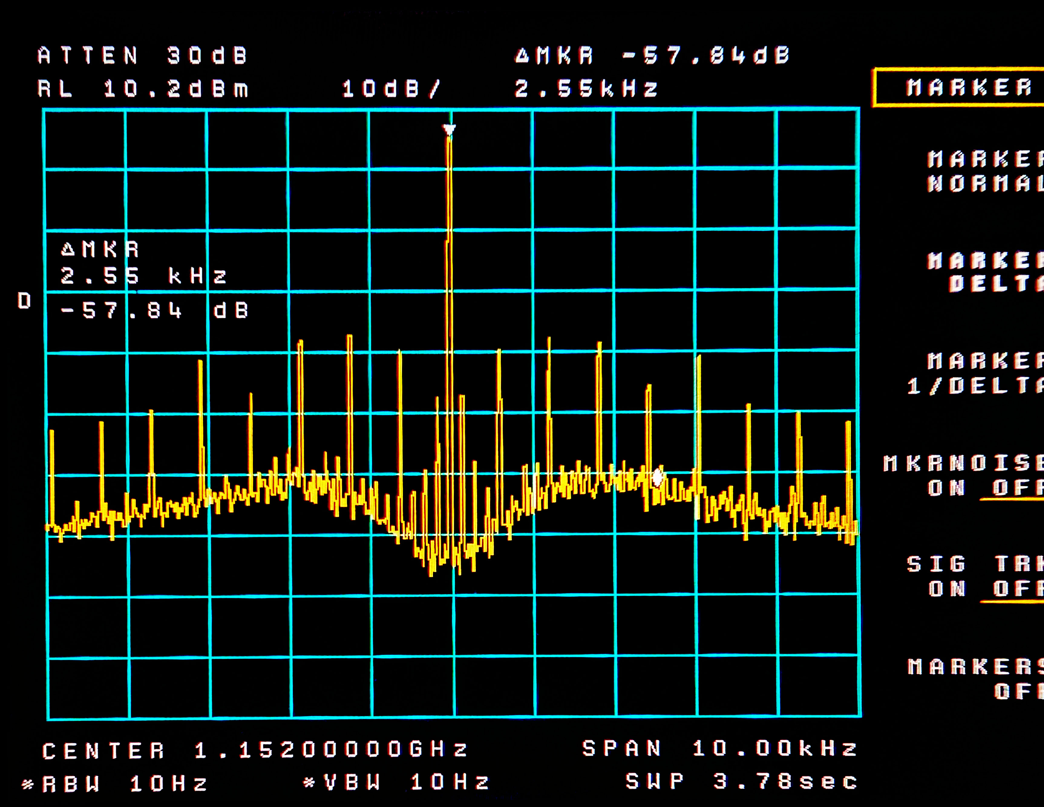
1152 Close
HP
MKU
CH1
CH2

Slide 30
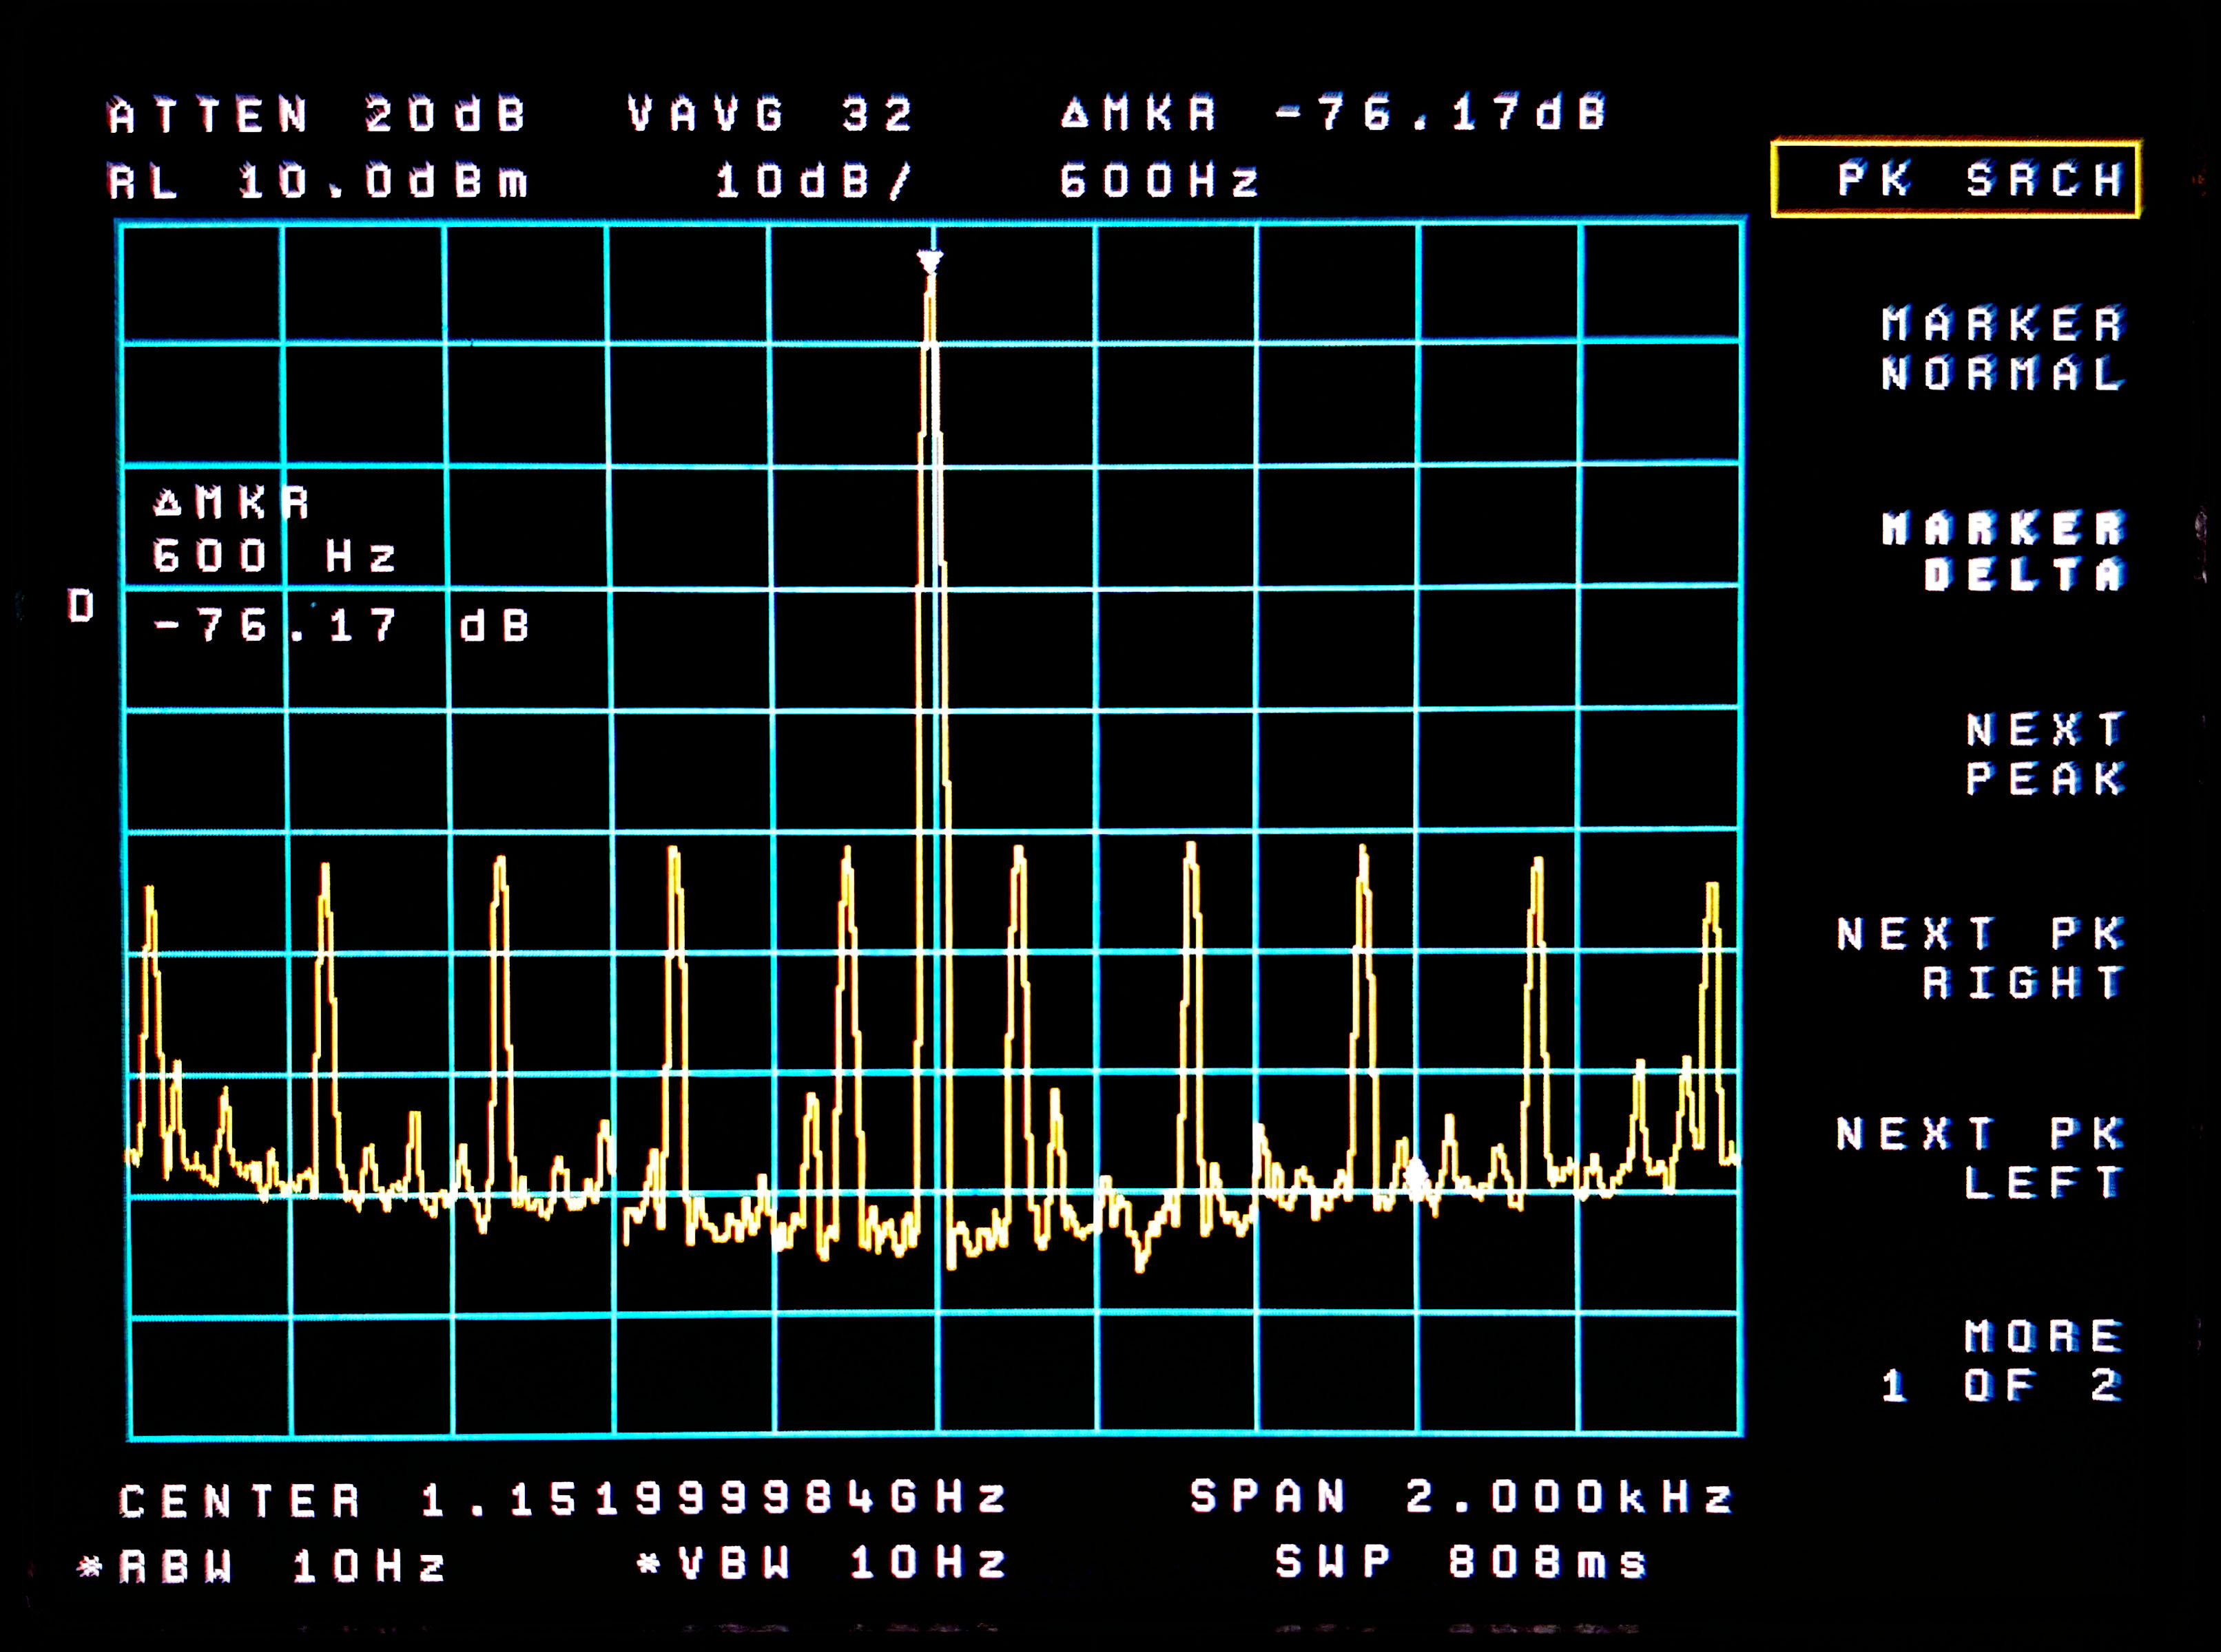
1152 Vey Close CH1

Slide 31
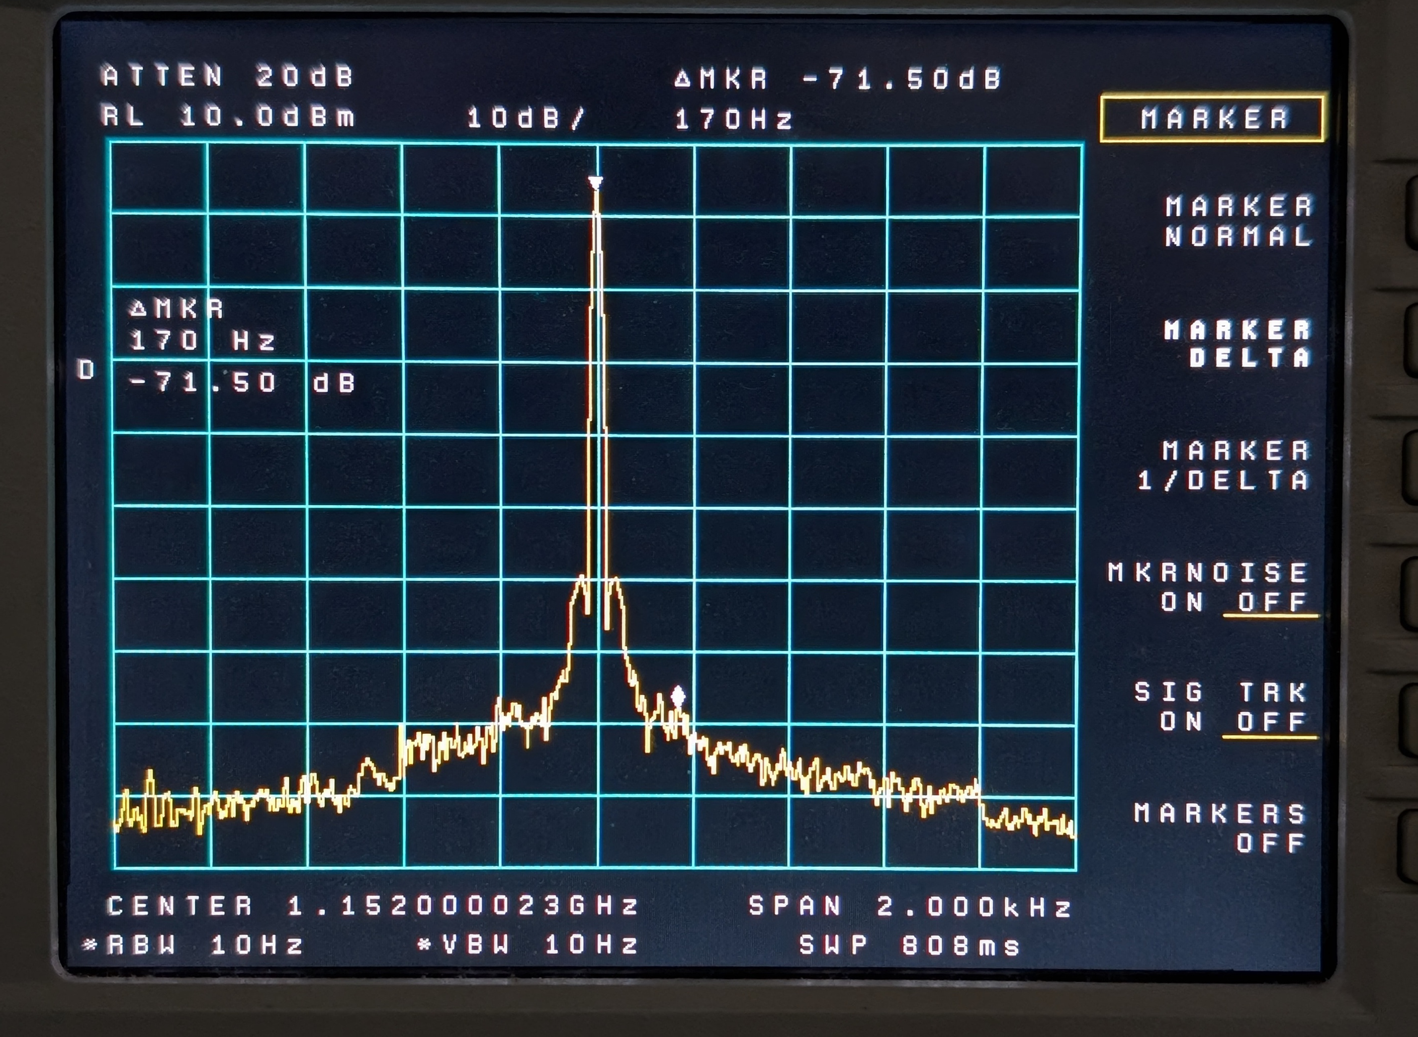
1152 Very Close MKU

Slide 32
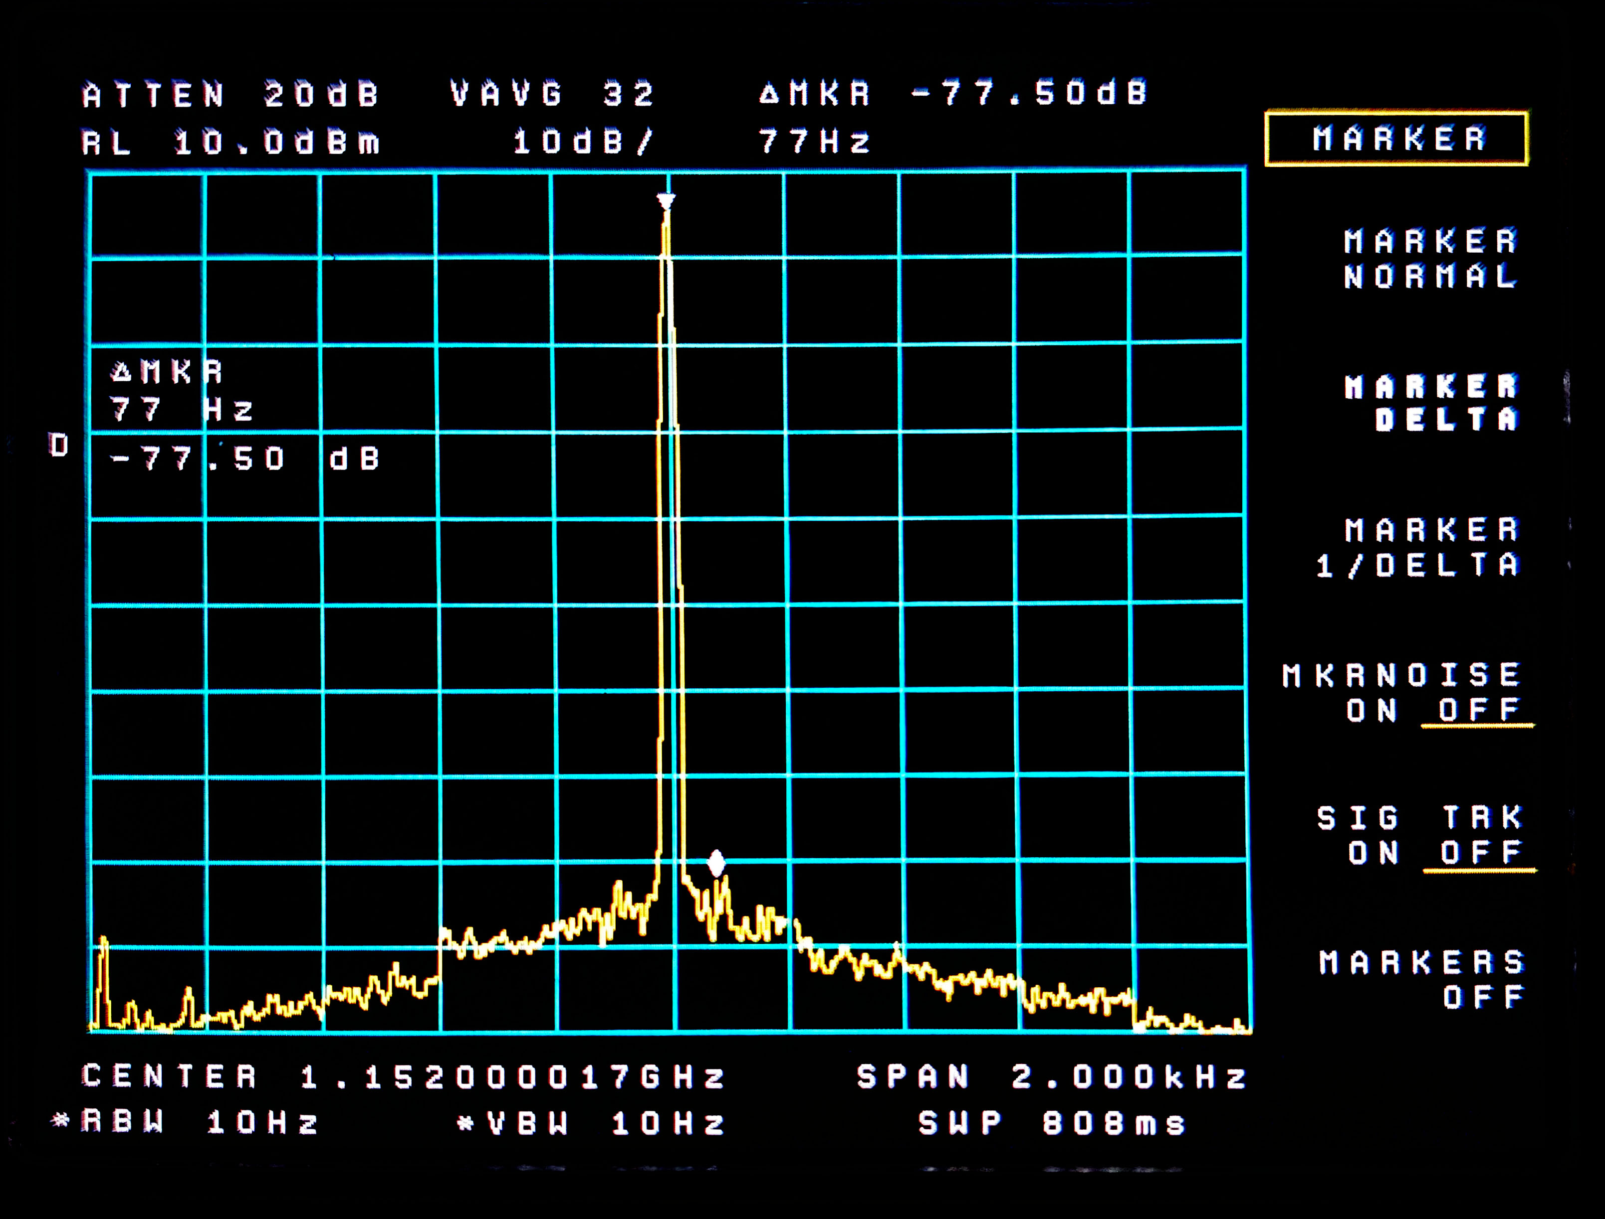
1152 Very Close VALON

Slide 33
Harmonics and Subharmonics
Except for the HP, all the IC synthesizers rely on a master (PLL) Fundamental Oscillator and
  multiplication for the highest frequency range
    e.g. 4 to 6.5 GHz VCO yields 8 to 13 GHz output
  no multiplication for the next lower portion
    e.g. 4 to 6.5 GHz (the fundamental VCO)
  division for the lowest ranges
    e.g. .054 to 4 GHz (dividing the fundamental)
Some Synthesizers have two ports, one for the top band, and another for the lower bands
There can be leakage of the wrong harmonics or subharmonics present

Slide 34
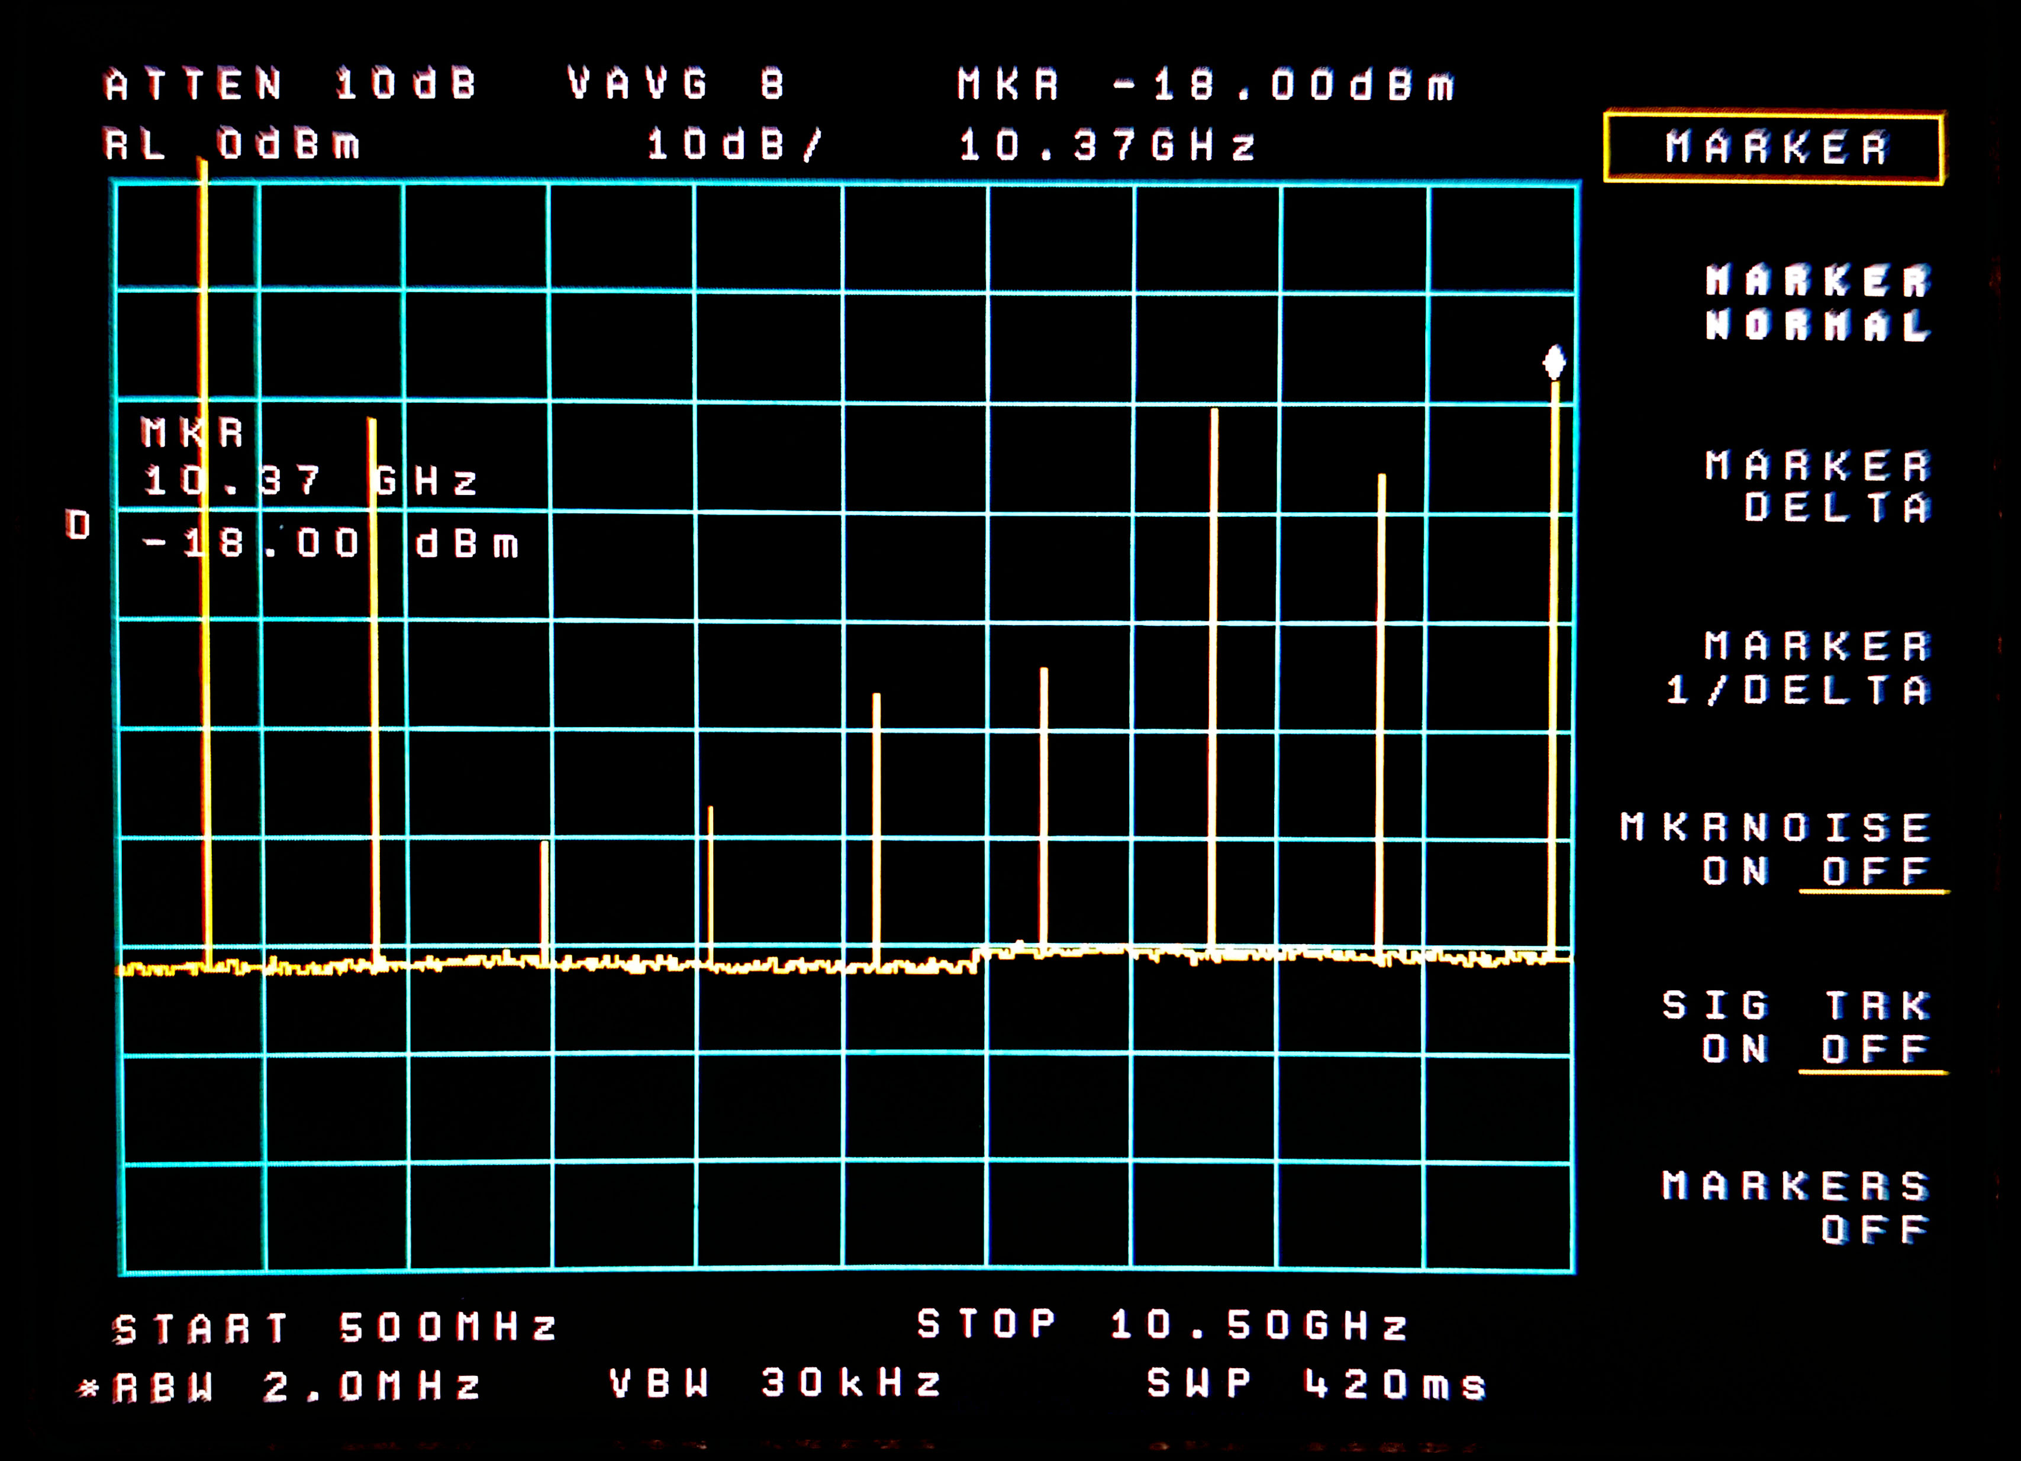
Harmonics – Valon @ 1.152 to 10

Slide 35
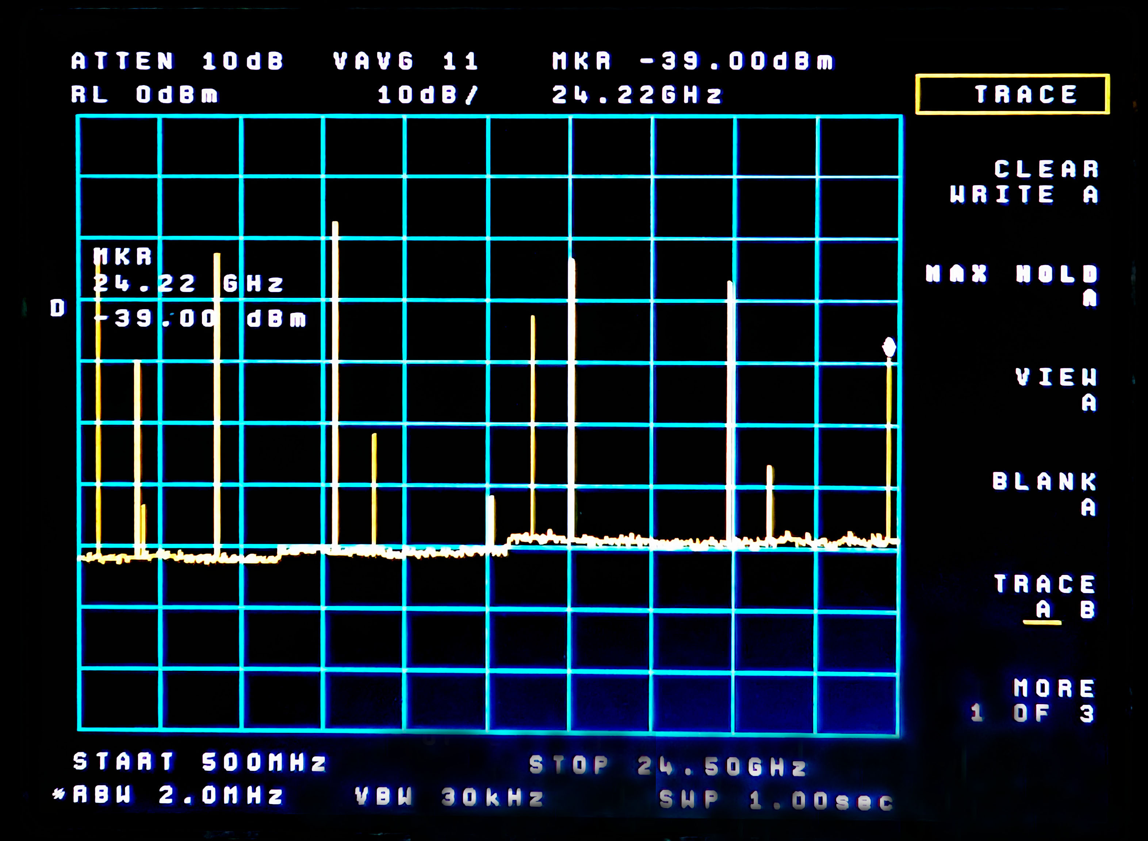
Harmonics – Valon @ 1.152 to 24
X1
X4
X9
X13
X17
X12
X21
X2
X10
X18
X11
8x = 9216 = Fund
Nothing
2X Fund = 1.4
Nothing

Slide 36
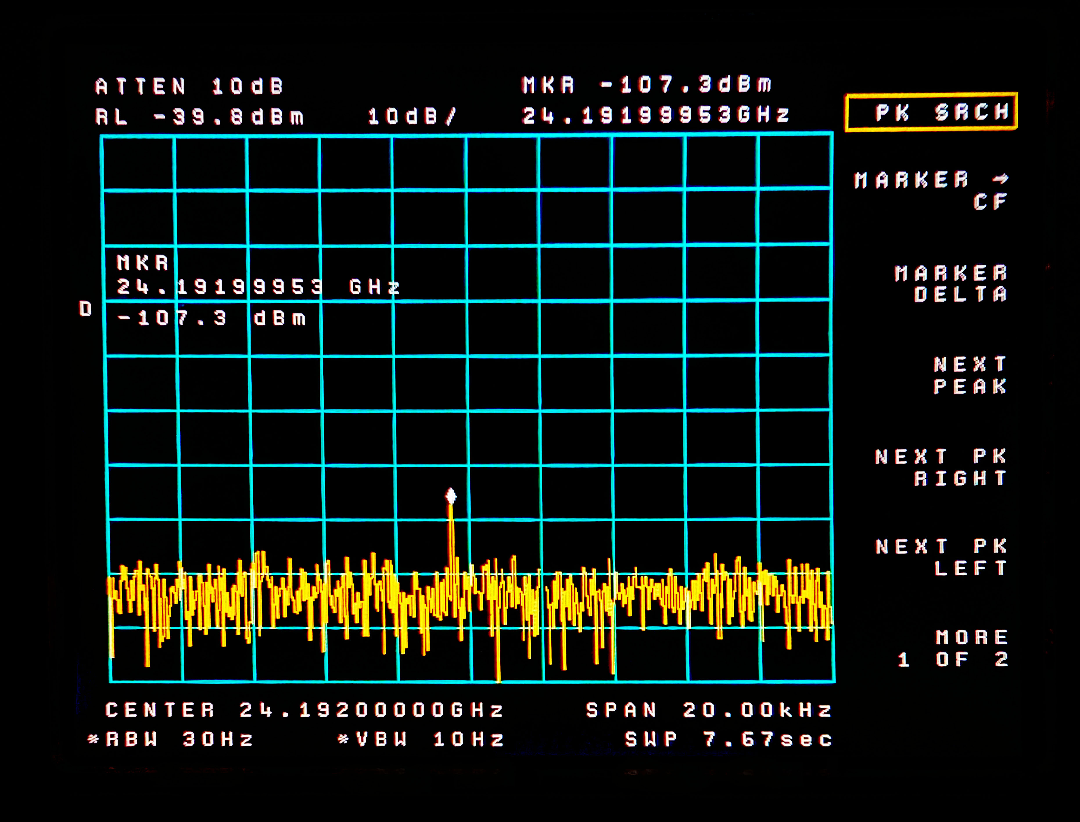
Harmonics – CH2 1152 at 24192
24.192GHz
-104 dBc

Slide 37
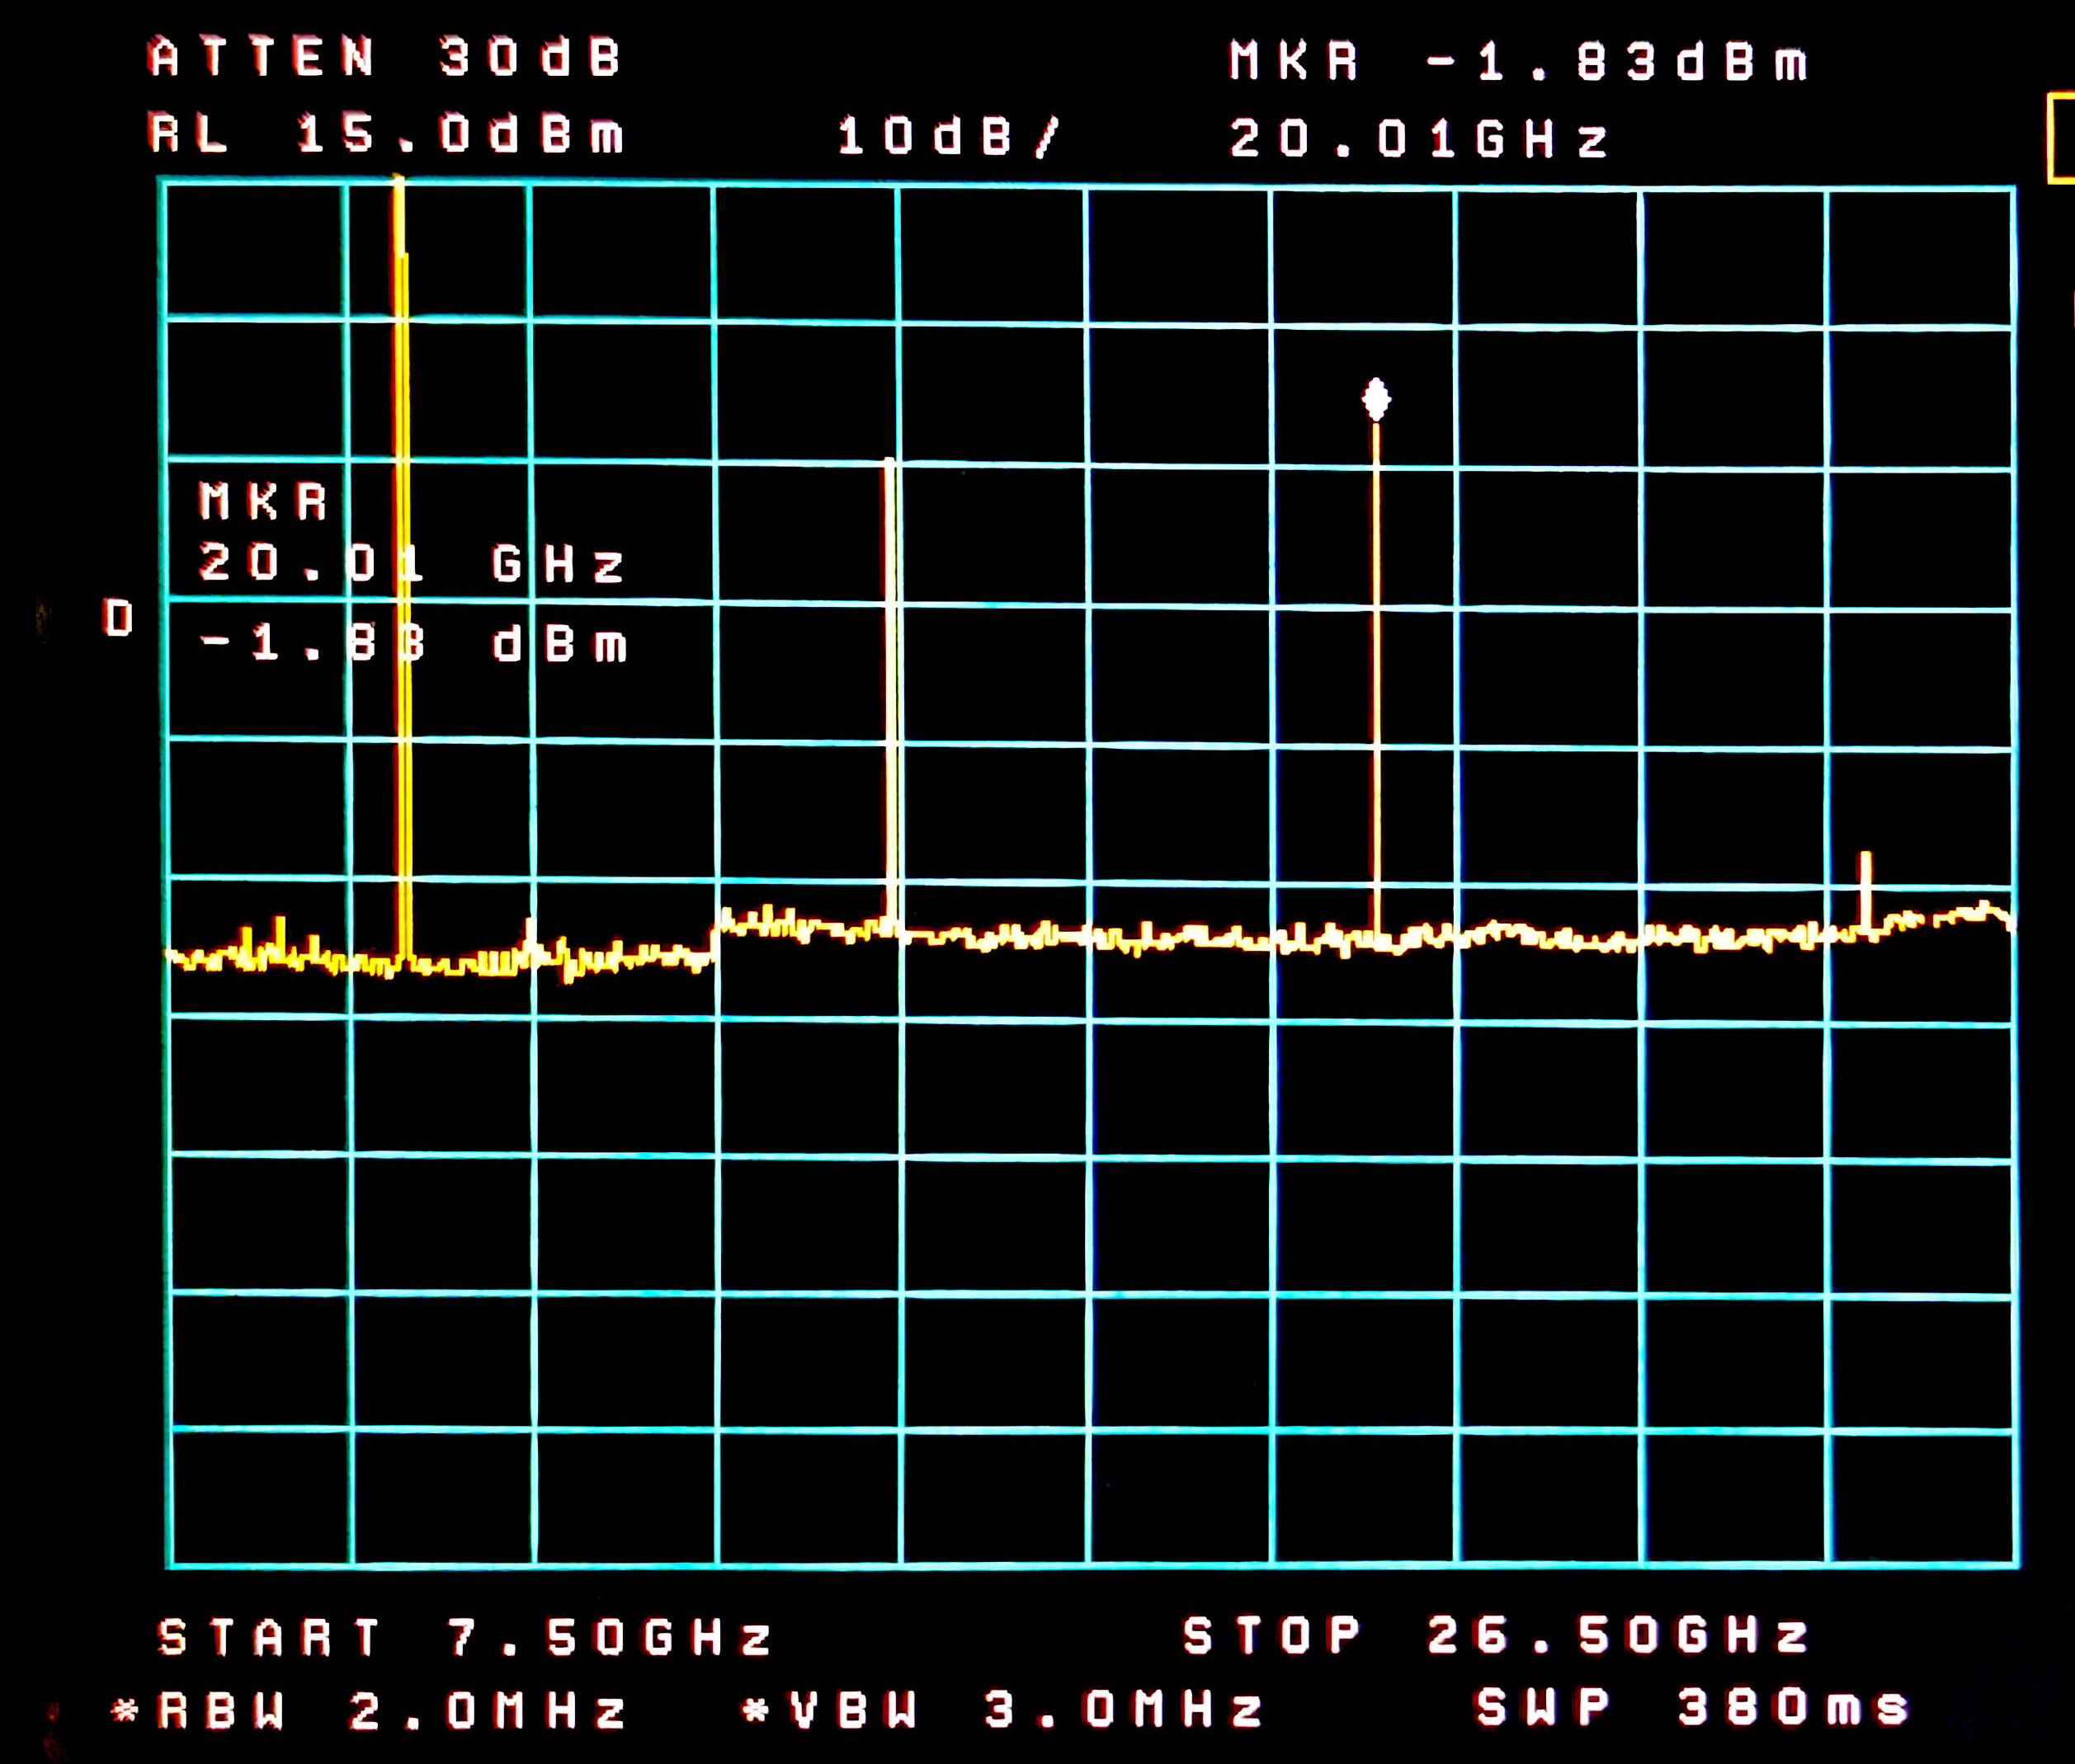
Harmonics – MKU @ 10 GHz Includes Harmonics of 5 GHz Subharmonic (fund)
10GHz
+15dBm
20GHz
-2dBm
15GHz
-5dBm
25GHz
-33dBm

Slide 38

Subharmonic Leakage of MKU @ 10 GHz = <-60dBc
5GHz
Under noise

Slide 39

Subharmonic Leakage
MKU @12 GHz = -47dBc

Slide 40
Explain Low Fundamental Leakage but Significant Harmonics of Fundamental
MKU has an excellent filter in place to remove subharmonics – which are really the fundamental of the VCO
However, it does generate harmonics of the VCO even though the user is asking for the second harmonic of the VCO in the 8-13 GHz (Primary output range)
Therefore, harmonics of the (fundamental) VCO appear in the nicely filtered output

Slide 41
Explain Low Fundamental Leakage but Leakage of Harmonics of Divided Fundamental
Just an Educated Guess
  Division of Frequency is a naturally non-linear process
  Therefore, the divided frequency is rich in harmonics while the fundamental is not
  These divided fundamentals will cover a large frequency range and therefore cannot easily be filtered

Slide 42
Harmonics & Subharmonics
Subharmonics suppression (F0 leakage)
  Valon -15 to -26dBc
  MKU -47 to below noise
  CH1 -2.6 to -19.5 dBc
  CH2 not measured
Harmonic Suppression of Divided F0
  Valon Almost no suppression
  MKU Almost no suppression
  CH1 No suppression
  CH2 not measured

Slide 43

You might want to use a filter
Pipe Cap W1GHZ Pipe Cap Filters Revisited
Band Pass, 2 GHz through 10 GHz easy and well documented

Slide 44

Minicircuits Filters (hundreds)
Plenty of Highpass and Bandpass

Slide 45

Filters, High Pass
Good to 11 or 13 GHz $32

Slide 46

Filters – High Pass
Good to 20 GHz $210

Slide 47


Slide 48
Talk Outline
Which Synthesizers ?
Synthesizer Innards
Tests performed
Results
Summary

Slide 49
Summary
 | HP 8431B | VALON TECH 5019 | MKU 8-13 PLL LO | EBAY CHINESE 2 Unit Similar AD5355
Wide Spectrum Quality | Excellent Final Floor extremely low | Excellent Final floor Very low Up to 20 GHz | Excellent Final floor very low | Good to Fair Some -40dBc Spurs Worse at Fractional F0
Narrow Spectrum Quality | Excellent Close in | Excellent Close in -55dBc 1KHz -80dBc | Excellent Close in -45dBc 1KHz -80dBc | Quite Poor Most Freqs ~Spurs -30dBc ~1KHz Floor -45dBc
Sub-harmonic Leakage | None | -15dBc To -26dBc | -47dBc To under noise floor | -4dBc to -19.5dBc
Harmonic | Not Measured | Not Measured | 3F0 -20dBc 5F0 -48dBc | 0dBc

Slide 50

Valon Programming
USB – Full Configuration Manager
  Runs on PC
  Set Frequency, Freq List, Sanning, Look at and modify Registers
Ethernet – Most of Configuration Manager
  Enter Frequency, Choose from List
  Web Based, can operate from phone!

Slide 51


Programmer MKU Old School
$100 - BUT
Appears that
Newer Display
No longer
Compatible

Slide 52

Programmer MKU New School
$400
The NEW
Kuhne Way

Slide 53

Advice to Fix Chinese 5355

Slide 54


Slide 55


Slide 56

SV1AFN.COM

Slide 57
Summary cont.
OBJECTIVE CHARACTERISTICS | CHOICE & CONSIDERATIONS | COST
Cheap, 8-13.8 GHz, Low Power, Spurs below -30 dBc All Frequencies but with spurs | Chinese Ebay Prefer #2 for Performance Prefer #1 for Cost | $100 to $170 Pre-Tarriff Consider Filters Look at Improvements
Affordable High Quality LO Solid, Tough | Kuhne MKU 8-13 PLL LO | $450 + another $400 for Programming Maybe a $30 Filter
Bench Source Run from PC or Phone | Valon 5000 series, 5019 goes to 20 GHz Also 8 and 30 GHz | $2500 and might want a $400 Filter
Bench Source works with other HP Equip for Scalar Analysis | HP 3431B or similar Not Portable | Used in the $2K to $4K Range. 5x that calibrated w guaranty

Slide 58


