Slide 1
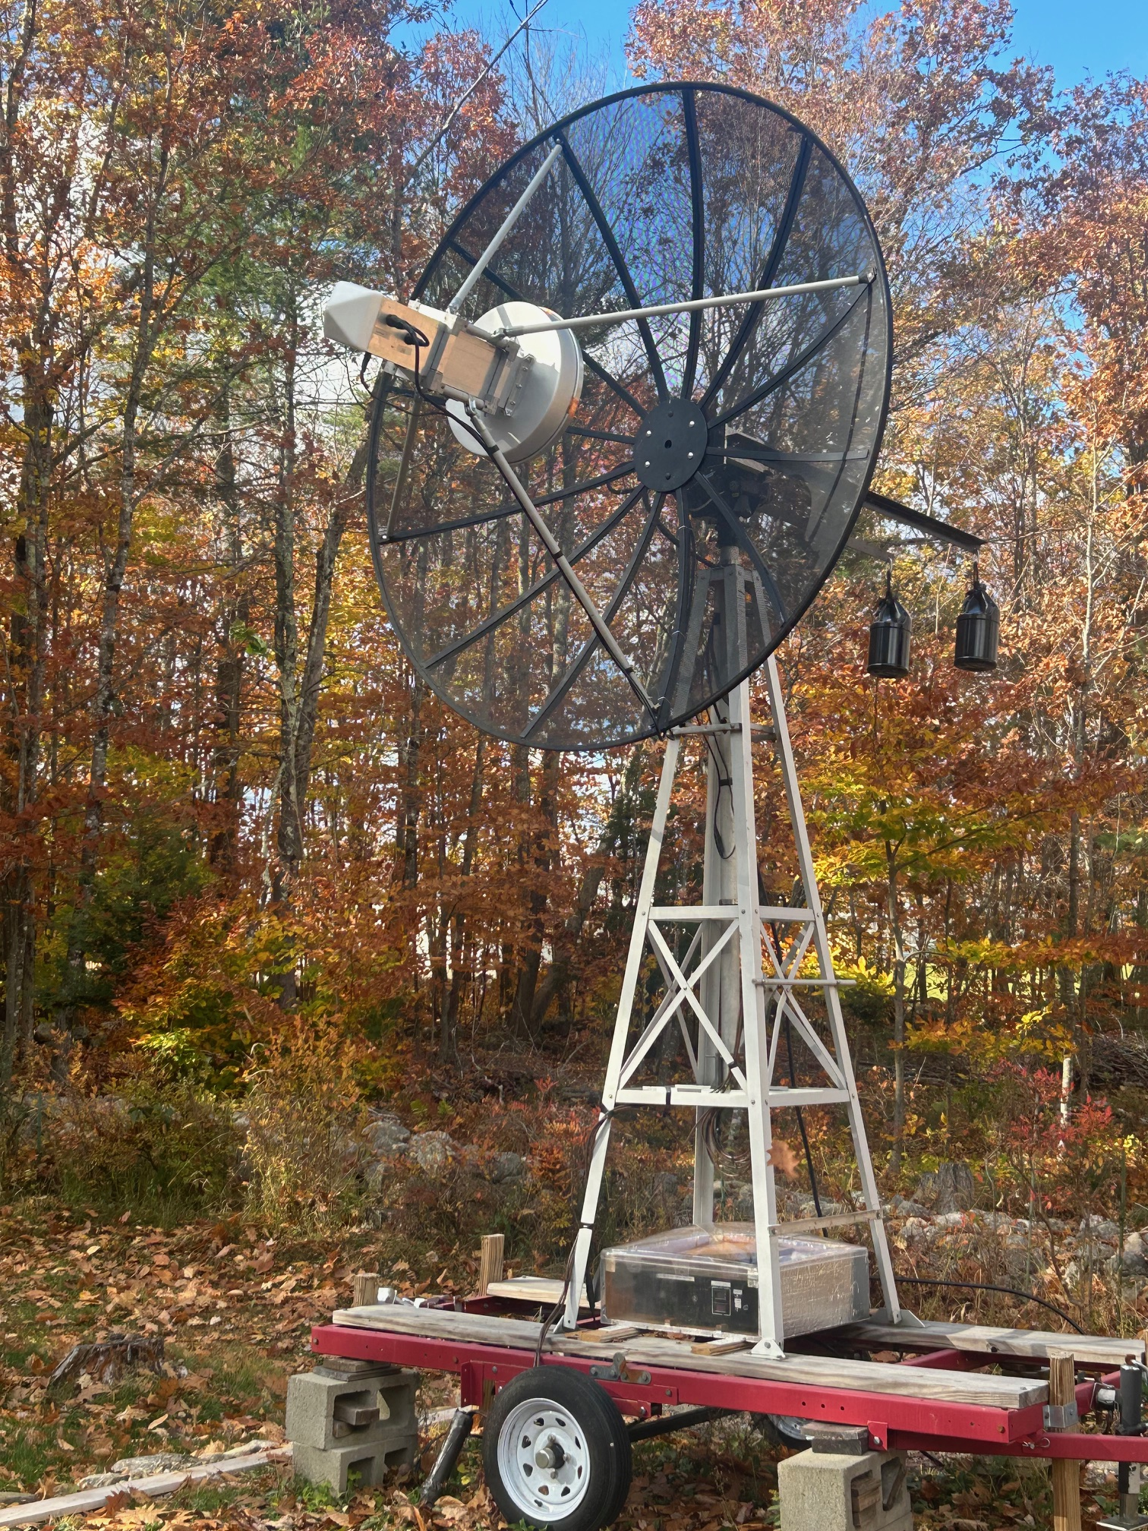
W1FKF 1296 MHz
2 meter mesh Dish
400 + watts at feed
5-9-25

Slide 2
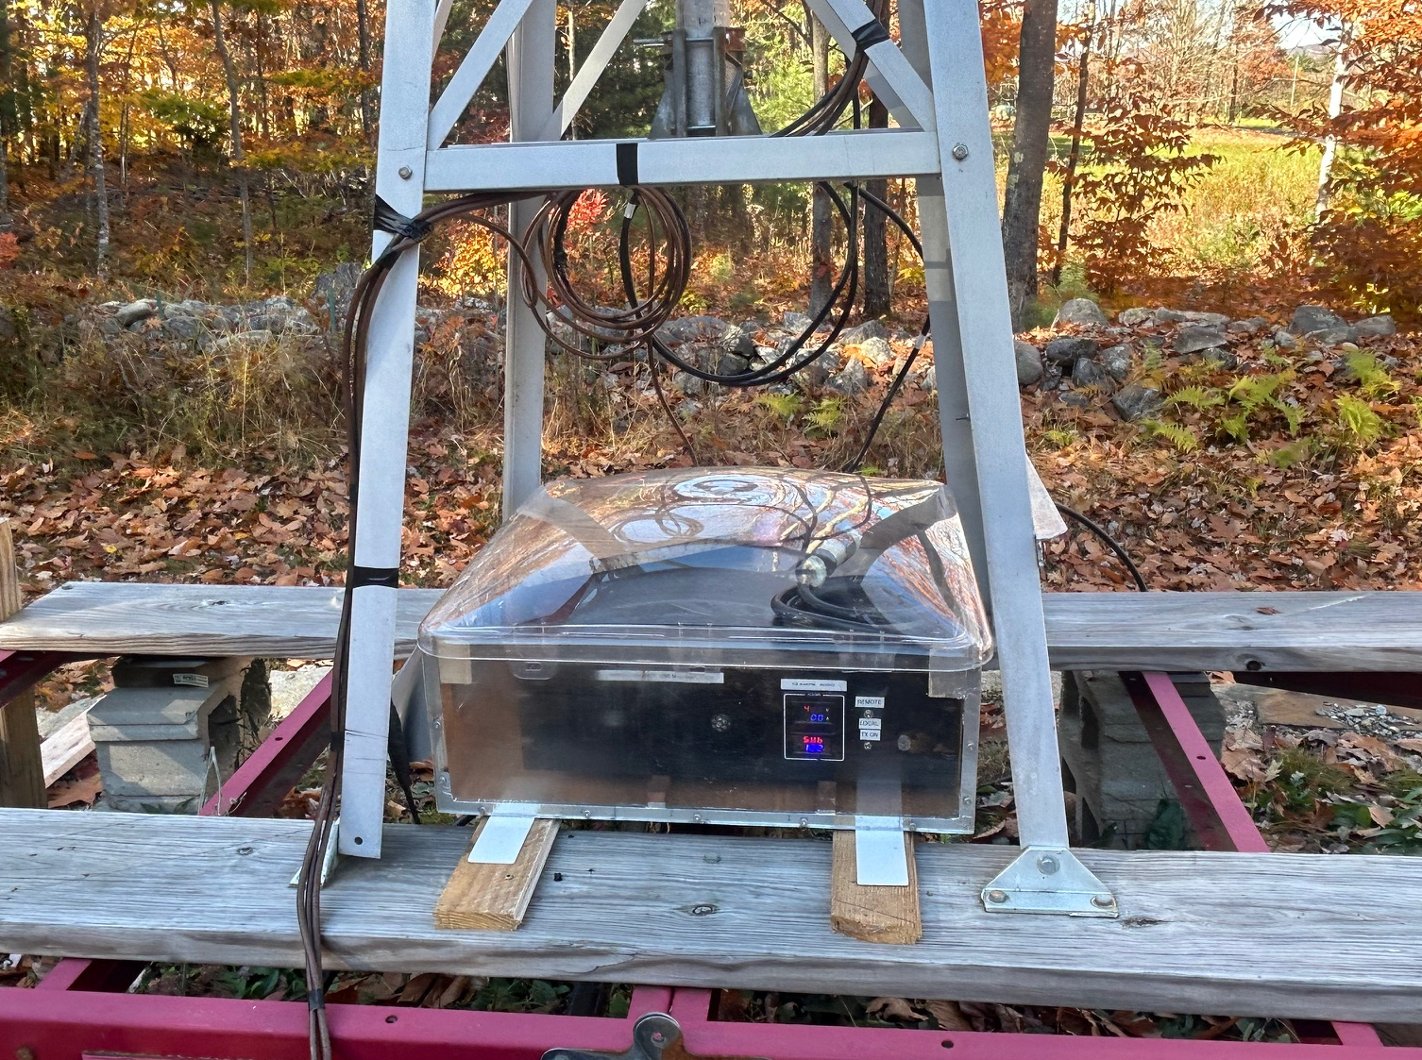
W6PQL 1296 Ampifier
(670 w)
10 Watt driver amp
2 x 24 volt power supplies
Sequencer , Etc.

Slide 3
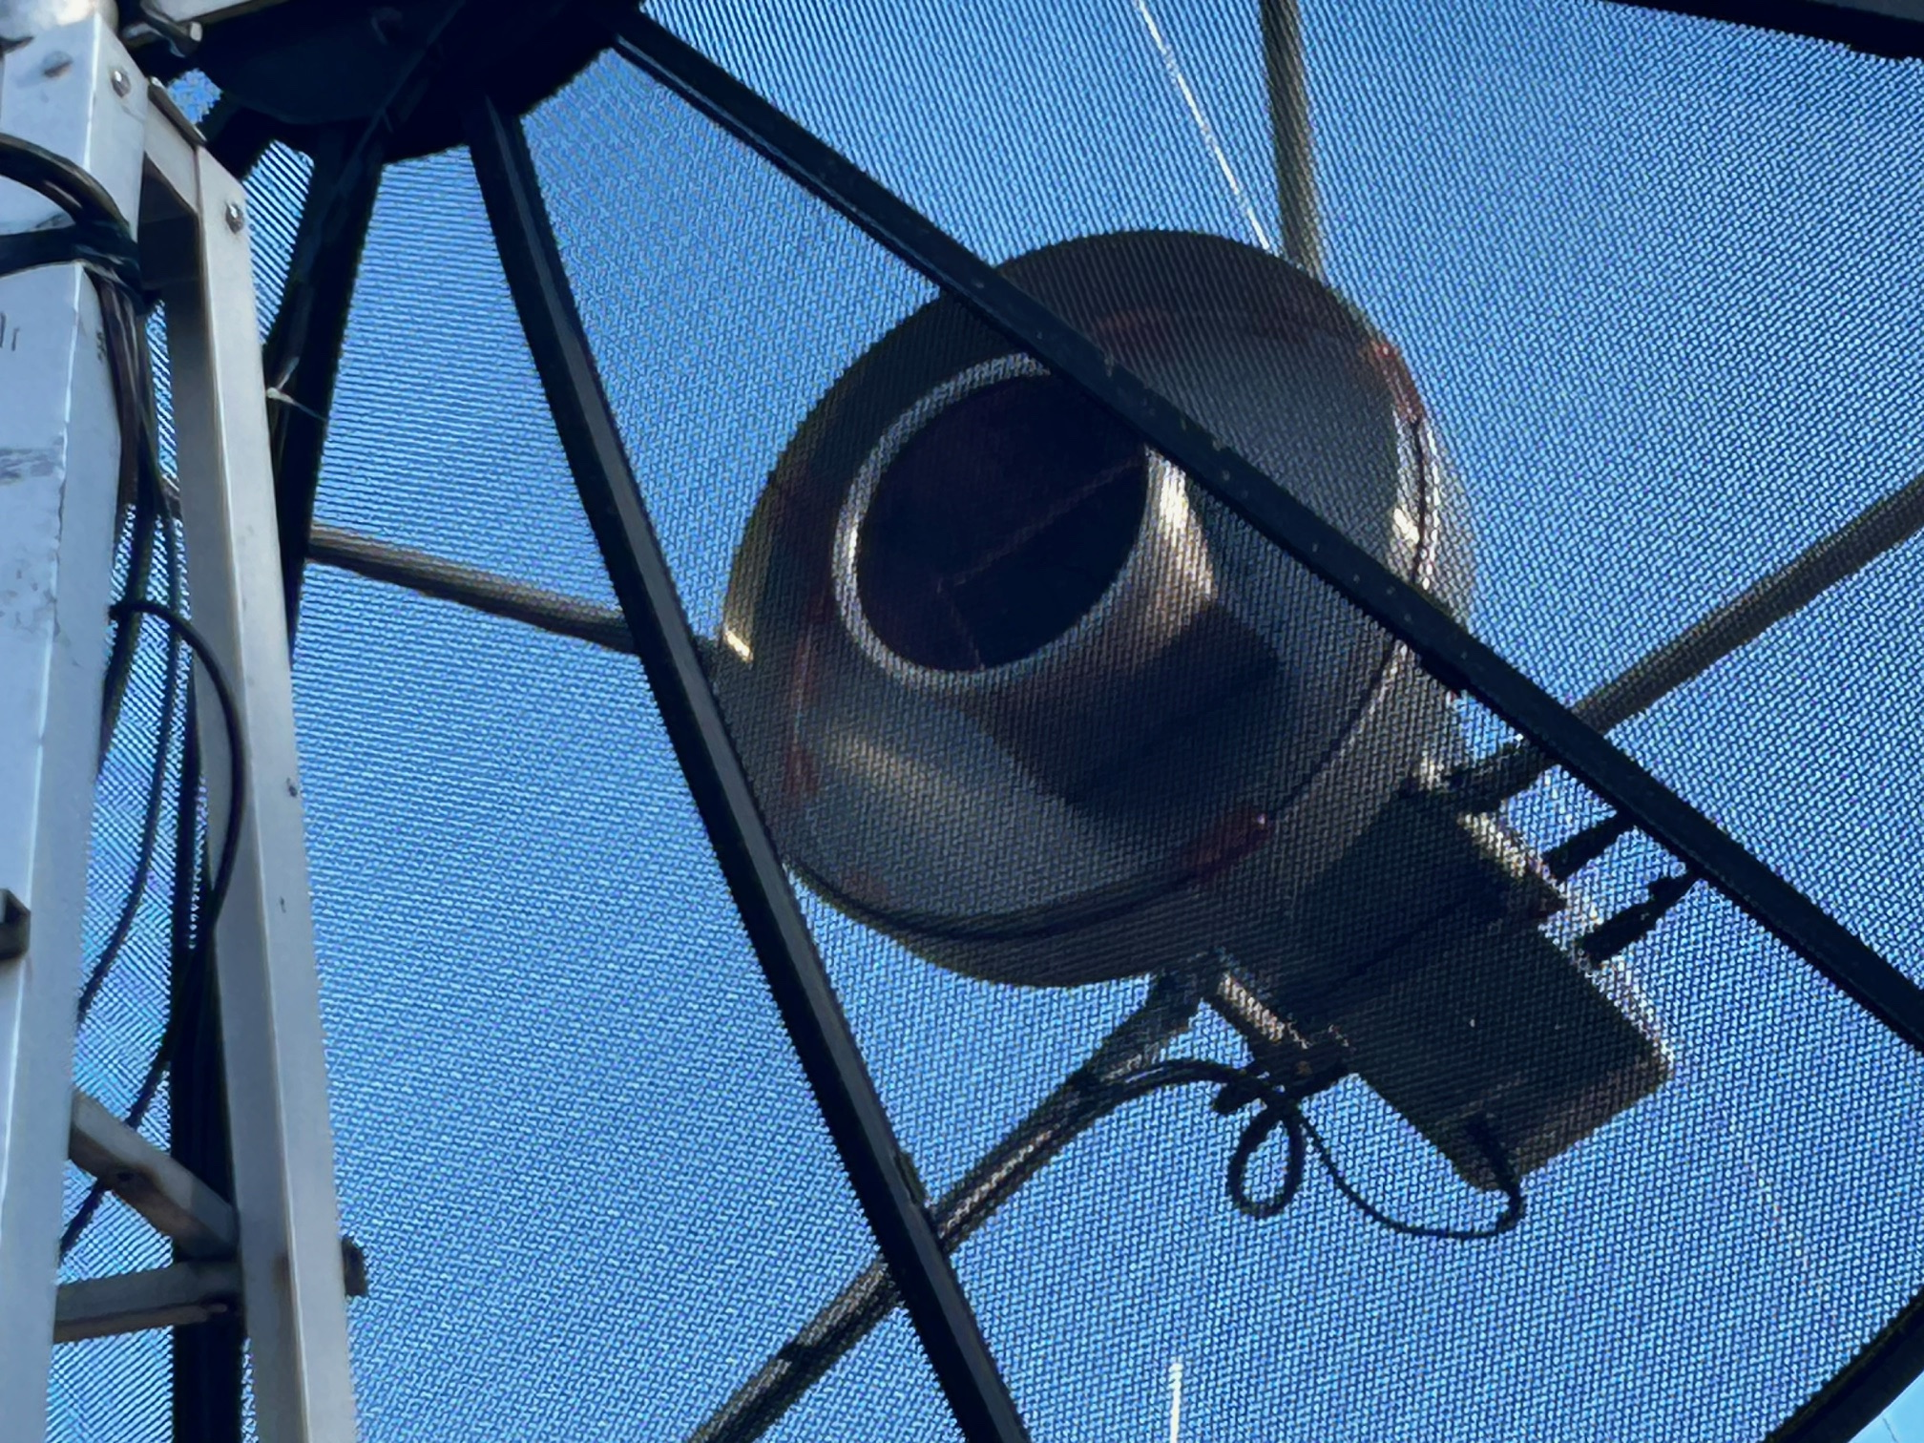
Ceptum Feed
with Square to round
transition

Slide 4
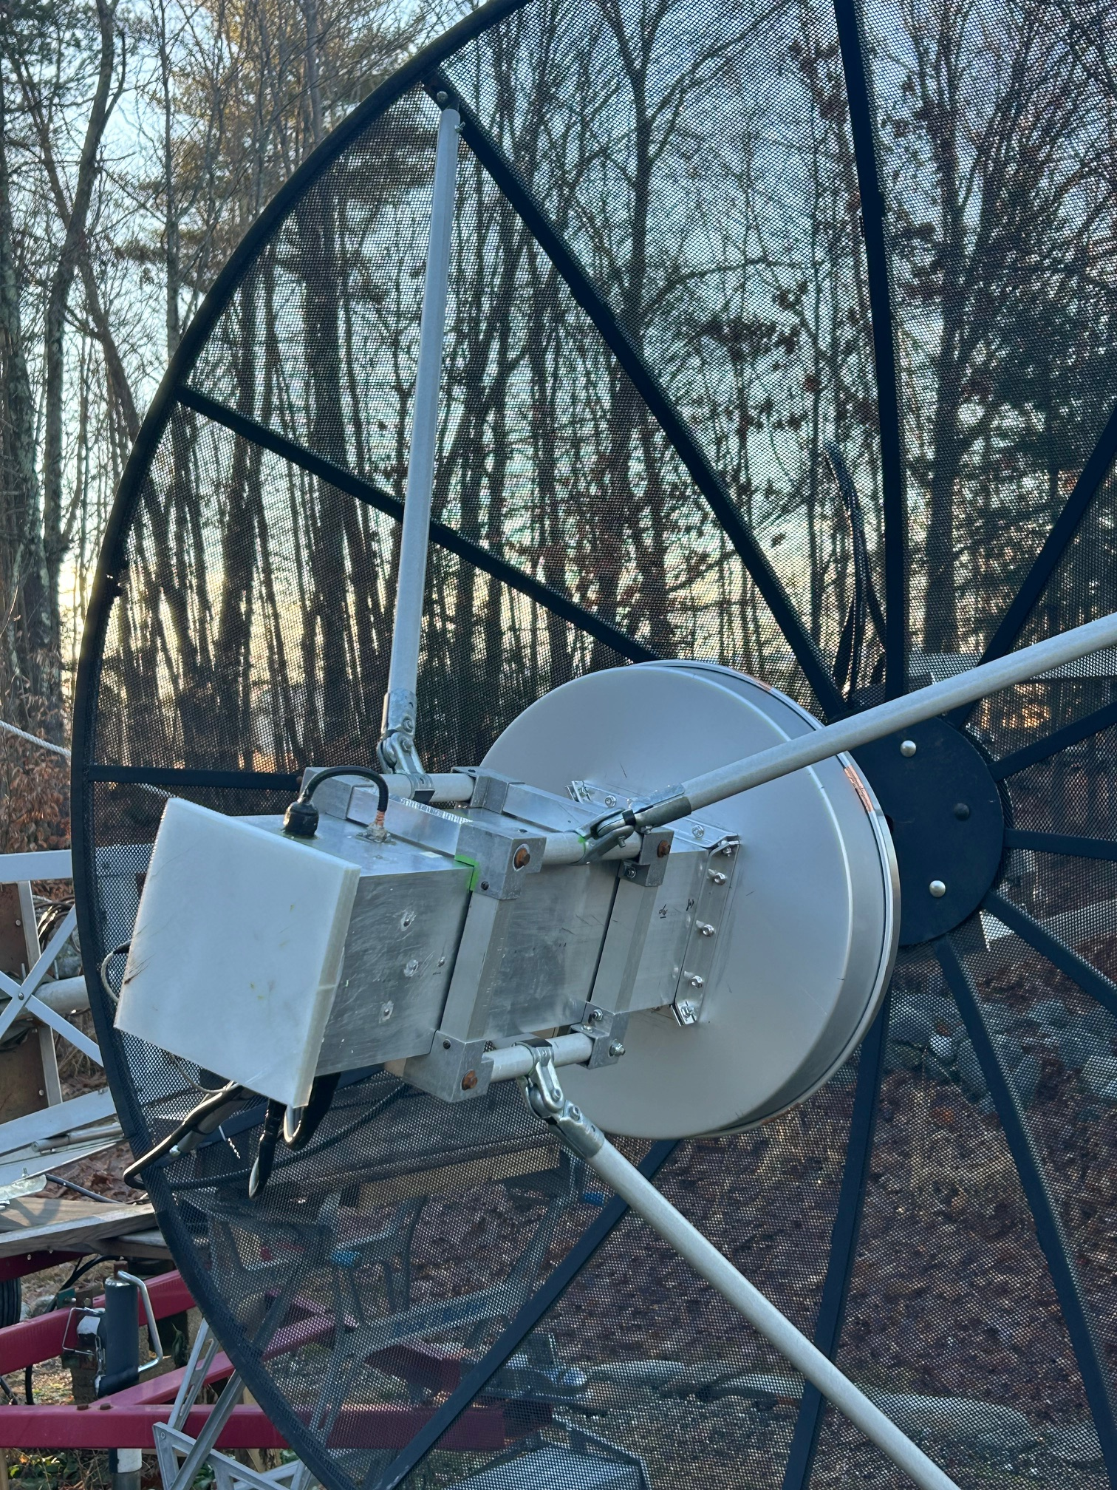
OK1DFC Septum Feed Feed
Fiberglass Struts
Preamp WD5AGO .3 dB nf
35 DB gain preamp
Isolation Rx Relay
In Back section of Feed

Slide 5
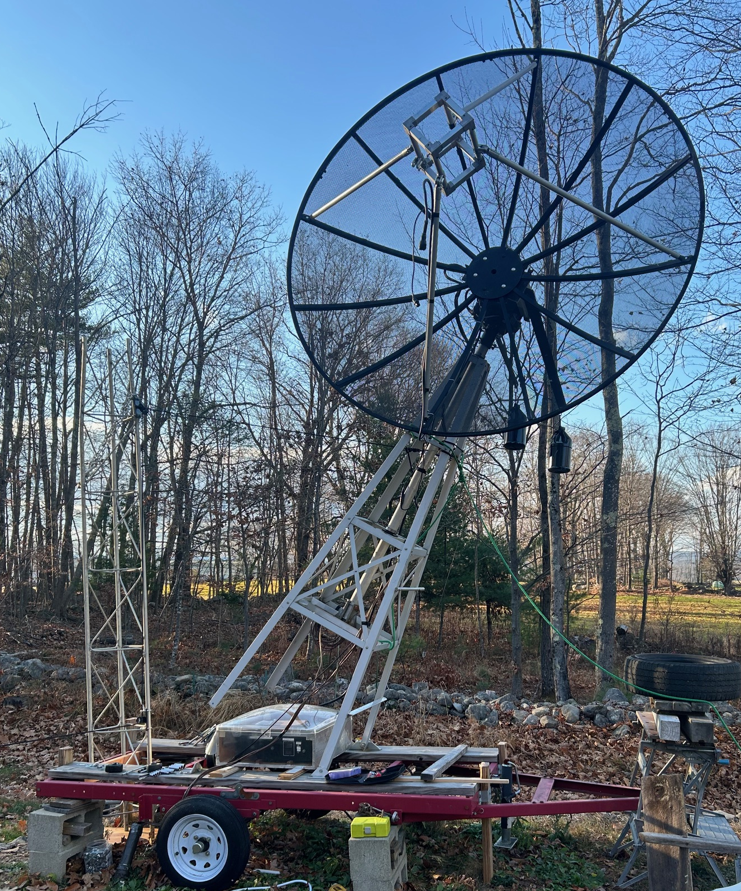
Tower can be layed
over to wok on

Slide 6
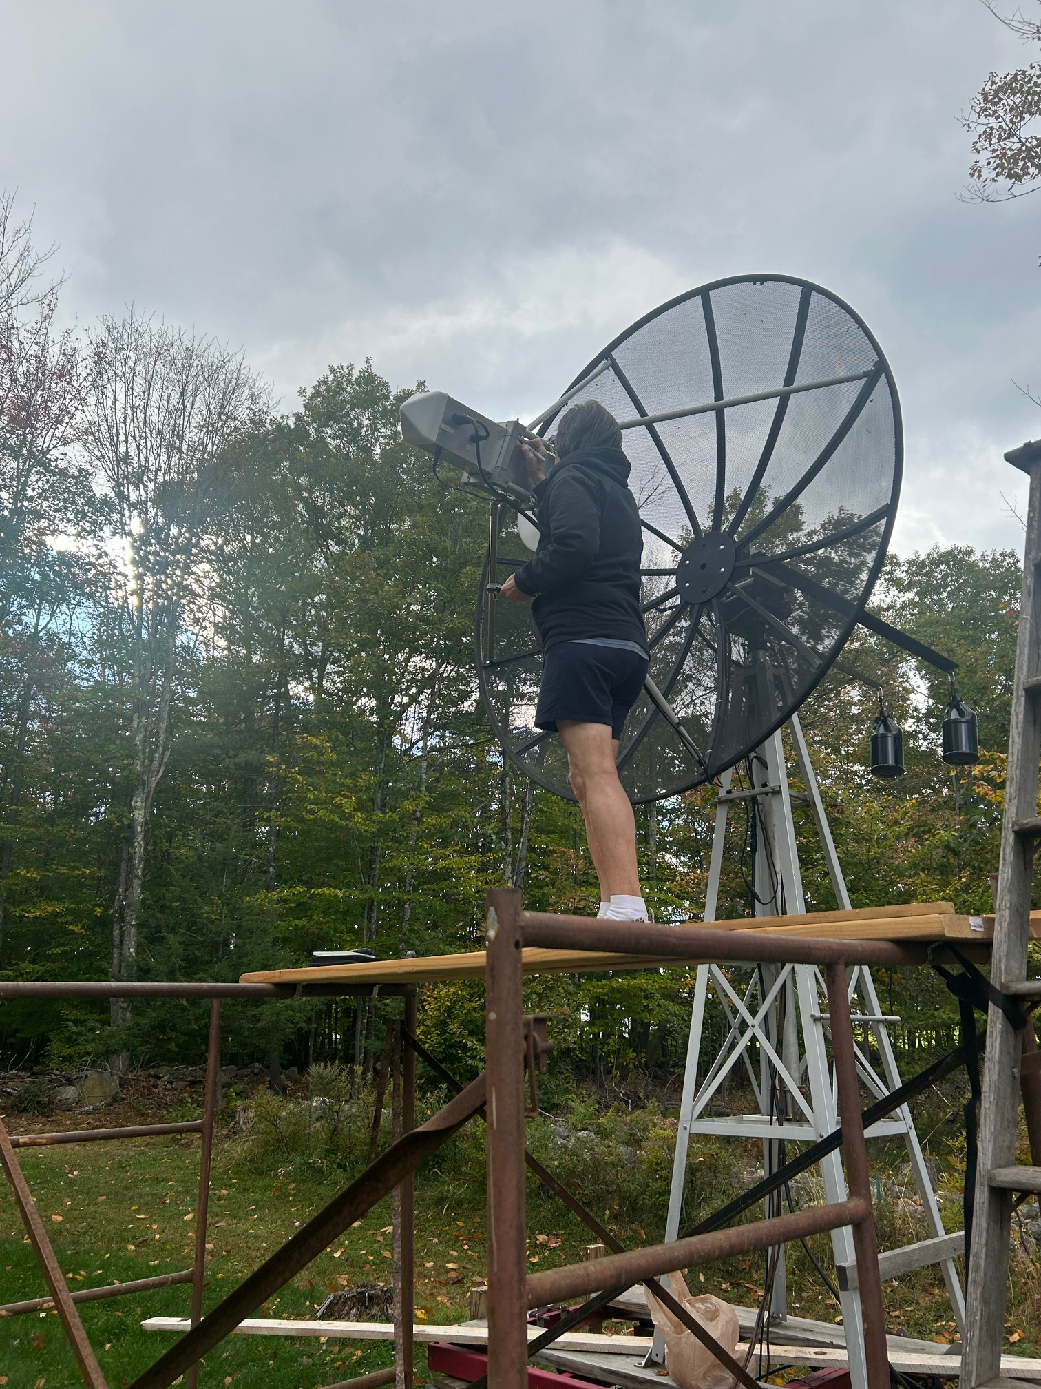

Slide 7
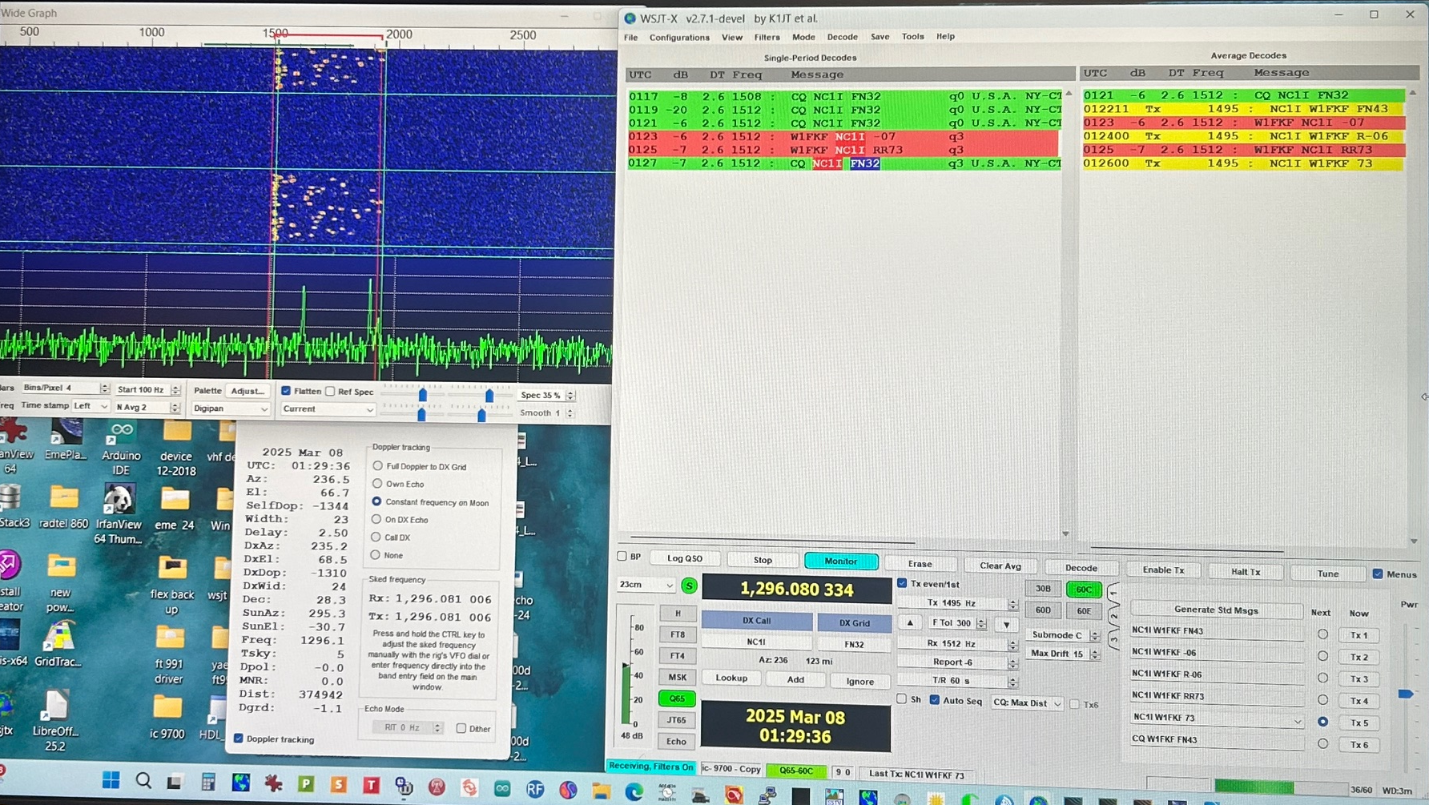
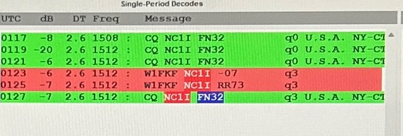

Slide 8
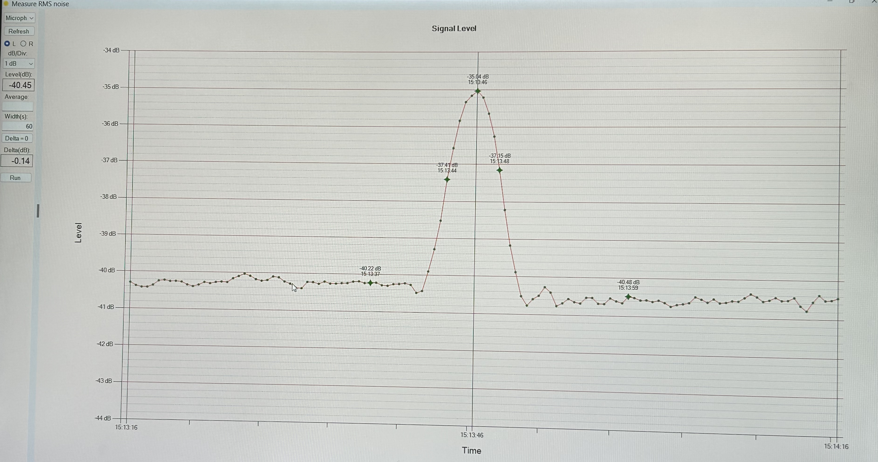
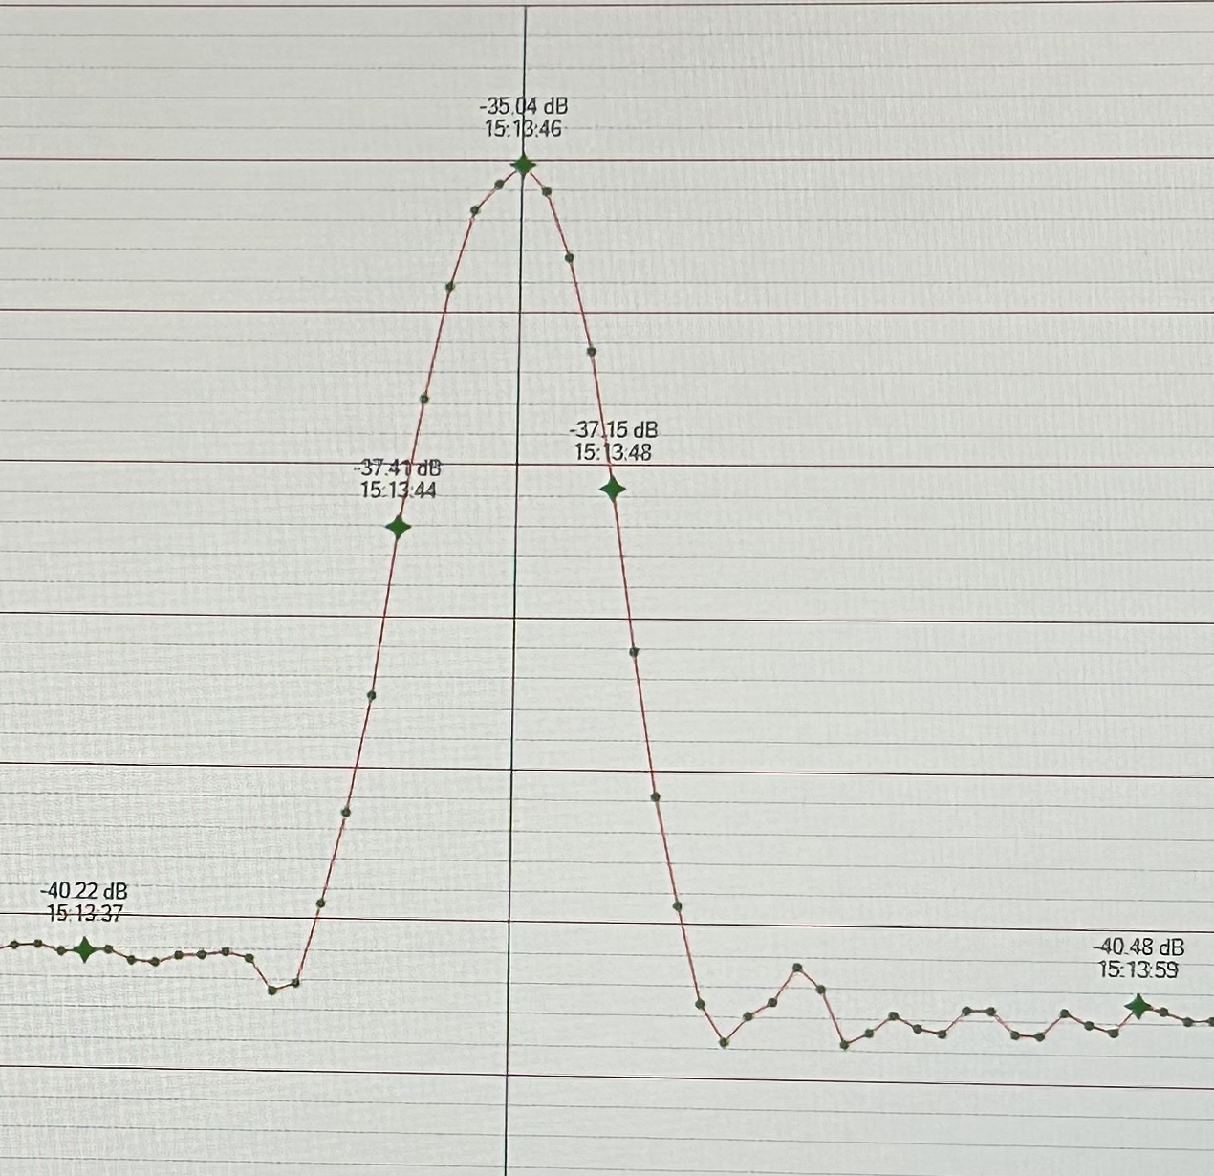

Slide 9
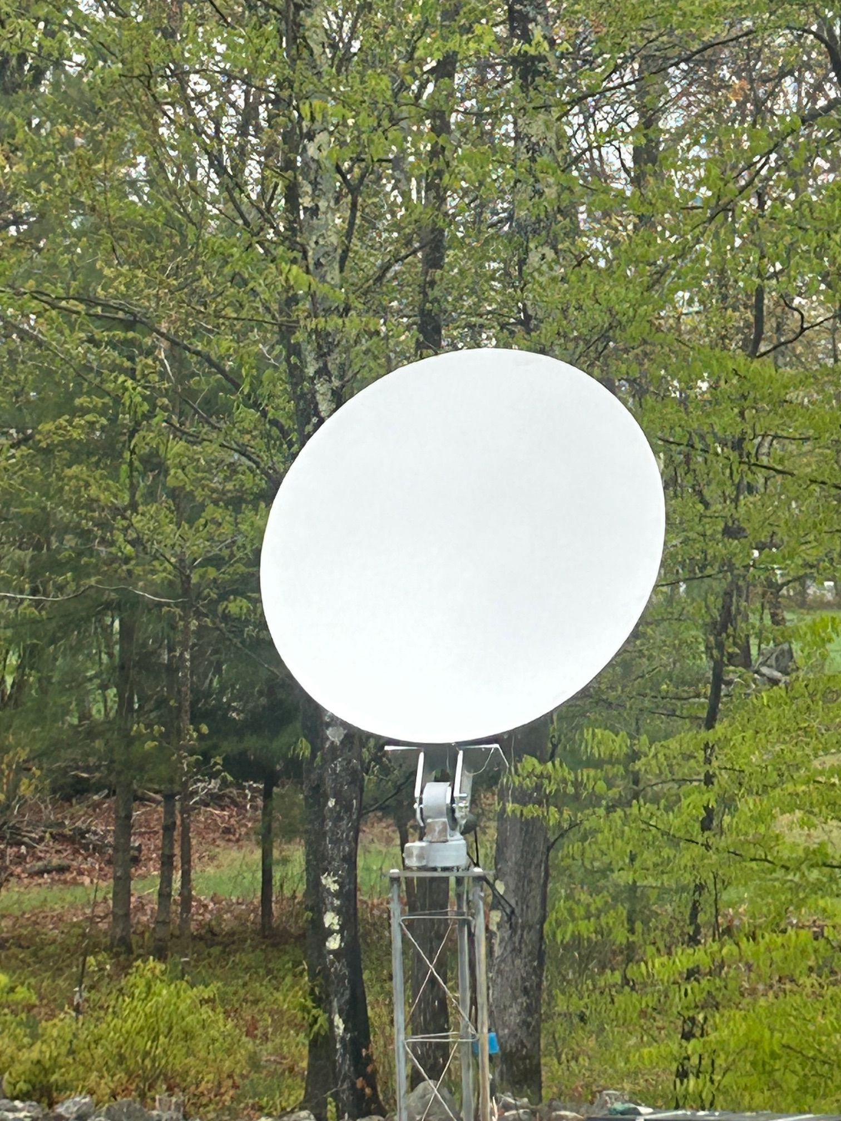
1.5 meter off- set dish
For 10 GHz EME
Good to 40 GHz
Work in progress

