Slide 1
Transmission Line Forum
Dale AF1T
Bob KB1QV
24 April 2026, Friday 14:00

Slide 2
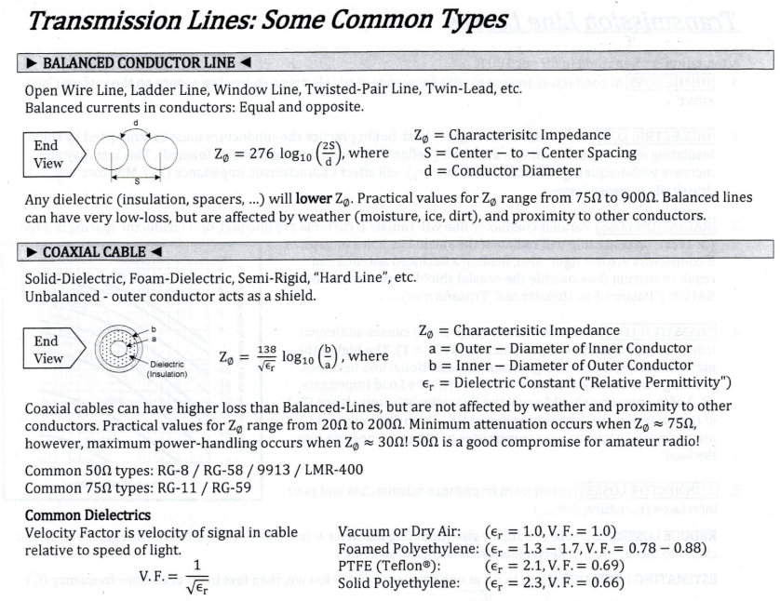

Slide 3
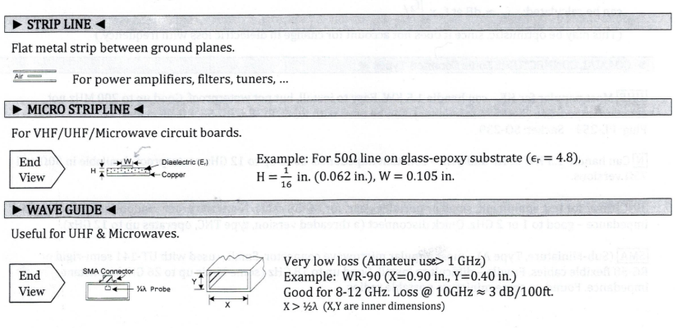

Slide 4
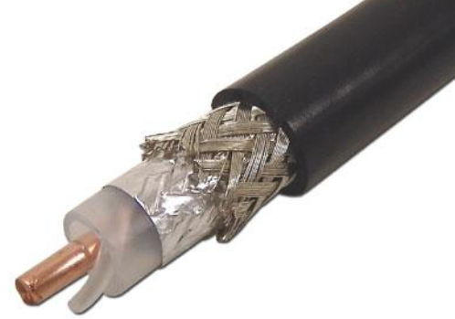
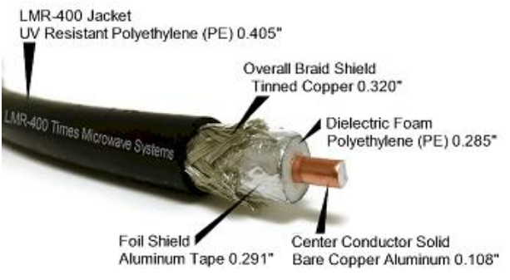
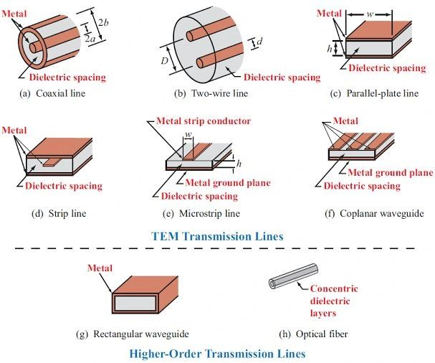
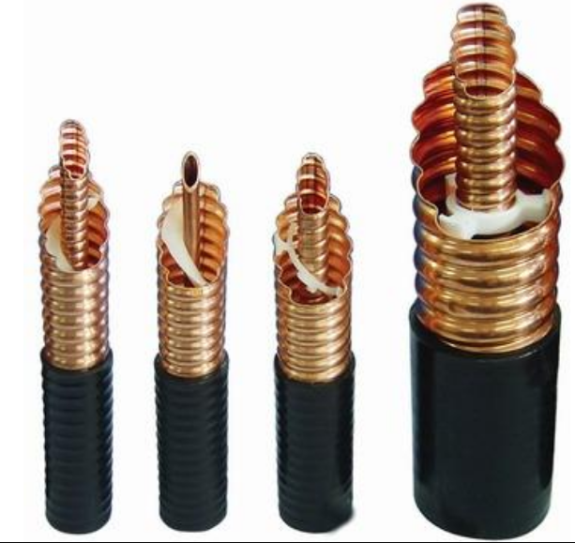
Types of RF Transmission Lines
Times LMR-400
Belden 9913
https://www.linkedin.com/posts/pradeep-khannur-a7b4358a_rf-basics-rf-transmission-lines-rf-transmission-activity-7352850289105756161-t0Ce
https://avarc.ca/wp-content/uploads/online-basic-course/Ch7-Transmission-Lines.pdf

Slide 5
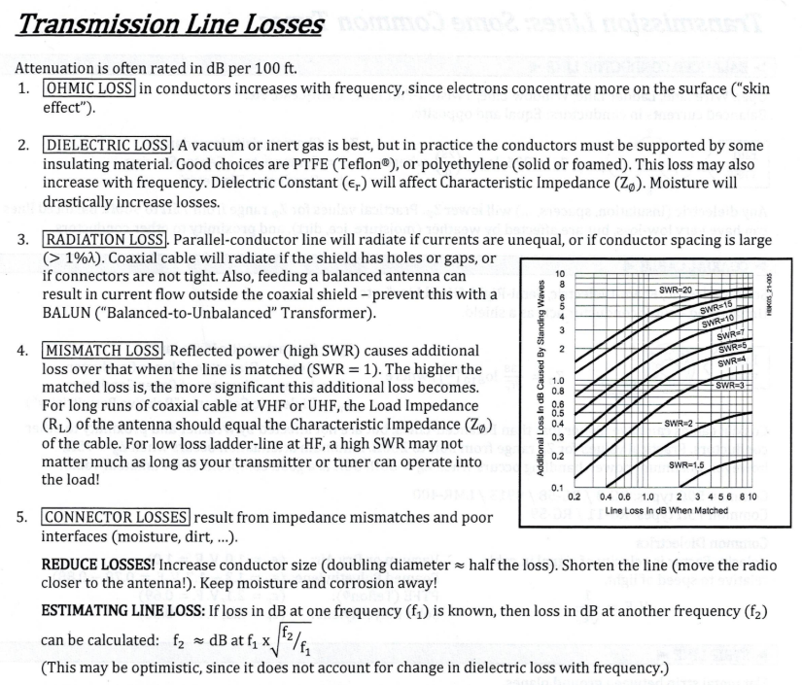

Slide 6
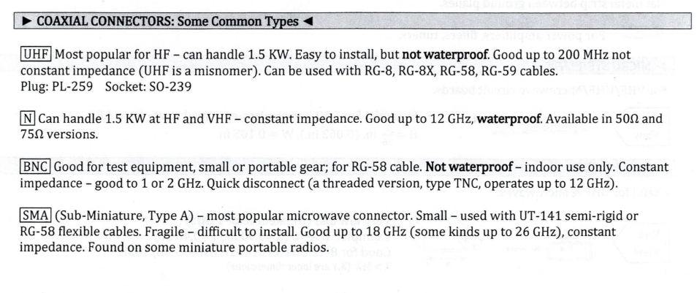
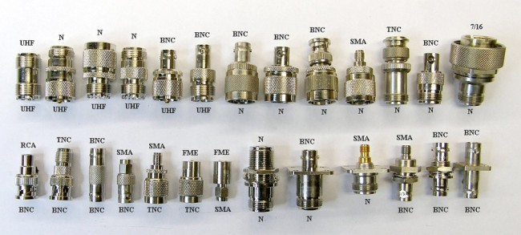

Slide 7
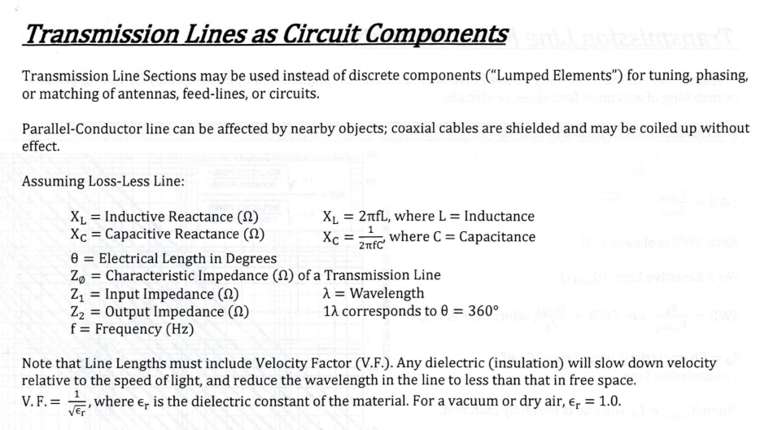

Slide 8
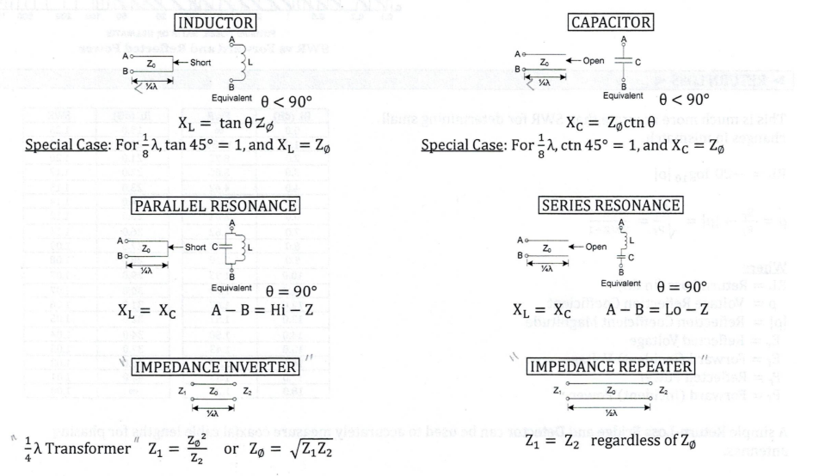

Slide 9
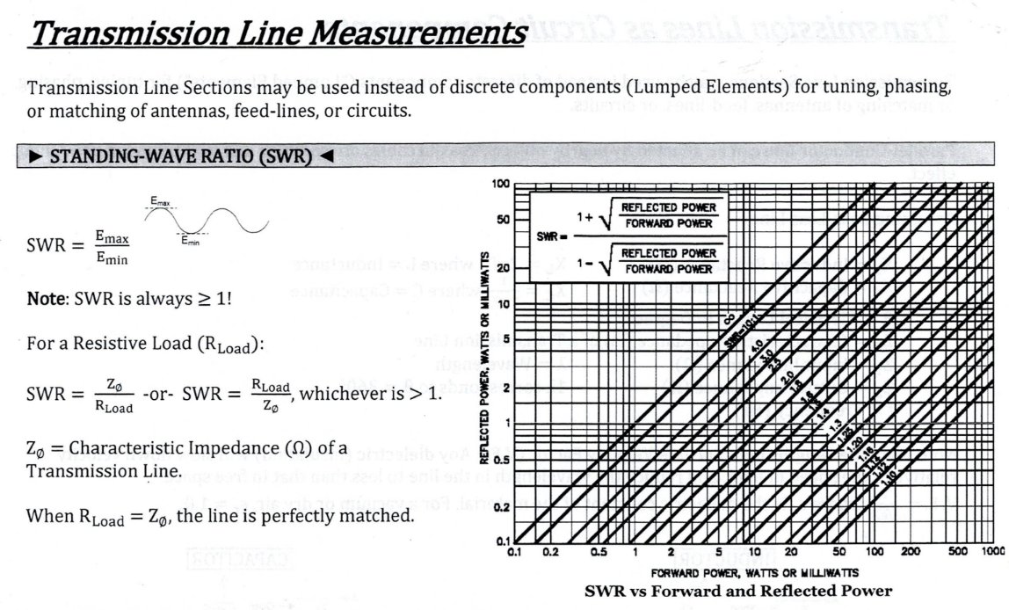

Slide 10
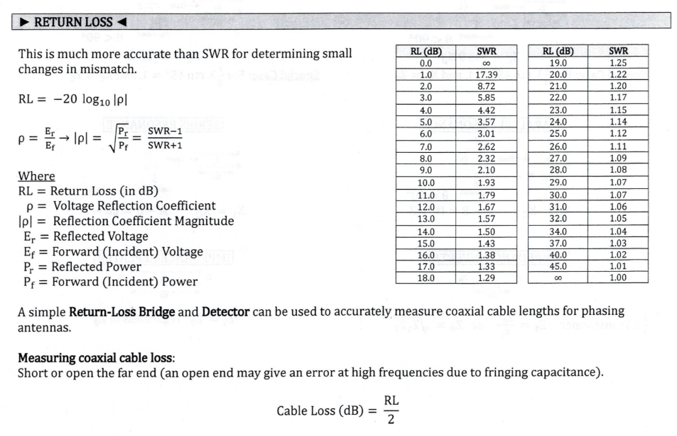

Slide 11
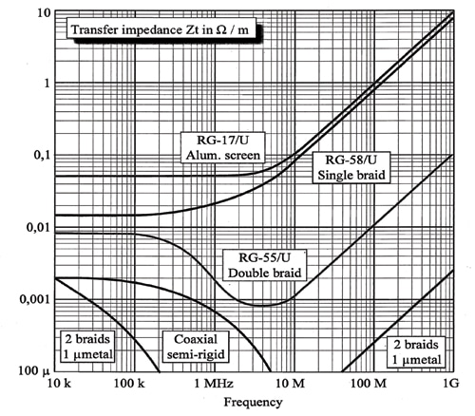
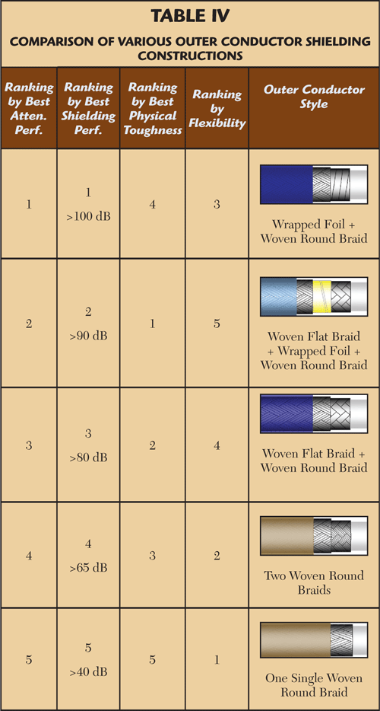
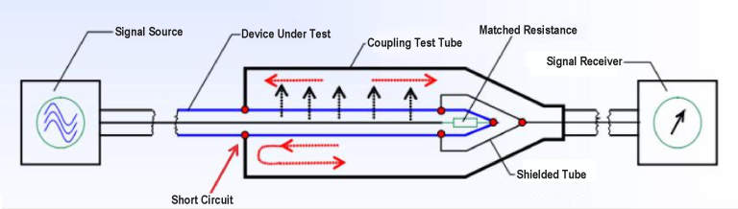
Shielding Effectiveness / Isolation
Measuring the Shielding Effectiveness (SE) of a coaxial cable involves quantifying how well its outer conductor (shield) prevents internal signals from leaking out and external electromagnetic interference (EMI) from leaking in. This is typically expressed in decibels (dB), where a higher value indicates better performance.
  Tri-axial Fixture
  Mode-Stirred Chamber
  Transverse ElectroMagnetic Cell
  Line Injection Method
https://interferencetechnology.com/simple-method-for-predicting-a-cable-shielding-factor-based-on-transfer-impedance/
https://www.microwavejournal.com/articles/9169-choosing-the-optimal-high-frequency-coaxial-cable
https://vinstronics.com/waht-is-triaxial-method/

Slide 12
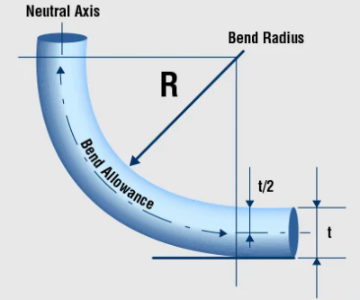
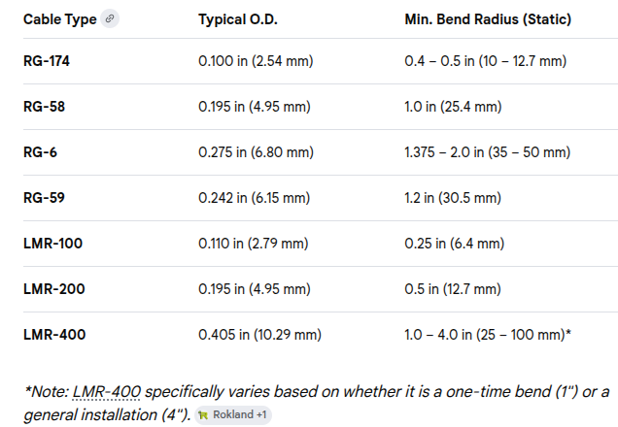
Bend Radius
The minimum bend radius of a coaxial cable is the tightest curve it can handle without damaging its internal structure or degrading signal performance. Bending a cable too sharply can crush the dielectric, displace the center conductor, or deform the shield, leading to increased signal loss (attenuation) and impedance mismatches.
If a manufacturer's specification is unavailable, you can use these common industry standards based on the cable's Outside Diameter (O.D.):
  Static (Fixed) Installations: 5 to 10 times the cable O.D..
  Dynamic (Repeated Flexing): 15 to 20 times the cable O.D..
  Micro-coax (e.g., U.FL cables): Typically around 6 times the O.D.

Slide 13
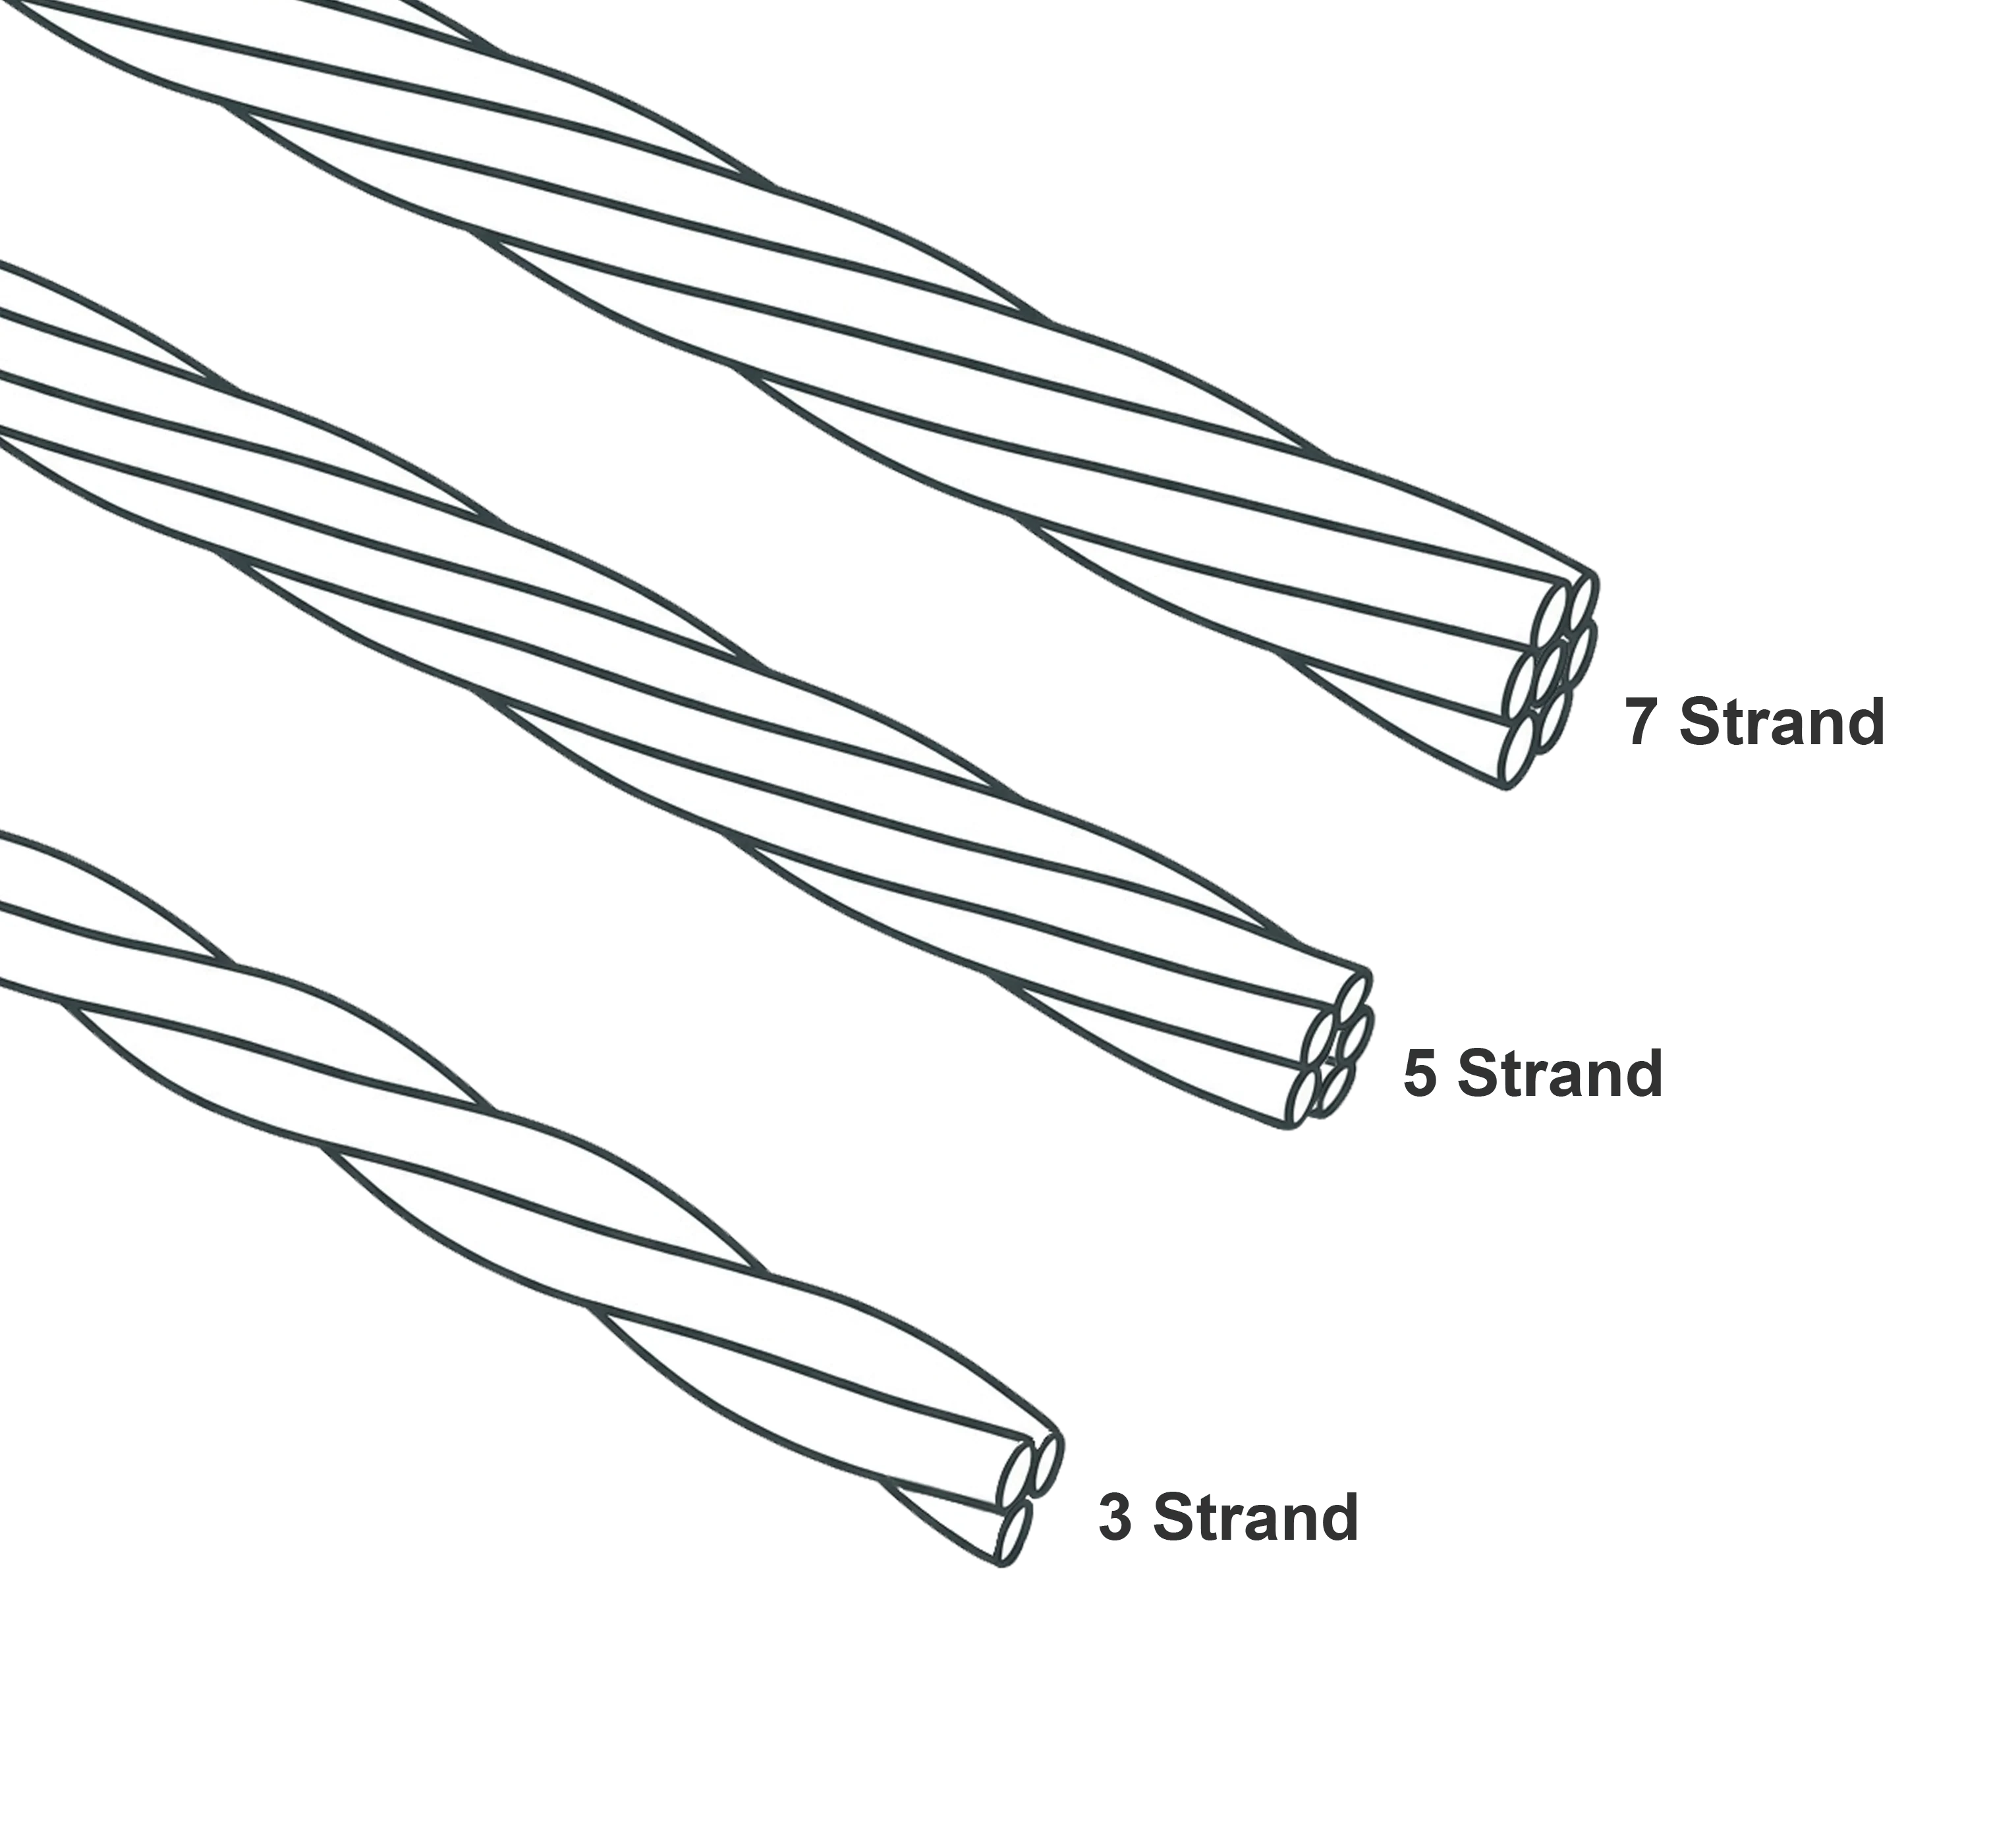
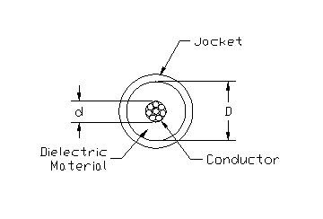
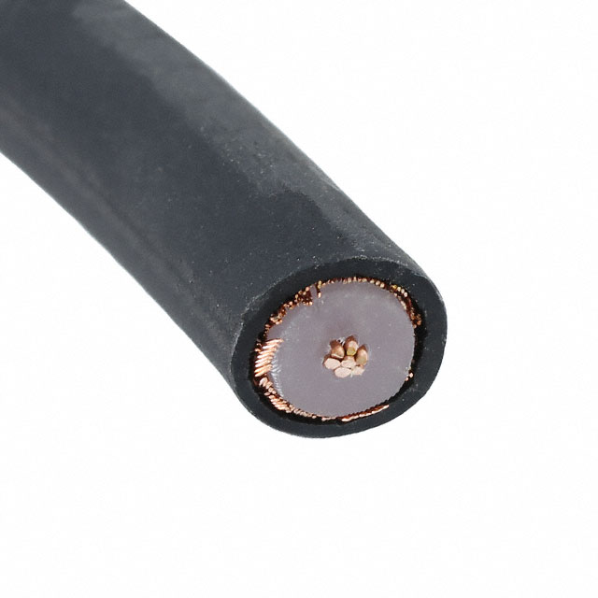
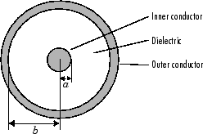
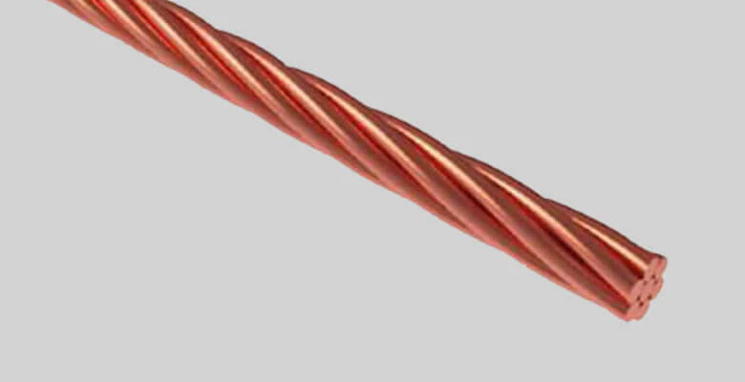
Solid vs. Stranded Center Conductor
Times Microwave Systems, LMR-400 Cable as an example
  LMR-400 Standard ( Solid) at 900 MHz is 0.13 dB/meter
  LMR 400 -UF (Stranded) at 900 MHz is 0.16 dB /meter
RG-213

Slide 14
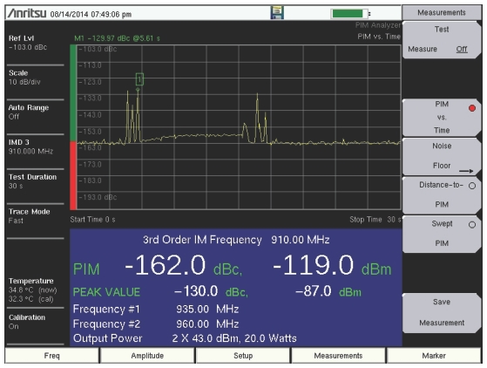
Passive InterModulation (PIM)
(PIM) in RF connectors and transmission lines is a form of signal interference caused by non-linear junctions in the signal path, such as loose, damaged, or corroded connections. It occurs when two or more high-power signals interact, creating unwanted, interfering frequencies that degrade receiver sensitivity and lower network capacity, particularly in 5G and cellular systems.
  Poorly Torqued Connectors: The most common cause, where insufficient pressure creates a non-linear contact.
  Contamination: Dirt, moisture, metal filings, or oxidation within the connector interface.
  Damaged Components: Scratched mating surfaces, damaged center pins, or kinked cables.
  Material Discontinuity: Using dissimilar metals or ferromagnetic materials (e.g., nickel) in the conductor path.
  Cold Solder Joints: Poor soldering in connectors or cable assemblies.
High-Risk Metals and Materials:
Nickel (Ni): Widely used in plating (e.g., nickel-plated connectors or gold-over-nickel plating). Nickel is ferromagnetic and acts as a major PIM source, potentially adding 20 to 40 dB of PIM to the signal.
Iron (Fe) & Steel: Common in structural components, connectors (especially stainless steel), and hardware (screws, bolts). Rusty iron or steel creates "rusty bolt" PIM, an exceptionally strong form of PIM.
Cobalt (Co): Similar to nickel, cobalt is ferromagnetic and should be avoided in RF paths.
Ferrites: Used in components like isolators and circulators. While necessary, they can produce higher PIM if cracked.
Aluminum (Al): Aluminum oxide, which forms rapidly on exposed surfaces, is a non-linear dielectric that can cause PIM through electron tunneling.
Copper (Cu) with Corrosion/Solder Flux: While pure copper is generally good, copper oxides or contaminated solder joints (if not properly cleaned) can create non-linear, diode-like effects.

Slide 15
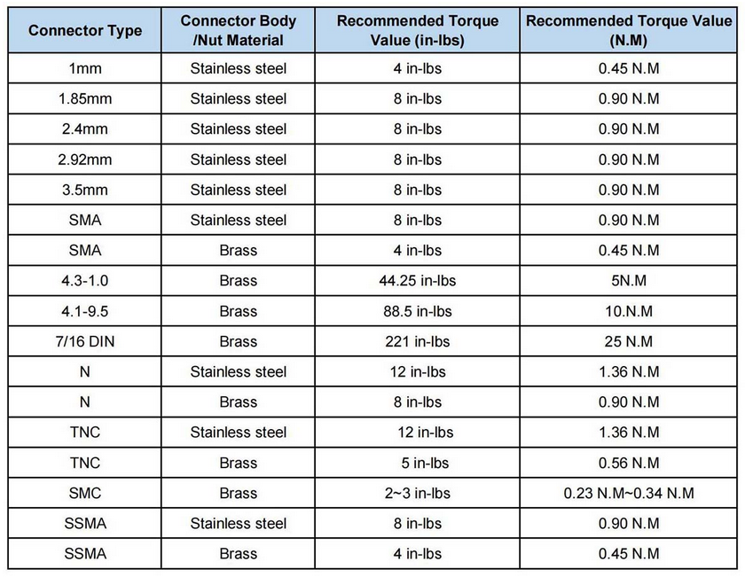
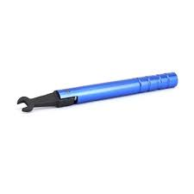
Connector Torque
Key Guidelines for Torque Application
Use a Torque Wrench: Always use a calibrated torque wrench to ensure proper mating force, specifically designed for the connector type (e.g., break-over wrenches).
Rotate Only the Nut: When connecting, turn only the coupling nut, not the cable or the connector body, to avoid damaging the center conductor.
Over-tightening Issues: Excessive torque can deform threads, crush the dielectric material, and destroy the connector interface.
Under-tightening Issues: Insufficient torque leads to poor grounding, high insertion loss, and intermittent signals.
Finger Tightening: Only suitable for temporary or low-frequency connections; it is generally insufficient for high-performance applications.
https://www.rfone.cn/articles/frequently-asked-questions-for-torque-wrenches

Slide 16
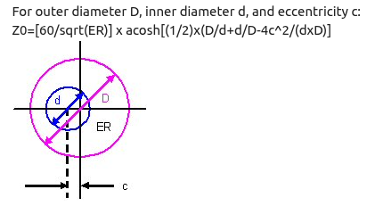
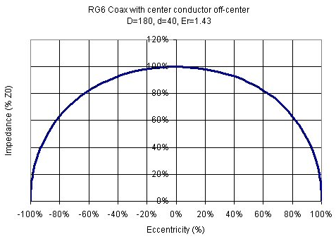
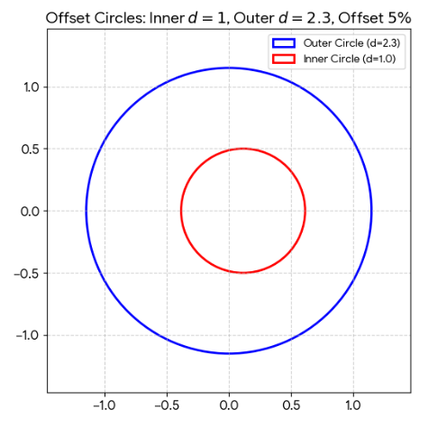
Concentricity
As the center conductor moves off-center, the characteristic impedance can only decrease; it will never increase. However, the change is relatively small compared to the physical displacement. For instance, a 50% deviation from the center typically results in only about a 10% drop in impedance.
https://www.microwaves101.com/encyclopedias/off-center-coax
5%

Slide 17
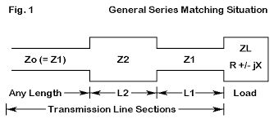
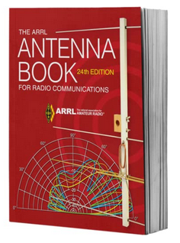
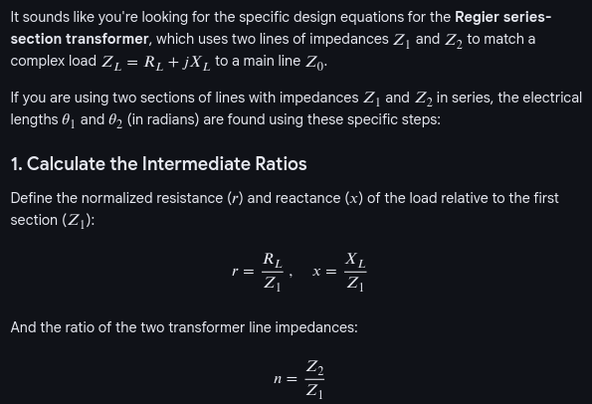
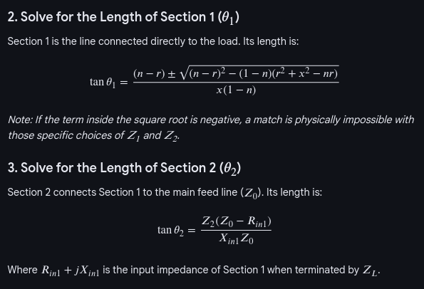
Transmission Line Impedance Matching
ARRL Antenna Book
24th Edition
Section 24.4.3

Slide 18
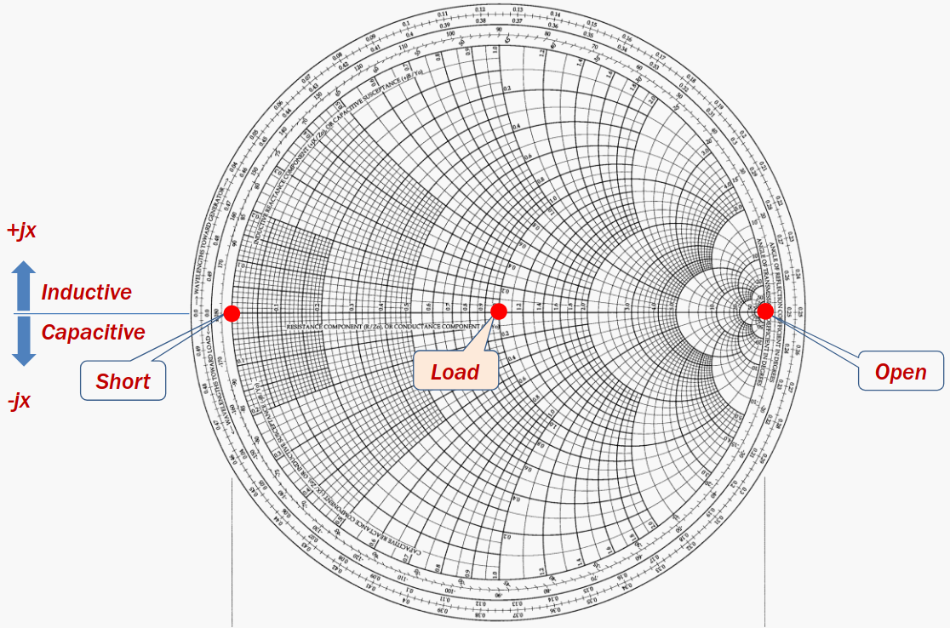
Smith Chart

