Slide 1
Offset Cassegrain Antenna Bob KB1QV
Focus Hard
49th Eastern VHF/UHF/Microwave Conference
25 April 2026

Slide 2
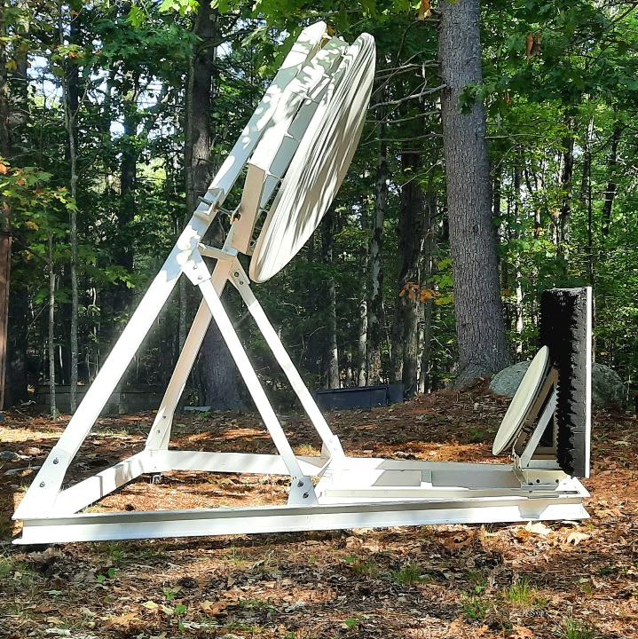
Contents
Antenna
Purpose
Challenges
Techniques
Results

Slide 3
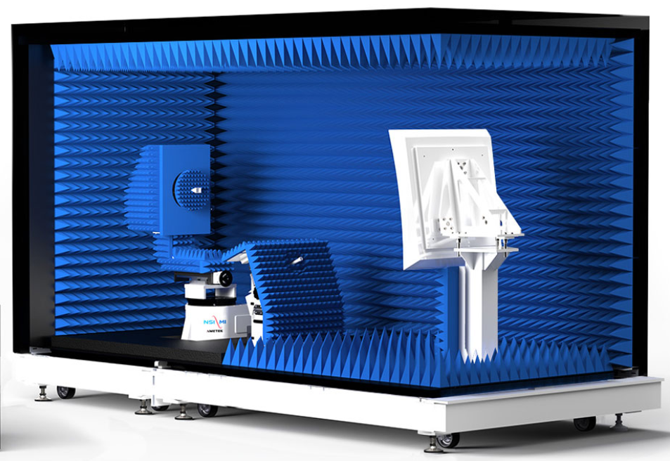
Antenna
Offset Cassegrain design
Parabolic main reflector
Hyperbolic sub reflector
Compact antenna range application
Used for automotive radar testing
24GHz and 77GHz
Obtained surplus
Don’t ask.
https://www.nsi-mi.com/system-solutions/far-field-systems/compact-range-systems/portable-compact-range-measurement-systems/portable-compact-range-measurement-system-18-05

Slide 4
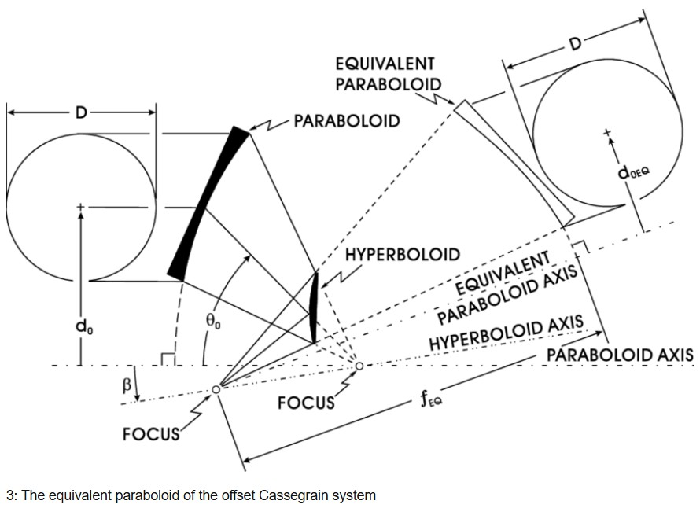
Purpose
Purpose
Find the focal point of the system
Verify system alignment
Determine desired placement and orientation for antenna feed
Once fully completed, use the system for microwave communications and radio astronomy

Slide 5

Challenges
The original feed and mounting hardware are not available
The design feed location is not known
There are alignment adjustments on both the main reflector and sub reflector
Positional geometry is likely very sensitive
The reflector surfaces are a matte off-white finish
The system was not originally intended to be used as an antenna

Slide 6
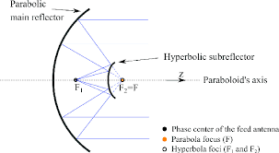
Techniques
Several methods will be tried to find the focus point of the system
Each will hopefully yield a best location
The locations will be averaged and weighed to make a final determination for the feed location
All techniques use wave phenomena that utilize the broadband nature of reflector surfaces
The various methods attempted are listed below:
Analytical techniques
Equations determined for the primary surfaces
E.M. Simulations considered
Optical, white light
Small mirrors distributed on surfaces
Projected from the focus to distant flat surface
Thermal / Infrared
Create a localized a heat sources at the focus point
Use a thermal camera to see how the main dish is illuminated
Acoustic / Sound
Put a planar sound source at a distance
Focus a microphone at focus to find the maximum
Microwave
Install a microwave source and coupled detector at the focus
Have a larger reflector at distance

Slide 7
Analytical
Determine the profile of the surfaces
The most important parameter is the vertical profile
It is assumed that the focus is symmetrical in azimuth and is on the center-line
The parabola was measured in two axis mechanically
The sub-reflector was laser scanned to make a surface model of the complex surface.
The relative location of the of each of the reflectors needs to be determined accurately
Analysis was outsourced

Slide 8
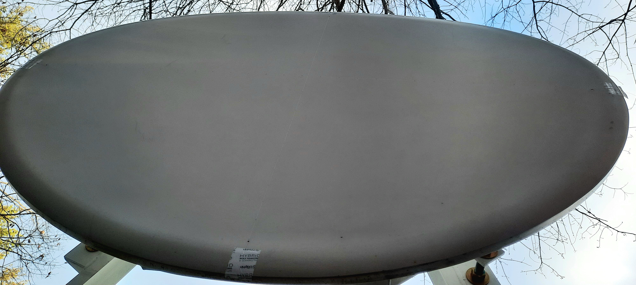

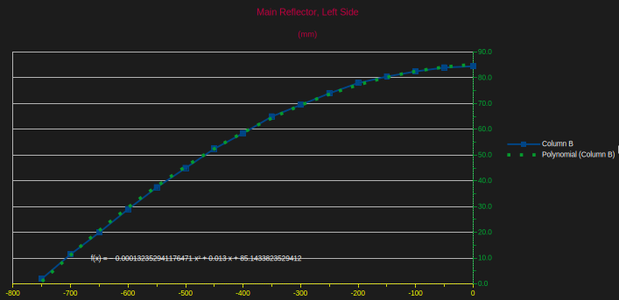
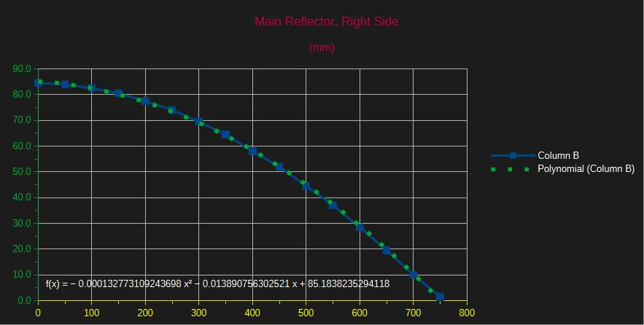
Geometry, Main Parabola

Slide 9
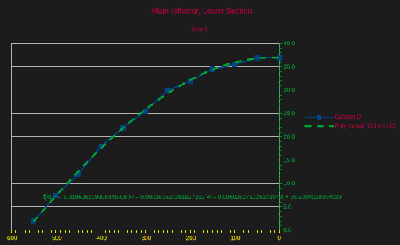
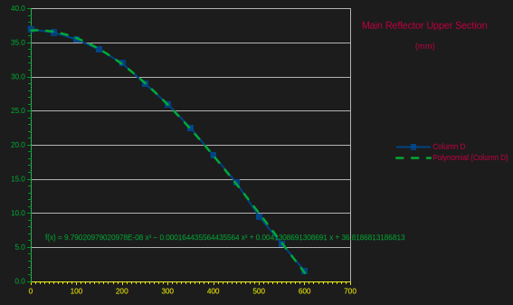
Geometry, Main Parabola Vertical Axis

Slide 10
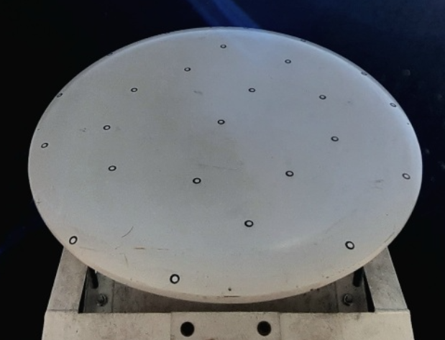
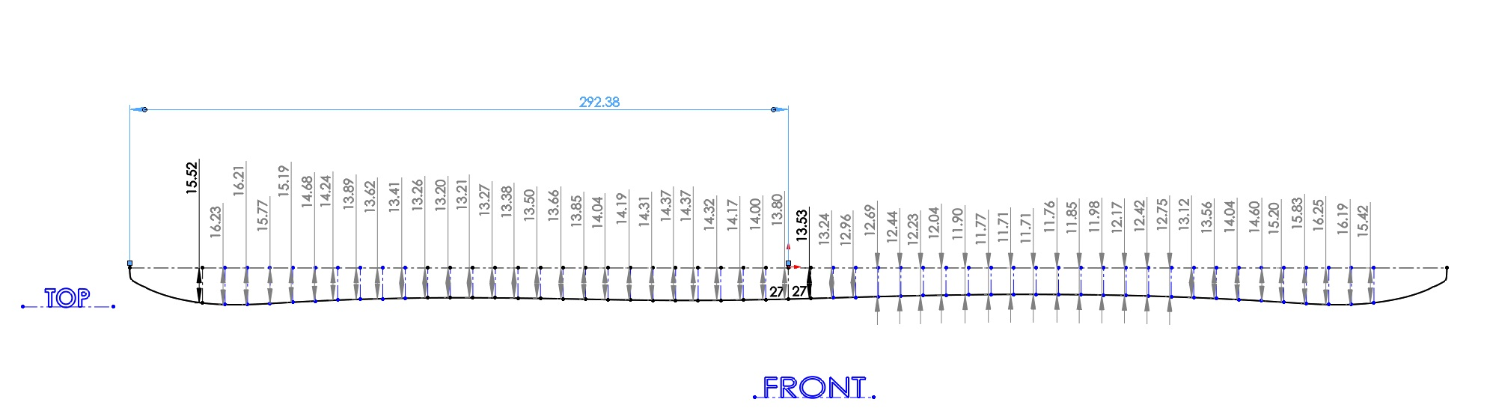
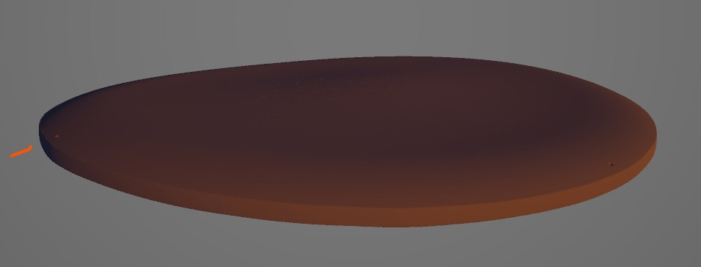
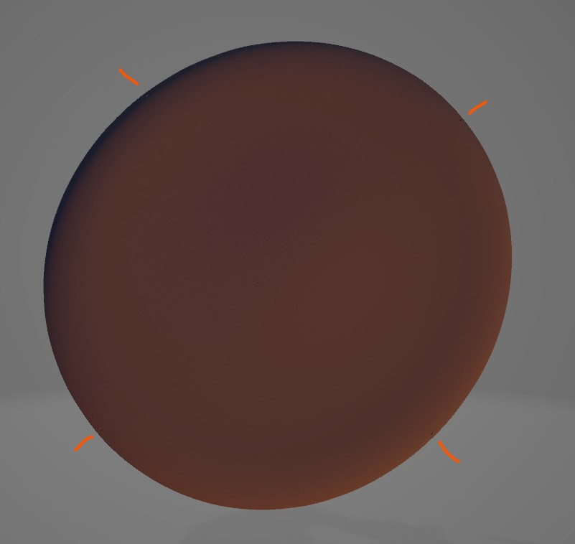
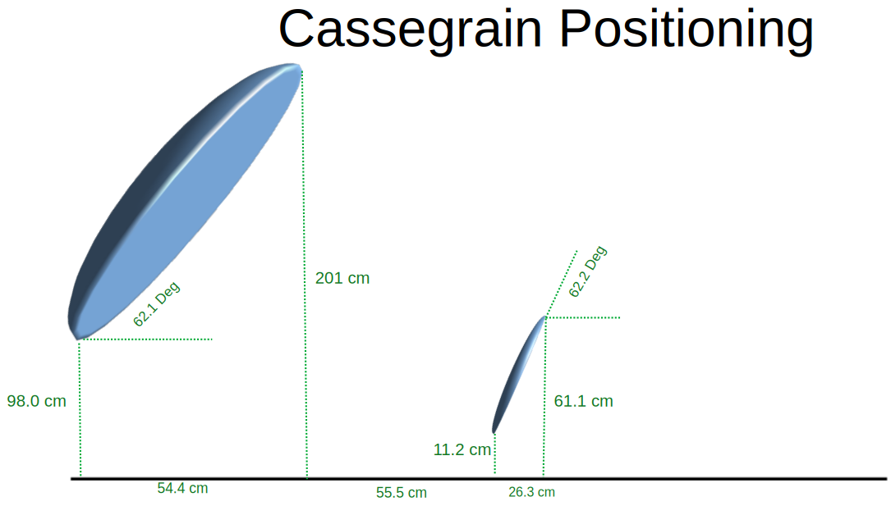
Geometry Sub-Reflector
Sub-reflector
Scan

Slide 11
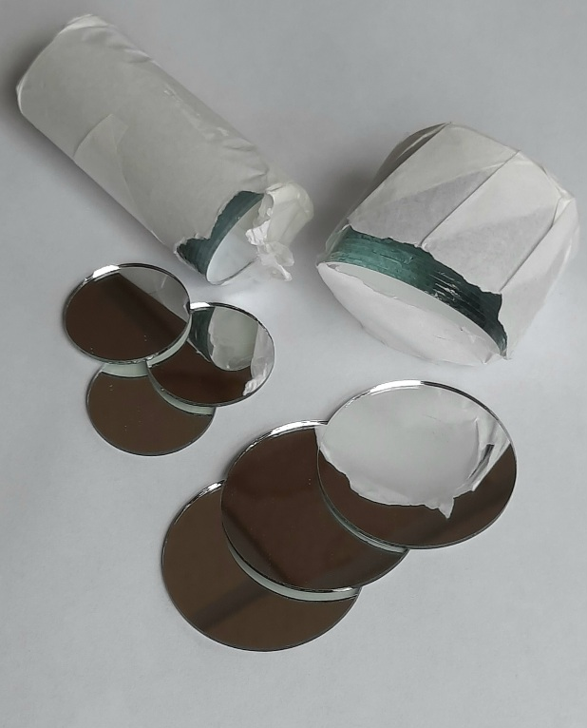
Optical
Strategically place mirrors on the antenna surfaces
Mirrors are attached with a thin layer of adhesive
Use a bright white light source at the focus
Project on to a flat white surface at night
Move the source until an optimum is found
Add or adjust location of flat mirrors as required
Verify that first reflection from the sub-reflector mirrors properly illuminate mirrors on the main reflector
It is more important that the vertical axis have the majority of mirrors.

Slide 12
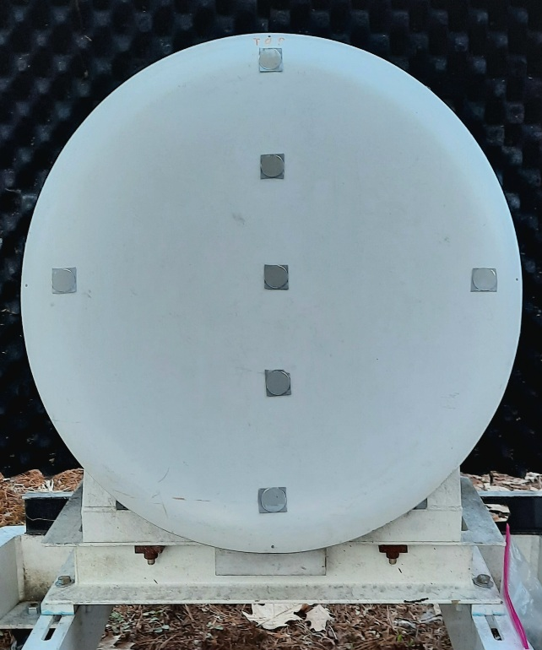
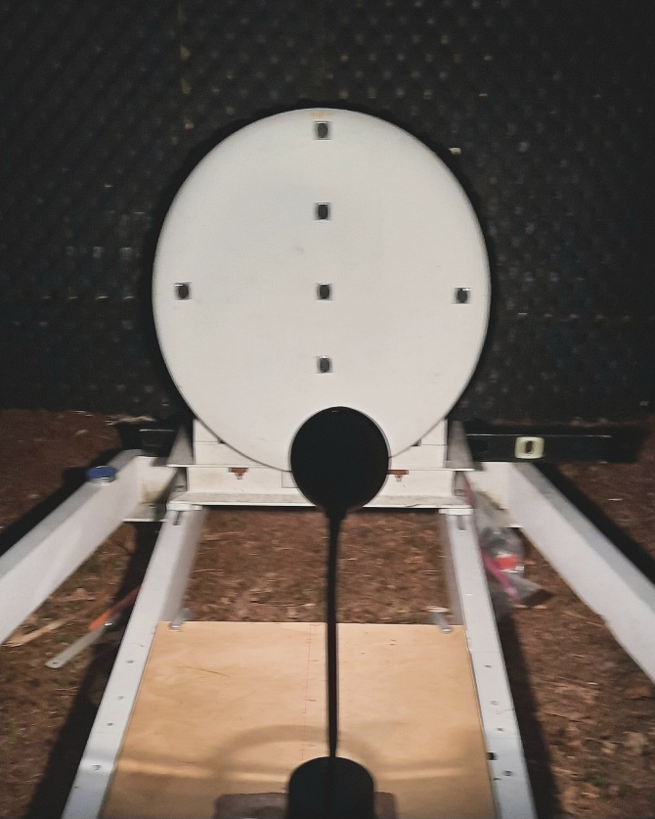
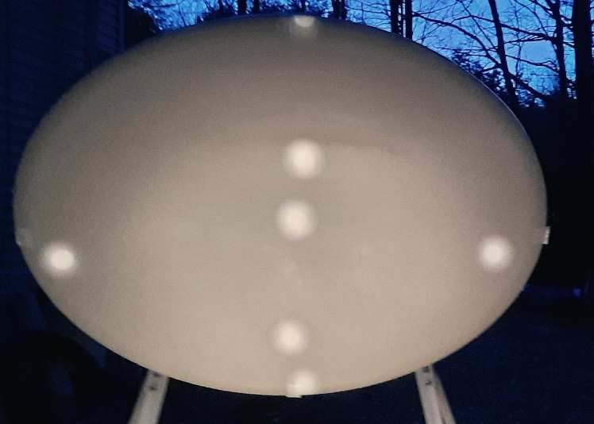
Optical Results

Slide 13
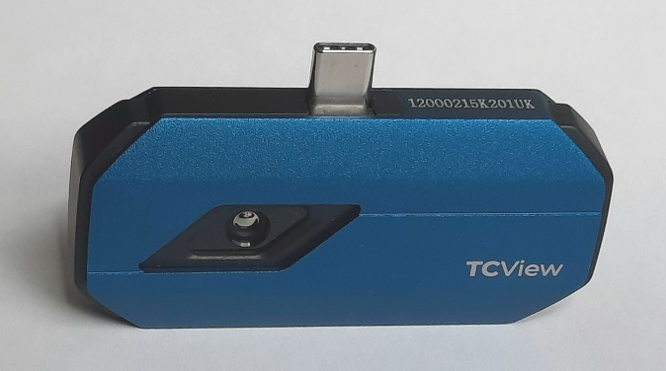
Thermal
Put an IR source at the focus point
This could be LED source or an actual heat source
Hopefully the off-white surface of the surfaces will be reflective enough
If not, aluminum foil can be added to enhance reflectivity
From a distance, observe the main reflector with the thermal camera
Verify that the camera is aligned on the system axis
Move the source until an optimum is found
Record images on USB C device.

Slide 14
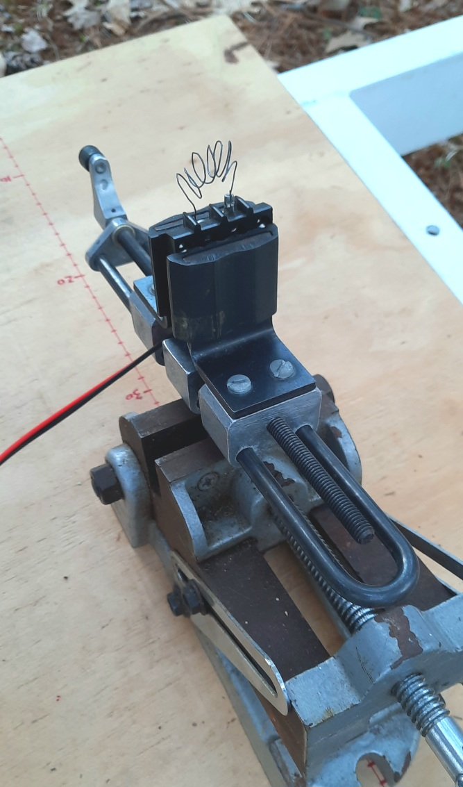
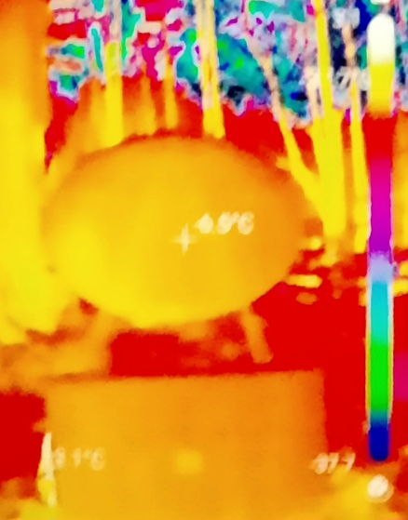
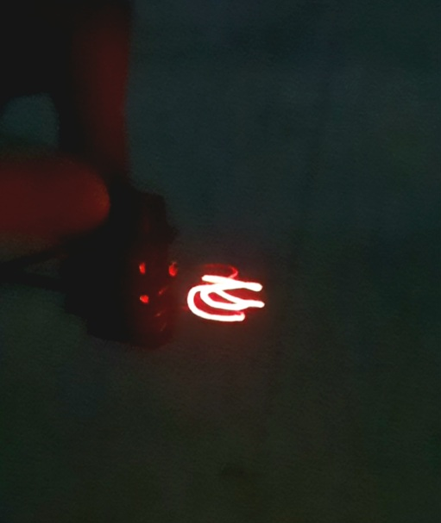
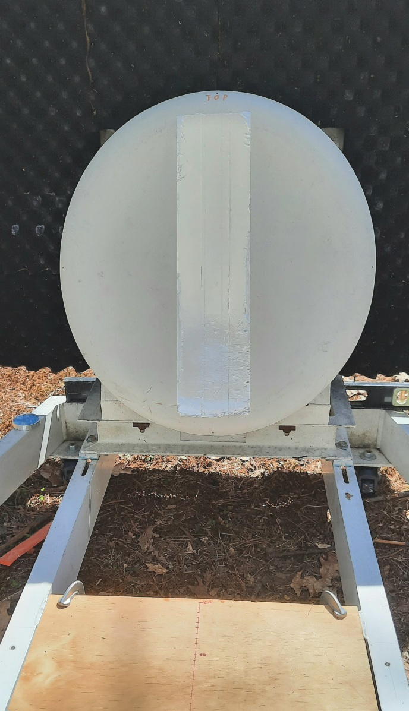
Thermal Images
~50 Watts

Slide 15
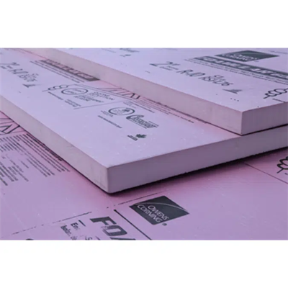
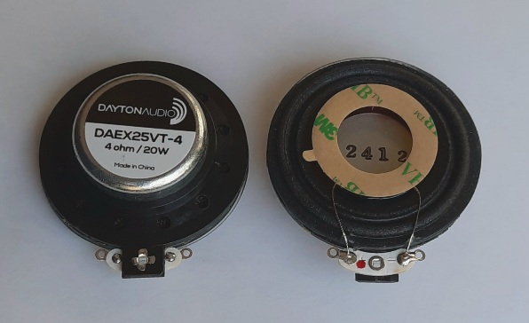
Audio
Crate a planar single audio tone at a distance
This can be accomplished with an audio driver and flat panel speaker
A small microphone is moved around in the focus are to find the maximum signal
A signal generator is used as the source
An oscilloscope is used as the receiver
An audio frequency is chosen that falls within the bandwidth of the devices
Likely around 10-15 kHz.
The RF frequency in GHz multiplied by 1.14 gives the acoustic frequency in kHz of equal wavelengths
Distributed Mode Loudspeaker (DML)

Slide 16
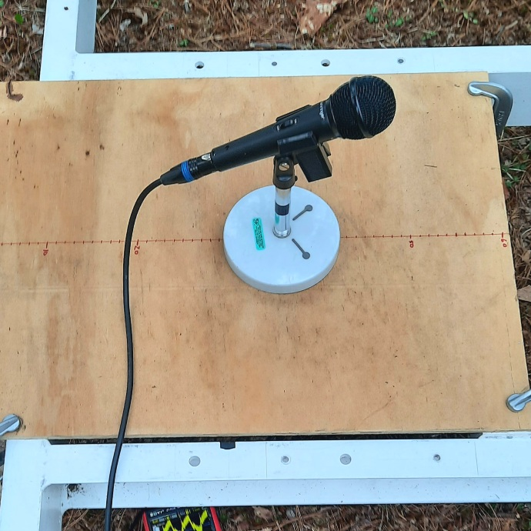
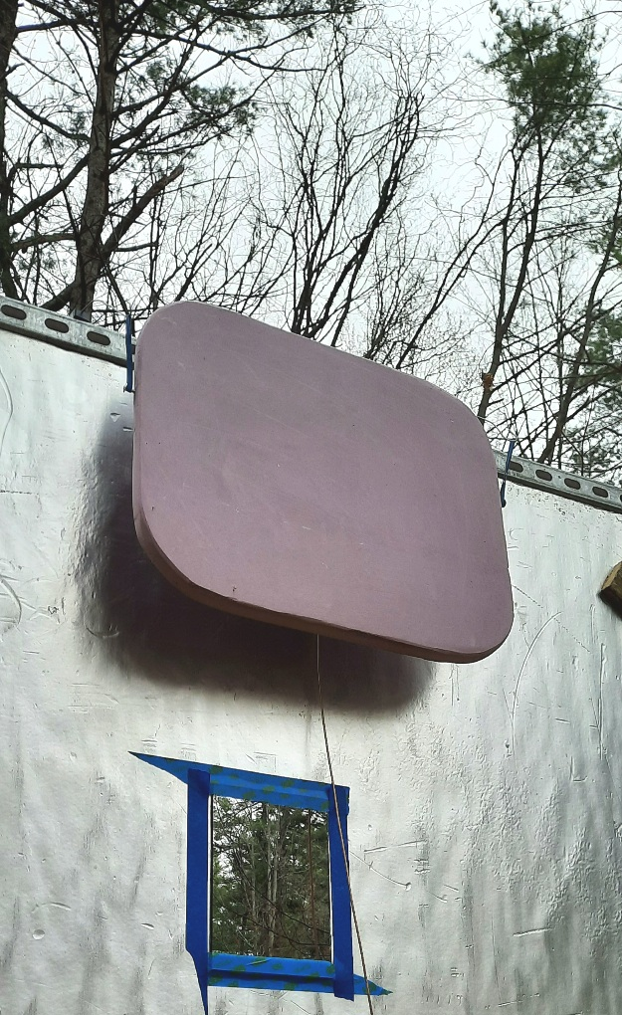
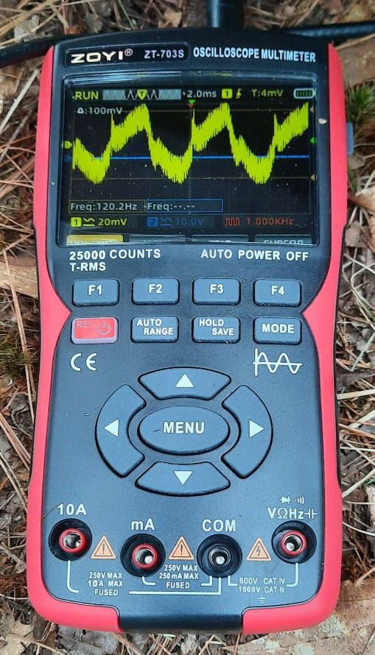
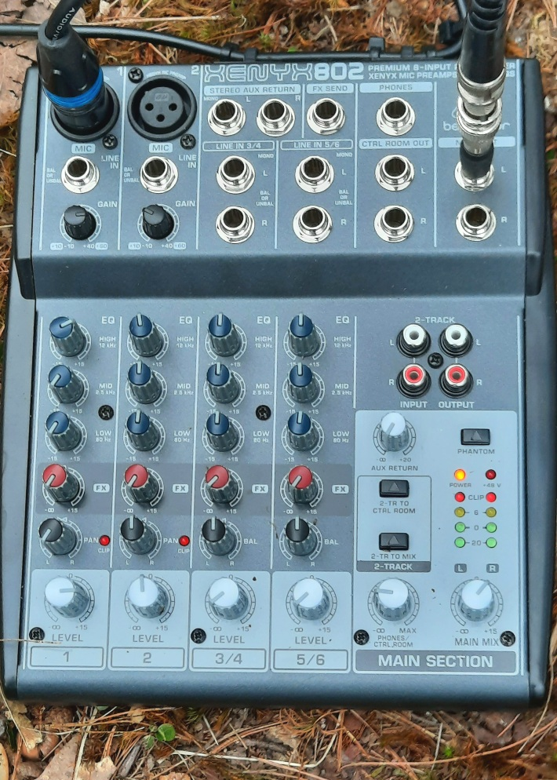
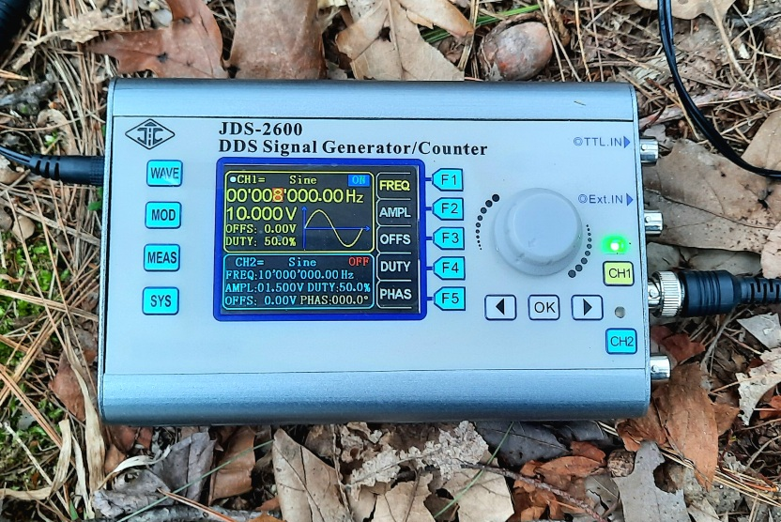
Audio Images

Slide 17
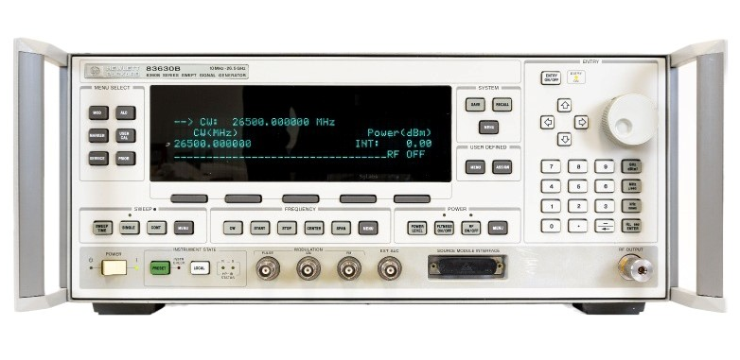
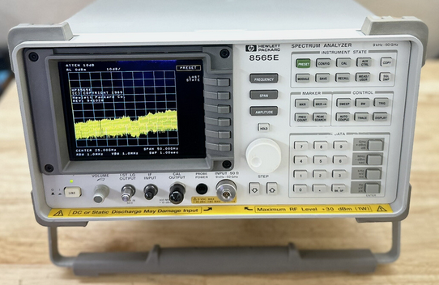
Microwave
A waveguide horn is put at the expected feed point
A highly reflective target is placed at a distance on the system axis
A frequency of 24 GHz will be used
Equipment available include a signal source and spectrum analyzer
A directional couple is used to measure the reflected energy from the distant target
Both a waveguide and a strip-line coupler are available
Move the feed horn until the highest amplitude is found
This is a 2-way measurement. Radar like.
This microwave measurement is most like how the antenna will be used in the field.

Slide 18
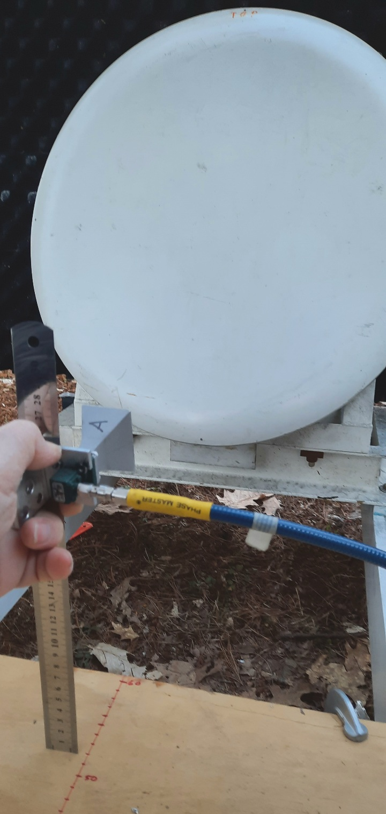
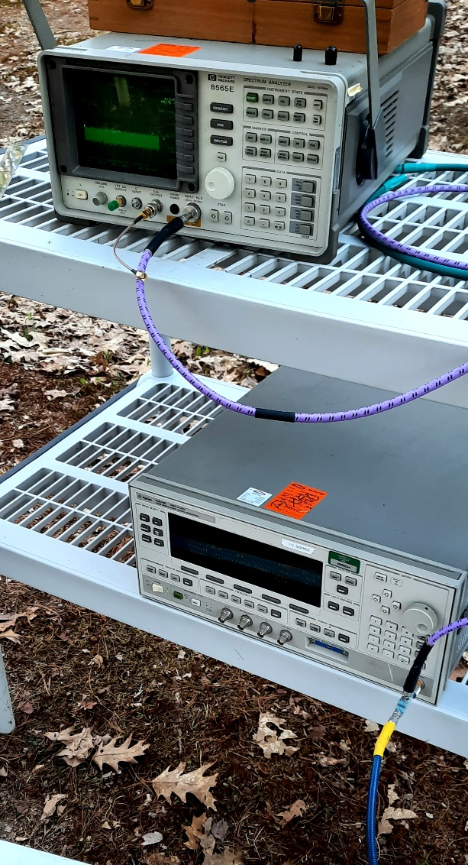
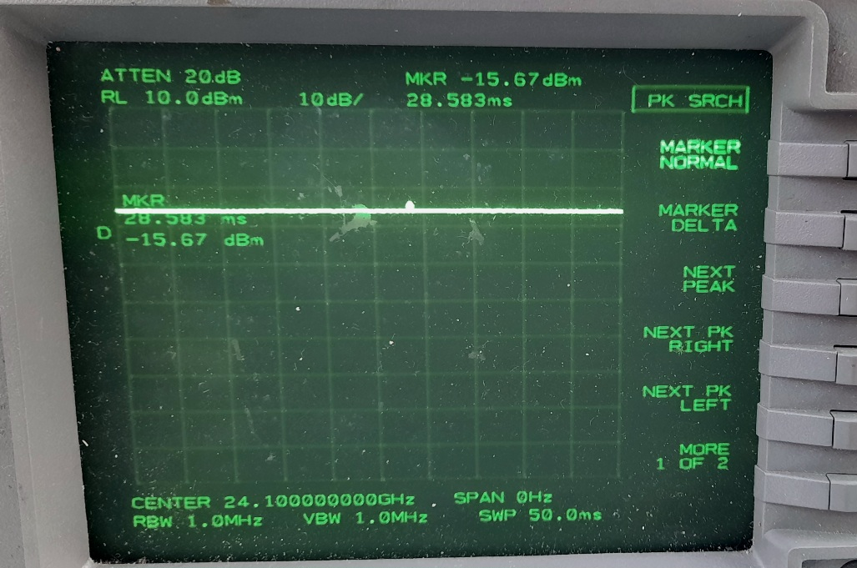
Microwave Images, Stripline
Spec-A, Max Hold

Slide 19
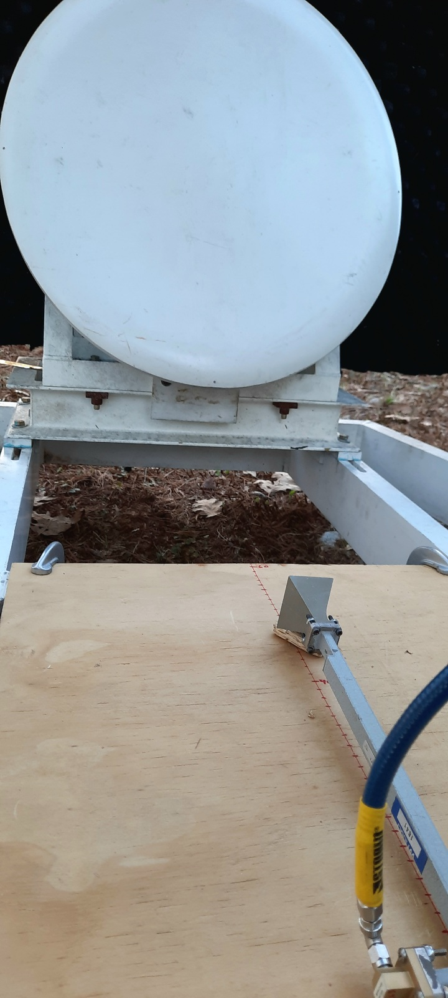
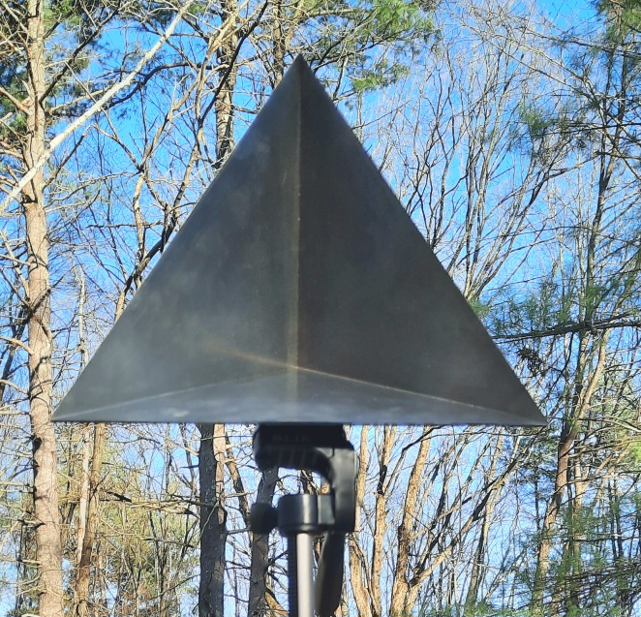
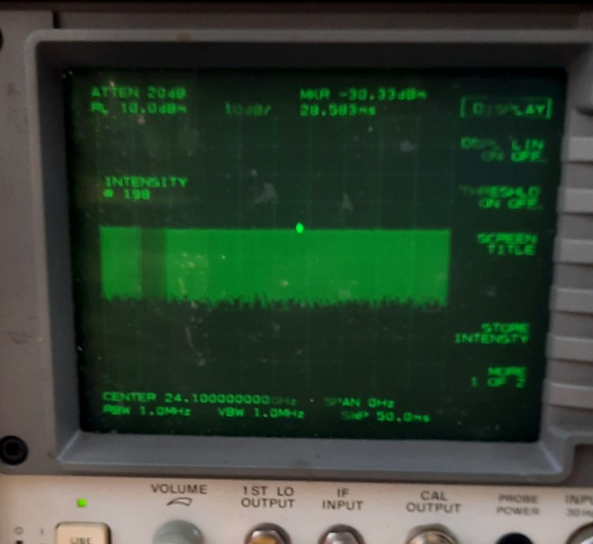
Microwave Images, Waveguide
Corner Reflector Target
Spec-A, Zero Span

Slide 20
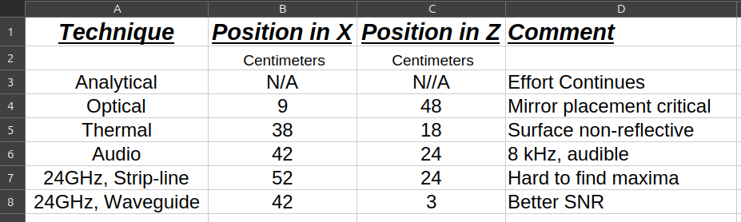
Position Results
There is no clear ideal location. However, in the X direction a number near the 40’s seems likely

Slide 21
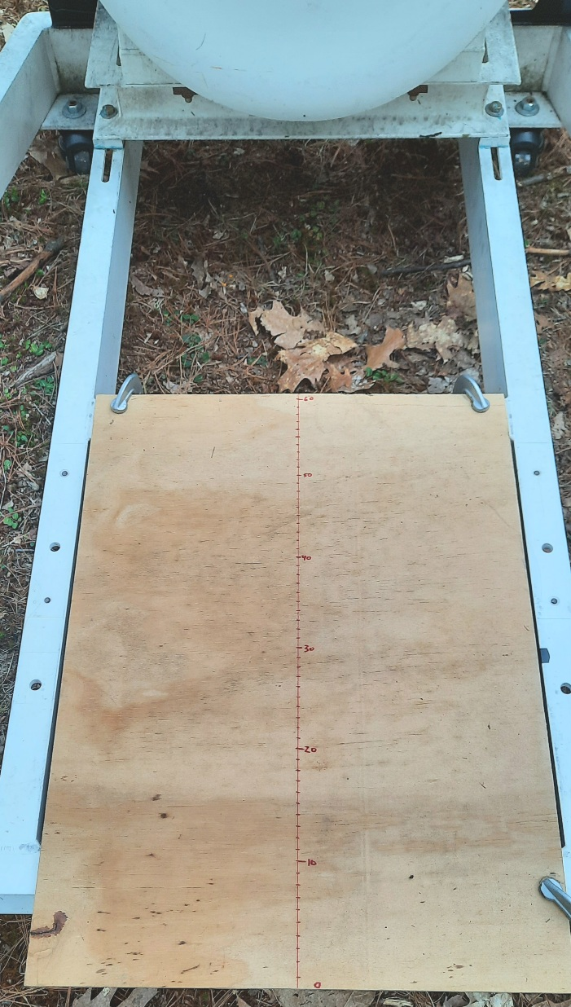
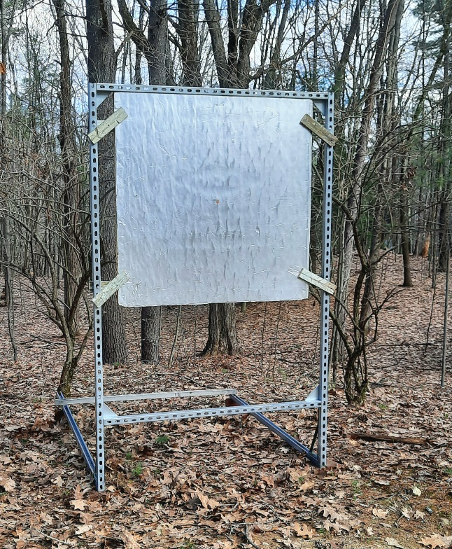
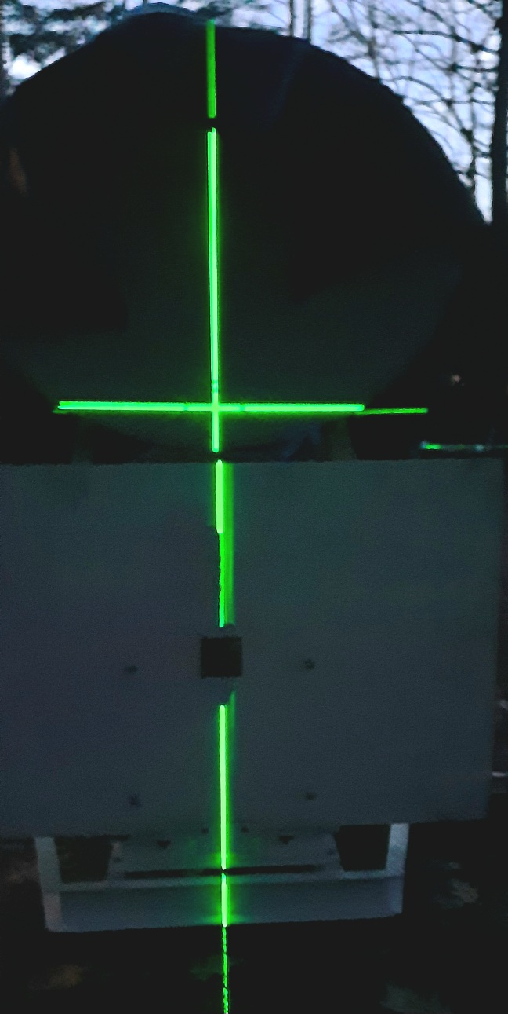
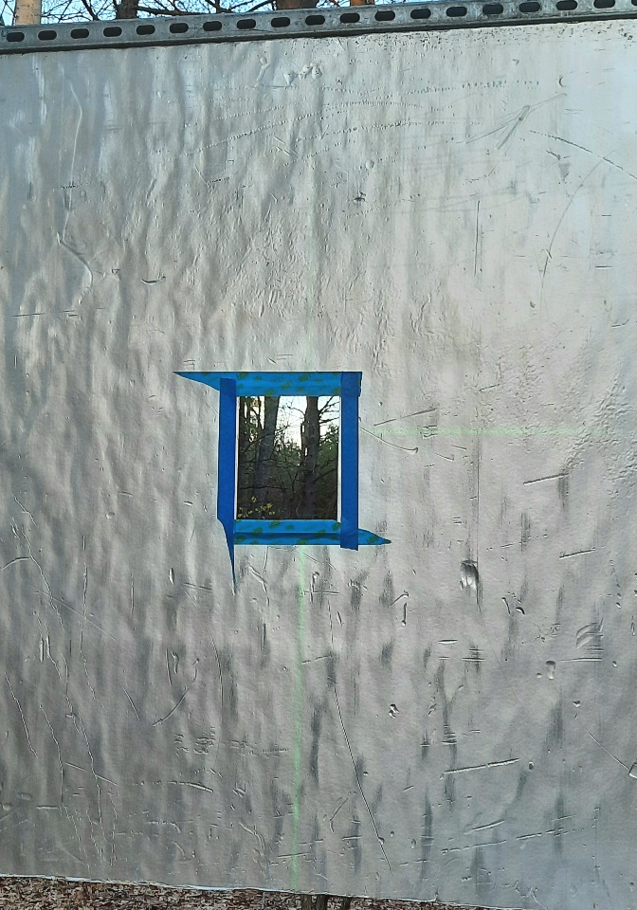
Set-Up
X-Axis
Coordinates
Target Structure
at 24 meters
Laser
Alignment
Flat First
Surface Mirror

Slide 22
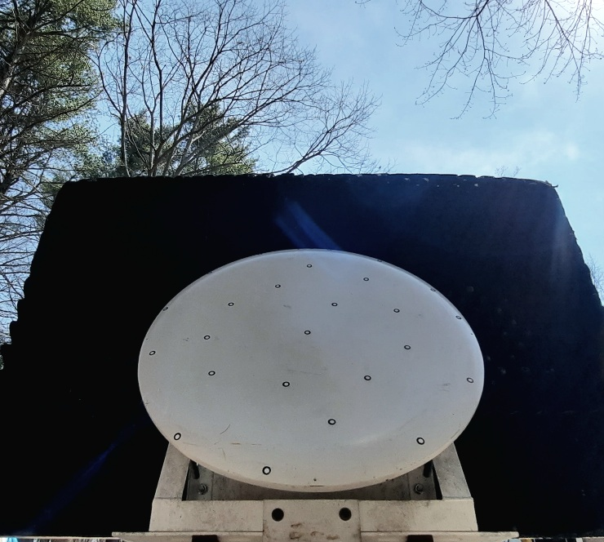
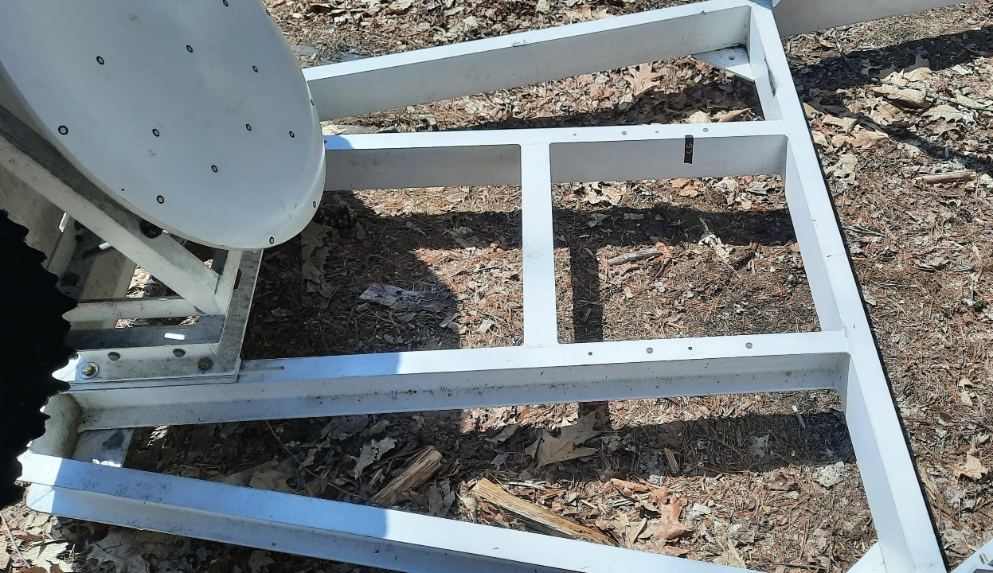
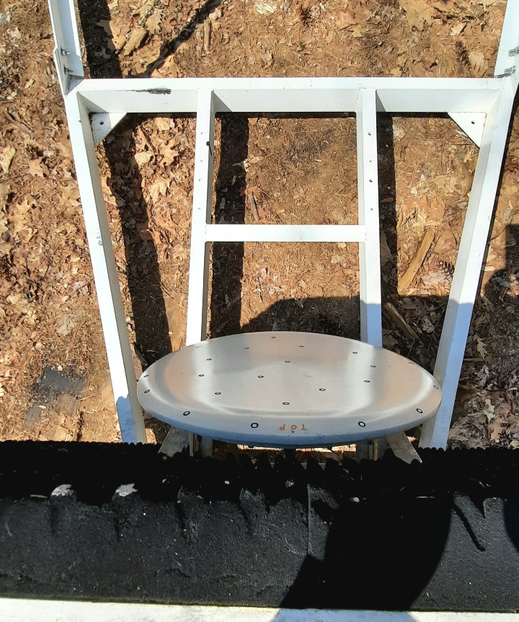
Other Views
Feed Perspective
Above Sub-reflector
Feed Mounting Region

Slide 23
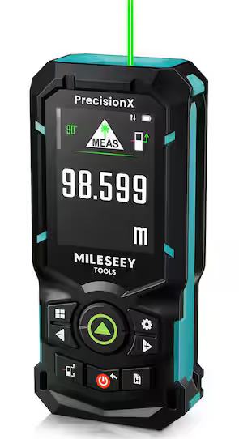
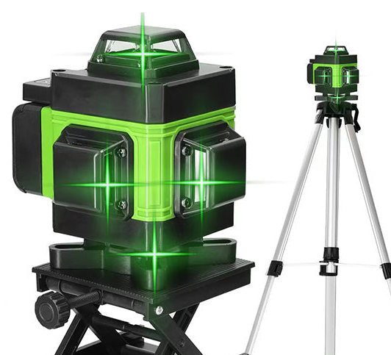
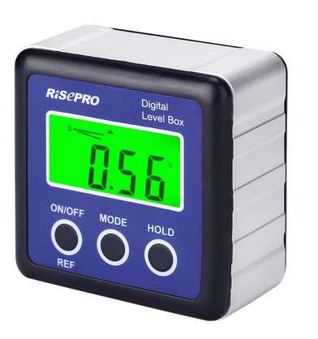
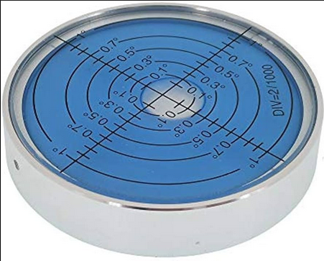
Set-up Equipment Used
Laser Level,
Vertical and
Horizontal
Laser Distance
Measure
Digital and Bubble Level

