Slide 1
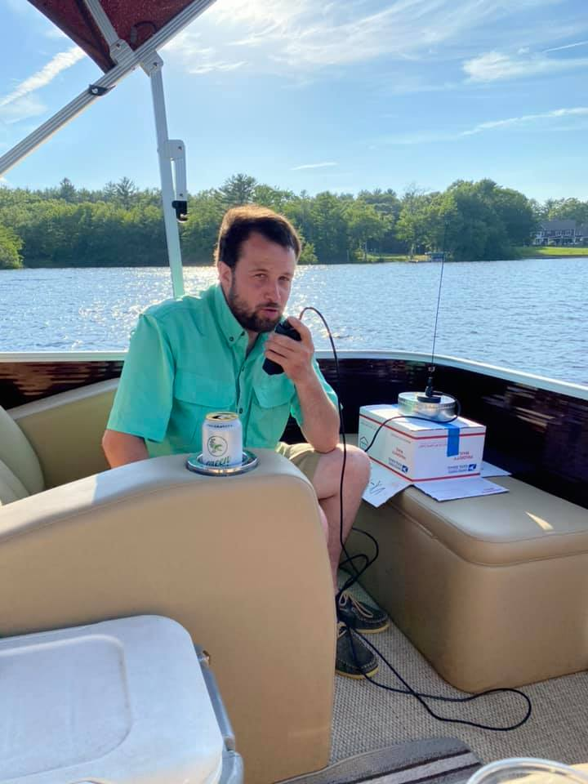
My VHF Journey
Portable Operating-
Chopmist Hill FN41du
Block Island, RI FN41fd
Nick Kettle KC1DWH
Operating Marine Mobile on Johnsons Pond RI

Slide 2
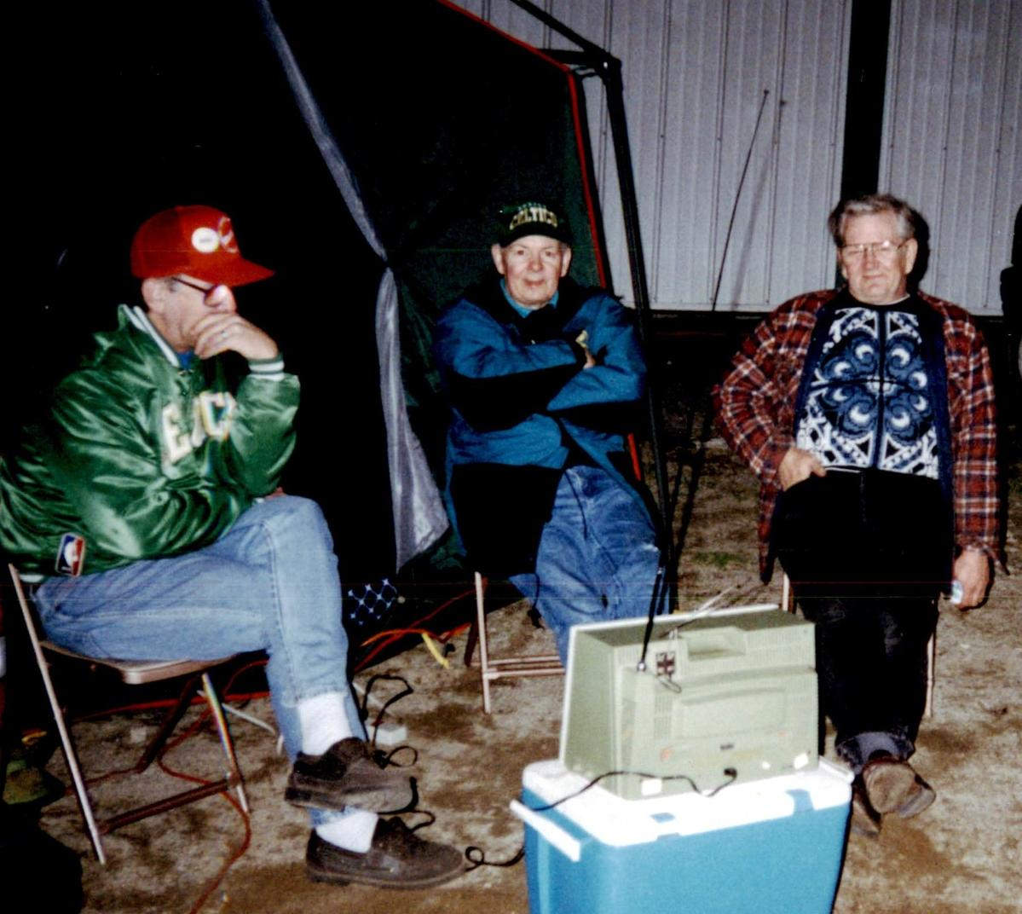
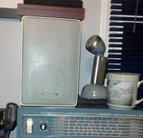
My Start in Ham Radio
Grandfather Bill May WA1WM (SK) got me started in the hobby along with his two Brothers Jerry May N1ULJ (SK) and Carl May W1CGM.
Uncle gave me a NC-155 that I used to listen on 75 meters AM
First Licensed in 2015 passing exam @ NEARfest
Would attend NEARfest and Field Day over the years with my grandfather, uncles and his friends in Fidelity ARC.
W1CGM Carl, WA1WM Bill, N1ULJ Jerry @ Hosstraders

Slide 3
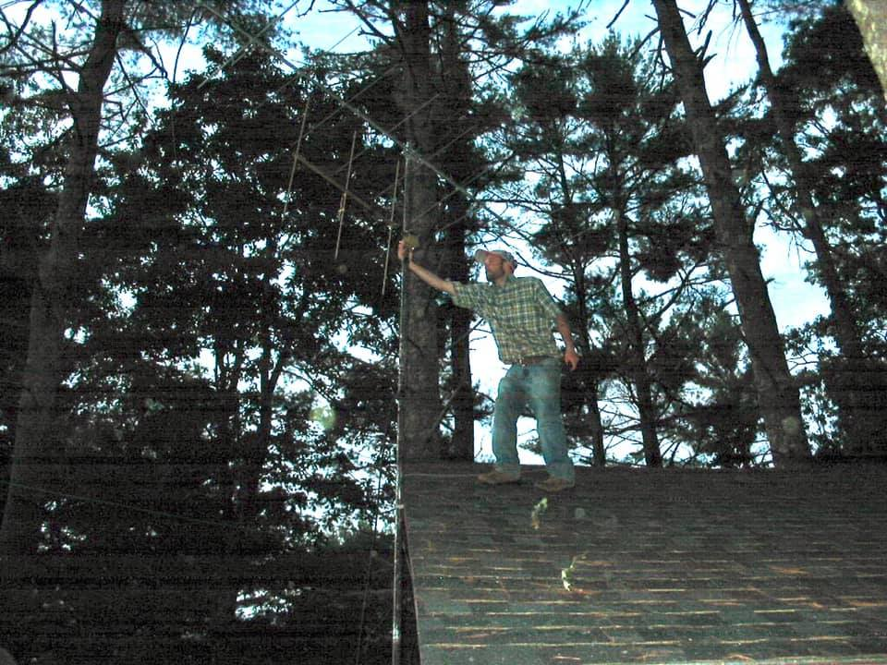
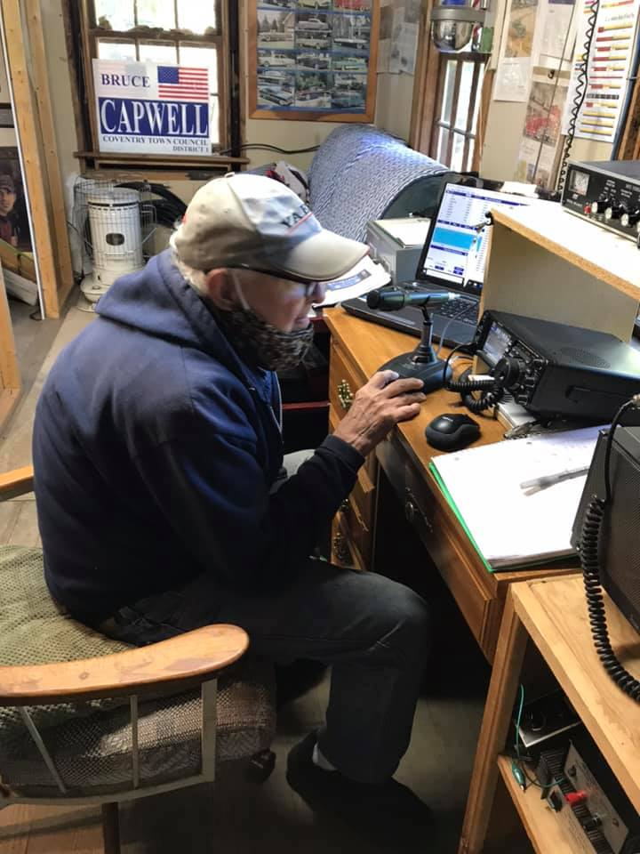
VHF Contest beginnings – June 2020
Inspecting 2-meter beam install on top of shack
Started getting involved in 2020 with June VHF contest
Most impressive contact with Aruba on 6 meters E- Skip
Operated from home QTH FN41CR
Antennas 6-meter 6 element quad and 9 element 2 meter beam and 3 element FM beam
Active on 6 and 2 meters
54 QSOs/ 36 Multipliers
44/26 on 6 & 10/7 on 2
1548 pts
WA1WM working 6 meters

Slide 4
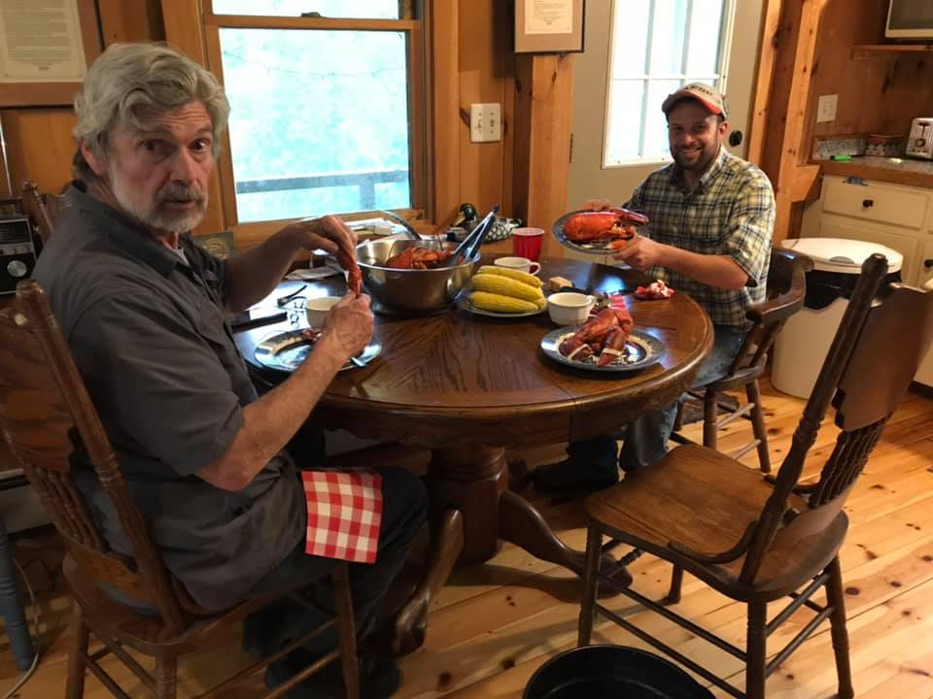
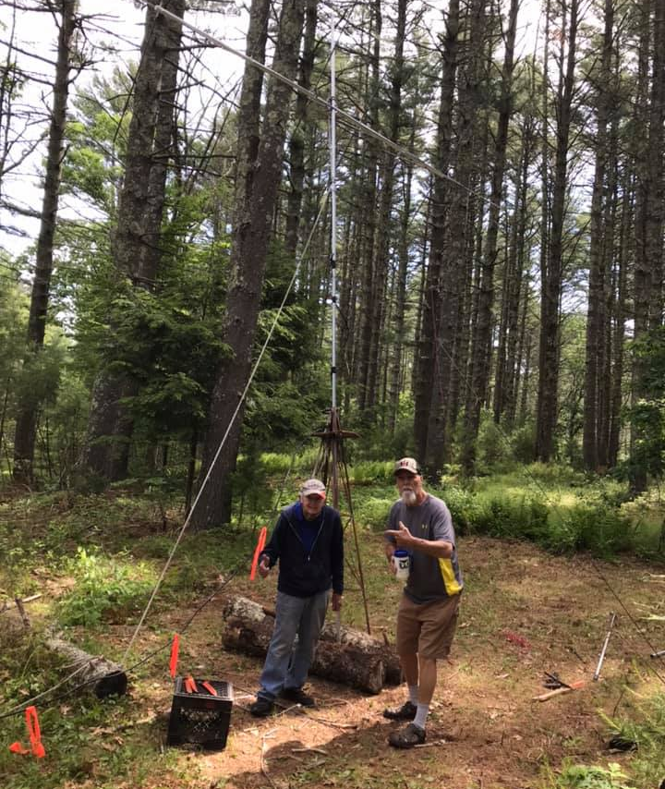
Food & Radio Club!
WI1I and Myself enjoying Lobster Clam Boil
WA1WM and Neighbor help set up Quad antenna

Slide 5
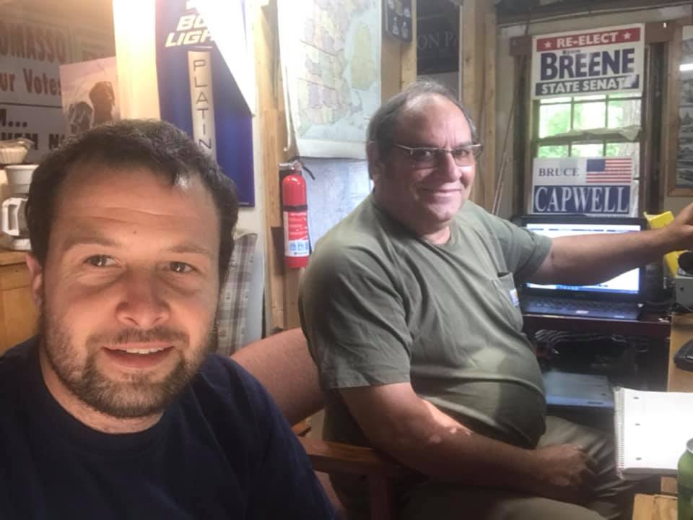
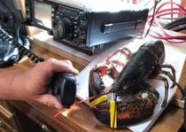
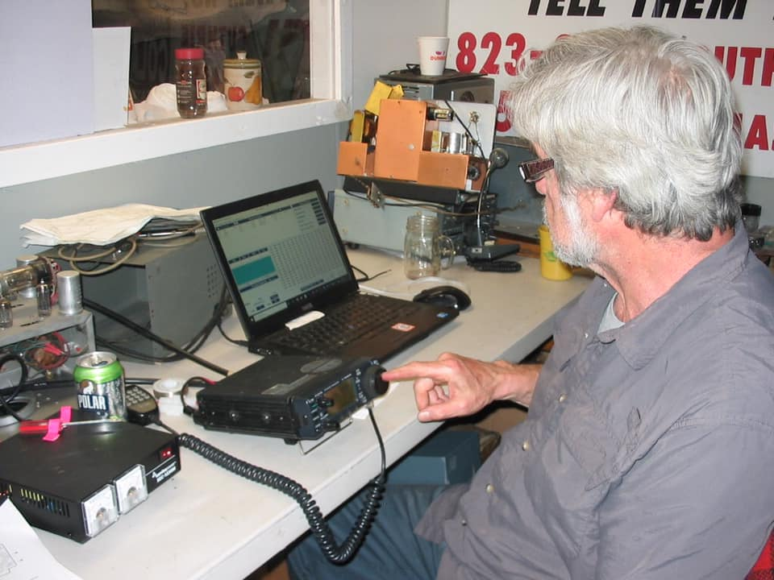
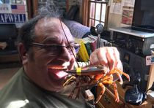
June 2021
Bit of a slump in this contest.
43 QSOs 25 Multipliers
37/22 on 6 meters and 6/3 on 2 meters
1000 pts
Radios Yaeau 991 and Icom 706 (2 meters)

Slide 6
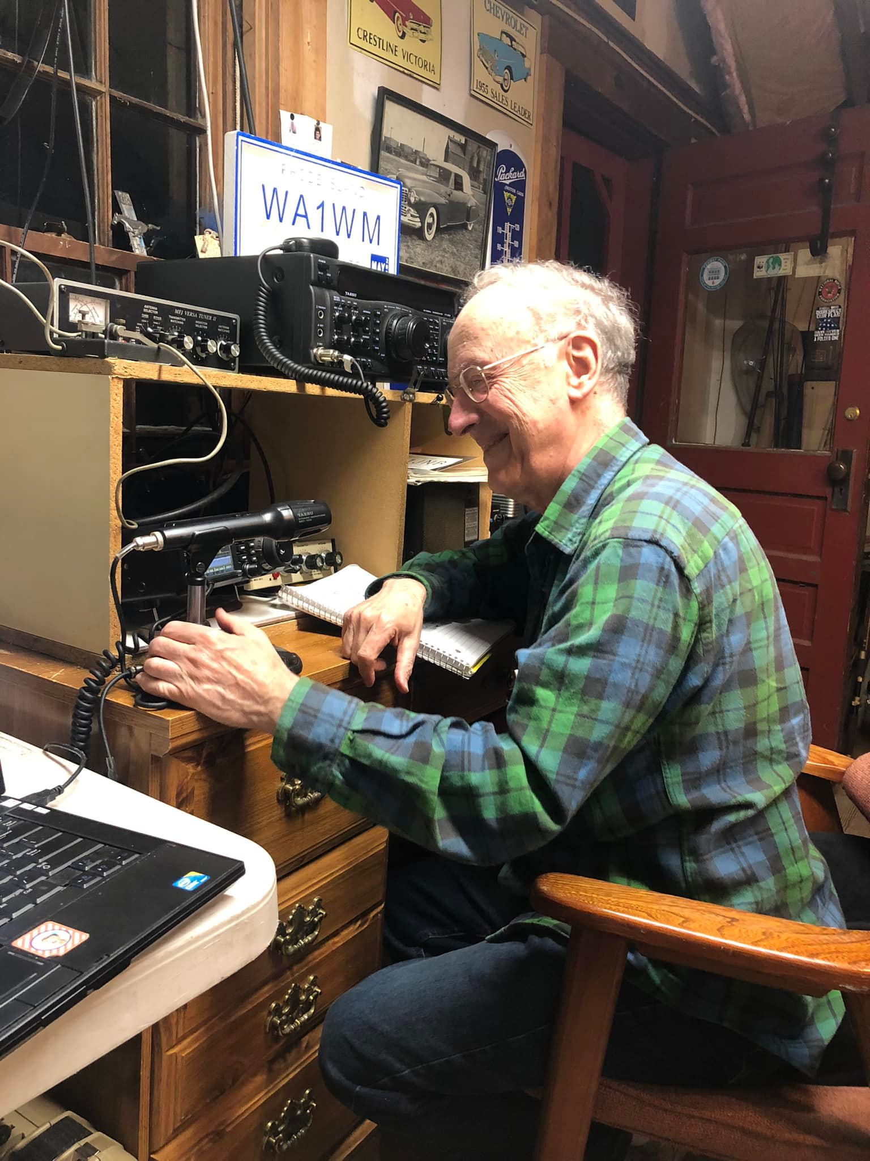
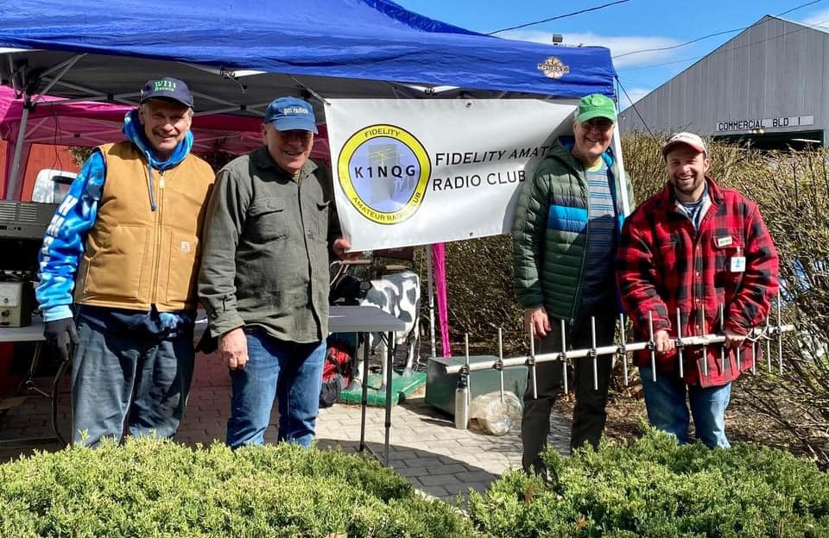
June 2022
K1KT operating
Added 70 Cm (432 ) this time!
70 QSOs and 43 Multipliers
67/40 on 6 meters 2/2 on 2 meters and 1/1 432
3,010 pts
WI1I, K1DFT, AB1HO & KC1DWH with new 432 beam @ NEARFEST

Slide 7
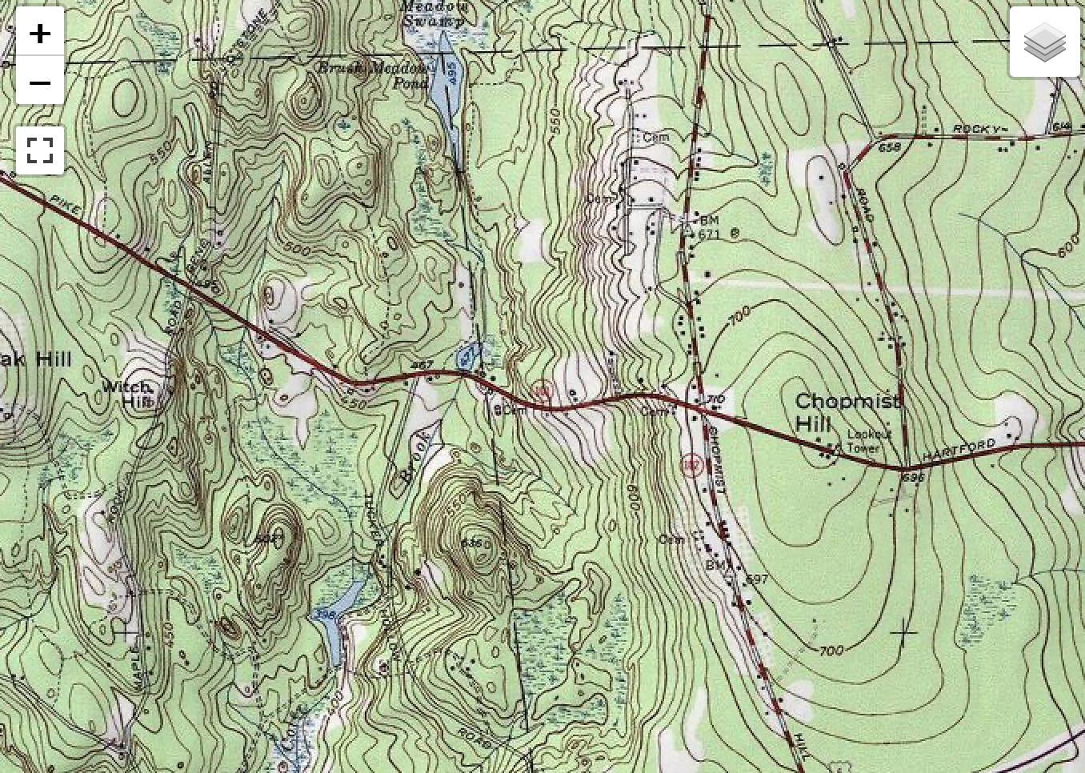
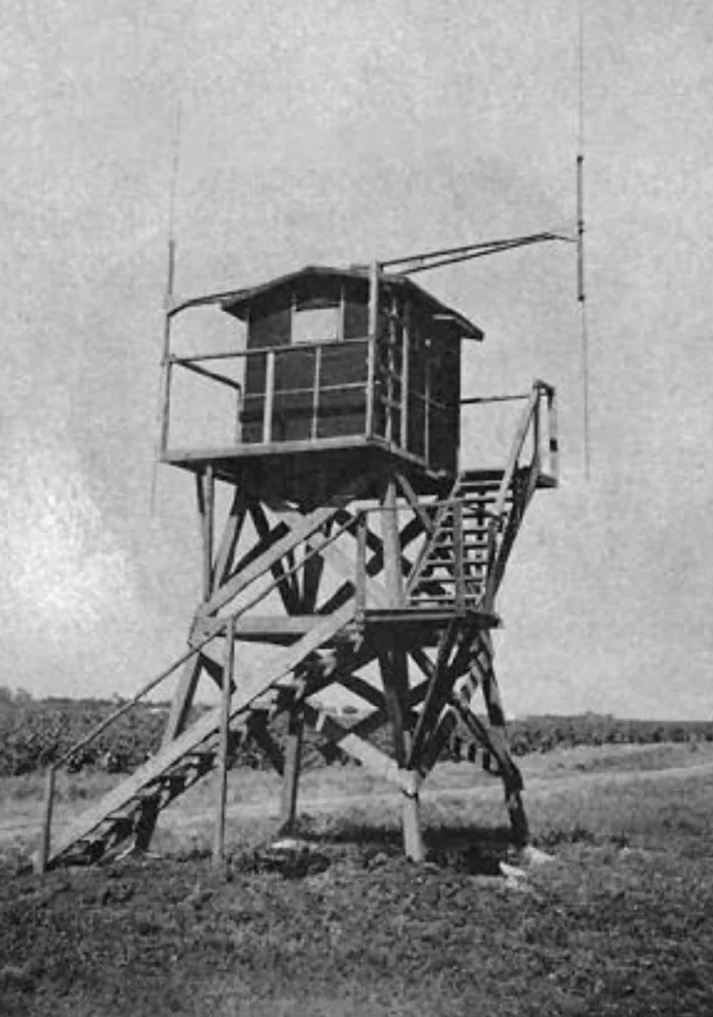
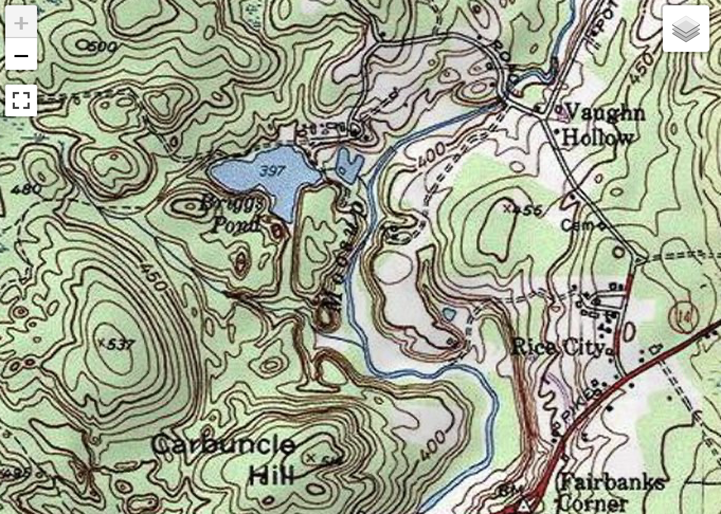
Time to go Portable!
Chopmist Hill
Operating with limits at the home QTH. I was in a valley at around 400’ in elevation and surrounded by 500”+ hills and hills even higher in Central/ Western CT.
Asked some friends with a location on Chopmist Hill in RI to set up for September VHF in 2022.Knowing the history of the area during WWII might be a good operating location.
Elevation increased to over 700’ from home QTH
Frm. home QTH

Slide 8
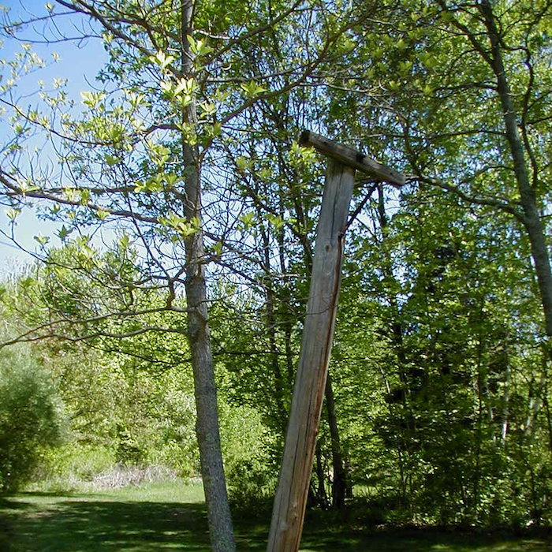
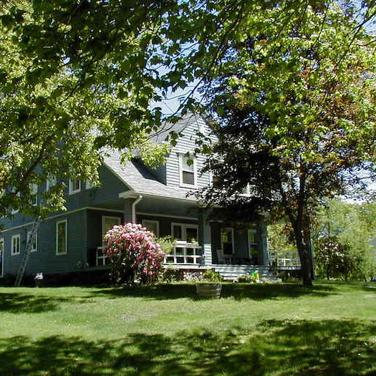
Chopmist Hill in WW2
Program started by the FCC in 1940 establish listening posts across the country to catch enemy spies and other signals of interest then be forwarded to the War Dept.
A 138- acre farm on Darby road was selected. They rented the property from the Suddard Family used 16 miles of wire for all the various antennas
The Chopmist Hill site became known as being very sensitive in being able to detect signals. The War Dept did a test to simulate a spy and the Chopmist post won detecting the signal and message content in 7 minutes before other posts.
During the war picked up German High command signals and tank to tank communications from Rommel's Afrika Corps also picked up the Japanese war ballons on the west coast that would be intercepted.
After war site was considered as possible UN location due to good communications.

Slide 9
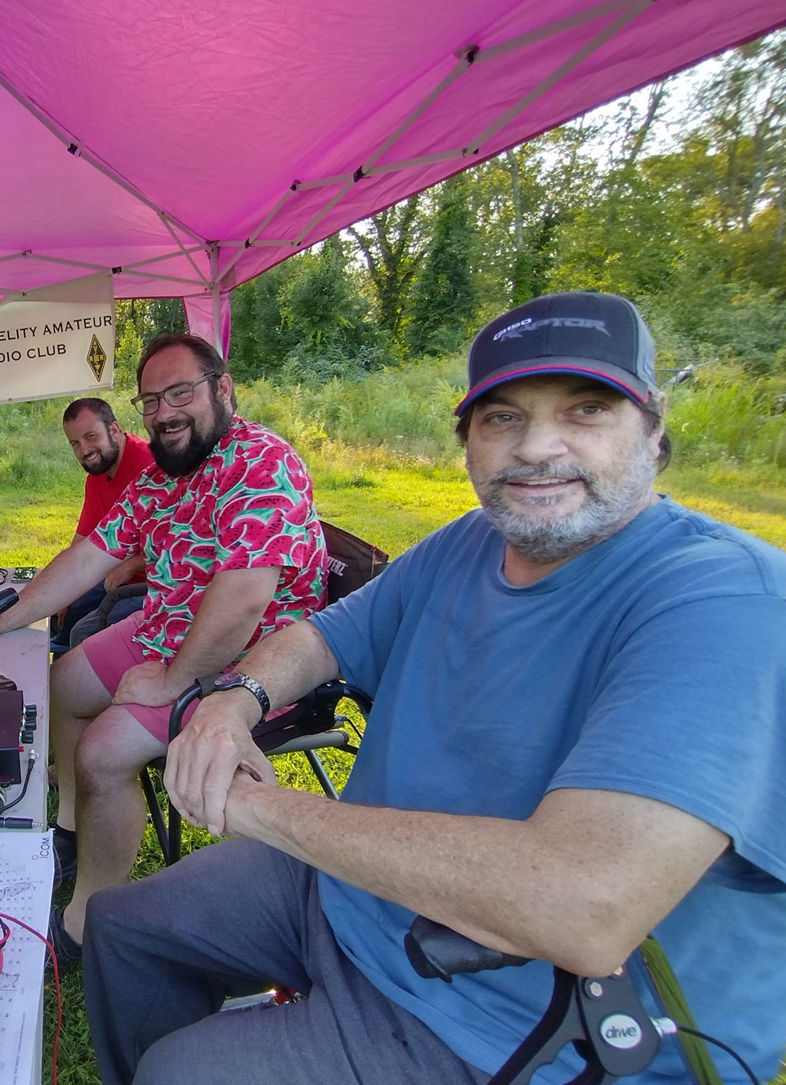
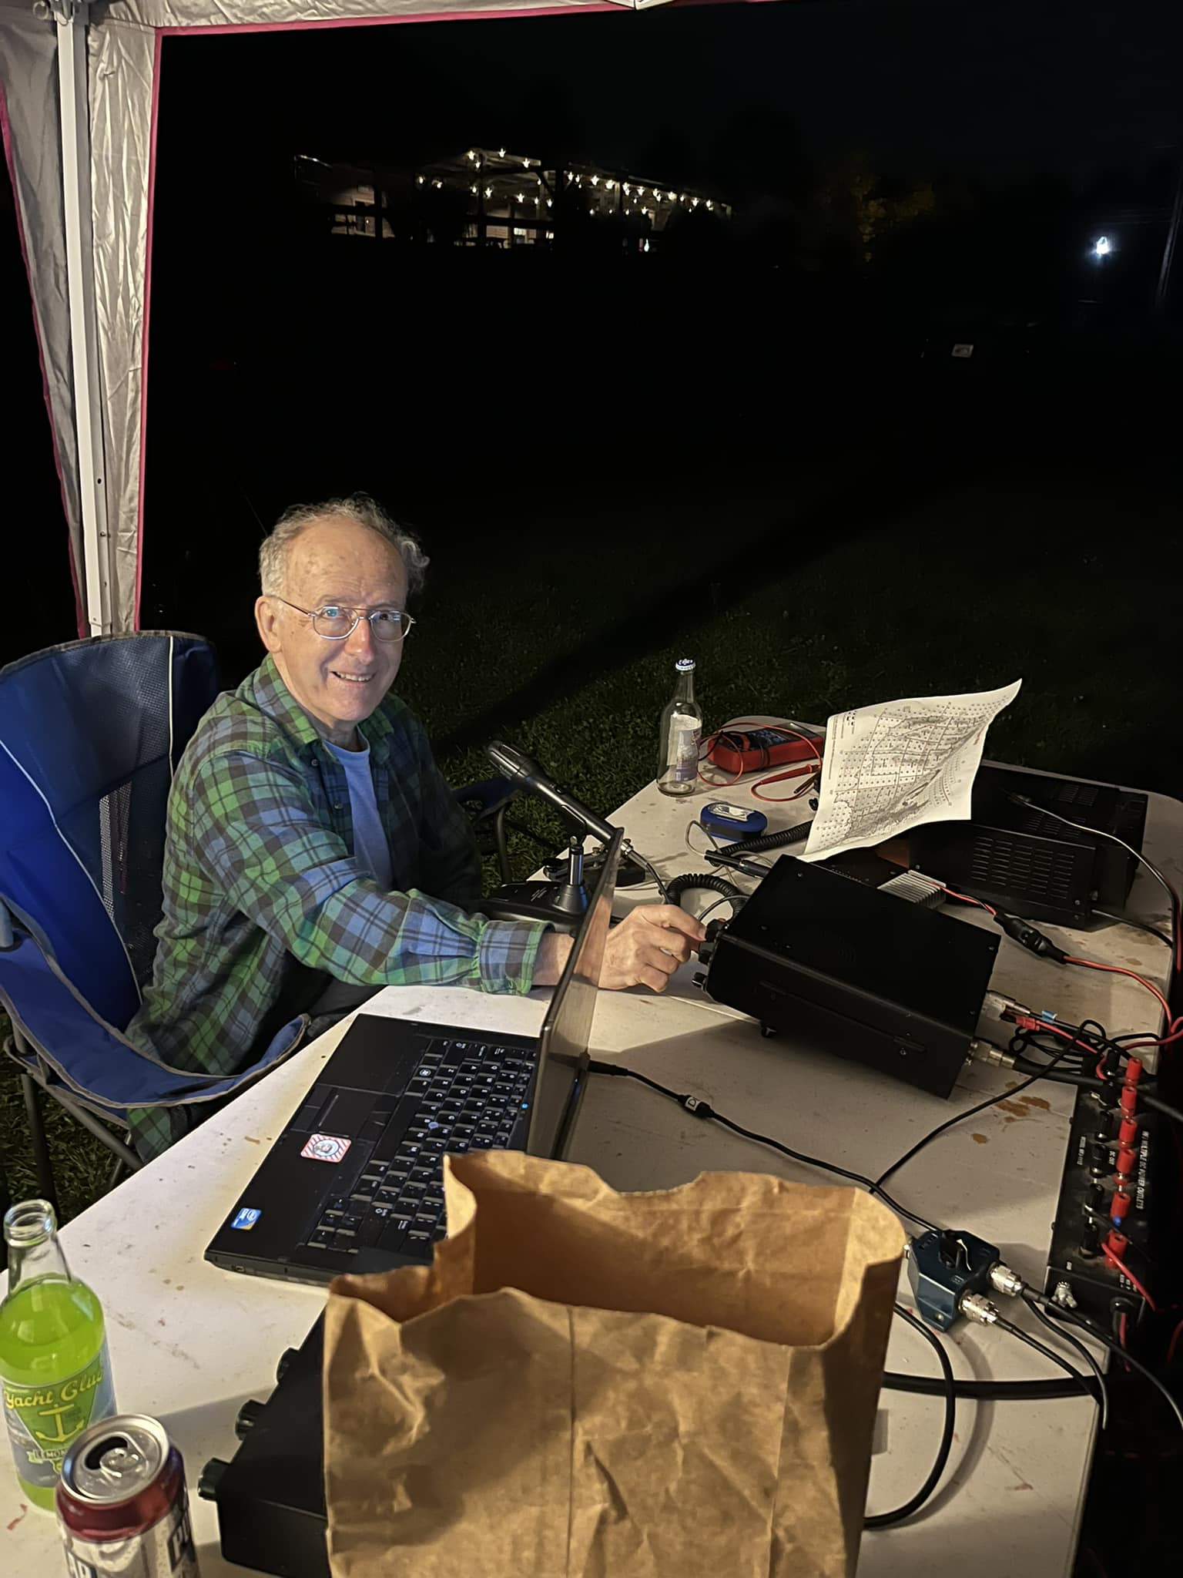
September 2022
First time going portable and first September effort!
Operated from Chopmist Hill RI First time
82 QSOs 32 Multipliers
37/12 on 6 meters 35/12 on 2 meters and 10/8 on 70 cm
2,816 pts
KC1KCC, N1ZJI and K1KT

Slide 10
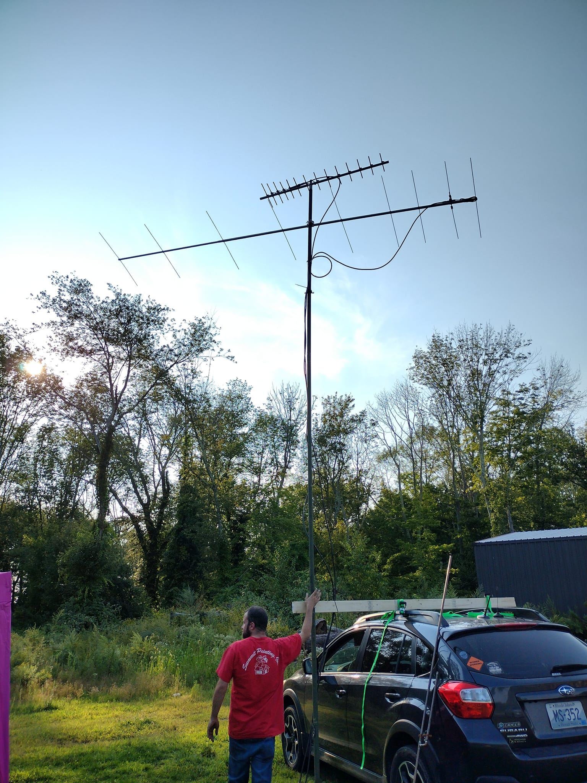
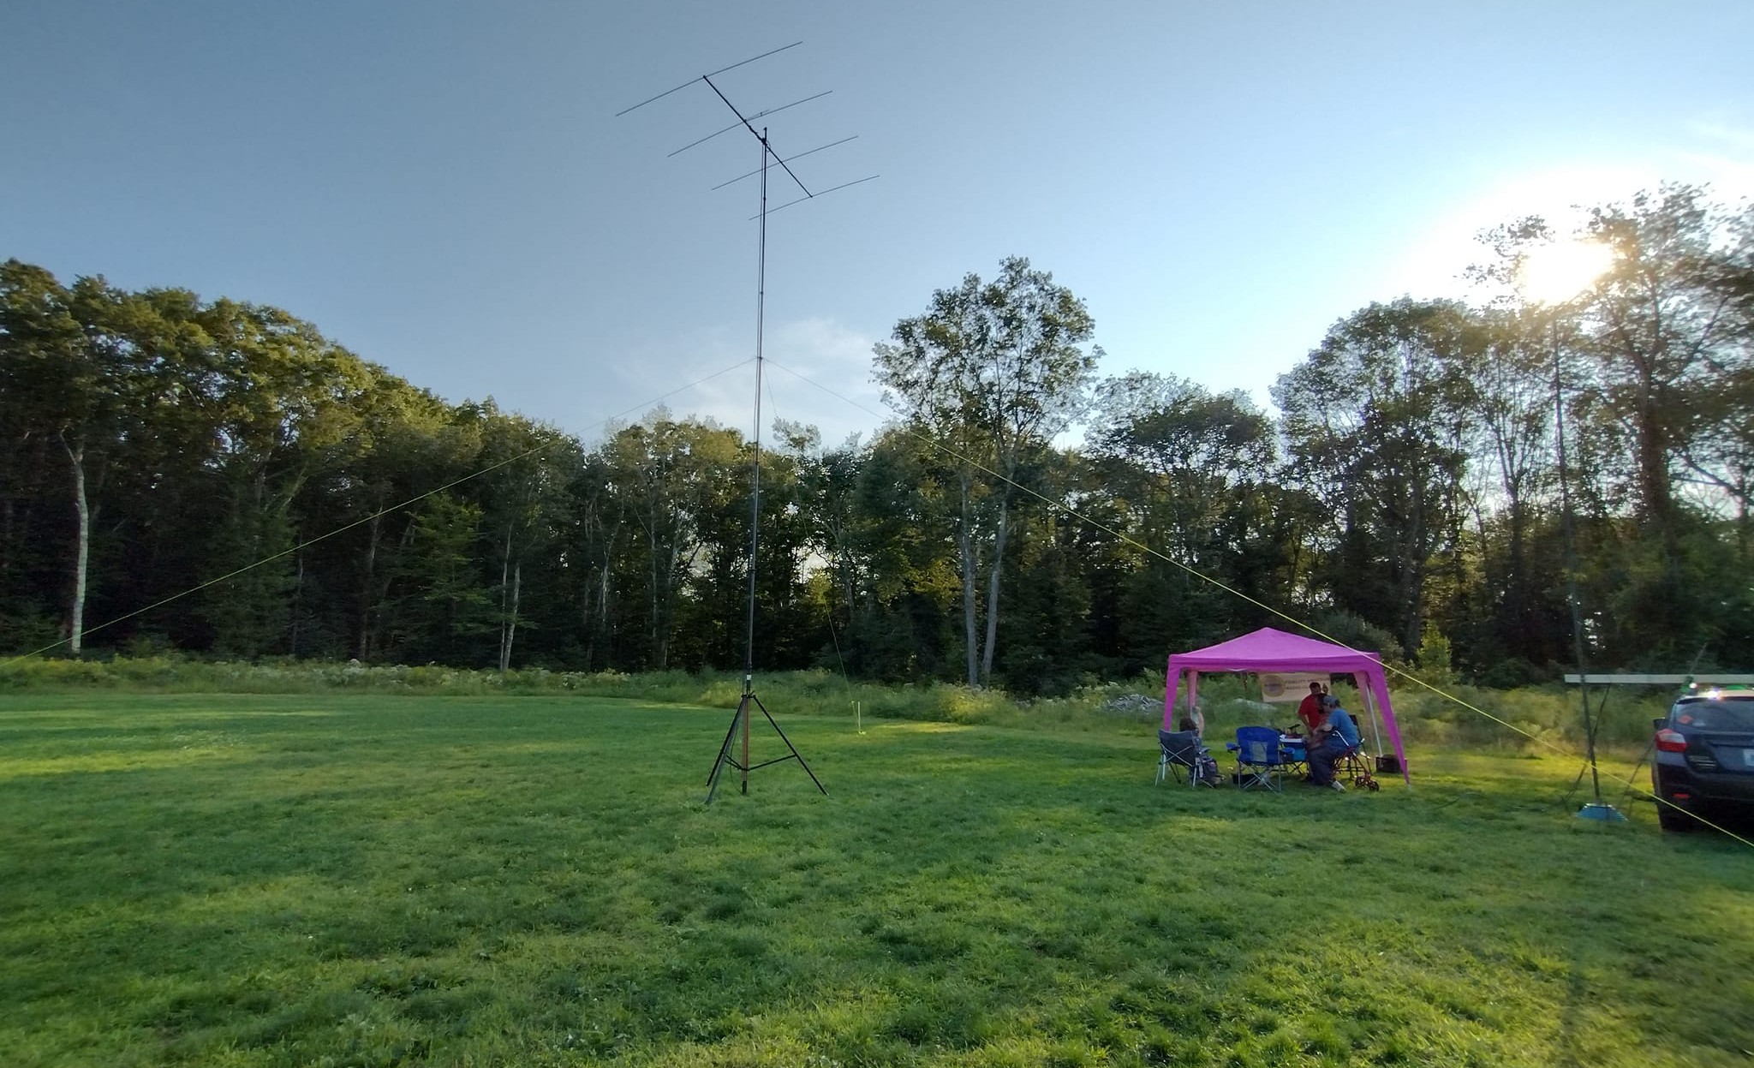
Antenna Set up
Operated 6, 2 and 432
6 meters had a 4 element beam easier to go portable with
9 element 2-meter beam
14 element 432 beam

Slide 11
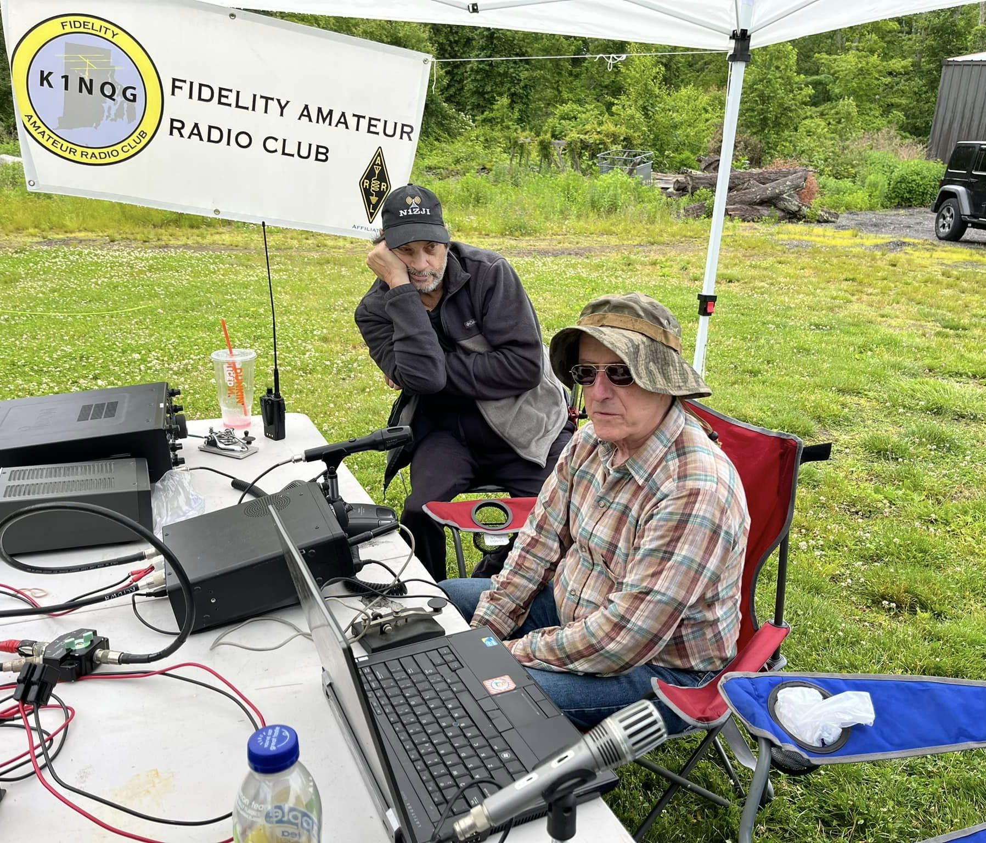
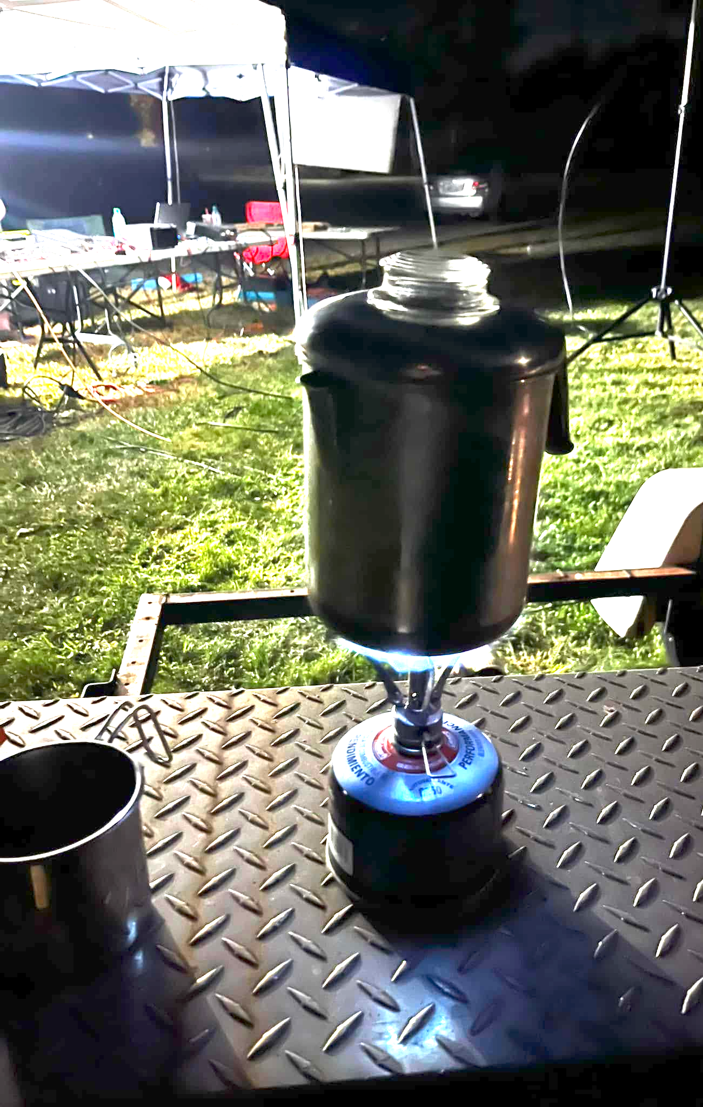
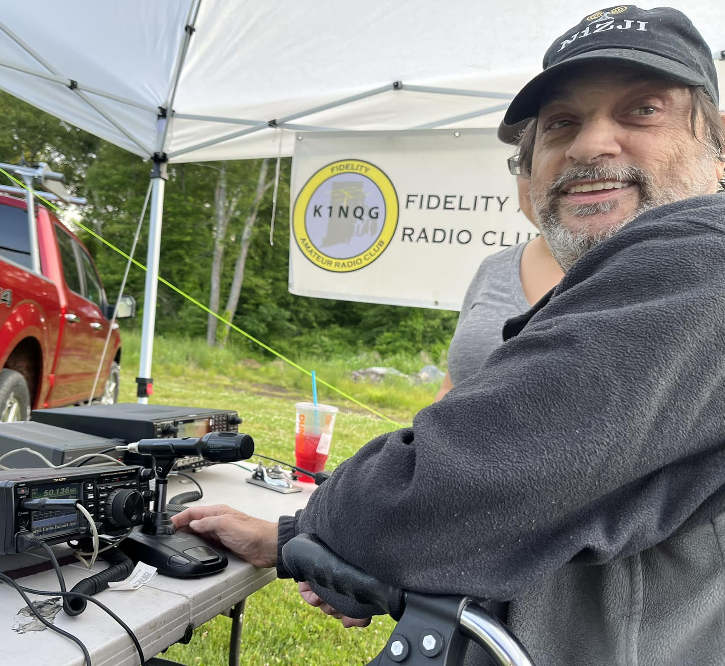
June 2023
N1ZJI & K1KT making contacts!
Added 222 Fm and 1.2 Ghz! Thanks to AA1VV for 222 rig and WI1I for 1.2 rig
124 QSOS 41 Multipliers
63/22 on 6 meters, 38/9 on 2 meters 5/2 on 222 14/5 on 432 & 4/3 on 1.2
5,986 pts
Downside- not easy to do the lobster/ Clambake, but we did have coffee!!

Slide 12
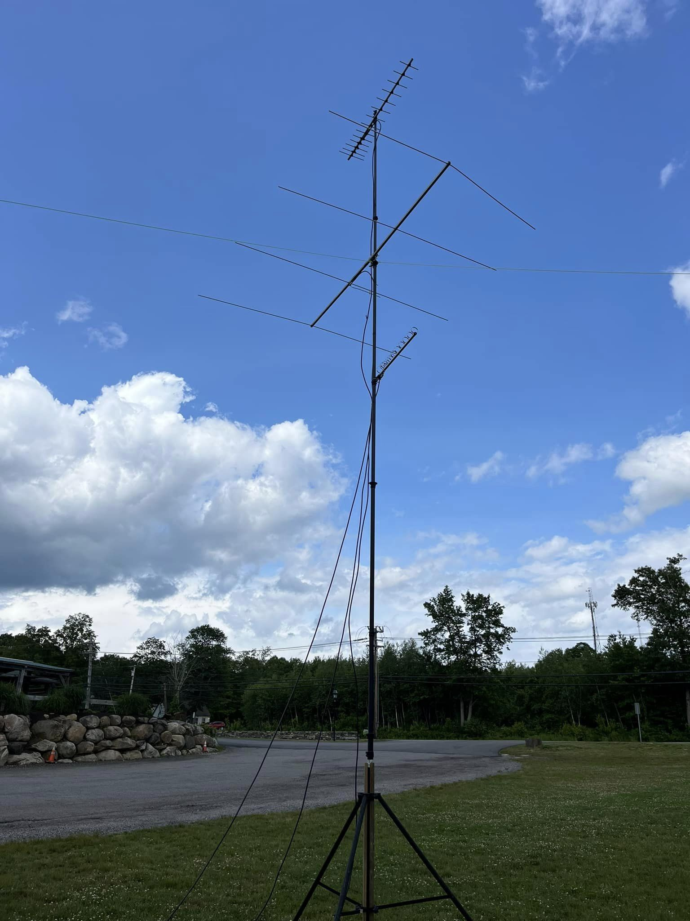
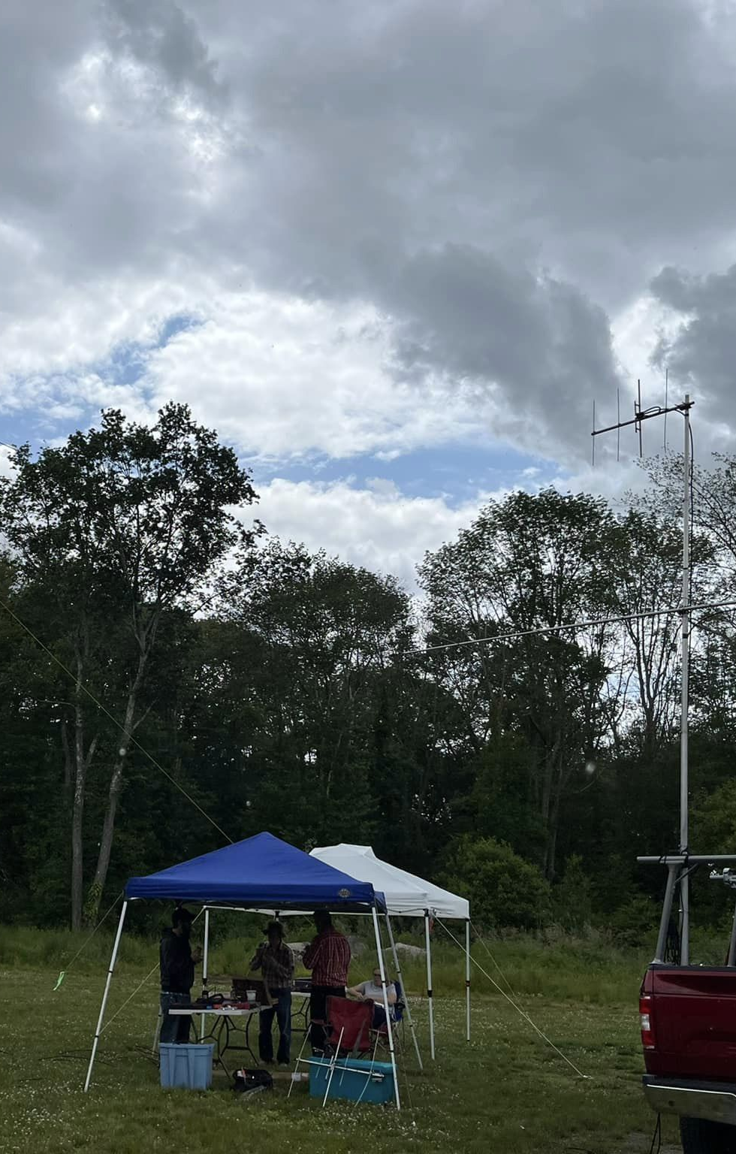
June 2023 - More Antennas!!
Added 4 element 222 beam thank you KA1BNO and small loop Yagi for 1.2 thank you WI1I

Slide 13
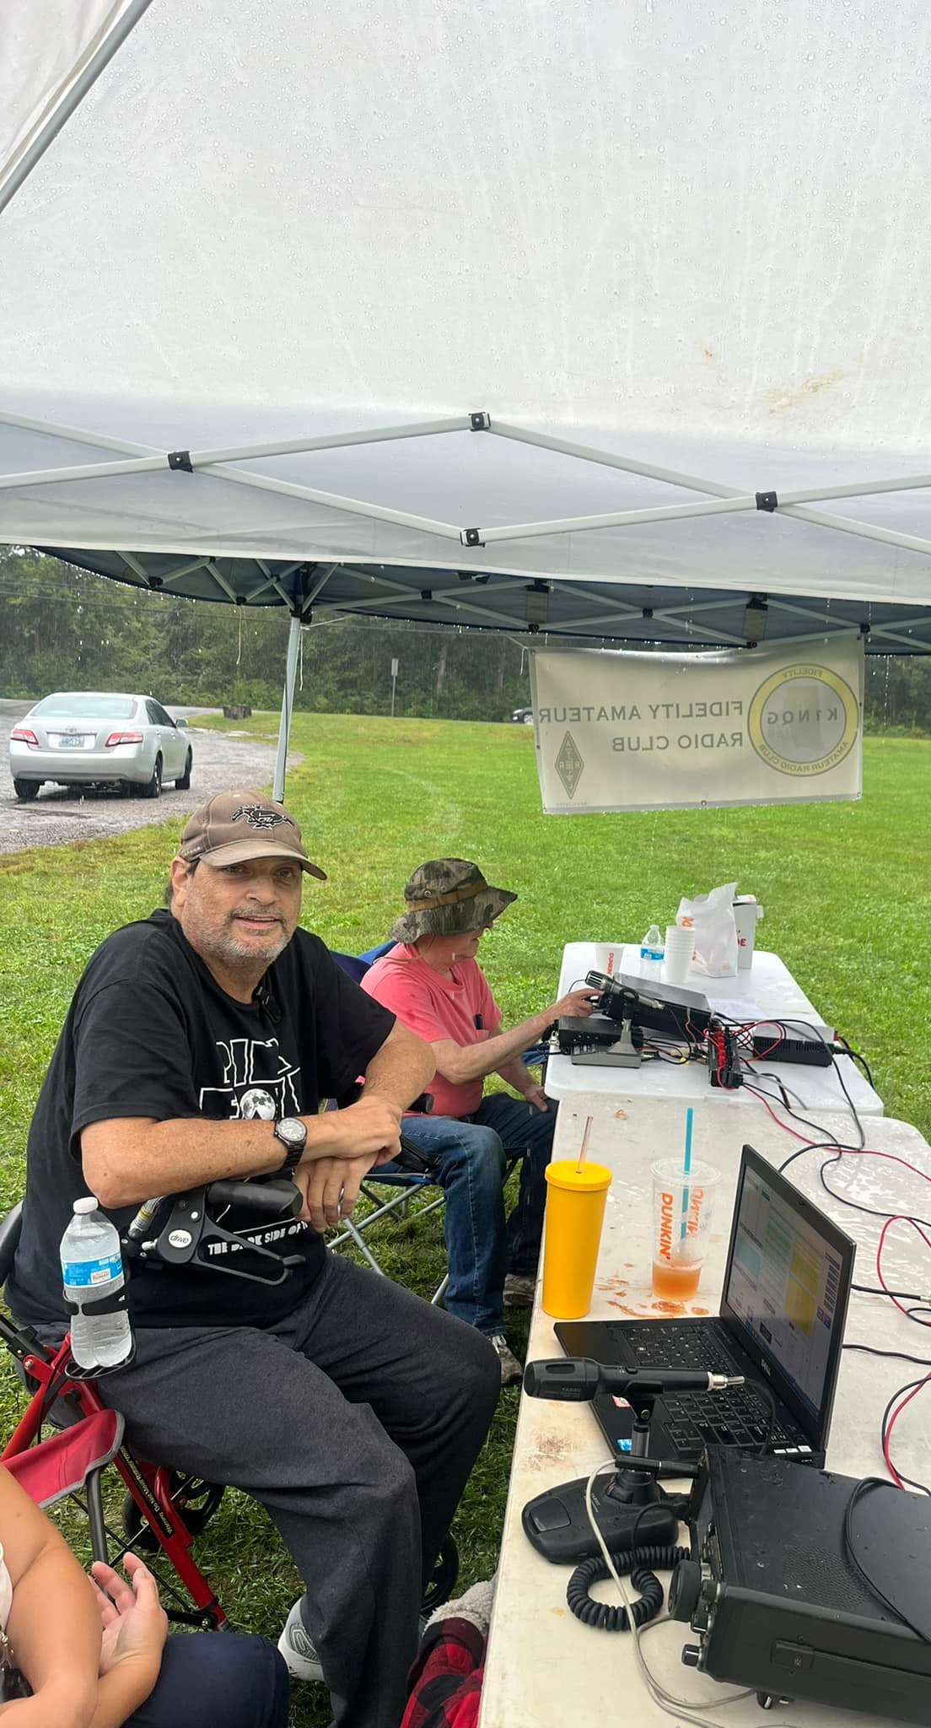
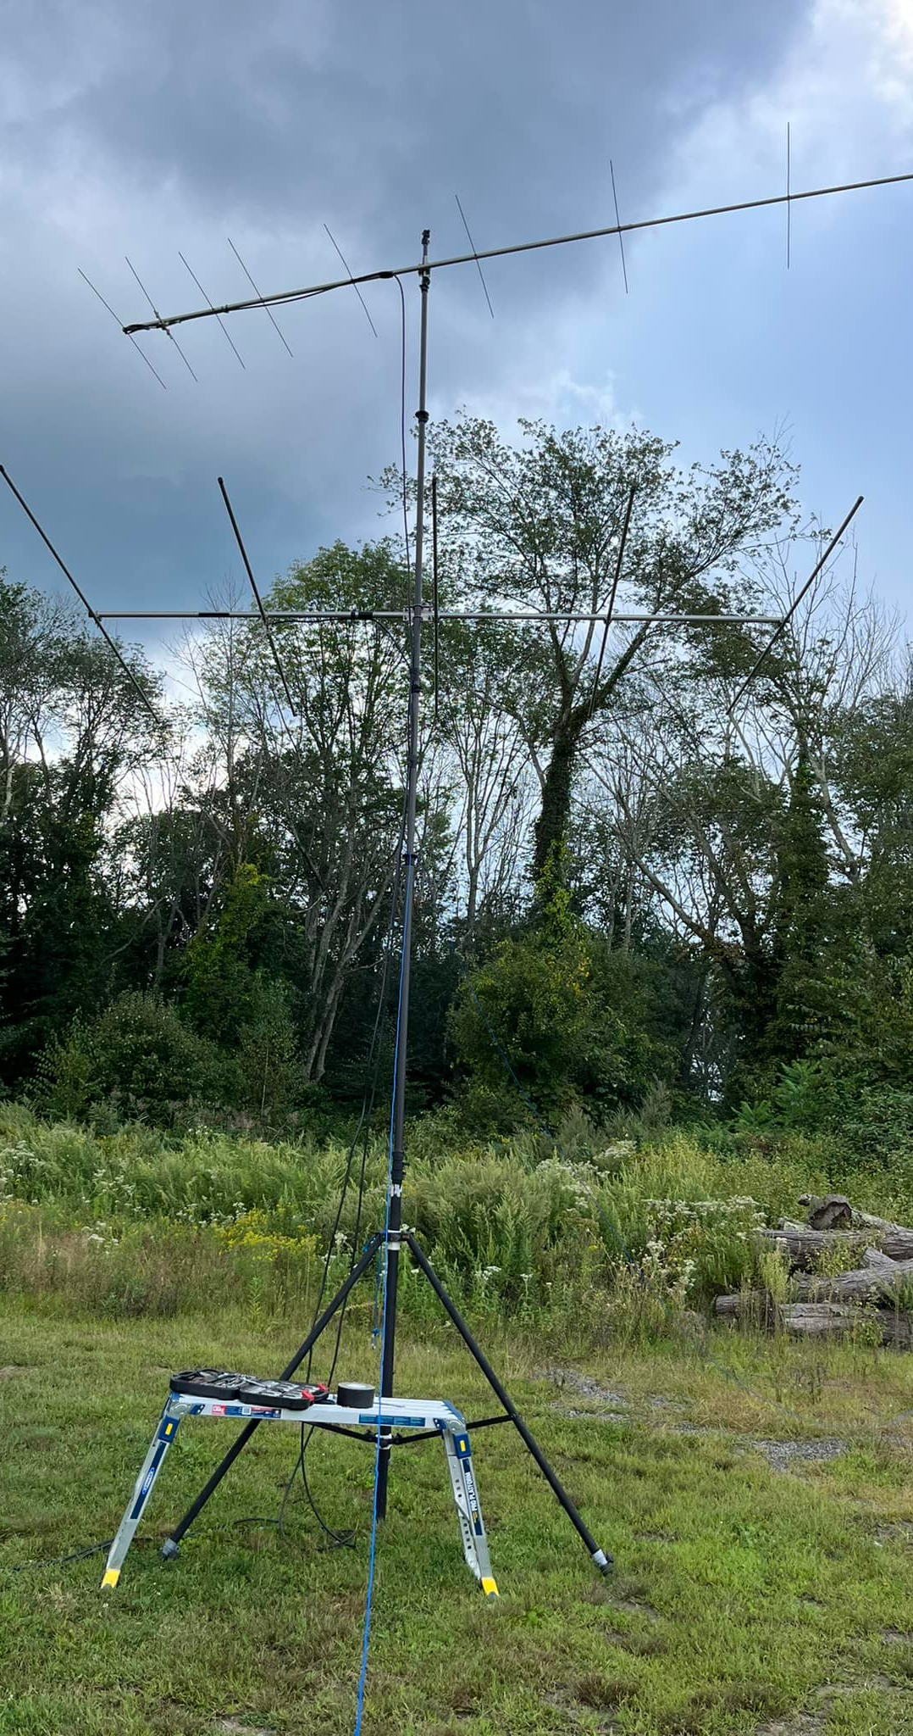
September 2023
4,719 pts
98 QSOs 39 Multipliers
47/14 on 6 meters, 29/11 on 2 meters, 3/3 on 222 (FM) 15/8 on 432 and 4/3 on 1.2 GHz
Improved antenna on 1.2 from June.
Contended with many Thunderstorms we had to stay in our cars for 4 hours or so!
N1ZJI & K1KT operating in between storms

Slide 14
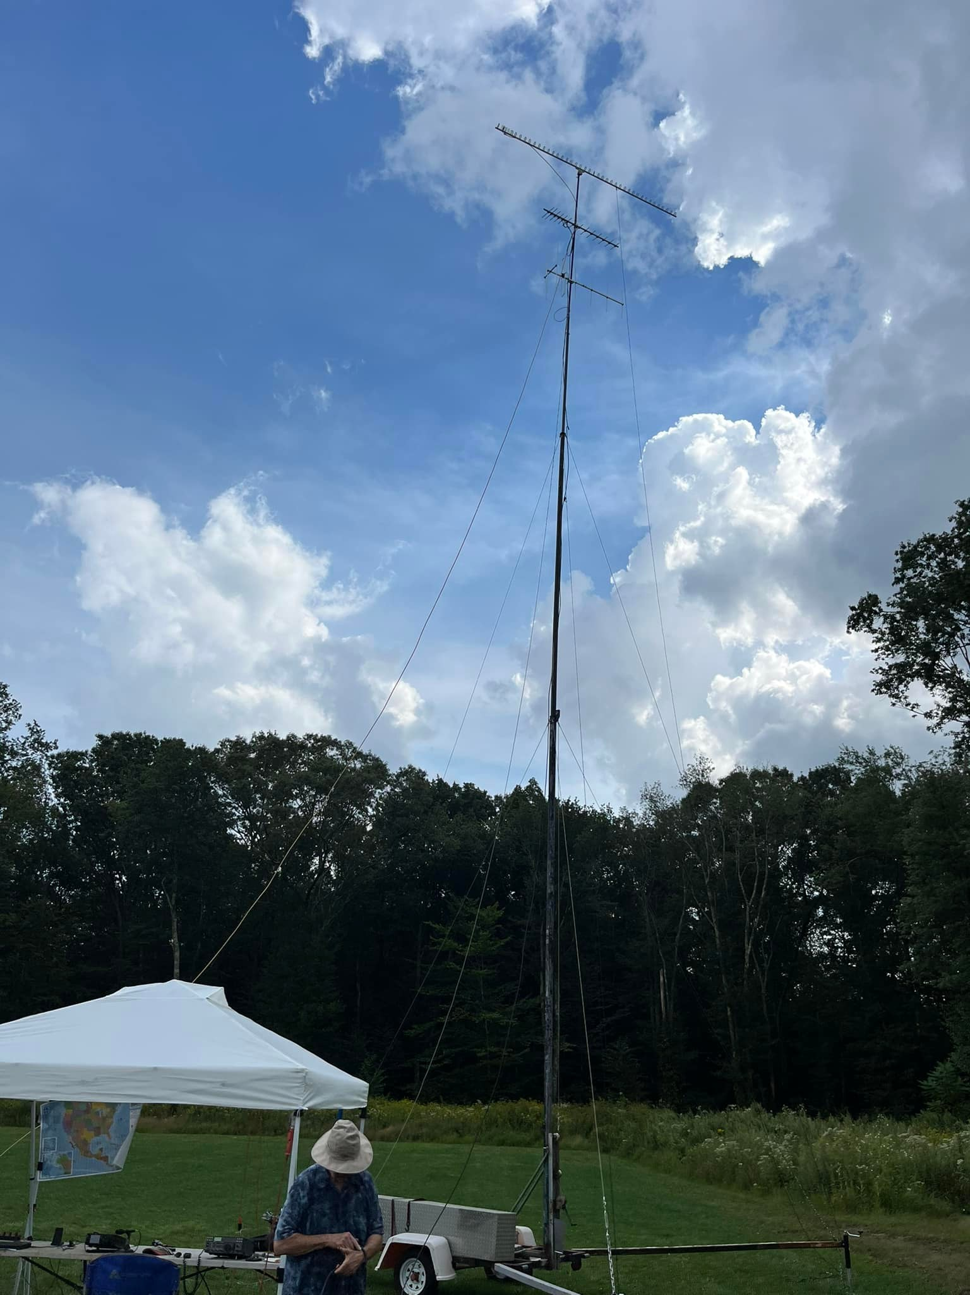
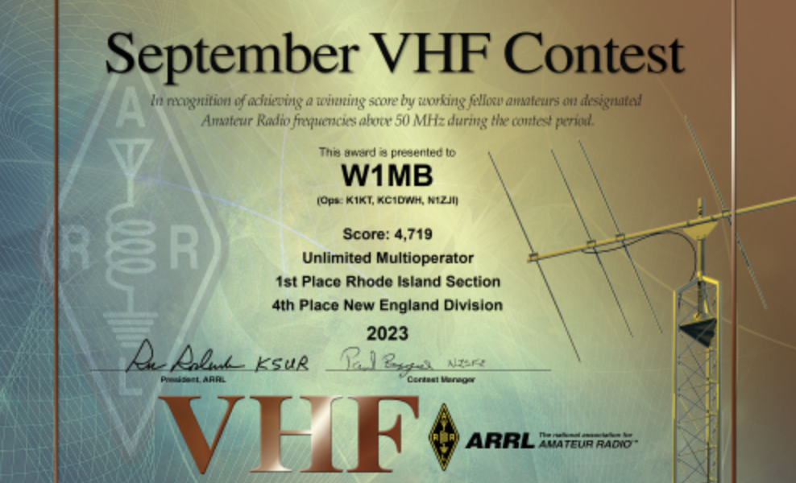
Increasing Gain!
New 45 element Loop Yagi on top of mast for 1.2 GHz
New 7 element 222 antenna thanks to WB2VVV!

Slide 15
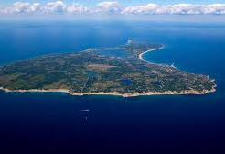
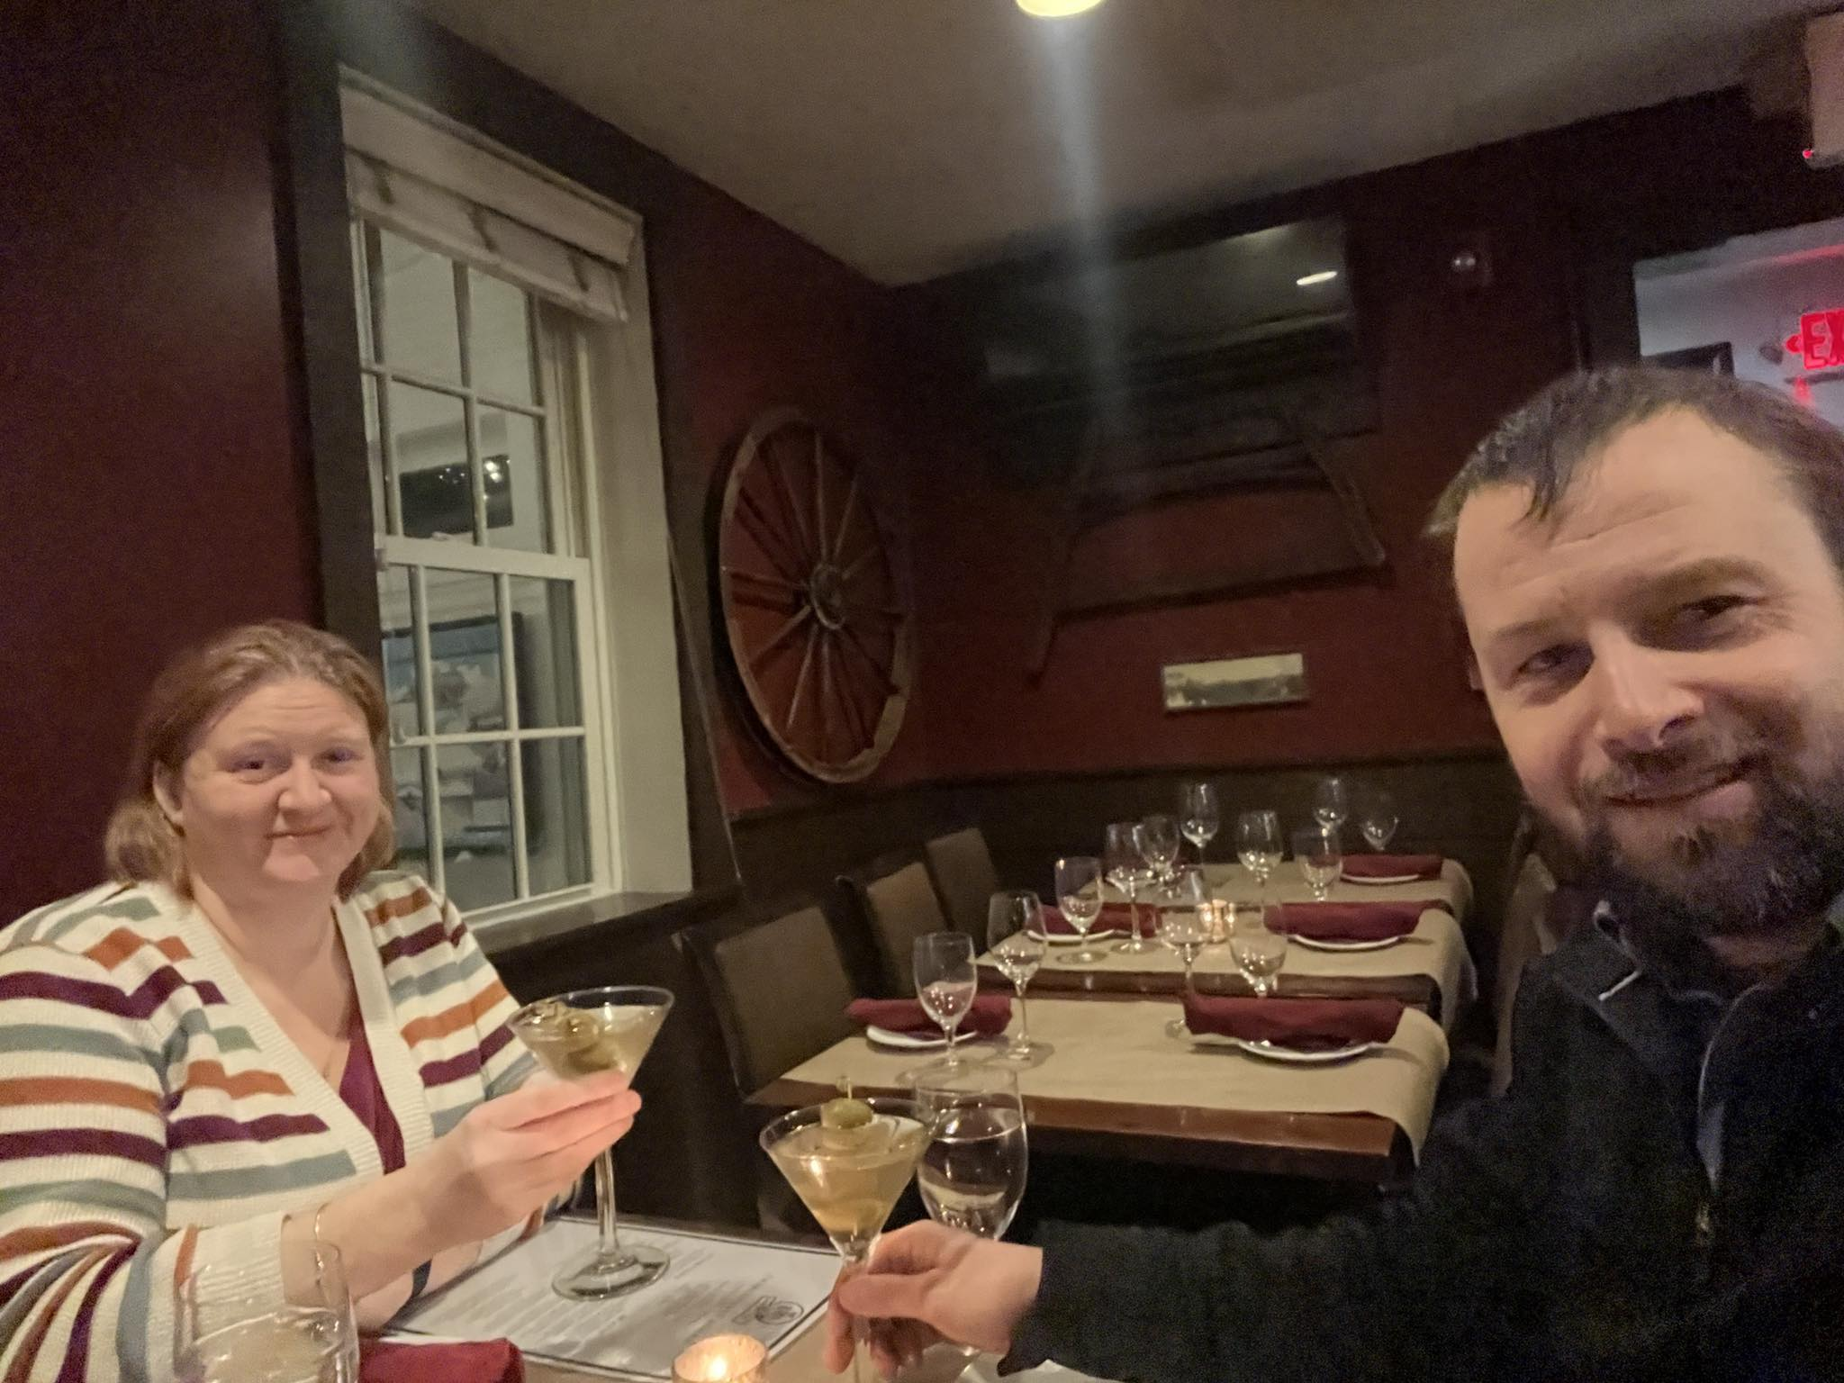
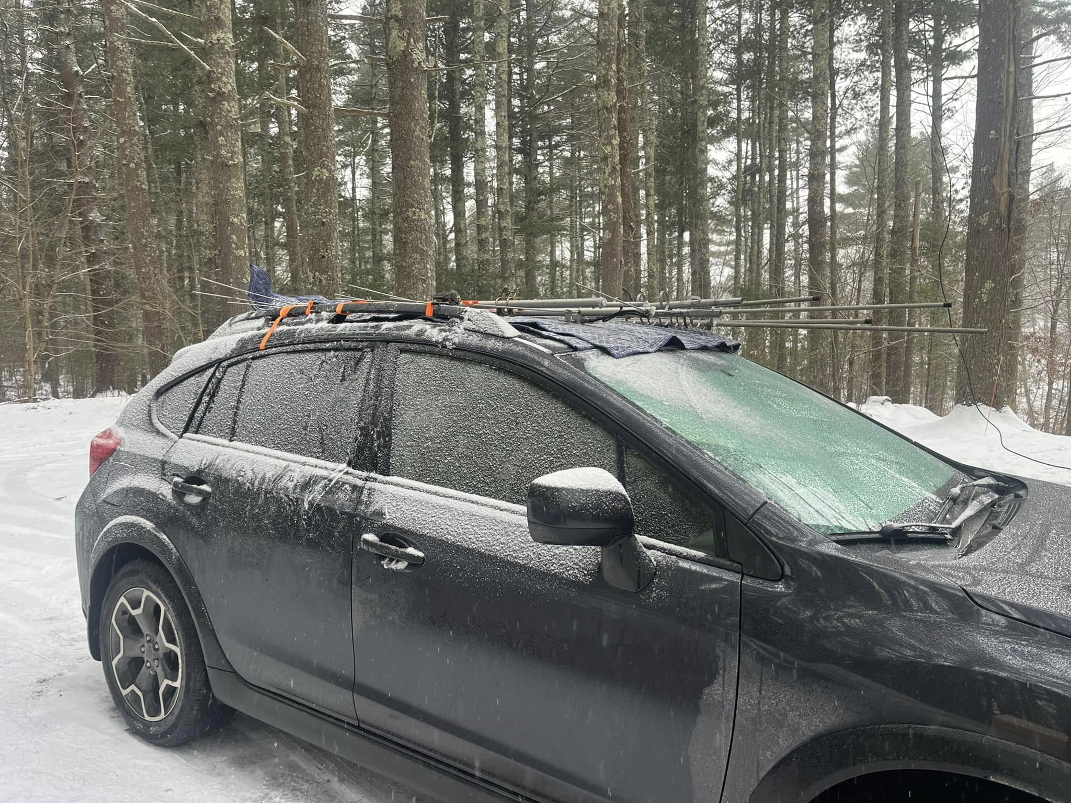
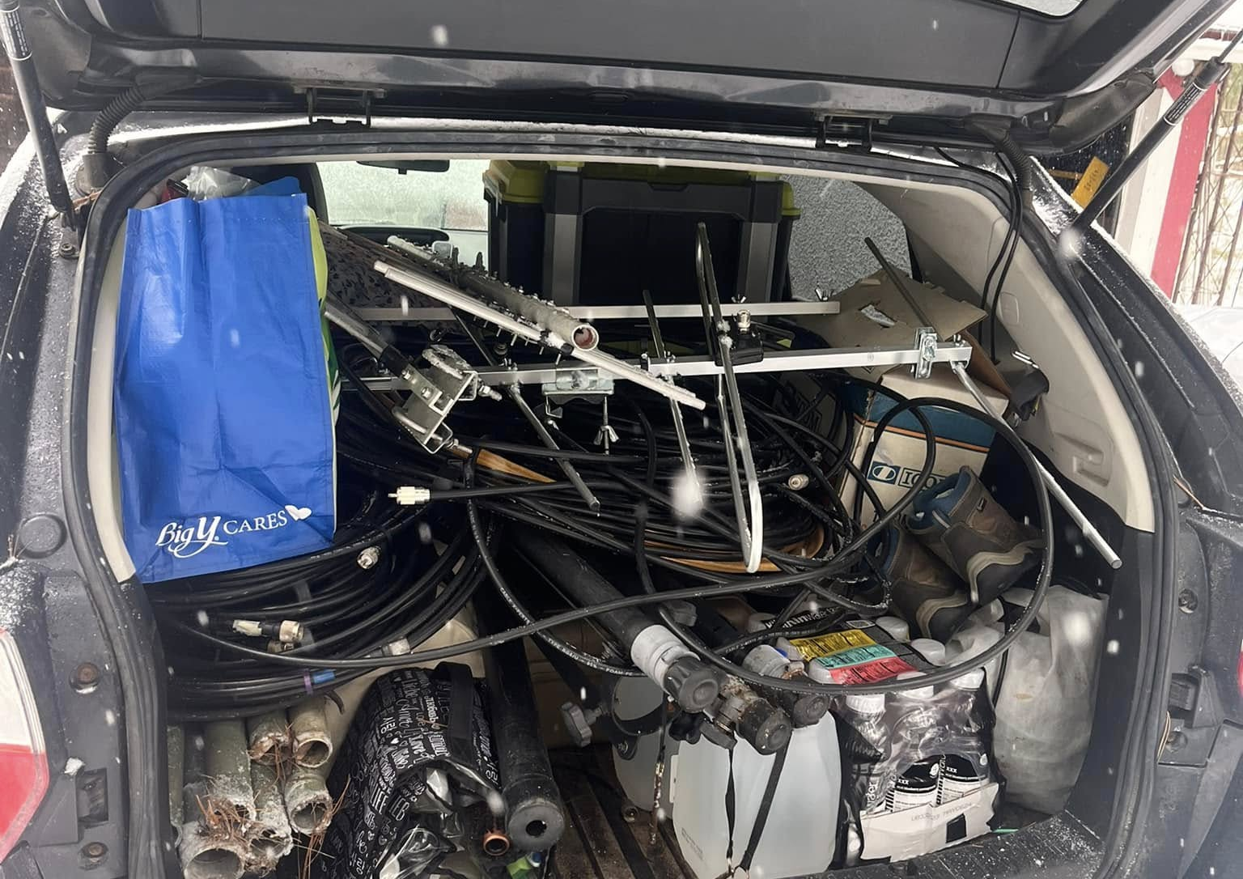
January 2024 BLOCK ISLAND!
Prior to this did January still at home, too cold to be operating outside on Chopmist Hill! Got inspiration from AF1T and K1RZ 10 GHz Contests going to Block Island
Called friend who has a house there and journeyed to Block Island 11 miles off the coast of RI.
This trip required some planning on what to bring, dealing with the ferries etc.
Location 112’ of elevation highest elevation on Island to NE is 180’ limited foliage also in the winter. So good horizon especially to WSW and to work grids up and down the coast.
Pro tip- take your antenna helper out for dinner and martinis!

Slide 16
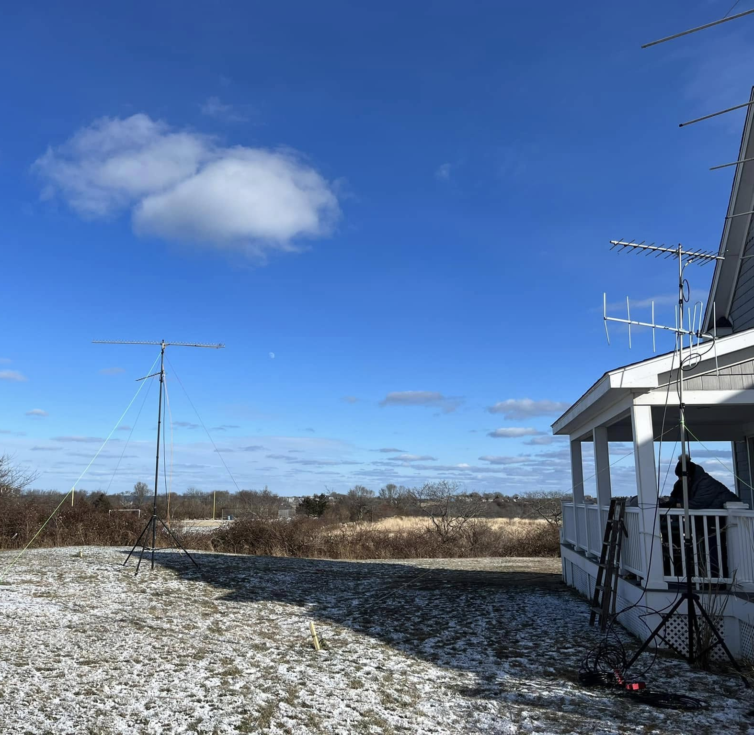
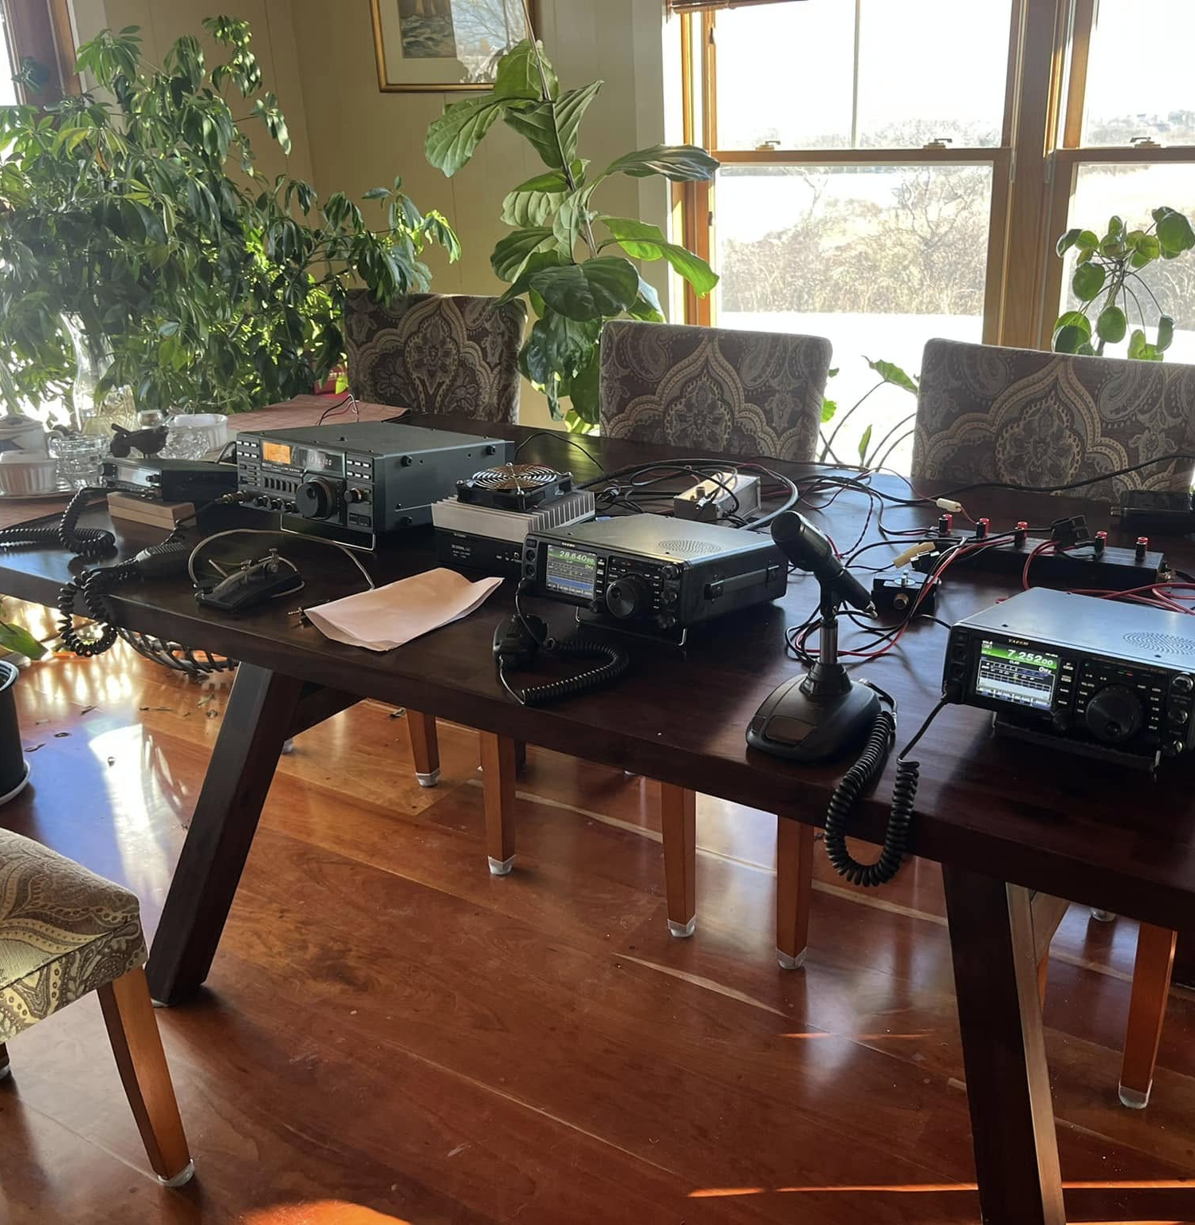
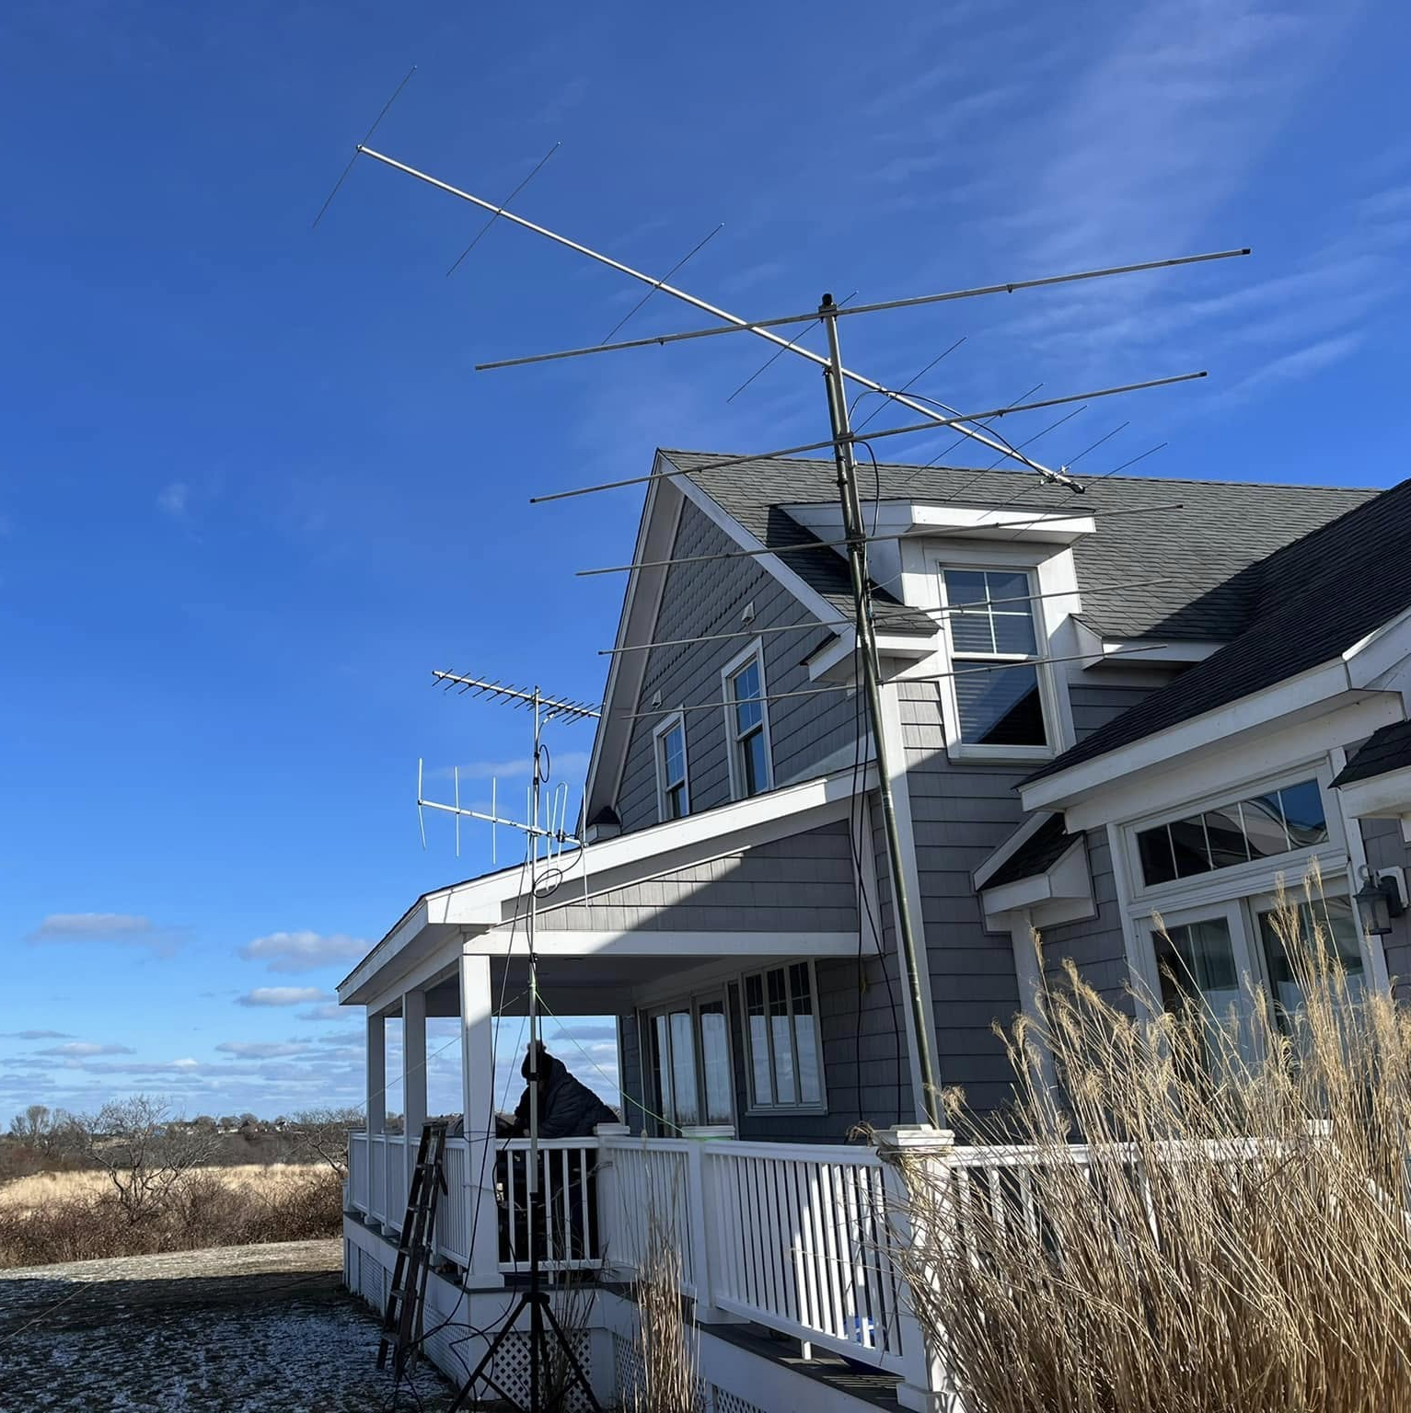

January 2024
72 QSOs and 34 Multipliers much better than 2023 at Home QTH almost triple the multipliers
222 was FM only all other bands CW, SSB and Digital
Added 902/903 with new Q5 transverter
4 element 6 meter beam replaced by 5 element

Slide 17
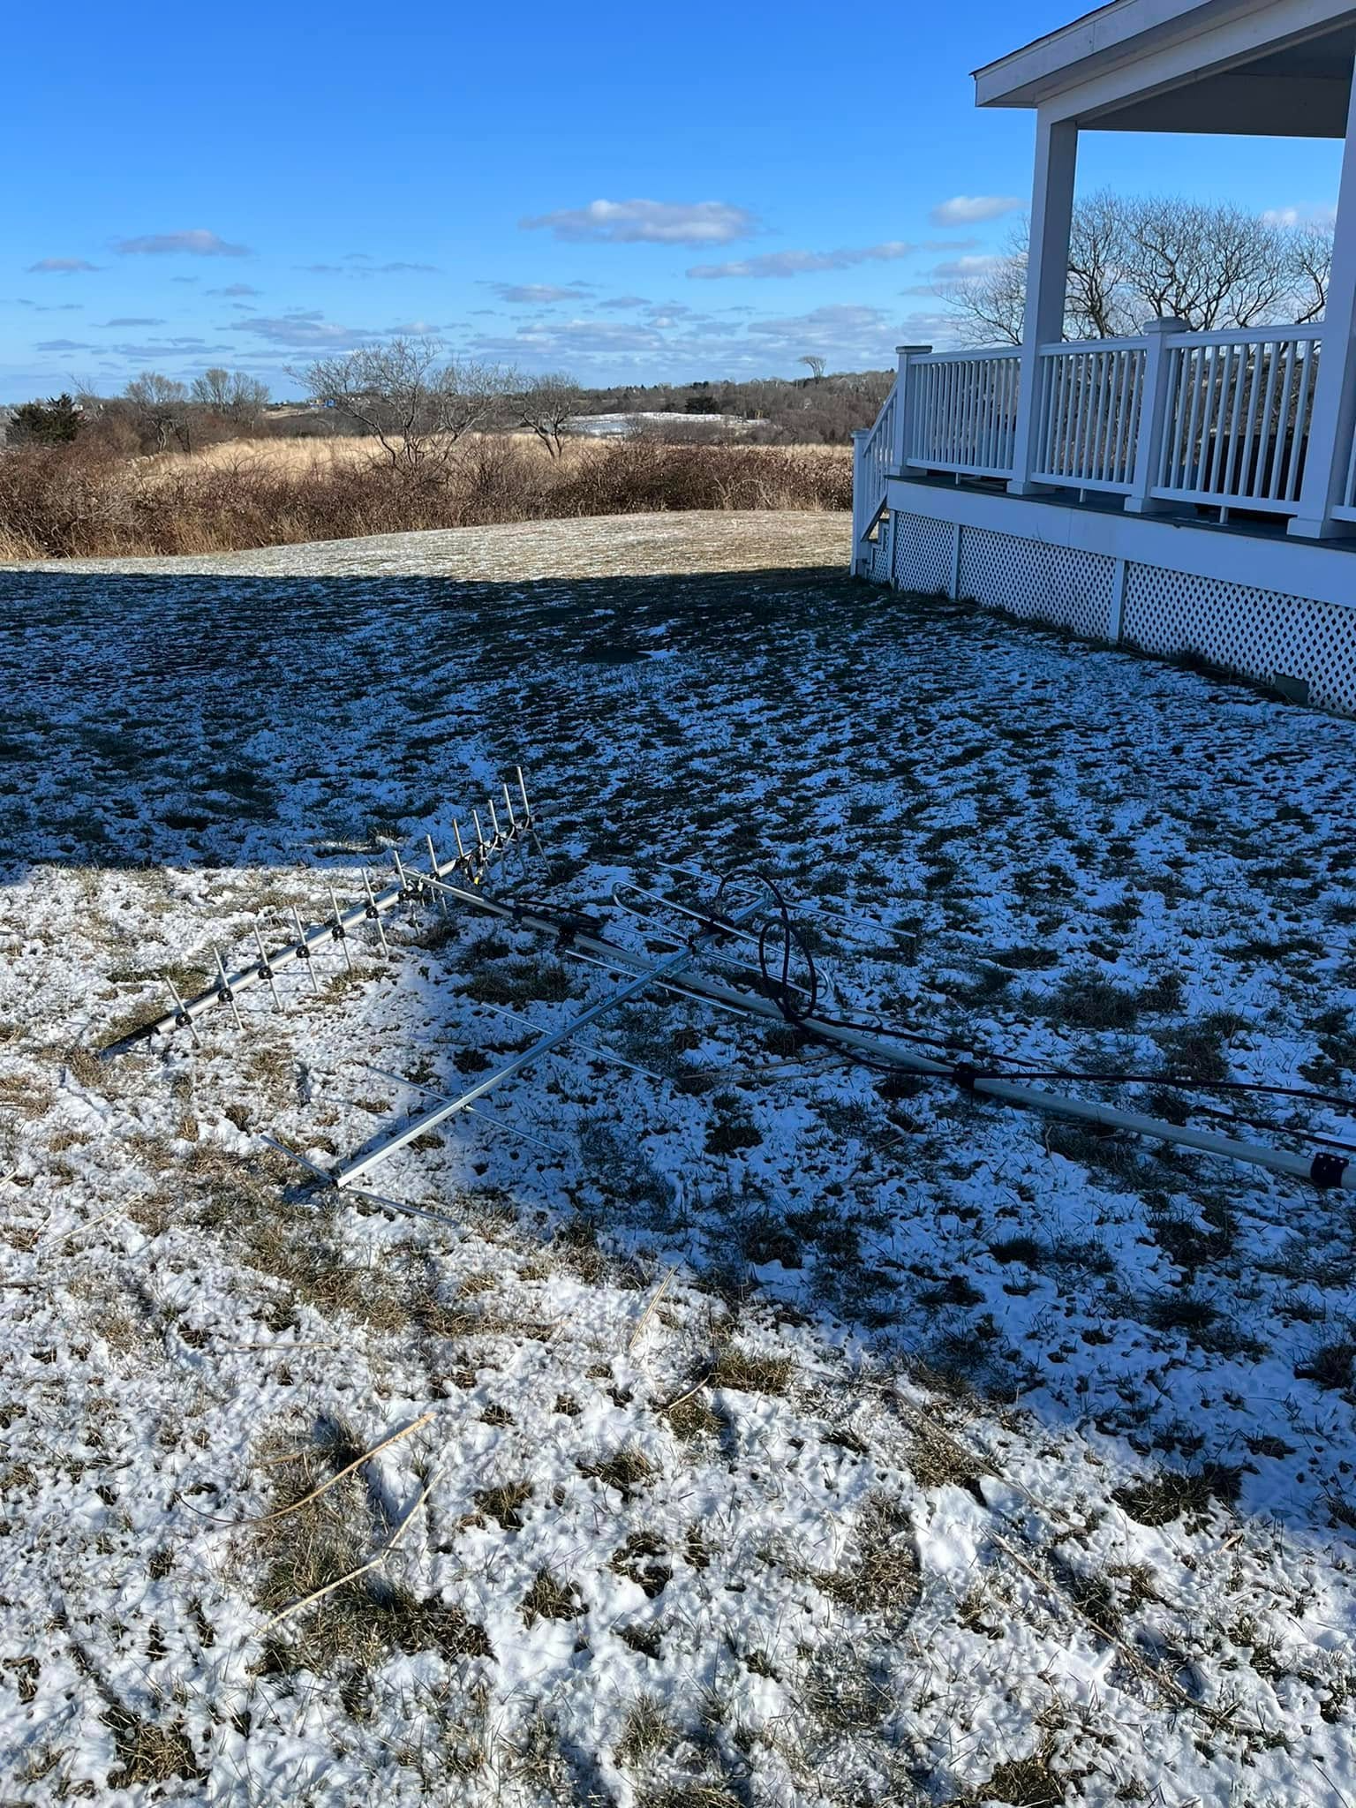
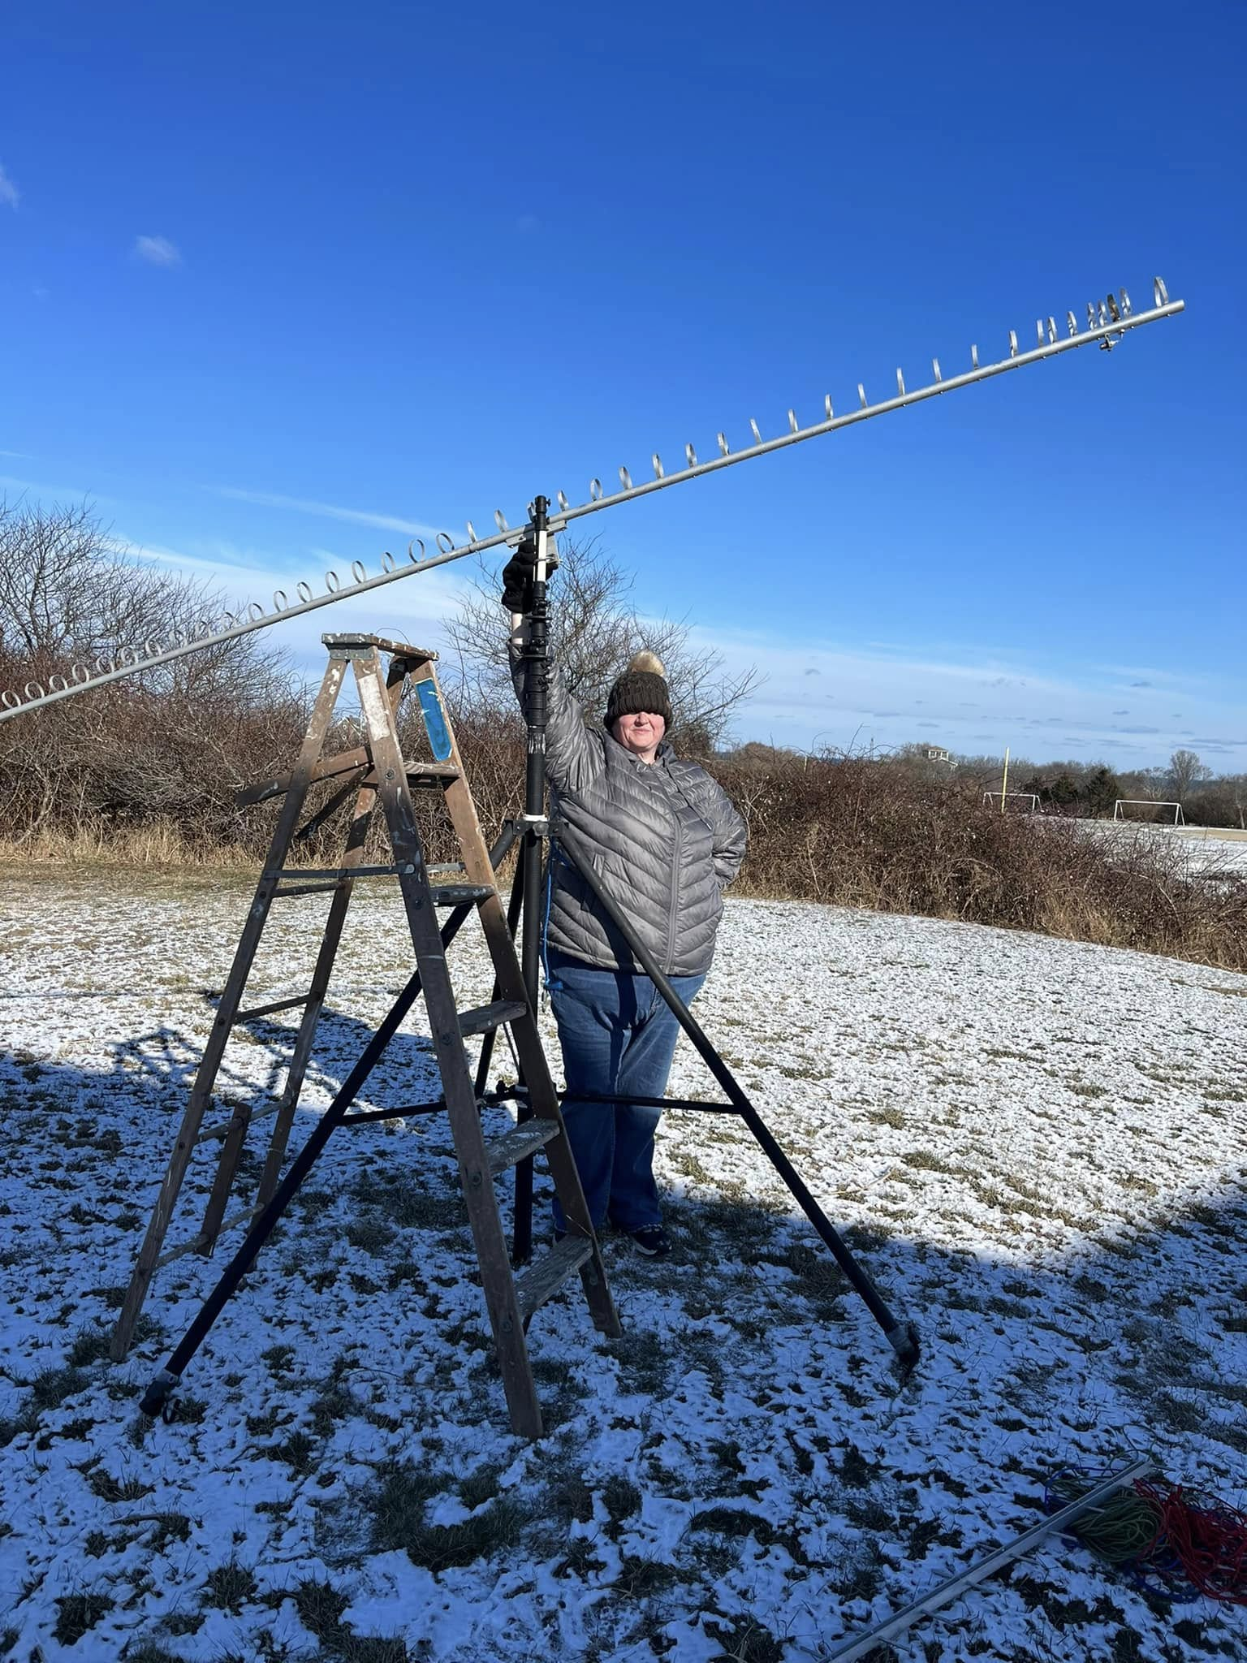
Problems!
KC1RHS helping with set up
One thing didn’t account for – Heavy WIND! Broke mast and 432 beam when it fell over an hour or so before the contest began.
Lack of trees to tie the mast down for 1.2 and 900 beam so we had to go to the one hardware store on the island and purchase stakes!

Slide 18
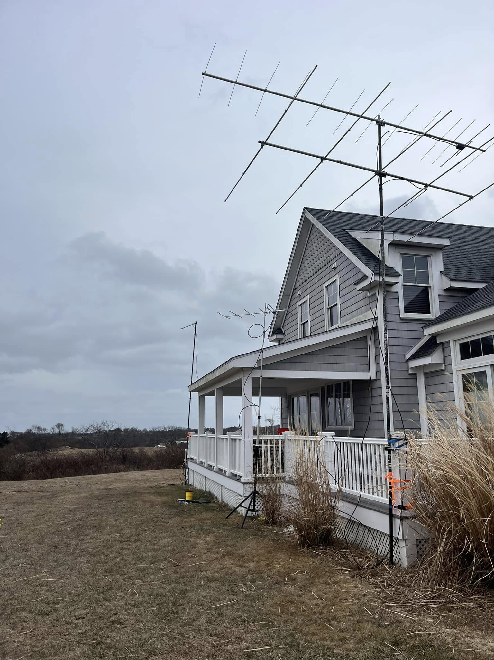
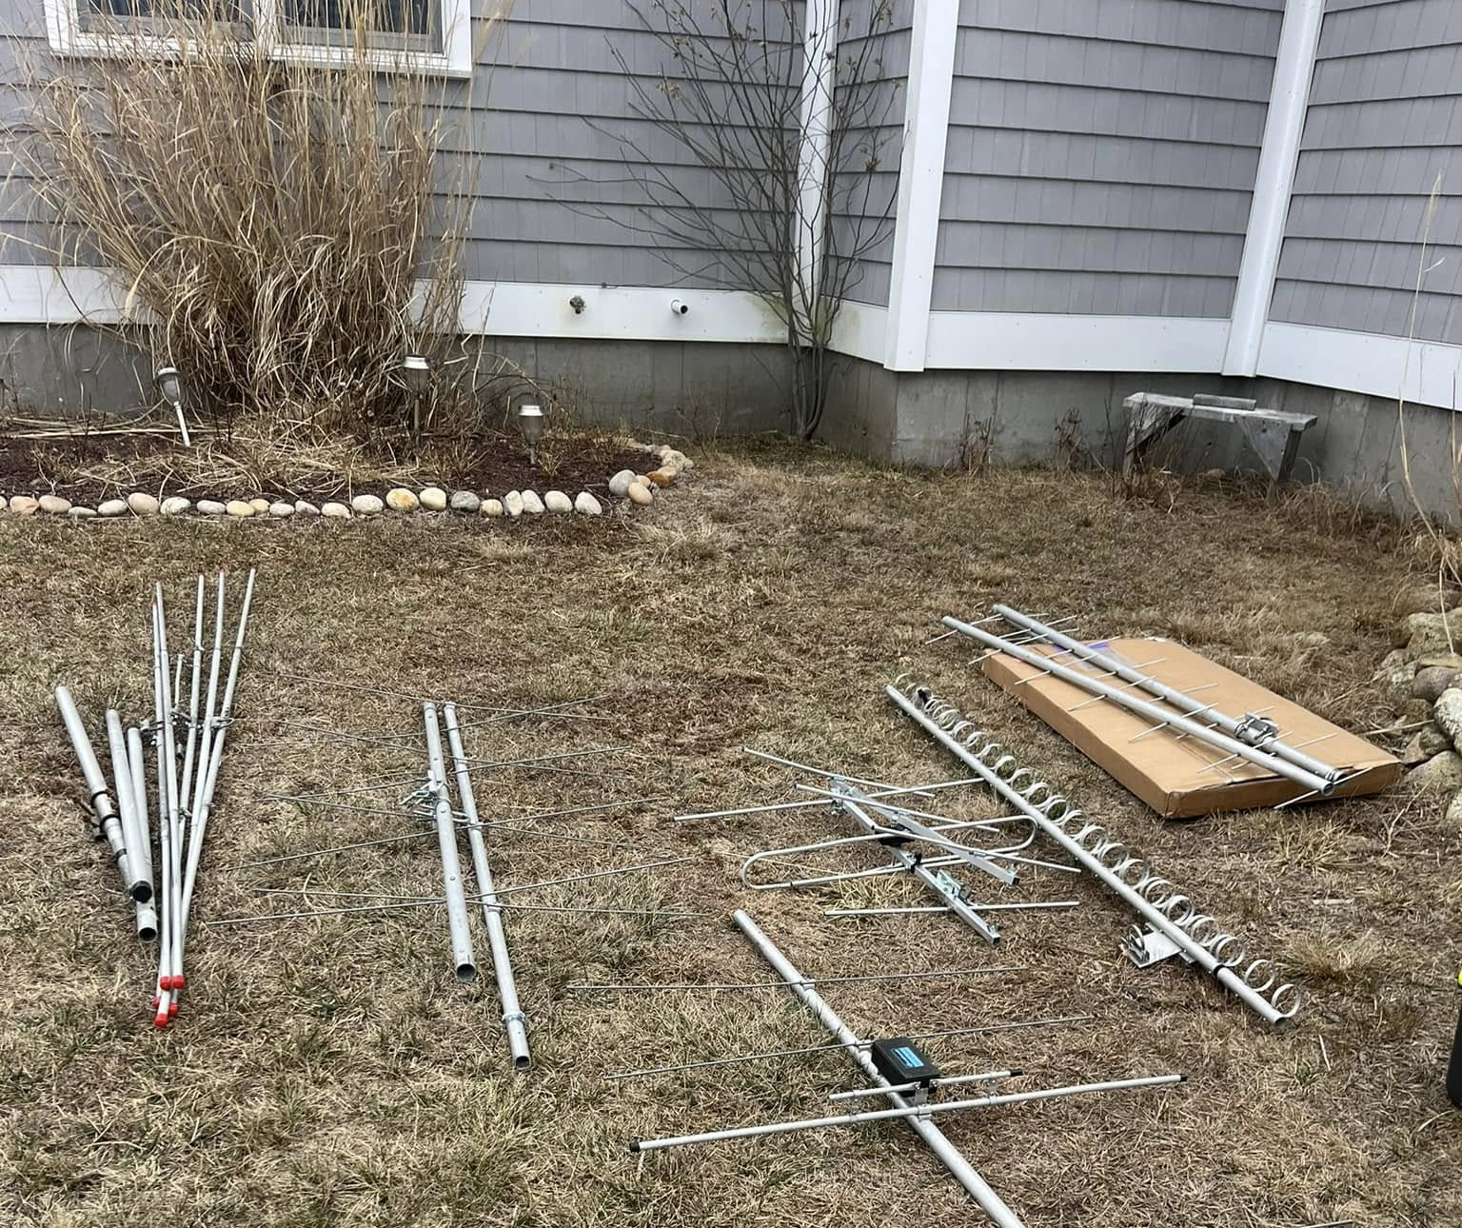
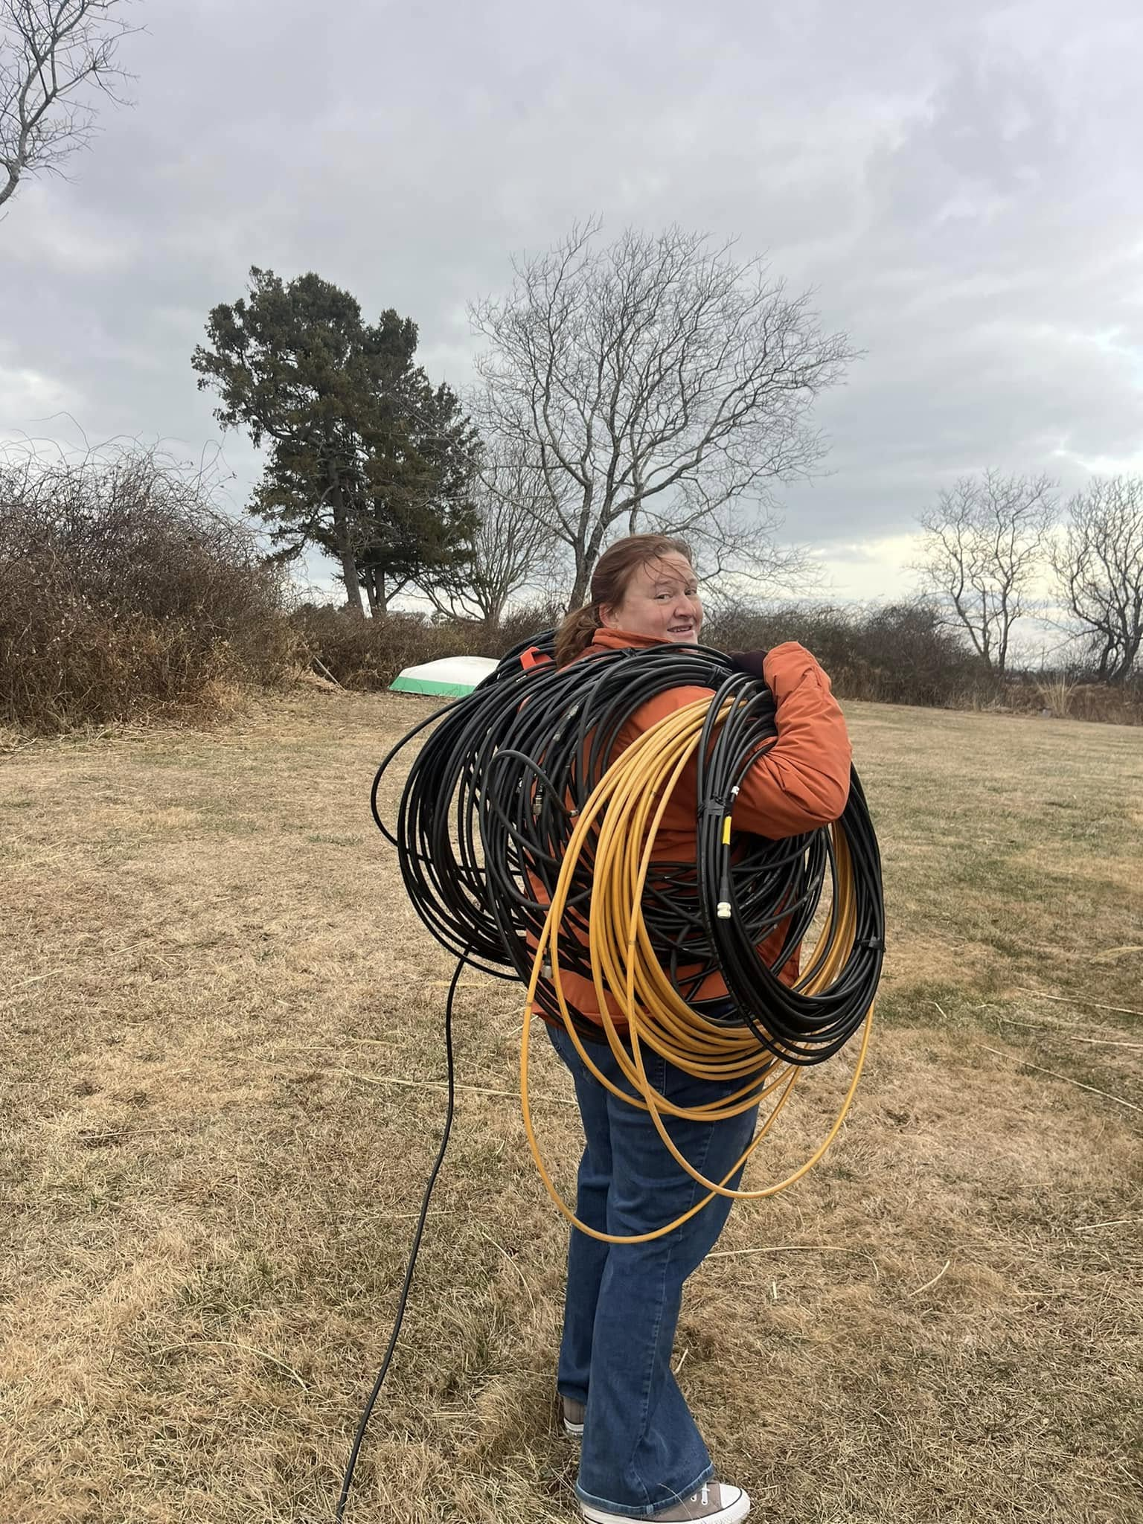
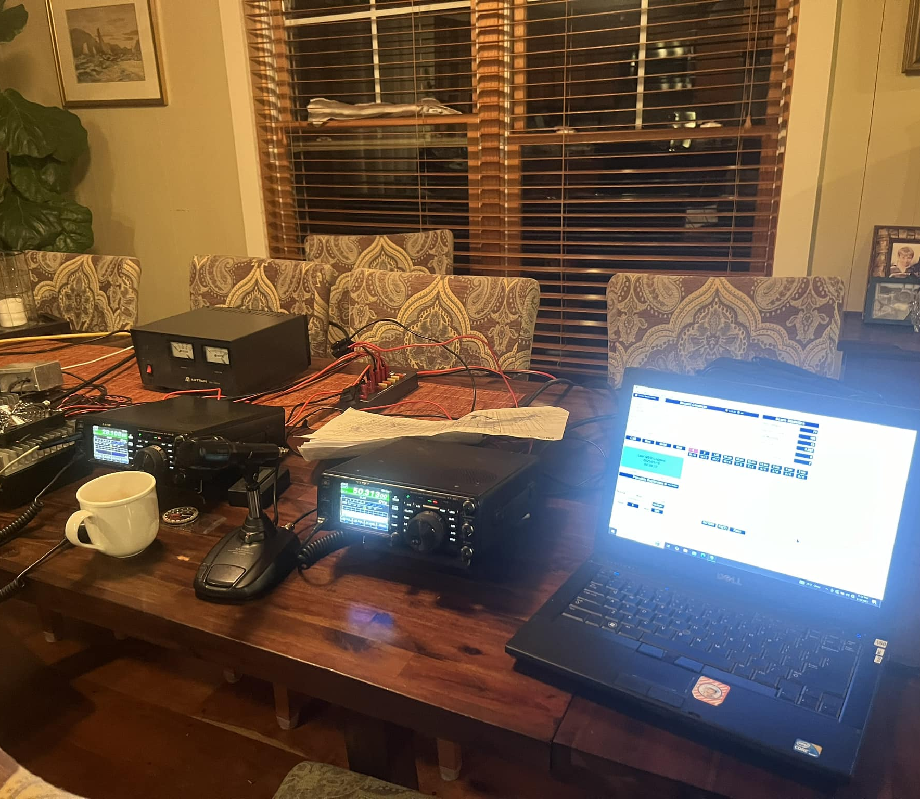
January 2025- Fine Tuning!
Added 222 transverter adding CW/SSB capabilities
136 QSOs and 48 Multipliers - 9,504 pts! Best score ever
Improved set up with better antennas on 2 meters (13 Elements) and 70 CM (25 Elements), Also improved coax with more LMR 400 for higher bands
Snow/ Sleet Sunday night made things difficult breaking down Monday, determined next time we start take down Sunday after contest based on conditions so antennas can “defrost”

Slide 19
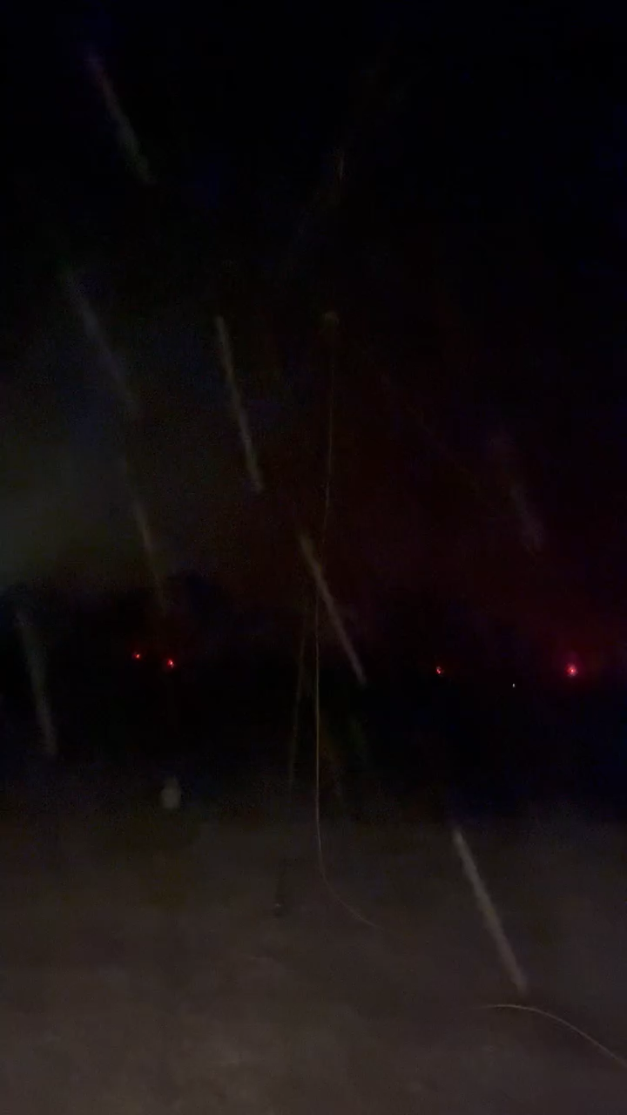
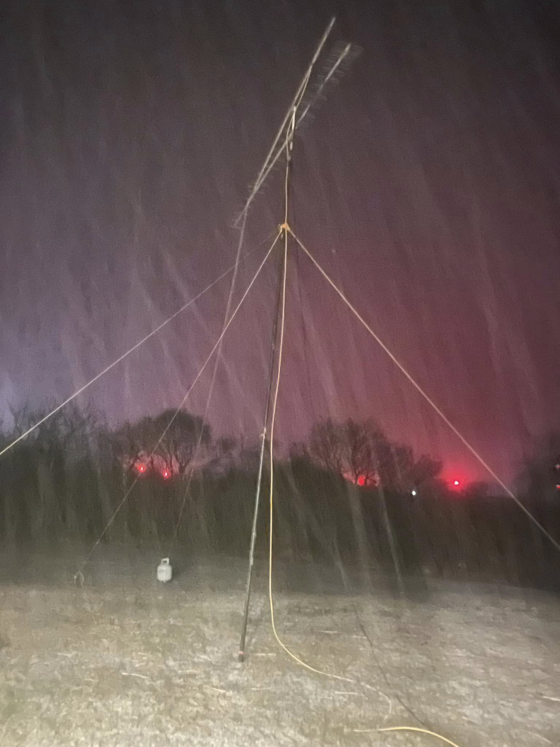
Snow “Scatter”

Slide 20
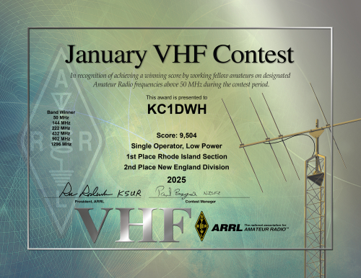
Hard work= Results

Slide 21
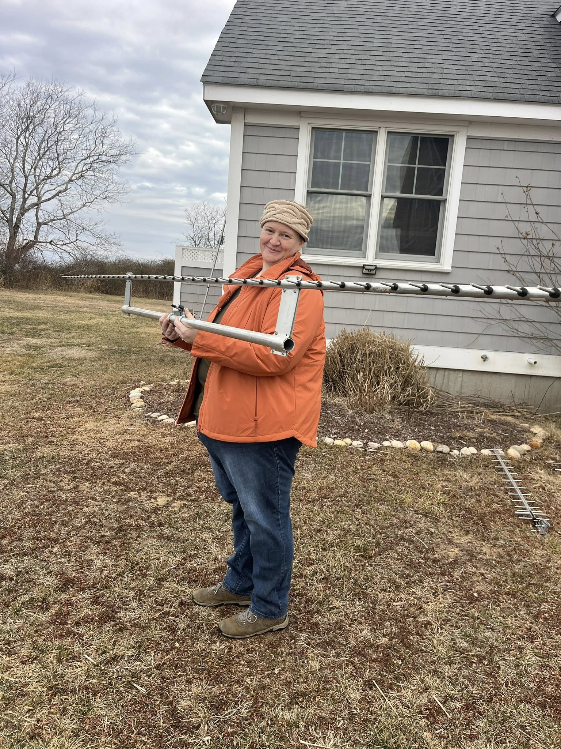
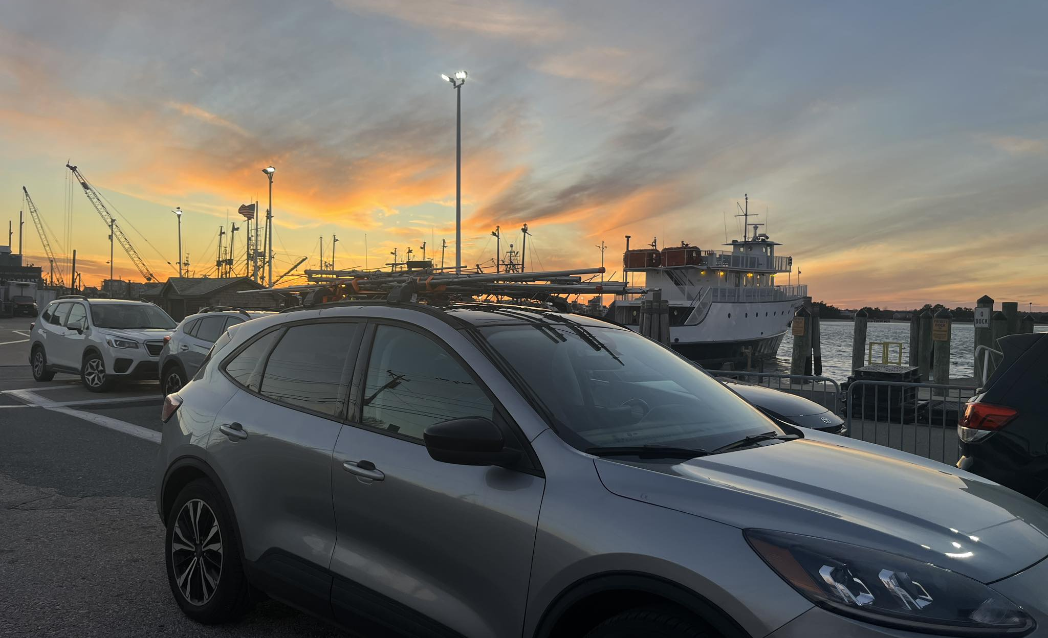
January 2026
Bit of a slump from 2025 did have some E skip on Sunday afternoon to EM12.
Ferry was a rough ride out and back!!
117 QSO’s & 47 Multipliers, 8,178 Pts.

Slide 22
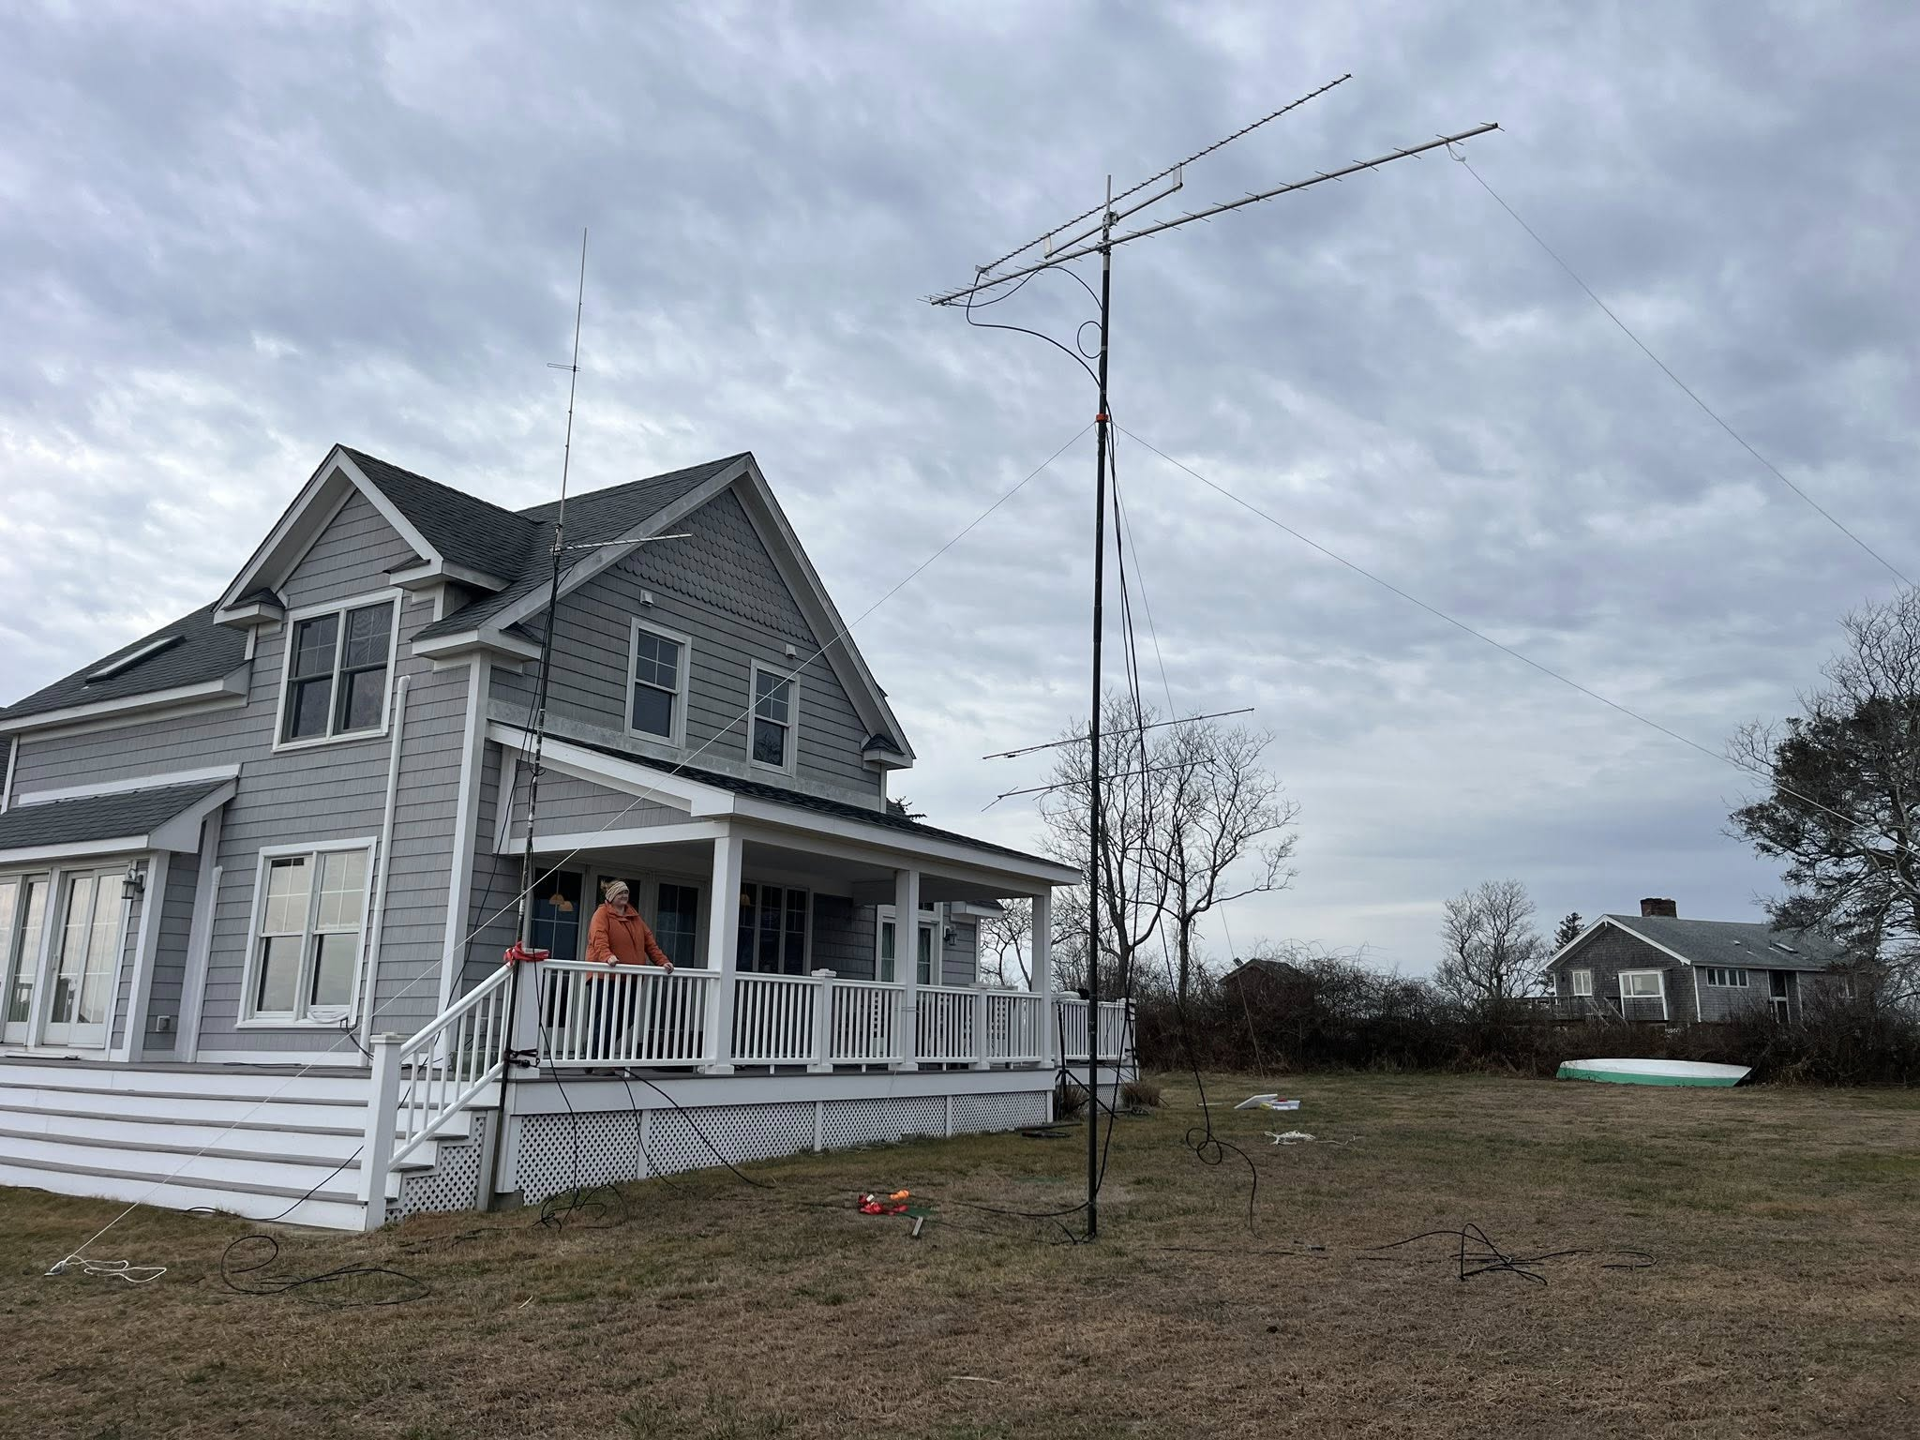


Jan 2026 Set up
Coax for 1296 switched to LMR 600 previous coax found to be lossy
Also got transverter for 1296 more power and new beam much more stable than loop yagi for portable work – M2 beam
Also brought out a ringo ranger for 2-meter simplex

Slide 23



Winter Wonderland

Slide 24


Winter Wonderland (Cont.)

Slide 25

Lessons learned
2 meter and 432 beams purchased @ NEARFEST
LOCATION LOCATION LOCATION- Elevation is key and access to horizon
More Bands= better score , adding more bands has increased multipliers and the challenge working say AF1T on 1.2 Ghz in January with the wind blowing adds to the fun!
SCHEDULE QSOs (ARRL contests only) – Use the K1RZ / W3SZ database! Call/ text to set up Scheds! Many contests other than AF1T and K1RZ my phone stays silent! I make many calls to make schedules
Continue improvements- make improvements to set up etc. Always on lookout for better antenna’s (more gain), better coax for less loss, etc. Refine set up to avoid same problems such as wind, freezing coax and antennas etc.
Research Location- wish to operate from- For instance it had been several years since I went to the location on Block Island thought we had trees to tie off too- had to run out to the store to get stakes.

Slide 26

Future Goals
Short term add 2304 set up already have amplifier and Antenna and just got in transverter
Long term goal Add 10 GHZ- have transverter need to fix it
Also have home capabilities to run a contest or activity night effectively from home station – just moved to FN41CQ – 430’ elevation

Slide 27

Any Questions?
Packed and ready to head to the ferry in 2024

