Slide 1
Measuring VSWR or Return Loss at Microwaves
Paul Wade W1GHZ

Slide 2
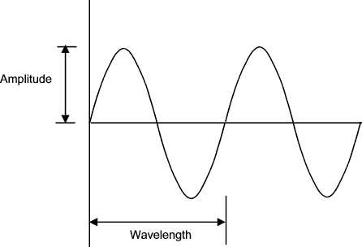

Microwaves
Traveling at Speed of Light
Hard to see
$Wavelength=\frac{300000000 m/sec}{1296000000 cycles/sec}$ = 23 cm

Slide 3

Visualizing Microwaves
Stop the sine wave – Short circuit
Voltage must be ZERO at short circuit
Wave stands still – Standing wave

Slide 4
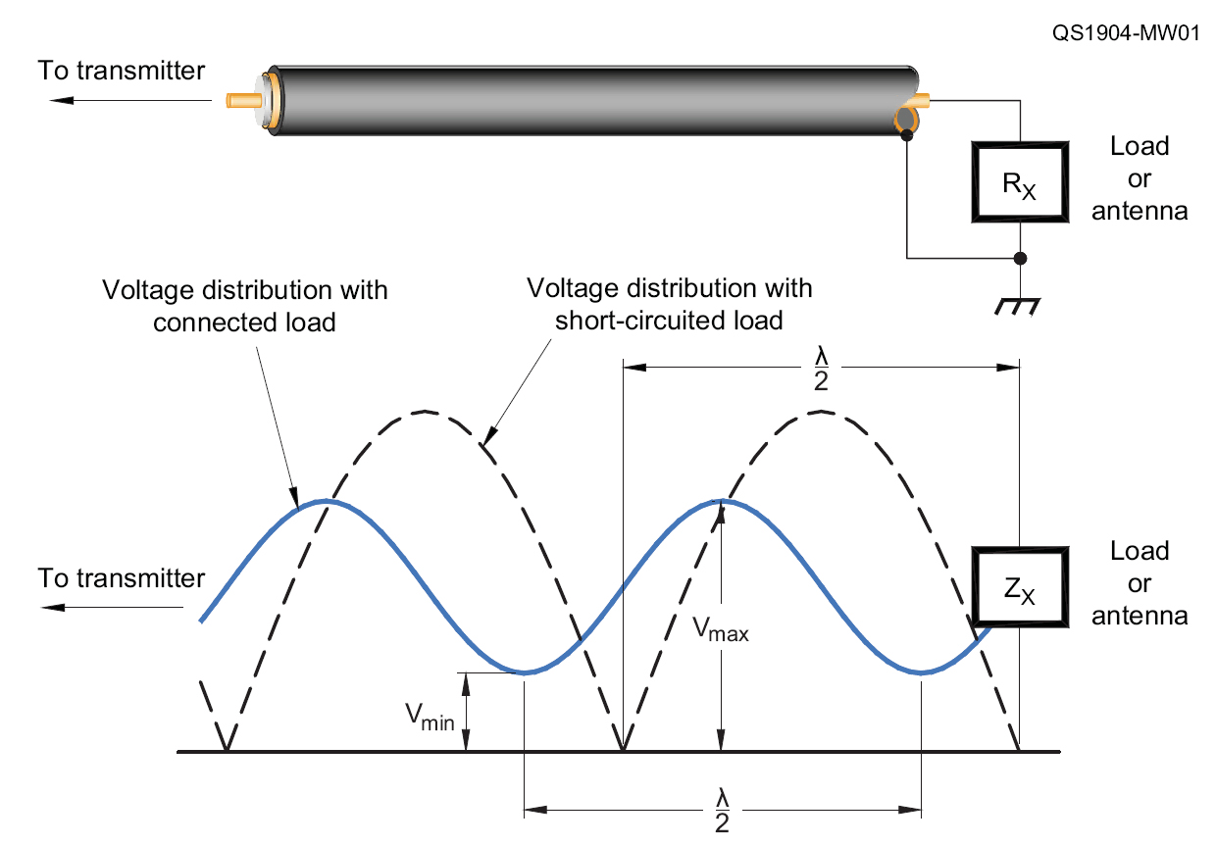
Standing Waves on T-Line

Slide 5

Standing Wave Ratio
$VSWR= \frac{V_{MAX}}{V_{MIN}}$
Measure voltage with moving probe on slotted line

Slide 6

Return Loss
Return Loss = −10·log$\left(\frac{Forward Power}{Reflected Power}\right)$
Return Loss = −|S11|
$VSWR=\frac{{1+10}^{{RL}/{20}}}{{1−10}^{{RL}/{20}}}$

Slide 7
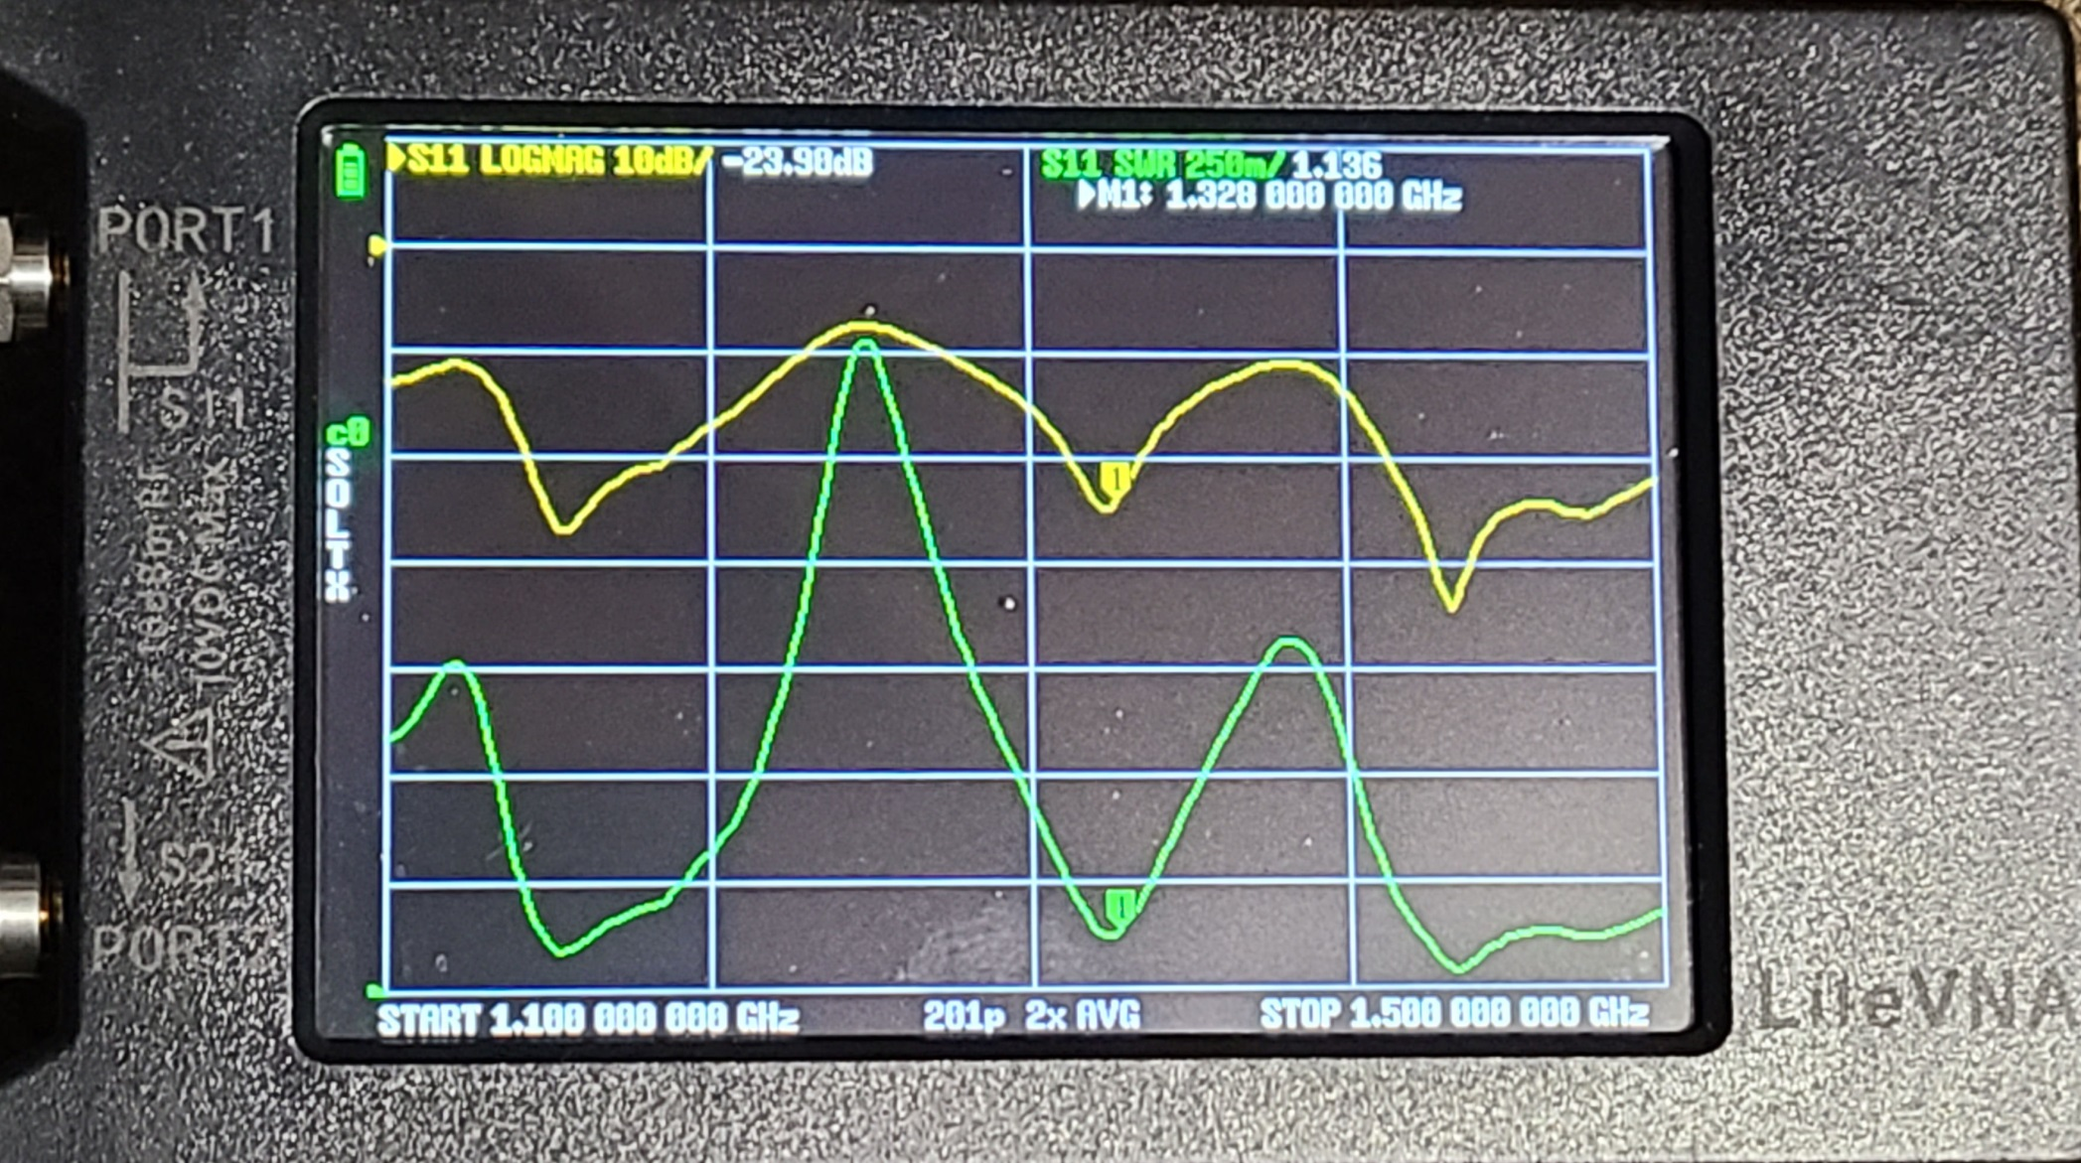
Return Loss and VSWR Vector Network Analyzer
S11
VSWR
Return Loss = −|S11|

Slide 8
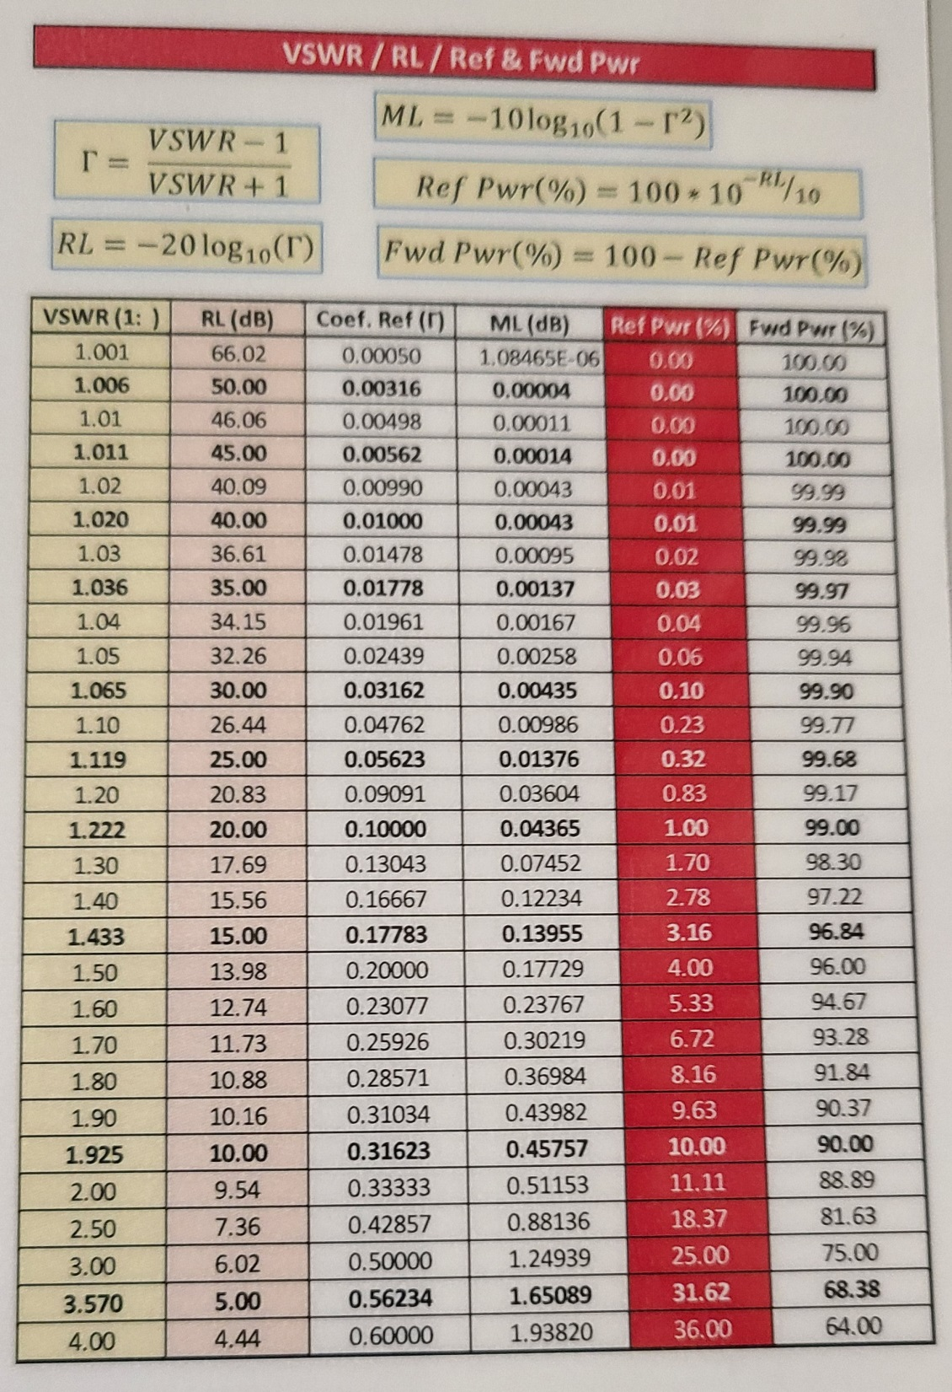
VSWR Return Loss & Reflected Power

Slide 9
Realistic Return Loss
20 dB RL = 1% Power reflected – OK
VSWR = 1.22
15 dB RL = 3% - not bad
VSWR = 1.43
10 dB RL = 10% - usable
VSWR = 1.92
< 10 dB - need to fix
> 20 dB - nice, but can we measure?

Slide 10
10 GHz and Up VNA
TinyVNA only to 6 GHz
10 GHz+ VNA
Big, Heavy, and Expensive
Big, Heavy, and Old
Waveguide Calibration problematic

Slide 11
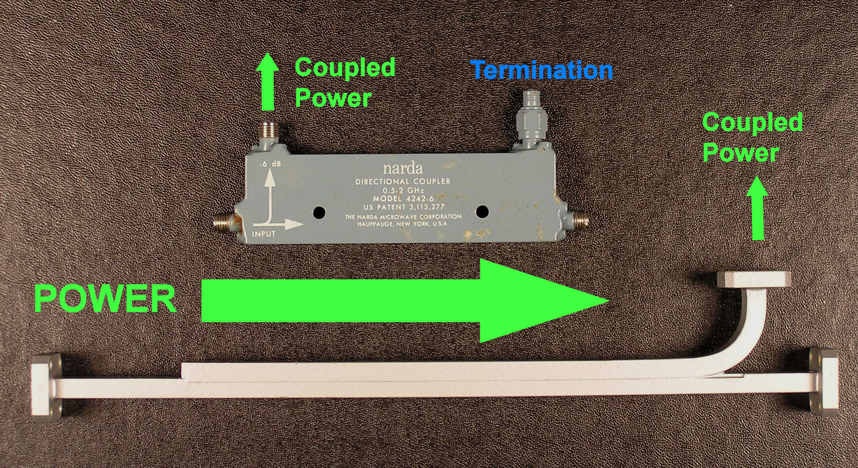
Directional Coupler Measure Power in one direction
Reverse coupler for reflected power

Slide 12
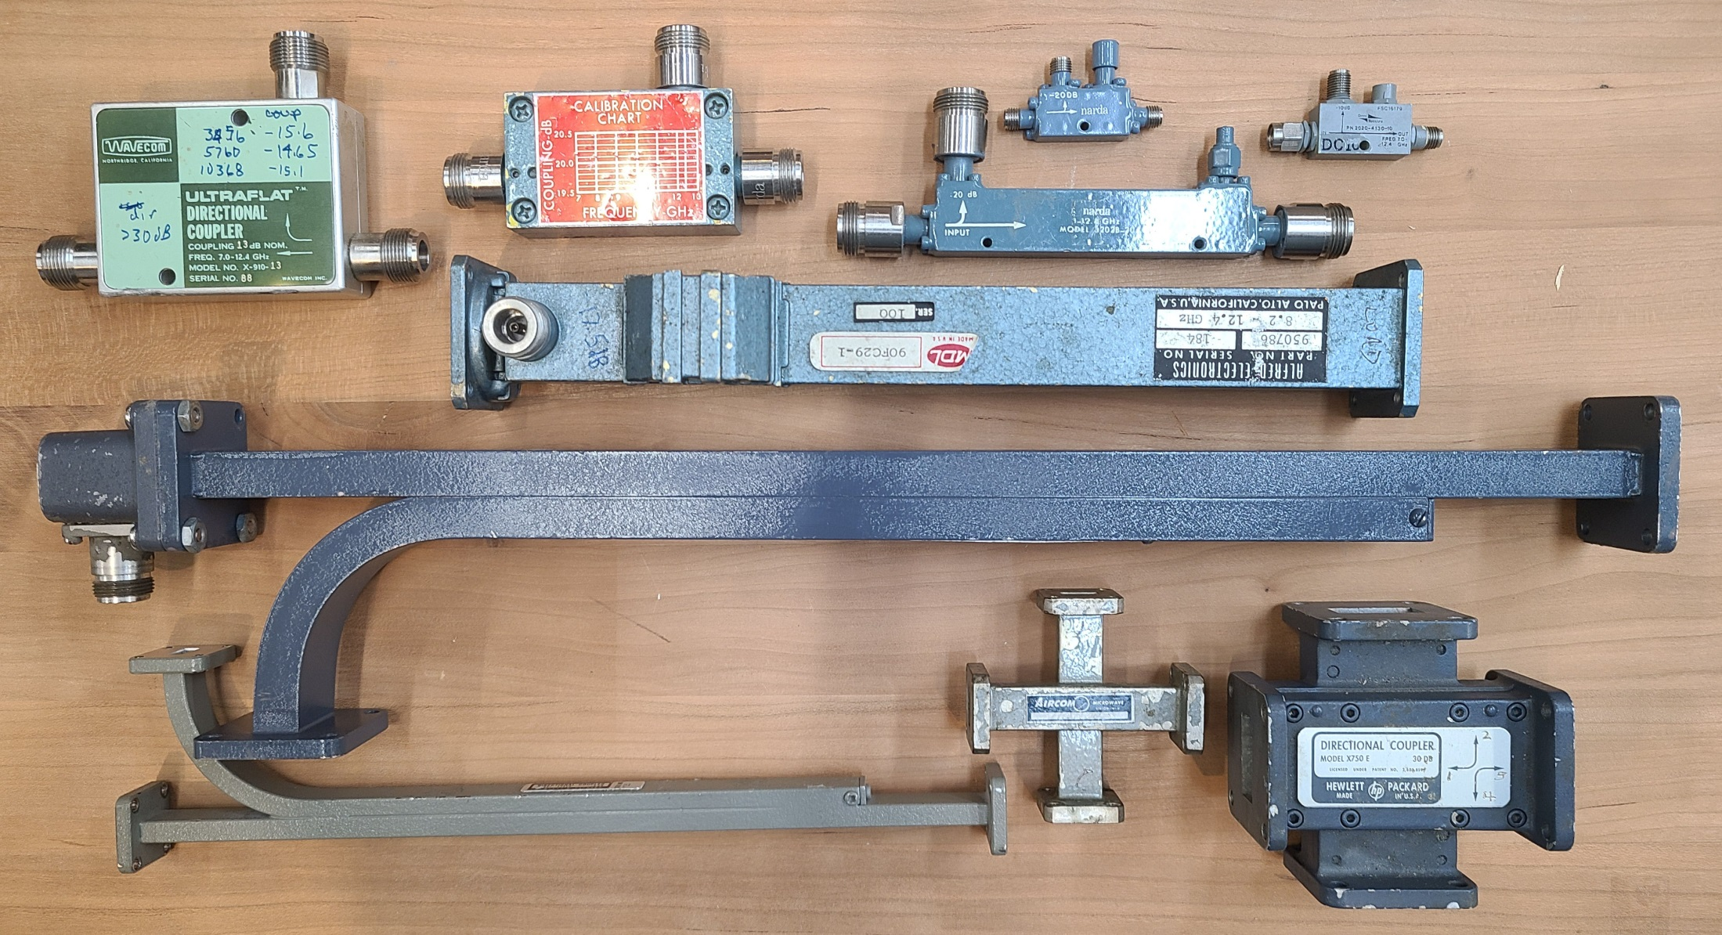
Directional Couplers

Slide 13
Directivity
Directional Couplers are not perfect
Some reverse power leaks into forward measurement = error in POWER
Some forward power leaks into reverse measurement = error in Return Loss
Leakage can add or subtract – depends on phase
Directivity is magnitude of leakage

Slide 14
Directivity & Error
Example:
Antenna Return Loss = 20 dB (1% reflected)
Coupler Directivity = 20 dB (1% leakage)
Coupler output can be between
High = 1% + 1% RL =17 dB
Low = 1% - 1% RL = ∞
Can you tune with this error?

Slide 15
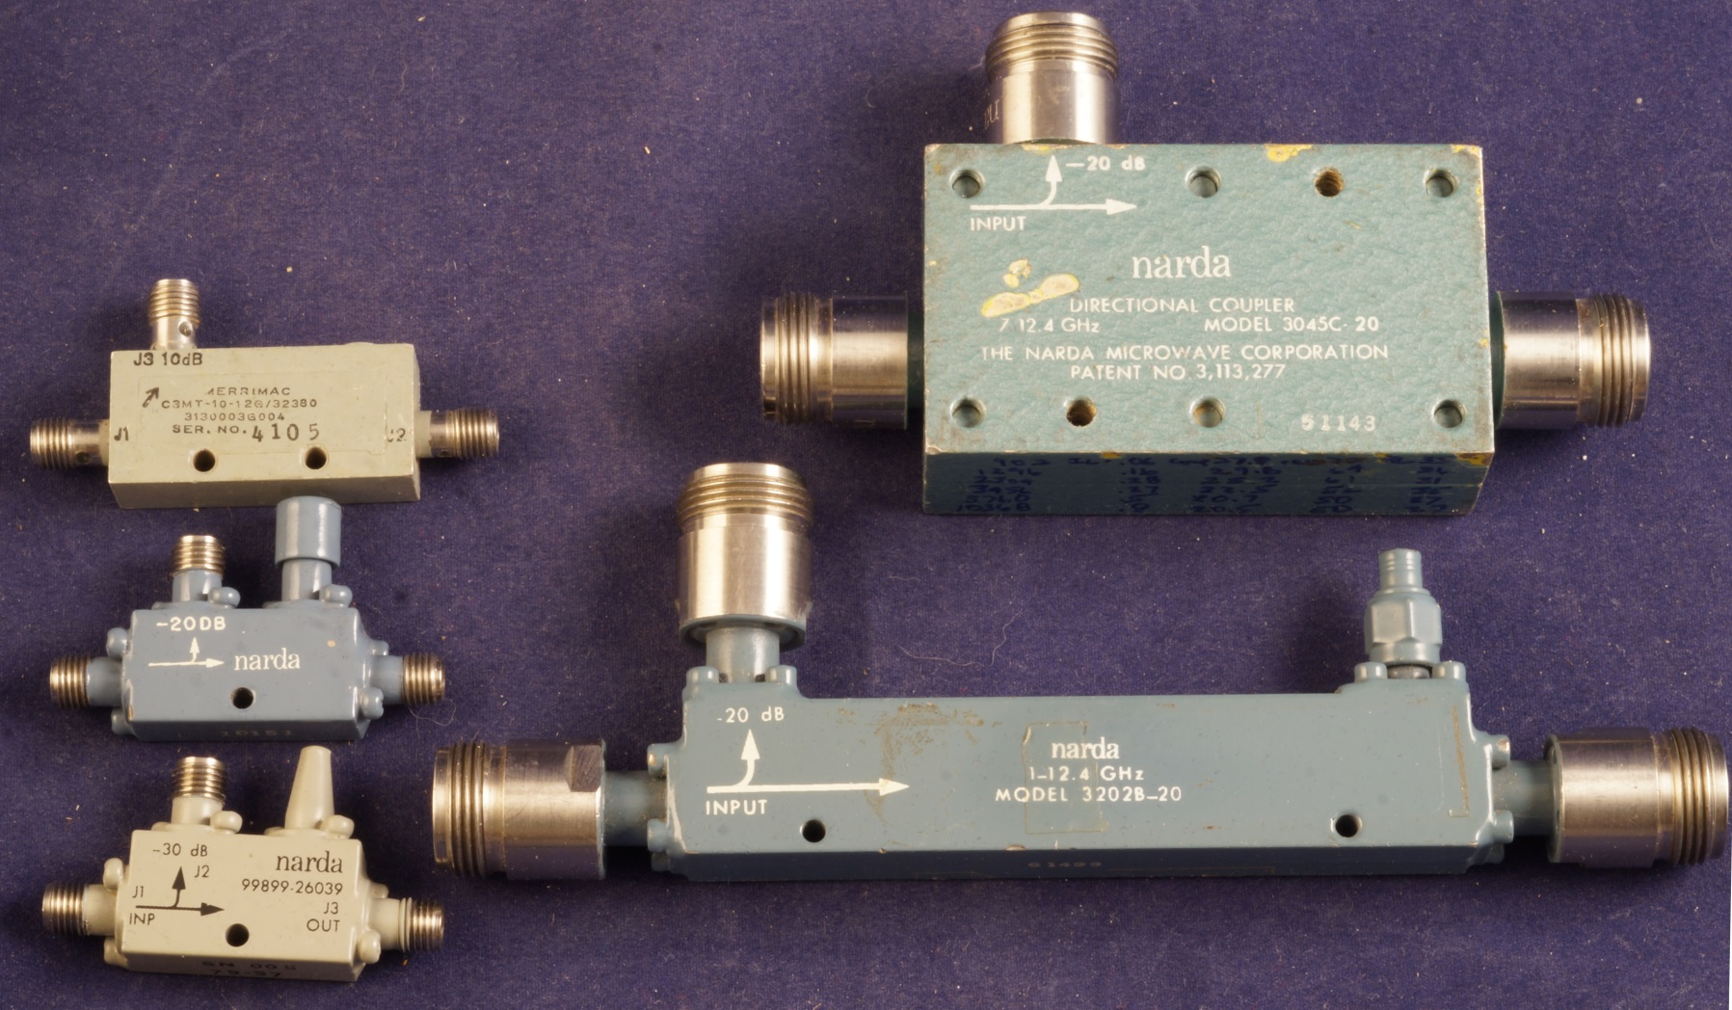
Coaxial Directional Couplers
Coupling Factor
Directivity 20 dB or less at 10 GHz

Slide 16
Sensitive Detector Required
Coupled reflected power down by:
Coupling factor - 10 to 30 dB
+ Return Loss – up to 40 dB
Need at least 50 dB below forward power
-50 dBm at small signal level
Test at high power?
Spectrum Analyzer
TinySA Ultra not that sensitive
Single frequency measurement
VNA

Slide 17
Diode Detector
More sensitive than power meter
Measures peak voltage, not power
Not linear – relative readings
Sensitive to harmonic content in signal

Slide 18
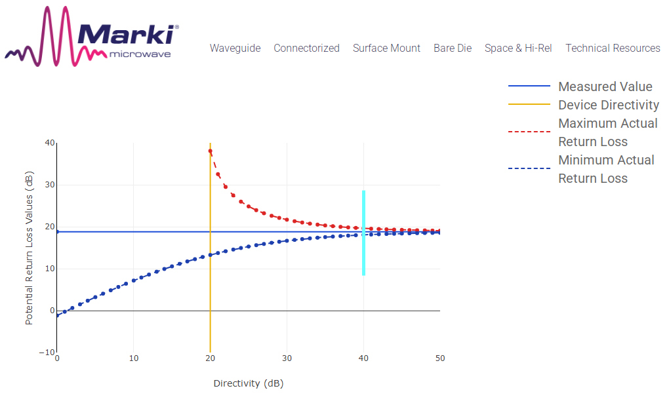
High Coupler Directivity for Accurate RL Measurement
Actual VSWR
Tools ->
Return Loss
Error
Calculator
1.04
Measured
VSWR=1.25
1.56

Slide 19
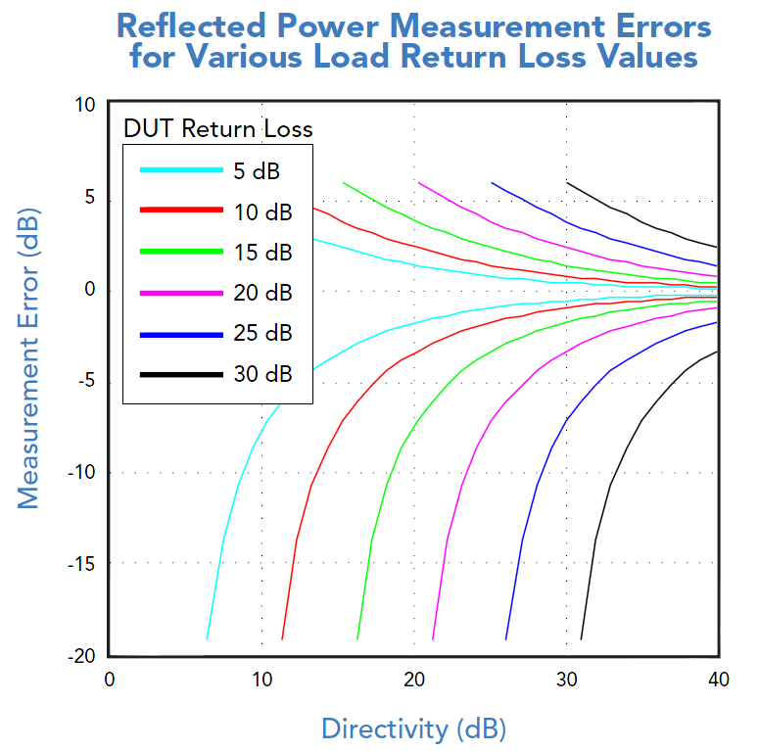

Slide 20
No Tuning Screws
Can’t make it better than you can measure
Can make it worse
Work to known good dimensions
Measure RL to check for problems
RL > 15 dB = good to go
RL < 10 dB = fix
Goal = good enough

Slide 21
VNA – accurate measurement
Calibration routine minimizes Directivity error
Short
Open
Load
TinyVNA only good to 6 GHz
10 GHz+ VNA
Big, Heavy, and Expensive
Big, Heavy, and Old

Slide 22
WAVEGUIDE
VNA needs good Waveguide Calibration
Waveguide Cal kits rare
Waveguide Cal routine?
Coax transitions are a problem

Slide 23
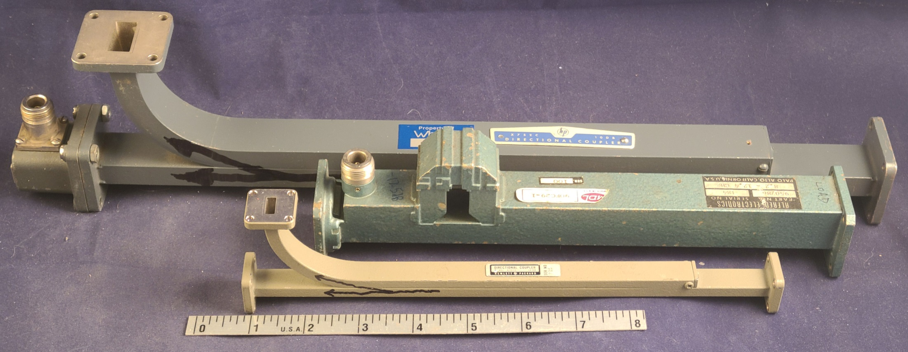
Waveguide Directional Coupler
Broadside Waveguide Coupler
Very High Directivity
HP tested for 40 dB min Directivity

Slide 24
Sensitive Detector Required
Coupled reflected power down by:
Coupling factor -- 10 to 30 dB
+ Return Loss – up to 40 dB
= at least 50 dB below forward power
-50 dBm small signal
Test at high power?
Spectrum Analyzer
TinySA Ultra not that sensitive at 10 GHz
Big and heavy
Single frequency measurement

Slide 25
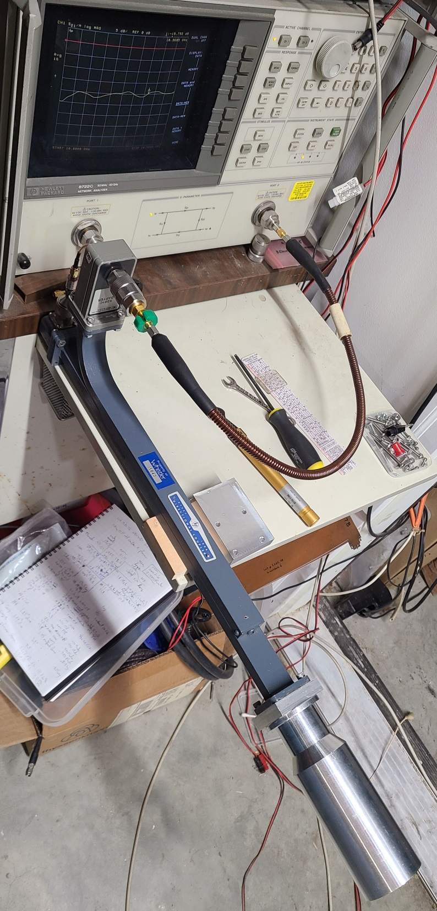
VNA as detector
Measure S21 with Port 2 at coupled port
No Calibration - Rely on coupler directivity
Measure WG short, then load (antenna)
Difference is Return Loss

Slide 26
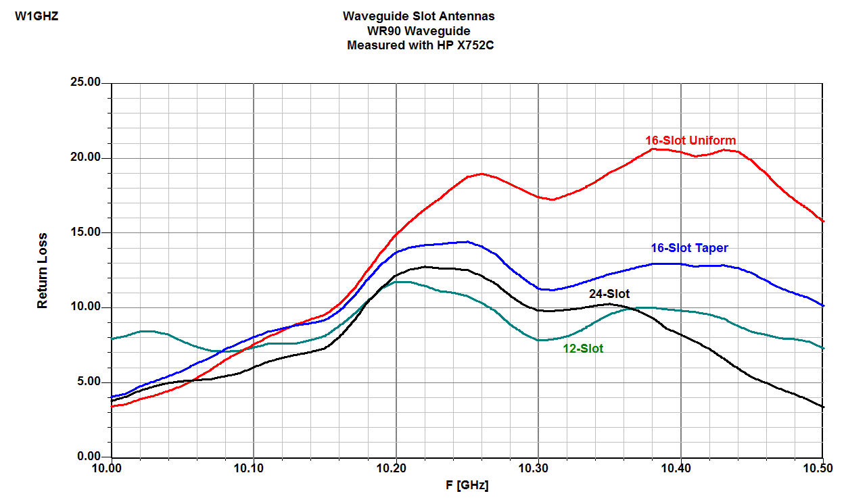
Swept Return Loss
Waveguide Slot Antennas

Slide 27
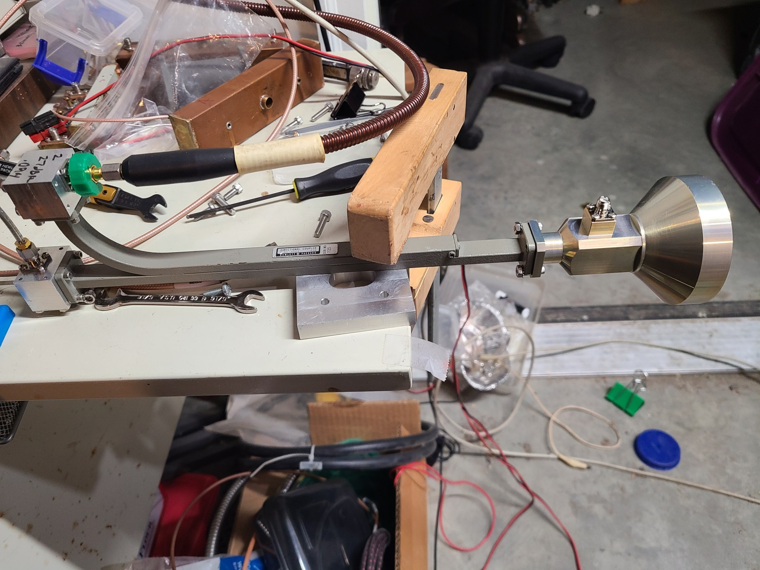
24 GHz with VNA

Slide 28
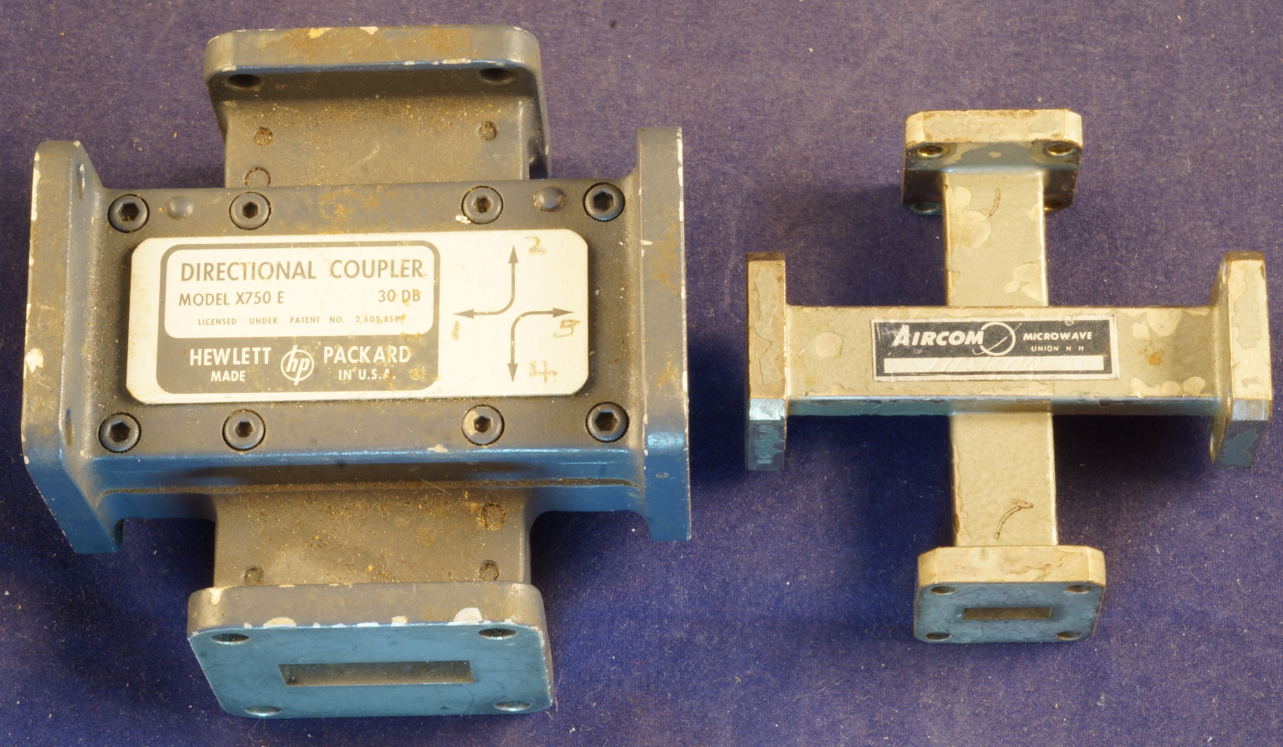
Cross-guide Couplers

Slide 29
Cross-guide Couplers
Crossed Waveguides
Directivity typically 20-25 dB
High coupling factor ≥ -30 dB
Better for power monitor & measurement

Slide 30
Summary
Accurate microwave measurement difficult
Give it your best shot
Goal = good enough
Get it on the air

Slide 31
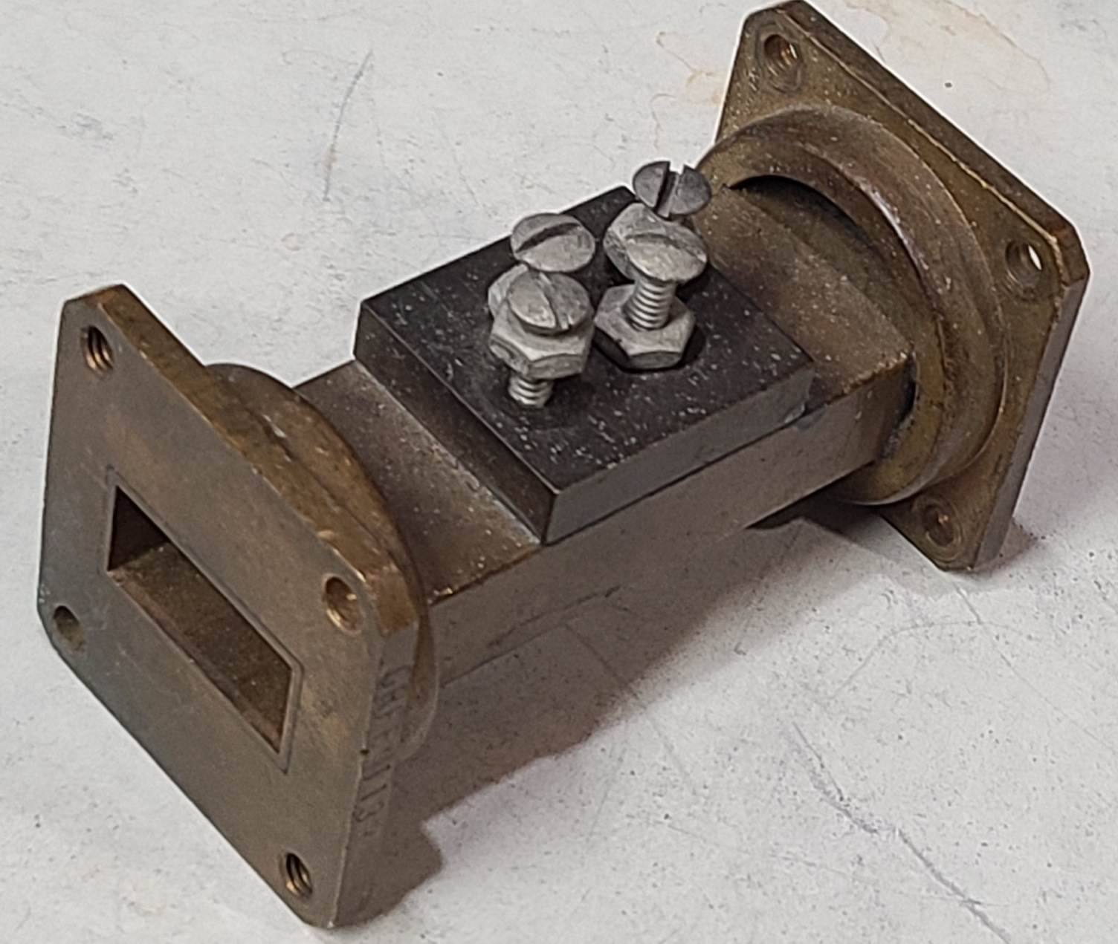
Or screw around

Slide 32
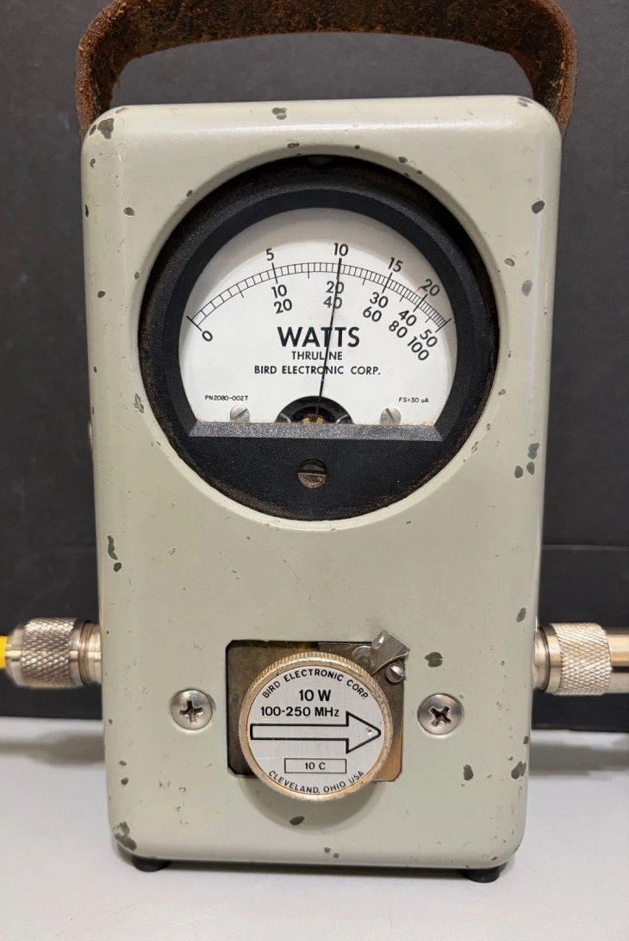
Lower Frequencies
Directivity ??
Diode detector -beware of harmonics

Slide 33
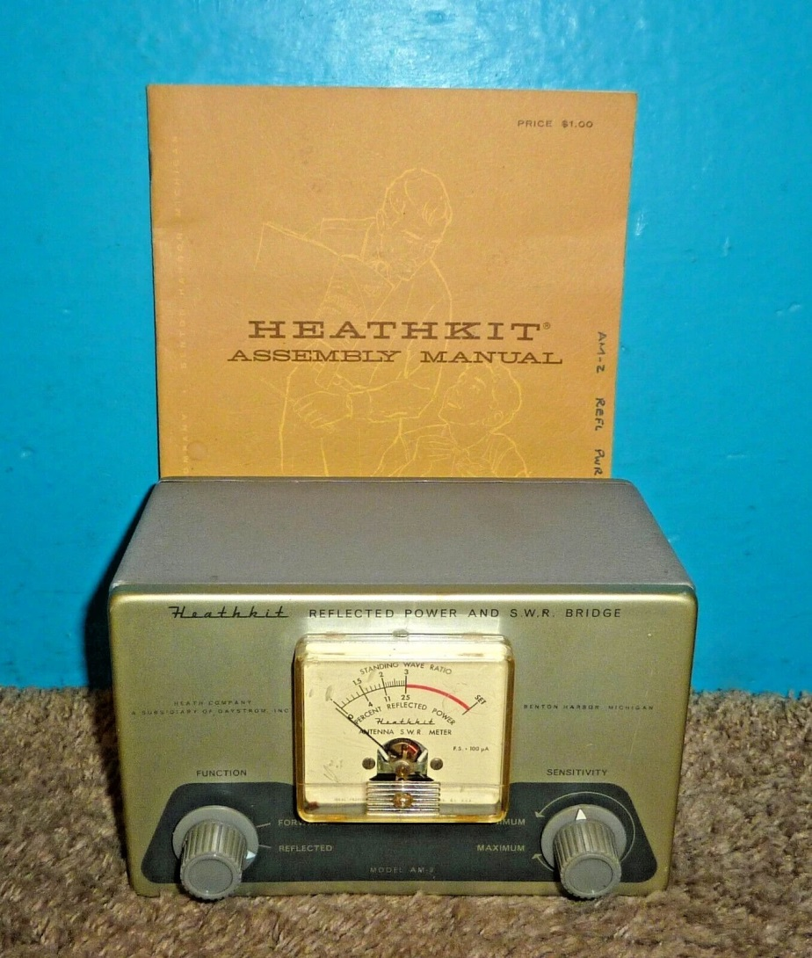
A Classic
Precision instrument!
Adjust that Antenna Tuna
To 1.000:1
Diode detector
Are other Amateur meters much better?

Slide 34


Slide 35

www.w1ghz.org

