Slide 1
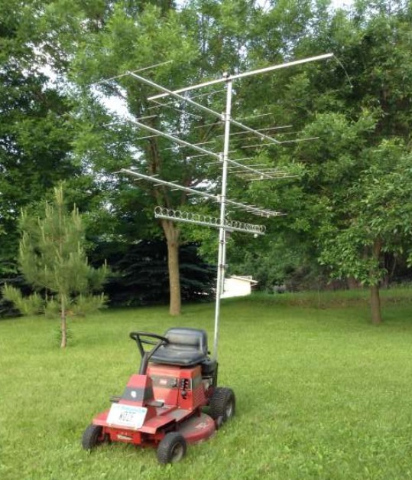
Six Meter Rover Antennas
W3CMP 04/2026
Legal Considerations
Physical and Electrical
Limitations
General Categories
New Ideas

Slide 2
Legal Considerations
Maximum Height for Vehicles - No Federal Limit. Height Set By States. In most states (Eastern U.S.) maximum height is 13.5 feet (162”)
Maximum width for Vehicles - 102” set by Federal Government
Maximum Single Vehicle Length - 40 feet including load
Projecting Load - regulated by states

Slide 3
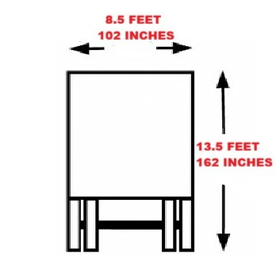
Height (Typical) and Width Limits

Slide 4
Projecting Loads – Overhanging Antennas
PA Vehicle Code § 4924
Front Overhang: Maximum 3 feet beyond the front bumper.
Rear Overhang: Maximum 6 feet beyond the rear of the bed or body.
Flagging/Lighting: A red flag/cloth (12 inches square) is required at the extreme end of the load if it extends
4 feet or more beyond the rear.
Nighttime Requirements: If traveling during hours of darkness, a red light (visible from 500 feet) must be
displayed at the end of the load instead of a flag.
Check Your Own State or States You Will Operate In

Slide 5
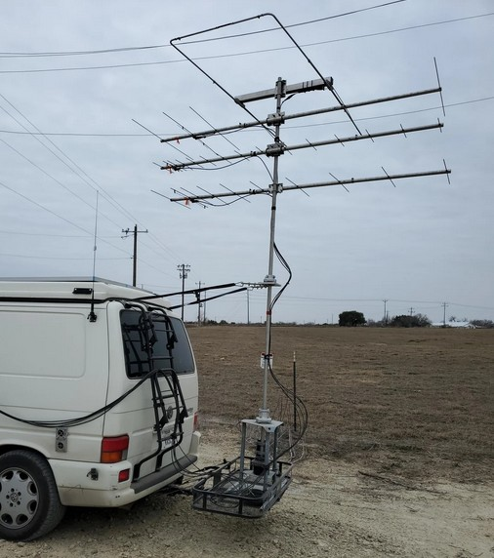
EXCESSIVE REAR OVERHANG
Yagis appear to be DS&E Rover
Specials – 8’ long
No red flag

Slide 6
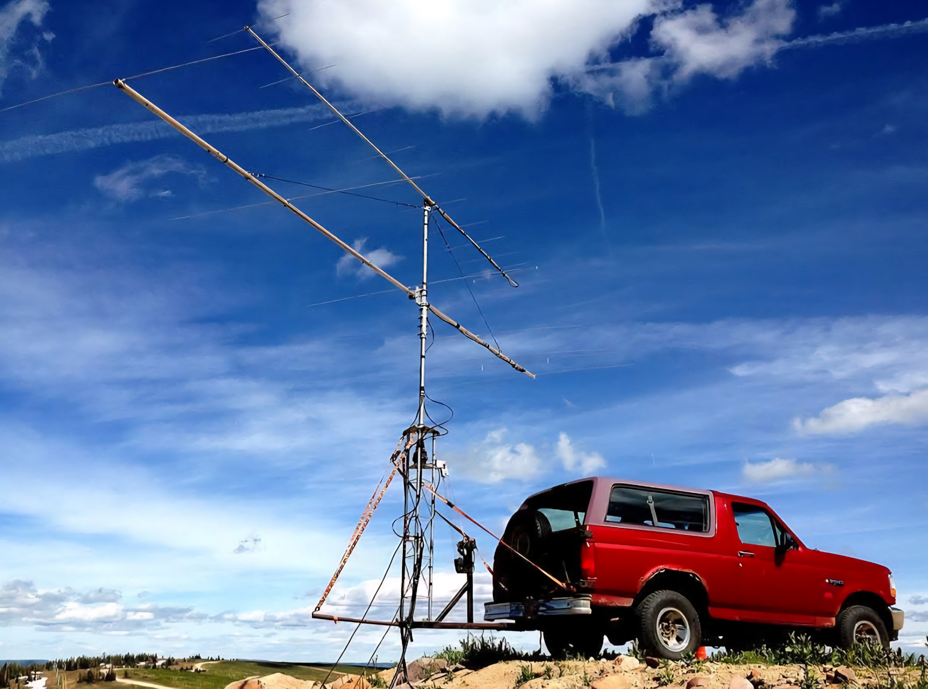
Overall Length Violation
Didn’t Get The Memo
12 Element 144 MHz Yagi 7 Element 50 MHz Yagi

Slide 7
Six Meter Electrical Considerations
Wavelength at 50 MHz = 239+ inches
½ WL ≈ 119 ½”
5/8 WL - Common Stacking Distance for Omnis = 150”
Element lengths of 50 MHz Yagis > legal width of vehicle
Antenna turning radius limits boom length

Slide 8
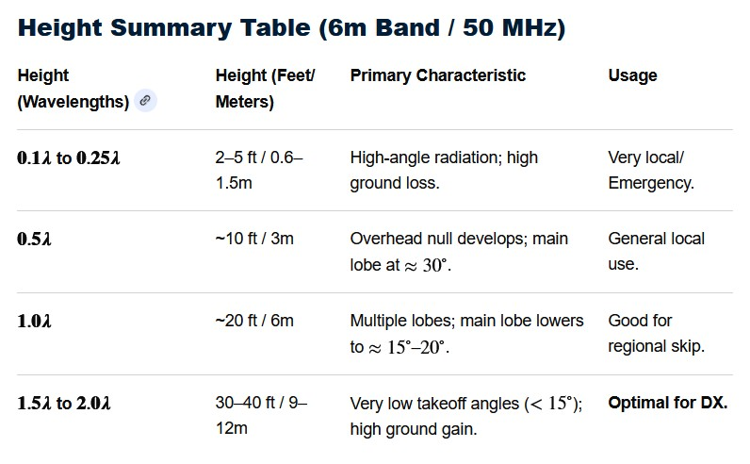
Six Meter Antenna Height
Propagation Characteristics

Slide 9

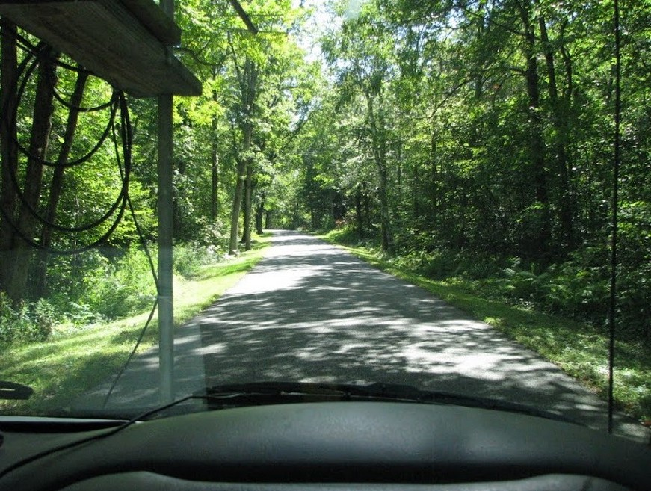
Practical/Physical Considerations
W1RT Rover Mohawk Mtn. CT – K1RA
Road To Fire Tower Site In PA

Slide 10

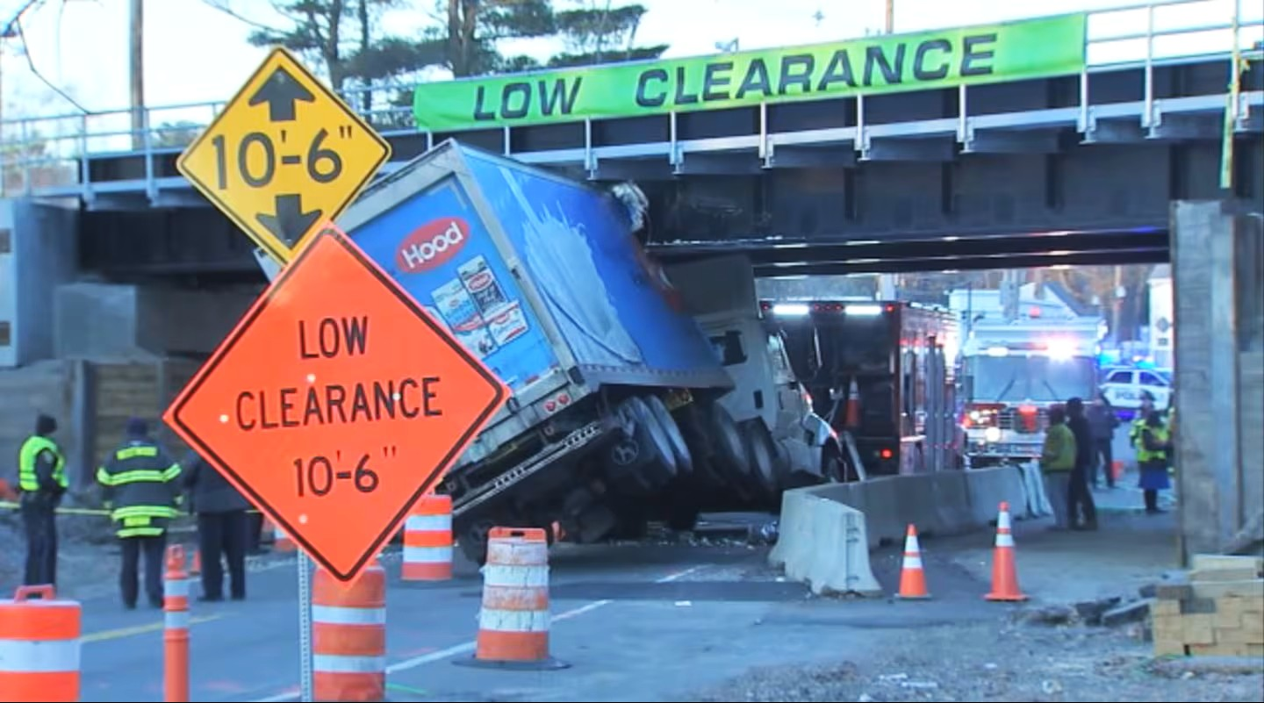
Operational Hazards
Bridge near Boston

Slide 11

Guaranteed Prosecution If Hit

Slide 12
Six Meter Antennas – Choices For Rovers
If the rover is an entirely mobile, run and gun operation, all street-legal 50MHz antennas are a compromise. If the rover involves stationary, stop and shoot hilltop operation, the mobile limitations may not apply.
Either way, weight and durability should be the biggest considerations. Highway speeds can reach hurricane force winds. For hilltop operation, ease and speed of setup and take down are paramount.

Slide 13
Gain of Six Meter Antennas – Some Suitable For Rovers

Slide 14
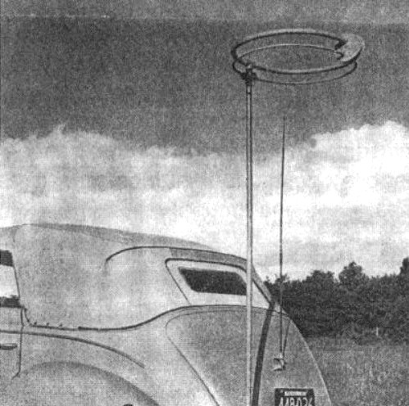
Omni Directional Six Meter Antennas
Original Six Meter Halo W1MUX
Generally some form of bent dipole -
circular or square
Hi-Par Saturn Six, Par Omni OA-50
Cushcraft Loop, Squalo, M2 HO-Loop
Turnstile?
CB 5/8 WL Vertical usable

Slide 15
Six Meter Omni Antennas
Advantages
  Easiest and Simplest to Use
  Receive and transmit in all directions – no rotor needed
  Do not exceed width limit on vehicle
Disadvantages
  Receive and transmit in all directions - gain < dipole
  Stacking Distance at 50 MHz = 12 ½ feet

Slide 16
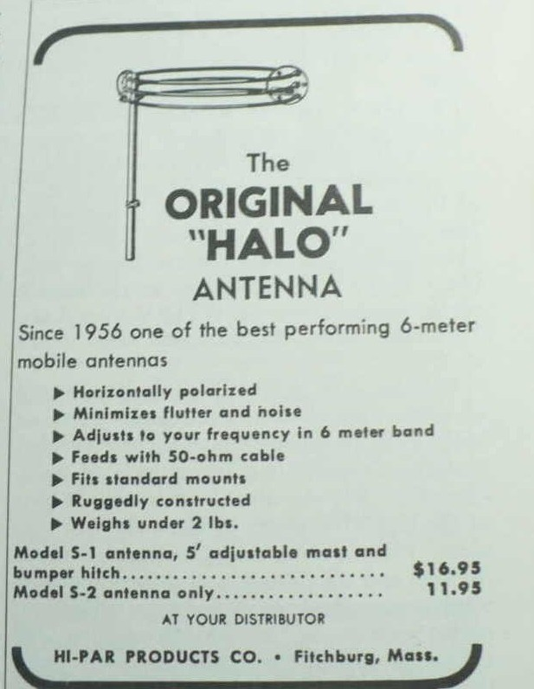
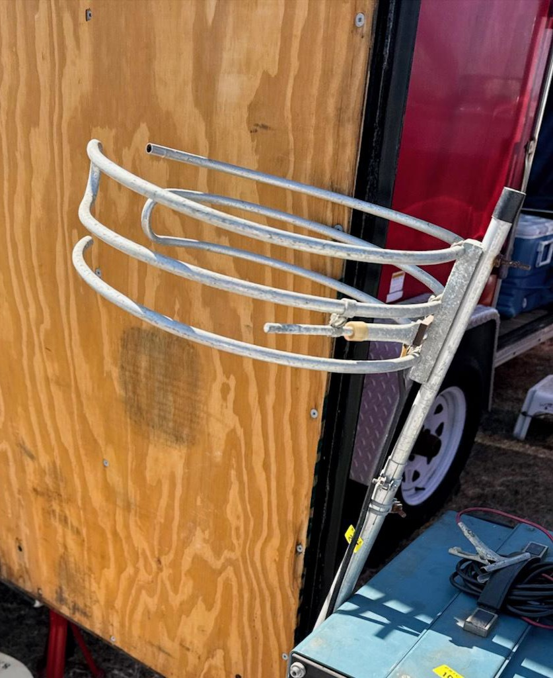
Typical Six Meter Halo Antennas
Early Halo Ad – Note Price
Cushcraft? Wheel – HamCation 2025

Slide 17
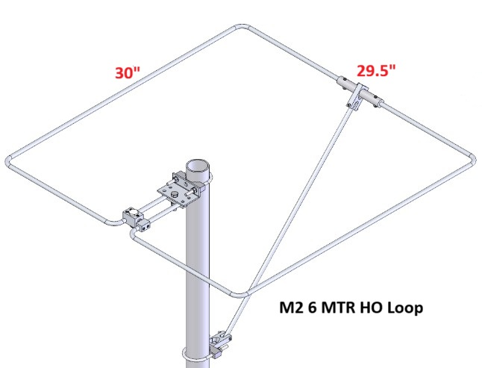
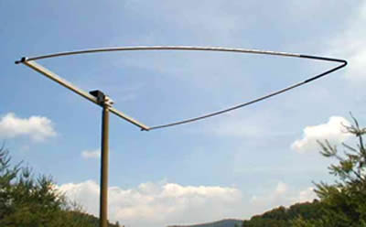
Common Non- Circular Six Meter Omni Antennas
M2 HO-Loop
Par Omni OA-50

Slide 18
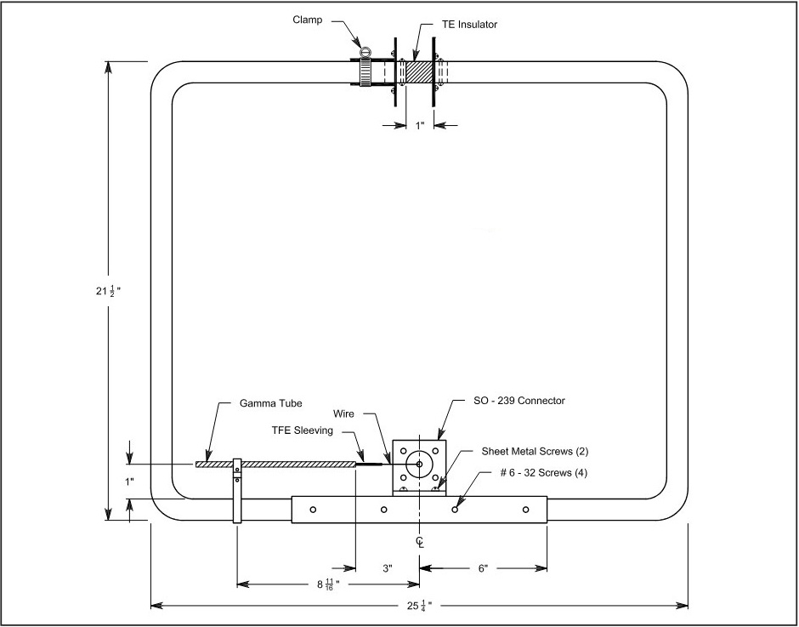
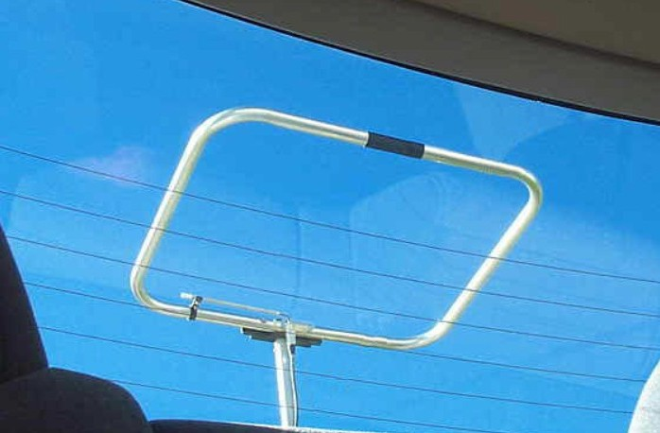
Homebrew 50MHz Squalo Antennas
W9SR Aluminum Folding Chair Six Meter Loop - January 2002 QST
W3DHJ Version

Slide 19
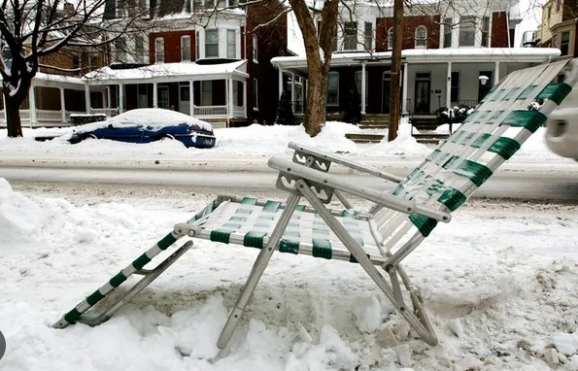
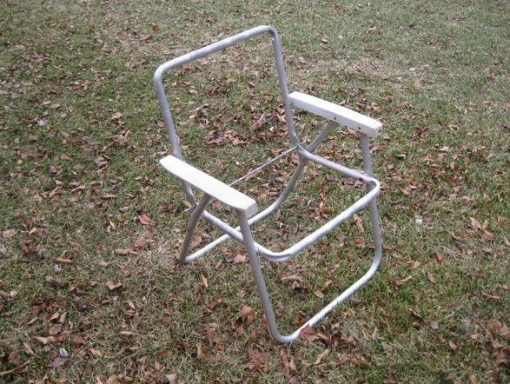
Raw materials For Six Meter Squalos
Endless Supply
Ready to Cut

Slide 20
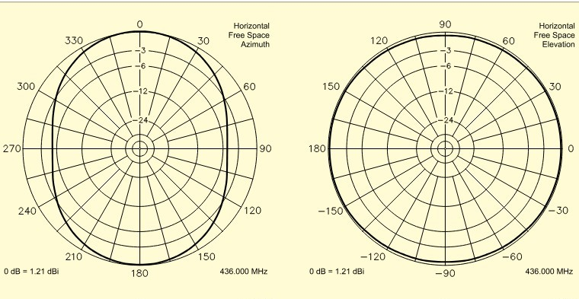
Gain of Squalo
Squalo gain = 1.21
dBi = -.9 dBd
W9SR

Slide 21
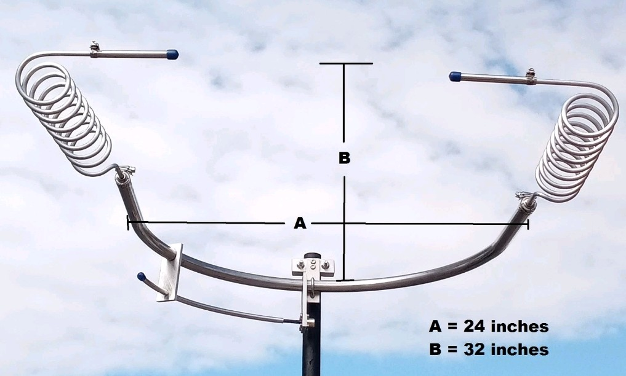
Six Meter Frankentenna
Ebay Seller – FreqTester
Smaller Than Squalo
Pattern?

Slide 22
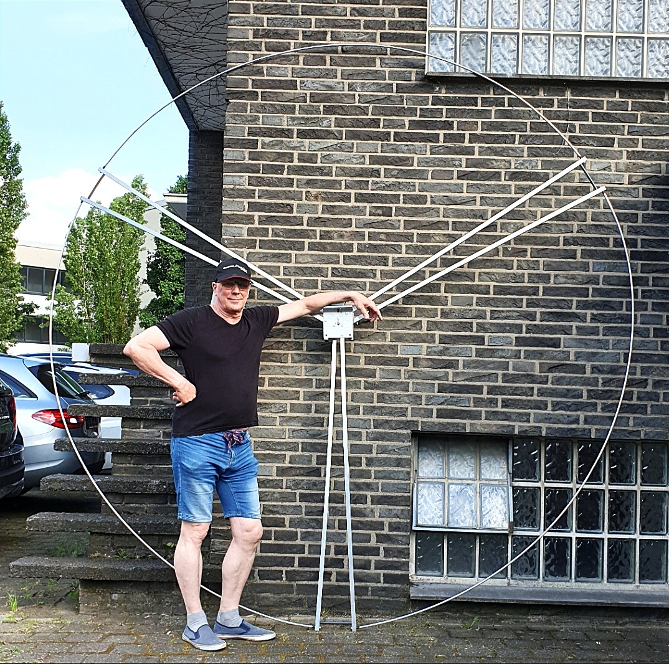
Big Wheel – Too Big
Works well on 144 MHz and 432 MHz
Gain ≈ 5 dBi
Approximate 12’ diameter too big for mobile/rover use
Available from Wimo and
DXEngineering

Slide 23
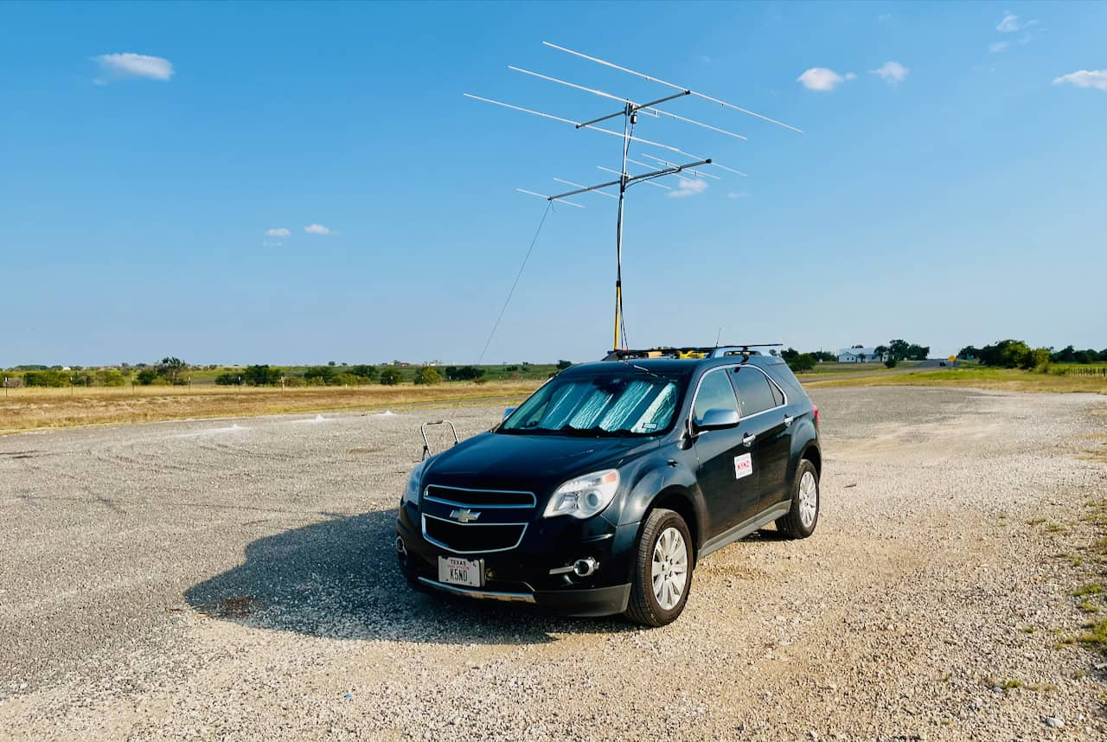
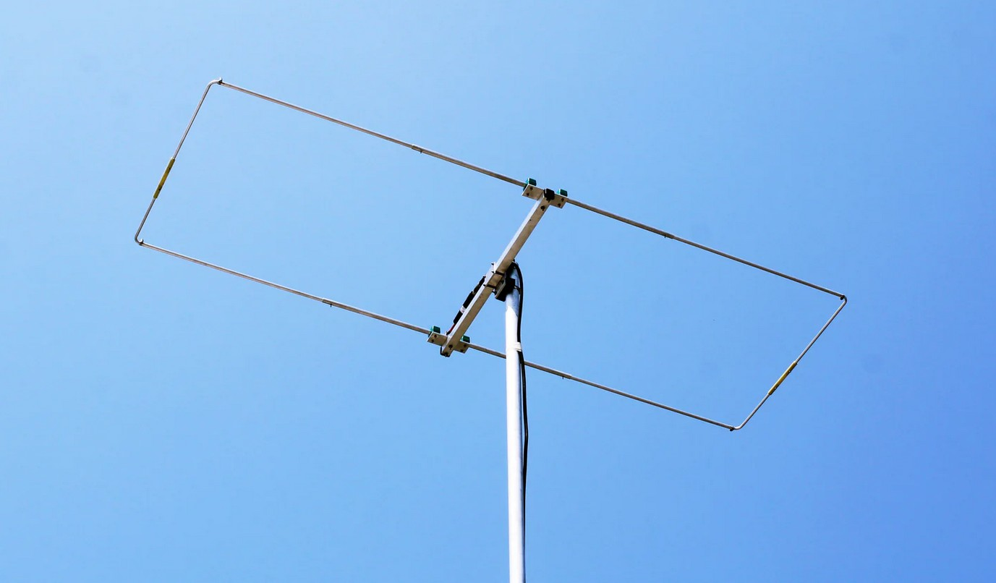
Directional Six Meter Rover Antennas
Yagi
KY5ND/R
Moxon

Slide 24
Yagi
Advantages
Directional
Most Gain 7 – 9 dBi (5 – 7dBd)
Works Well For Fixed Rover
Cheap if CC parts lying around
Many designs to play with
Drawbacks
Size – element lengths exceed
maximum vehicle widths – must
be mounted transversely
Requires Rotator
Assembly often required
Can’t be used effectively while
in motion

Slide 25
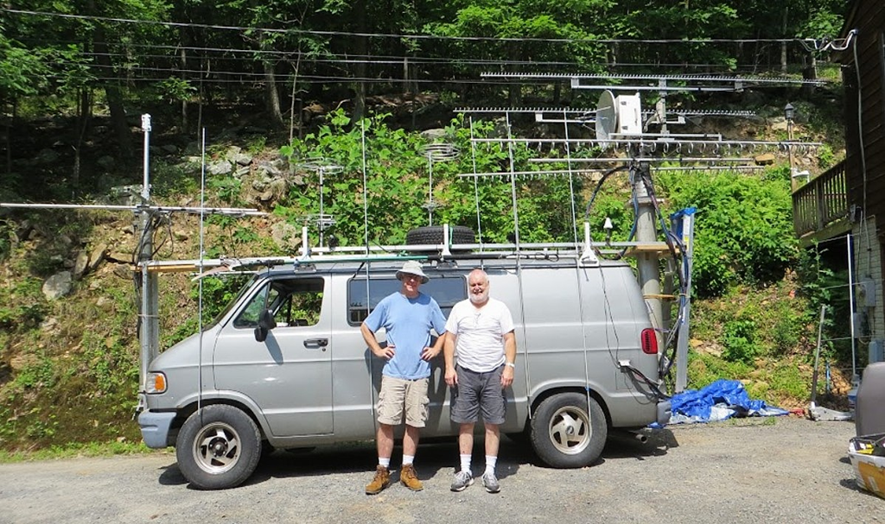
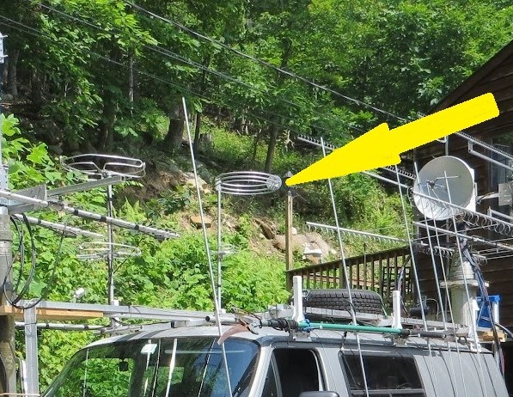
50 MHz Rover Yagis
K8GP/R June 2016 VHF Contest
50 MHz Yagi Strapped To Van
Andy K1RA Terry W8ZN
Omni Antenna For 50 MHz Operation While Moving

Slide 26
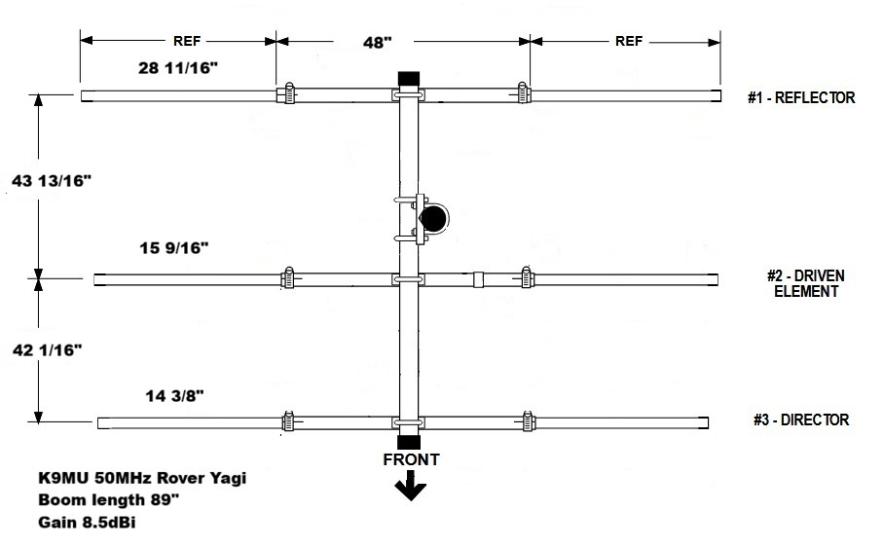
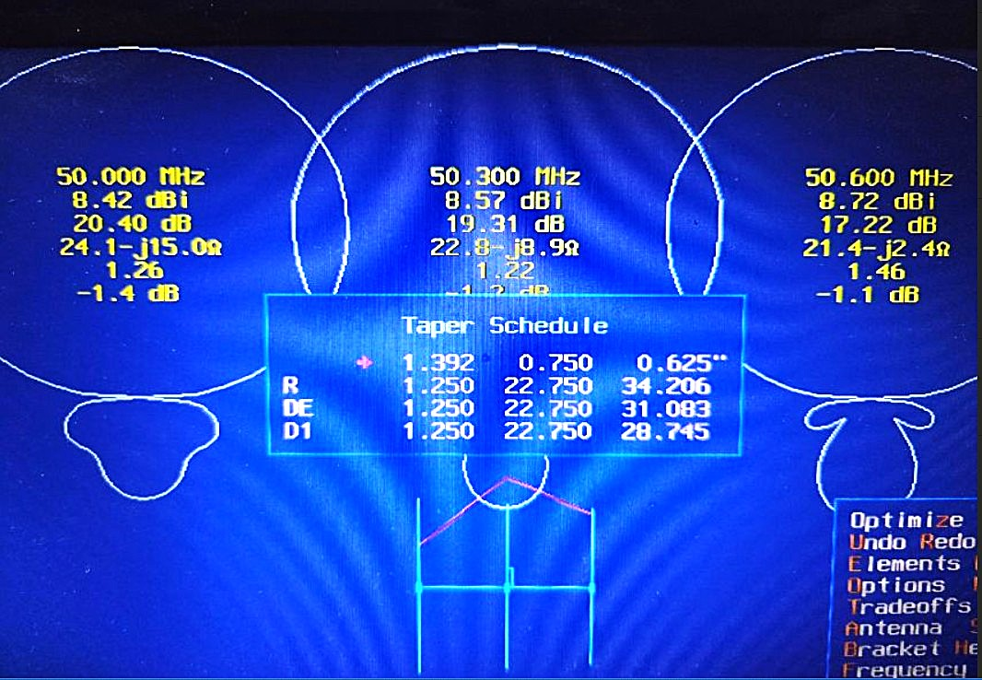
Three Element Rover Yagi Design
K9MU 3 Element Yagi – 89” Boom
Pattern

Slide 27
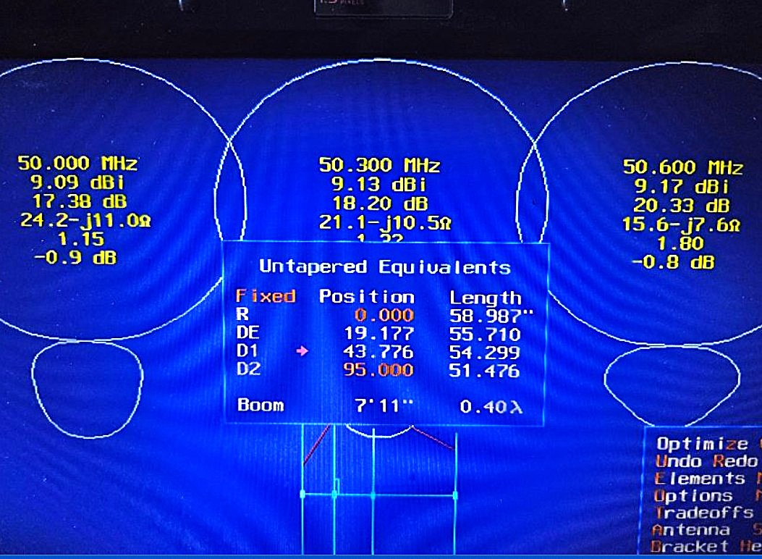
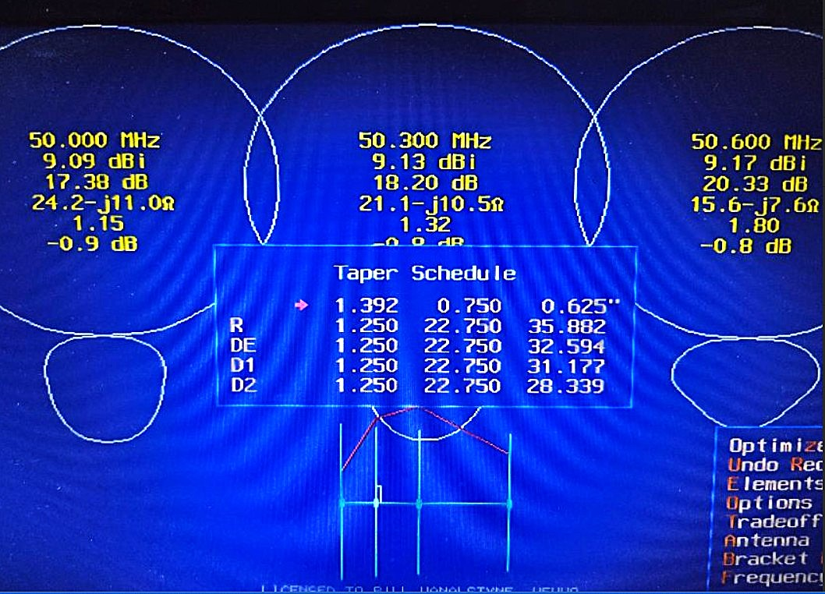
Four Element Rover Yagi Design
K9MU 4 Element Yagi 97” Boom
Element Positions
Pattern and CC Element Taper

Slide 28
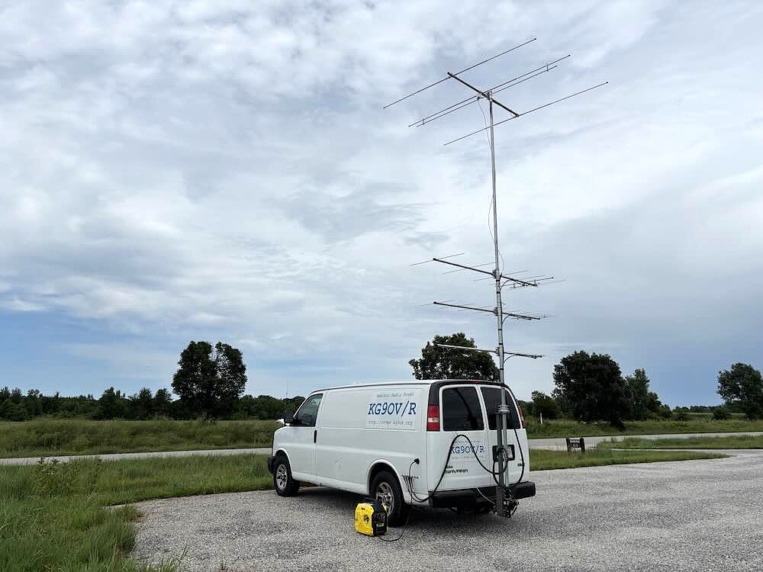
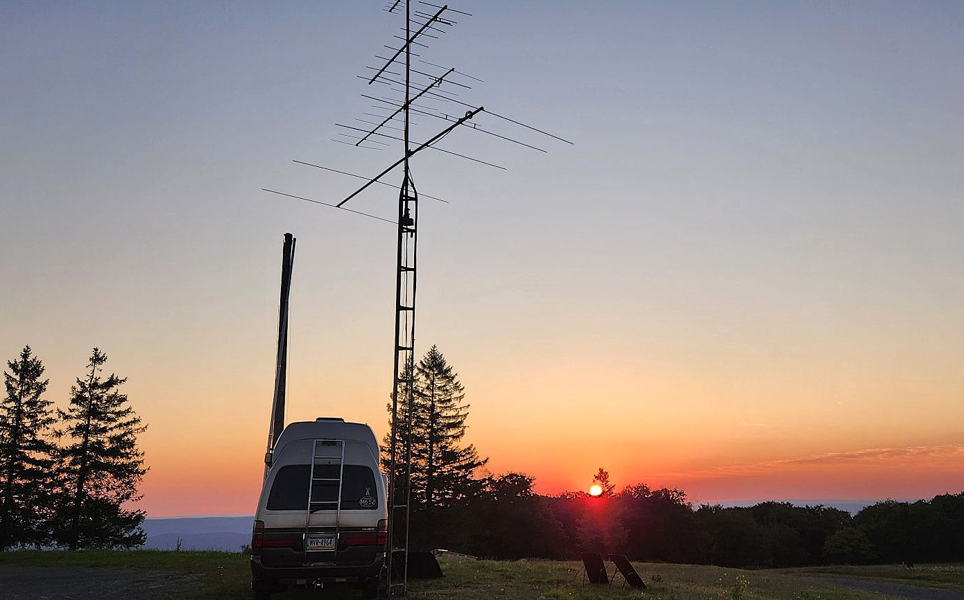
Six Meter Yagis In The Field
Stop and Shoot
KG9OV/R
N3IDR/R Blue Knob PA FN00
Elevation 3040’

Slide 29
Moxon
Advantages
Drawbacks
Most Popular Rover Directional Antenna
Broad Front Pattern 75 – 80°
Good Gain 6.1dBi (4 dBd)
Excellent F/B 20 – 25 dB
Element lengths ≈ 85” – do not exceed legal vehicle width
Lower gain than 3 element yagi
Requires rotator
Lightweight
Lower gain than 3 element yagi
Requires rotator
Not Many Manufacturers – Roll
your Own – programs on internet,
QST April 2004
Commercial antennas –
Par Omni SM-50,
RF-Dxing (India) RFD-MX6
EAntenna – 6MOX DXEngineering

Slide 30
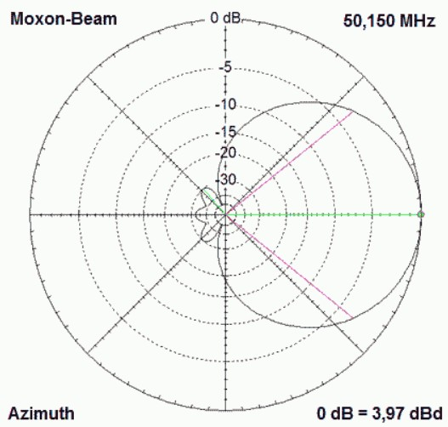
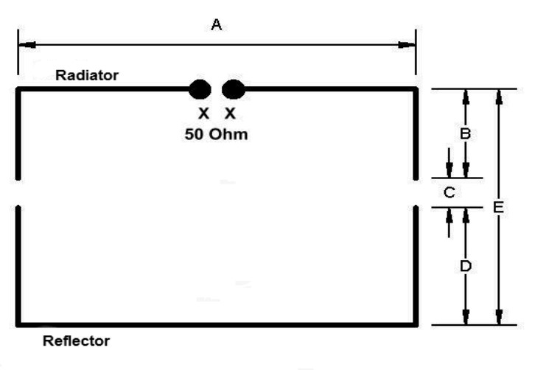
Moxon
Moxon Pattern Plot DK7ZB
Moxon Configuration

Slide 31
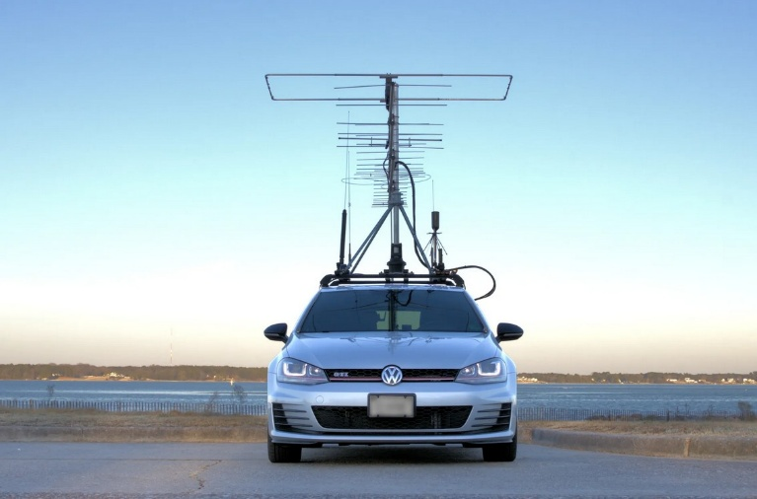
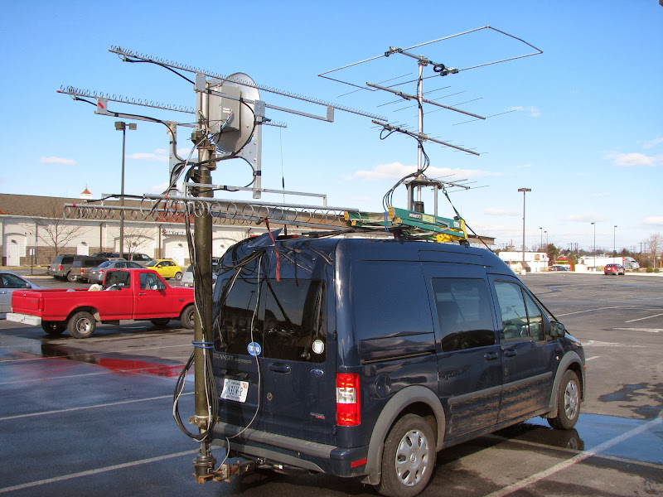
Six Meter Moxons In Field – Still A Large Antenna
KE4WMF/R
N3UW/R with K1RA

Slide 32
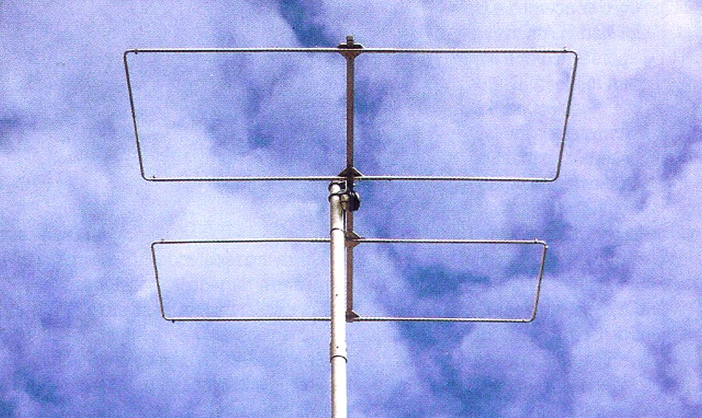
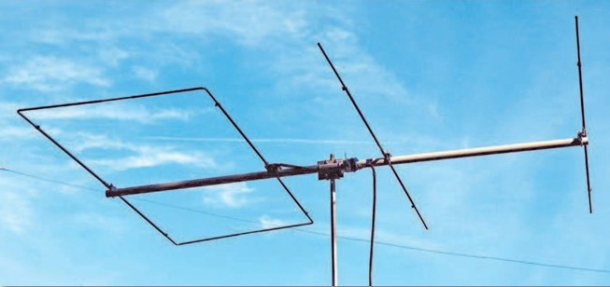
Six Meter Rover Antennas - New Ideas
Super Moxon - GW4YDX
Moxy - K1BUK

Slide 33
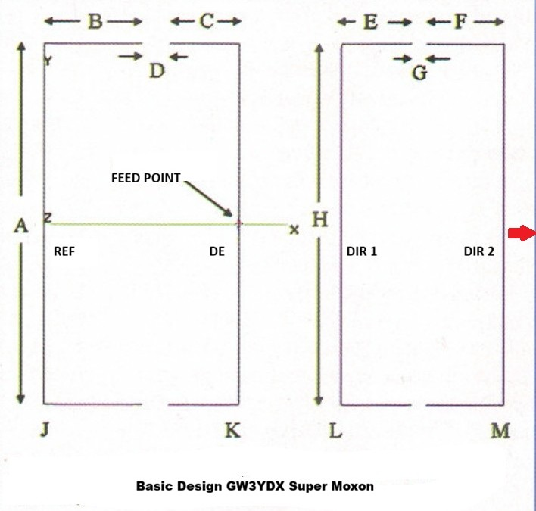
Super Moxon Information
Invented by Roger Stone
GW3YDX (SK)
Described in July 2010 Radcom (UK)
Designed for 6, 4, and 2 meters
Four bent elements on single boom
76” Boom (1861 mm element length to
tubing centers)
Longest Element Length (A) 85”
allows antenna to be mounted in line
with vehicle and other antennas
Highest Gain for boom length - 8.82 dBi

Slide 34
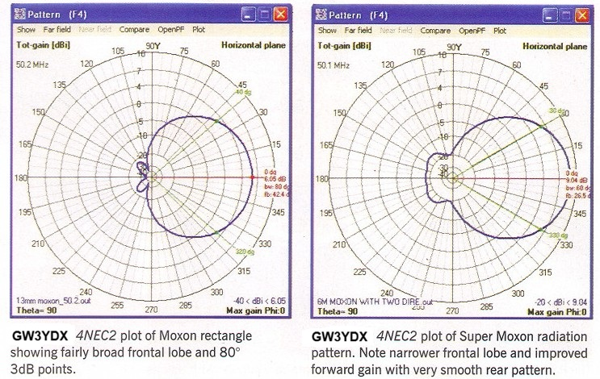
Super Moxon Pattern vs. Moxon
Radcom(UK) July 2010

Slide 35
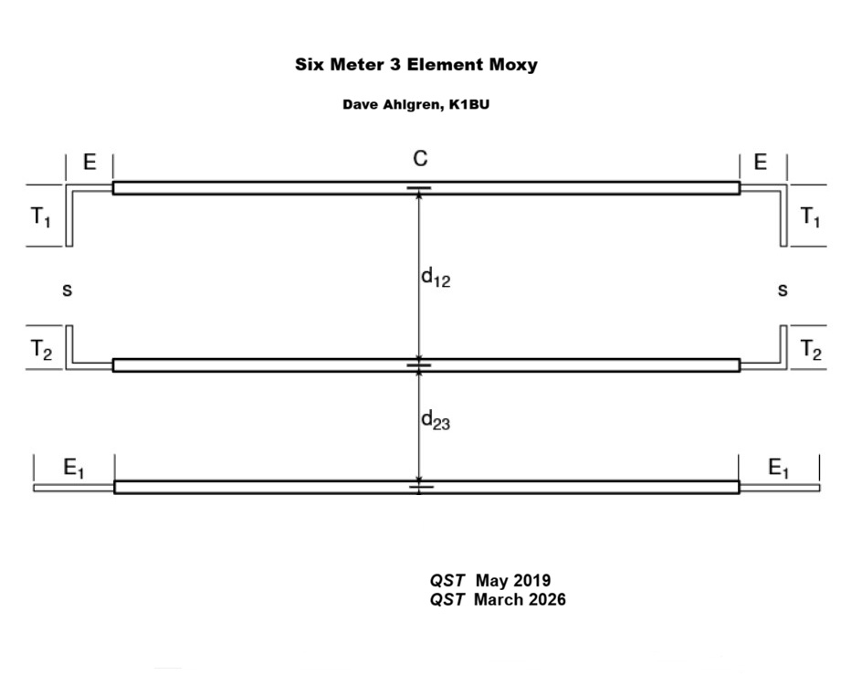
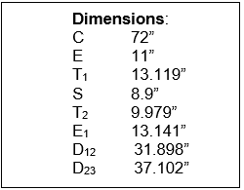
Moxy
Invented by Dave Ahlgren K1BUK
Half Moxon, Half Yagi
Described in May 2019 QST and
March 2026 QST
Designs for 3 - 6 element antennas
Can be mounted in line with other antennas

Slide 36
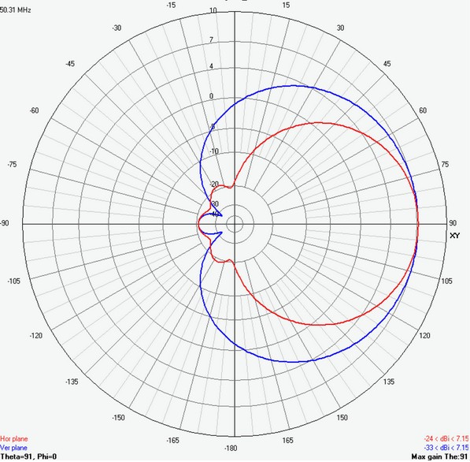
Pattern For 3 element Moxy
Red= Horizontal Plane
Blue = Vertical Plane
Gain 7.15 dBi, F/B 31 dB
2019 four element antenna was designed for 50.2 MHz as compromise between SSB/CW and FT8 uses. 2026 antennas were designed for 50.3 MHz. The 2026 three element design works well from 50 - 51 MHz without perceptible difference in performance.
To center on 50.125 MHz scale by 1.00375
K1BUK March 2026

Slide 37
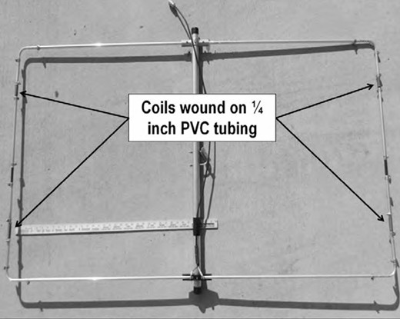
Other Ideas - Shrunken Moxon
Designed by Jon Platt W0ZQ
Described in 48th Proceedings of the
Central States VHF Society
Proceedings
Modified MFJ 1896 Moxon
Element lengths reduced to
approximately 60”; boom length
unaltered
Preliminary work not completed
EZNEC files available
W0ZQ

Slide 38
On six meter rover antennas:
“When the band is open, it doesn’t matter what antenna you use. When the band is closed, it doesn’t matter either.”
                Jack Nyiri AB4CR/R

