Slide 1
The following presentation and all materials provided are the intellectual property of The American Radio Relay League, Inc. (“ARRL™”). No part of this presentation may be copied, recorded, reproduced, or distributed in any manner without express written permission from an authorized representative of the ARRL specifically referencing this presentation and material.
Copyright 2026 ARRL™
All Rights Reserved
Notes:
Do not edit this slide. Do not add content to this slide.

Slide 2
ARRL Contest/Operating Events Update Bart Jahnke, W9JJ ARRL Radiosport Manager

Slide 3
What are the benefits of Contesting?
Promote on-the-air activity
Push the boundaries of propagation
Challenge ourselves to build and improve
Provide and encourage competition
Strengthen our readiness for public service
Use our valuable frequency allocations
Enhance international goodwill
Have fun on the air!

Slide 4
World’s Largest Radiosport Program
15 Primary Contests
9 Other Operating Events
Plaques are available in the following ARRL contests:
November Sweepstakes CW
November Sweepstakes Phone
RTTY Roundup
International DX Contest CW
International DX Contest Phone
International Digital Contest
June VHF Contest

Slide 5
ARRL HF Contests – Logs Received – 2026-2017

Slide 6
VHF + Contest Activity (Logs) Logs Received – 2026-2017

Slide 7
VHF Contest Logs/Participation – An Alternate Perspective

Slide 8
Results Authors Needed for the Following Contests:
January VHF
ARRL International Digital Contest
ARRL 222 and Up Distance Contest (TBD)
EME
Contact Bart Jahnke, W9JJ w9jj@arrl.org if you’re interested in authoring the results articles for any of the above events.

Slide 9
What’s the Hot Topics in ARRL Contests/Events?
America250-WAS All Bands (Except 60m), each State has two 7-day activations on 3 modes.
New energy and outreach with newcomers: We welcome shared departmental time from Max Freeman, N4ML, who is just back from the 3Y0K Bouvet DXpedition bringing more engagement in Youth Incentives in Contests, in Operating, in Social Media and with overall Educational outreach)
More overall social media exposure
Expanded emphasis on Limited Antenna Overlay (100 watts and a Wire)

Slide 10
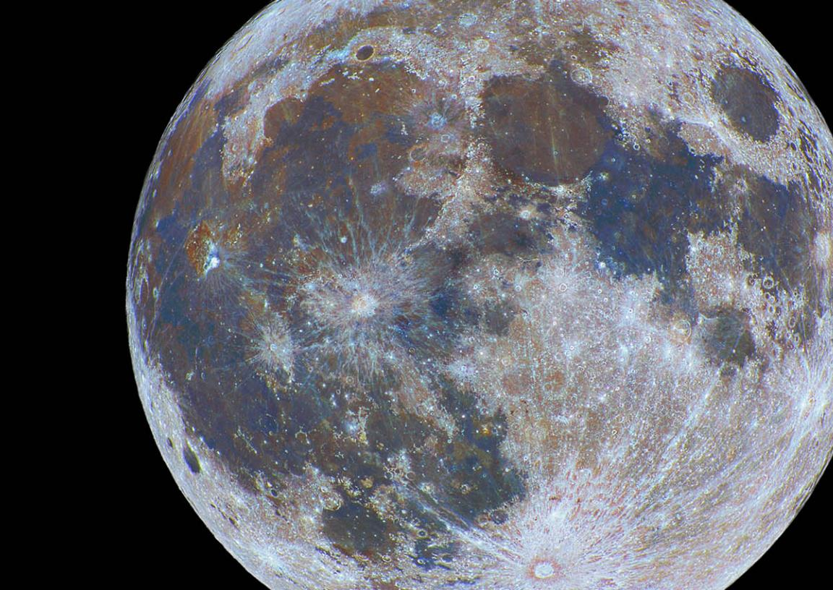
2026 EME Contest Weekends
Dates are selected to avoid conflicts with ARI EME Contest (last weekend of Sept) and IARU Region 1 VHF contests (first weekends of Sept, Oct, and Nov.)
Weekends 1 and 2: 2.3 GHz and up
August 8 - 9
September 5 - 6
October 3 - 4
Weekends 3 and 4: 50 MHz – 1.2 GHz
November 28 - 29
December 26 - 27

Slide 11
Open Forum Discussion:
Topics?
Future of 222 and Up Distance Contest
How to move active VHFers from Digital to Analog during events
How to encourage higher band activity
Ideas for other short term operating events

Slide 12
The Three Keys to Contest Success
Get on the air!
Have fun!
Send in your event logs!

Slide 13


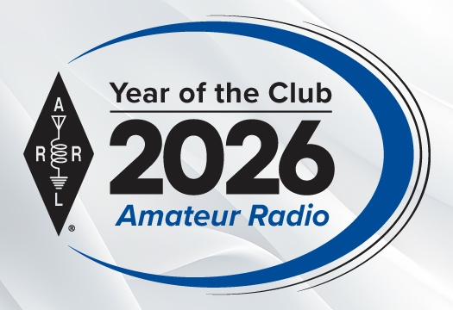
Thank you for being an ARRL Member! www.arrl.org/join

Slide 14

www.arrl.org Copyright © 2026
Notes:
Do not edit this slide. Do not add content to this slide.

