Slide 1
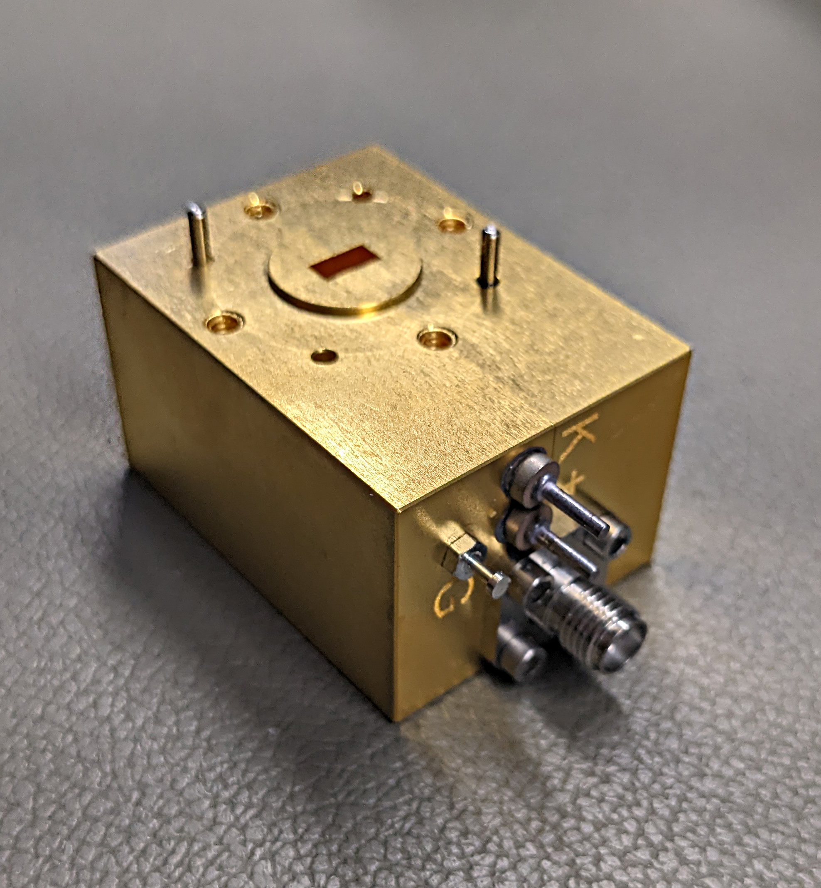
An Approach to 5.7,10, 24, 47GHz Q65 mode Beacons
NEWS VHF CONFERENCE 2026
Tom WA1MBA
Paul W1GHZ

Slide 2
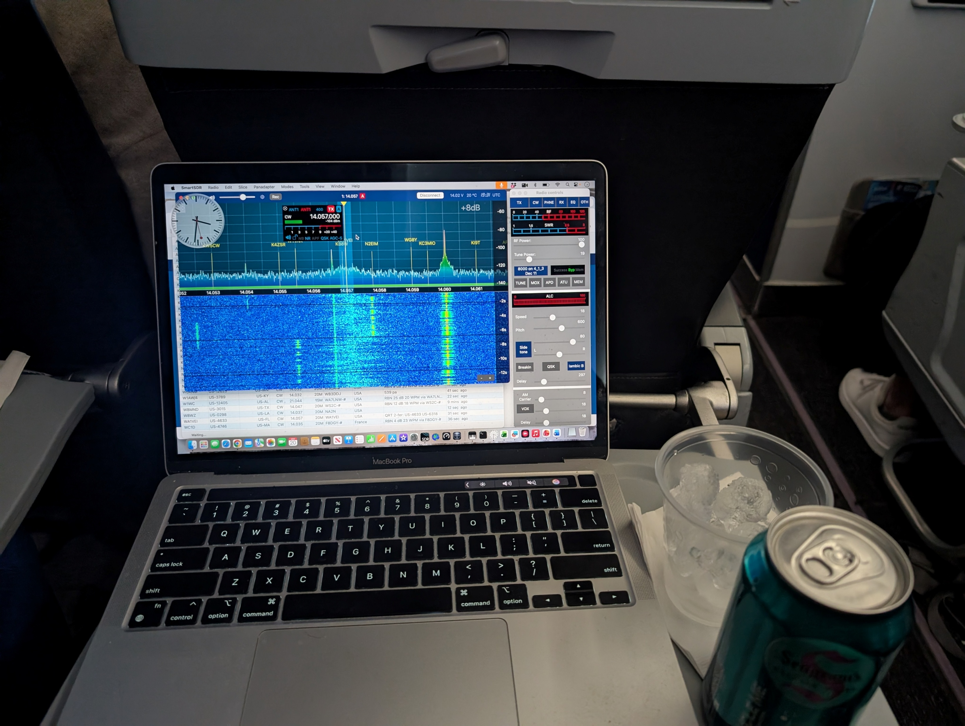
20 Meter CW QSO while on Jet Blue Flight 2066
WA1MBA (MA)
WA1VEI (FL)
14.057 559 529
APR 20, 2026
11:29 Z

Slide 3
5.7 thru 47 GHz Q65 Beacons
Original Intent – 47 GHz Beacon to show activity on the band
Has become: Make a simple and cheap beacon board
Get Morse and Q65 Modes on Microwave bands
Build from existing proven designs
Obtain good LO and Image rejection

Slide 4
Original Intent: 47 GHz Beacon
Several years ago, the 47 GHz band was under attack “Not being used by hams”
We met at the VHF Conference and agreed that beacons would demonstrate amateur activity
WA1MBA developed a 47 GHz quadrupler for beacon use
Could also be used as bench multiplier and LO source.

Slide 5
Problem - Simple & Cheap Q65 5-to-47 GHz Beacons
Want a weak signal format for beacons on 5, 10, 24 and 47 GHz “below the noise”
Straightforward to make a CW beacon
Good weak signal modulation = Q65 variants
Method: generate signal at 5, 8 – 12 GHz range that has Q65 (plus morse) modulation, and Multiply* to final band
Be a bit careful of excess Phase Noise, out-of-band leakage
Must be reproducible
* Don’t need subsequent multiplier to get 5 and 10 GHz

Slide 6

Learn (use) what others have done

Slide 7
Architecture and Solutions
The RFZero™ Arduino synthesizer is affordable (US$80), GPS frequency locked & can make carrier, morse, and digital modes incl Q65 variants at VHF frequencies up to 300 MHz
Learned from Jim KM5PO - USE THE RFZERO AS A BEACON IF
Needed to design and test a single circuit board that does mixing of the Q65 IF with an LO to produce a 5, or 8 to 12 GHz Signal for direct use on 5 of 10 GHz or further multiplication for 24 or 47 GHz Beacon – Started with the W1GHZ 10 GHz Xvrtr Board
Use Multipliers as needed to get from LO+IF to Final Band
Example: The WA1MBA Quadrupler can multiply +4dBm signals in the 11.7 GHz range up to the 47 GHz band with 20 mW output power (US$400)
Sector Horn is available - W1GHZ
Covers 24 and 47 GHz, Use other standard beacon antennas for 5 and 10 GHz (Slots)

Slide 8

Beacon Examples
L
Circuit Board
GPS
RFZero
435 MHz
BPF
11.772
GHz
145
MHz +
Harm
435
MHz
Mixer
I
R
L
GPS
7 - 12 GHz
Synthesizer LO
10 MHz Ref
Multiplier
11.337
GHz
47.088
GHz
X 4
Horn
LO | RF | MULTIPLIER | BEACON
9.993.200 | 10.368.200 | 1 | 10.368.200
7.629.060 | 8.064.060 | 3 | 24.192.180
11.661.090 | 12.096.090 | 2 | 24.192.180
11.337.090 | 11.772.090 | 4 | 47.088.360

Slide 9
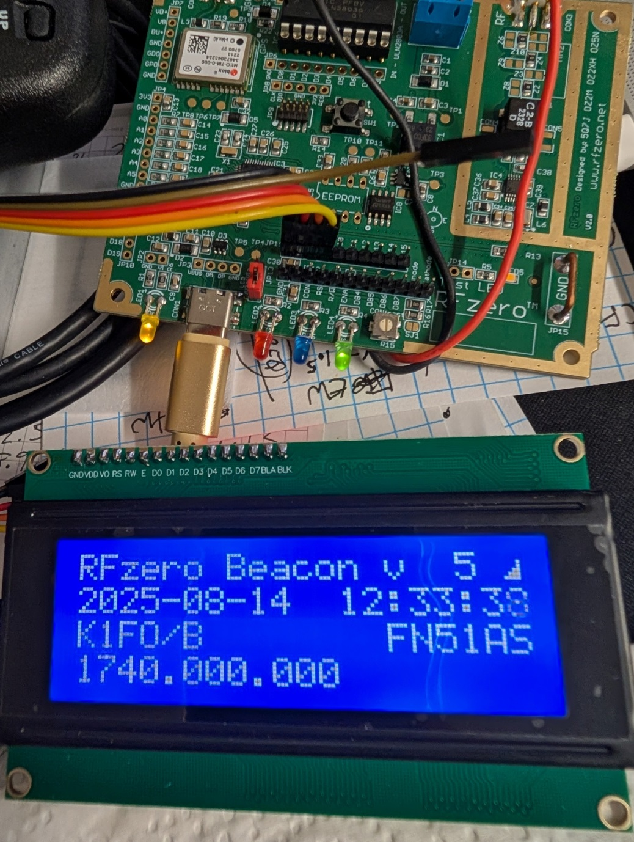
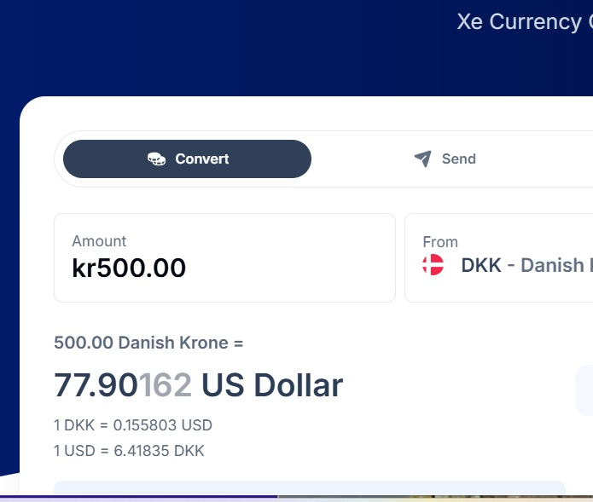
RFZero™ specialized Arduino PCB
https://rfzero.net/
Excellent website, loads of
accessories, components,
software downloads, advice,
and a “.io” community

Slide 10
Selecting the Frequency and Multiple for the RFZero™ software
RFZero™ program asks for final frequency and multiplication factor.
I want a high IF for easier filtering of LO and image, so I chose 435 MHz which can be easily and cheaply filtered. That will effectively be multiplied by 4x in the quadrupler. So, I told the software I wanted 1,740 MHz final frequency
For the multiplier I could state “16” and get 108.75 and therefore would use the 4th harmonic of the fundamental.
But odd harmonics are stronger, so select x12 and it will generate a 145 MHz fundamental and the 3rd harmonic is strong at 435 MHz
It divides the frequency spread of the Q65 signal by the multiplier so that the final RF has the right tone spacing

Slide 11
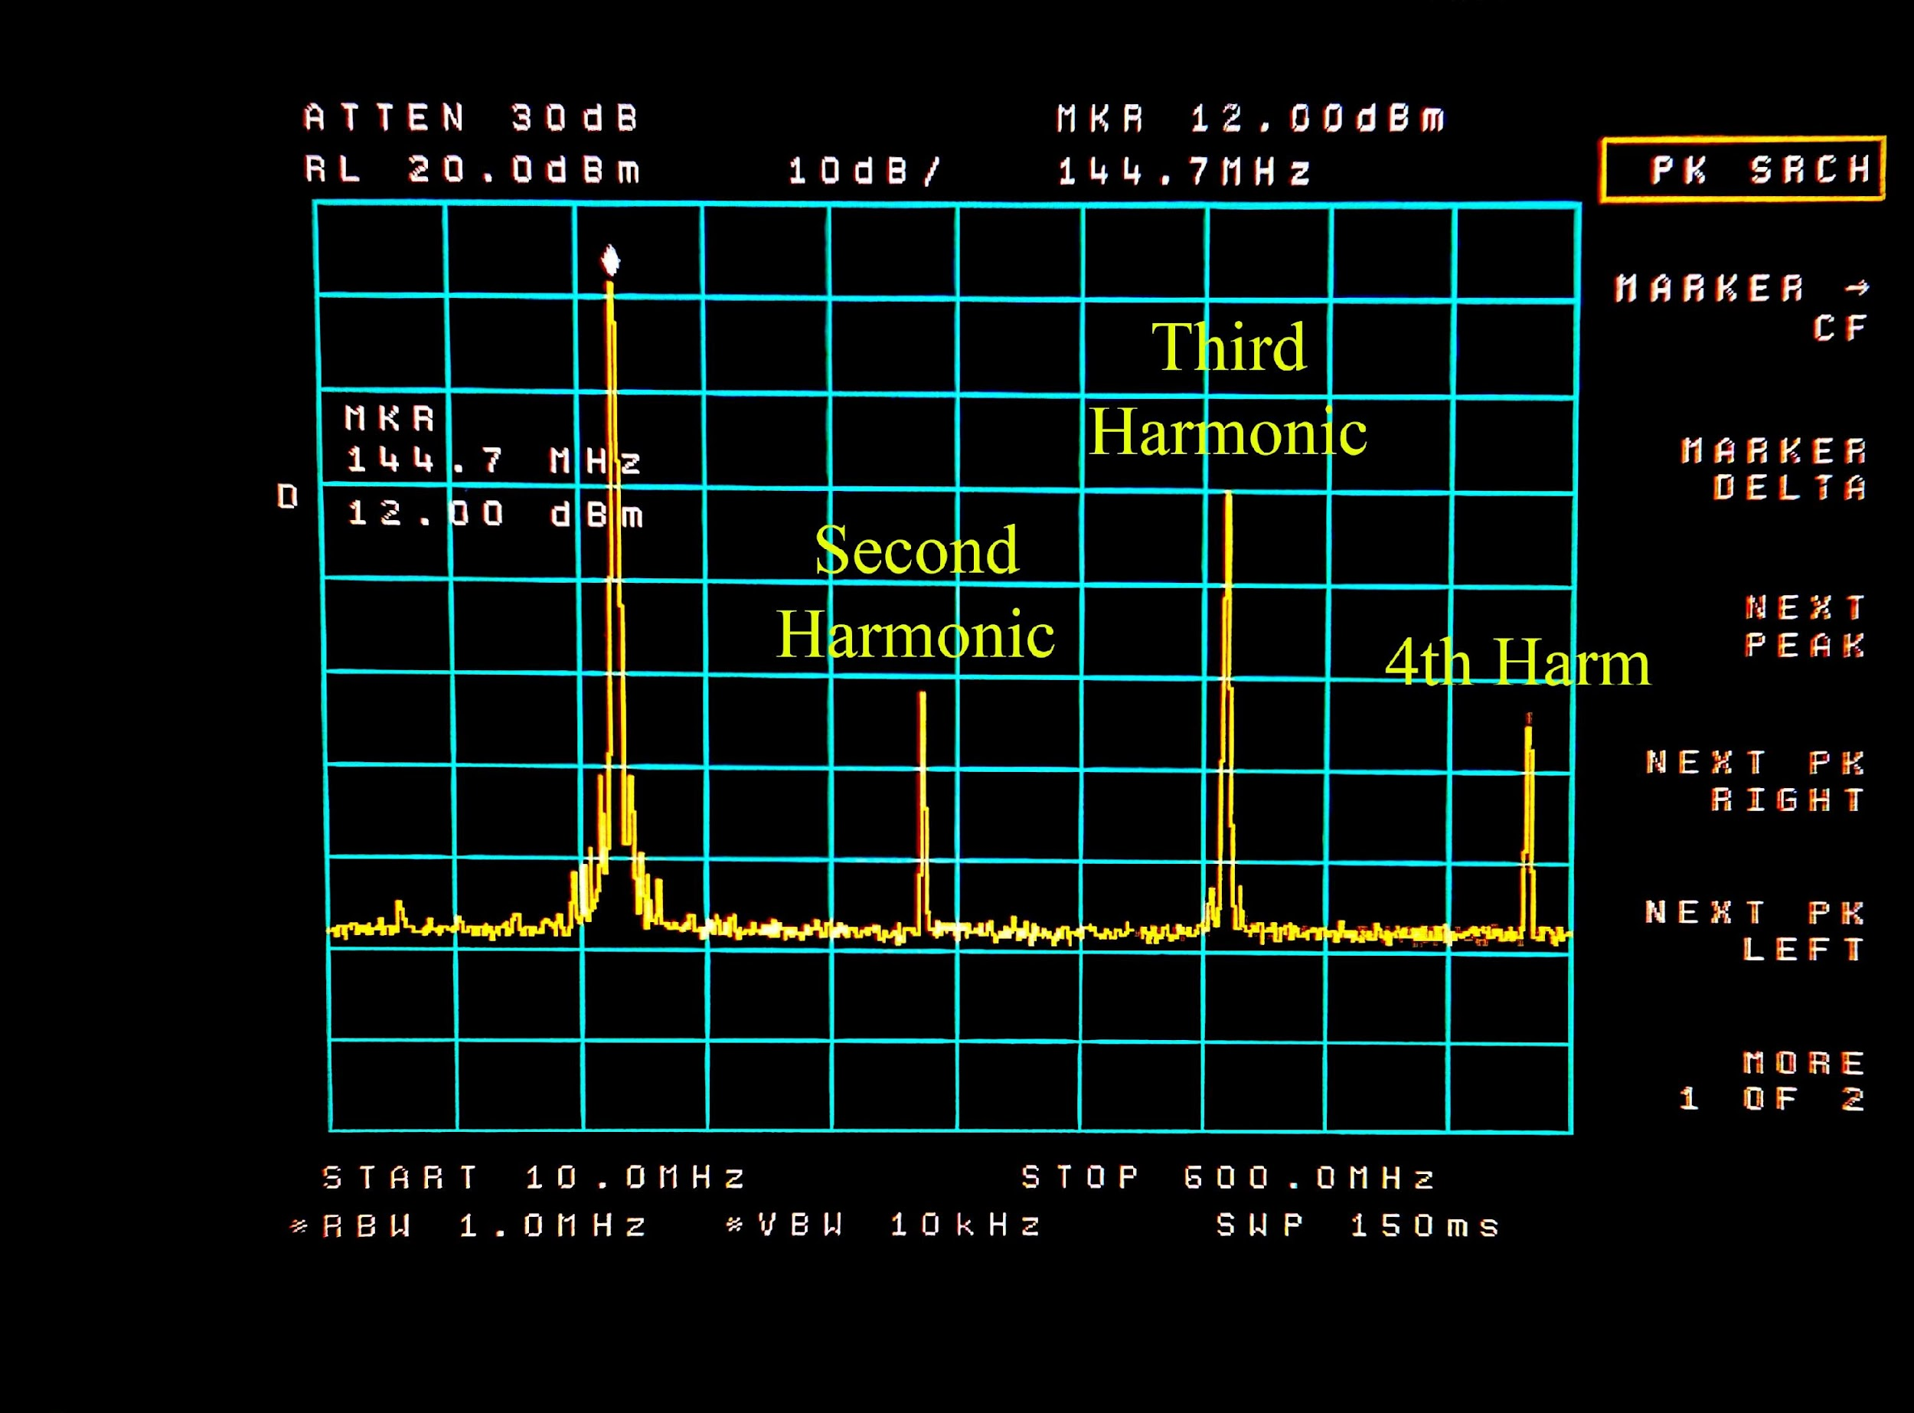
RFZero ™ Odd Harmonics Stronger than even

Slide 12
Noise – example – 47 GHz Beacon
Phase plus Amplitude noise from RFZero™ at 100 MHz is shown to range from -70dBc close in to -75 dBc at 10 kHz.
When multiplied x12 (take 3rd harmonic and the quadrupler does x4) we would expect a 22 dB increase to the -48dBc to -53dBc range
The Kuhne LO at 11.7 GHz exhibits -72dBc close in to -90 at 10 kHz
When multiplied by x4 (the Quadrupler)this increases by 12 dB to -60dBc to -78 dBc range
The final beacon signal contains noise dominated by the RFZero phase+amplitude noise of -48 dBc in close to -53 dBc at 10 kHz
These are just estimates. (YMMV)

Slide 13
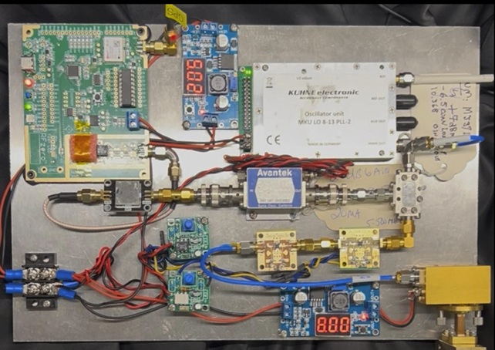
Prototype 47GHz Q65 Beacon Without 11.7 GHz filter
Constructed by Jim KM5PO
Uses spare amplifiers I had on hand (no RF filters)
Tested and got good decodes at 47 GHz
Kuhne
8-13 LO
Synth
RFZero
IF Booster
Mixer
435 BPF
11 GHz Amps
(2x 10 GHz LNAs)
Quadrupler
Horn

Slide 14
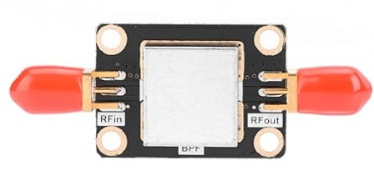
Evolution Simplify by putting things on one board
To simplify construction and reproduce, wanted to put separate items on one board
Inexpensive 433 MHz 10 MHz wide connectorized BPF available on-line for about $13 for filtering out unwanted harmonics from the RFZero IF signal
So, put mixer, LO booster amplifier, and 11.7 GHz amplifier/filter chain on one board
W1GHZ makes 10 GHz Personal Beacon and Simple 10 GHz Transverter boards (amplified filters)

Slide 15
Evolution 11.7 GHz Filter
Pipe Cap Filters (like most filters) may be designed to trade-off bandwidth for insertion loss – wire probe length does it
Affordable PCB material is lossy at 11.7 GHz, so gain is needed to overcome both that loss and filter insertion loss
Sharp filtering is needed to reduce LO and Image frequencies as those will lie in non-amateur EHF bands

Slide 16
Evolution Simplify extra circuits to One Board
After several experiments settled on a modification of W1GHZ “Simple 10 GHz Transverter” board by connecting 3 pipe-cap filters and 5 amplifier stages for 11.772 GHz
One amplifier stage was replaced with a MAR3+ for 435 MHz IF booster
Mixer in Transverter board is in spec
Modified board is “quite messy” but worked perfectly

Slide 17
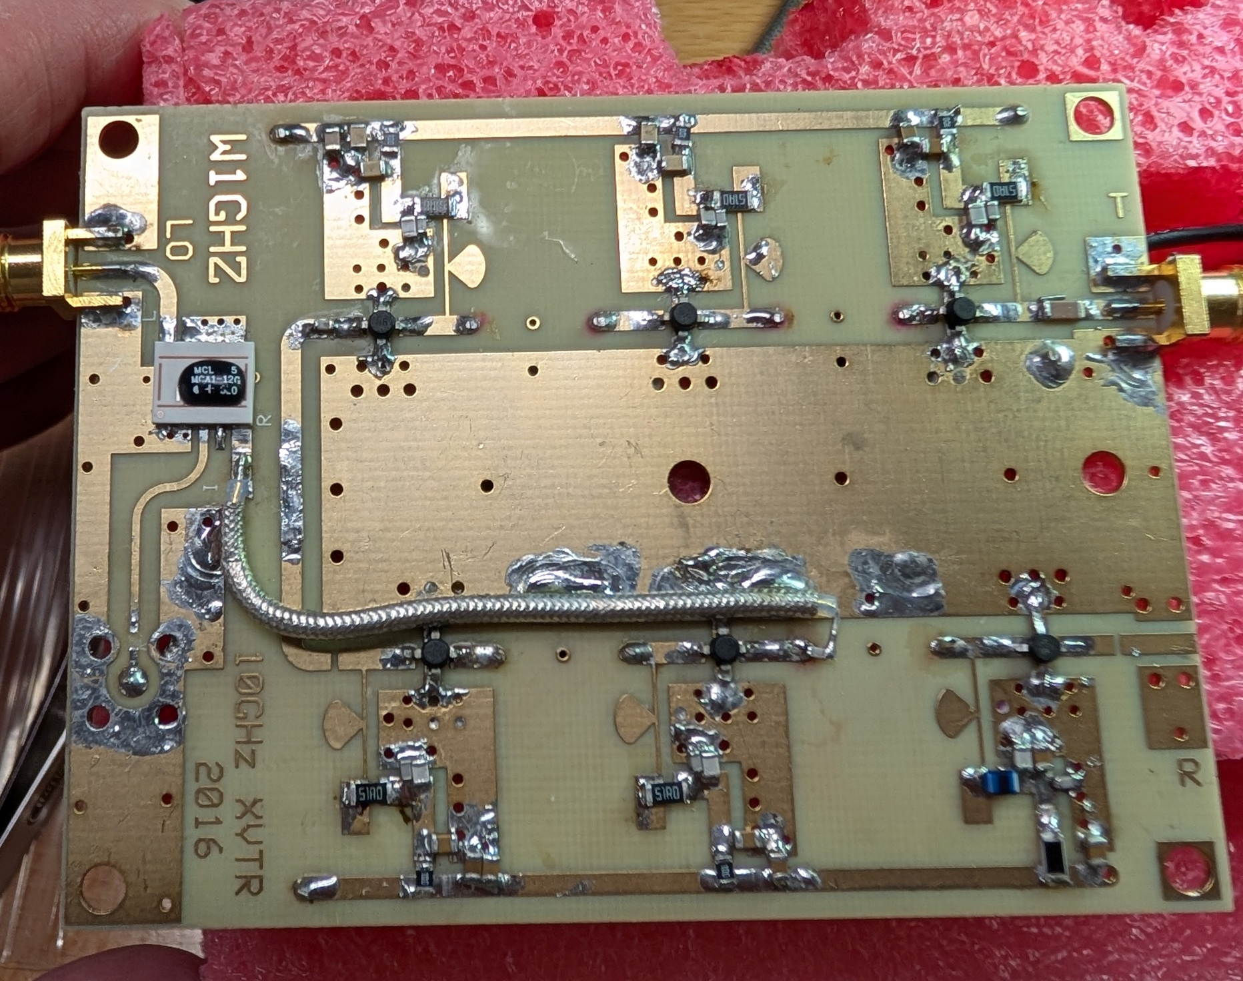
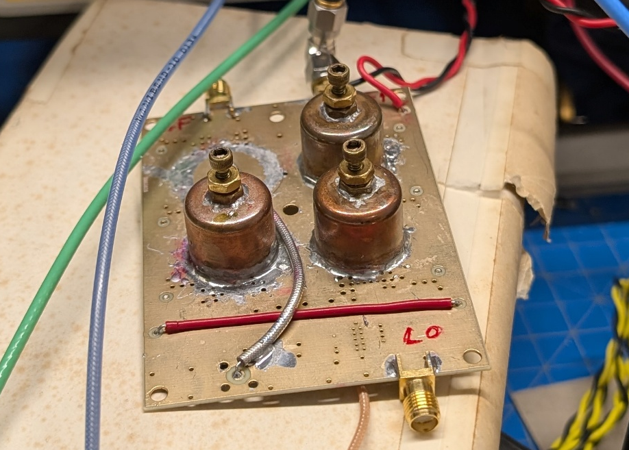
Evolution 1st attempt Hack W1GHZ 10 GHz Transverter PCB
Coax lines added to make IF Booster and 3 pipe-caps,
5 amplifier 11.7 GHz Filter
Used the remaining amplifier stage to boost IF with MAR3+
Bottom and Top of modified “Simple and Cheap10 GHz Xvtr Board”

Slide 18
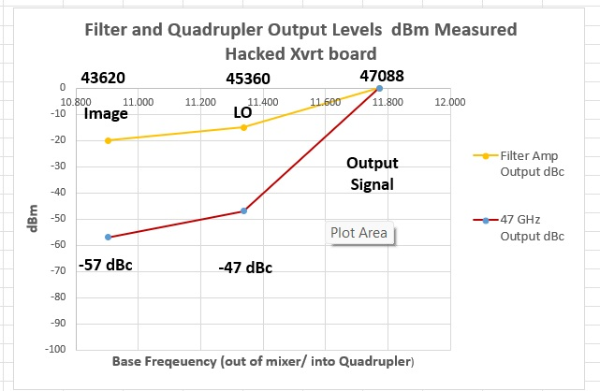
Evolution Filter Prototype Performance

Slide 19
“Frigging Stupid Pipe Caps Can’t live with’em and can’t live without’em”*
PIPE CAPS | OTHER SOLUTION
COST $1, Several Hours first time | COST $ 1,000, No effort
Visual – Eh, who’s looking? | Looks Great, but hidden
Performance Quite acceptable if put in series with amplifier stages | Performance Great in one unit
Tuning – Pretty easy, and adjustable across wide range | Tuning – usually limited
Satisfaction – Built it myself | Satisfaction – Bought it myself
* Quote from WA1MBA

Slide 20
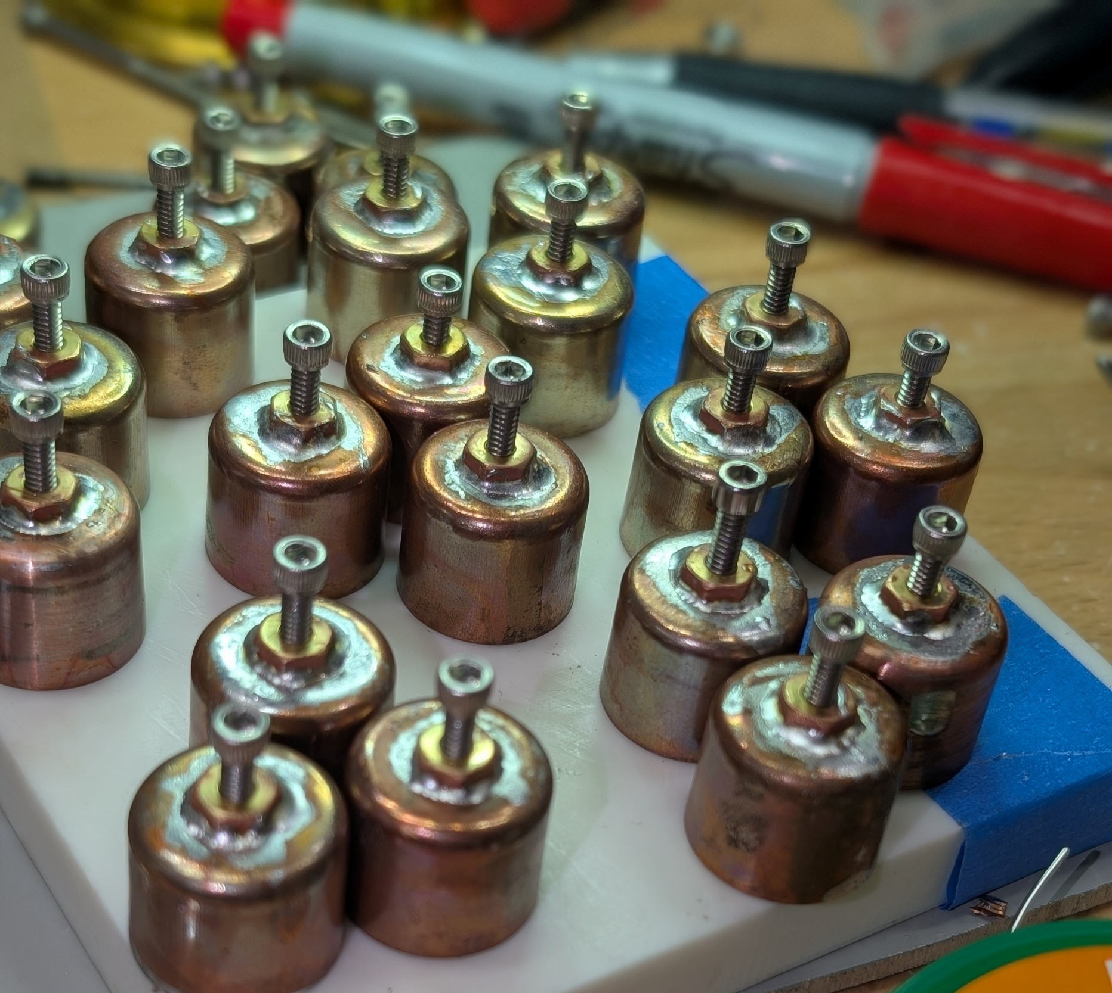
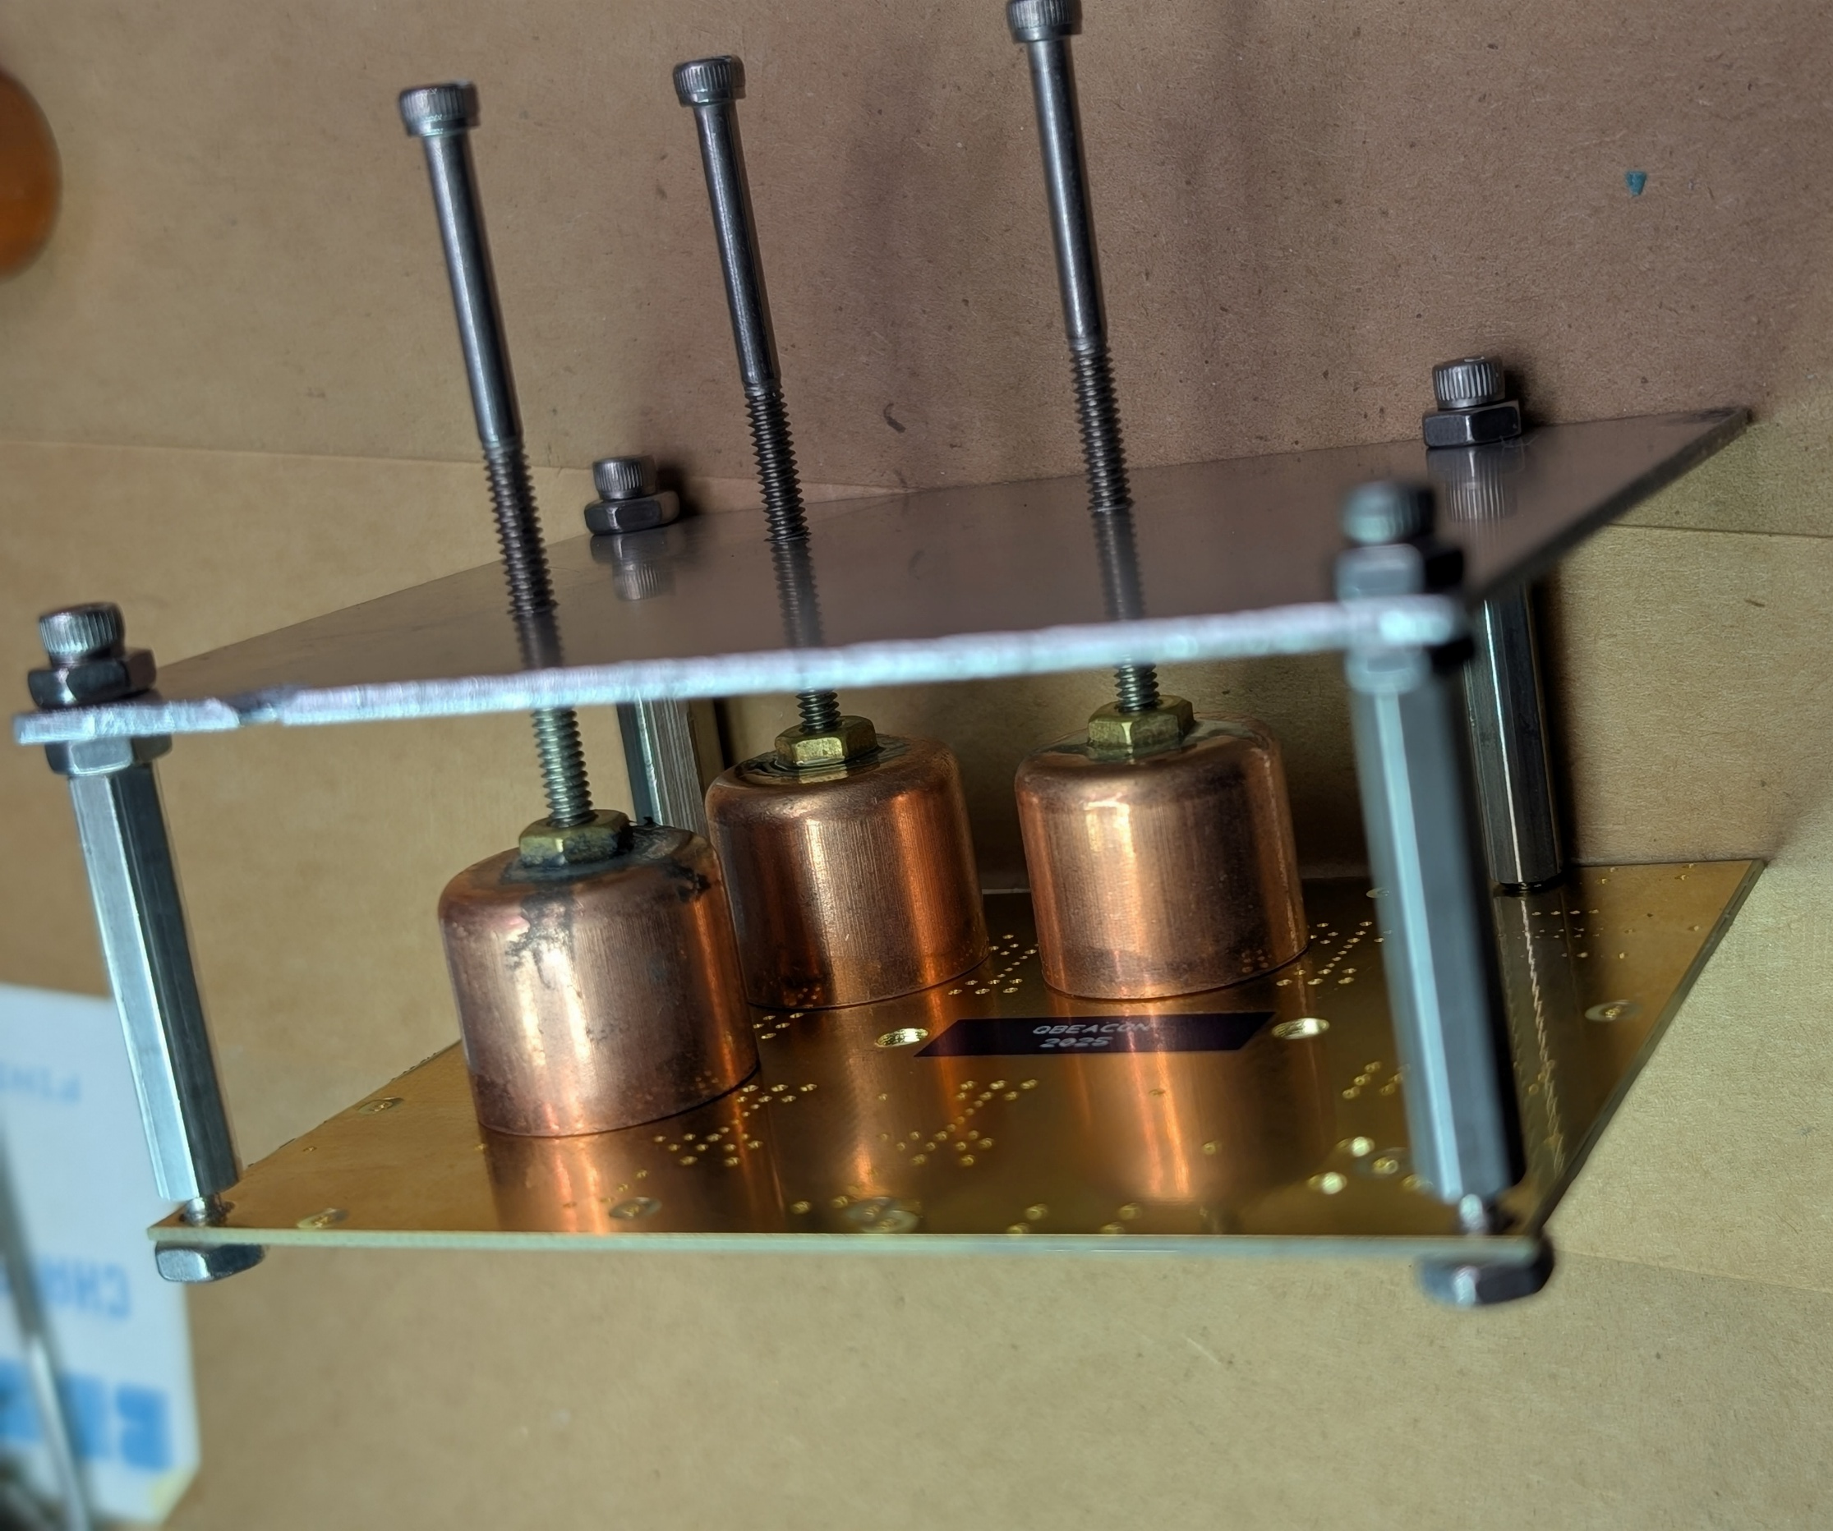
Better result if you make a Jig for Soldering Pipe Caps to Board (thanks Don W1FKF)

Slide 21
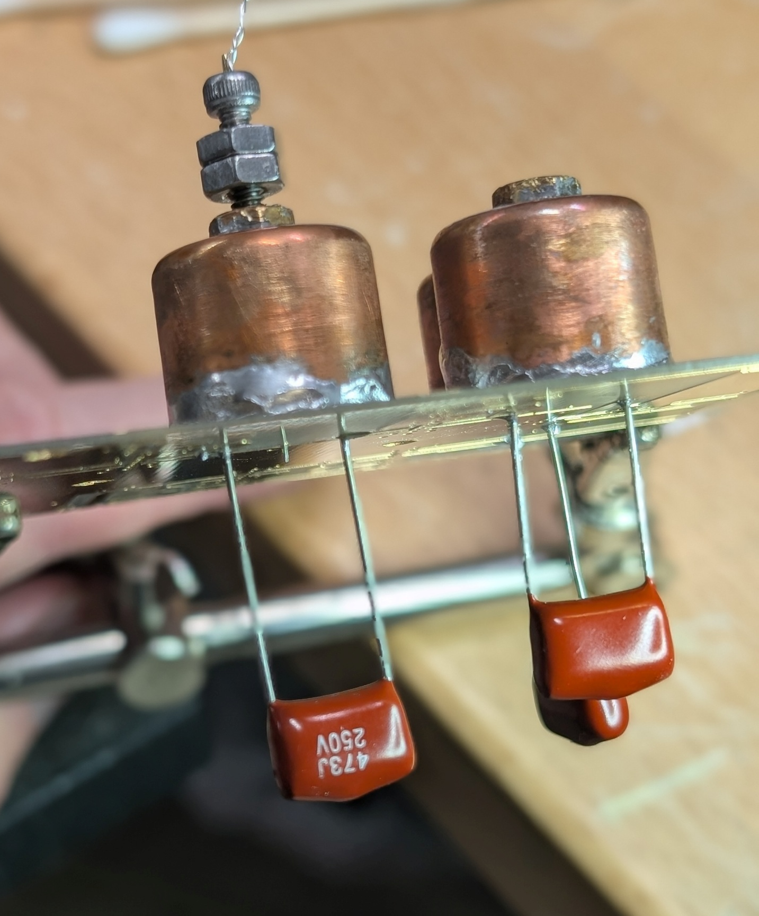
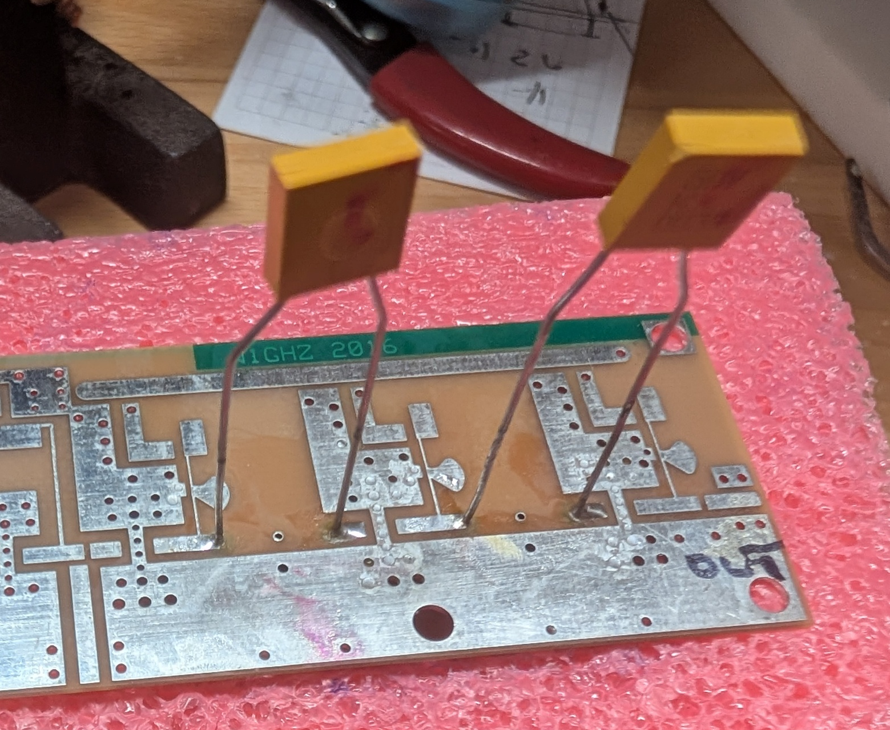
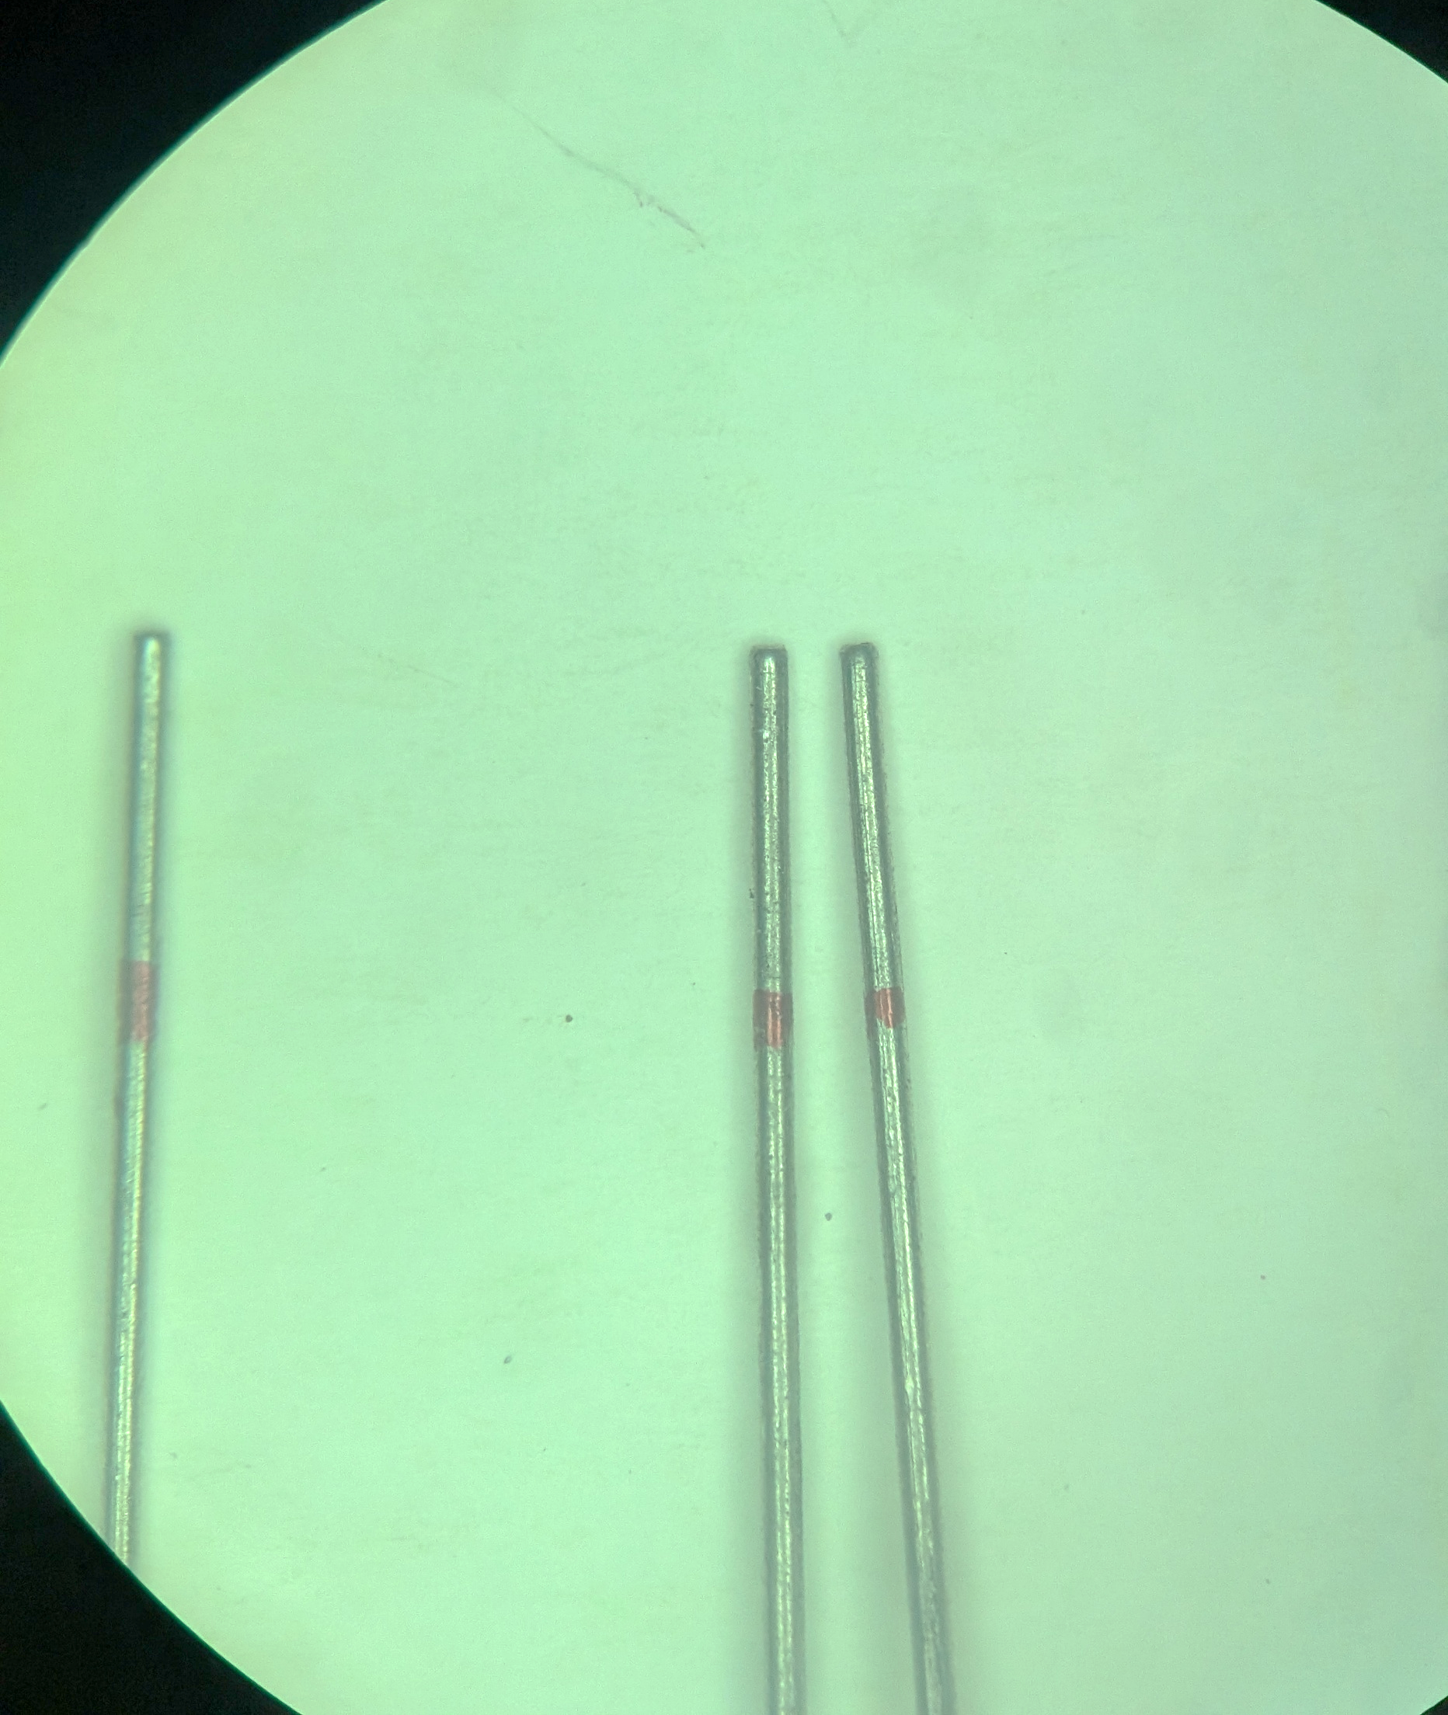
Adjusting and Reproducing Pipe-Cap Probe Lengths
Working in the Blind
makes it difficult to
get probe lengths right

Slide 22
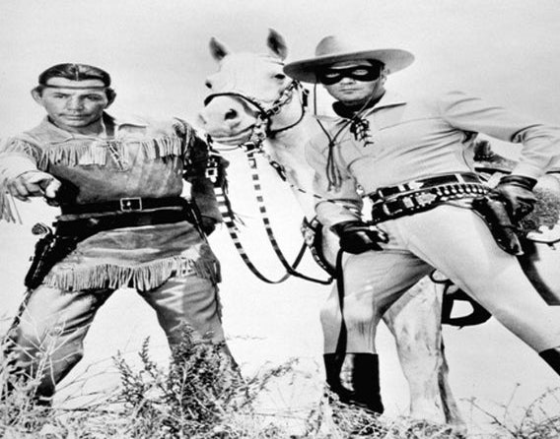

LOOK KEMOSABE,
THERE IN THE DIRT
A GOLDEN PIN

Slide 23
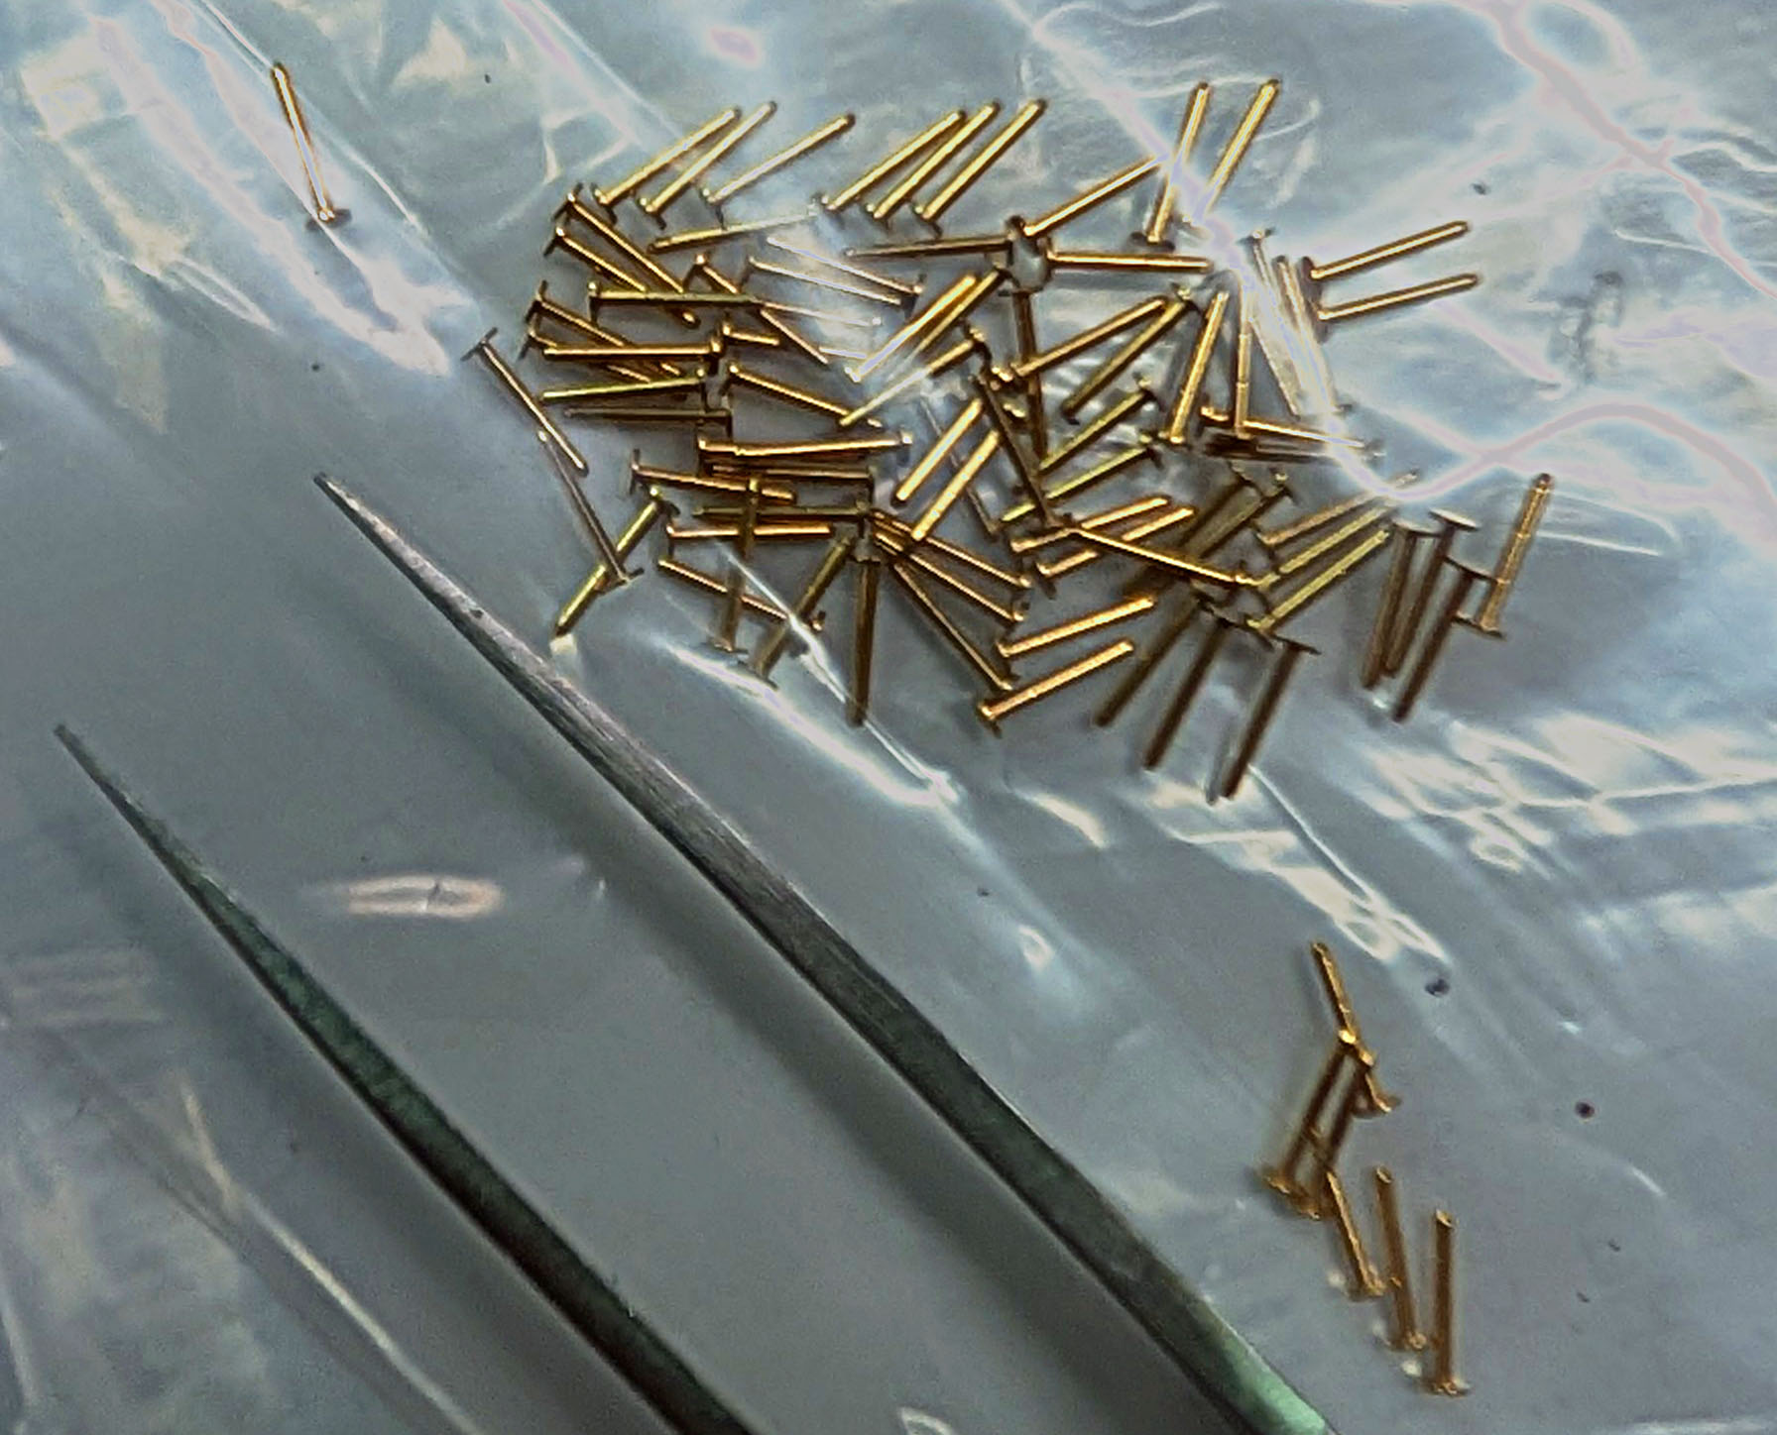
Pins for Pipe-cap Filter Probes Precise Length, Mouser & Digikey

Slide 24
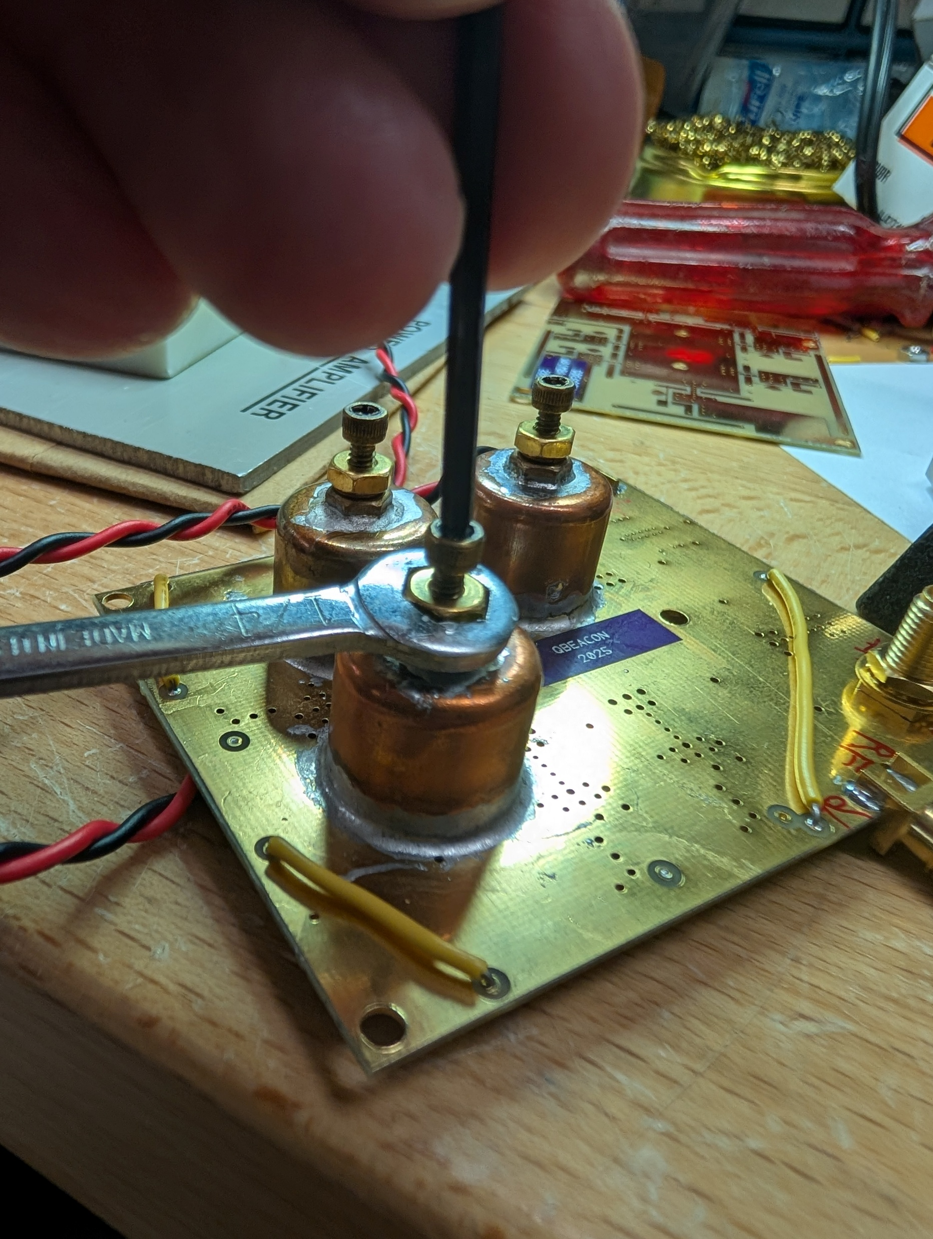
Tuning is pretty straight-forward Easiest if you have a sweeper

Slide 25
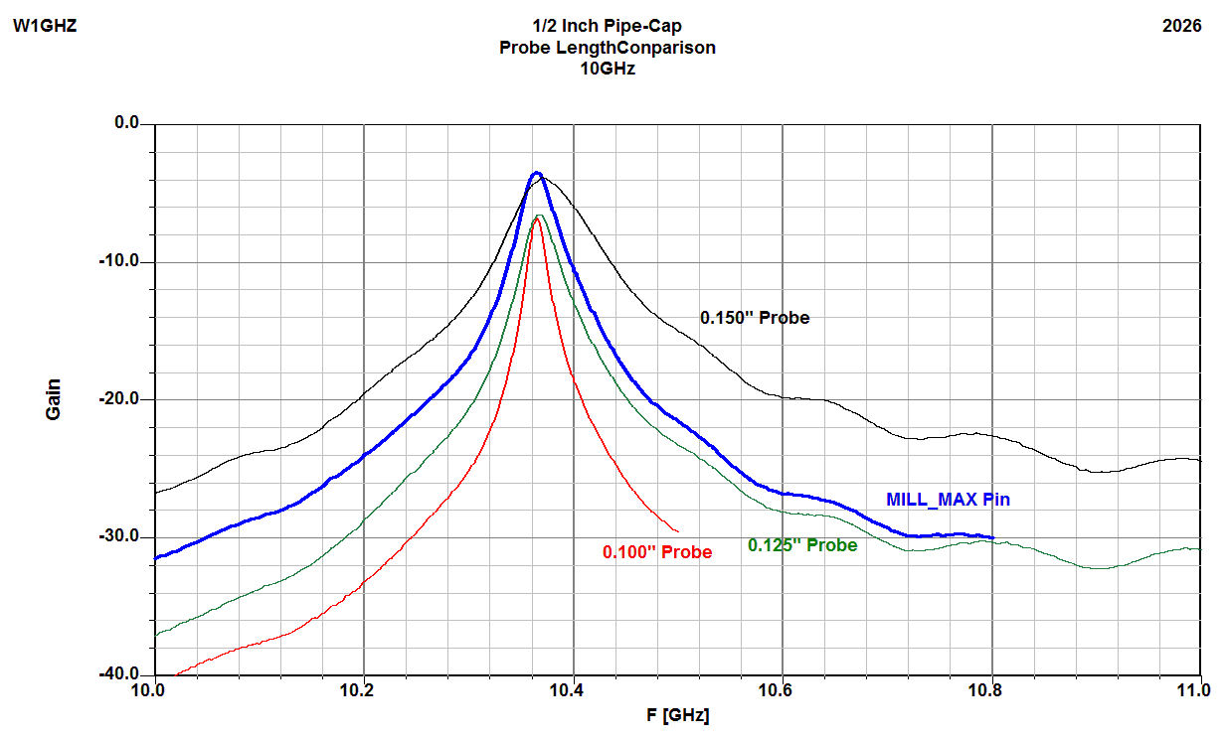
10 GHz Pipe-Cap Filter with Pins

Slide 26
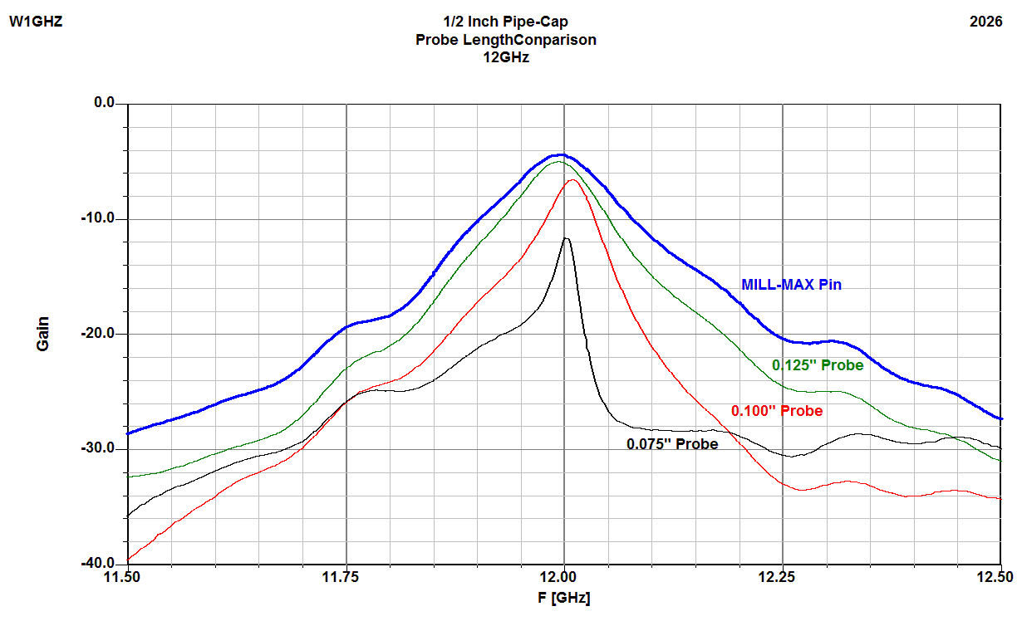
12 GHz Pipe-Cap Filter with Pins 24 & 47 GHz

Slide 27
Pipe-Cap Filter Note
What about pipe-cap filter loss?
Some loss is good
Loss between amplifier stages reduces interaction between pipe-caps
Smoother tuning
Improved stability
Say it Loud, Say it Clear
“Gain is cheap”

Slide 28
Phase Noise - Advice
All synthesizers have phase noise
Reduce phase noise by frequency selection
Pick an LO frequency that uses integer-N PLL
Set beacon frequency with RFZero™ IF
No reason IF frequency must be in ham band, but need to filter out unwanted harmonics
Want to choose IF so that subsequent mixing components LO and Image can be sufficiently rejected by pipe-cap filters – higher IF is better

Slide 29
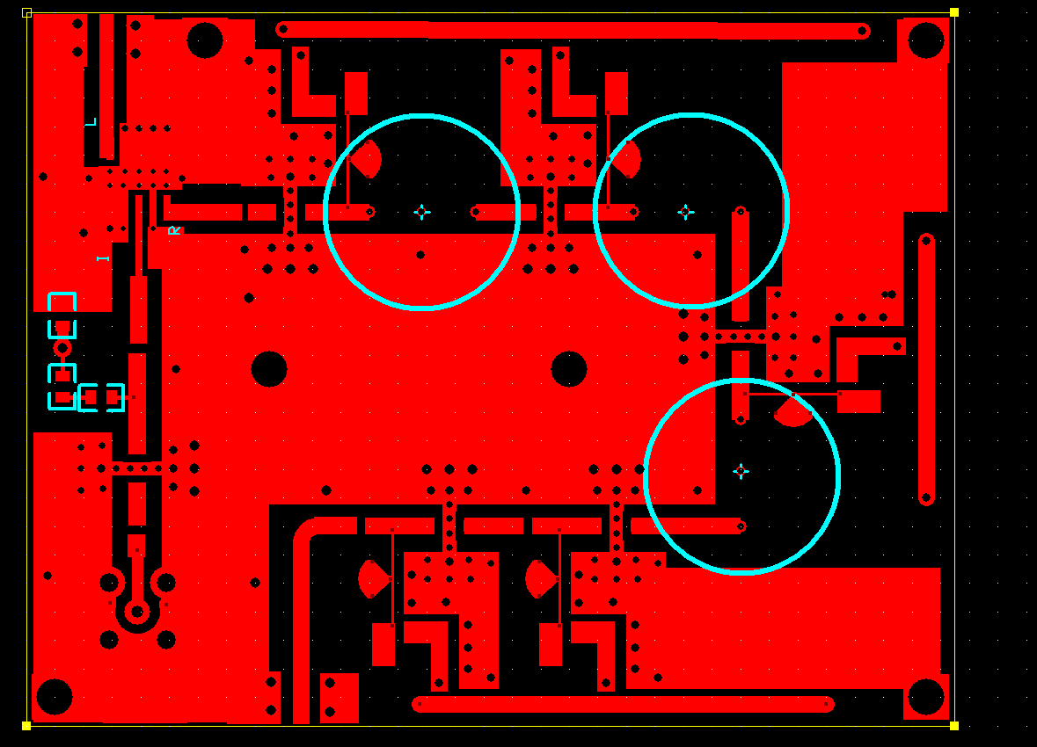
First trial PCB re-design for Beacon Project
LO INPUT
MIXER
RF
FILTER
& AMP
SECTION
IF
BOOST
IF
INPUT
RF
OUTPUT

Slide 30
First Trial PCB
Five amplifier stages
Test = Too much gain
Excess LO and Image leakage
Excessive cost with 5 amplifier stages
Redesign with Four amplifier stages for Version 2

Slide 31
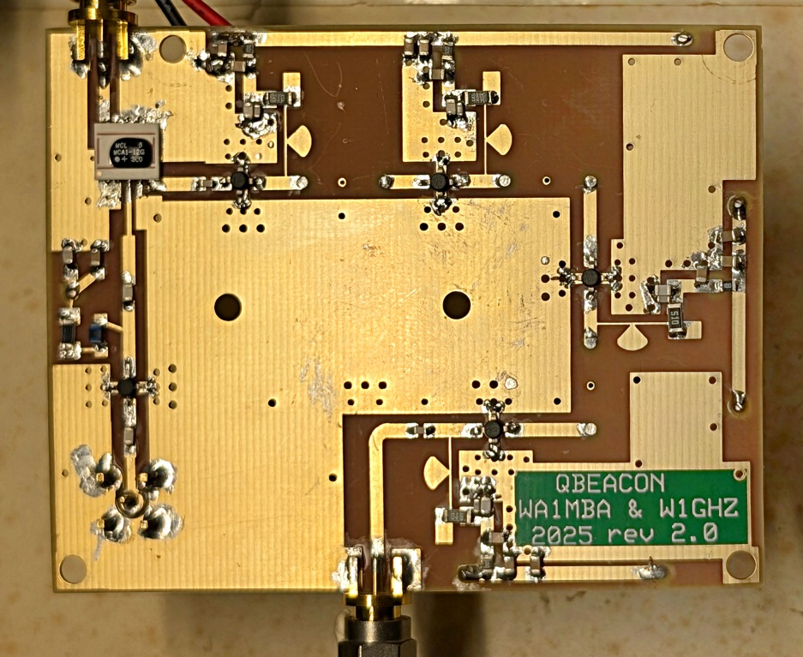
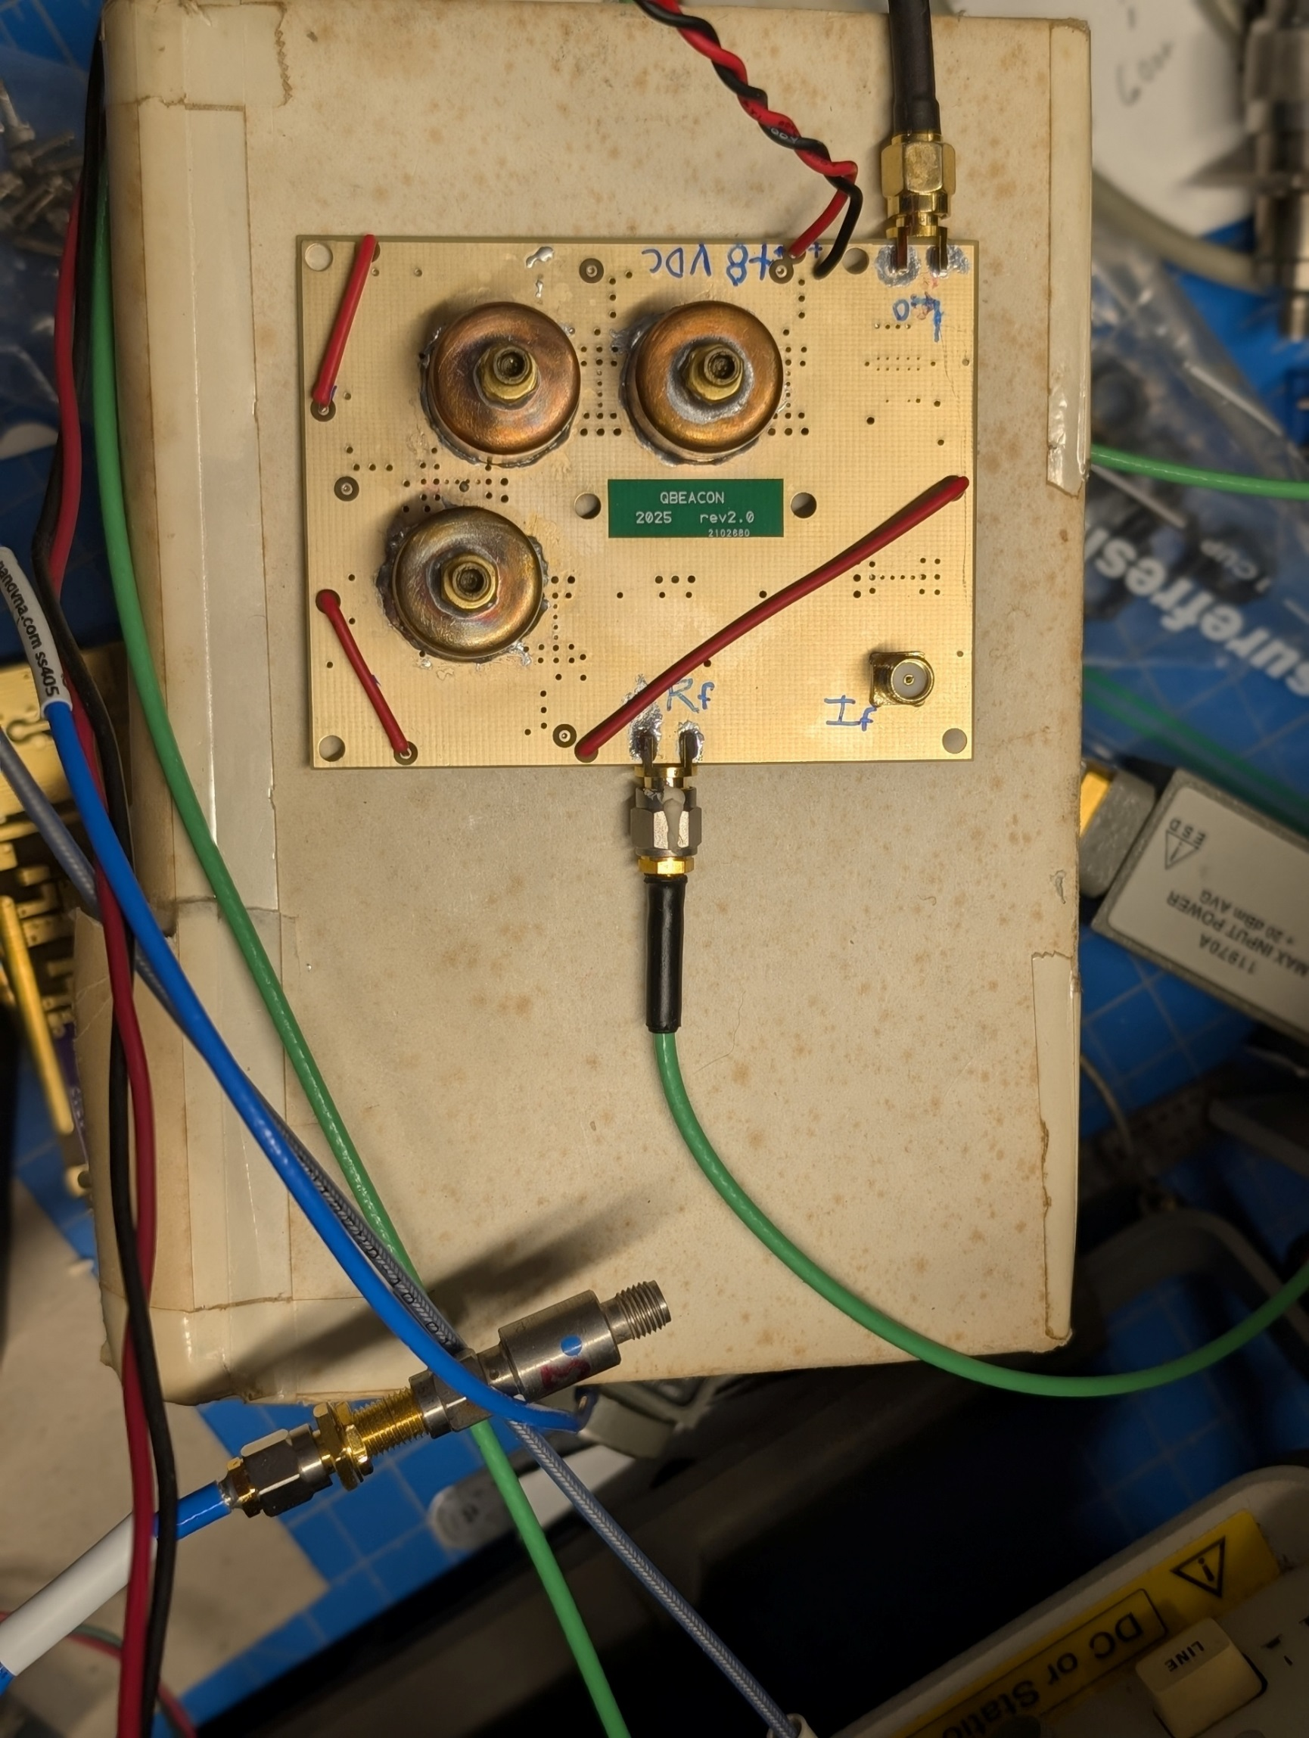
QBEACON CIRCUIT BOARD V2 Simpler and Cheaper
Up-Converter for 5,10 GHz + Microwave Beacons
(add multiplier for 24 & 47)
IF Amplifier, Mixer, 4 RF Amplifiers, 3 Pipe-Cap Filters
External: LO 5 -13 GHz at +7 dBm, 435 MHz IF at -12dBm
RF Out at +7dBm Requires: 8VDC at 250 mA

Slide 32


Slide 33
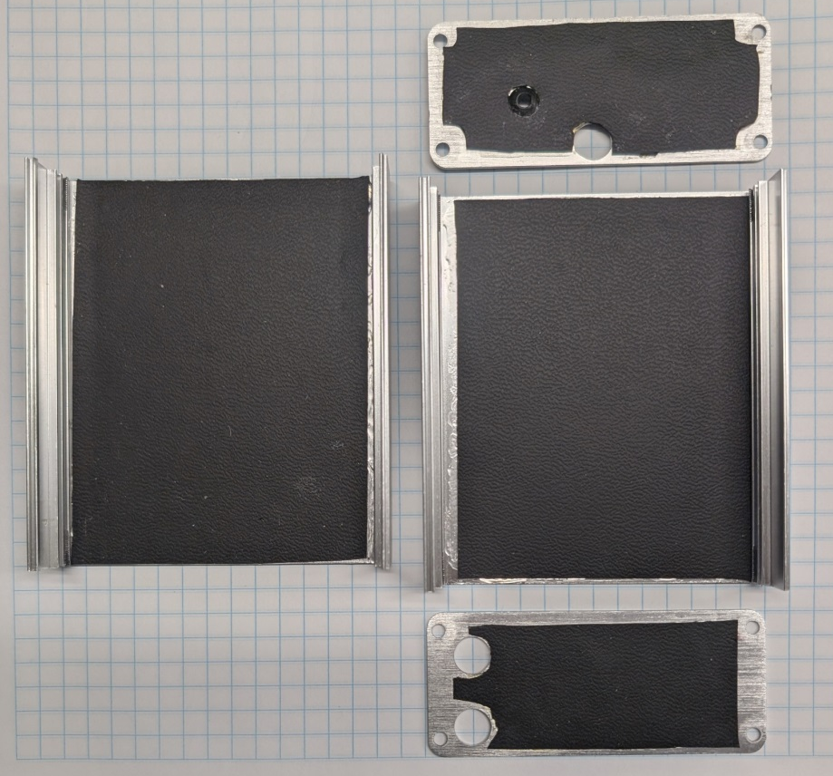
Enclosure Increases LO Leakage Standard size aluminum box from Amazon. LO couples from input to output, RF Absorber reduces it
Glued ferrite loaded silicone rubber to enclosure walls
Tested each experiment for LO Leakage

Slide 34
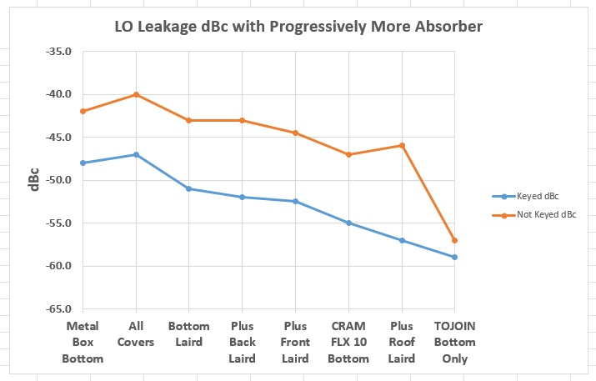
Evolution of Absorber use to reduce LO Leakage in RF output

Slide 35
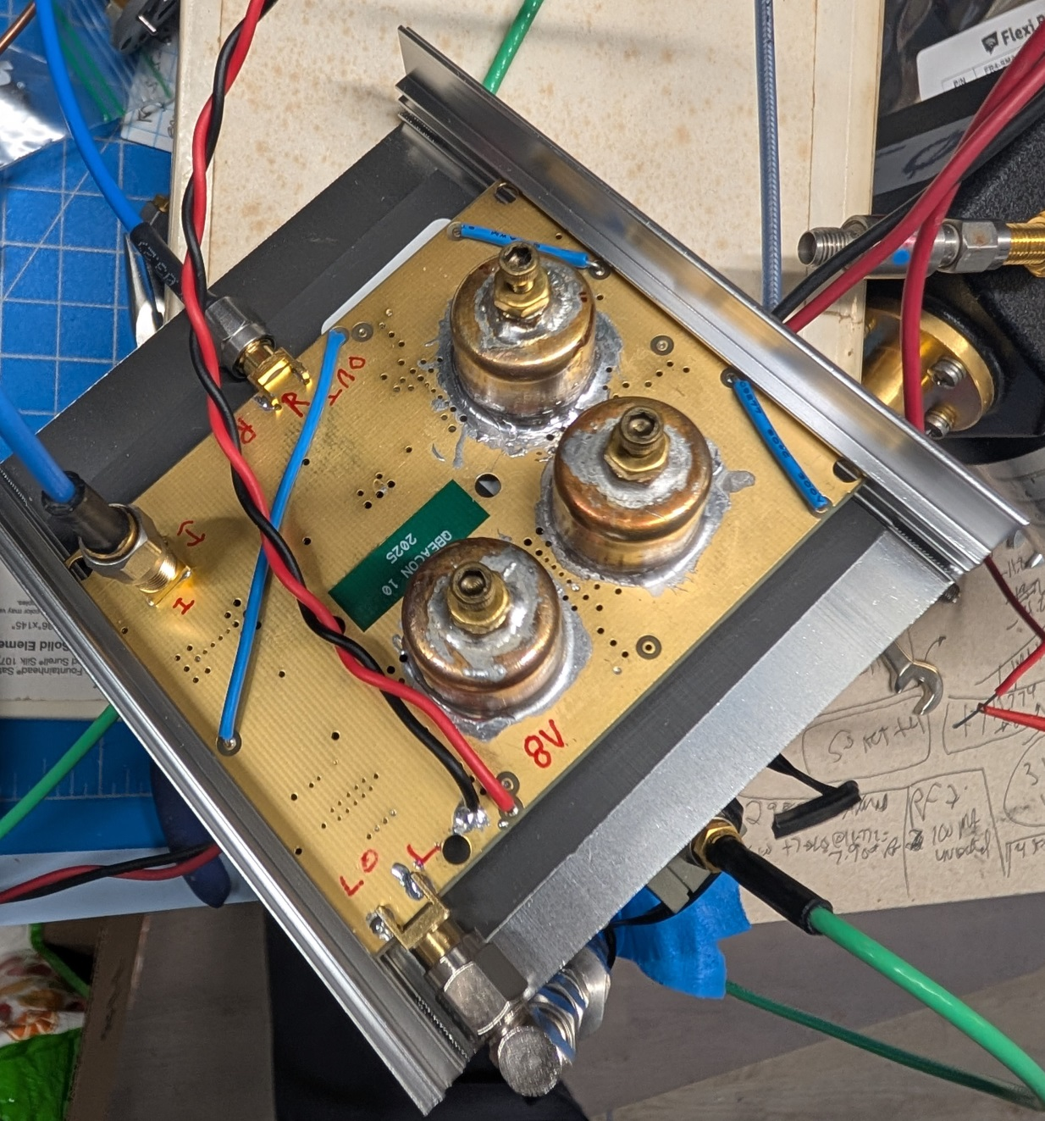
V2 PC board in Enclosure
Inexpensive
Extruded aluminum enclosure from Amazon
Single Piece of
TOJOIN 2mm
Absorber reduces
LO and Image Leakage

Slide 36
Remember Jim’s Q65 beacon board without a filter?

Slide 37
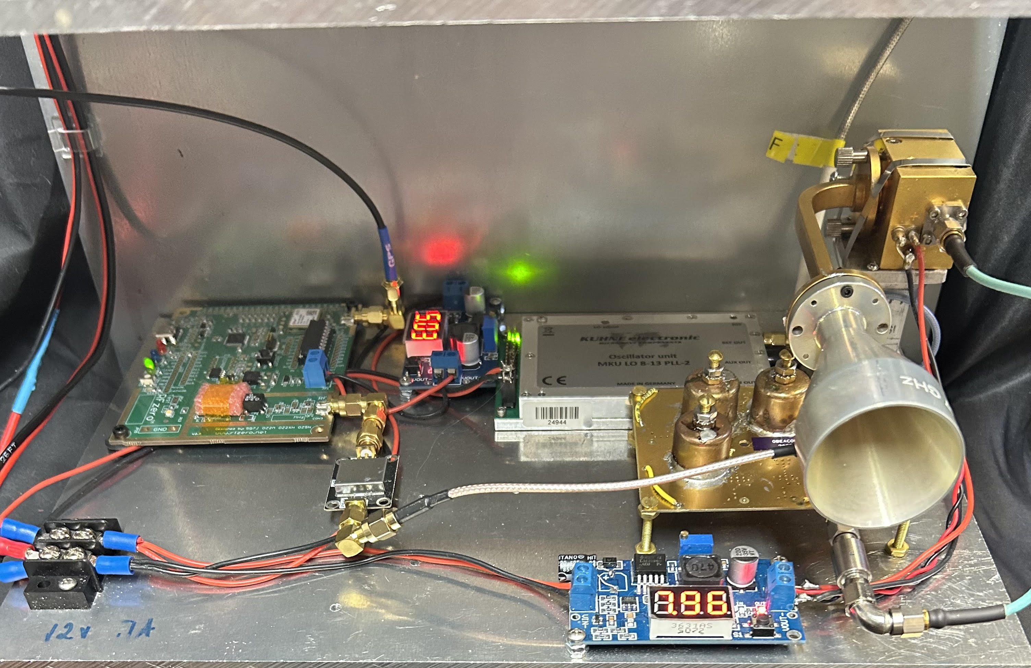
KM5PO V2 47 GHz Beacon with QBEACON board

Slide 38
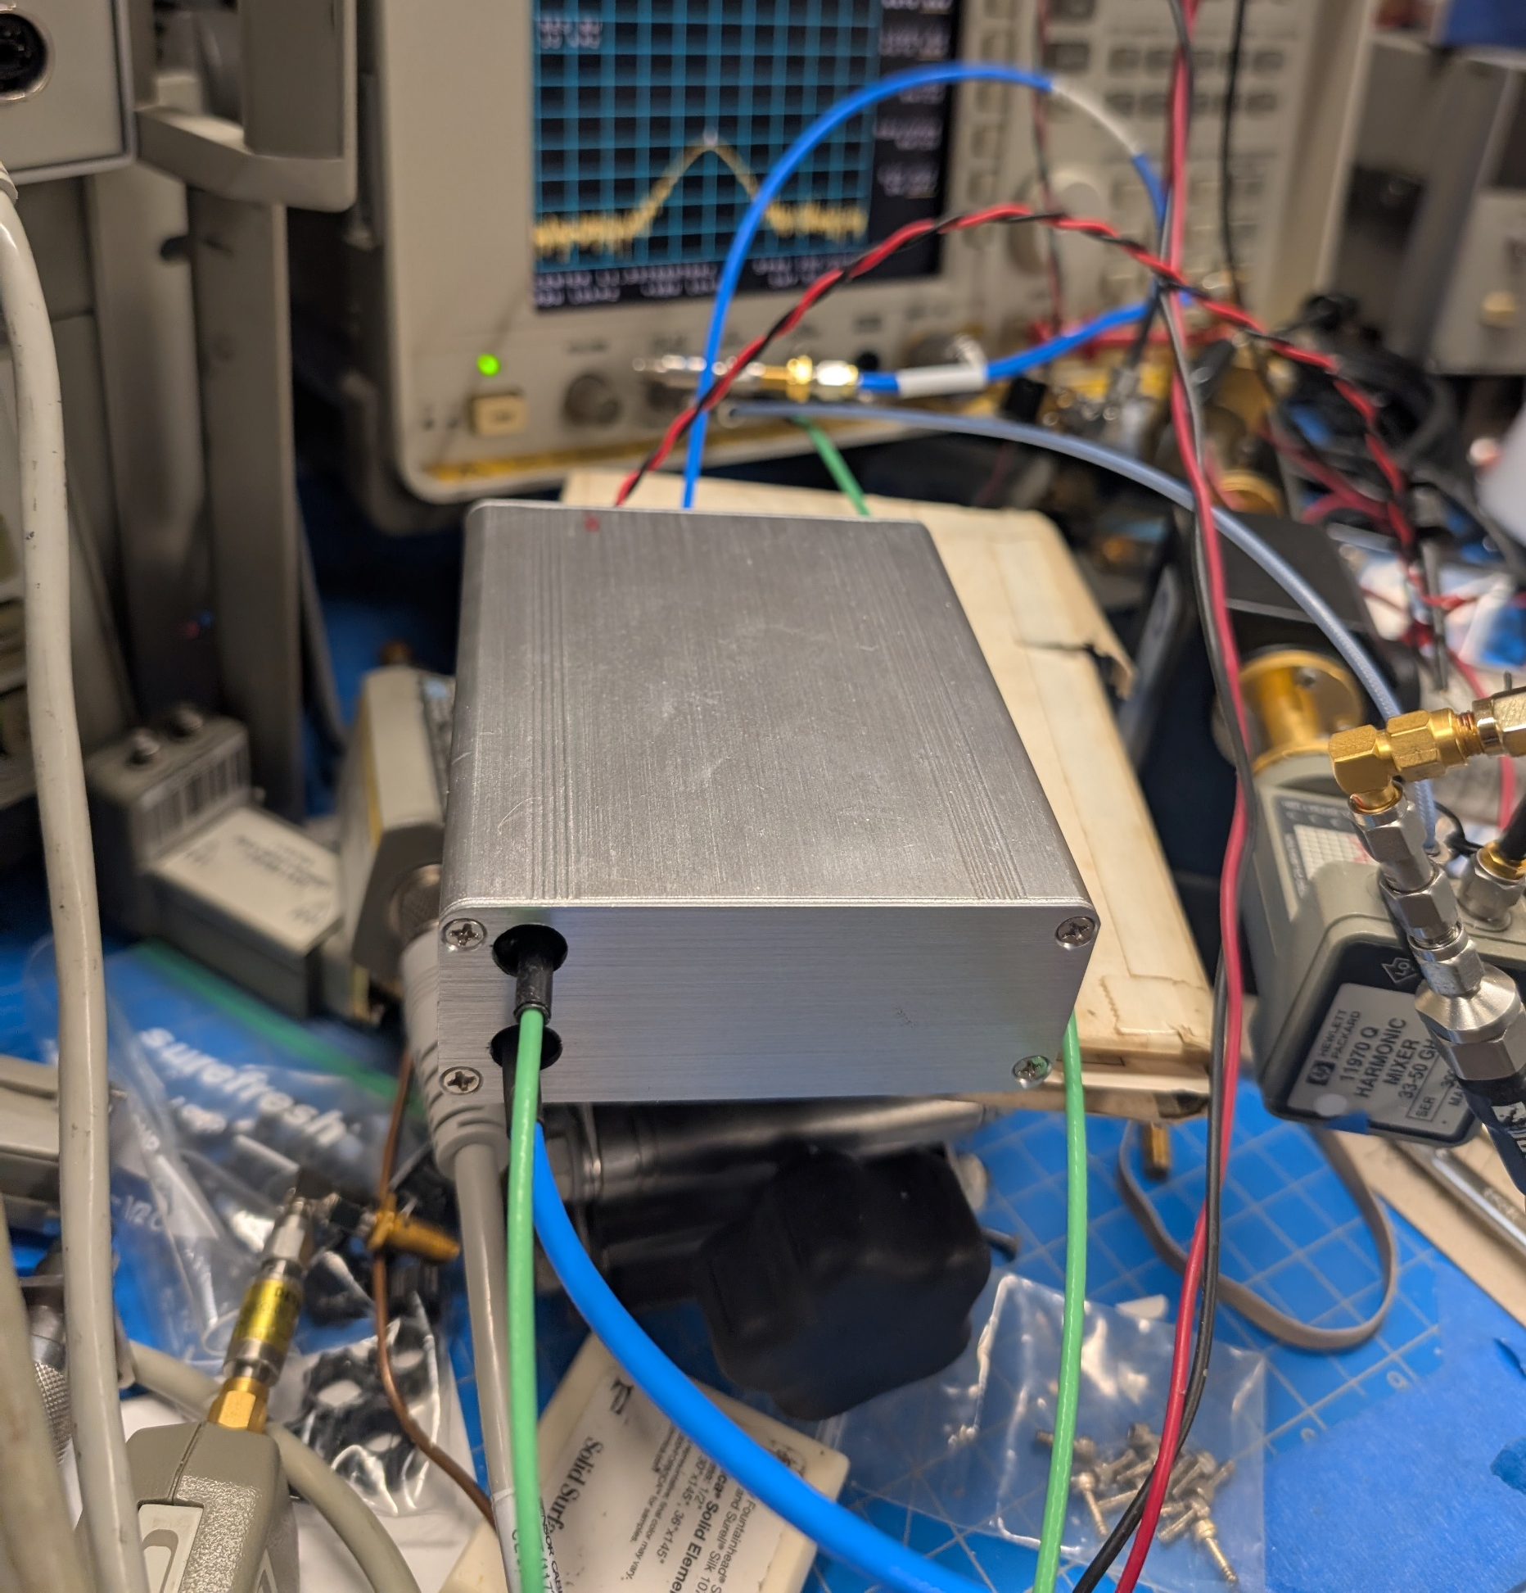
Board in Enclosure, Operating
8 VDC
RF OUT
IF IN
LO IN

Slide 39
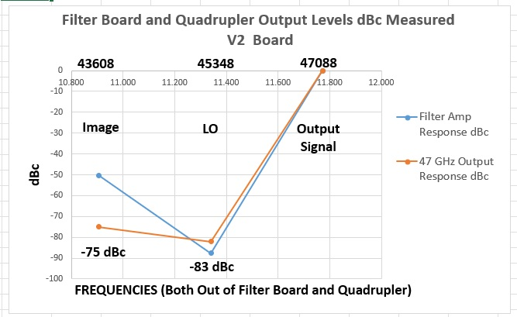
V2 Performance in Enclosure

Slide 40
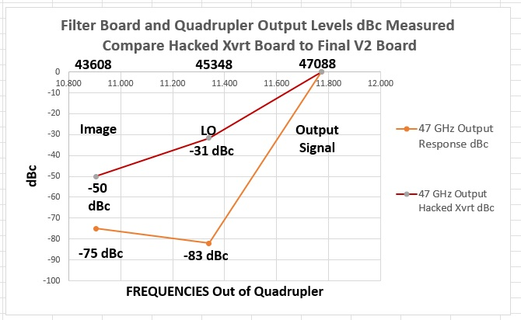
Hacked Xvrt Board vs. V2 Board On 47 GHz

Slide 41


Slide 42
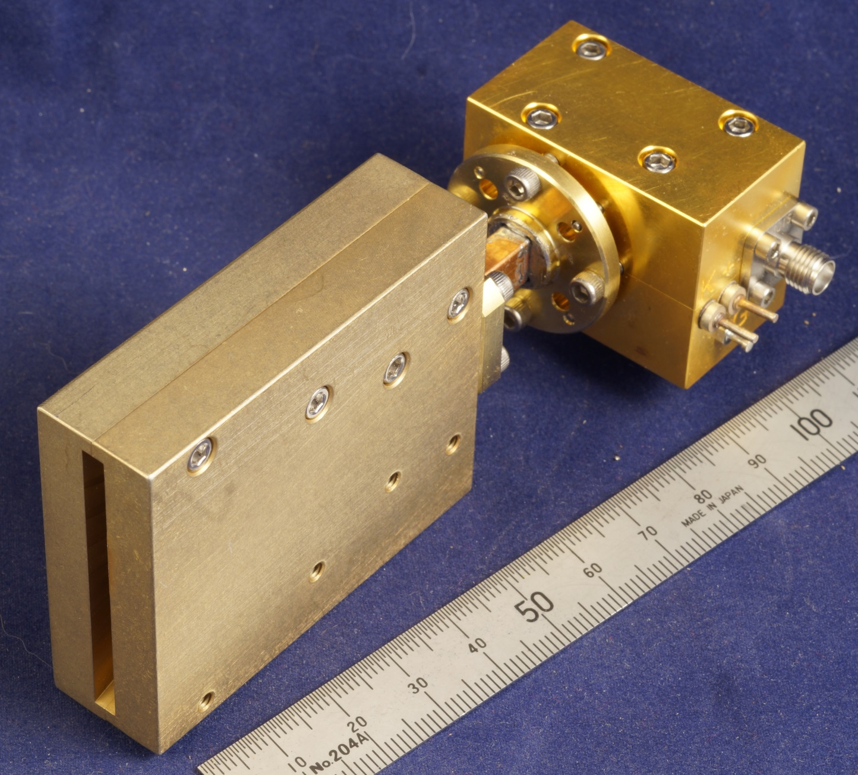
47 GHz WA1MBA Quadrupler with W1GHZ Sectoral Horn

Slide 43
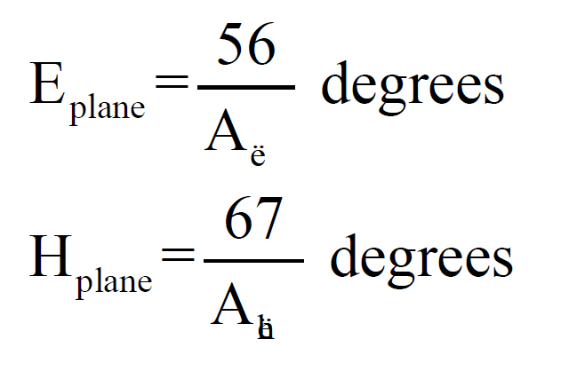
Horn Antenna Beamwidth
Large Aperture gives Narrow Beam
Small Aperture gives Wide Beam

Slide 44
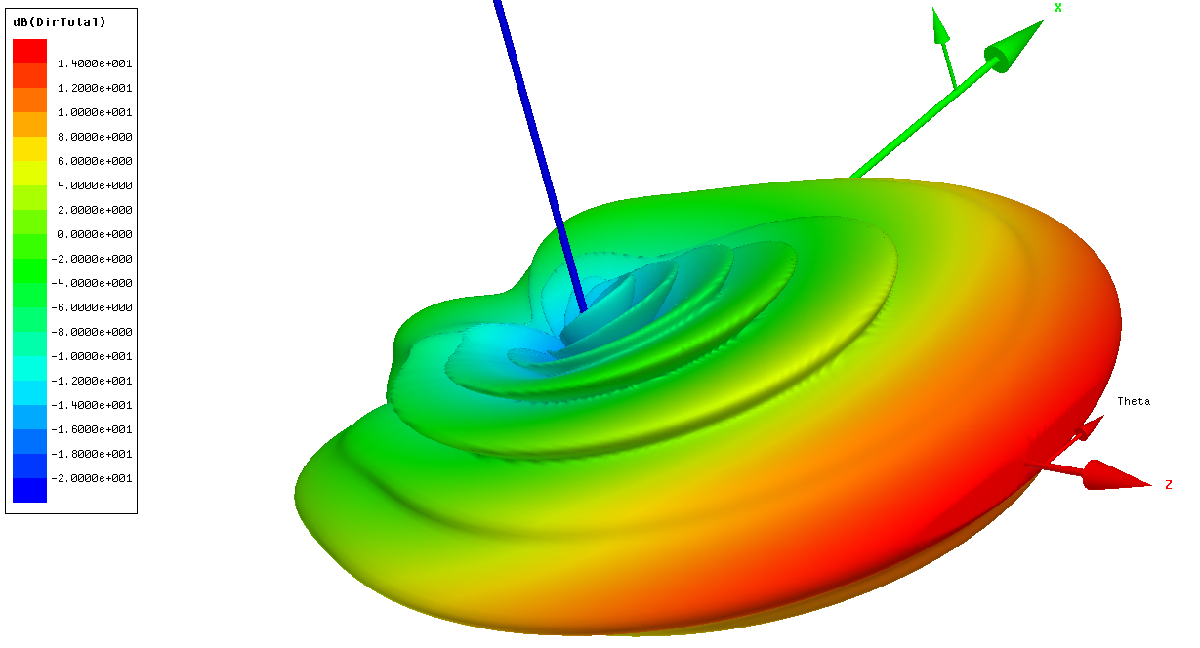
47 GHz Sectoral Horn E = 0.56λ H = 7.2λ

Slide 45
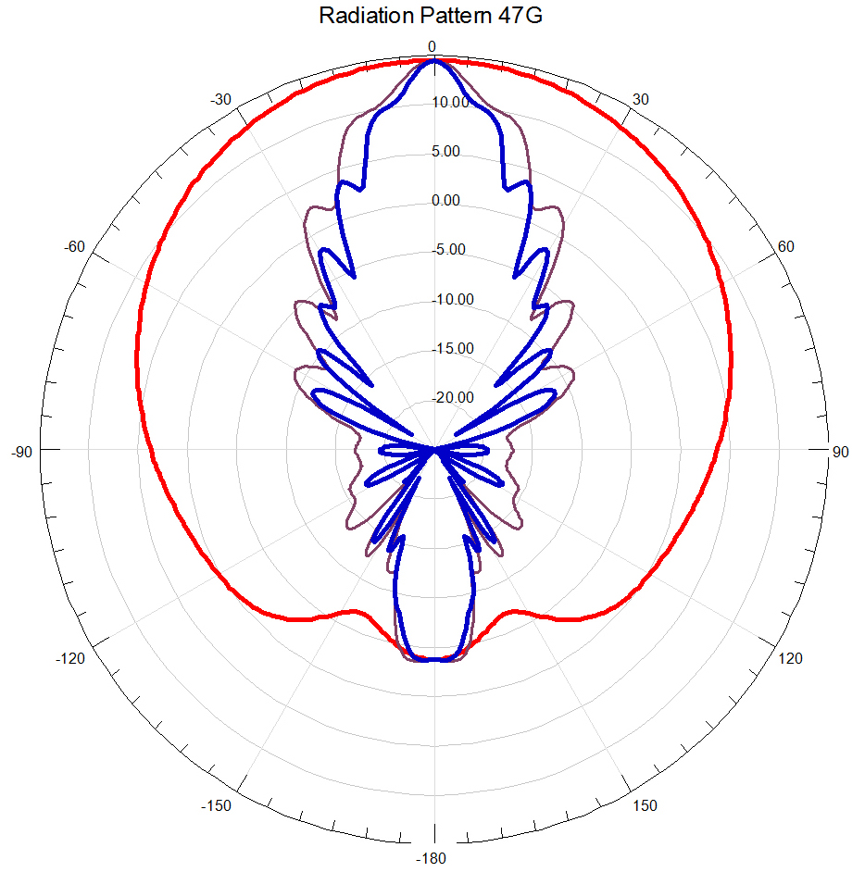
47 GHz Sectoral Horn E = 0.56λ H = 7.2λ
BEAMWIDTH
3 dB ~ 60°
10 dB ~ 100°

Slide 46
47 GHz Sectoral Horn
0.56λ = 0.140 inches
WR-28 waveguide height = 0.140 inches
No height taper – easier machining
WR-28 waveguide works at 47 and 24 GHz

Slide 47
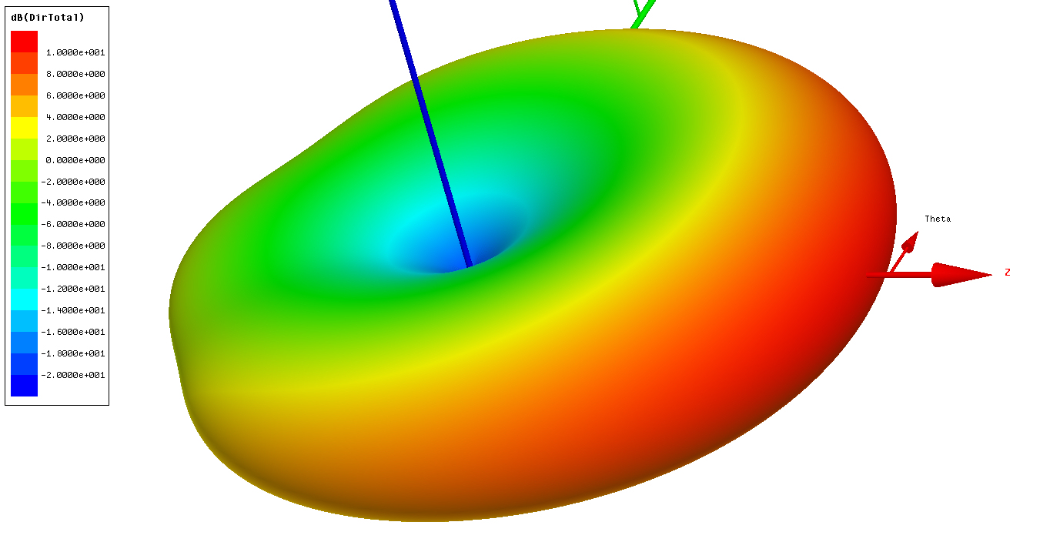
47 GHz Sectoral Horn at 24 GHz

Slide 48
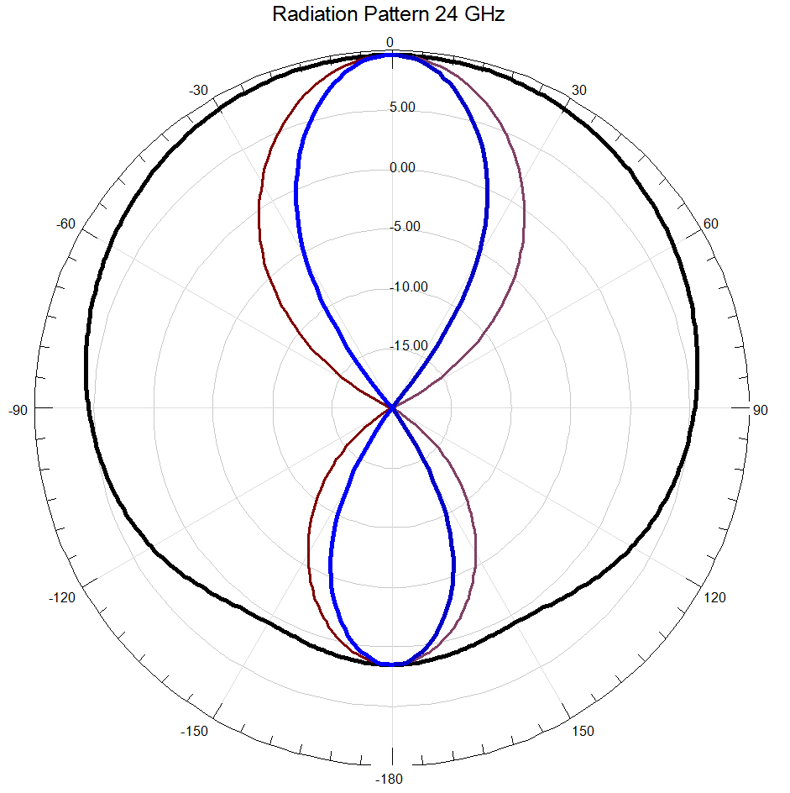
47 GHz Sectoral Horn at 24 GHz
BEAMWIDTH
3 dB ~ 90°
10 dB ~ 200°

Slide 49
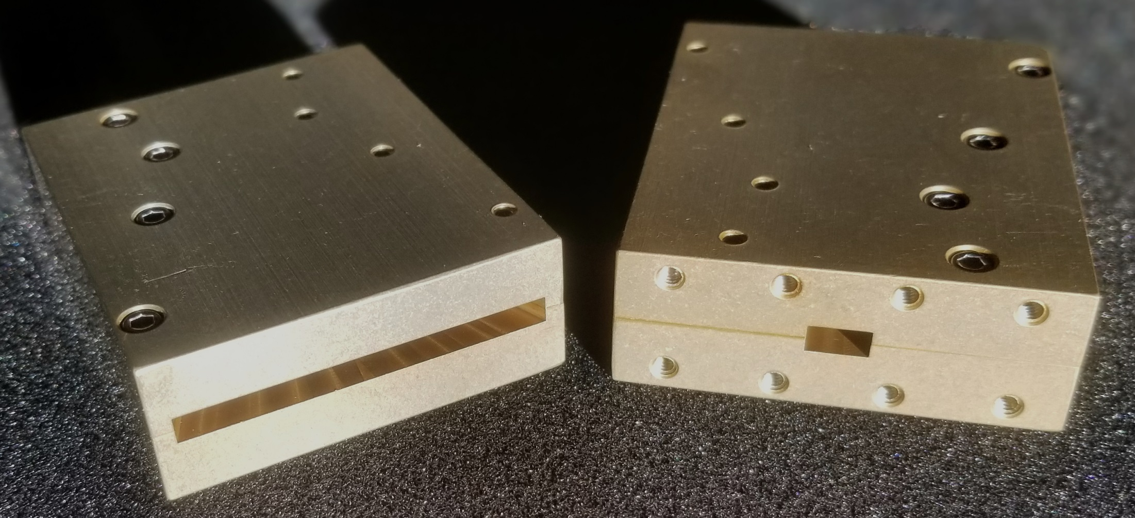
Production Sectoral Horns for 47 or 24 GHz WR-28 Waveguide for both

Slide 50
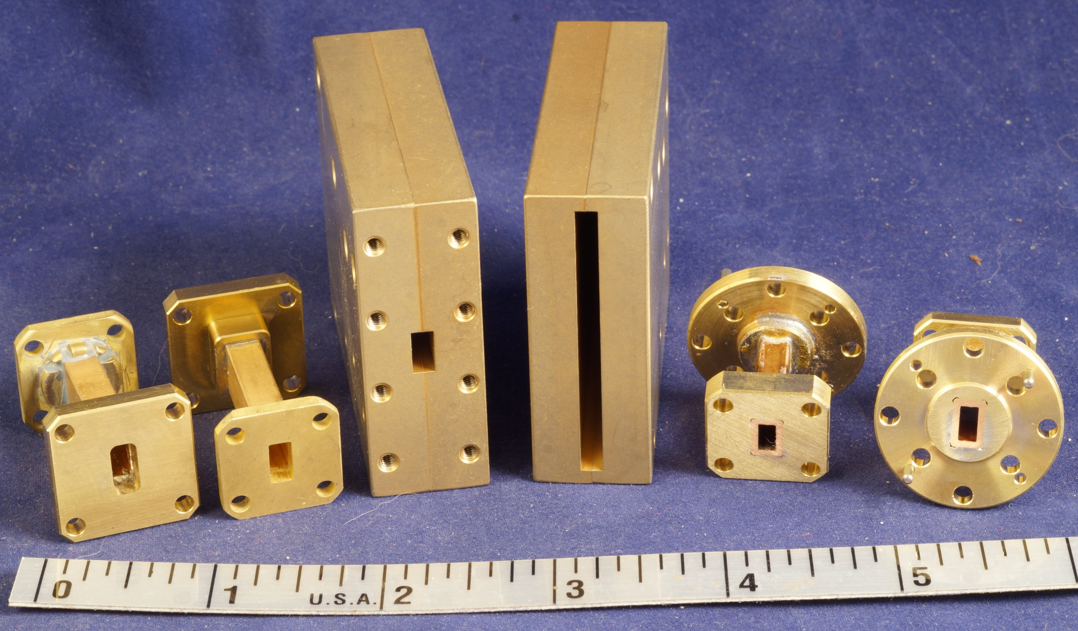
Waveguide Adapters for WR-24 and WR-22

Slide 51
Which Q65 Mode to use on Microwaves?
TONE SPACING IN HERTZ
MODE IS
T/R(S)- A|B|C|D|E|F
e.g. 30-C, 120-B
SECS | A | B | C | D | E | F
15 | 6.67 | 13.33 | 26.67
30 | 3.33 | 6.67 | 13.33 | 26.67
60 | 1.667 | 3.33 | 6.67 | 13.33 | 26.67
120 | .75 | 1.5 | 3 | 6 | 12 | 24
300 | .289 | .58 | 1.16 | 2.31 | 4.67 | 9.34
Wider Tone Spacing allows for more signal spreading like perhaps with rain scatter
Shorter Time makes quicker QSOs
Longer Time has better sensitivity (signal below the noise)

Slide 52
Which Q65 Mode best for Microwave Beacons?
NTMS
For Tropo QSO’s 30-A and 15-A. Reason = Quick QSO
For Beacons 60-C, the same as is used for 1296 EME Reason = Longer Integration Time for S/N and some tone spread for doppler/multipath scatter smearing
NEWS
W1FKF built 2x 10GHz Beacons with 30-D
Although 60-C has 3 dB better s/n, much of the beacon cycles are spent in digital while continuous tone and morse are also valuable
The 10GHz EME beacon is on 60-E
You
Whatever your choice, post it, including the WZ1V Beacon list

Slide 53
Summary
Q65 Beacons for 5, 10, 24, and 47 GHz
RF Zero (IF source) $80 assembled
Qbeacon PC Board – Simple and cheap
Add Synthesizer LO *
Add Multiplier for 24 and 47 GHz
10 & 5.7 GHz Beacon (add amplifier)
Inexpensive Beacon
*can use cheaper 3-4 GHz synth and W1GHZ Personal Beacon board to multiply up to desired 10-12 GHz LO range

Slide 54
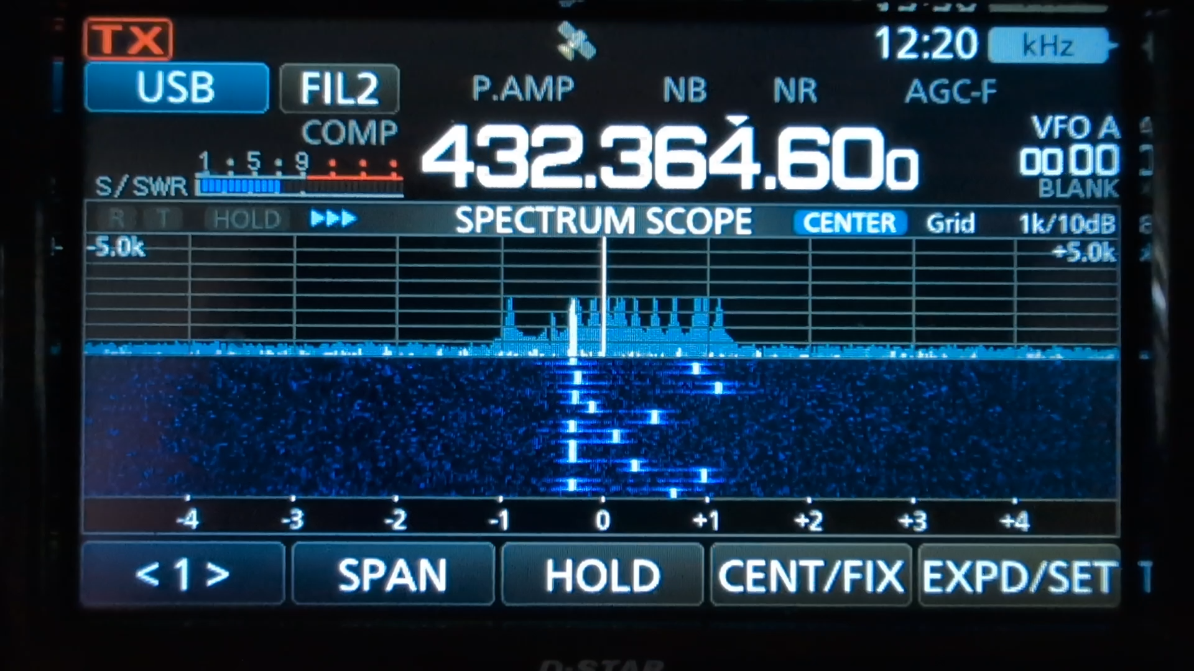
At 47 GHz

Slide 55
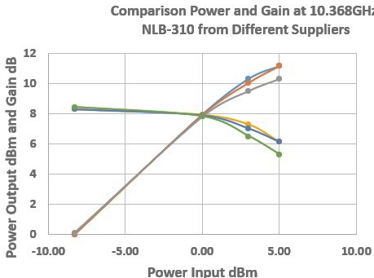
Where to get
WA1MBA can supply a few options:
Bare Boards
Kits (with instructions)
Including hard to find NLB310 MMICS
Can include prepared pipe caps
Can solder pipe caps onto boards
Built / tuned to your frequency
Paired with 47 GHz Multiplier
W1GHZ can supply
24 & 47 GHz Sector Horn (same horn)
Adapter to WR22/19 for 47, to WR42 for 24
You must supply
LO, 8V Power, Enclosure, control, etc

Slide 56
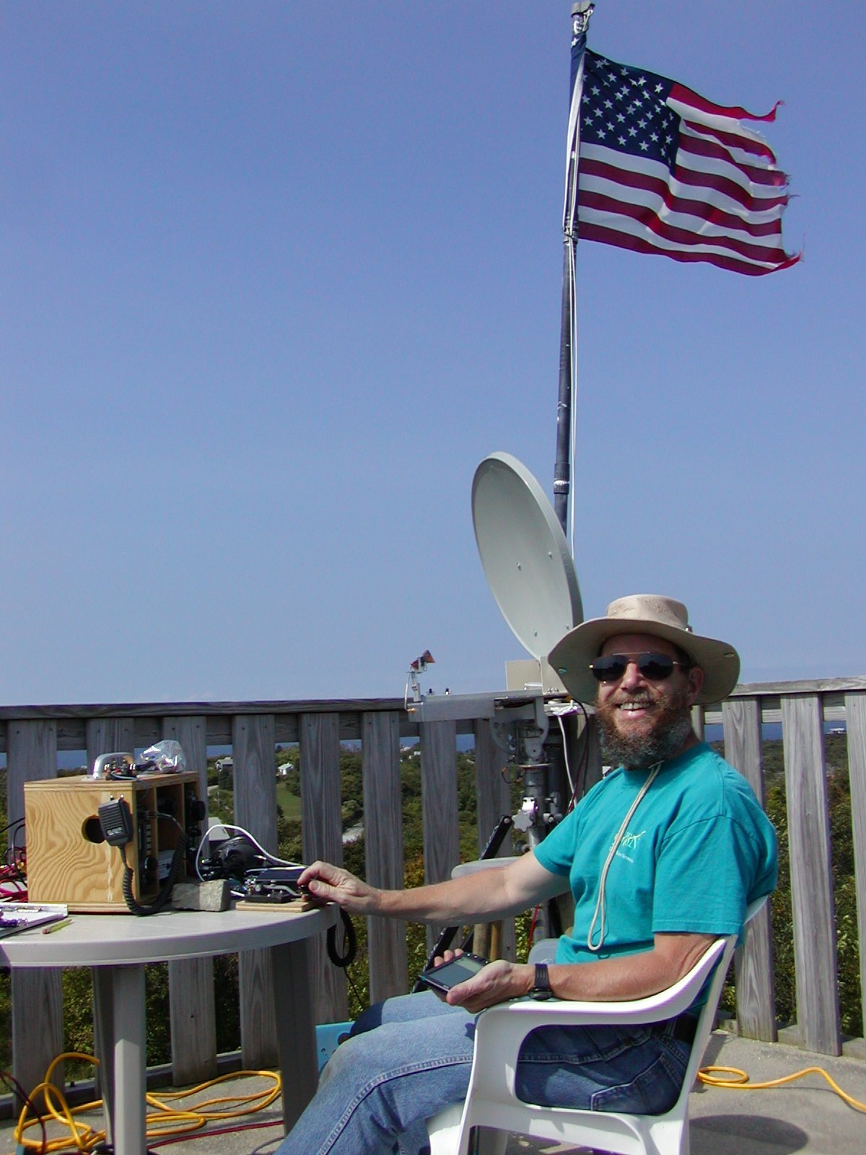
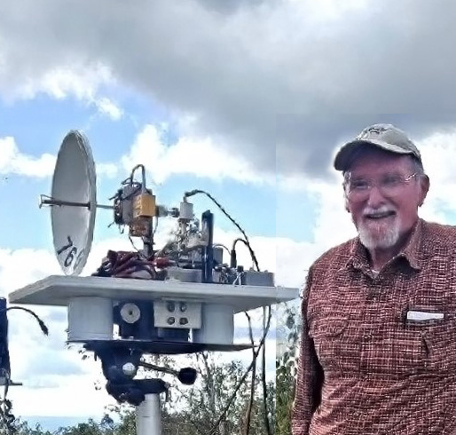
www.wa1mba.org
www.w1ghz.org

Slide 57
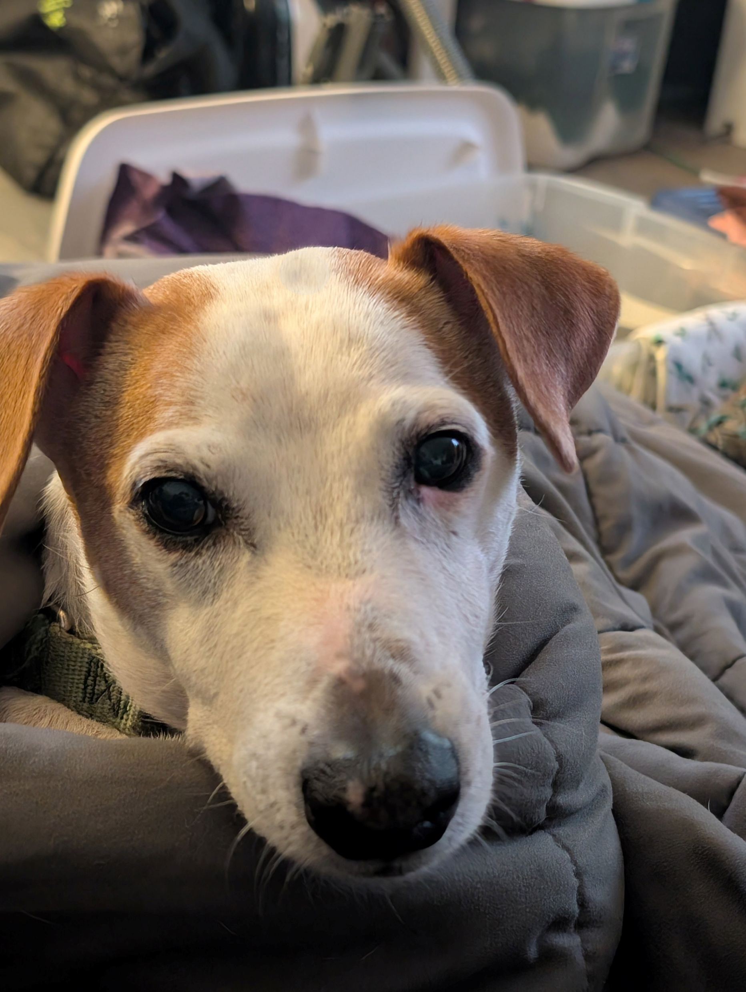
QUESTIONS?

