Slide 1
The BRMS 10 GHz Q65/CW Beacon
49th Eastern VHF/UHF/Microwave Conference
Windsor, CT
April 2026
Dennis Sweeney WA4LPR
wa4lpr@arrl.net
Blue Ridge Microwave Society (BRMS)

Slide 2
The Overview
BRMS 1296 MHz beacon and why a Q65/CW 10 GHz beacon
Beacon design considerations
Q65/CW beacon structure
Indoor Unit (IDU)
Local Oscillator
Outdoor Unit (ODU)
Antenna
Telemetry
Control Computer
And thanks to the BRMS team!

Slide 3
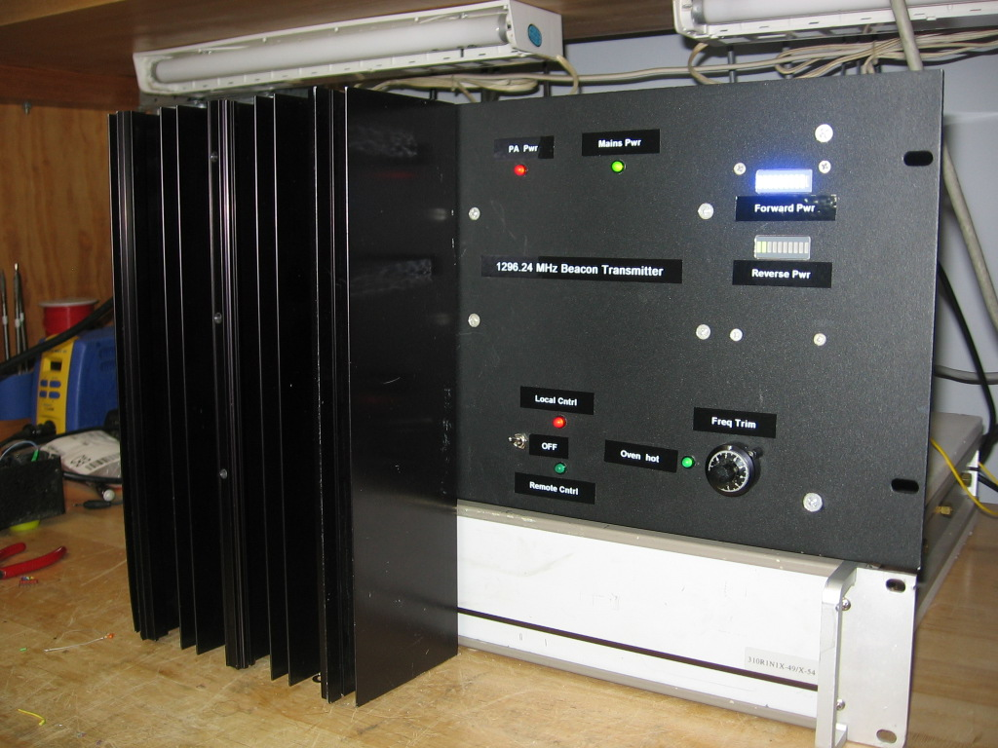
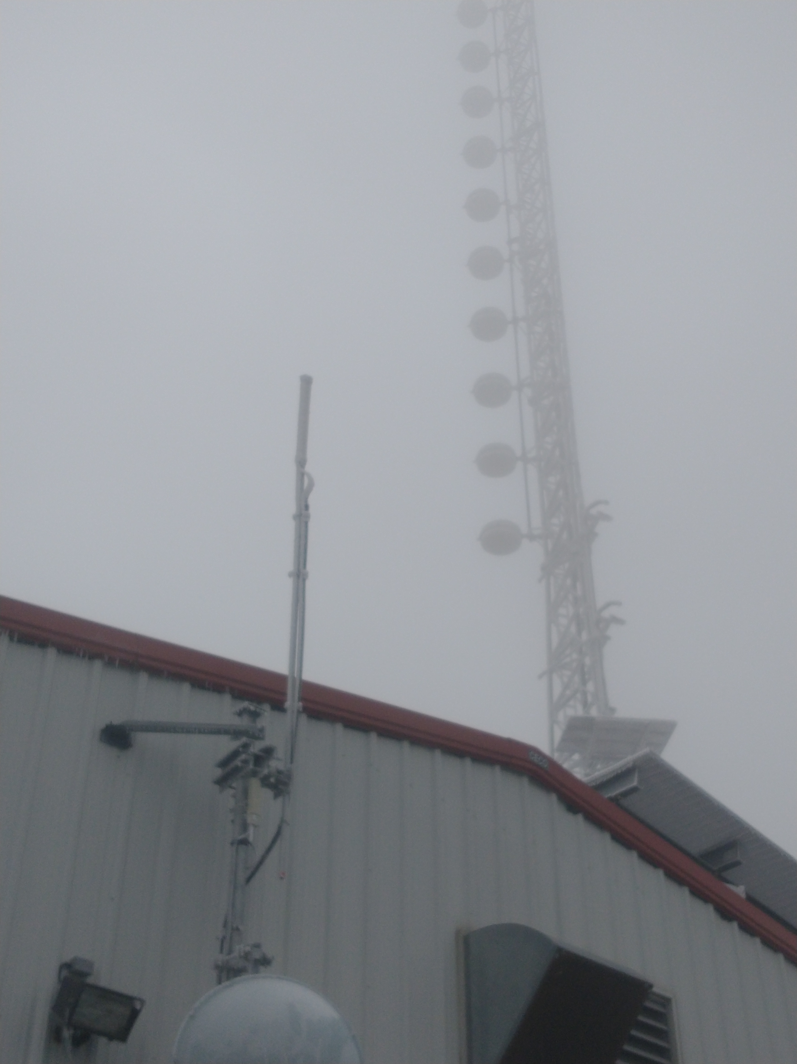
The BRMS Beacon and Q65
BRMS deployed a 1296 MHz (1296.24 MHz) beacon in Sept 2020
  Poor Mt. near Roanoke, VA (EM97we @ 3800 ft)
  On the air continuously since Sept 2020!
  Can be heard in much of VA, copied down into SC
  and as far away as EN41 in Illinois
  Success generated interest in a 10 GHz beacon
  BRMS discussions suggested a WSJT Q65 waveform
Advantage of a Q65 waveform
  Tolerates Doppler
  Copied deeper into the the noise than CW
  Good for scatter type propagation
  Allows for long term automated monitoring
N6CA published a Q65 beacon design in 2022
  Complex as there was no simple way to generate Q65
  Q65 software for the RFzero is now available
1296 beacon
and antenna

Slide 4
Beacon Considerations
A beacon has to run 24/7/365
  Conservative operation required for the long term survival
  1296 beacon heat sink large but no fan, fans get dirty and fail
  Outdoor operation requires thermal analysis.
Beacons often run in harsh RF environments
  1296 beacon shares a location with 400 kW of FM transmitters!
  Careful shielding, filtering and operation to commercial standards are a must
  Then, there is the ice and the birds that attack the cables!
Remote control and remote monitoring desired
A beacon is used as a reference
  Frequency, timing accuracy/stability and low phase noise required particularly for Q65

Slide 5
Q65/CW Beacon Structure
The beacon is the transmit side of a transverter
  A Leo Bodnar GPS generating 429 MHz is multiplied to 10296 MHz.
  Mixed with 72.24 MHz RFzero Q65/CW signal to output 10368.24 MHz
  60D is Q65 sub mode. Recommended for 10 GHz rain & tropo scatter
  A JCA48-4111B1 amp after the mixer and filter raises output to 20 dBm
RFzero generates a two minute time sequence
~15 sec
51 sec
54 sec
Q65-60D
CW ID
carrier
Q65 start even
minute
CW ID and carrier
odd minute

Slide 6
Why the 72.24 MHz IF for up the conversion?
The 50-200+MHz mountain top RF environment has many (very!) strong signals
  Multiple FM repeaters in the 2m band discouraged use of a 144 MHz IF
  72.24 MHz falls in the lightly used 72-76 MHz gap in the TV band
  Computer mixer spur analysis done to insure no close in mixer spurs
  A 72 MHz BPF in the output of the RFzero suppresses
  close by TV signals and RFzero output spurs
But the 72.24 MHz IF requires a very good 10 GHz filter!
  A 5 section post coupled waveguide filter designed with WGFIL
  LO suppressed by approximately 55 dB
  Mixer spurs suppressed to limit of measurement at about 75 dB
  No out-of-band spurious found

Slide 7
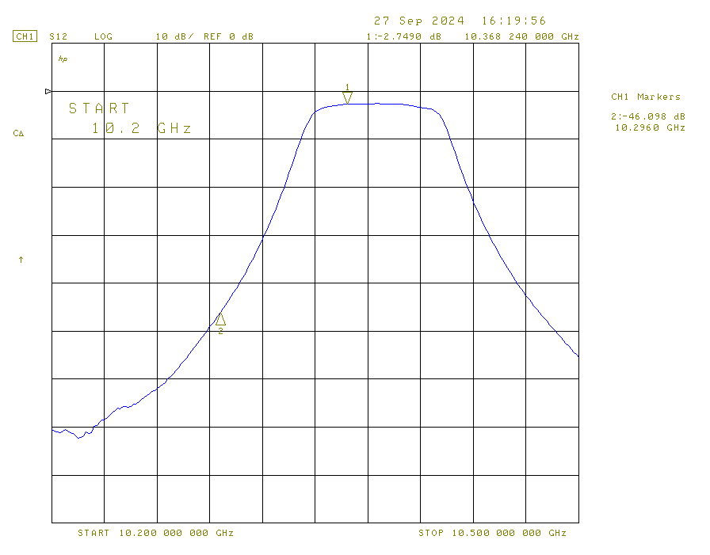
10 GHz Waveguide Filter
BW 70 MHz 0.1 dB ripple
Calculated 3 dB BW -= 79.42 MHz
Measured 3 dB BW = 74.97 MHz
Marker 1: 10368.24 MHz
Insertion loss = 2.75 dB
Marker 2: 10296 MHz (LO)
~ -43.3 dB wrt 10368.24 MHz

Slide 8
Indoor Unit (IDU)
GPS from
ZAPD-20
Power Splitter
10296 MHz LO
10dBm
10368.24 MHz
72 MHz
BPF
72.24 MHz
-10 dBm
RFzero
REMEC
MC64PG Mixer
10368.24 MHz
5 element WR75 WG BPF
Fo = 10368.24 MHz
BW = 70 MHz 0.1 dB ripp
20dBm
JCA48-4111B1
30 dB gain
by W3SZ W3SZ
Indoor Unit
To ODU
16 dB cable loss
100 ft LDF1-50
Power levels are approximate

Slide 9
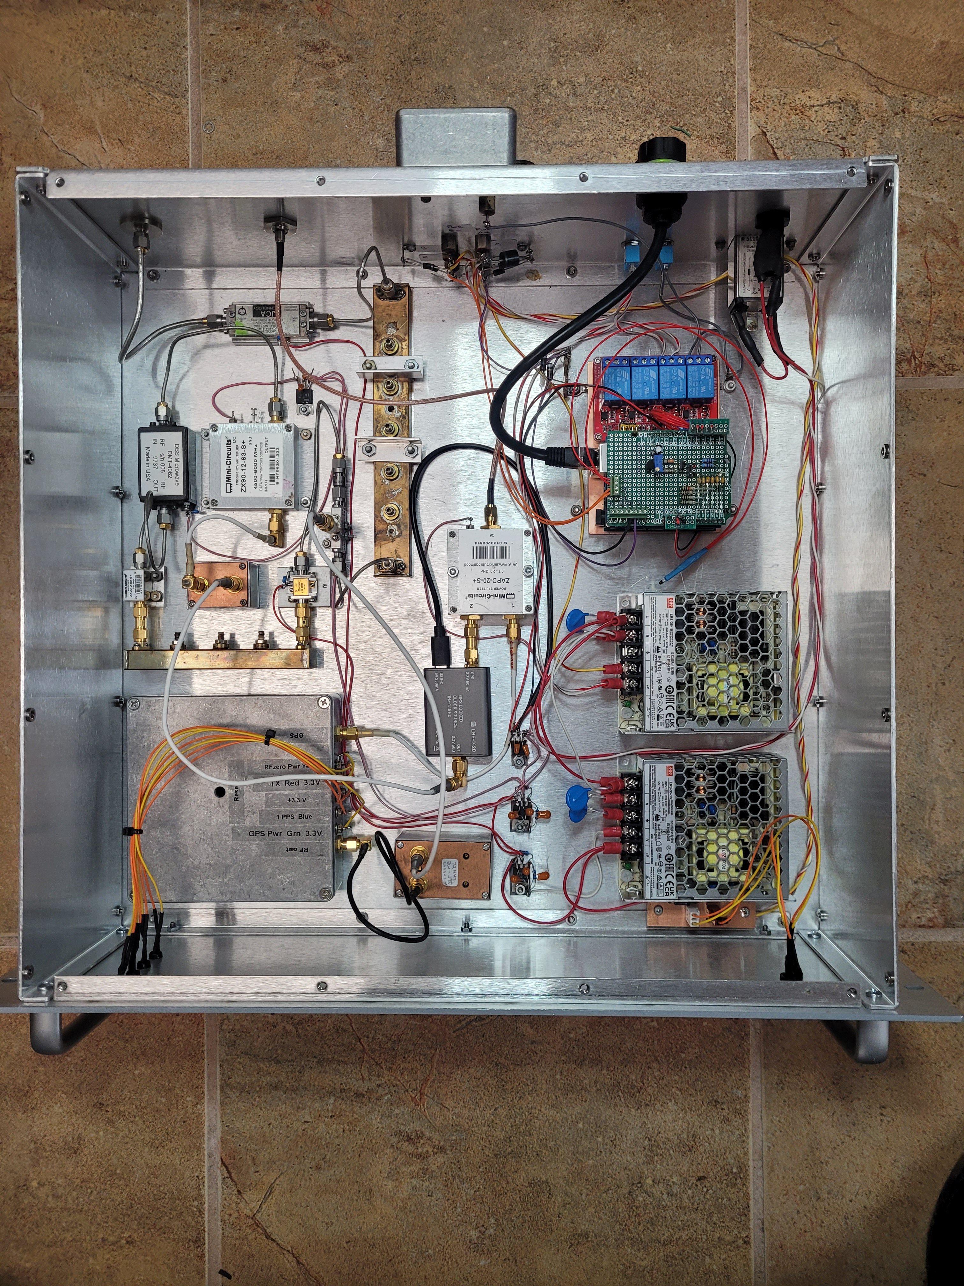
Indoor Unit
by W3SZ W3SZ

Slide 10
Indoor Unit (IDU)
IDU built in RF tight 3U rack box
  RFzero, RF modules, amps & filters are in shielded enclosures
  Ethernet connection is a shielded dongle, mains power is fed through a power entry module with 130V varistors line-to-line & line-to-ground
  Twisted pair I/O lines protected with diode transient suppressors,
  feed thru caps and ferrite beads
10386.24 MHz fed to ODU through low loss microwave coax
  LDF1-50: Loss about 16 dB for 100 ft of cable
RFzero activity LED’s brought out to front panel with feed thru’s
Beacon powered by two Mean Well 18V switching supplies
  LDO 12 & 15V regulators configured to suppress switching noise
A 2nd supply powers ODU
  To prevent voltage difference between IDU and ODU both the + and – of the 2nd supply fed up to the ODU where the – is grounded

Slide 11
Local Oscillator
GPS Ant
ZAPD-20
Pwr Splitter
To RFzero GPS
Leo Bodnar
GPS
MiniCircuits
ZX90-12-63
X12 Mult
600 MHz
LPF
429 MHz
5148 MHz
DMT-4082
22 dB gain
MiniCircuits
ZX90-2-50
X2 Mult
10296 MHz
12 dBm
0 dBm
by W3SZ W3SZ
3 element WR75 WG BPF
Fo = 10296 MHz
BW = 95 MHz Butterworth
10dBm
Power levels are approximate
AFW/154-5012-140
12 dB gain

Slide 12
Local Oscillator
Leo Bodnar and RFzero GPS driven through a
MiniCircuits ZAPD-20 splitter
  Modified with a DC block and bias tee and voltage regulator for a GPS antenna
  Marine GPS antenna used to withstand RF environment and exterior operation
Leo Bodnar output is square wave so followed by 600 MHz LPF
Frequency multipliers are MiniCircuits parts
  Cost effective and can be ordered directly from MiniCircuits
LO filtered with 3 element post coupled waveguide filter
  Output is clean except spurs at +/- 15 kHz and +/- 6.2 MHz of 10296 MHz,
  likely due to Leo Bodnar but over 55 dB down so not problematic
Phase noise measured with HP8673B synthesizer reference
  -84 dBc at 1 kHz offset and -94 dBc at 10 kHz
  Possibly a bit better, measurement appears limited by phase noise from HP8673

Slide 13
Indoor Unit
by W3SZ W3SZ

Slide 14
Outdoor Unit (ODU)
Built into Hammond EJ12108AL aluminium enclosure
  Rugged but expensive: lighter than the steel, won’t rust, adds heat sink
  10”X9”X1.25” heat sink in rear panel, adequate heat sink w/o fan
  Metal enclosure offers additional shielding
ODU main components
  26 dB gain driver amplifier & PE1RKI 4 watt power amp
    PE1RKI amp limited to 2 watts by available drive
    Gain controlled with an attenuator
  MIC29502 12V LDO regulator for PA and
  LM1084 6V LDO regulator for driver

Slide 15
Outdoor Unit (ODU)
PE1RKI
10 GHz power amp
9 dB gain
905447 amp
26 dB gain
Attenuator
20dB coupler
10368.24 MHz
from IDU
Isolator
-1dBm
24dBm
33 dBm
10dB attenuator
Slot
Antenna
Output power monitor
Heat sink temp sensor
Detector
Outdoor Unit
Power levels are approximate

Slide 16
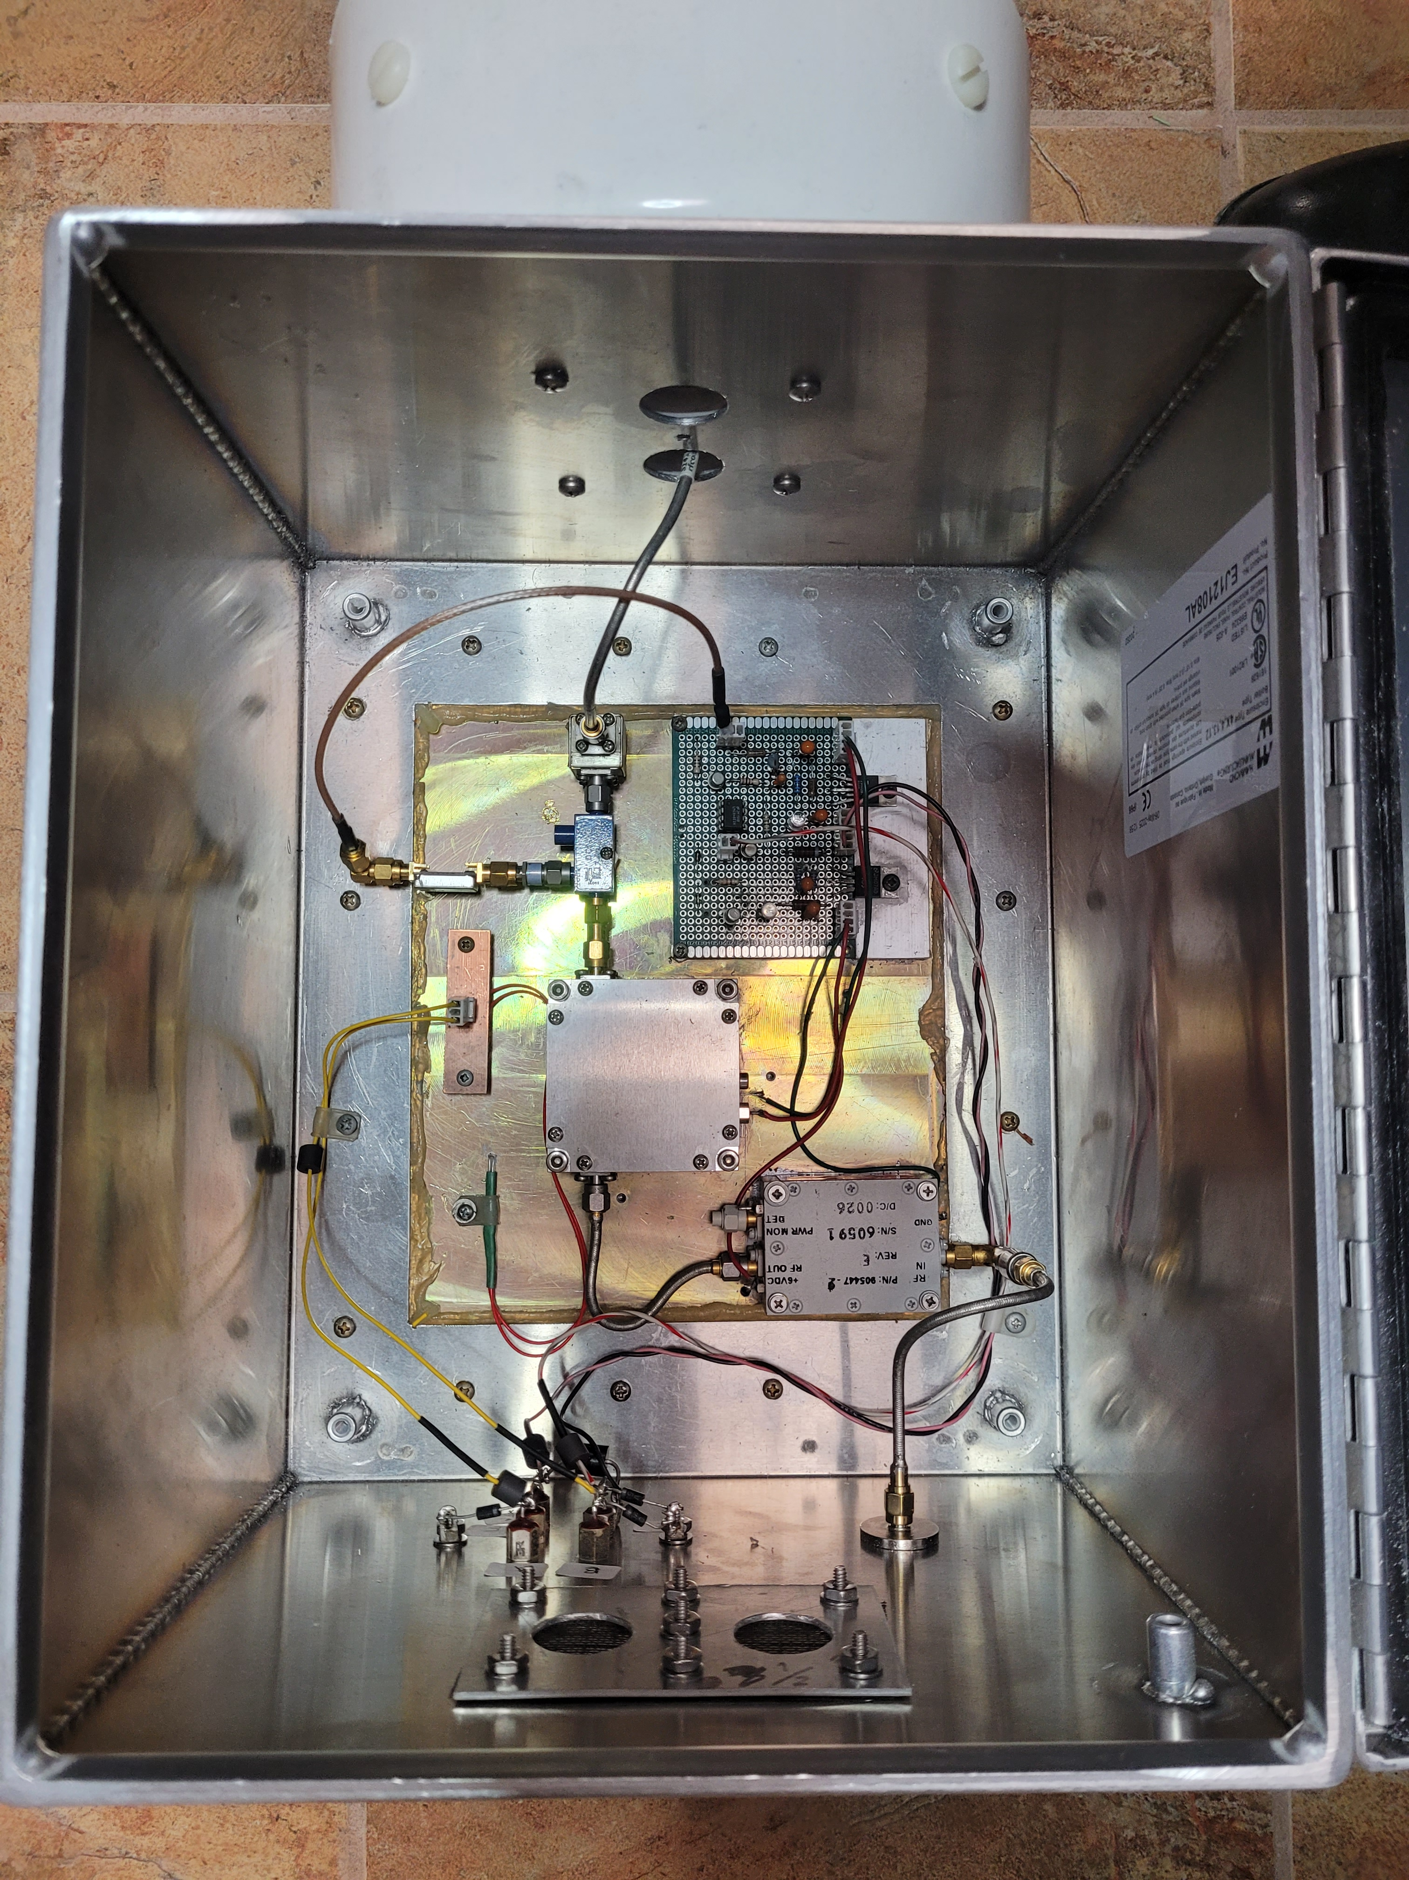
Outdoor Unit

Slide 17
Outdoor Unit Thermal Analysis
ODU exposed to exterior environment
  Temperature data came from a weather station on Poor Mt.
  Estimated min/max temperature: -26°C to 35°C (-15°F to 95°F)
  ODU dissipates ~25W
  Measured heat sink thermal resistance ~0.3°C/W
  Heat sink runs 7-8°C above ambient: -18°C to 43°C (0°F to 110°F)
Amps and heat sink tested in household freezer and oven
  Tested -4°C to 43°C (25°F to 110°F): performance acceptable
  PE1RKI amp replaced Harris amp that exhibited over 3 dB variation
All components in ODU specified down to at least -25°C
  Transistors are in hermetically sealed metal packages

Slide 18
Antenna
Antenna is a 16 slot WR90 waveguide antenna
  Proven design from W1GHZ
  Side “wings” added to improve omnidirectional pattern
  Slots placed with Taylor amplitude distribution
  Wings & amplitude distribution result in cleaner pattern at the
  cost of a small reduction in gain
Return loss exceeds 20 dB with a three screw tuner
Beacon effective radiated power 15-18 watts
Antenna effective as a narrow band output filter
  Antenna filter and a ferrite isolator keep external signals from reaching the non-linear PA where they can create interference mixing products

Slide 19
Antenna
Antenna protected with 6” dia. Schedule 40 PVC pipe
  Tested section got slightly warm in a microwave oven
Antenna loss test
  Excited antenna with 0.25W @ 10368 MHz
  Radiated power checked with HP435 power meter & 15 dB gain horn
  at about 4 meters distant
  No substantial difference with or with out the PVC pipe shroud
Antenna shroud and ODU sealed with an electronics grade
non-corrosive RTV silicon rubber
  Weatherproof vents added to prevent condensation and screened to keep the critters out

Slide 20
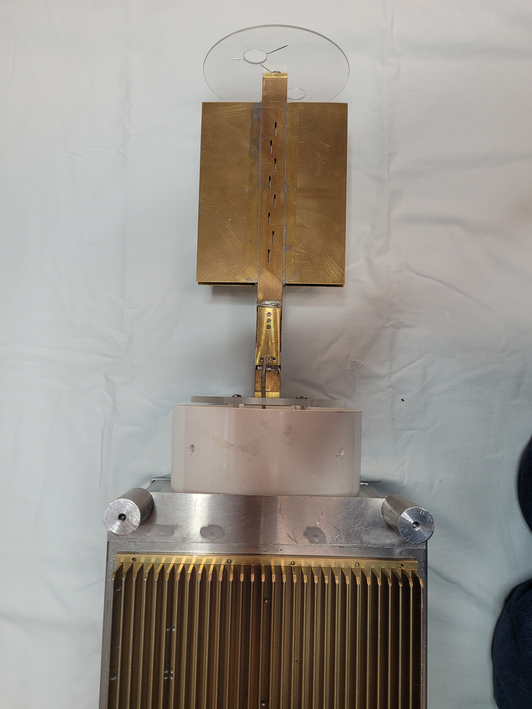
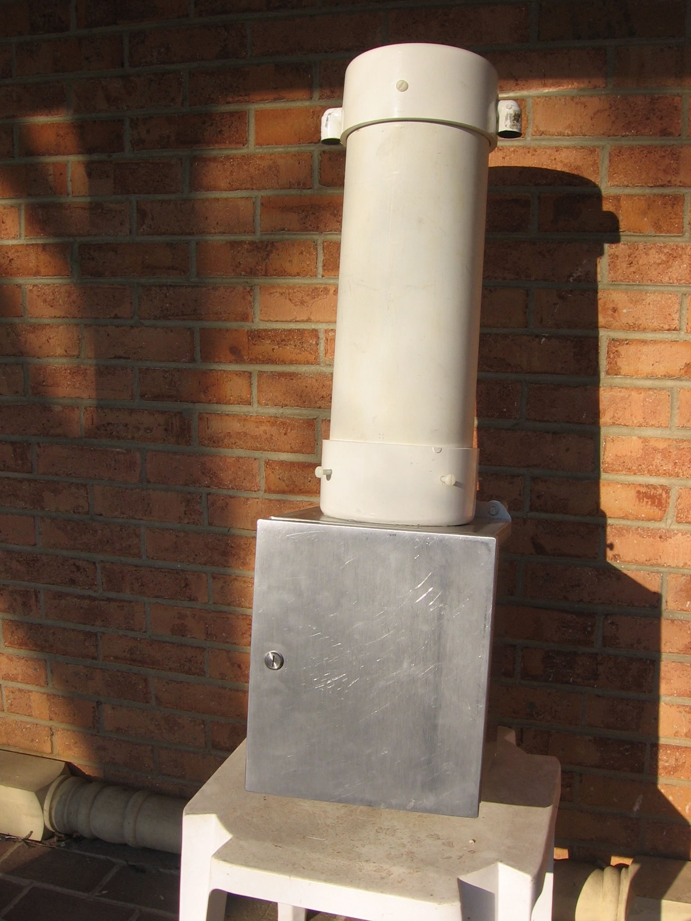
Antenna

Slide 21
Telemetry
ODU heat sink temperature and beacon power monitored
Temperature monitored w/thermistor in ODU heat sink
  Powered by IDU and resistance value sent down on a twisted pair
Beacon RF power monitor
  20 dB coupler, 10 dB attenuator and diode detector monitors PA output,
  detector output voltage about 1.5V for 2 watt output
  Two LMC6482 op amps configured as a voltage controlled current source send a current down a twisted pair to the IDU
    A resistor in the IDU scales the current into a voltage and the computer reads it, squares it & estimates the power with a linear curve fit

Slide 22
Computer Control
WiFi & wired Ethernet both available on Poor Mt.
  Chose Ethernet to avoid radio problems in the RF environment
  Control computer is an Arduino Uno with an Ethernet shield
    An IP address, username and password required for access
    User interface is simple text but it works!
Computer Control
  Arduino A/D’s read the thermistor voltage and scaled PA power,
  computer calculates heat sink temperature and beacon power
  Data can be read over the Internet
  The computer also has a shield with programmable power relays
    One relay can disconnect the power to the 10 GHz ODU
    Another relay available to control the 1296 beacon

Slide 23
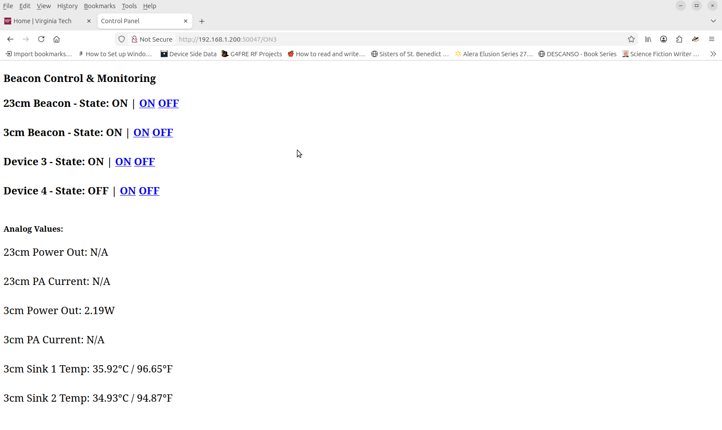
Control Interface

Slide 24
Installation
Beacon run continuously for two weeks on the bench
  Hopefully it will be as robust as the 1296 beacon (it has been on the air for over 40,000 hours now!)
Arrangements for installation on Poor Mt underway
  We have access and it should be on the air by late spring
  Still studying mounting options to protect it from ice and birds!

Slide 25
Thanks to the team!
The BRMS beacon has been a team effort
K4RCA researched and obtained a number of beacon components
  Provided the Leo Bodnar GPS, RFzero and PE1RKI power amplifier
WA4PGI provided the computer & wrote the software
KE4RGYprovided the cabling
  Obtained the microwave coax & its connectors, the power, the Ethernet and
  the GPS antenna cables
W4YN, a professional machinist, cut the antenna on a CNC machine
  We thank W1GHZ for his published antenna and waveguide information
W4KZK provided Poor Mt weather data used in the thermal analysis
KF4YLM and his team have arranged for hosting and installation
Not possible to acknowledge everyone but our thanks go to all those who provided helpful suggestions and additional components.

Slide 26

We May be Looney Tunes but That Ain’t All Folks!
Questions? Discussion

